Slide 1
深度學習數學基礎-1 向量、微分、PyThorch
萬能科技大學資訊工程系暨電資研究所
江義淵 助理教授

Slide 2
向量

Slide 3
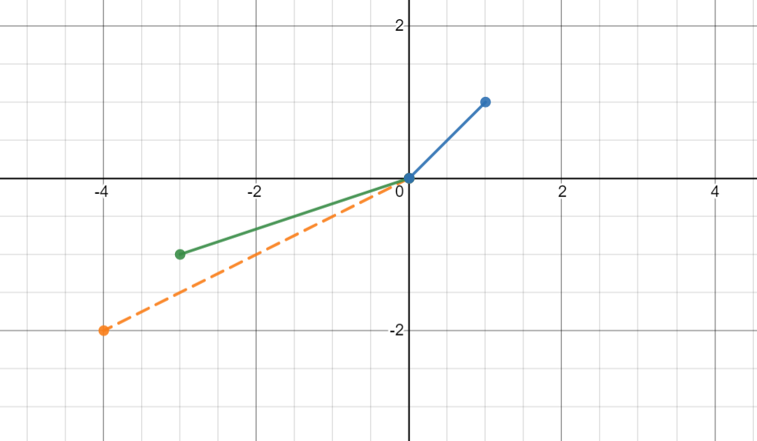
向量(vectors)的概念

Slide 4
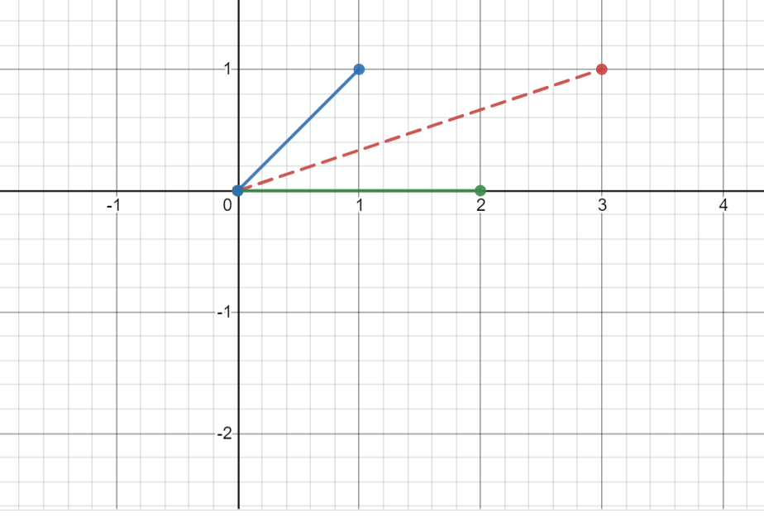
向量相加

Slide 5
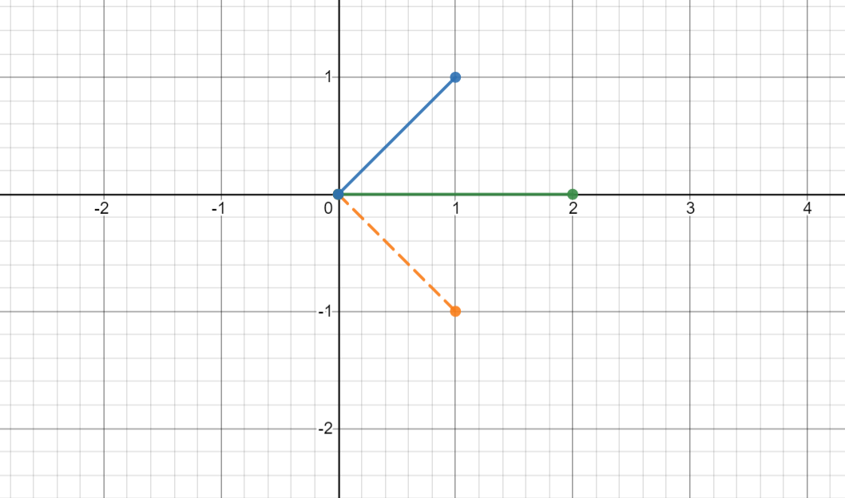
向量相減

Slide 6
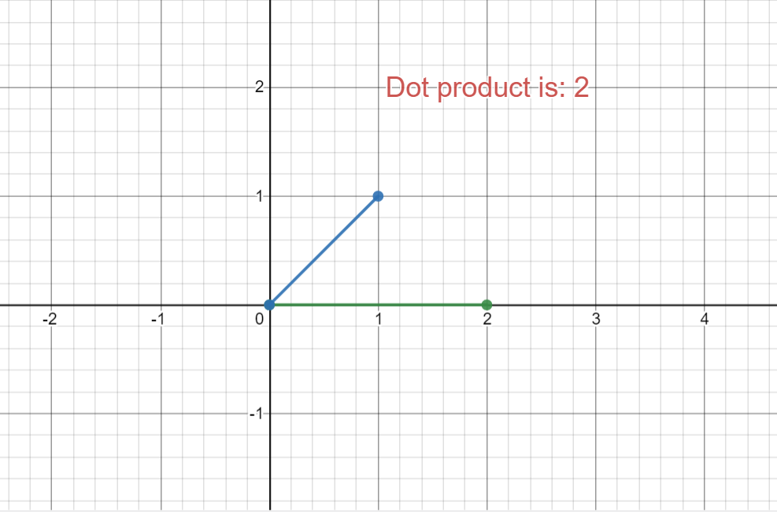
向量內積(1)

Slide 7
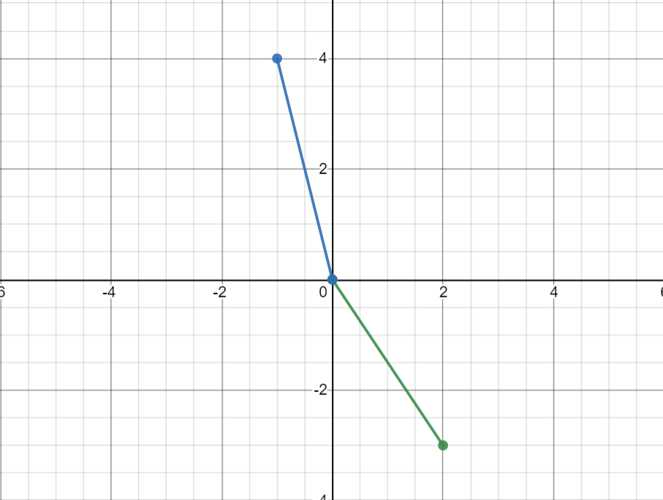
向量內積(2)

Slide 8
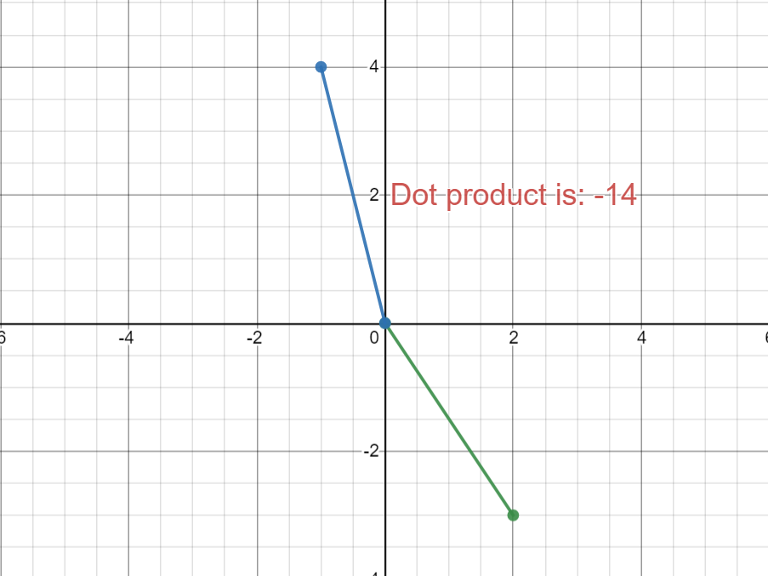
向量內積(2)

Slide 9
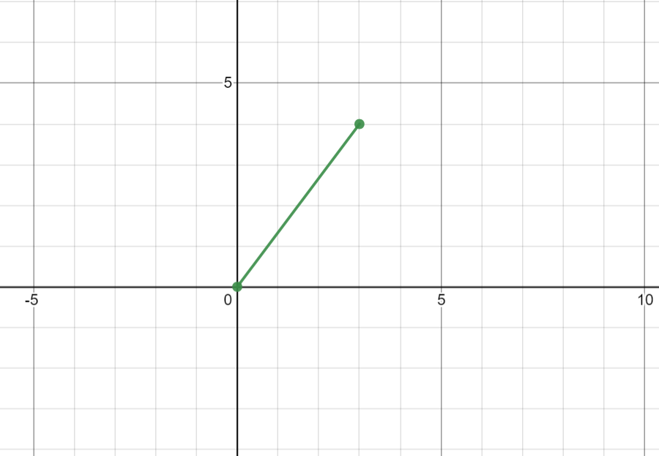
向量的長度

Slide 10
函數與函數的導數

Slide 11
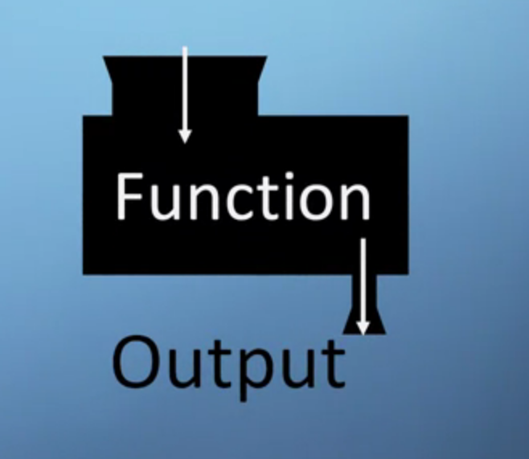
函數(function)

Slide 12
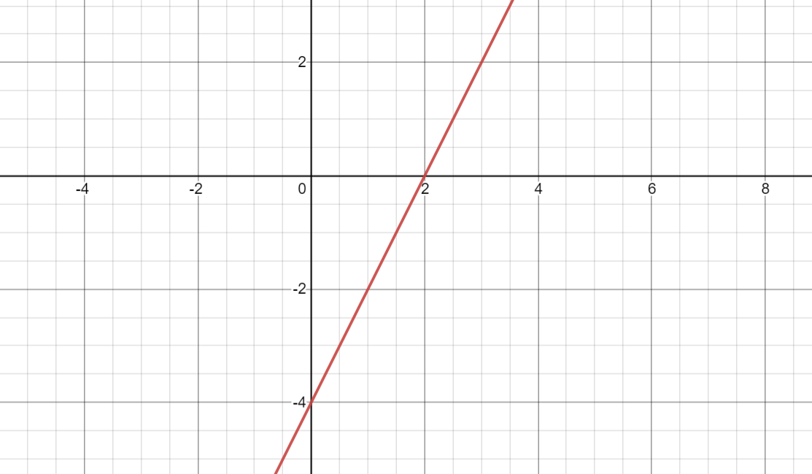


Slide 13
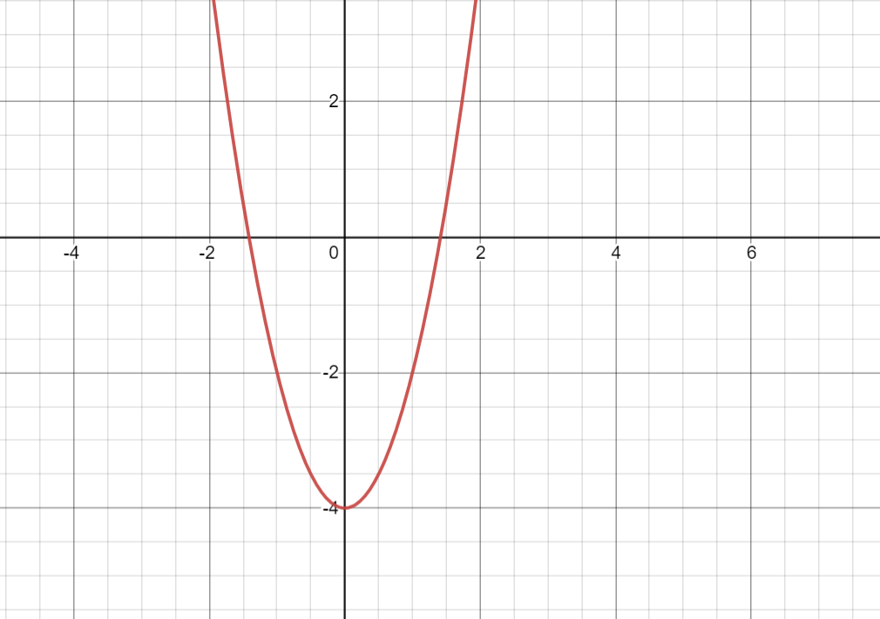


Slide 14
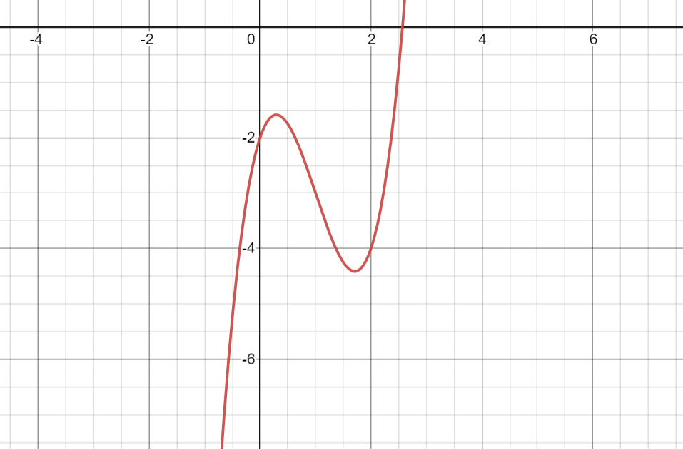


Slide 15
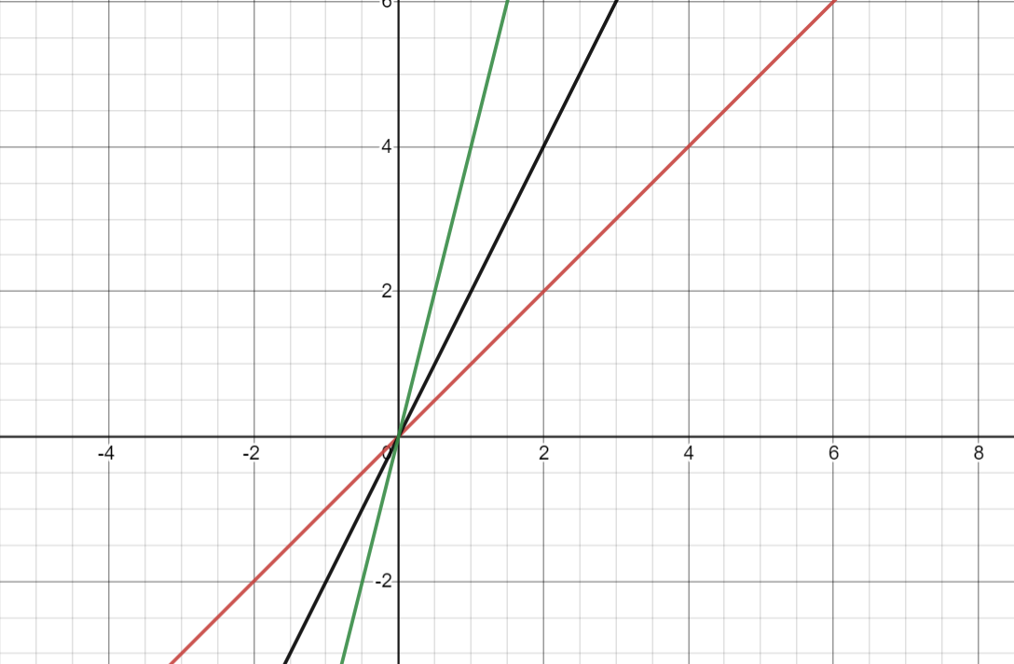
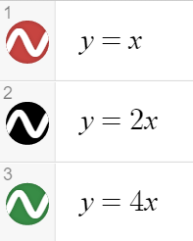
斜率

Slide 16

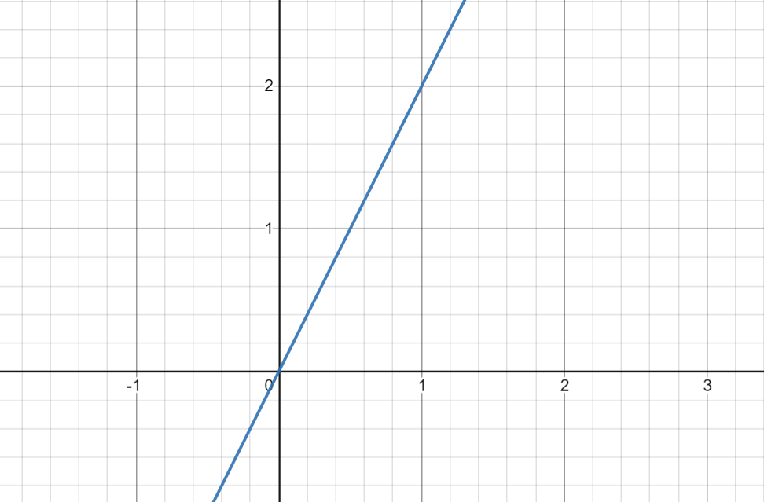
斜率的定義

Slide 17
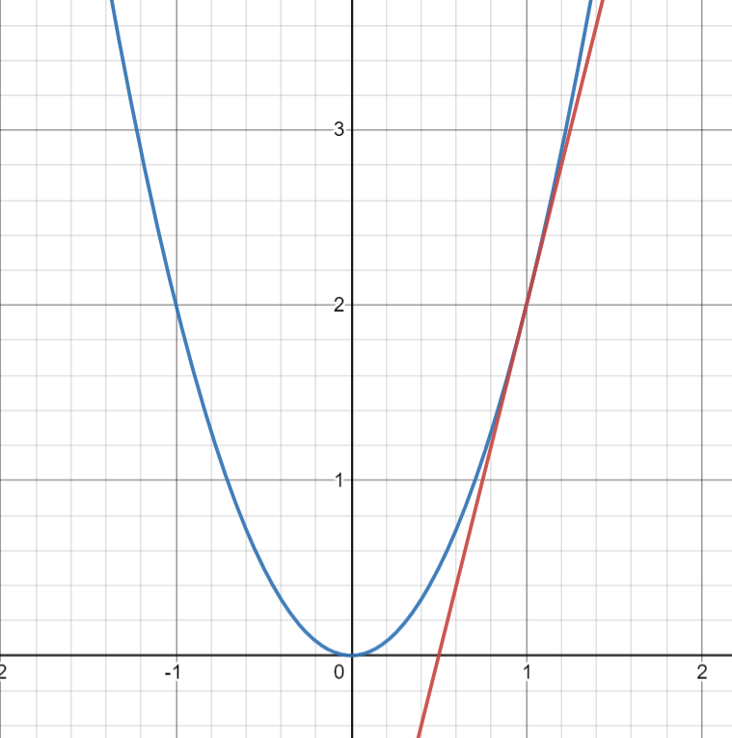
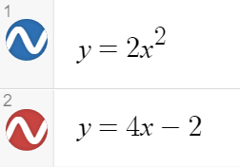
切線

Slide 18
切線斜率?

Slide 19
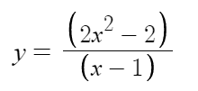
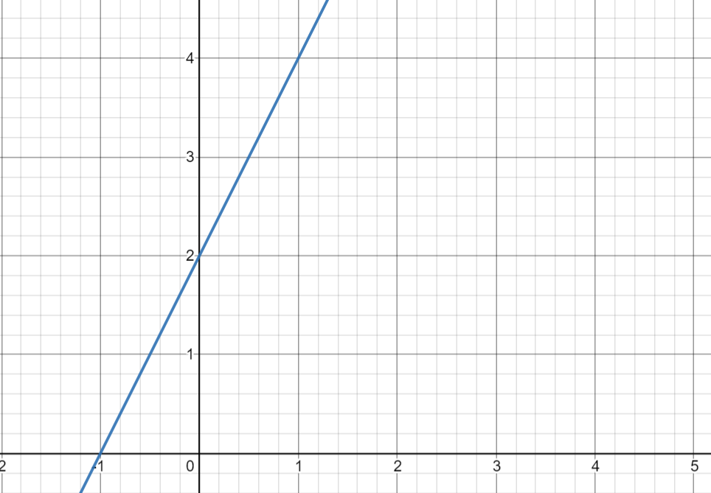
極限值與函數值不相等的例子

Slide 20
PyTorch

Slide 21
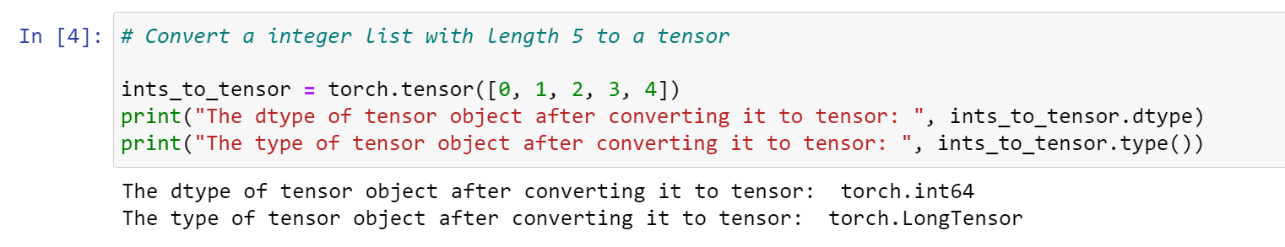
整數List轉成Tensor

Slide 22
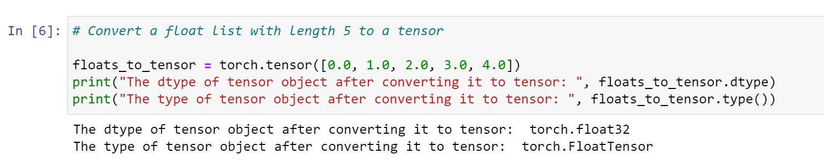
浮點數List轉成Tensor

Slide 23
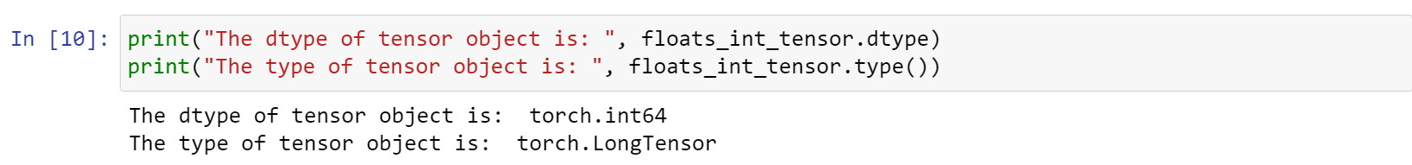
浮點數List轉成整數Tensor

Slide 24
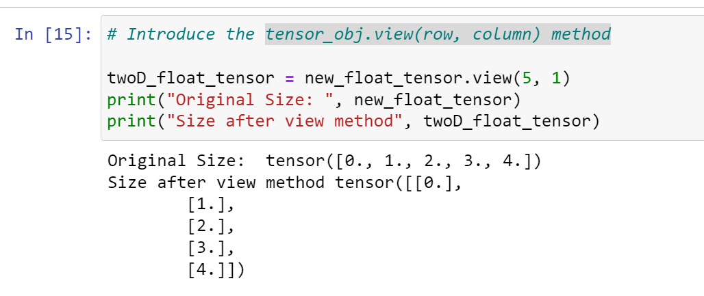
tensor.view

Slide 25
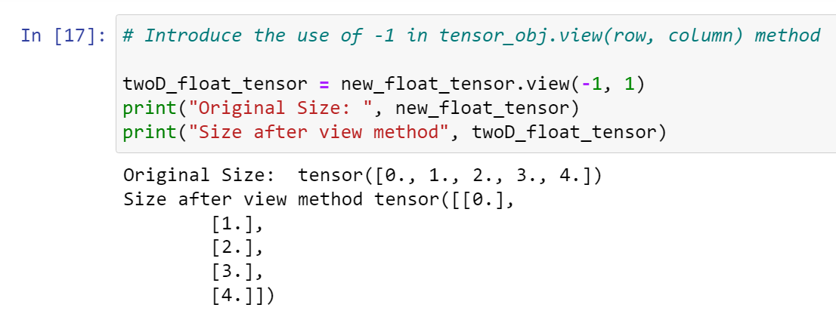
Index -1 是甚麼?

Slide 26
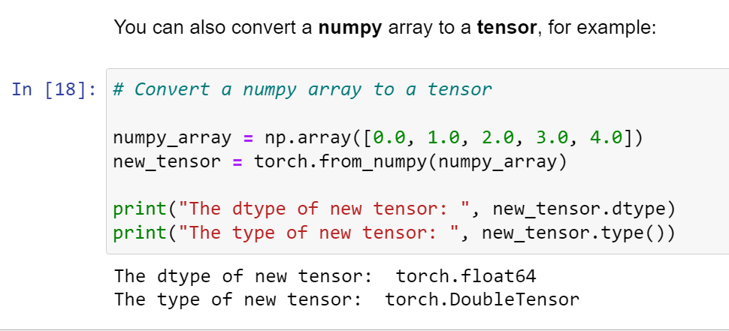
convert a numpy array to a tensor

Slide 27
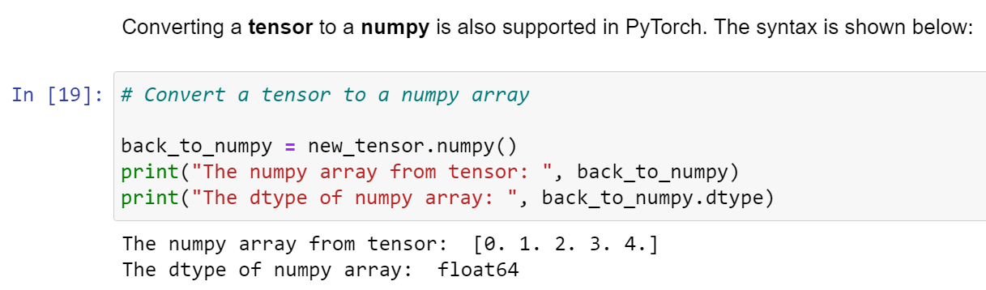
Converting a tensor to a numpy

Slide 28
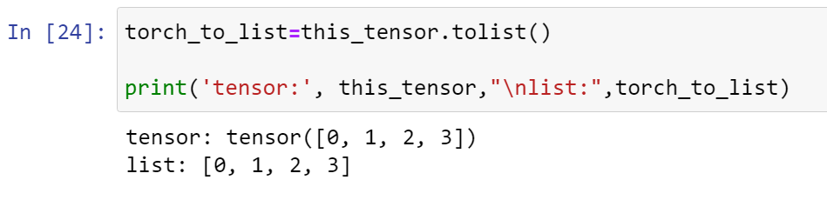
tolist()

Slide 29
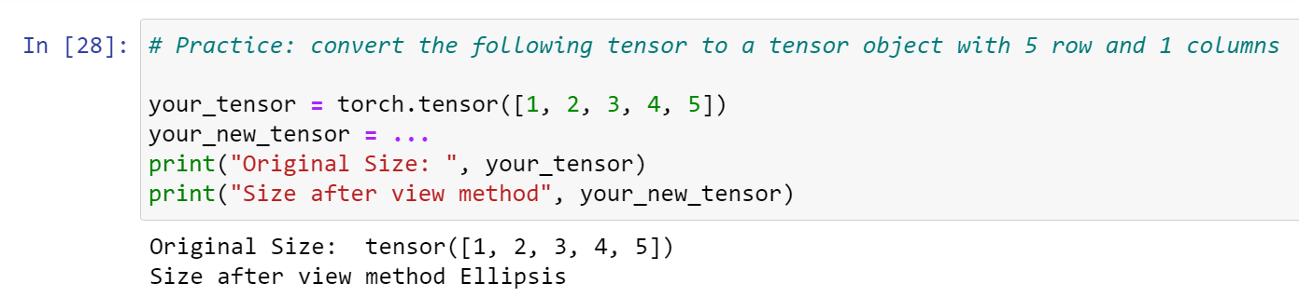
Practice: convert the following tensor to a tensor object with 5 row and 1 columns

Slide 30
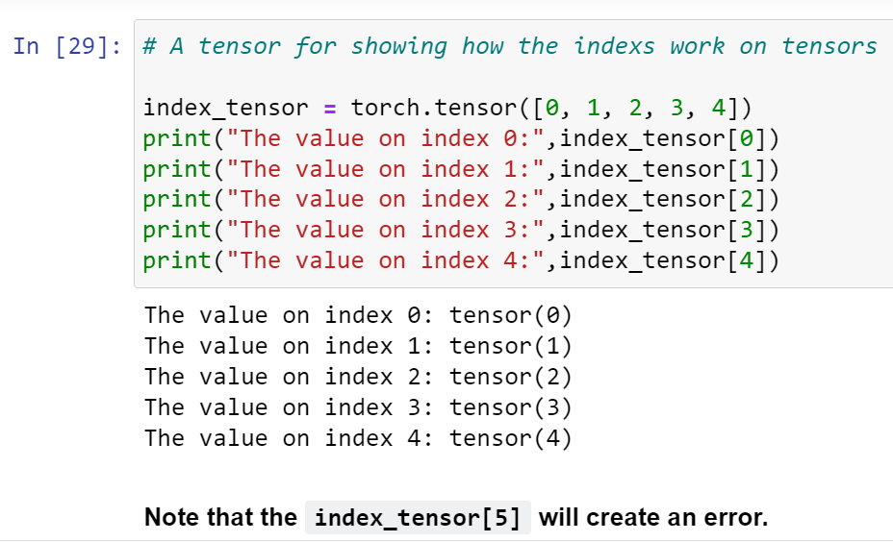
Index of a tensor

Slide 31
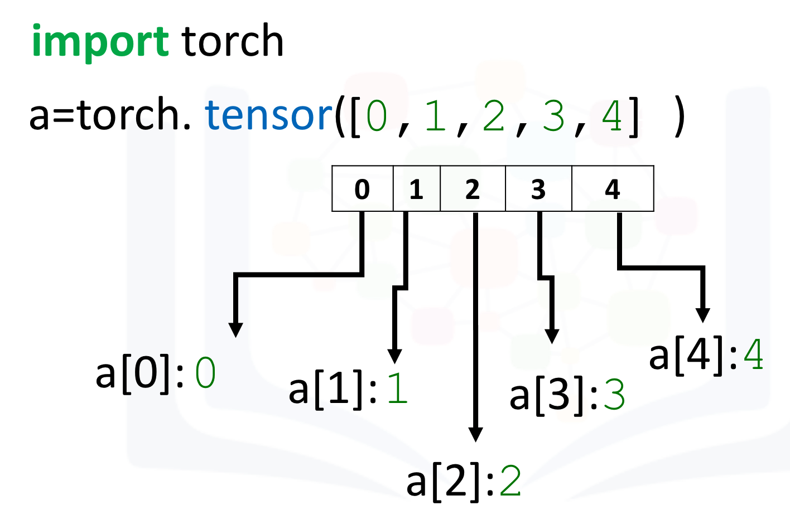

Slide 32
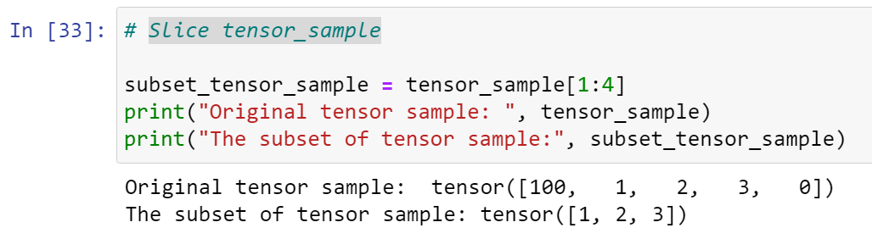
Slice tensor_sample

Slide 33
Note:
Note: The number on the left side of the colon represents the index of the first value. The number on the right side of the colon is always 1 larger than the index of the last value. For example, tensor_sample[1:4] means you get values from the index 1 to index 3 (4-1).

Slide 34
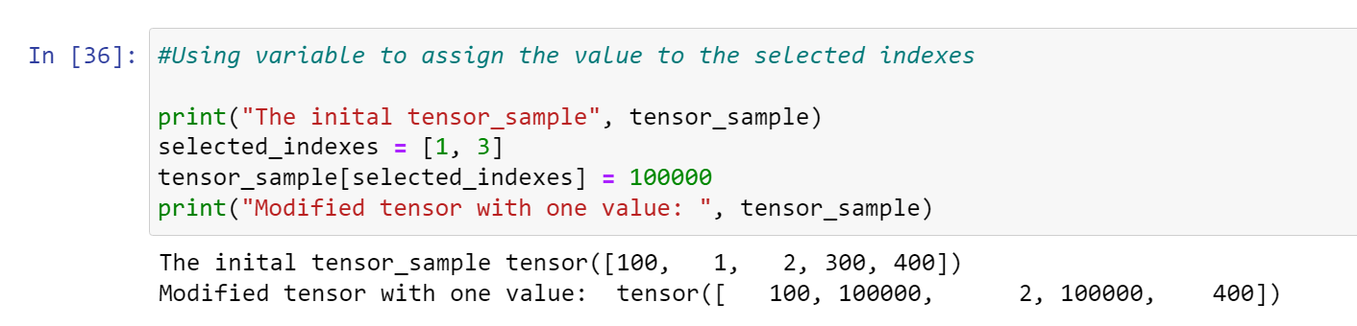
Using variable to assign the value to the selected indexes

Slide 35
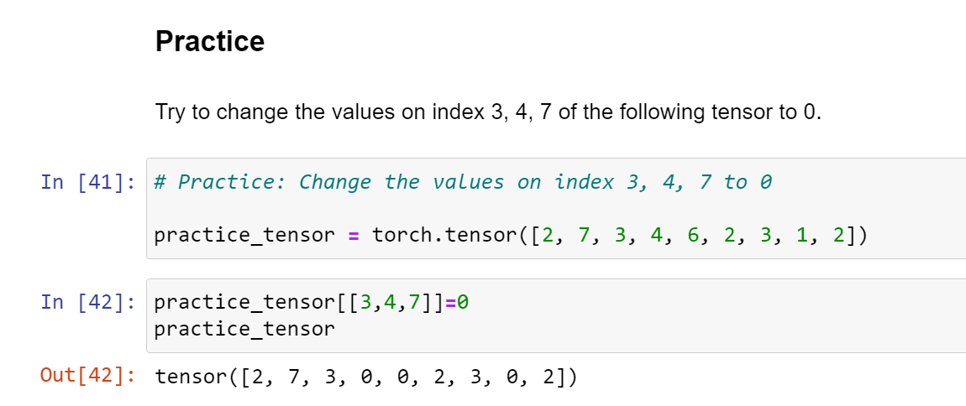

Slide 36
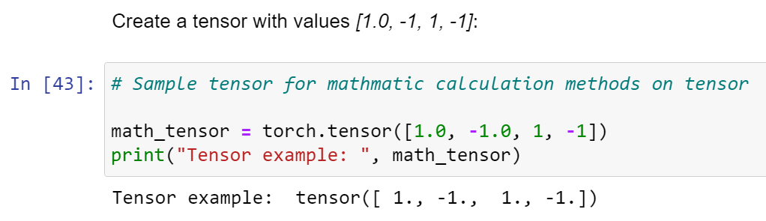
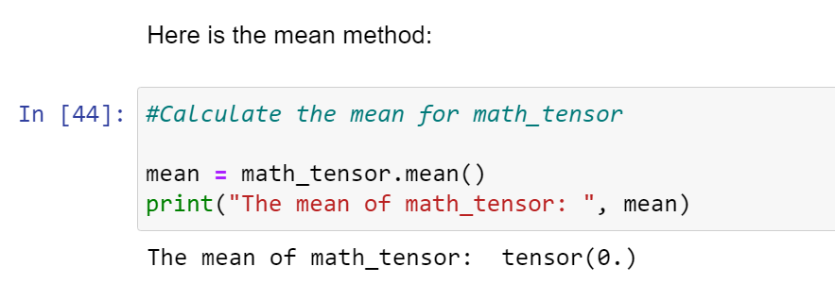
計算tensor平均

Slide 37
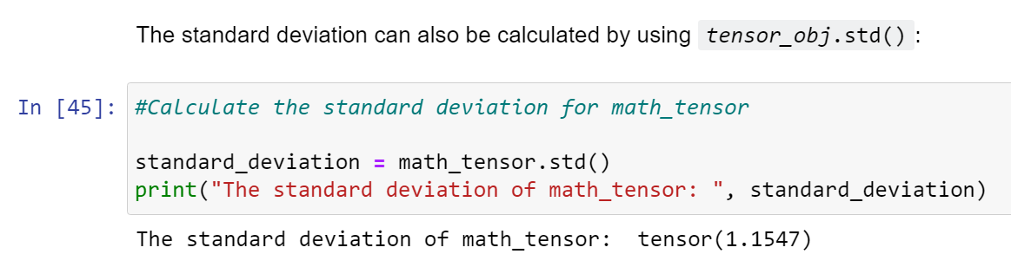
計算tensor標準差

Slide 38
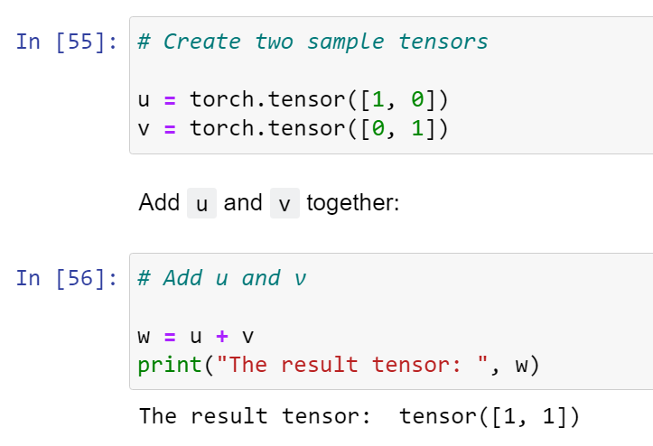
Tensor Addition

Slide 39
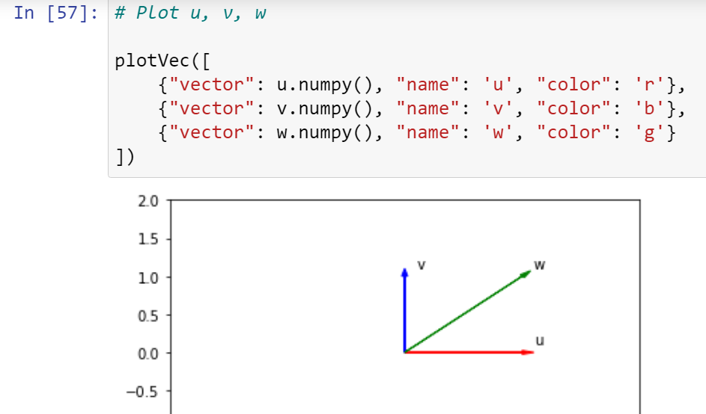

Slide 40
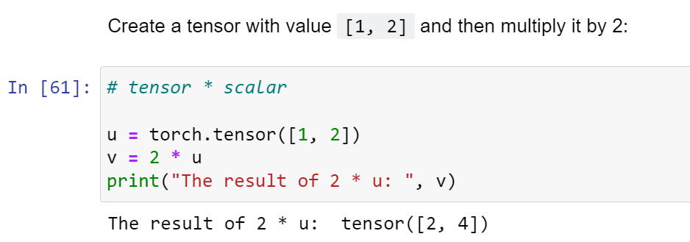
Tensor scalar product

Slide 41
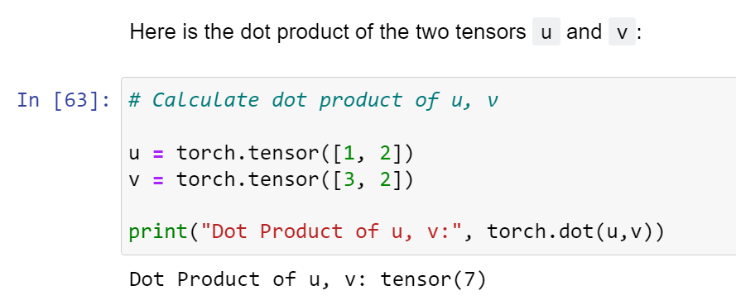
Dot Product (內積)

Slide 42
Practice
Convert the list [-1, 1] and [1, 1] to tensors u and v. Then, plot the tensor u and v as a vector by using the function plotVec and find the dot product.

Slide 43
Differentiation in PyTorch

Slide 44
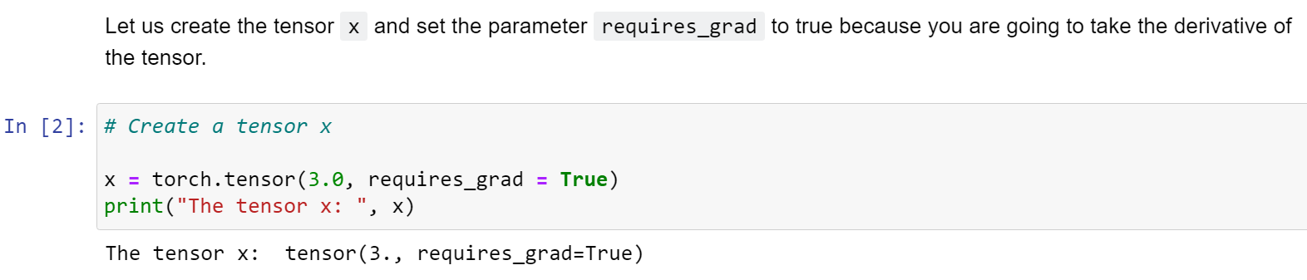
Derivatives

Slide 45
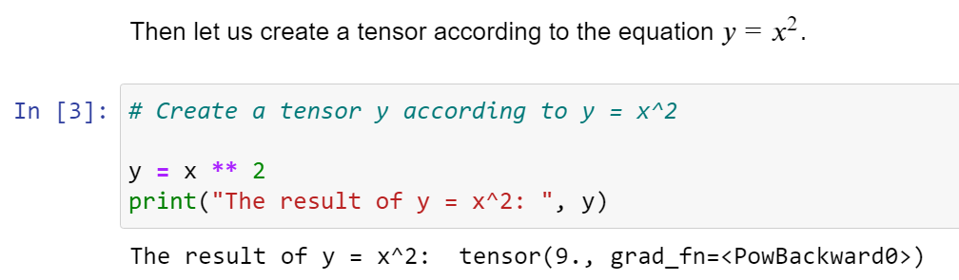
設定函數 y = x**2

Slide 46
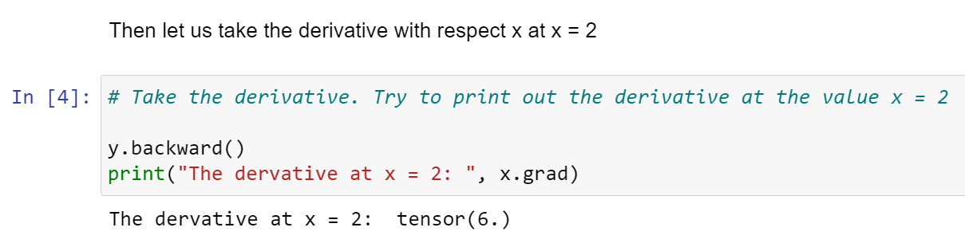
微分

Slide 47
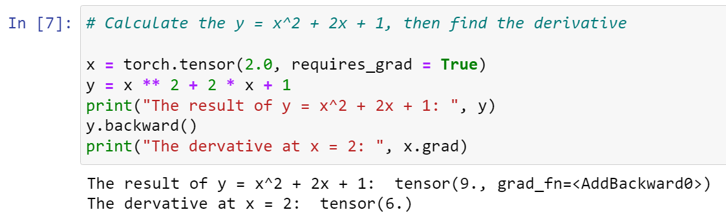
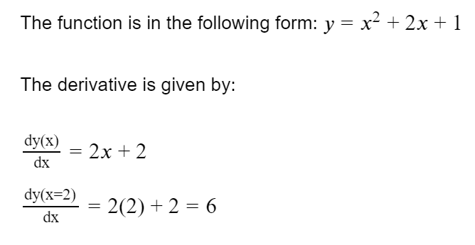
more complicated function

Slide 48
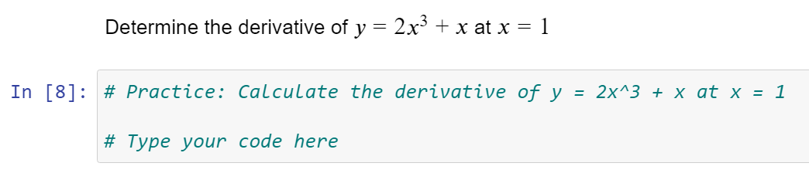
練習
答案：7

Slide 49
習題解答
Lecture1-ex1
A ,D, AC, BD, C, C, C
Lecture1-ex2
1. -4
2. 0
3. 2
4. -6
5. 14
6. +4/-4
7. 2
8. -3
9. 0
10. y=-4x-2

Slide 50
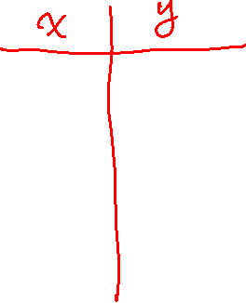
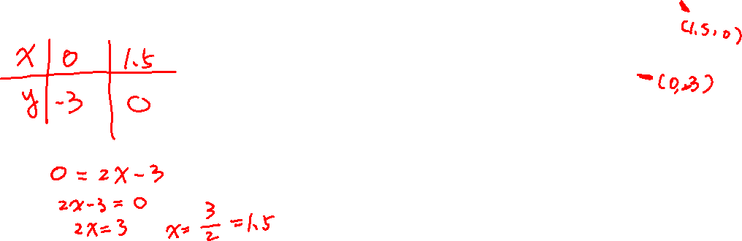
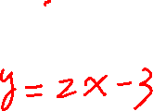
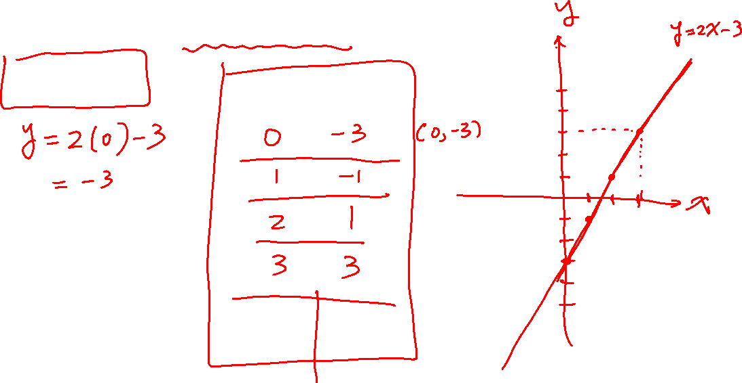
Q1. 如何畫出函數圖形?

Slide 51
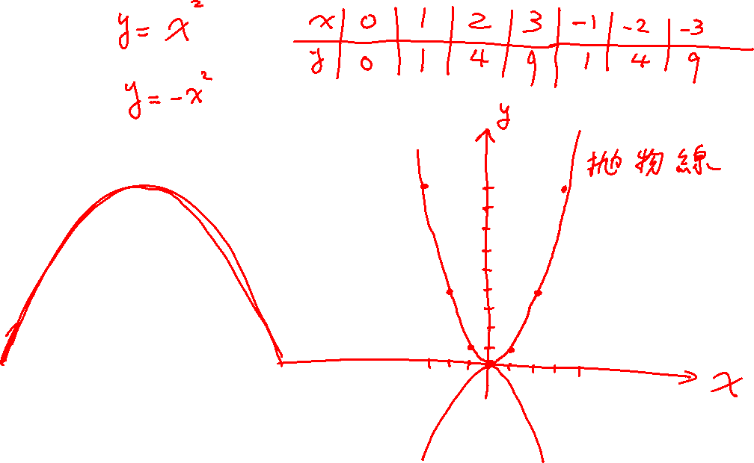

Slide 52

Q2. 如何求直線方程式的斜率?

Slide 53


Slide 54


Slide 55


Slide 56
Q3. 如何求通過兩點的直線?

Slide 57




Slide 58




Slide 59



