Slide 1
Run, skeleton, run: skeletal model in a physics-based simulation
Mikhail Pavlov Sergey Kolesnikov Sergey M. Plis
Reason8

Slide 2
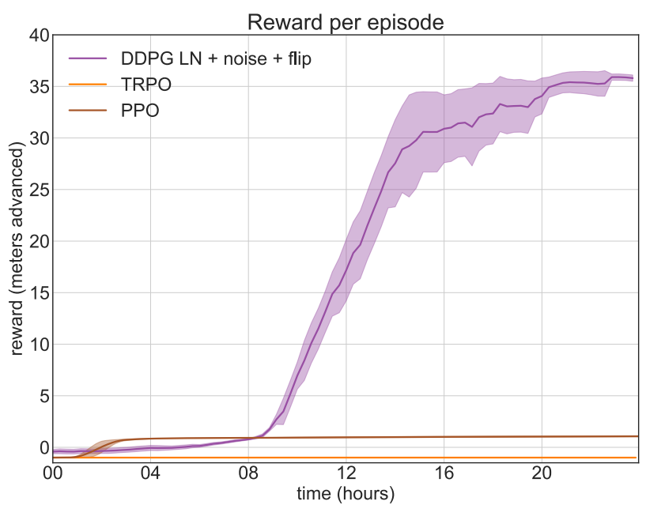
Methods:
On-policy methods: On-policy RL methods can only update agent’s behavior according to the current policy
1. Trust Region Policy Optimization(TRPO)
2. Proximal Policy Optimization(PPO)
Off-policy methods: off-policy methods allow
learning based on all data from arbitrary policies.
It significantly increases sample-efficiency of
such algorithms relative to on-policy based methods
1. Deep Deterministic Policy Gradient (DDPG)
to my knowledge, most high score agent used DDPG
in Learning to run

Slide 3
DDPG improvements:
some standard reinforcement learning techniques:
1). observation preprocessing
2). action repeat (repeat each action 5 times)
3). scaled reward(10 x)
4). additional fail penalty reward
2. Parameter noise:
perturbs network weights encouraging state dependent exploration.Using parameter noise only for the actor network.
3. Layer norm:
layer normalization stabilizes the learning process in a wide range of reward scaling
4. Actions and states reflection symmetry:
The model has bilateral body symmetry. State components and actions can be reflected to increase sample size by factor of 2.

Slide 4
Action space noise && Parameter space noise for Exploration
Action space noise : Consider the continuous action space case. When using Gaussian action noise, actions are sampled according to some stochastic policy, generating
at = πθ(st) + N (0; σ2I).
Therefore, even for a fixed state s, we will almost certainly obtain a different action whenever that state is sampled again in the rollout, since action space noise is completely
independent of the current state st (notice that this is equally true for correlated action space noise)
Parameter space noise : To achieve structured exploration, we sample from a set of policies by applying additive Gaussian noise to the parameter vector of the current policy:
θe = θ + N (0; σ2I).
Importantly, the perturbed policy is sampled at the beginning of each episode and kept fixed for the entire rollout. For convenience and readability, we denote this perturbed policy as πeθ.

Slide 5
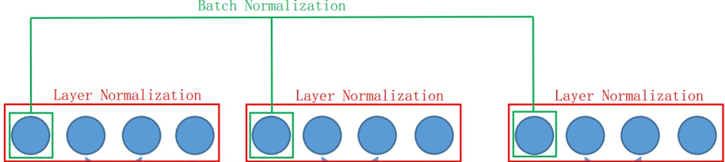
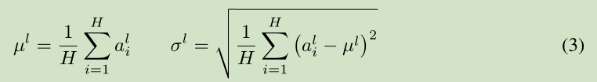
Batch Normalization && Layer Normalization
In the DDPG paper, batch normalization was used
Batch normalization is Influenced by the mini-batch size

Slide 6
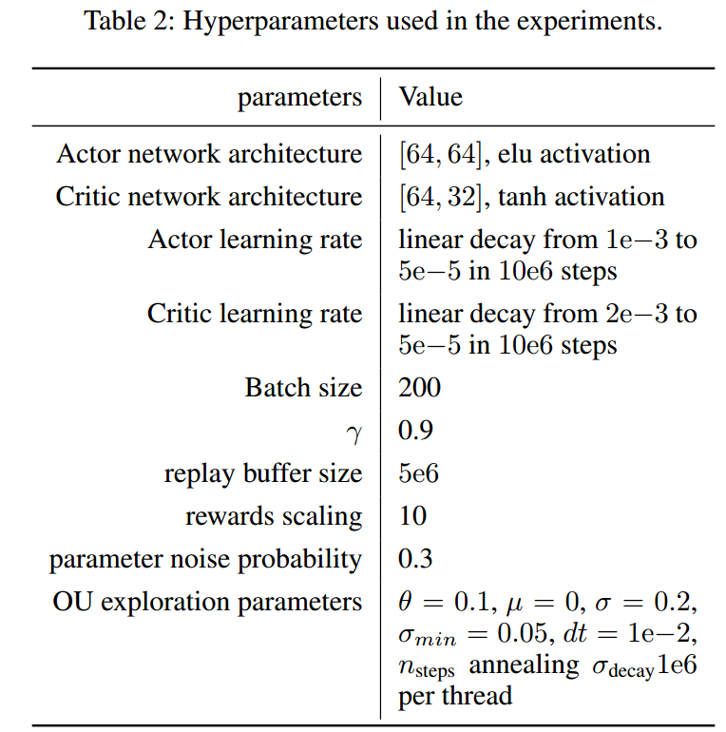
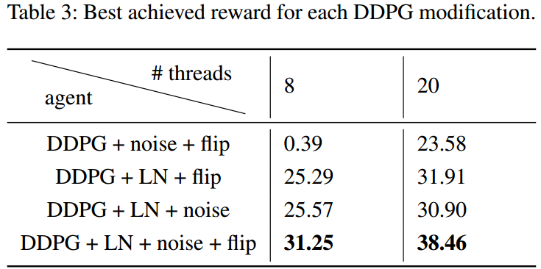
Hyperparameters:
1. Actor and Critic network architecture [64; 64]. So small!
Recommended value: [400, 300]
2. Replay buffer size: 5e6. Recommended value:1e6
3. Batch size: 200. Recommended value:64
4. Discount factor: γ = 0.9. Recommended value:0.99
In my understanding:
1. It is easy to train a small network, it seems that [64,64]
is enough.
2. The replay buffer is so big, which may means that it need
to train as many as possible episodes
3. Batch size is relevant to the Replay buffer size
4. It is easy to train with a low Discount factor under the
factor that repeating each action 5 times
(agent will look ahead 1/(1-γ) steps, when γ is 0.9 and
repeating 5 times, the agent will look ahead 50 steps,
equal to γ = 0.99 without repeat)

Slide 7
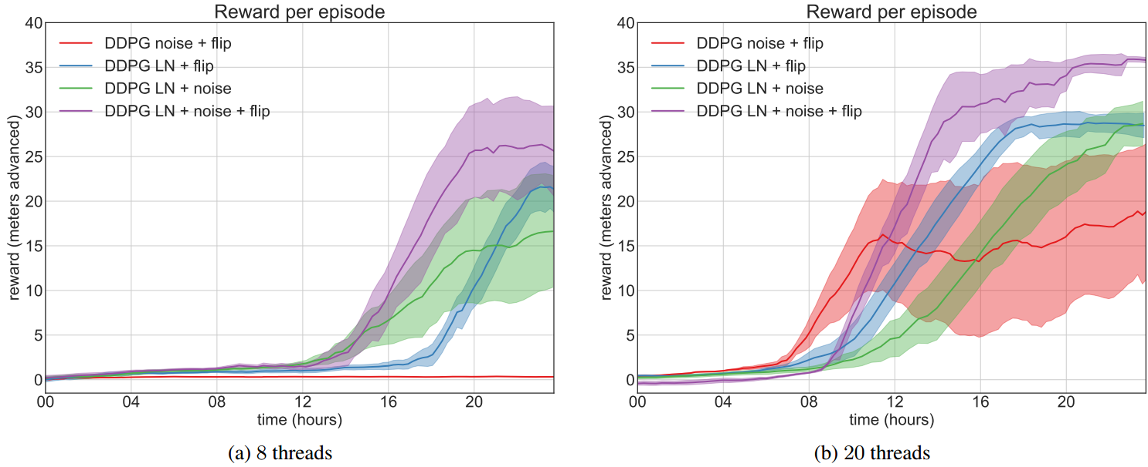
Testing improvements of DDPG with different component in different threads(cores).
From the figure above, The model containing all modifications scores the highest reward. It seems that Layer Norm > noise = flip.
As expected, increasing the number of threads improves the result.

Slide 8
Stability:
n processes collected samples with fixed weights all of which were processed by the learning process at the end of an episode, which updated their weights
2.Layer normalization stabilizes the learning process

Slide 9
我的工作（9.1~11.13）:
9.1~9.7:上手比赛，在自己电脑上使用官方提供的基于keras-rl的DDPG算法跑了几天，跑得很慢，效果
很差，完全无法收敛。。。
9.8~9.14:去官方交流区发现模拟环境很慢，必须要多进程，于是自己试着把官方算法改成并行，但效果不好，分数基本突破不了3分。。。期间试过改参数，对状态进行预处理，均没效果。
9.15~9.30:有大神开源了他基于tensorflow的代码和并行的DDPG代码，但他的进程间通信部分自己当时没看懂，然后花了很长时间做这个。用这份代码到十月初可以在无障碍的情况下跑到22分，然后在服务器上并行跑，在第一轮最高跑到了19分。
10.1~10.13:这段时间主要尝试修改reward函数，添加了姿态惩罚项，第一轮最高达到了33分;期间尝试训练跳着前进的步态，最高达到了32分，之后便一直提不上去。
10.14~10.21:这几天想到模拟环境是近似左右对称的。同时还发现把action二值化，agent也能跑得很流畅。尝试将其应用到无障碍的环境下，跑了3天最高能到39分！于是便放弃了跳的步态，以不同的方式加入对称条件，到21号，在第一轮能达到39.5分。同时第二轮规则出来。在第一轮的基础上将障碍增加到了10个。10.22~11.1:在一台4核电脑上继续跑第一轮的代码，连续跑了一个星期最高达到了42.17分;在服务器上用16核跑第二轮的代码，虽然峰值能到33分左右，但agent的平均分只有十几分，agent很容易摔倒。
11.2~11.9:前几天，在租的服务器上继续跑，发现虽然峰值能达到41分，但平均分还是提不上去，很不稳定。于是后几天把action二值化取消，最后勉强达到了均分24左右的agent，而分数的峰值也降到了36。
11.10~11.13:这些天尝试过降低学习速率、改变batch大小，均分能达到30，但时间已经不够了。

