Slide 1
The FloorSet Challenge
Data-Driven-SoC-Floorplanning
ICCAD 2026 Contest Problem C
Presenter:
Cheng-An Tsai
Advisor:
Hung-Ming Chen

Slide 2
Outline
Problem Statement
  Inputs and Outputs
  Hard and Soft Constraints
  Evaluation Metrics
Related Work
Proposed Methodology
Planned Tasks

Slide 3
Outline
Problem Statement
  Inputs and Outputs
  Hard and Soft Constraints
  Evaluation Metrics
Related Work
Proposed Methodology
Planned Tasks

Slide 4
Problem Statement
Inputs and Outputs
Inputs:
  block_count
  area_targets: target area of each block
  b2b_connectivity: weighted block-to-block connections
  p2b_connectivity: weighted pin-to-block connections
  pins_pos: fixed pin coordinates
  constraints: [fixed, preplaced, MIB ID, cluster ID, boundary code]
  target_positions: target (x, y, w, h) for fixed-shape and preplaced blocks
Outputs:
  A list of block placements: [(x_i, y_i, w_i, h_i)] for all blocks
  Floating-point coordinates are allowed.
  Any aspect ratio is allowed, as long as the area and hard constraints are satisfied.

Slide 5
Problem Statement
Hard and Soft Constraints
Hard Constraints:
  No overlap between any two blocks.
  Soft-block area must be within 1% of the target area.
  Fixed-shape blocks must preserve exact target dimensions.
  Preplaced blocks must preserve exact target position and dimensions.
  Any hard-constraint violation makes the solution infeasible with cost = 10.
Soft Constraints:
  Grouping: blocks in the same group should abut and form one connected component.
  MIB(Multi-Instantiation Blocks): blocks in the same MIB group should have identical dimensions.
  Boundary: specified blocks should touch the required bounding-box edge or corner.

Slide 6
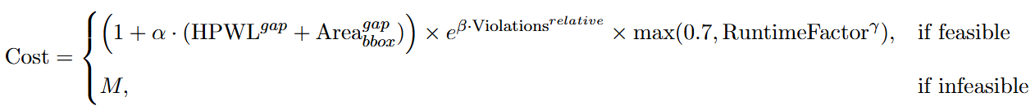
Problem Statement
Evaluation Metrics
Cost = (1 + 0.5 × (HPWL_gap + Area_gap))
× exp(2.0 × V_relative)
× max(0.7, RuntimeFactor^0.3)
If infeasible: Cost = 10
  Higher than any reasonable feasible solution
  But not so extreme that a single failure dominates the entire score
Total Score: Σ_i softmax(n_i) × Cost_i
  Large-case feasibility is more important than small-case average performance.
  Feasibility first, then quality and runtime.
Notes:
因為權重是 exponential，所以 120-block case 的權重最大
如果剛好每個 size 21 到 120各一個 case
120-block case weight ≈ 63.2%
119-block case weight ≈ 23.3%
118-block case weight ≈ 8.6%
Top 5 largest cases together ≈ 99.3%個 case

Slide 7
Problem Statement
Evaluation Metrics
Official Evaluation Framework
iccad2026_evaluate.py
evaluator, validator, scoring, visualization, and data loaders
optimizer_template.py
B*-Tree Simulated Annealing baseline
training_example.py
example of differentiable contest-cost training

Slide 8
Outline
Problem Statement
Related Work
Proposed Methodology
Planned Tasks

Slide 9
Related Work
Classical Floorplanning:
  Sequence Pair, B*-Tree, and Corner Block List represent legal floorplan structures.
  Simulated Annealing and other metaheuristics are robust but often slow on large constrained cases.
Graph-Based Learning:
  GraphPlanner and GNN-based approaches learn structural information from netlists.
  They are useful for predicting placement relationships but usually require legalization.

Slide 10
Related Work
RL-Based Floorplanning:
  GoodFloorplan and other RL methods formulate floorplanning as a sequential decision problem.
  They can learn placement strategies but may suffer from training instability and sequential error accumulation.
Generative Models:
  Diffusion-based placement can generate high-quality layouts quickly.
  However, strict legality still requires guidance or repair.

Slide 11
Outline
Problem Statement
Related Work
Proposed Methodology
Planned Tasks

Slide 12
Proposed Methodology
Constraint-Aware Graph-Based Constructive Floorplanner
Core Idea:
Convert the instance into a heterogeneous graph.
Use a graph encoder to learn connectivity and constraint-aware block features.
Use a constructive decoder to place blocks step by step.
Use legality masks to prevent invalid placements.
Use exact repair and local search to improve soft constraints, HPWL, and area.
Notes:
Heterogeneous graph 異質圖

Slide 13
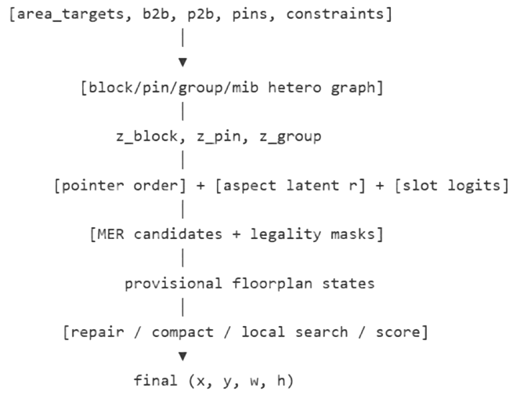
Proposed Methodology
Architecture

Slide 14
Proposed Methodology
Architecture
Input Parsing
Graph Construction
• Block nodes: area, fixed/preplaced flags, MIB ID, cluster ID, boundary code.
• Pin nodes: fixed coordinates.
• Edges: block-to-block, pin-to-block, group membership, and MIB membership.
Graph Encoder
• Extract structural embeddings from netlist and constraint relations.
Constructive Decoder
• Predict placement order, block shape, and candidate slot.
Legal Placement Engine
• Use B*-Tree / MER / skyline-style representation to avoid overlap.
Repair and Local Search
• Fix hard constraints first.
• Then reduce MIB, grouping, and boundary violations.
• Finally optimize HPWL and bounding-box area.
Notes:
Skyline-style representation:已放好的 block 形成了一條外輪廓 / frontier，下一個 block 只能放在這條 frontier 上的合法位置

Slide 15
Proposed Methodology
Constraint-Aware Graph-Based Constructive Floorplanner
Hard-Constraint Handling:
  Preplaced blocks are locked to target (x, y, w, h).
  Fixed-shape blocks use target (w, h).
  Soft blocks use area-preserving shape parameterization.
  Candidate placements that cause overlap are masked out.
Soft-Constraint Handling:
  MIB groups share a common shape parameter.
  Grouping constraints are handled by group-aware placement priority and repair.
  Boundary constraints are handled by boundary-aware slot selection and final edge-push repair.

Slide 16
Proposed Methodology
Training Strategy
Supervised / Imitation Learning:
  Learn from the 1M optimal-by-construction training samples.
  Predict placement order, shape parameters, and candidate slots.
Differentiable Proxy Loss:
  Use the official differentiable cost for HPWL, area, overlap, and area tolerance.
Additional Constraint-Aware Losses:
  Fixed/preplaced exactness loss
  MIB shape consistency loss
  Group connectivity surrogate loss
  Boundary distance loss
  Candidate ranking loss
Evaluator-in-the-Loop:
  Regularly export validation solutions.
  Re-score them using the official evaluator.
  Use feasible rate and large-case score for model selection.

Slide 17
Outline
Problem Statement
Related Work
Proposed Methodology
Planned Tasks

Slide 18
Thanks for listening.

