Slide 1
The FloorSet Challenge
Data-Driven-SoC-Floorplanning
ICCAD 2026 Contest Problem C
Presenter:
Cheng-An Tsai
Advisor:
Hung-Ming Chen

Slide 2
Outline
Problem Statement
  Inputs and Outputs
  Hard and Soft Constraints
  Evaluation Metrics
  Evaluator Update from v9 to v10
Related Work
Proposed Methodology
Implementation
Experimental Results
Conclusion
Future Work

Slide 3
Outline
Problem Statement
  Inputs and Outputs
  Hard and Soft Constraints
  Evaluation Metrics
  Evaluator Update from v9 to v10
Related Work
Proposed Methodology
Implementation
Experimental Results
Conclusion
Future Work

Slide 4
Problem Statement
Inputs and Outputs
Goal: generate legal and high-quality SoC floorplans from FloorSet instances
Inputs:
  Block information: number of blocks and target area of each block
  Netlist information: block-to-block connectivity and pin-to-block connectivity
  Pin information: pin coordinates
  Constraint information: [fixed, preplaced, MIB ID, cluster ID, boundary code]
  Optional training labels: fp_sol, tree_sol, and metrics_sol
Outputs:
  A list of block placements: [(x_i, y_i, w_i, h_i)] for all blocks
  Floating-point coordinates are allowed.
  Any aspect ratio is allowed, as long as the area and hard constraints are satisfied.

Slide 5
Problem Statement
Hard and Soft Constraints
Hard Constraints:
  No overlap between any two blocks.
  Soft-block area must be within 1% of the target area.
  Fixed-shape blocks must preserve exact target dimensions.
  Preplaced blocks must preserve exact target position and dimensions.
  Any hard-constraint violation makes the solution infeasible with cost = 10.
Soft Constraints:
  Grouping: blocks in the same group should abut and form one connected component.
  MIB(Multi-Instantiation Blocks): blocks in the same MIB group should have identical dimensions.
  Boundary: specified blocks should touch the required bounding-box edge or corner.

Slide 6
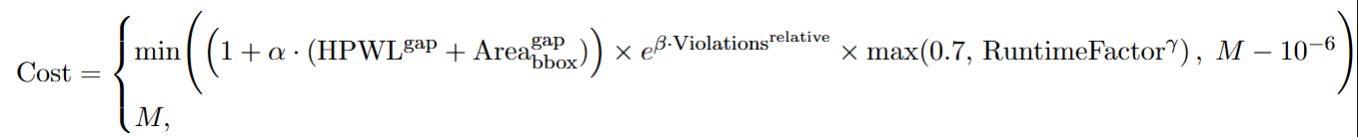
Problem Statement
Evaluation Metrics
Cost = (1 + 0.5 × (HPWL_gap + Area_gap))
× exp(2.0 × V_relative)
× max(0.7, RuntimeFactor^0.3)
If infeasible: Cost = 10
  Higher than any reasonable feasible solution
  But not so extreme that a single failure dominates the entire score

Slide 7
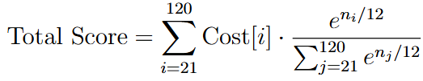
Problem Statement
Evaluator Update from v9 to v10
Main Changes
The local evaluator keeps the runtime term in the formula, but evaluates validation cases with neutral RuntimeFactor = 1.0
  Official leaderboard runtime can still differ because it depends on per-test-case cross-submission medians
v10 scoring makes large instances important, but not dominated by only one case
Fixed-shape and preplaced legality are treated as hard feasibility conditions
Notes:
官方的公式仍然有 runtime term，但本地 validation 因為沒有官方「同一 test case 上所有 submission 的 median runtime」，所以把 RuntimeFactor 固定成 1.0，也就是 neutral runtime
v9 時比較容易誤以為最後幾個大 case 完全主導分數，但 v10 的 weighting 讓整體 validation 更重要
因為權重是 exponential，所以 120-block case 的權重最大
如果剛好每個 size 21 到 120各一個 case
120-block case weight ≈ 63.2%
119-block case weight ≈ 23.3%
118-block case weight ≈ 8.6%
Top 5 largest cases together ≈ 99.3%個 case

Slide 8
Outline
Problem Statement
Related Work
Proposed Methodology
Implementation
Experimental Results
Conclusion
Future Work

Slide 9
Related Work
Classical Floorplanning
  Constructive placement methods
  B*-tree and sequence-pair representations
  Simulated annealing and search-based optimization
  Legalization and repair after initial placement
Learning-based EDA
  GNNs for netlist and block-relationship modeling
  Learned placement priors for better initial solutions
  Data-driven ranking or guidance for optimization
Our Work
  We combine learned priors with a deterministic, constraint-aware solver
  The model predicts guidance; the solver produces legal placements
Notes:
Learning-based EDA 則常用 GNN 來理解 netlist
比純 neural output 更穩定，也比純 heuristic 更能利用 training data

Slide 10
Outline
Problem Statement
Related Work
Proposed Methodology
  Core Idea
  Architecture Evolution
  Latest Architecture
Implementation
Experimental Results
Conclusion
Future Work

Slide 11
Proposed Methodology
Core Idea
Convert each FloorSet instance into a graph-guided placement problem
  Heterogeneous graph modeling keeps netlist, pin, and constraint semantics visible to the encoder
Use a neural encoder to predict reusable guidance signals
  Learning improves layout quality by predicting useful geometric priors
Decode guidance into multiple candidate placements
Repair candidates using constraint-aware geometry rules
  Repair protects feasibility under hard and soft constraints
Select the best candidate using proxy ranking
  Candidate ranking separates model prediction from final scoring decisions
Notes:
hard-legal, proxy cost 低, soft violations 少, HPWL proxy 和 bbox area 好
model 提供方向，solver 負責裁判

Slide 12
Proposed Methodology
Architecture Evolution
Stage | Main Attempt | Reason for Change
v1/v2 | Build initial GNN-guided floorplanning path | Need richer representation for pins, clusters, MIB, and boundaries
v3 | Add relative-order decoding, pairwise heads, checkpoint experiments | Keep neural output as guidance instead of direct placement
v4 | Add richer graph attention and structural context | Preserve the same downstream solver while improving encoder capacity
v5 | Typed nodes and typed relations for blocks, pins, clusters, MIB, boundary | Do not promote by validation loss alone
v10 | Add proxy ranking, narrow grouping pair bias | -
Notes:
GNN 證明 learned guidance 有用，但 context 不夠；Graph Transformer 讓 representation 更豐富；HGT 嘗試 typed heterogeneous graph，但還不能只靠 validation loss promotion；v10 control layer 則讓我們把 scoring policy、runtime、soft constraints 的 trade-off 放在共同控制層處理
narrow grouping pair bias: 在 relative-order placement 中，如果兩個 block 屬於同一個 cluster/group，而且這個 cluster 有 grouping pressure，且 horizontal/vertical 的排序選擇本來就很接近，它會對 cluster 偏好的方向加一點 bonus

Slide 13
Proposed Methodology
Latest Architecture - Inference Path
Instance Parsing
  Convert evaluator tensors into an Instance
  Normalize block areas, nets, pins, and constraints
Guidance Generation
  Build graph input for the selected encoder
  Run the neural model and convert predictions into AnchorGuidance
Decoder
  Use anchors, priorities, aspect hints, and pairwise-axis logits
  Construct relative ordering and initial block rectangles
Repair
  Fix hard legality first
  Then reduce boundary, grouping, and MIB soft violations
Placement Selection
  Rank candidates using hard legality, proxy cost, soft penalties, and quality metrics
  Return final (x, y, w, h) placement list

Slide 14
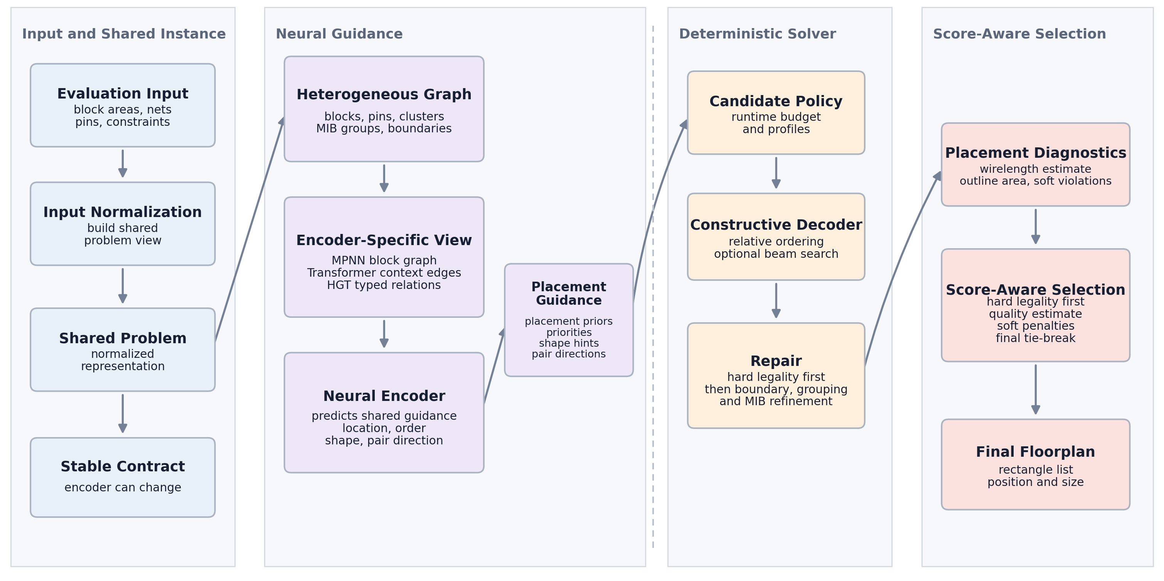
Proposed Methodology
Latest Architecture - Inference Path
Notes:
Shared Problem:共用的問題表示，後面的 graph construction、neural guidance、decoder、repair、ranking 都讀同一份 problem representation
Constructive Decoder:把「模型建議」轉成「實際初始 placement」
Placement Diagnostics: 對每個 repaired candidate 計算診斷資訊，例如 wirelength estimate、outline area、soft violation counts。這一步不是再改 placement，而是幫後面的 ranking 判斷哪個 candidate 比較好
Score-Aware Selection:根據 legality 和 quality 指標選出最佳 candidate。排序邏輯大致是：hard legality 優先，接著看 score proxy (bbox area, soft violation relative penalty)，再看 soft penalties，最後用 wirelength / outline area 。這就是「model proposes, solver decides」。

Slide 15
Proposed Methodology
Latest Architecture - Training Path
Load FloorSet-Lite sample
Extract instance tensors and fp_sol
Detect clean and dirty samples using soft-constraint checks
Build training target record
Repair dirty labels into pseudo targets
Build encoder-specific graph inputs
Train shared prediction heads
  GNN, Graph Transformer, and HGT can be compared fairly
  Downstream decoder receives the same guidance format
Notes:
乾淨資料可以直接當 target；dirty sample 用 solver/repair 把它修成一個比較合法、比較適合學習的 target，再拿這個修過的結果來監督模型

Slide 16
Outline
Problem Statement
Related Work
Proposed Methodology
Implementation
  Dataset Format and Target Construction
  From GNN to Graph Transformer to HGT
  Constraint-Aware Decoding and Repair
Experimental Results
Conclusion
Future Work

Slide 17
Implementation
Dataset Format and Target Construction
Field | Meaning | Current Use
area_target | Target area for each block | Model input and hard-area reference
b2b_connectivity | Block-to-block nets | Graph edges and connectivity features
p2b_connectivity | Pin-to-block nets | Pin and net context
pins_pos | Pin coordinates | Graph features and placement context
placement_constraints | Fixed, preplaced, MIB, cluster, boundary flags | Constraint-aware features and repair rules
fp_sol | Reference rectangles | Main geometry supervision
tree_sol | B*-tree-like floorplan structure | Not used in current training path
metrics_sol | Area, pin, net, wirelength, and constraint metrics | Mostly metadata today; useful future auxiliary signal

Slide 18
Implementation
From GNN to Graph Transformer to HGT
MPNN = Message Passing Neural Network
HGT = Heterogeneous Graph Transformer
Training Outputs
  Anchor Center Target
  Priority Target
  Log-aspect Target
  Pairwise Relation / Axis Target
Encoder | Representation | Strength
GNN / MPNN | Blocks as nodes, connectivity as edges | Simple, stable, strong early baseline
Graph Transformer | Richer attention over structural graph context | Current strong production-style encoder
HGT | Typed nodes: block, pin, cluster, MIB, boundary | Better match to FloorSet semantics
Notes:
anchor: 預測中心點
priority: ordering and placement priority-
log_aspect: shape preference for soft blocks
pair_logits: pairwise horizontal / vertical relation hints

Slide 19
Implementation
Constraint-Aware Decoding
Start from learned anchors and placement priorities
Use log-aspect predictions to guide soft-block shape
Use pairwise-axis logits to resolve ambiguous relative order
Generate candidate placements instead of committing to one neural prediction

Slide 20
Implementation
Repair Strategy
Hard legality first:
  area tolerance
  fixed-shape legality
  preplaced legality
  overlap removal
Soft-constraint improvement second:
  boundary snapping
  grouping / cluster cohesion
  MIB shape consistency
Candidate acceptance is controlled by proxy ranking

Slide 21
Outline
Problem Statement
Related Work
Proposed Methodology
Implementation
Experimental Results
  Architecture Performance Comparison
  Floorplan Visualization
Conclusion
Future Work

Slide 22
Experimental Results
Architecture Performance Comparison
Version | Key Result | What We Learned
GNN Promotion | total about 2.33 to 2.65, 100/100 feasible | Learned anchor guidance clearly improved deterministic placement
No-checkpoint Guidance | total 6.2174, no-runtime 4.6289 | Deterministic repair can preserve legality, but initial solution quality strongly limits final score
Configured Anchor-GNN | total 3.2697, no-runtime 2.0326 | Guidance path was robust, but block-level representation still limited constraint reasoning
Graph Transformer | total 2.1107 | Richer structural context became the strongest current checkpoint
HGT | total 2.2144 | Typed heterogeneous modeling is promising but not yet superior

Slide 23
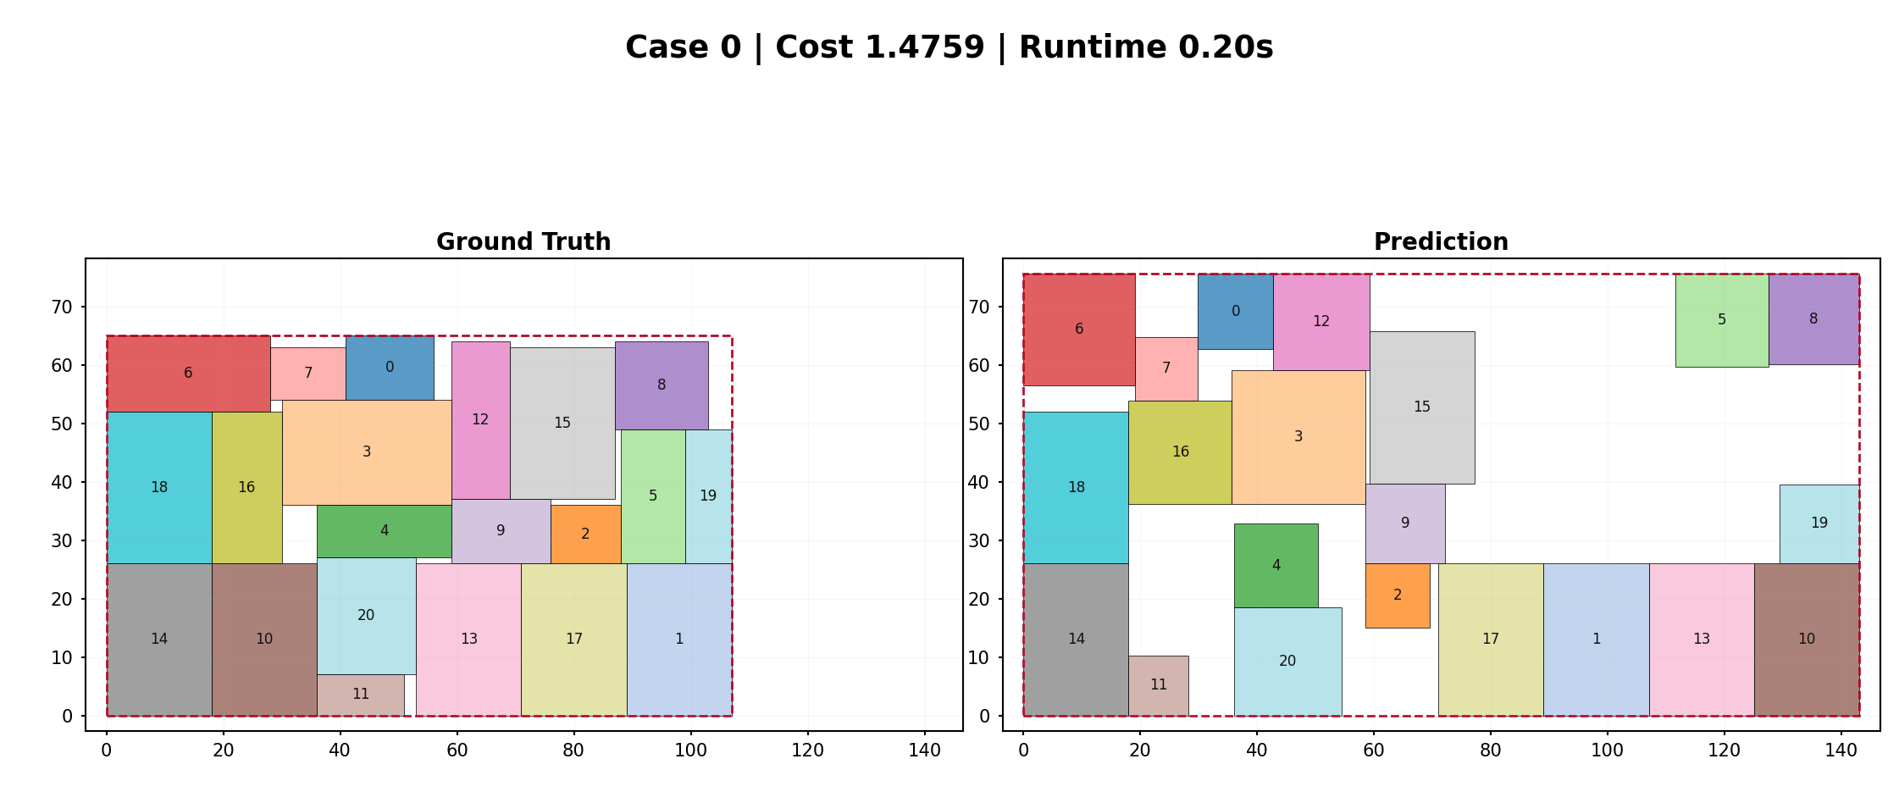
Experimental Results
Floorplan Visualization

Slide 24
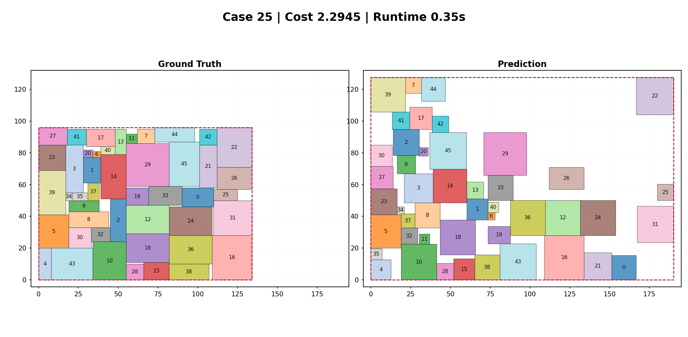
Experimental Results
Floorplan Visualization

Slide 25
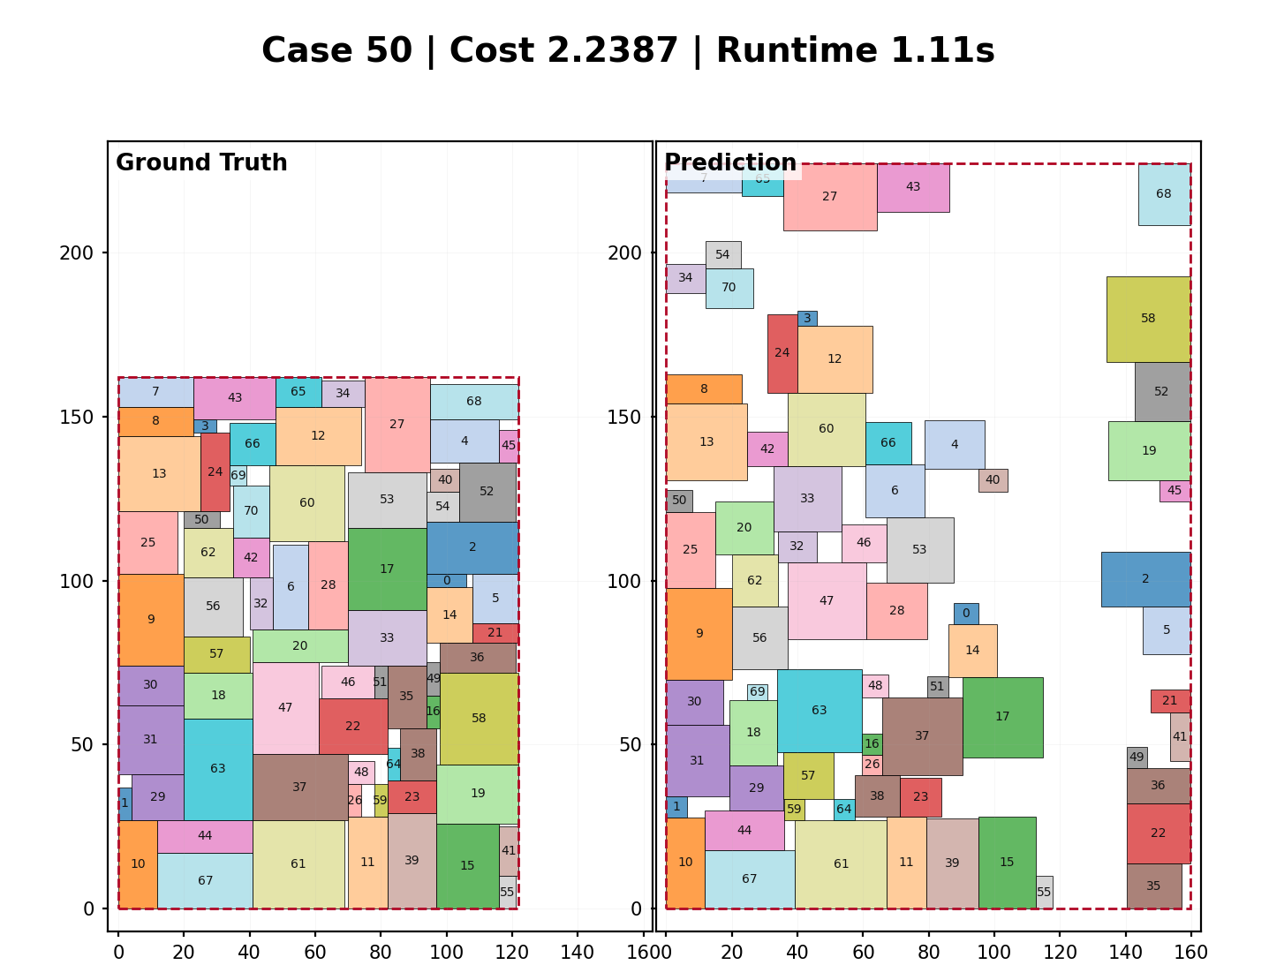
Experimental Results
Floorplan Visualization

Slide 26
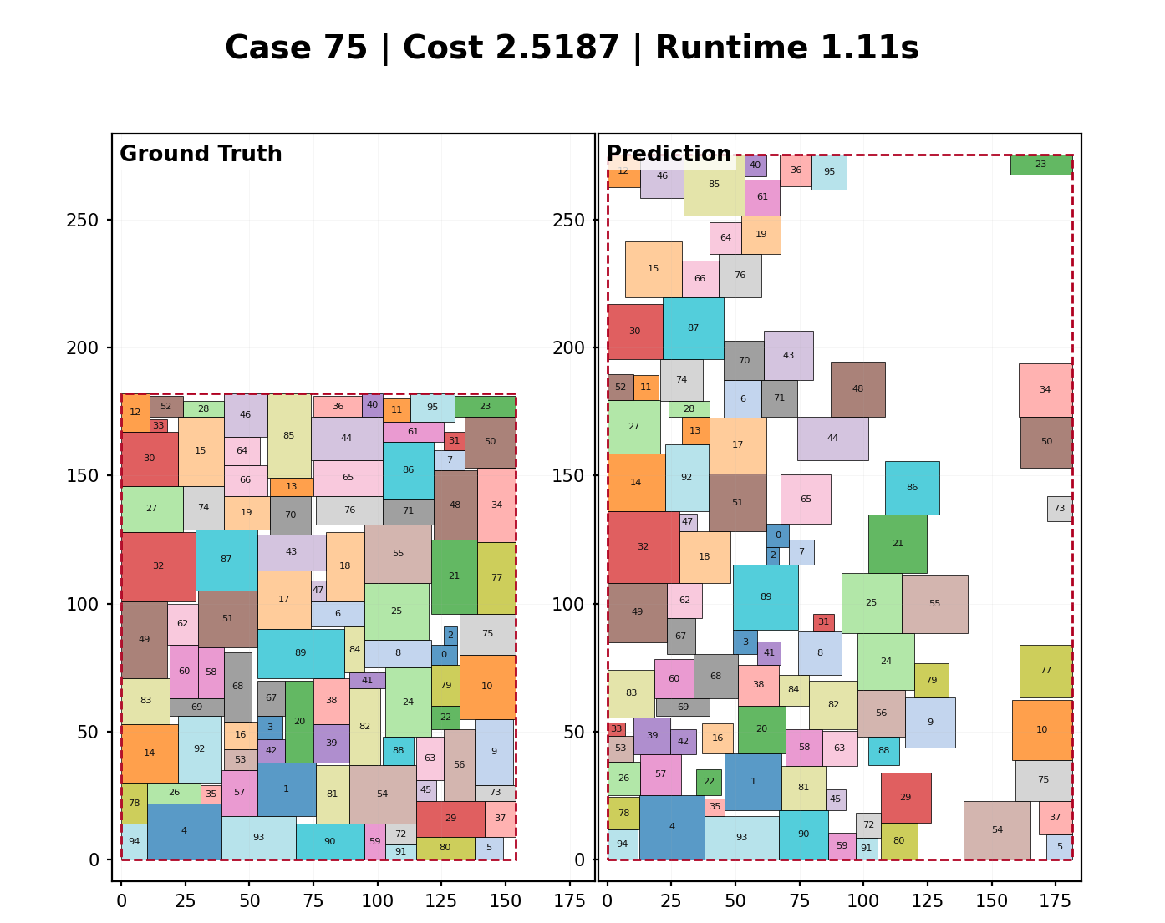
Experimental Results
Floorplan Visualization

Slide 27
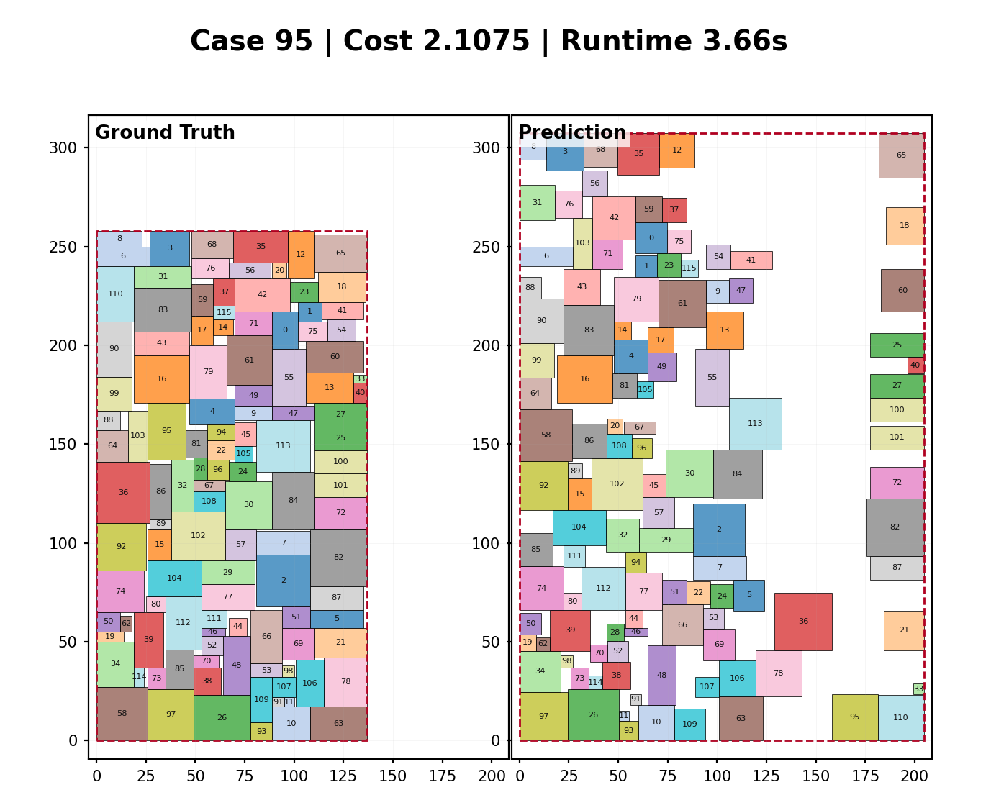
Experimental Results
Floorplan Visualization

Slide 28
Outline
Problem Statement
Related Work
Proposed Methodology
Implementation
Experimental Results
Conclusion
Future Work

Slide 29
Conclusion
The final system is a hybrid floorplanning solver:
  neural guidance for geometry priors
  deterministic decoding for stable placement construction
  repair for hard and soft constraints
  score-aware candidate selection
The architecture evolved from GNN to Graph Transformer and HGT-compatible design
The most important engineering lesson is to keep the solver contract stable while improving the encoder and control layer

Slide 30
Outline
Problem Statement
Related Work
Proposed Methodology
Implementation
Experimental Results
Conclusion
Future Work

Slide 31
Future Work
HGT continuation
Decoder replacement or upgrade
  Replace the current relative-order decoder with a stronger learned or search-based decoder
  Diffusion decoder
  Analytical decoder
Use currently underused dataset fields
  tree_sol: Train a tree-aware decoder
  metrics_sol: Train auxiliary prediction heads for wirelength, area, and difficulty

Slide 32
Thanks for listening.

