Slide 1
BOB
Build Orchestration Bot
A Production-Ready Framework for Autonomous AI-Assisted Development
"Can We Build It? Yes We Can!"
Yaakoub Elkhamra, PhD
January 2026

Slide 2
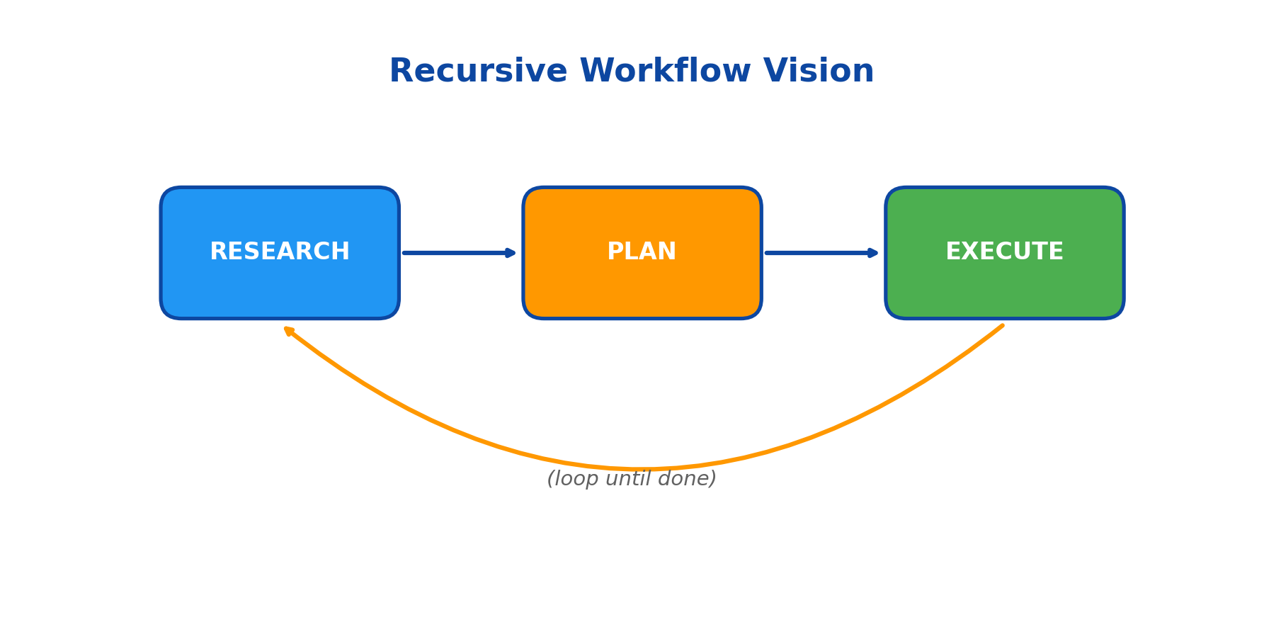
The Origin Story
How BOB Came To Be
THE VISION
Build a recursive workflow:
RESEARCH -> PLAN -> EXECUTE
(loop until done)
THE PROBLEM
Tokens were an issue
Complex workflows = massive context
API costs added up quickly
THE BREAKTHROUGH
Claude Code Max subscription
Started with Claude Code Harness Demo
Built with Claude Code SDK

Slide 3
Why The Harness Design Works
Key Design Patterns That Enable Autonomous Coding
1. ORCHESTRATION OVER AGENTS
3. RESEARCH-FIRST PRINCIPLE
Single agent = limited scope
Orchestrator = coordinates multiple agents
Each agent specialized for its task
Clean separation of concerns
Fail-fast is expensive with LLMs
Research before implementation
Domain knowledge persists across sessions
Prevents repeated failures
2. ESCALATION PATTERN
4. DAG-BASED TASK SCHEDULING
Start cheap, escalate when needed
Sonnet handles 70%+ of tasks
Opus for complex reasoning
Diagnosis for persistent failures
Dependencies define execution order
Independent tasks run in parallel
Topological sort ensures correctness
Maximizes throughput
KEY INSIGHT: The harness design decouples task specification from execution strategy.
This allows the system to adapt its approach based on task complexity and failure patterns, without changing the task definition itself.

Slide 4
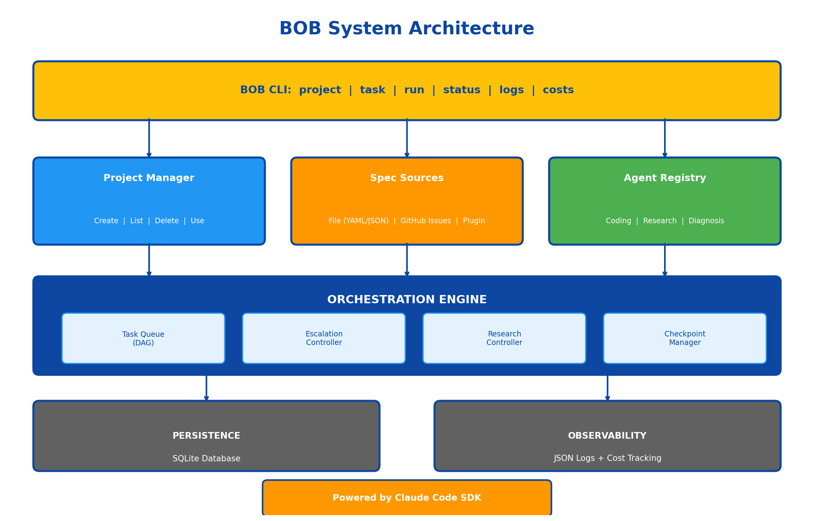
System Architecture
Layered Design for Modularity and Extensibility
DESIGN HIGHLIGHTS
CLI provides unified interface
Three core managers:
- Projects (isolation)
- Specs (flexibility)
- Agents (specialization)
Orchestration engine:
- DAG task scheduling
- Escalation control
- Research coordination
SQLite for persistence
JSON logs for observability

Slide 5
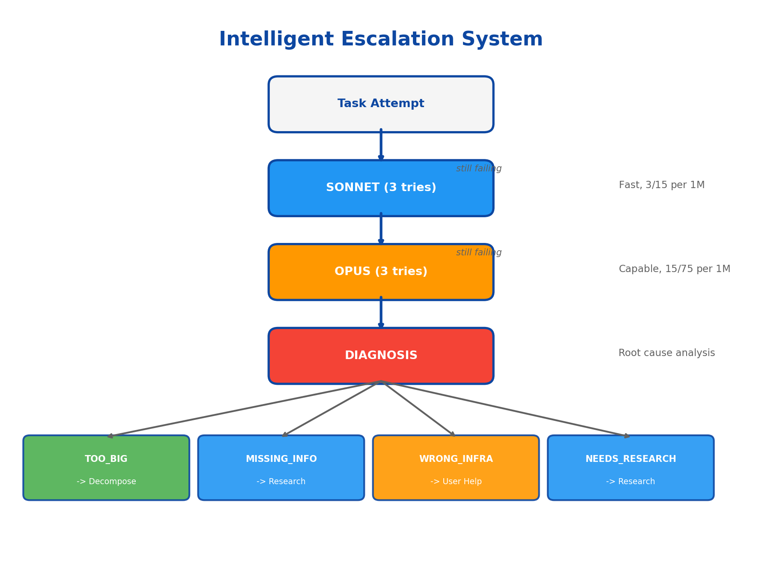
Intelligent Escalation System
Automatic Failure Recovery
HOW IT WORKS
1. Start with Sonnet (fast, cheap)
- 3 attempts before escalating
- Handles 70%+ of tasks
2. Escalate to Opus if needed
- More capable reasoning
- 3 more attempts
3. Diagnosis on persistent failure
- Analyzes root cause
- Takes targeted action
COST BENEFIT
Sonnet: $3/$15 per 1M tokens
Opus: $15/$75 per 1M tokens
5x savings on most tasks!

Slide 6
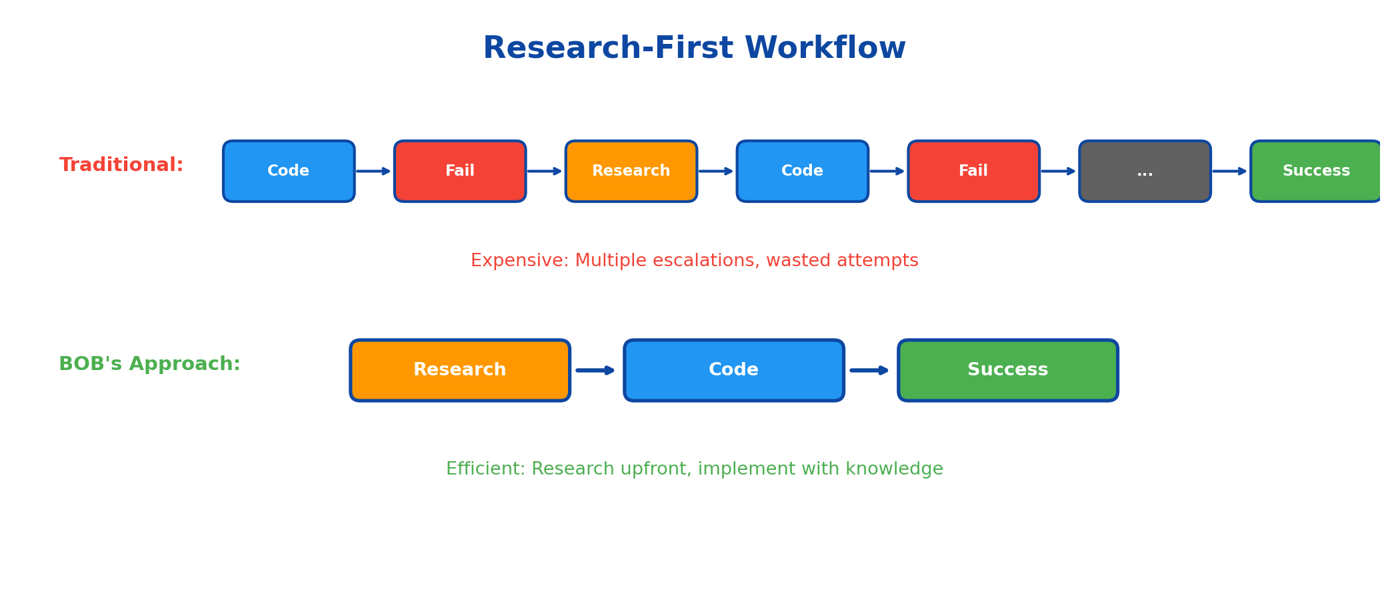
Research-First Workflow
Proactive Knowledge Acquisition
The Pattern:
Mark tasks with research_required: true and provide research_queries. BOB researches BEFORE coding, storing findings for the implementation phase. This eliminates expensive trial-and-error cycles.

Slide 7
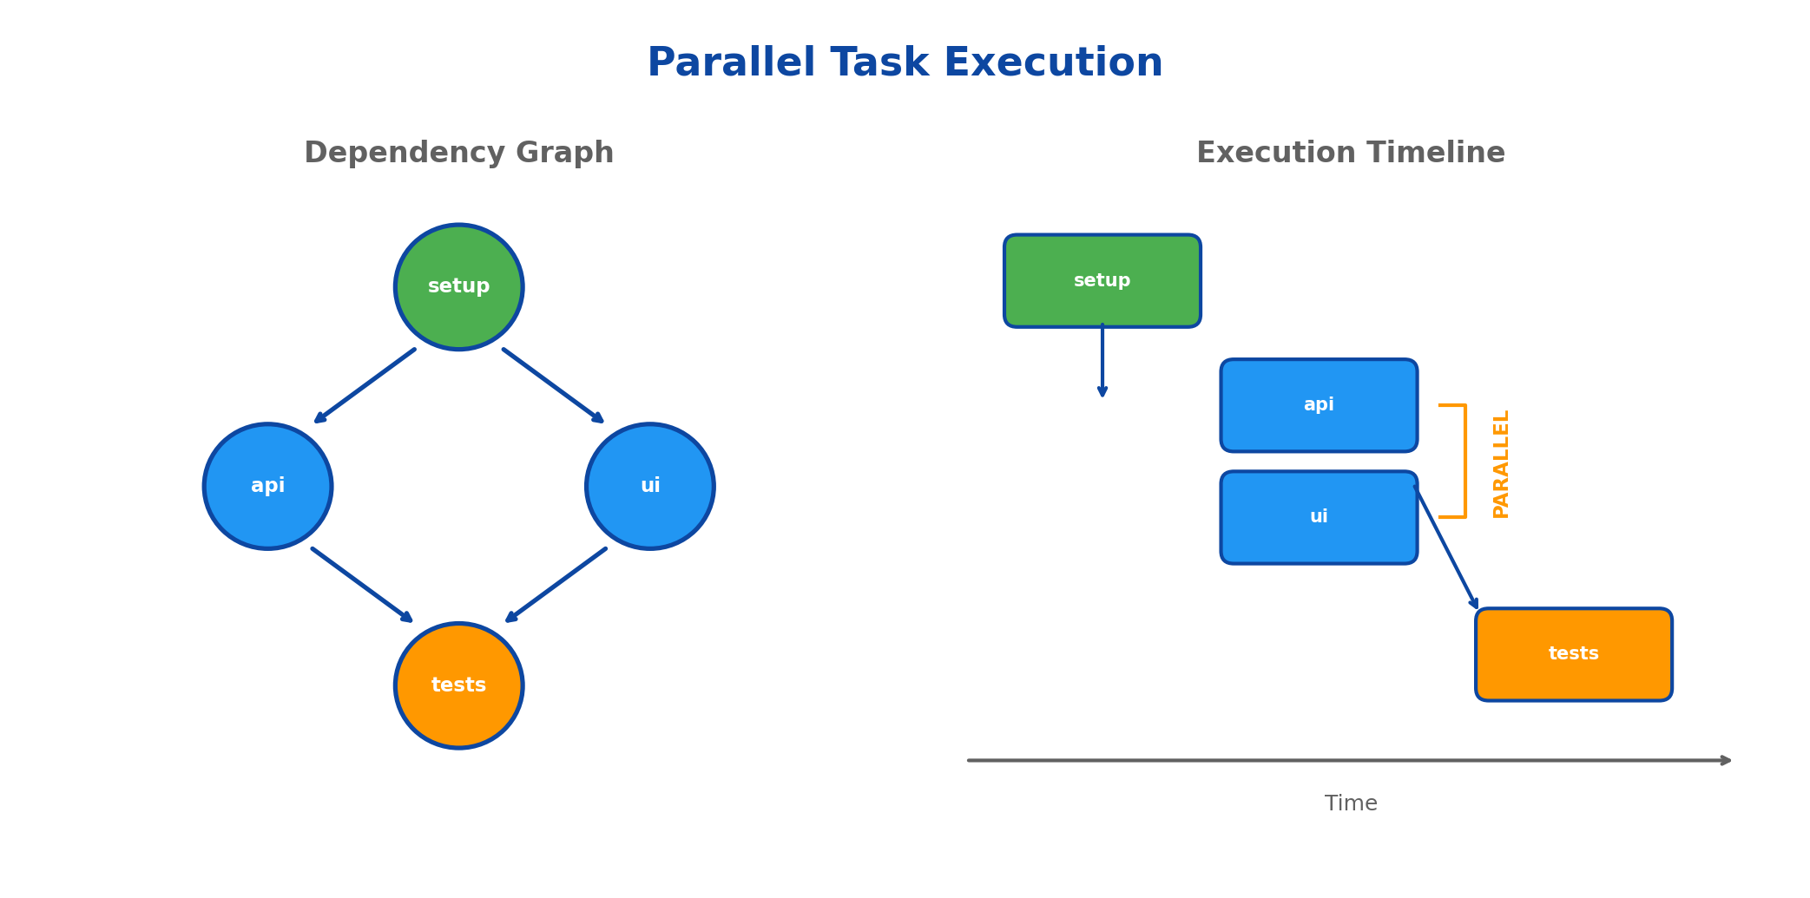
Parallel Task Execution
DAG-Aware Concurrent Processing
Independent tasks execute concurrently | Dependency resolution via topological sort | Each task gets isolated session | Failures don't block independent work

Slide 8
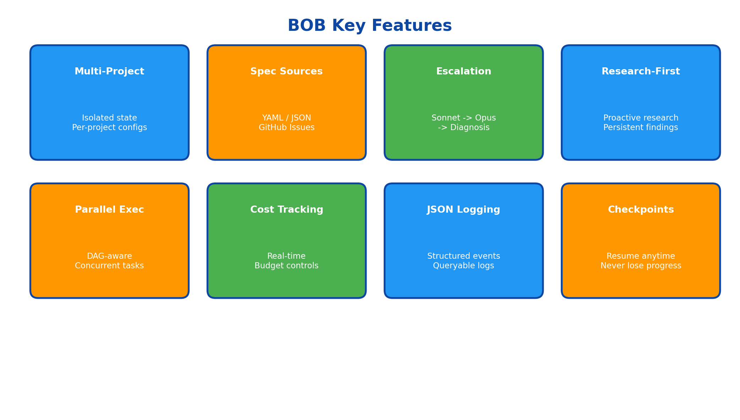
Key Features Overview
Production-Ready Capabilities

Slide 9
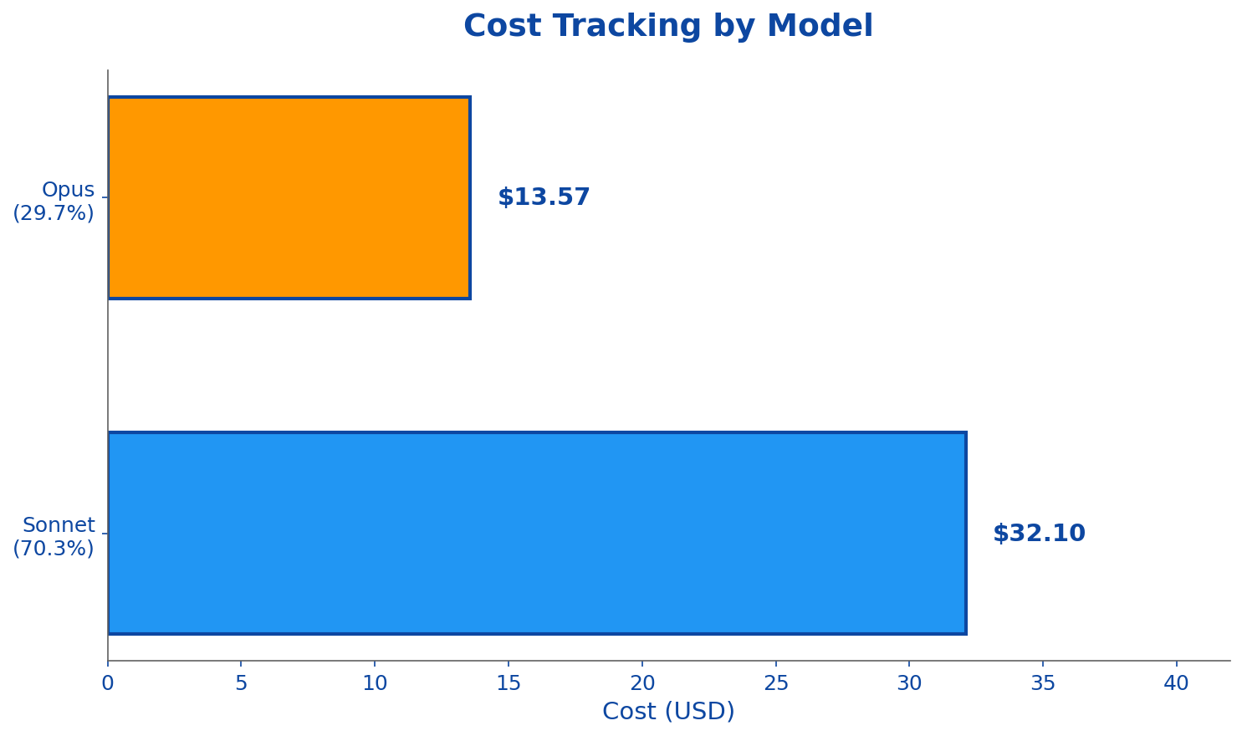
Real-Time Cost Visibility
Budget Controls and Tracking
COST FEATURES
Per-project cost tracking
Per-session breakdown
Per-model analysis
Per-agent attribution
BUDGET CONTROLS:
- max_cost_per_project
- max_cost_per_session
- warn_at_percent threshold
All costs visible via: bob costs

Slide 10
Developer-Friendly CLI
Comprehensive Command Interface
PROJECT
TASK
EXECUTION
MONITORING
bob project create
bob task list
bob run
bob status
bob project list
bob task show <id>
bob run --parallel 3
bob logs --follow
bob project use
bob task retry <id>
bob run --dry-run
bob costs
bob project status
bob task list --needs-research
bob run --resume
bob logs --json | jq
All commands support --json for scripting integration
bob task list --json | jq '.[] | select(.status=="failed")'

Slide 11
Flexible Specification Sources
Multiple Formats, One Interface
YAML
JSON
Markdown
GitHub Issues
name: My App tasks: - id: auth title: User Auth priority: critical depends_on: - database acceptance_criteria: - Login works - Logout works
{ "name": "My App", "tasks": [{ "id": "auth", "title": "User Auth", "priority": "critical", "depends_on": [ "database" ] }] }
# My App Spec ## auth: User Auth [priority:critical] [depends:database] Implement user authentication. ### Criteria - Login works - Logout works
Issue #42 Title: User Auth Labels: - ai-implement - priority-critical Acceptance: - [ ] Login works - [ ] Logout works
$ bob project create app ./workspace github://org/repo?label=ai-implement
Sync GitHub issues directly as tasks - labels become priorities and metadata!

Slide 12
Quick Start Guide
Get Running in Minutes
1. INSTALL
2. CREATE
3. DEFINE
4. RUN
git clone https://github.com/yye00/bob.git
bob init
# spec.yaml
bob run
cd bob && ./init.sh
bob project create my-app ./workspace file://spec.yaml
tasks:
bob status
export ANTHROPIC_API_KEY='...'
- id: setup
bob logs --follow
priority: critical
https://github.com/yye00/bob

Slide 13
Summary
Production-Ready Autonomous Coding
CORE CAPABILITIES
PRODUCTION READY
Multi-project management
Intelligent escalation (Sonnet -> Opus -> Diagnosis)
Research-first workflow
Parallel DAG-based execution
Real-time cost tracking
Structured JSON logging
Checkpoint and resume
1,200+ tests passing
SQLite persistence
Comprehensive CLI
GitHub Issues integration
Built with Claude Code SDK
"Can We Build It? YES WE CAN!"
Yaakoub Elkhamra, PhD | https://github.com/yye00/bob

