Slide 1

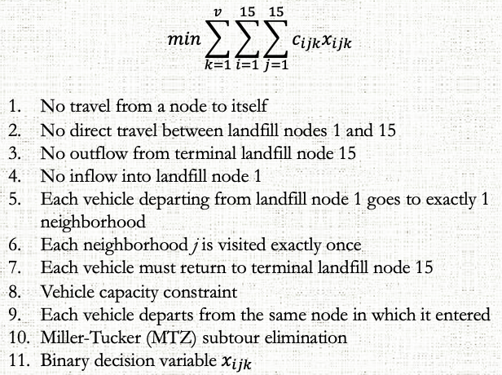



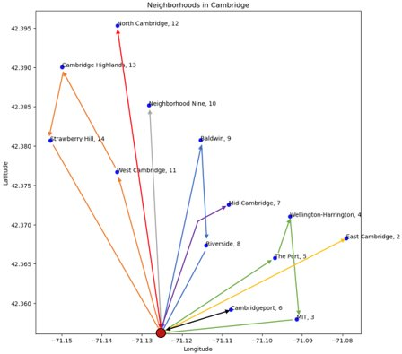







Cambridge Garbage Vehicle Routing
Brittany Nguyen (MBAn '23)
Yen Hann Yoo (MBAn '23)
Project Overview
Formulation
Practical Impact
EXECUTIVE SUMMARY
Refuse (garbage) vehicles are frequently employed to transport MSW from households to waste treatment facilities (landfills, incinerators, and transfer stations). So, a Capacitated Vehicle Routing Problem (CVRP) using integer optimization was explored over 13 Cambridge neighborhoods to optimize garbage vehicle routing.
PROBLEM STATEMENT​
Minimize operating costs (or emissions) of all vehicles across all routes whilst ensuring that garbage is fully removed from each neighborhood and that vehicle capacities are not exceeded.
WHY DO WE CARE?
Garbage vehicle routes are not usually optimized to minimize operating costs. Another issue is the poor fuel economy and emissions of these vehicles, which are harmful to nature.
0.86% Savings
Reallocate funding
0.85% Reductions
3rd highest mean fuel consumption annually and 2.5 MPG fuel economy
Key Findings
Data
What to do if we had Another Week?
Neighborhood locations
Robust Optimization: Factor uncertainty into costs and emissions
Restructure Data & Incorporate “Trade-Off”
Disaggregate Neighborhoods & Include More Waste Treatment Facilities
Compare with Column Generation Methods
Cost savings over baseline model: 0.86%
Haversine distances
Waste produced per neighborhood
Route Costs
Emission reduction over baseline model: 0.85%
Emissions
15.071—The Analytics Edge Fall 2019
15.093—Optimization Fall 2022

