Slide 1
Model Checking Collaboration, Competition and Dense Fault Resilience
研究生:黃重豪
指導教授:王凡 博士
口試委員:
地點:
時間:

Slide 2
Outline
Motivation
Contribution
Game graph
BSIL & TCL
Existing logics about game and strategy
Running example
Syntax and semantics
Expressive power
Algorithm and complexity
SW Resilience against Dense Errors
Fault tolerance
Safety resilience games
AMC with events
Algorithm and complexity
Experiment
Conclusion

Slide 3
Motivation
Formal verification of open systems requires taking user’s behavior into consideration.
Existing techniques suffer from either lack of expressive power or expensive time complexity.
If generic model checking techniques are unavoidably with high complexity, we can try to focus on certain aspect and develop corresponding algorithm to solve the problem.

Slide 4
Contribution
Logics, BSIL&TCL, which can specify the relationship between the strategies used to fulfill different sub-formula
Syntax & semantics
Expressive power
Model checking algorithm
Complexity
A new criteria called dense fault resilience
Addressing the justification
An algorithm to verify the dense fault resilience of open systems
The complexity proof of the algorithm
Implementation and experiment

Slide 5
Game Graph
[1,-]
p,q
p
[0,1]
[1,-]
[0,-]
[0,0]
[-,1]
[-,0]
q
[-,0]
∅
[-,1]

Slide 6
Game Graph
concurrent game graph (CGG) is a tuple A= <m, Q, r, P, λ, E1, E2, Δ, δ>
M is the number of agents in the game.
Q is a finite set of states.
r ∈ Q is the initial state of A.
P is a finite set of atomic propositions.
Function λ : Q → 2P labels each state in Q with a set of atomic propositions.
E1 and E2 are finite sets of move symbols that the protagonist and the antagonist can respectively choose in transitions. A pair in E1xE2 is called a move vector.
E2 is partitioned into error and and non-error moves (Eerror and Enoerr )
Δ is a set of tokens that can be issued by the agents during transitions.
δ : (R × [1,m]) → is a function that specifies the token (move symbol) issued by each agent in a transition.

Slide 7
Existing logics about game and strategy
ATL* [AHK2002]
<1, 2, 3> (( ￢j1)∧( ￢j2)∧( ￢j3))
AMC (Alternating μ-Calculus) [AHK2002]
μ x.{1, 2, 3}(x ∨ (( ￢j1)∧( ￢j2)∧( ￢j3)))
GL (Game Logic) [AHK2002]
∃{1,2,3} (( ￢j1)∧( ￢j2)∧( ￢j3))
SL (Strategy Logic) [CHP2010]
⟨⟨x⟩⟩ ⟨⟨y⟩⟩ ⟨⟨z⟩⟩(1,x)(2,y)(3,z) ∧_{a∈[1,3]} ¬ j_{a}
⟨⟨S1⟩⟩ ⟨⟨S2⟩⟩ ⟨⟨S3⟩⟩(1,S1)(((2,S2)(3,S3)(( ￢j1)∧( ￢j2))∧((2,S3)(3,S3) ￢j3))

Slide 8
Basic Strategy-Interaction Logic(BSIL)
An extension of ATL
Can specify the relationship between strategies used to satisfy different sub-formulas
Relatively low model checking complexity(PSPACE)
Ex. ⟨1,2,3⟩∧a∈[1,3] ¬ ja All player can cooperate to avoid getting into jail ⟨1,2⟩((⟨+∅⟩¬ j₃)∧(⟨+3⟩¬(j₁∧j₂) ∧(⟨+3⟩(j₁∧j₂))) Player 1 and player 2 have strategy to make player 3 keep free. And under the same strategy player 3 can make player 1 and player 2 free. And under the same strategy player 3 can make player 1 and player 2 always in jail.

Slide 9
Temporal Cooperation Logic(TCL)
An extension of BSIL
More expressive power
Higher model checking complexity(EXPTIME)
Ex. <1>((<+>¬betray₁)∧(betray₂ ∨ betray₃)) Player 1 is forgiving <2>((<+>¬betray₂) ∨ <+1>((<+>¬betray₁)∧(betray₂∨betray₃))) Player 2 should avoid betrayal while player 1 can be unforgiving

Slide 10
Comparison
Expressiveness:
BSIL&TCL can specify the interaction between the “strategies” while ATL*, GL, and AMC cannot
BSIL is less expressive than SL
Model checking complexity:
ATL: PTIME
ATL*, GL, SL: Doubly EXPTIME-complete
AMC: EXPTIME-hard
BSIL: PSPACE-complete
TCL: EXPTIME-complete

Slide 11
Running Example
To precisely express following spec for a bank system with 3 player(bank B, client C, and partner bank PB)
B has to make sure no one can check other user’s password
B and C can cooperate to let C can deposit his account
B, C and PB can cooperate to let C transfer his money from PB to B
The previous 3 requirements share the same strategy of B
ATL: <B>( ￢checkPW ∧ <C> depositDone ∧ <C,PR> transferDone) or <B> ￢checkPW ∧ <B,C> depositDone ∧ <B,C,PR> transferDone are both not fit the requirement perfectly

Slide 12
Running Example(cont.)
SL: <B1><C1><C2><PB1>[C3][PB2][PB3]( (B,B1)(C,C3)(PB,PB2)￢checkPW ∧ (B,B1)(C,C1)(PB,PB3)depositDone ∧ (B,B1)(C,C2)(PB,PB1)transferDone) can perfectly describe the spec. But the model checking complexity is Doubly EXPTIME-complete
BSIL: <B>( ￢checkPW ∧ <+C> depositDone ∧ <+C,PR> transferDone)

Slide 13
Syntax
BSIL
state formulas φ ::= p | ￢φ1 | φ1 ∨ φ2 | <A>τ | <A>θ
tree formulas τ ::= τ1 ∨ τ2 | τ1 ∧ τ2 | <+A>τ1 | <+A>θ
path formulas θ ::= ￢θ1 | θ1 ∨ θ2 |  φ1 | φ1Uφ2
TCL
state formulas φ ::= p |¬ φ ₁| φ ₁ ∨ φ ₂| <A> τ
tree formulas τ ::= φ | τ ₁ ∨ τ ₂| τ ₁∧ τ ₂|<+A>τ₁ |<+A> θ₁U τ₁ |<+A> θ ₁R τ₁|<-A> τ₁ |<-A> θ₁U τ₁ |<-A> θ ₁R τ₁
path formulas θ ::= φ | θ ₁ ∨ θ ₂| θ ₁∧ θ ₂|<+A> θ ₁ |<+> θ ₁U θ ₁ |<+> θ ₁R θ ₁|<-A> θ ₁ |<-A> θ ₁U θ ₁|<-A> θ ₁R θ ₁
No universal strategy quantifier [+A]

Slide 14
BSIL Semantics
G, q |= _{Σ} p if and only if p ∈ λ(q).
For state formula φ1, G, q |= _{Σ} ￢φ1 if and only if G, q |= _{Σ} φ1 is false.
For state or tree formulas ψ1 and ψ2, G, q |= _{Σ} ψ1 ∧ ψ2 if and only if G, q |= ψ1 and G, q |= ψ2.
For state or tree formulas ψ1 and ψ2, G, q |= _{Σ} ψ1 ∨ ψ2 if and only if either G, q |= _{Σ} ψ1 or G, q |= _{Σ} ψ2.
G, q |= _{Σ} <A>τ if and only if there exists an S-profile ∏ of A with G, q |= ∏ τ .
G, q |= _{Σ} <+A>τ if and only if there exists an S-profile ∏ of A with G, q |= _{Σ ◦ ∏} τ
G, q |= _{Σ} <A>θ if and only if there exists an S-profile ∏ of A such that, for all plays ρ from q compatible with ∏, ρ |= ∏ θ holds.
G, q |= _{Σ} <+A>θ if and only if there exists an S-profile ∏ of A such that, for all plays ρ from q compatible with Σ ◦ ∏, ρ |= _{Σ ◦ ∏} θ holds.

Slide 15
BSIL Semantics(cont.)
For a path formula θ1, ρ |= _{Σ} ￢θ1 if and only if it is not the case that ρ |= _{Σ} θ1.
For path formulas θ1 and θ2, ρ|= _{Σ} θ1∨θ2 if and only if either ρ|= _{Σ} θ1 or ρ|= _{Σ} θ2.
ρ |= _{Σ} ψ1 if and only if G, ρ[1,∞) |= _{Σ} ψ1.
ρ |= _{Σ} ψ1Uψ2 if and only if there exists an h ≥ 0 with G, ρ[h,∞) |= ψ2 and for all j ∈ [0, h), G, ρ[ j,∞) |= _{Σ} ψ1.

Slide 16
TCL Semantics
State Formula
T_{q},π,σ⊨φ iff last(π)⊨φ
Tree Formula
T_{q},π,σ⊨<+A>τ₁ iff each successor π’ of π in T_{q}< π, σ, ψ>, T_{q},π’,σ ⊨ τ₁
T_{q},π,σ⊨<+A> θ₁Uτ₂ iff ∃k≥|π|-1 s.t T_{q},π’[0,k],σ⊨ τ₂ and ∀h∈[|π|-1 ,k-1], T_{q},π’[0,h],σ⊨ θ₁
……
θ₁
π
θ₁
θ₁
θ₁
π’
τ₂

Slide 17
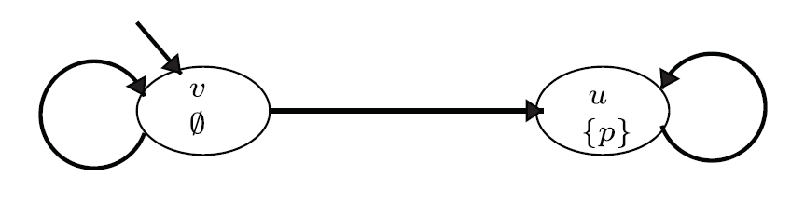
Memoryful
The following is a formula in BSIL∩ATL* which cannot be fulfilled through a memoryless strategy <1>((￢p)∧p)

Slide 18
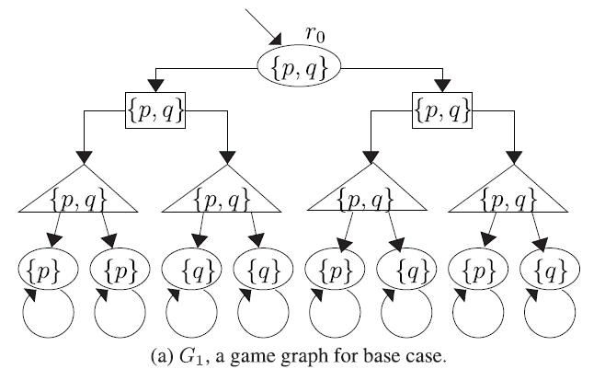
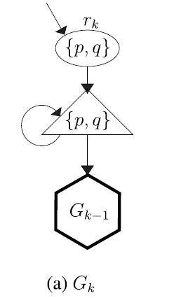
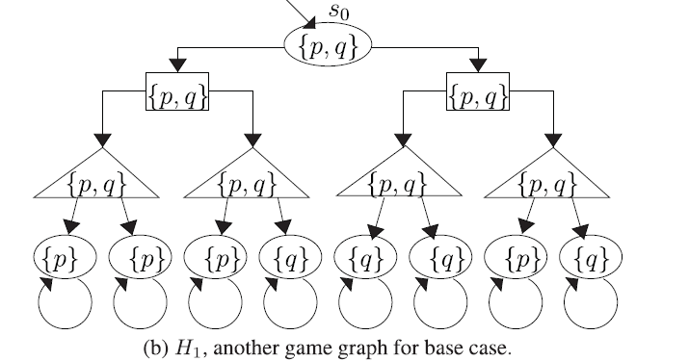
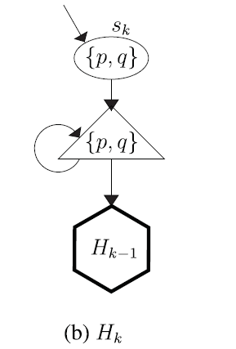
Expressive power
BSIL: <1>((<+2>p)∧(<+2>q))
GL: with 1 modal operator let φ1 be ∃ψ, ∀ψ ∃∅.φ1 ∃{1}.φ1, ∃{2}.φ1, ∃{3}.φ1 ∃{1,2}.φ1, ∃{2,3}.φ1, ∃{1,3}.φ1 ∃{1,2,3}.φ1
GL with 1 modal operator cannot tell the difference between G1, H1
GL with k modal operator cannot tell the difference between Gk, Hk

Slide 19
Algorithm-BSIL to DNBB
disjunctive normal Boolean bound formula
BSIL:<1, 2>(<+3>(p ∨ q) ∧ <+3>(<+2>r ∨ <+4>q))
DNBB: ((1, s1)(2, s2)(3, s3)(p∨q)∧(1, s1)(2, s5)(3, s4)r) ∨((1, s1)(2, s2)(3, s3)(p∨q)∧(1, s1)(2, s2)(3, s4)(4, s6)q)

Slide 20
Algorithm-Pass down obligation
(1.a)θ₁ ∧ (1.a)θ₂ ∧ (1.b)θ₃
θ₁,θ₂,θ₃
OR
θ₁,θ₂,θ₃
OR
θ₁,θ₂,θ₃
[0,0]
[1,-]
[0,0]
[1,-]
[0,0]
[1,-]
[0,1]
[0,1]
[0,1]
θ₁ ,θ₂
θ₃
θ₃
θ₃
θ₁ ,θ₂
θ₁ ,θ₂
θ₃

Slide 21
Algorithm-BSIL
Rewrite BSIL to DNBB
Guess the obligations
Pass down the unfulfilled obligations according to the strategy variable binding and the transition function of current state
Recursively check the successors in the computation tree
While encountering repeated game state, if the obligation set remain the same, return false.

Slide 22
Model Checking Example-BSIL
Checking (1.a)(2.b)q∧(1.a)(2.c)¬q
Game graph: Computation tree:
(1.a)(2.b)q
(1.a)(2.c)¬q
p
p
(1.a)(2.b)q
(1.a)(2.c)¬q
pq
[0,-,-]
[1,-,-]
pq
∅
(1.a)(2.c)¬q
[-,-,1]
[0,-,-]
q
(1.a)(2.b)q
q
[-,0,-]
∅
pq
[-,1,-]
pq
∅
[-,-,0]
(1.a)(2.b)q

Slide 23
Complexity-BSIL model checking is PSPACE-easy
Let |x| be the length of the BSIL formula
The calculation and pass down of obligations can be done non-deterministically in linear time
It takes at most |Q| steps to satisfy an UNTIL expression
The maximum depth of the computation tree is |x||Q|

Slide 24
Complexity-BSIL model checking is PSPACE-hard
Given QBF property η ≡ ∃p∀q∃r((p∨ q ∨ r) ∧ (￢p∨￢r))
BSIL:<1>((p∨q∨r) ∧ (￢p∨￢r))
∅
∅
∅
∅
p
q
r

Slide 25
Model Checking Example-TCL
Checking <1>(<+2>pU<+3>q)
Closure:{p, q, pUq, q, pUq}
Game graph: Computation tree:
p
(1.a)(2.b)(3.c)pUq, p
p
(1.a)(2.b)(3.c)pUq
pq
(1.a)(2.b)(3.c)q
[0,-,-]
[1,-,-]
pq
[-,-,1]
[0,-,-]
q
(1.a)(2.b)(3.c)q
q
[-,0,-]
∅
[-,1,-]
[-,-,0]

Slide 26
Complexity EXPTIME-easy
Similar to BSIL, Let |x| be the length of the TCL formula
The maximum depth of the computation tree will be |Q|*|X|*2^{|X|}

Slide 27
Complexity-TCL model checking is EXPTIME-hard
Reduction from PEEK-G₆ game[1979]:
Propositions p₁…p_{h+k}
Safety agent control P1={p₁,p₂…}
Reachability agent control P2={p_{h+1},p_{h+2}…p_{h+k}}
The Reachability agent wants to satisfy a Boolean formula β over P1∪P2
In each turn, each agent can change the truth value of one of his own propositions
t₁
t₂
t_{h+k}
k
r
…
_{f1}
_{f2}
f_{h+k}
1

Slide 28
Fault Tolerance
More than checking whether or not a system satisfies a given property
Bounded number of failures: Check the max number of failures a system can tolerant before exhibit an error
Unbounded number of failures: Given a bound on the number of “dense failures”. Check if the system can be “fully recovered” after these dense failures

Slide 29
Error Models
Fault tolerance refers to various basic fault models, such as a limited number of errors. [H. Jin, K. Ravi, F. Somenzi]
Robustness based on Hamming and Lewenstein distance related to the number of past states. [L. Doyen, T.A. Henzinger, A. Legay, D. Nickovic]
Ratio Games: minimize the ratio between failures induced by the environment and system errors caused by them. [R. Bloem, K. Greimel, T.A. Henzinger, B. Jobstmann]

Slide 30
Dense Fault
Two successive failures are in the same group of dense failures if the sequence of states separating them was not long enough for recovery in the respective safety/reachability game.

Slide 31
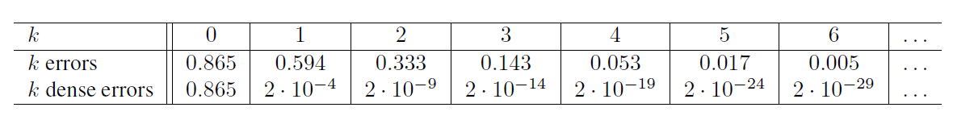
Why dense fault
System Operation time: 20 hour
Mean time between errors: 10 hour
Repair time: 3.6 sec
Since errors occur with a known average rate and independently of the time since the last event, we use Poisson distribution(with coefficient 2) for “k errors” in the above table

Slide 32
Recovery Segment
A play prefix ρ is a recovery segment to safety region S ⊆ Q \ F iff
ρ(0) ∈ S
If |ρ| = ∞, then all states in ρ[1,∞) are in Q\(S ∪ F). In this case, ρ is called a failed recovery segment.
If |ρ| ≠ ∞, then all states in ρ[1, |ρ| − 2] are in Q \ (S ∪ F) and last(ρ) = ρ(|ρ| − 1) is either in F or S. If last(ρ) ∈ F, ρ is also a failed recovery segment; otherwise, it is a successful one.
level(ρ, S): the number of error moves between states in ρ with respect to the safety region S: {i ∈ [0, |ρ| − 1) | ρ_e(i) |= Eerror}

Slide 33
Gain
gain(ρ, S): The maximal integer k ∈ N such that, for all recovery segments ρr to S in ρ, if level(ρr, S) ≤ k, then ρr is a successful recovery segment to S.
Gain(Γ,S): the maximum gain that the protagonist can manage with memoryless strategies on game graph K.
Γ is k-resilient if there exists a non-empty S ⊆ Q \ F with gain(Γ, S) ≥ k.

Slide 34
AMCE Alternating-time μ-calculus with events
AMCE is an extension of AMC
AMC example: μX(safe ∨ <1>  X)
Extension 1: Boolean combination <1>((smoke ⇒  alarmOn) ∨  windowClosed)
Extension 2: Restriction on transitions <1>(( ^{2:error}alarmOn) ∧ ( ^{￢2:error}￢alarmOn))

Slide 35
Algorithm-Base case
Safety and Reachability Objective, sfrch_{k}(S), denotes the states from which the protagonist wins the above game
A state q ∈ S can stay in sfrch₀(S) if there is a choice e ∈ E1 such that for all f ∈ E2, δ(q, e, f) ∈ sfrch₀(S).
sfrch₀(S) = νX(S ∧ <1>  ^{error} x)
sfrch₀(S) can be constructed by greatest fixed point algorithm

Slide 36
Algorithm - Inductive Case - cone
Given a region L⊆S\F, the controlled limited attractor, is a set of states which there is a controlled path to move to X without leaving L.
cone_{L}(X) = μY.(X ∨ (L ∧ <1>  ^{￢2:error} Y ))
cone_{L}(X) can be constructed by greatest fixed point

Slide 37
Algorithm - Inductive Case - frag
Given a set B⊆S, the fragile of B, frag(B), is the set of states which has more than 1 uncontrolled successor in B.
frag(B) = [1]  ￢B
Q \ frag(B) = <1>  B.
frag(B) and Q\frag(B) can be constructed with least fixed algorithm

Slide 38
Algorithm - Inductive Case - sfrch_{k}(S) and res_{k}(S)
L0
S\cone
L_{k} = L₀ \ frag(Q \ cone_{Lk−1}(S))
sfrchk(S) = sfrch0(S ∧ L_{k})
resk(G) = νS.((Q \ F) ∧ sfrchk(S)), the set of k-resilient states
cone
G
F
G
F
k times
L1
S\cone
cone
G
Frag
Frag
F
G
F

Slide 39
Complexity
kmax is either infinite or no greater than |Q\F|.
if k> |Q\F| -> exists fail recovery path ρ with k+1 states
However, there are only |Q\F| safety states -> repeat states in the path
There should be a shorter fail path -> contradiction
A memoryless control strategy for the states in sfrchk(S) can be constructed in time linear in both k and the Game size |G|
All individual steps in the construction are linear in the size of the safety resilience game, and there are O(k) of these operations in the construction.
resk(G) and a memoryless k-resilient control strategy for resk(G) can be constructed in O(k·|Q\F|·|G|) time.
There are at most |Q\F| times of sfrchk(S) during the process of finding resk(G)

Slide 40
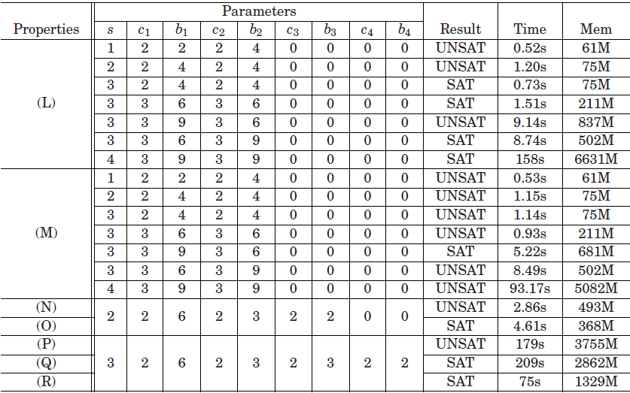
Experiment-BSIL

Slide 41
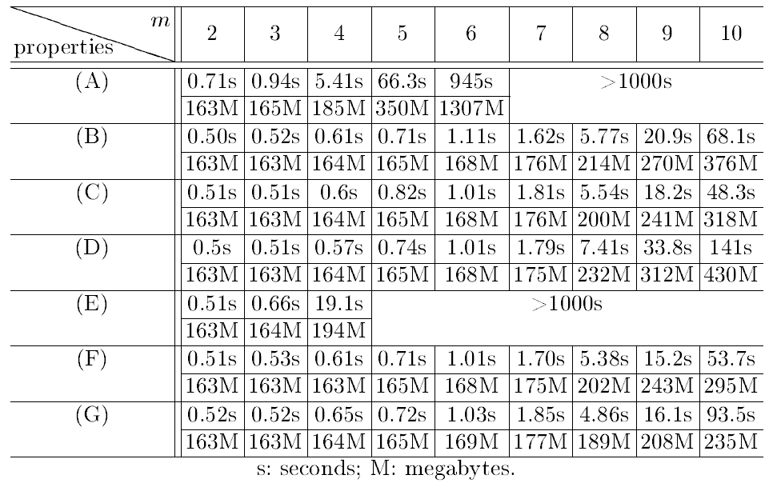
Experiment-TCL

Slide 42
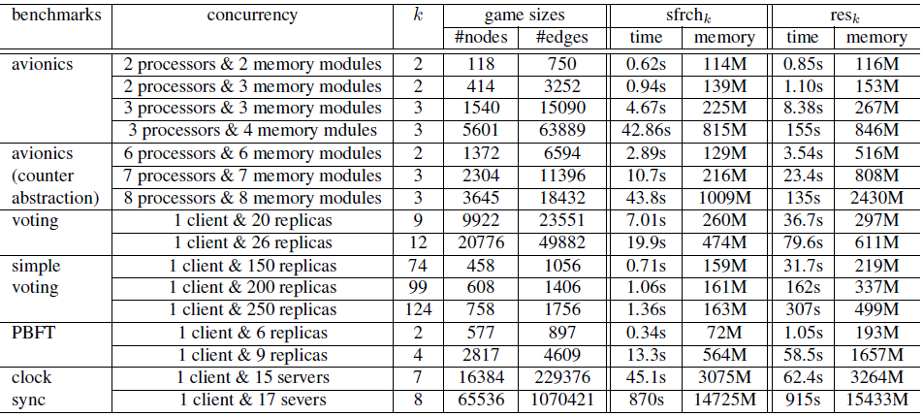
Experiment-Resilience

Slide 43
Conclusion
BSIL and TCL reach a balance between expressiveness and verification efficiency with the capability to describe strategy inherit/release properties
The dense error resilience defines a new error model which and can be verified in PTIME.

Slide 44
Q&A

Slide 45
Backup

Slide 46
Expressive power
BSIL: <1>((<+2>p)∧(<+2>q))
AMC

Slide 47
Temporal Cooperation Logic(TCL)
Allow strategy interaction quantifiers to cross temporal modal operators
<1,2,3>∧ _{a∈[1,3]} ((<+∅> ¬ jail_{a}) ∨ (<-a>  jail_{a})) no agent stays in jail indefinitely, if she can avoid it. (Nash equilibrium)
<2>((<+>¬betray₂) ∨ <+1>((<+>¬betray₁)∧(betray₂∨betray₃))) Player 2 should avoid betrayal while player 1 can be unforgiving

