Slide 1
A Transformer-Based Deep Learning Approach to Anomaly Detection of High-Bandwidth Multivariate Time-Series Satellite Communications
Alexey Yermakov (Advised by Nathan Kutz and Lillian Ratliff)

Slide 2
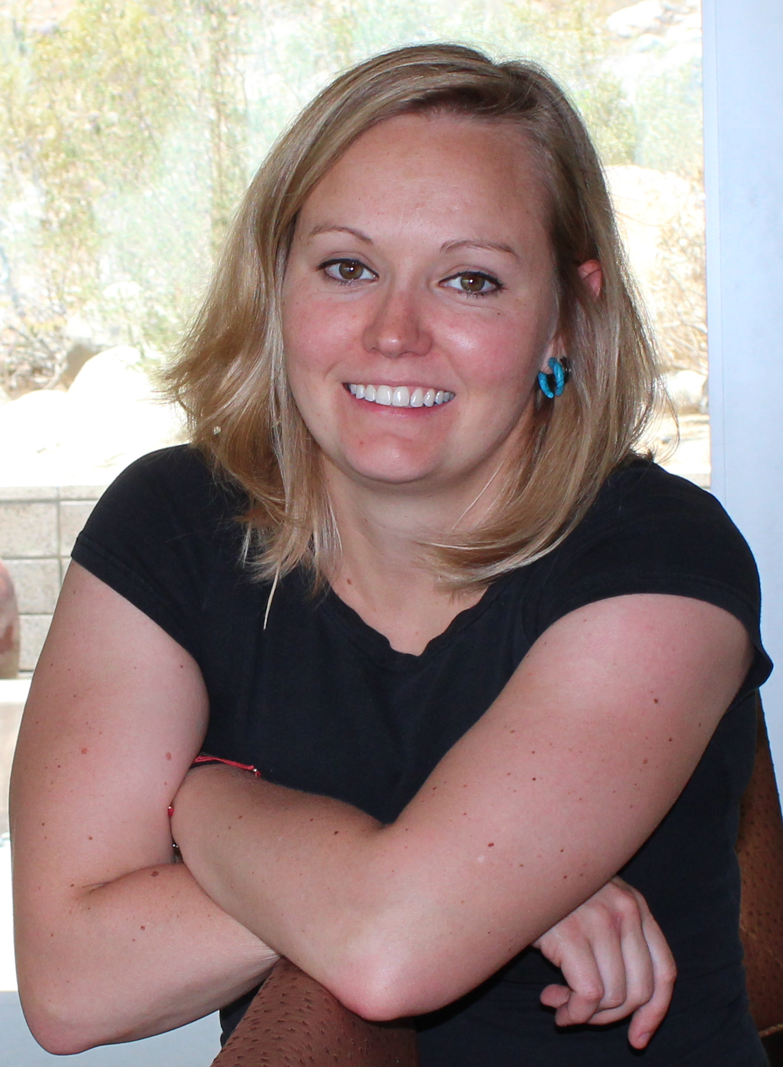


Important People
Dr. Lillian Ratliff
(Advisor)
Dr. Nathan Kutz
(Advisor)
Dr. Kyongsik Yun (KS)
(JPL Collaborator)

Slide 3
Background

Slide 4
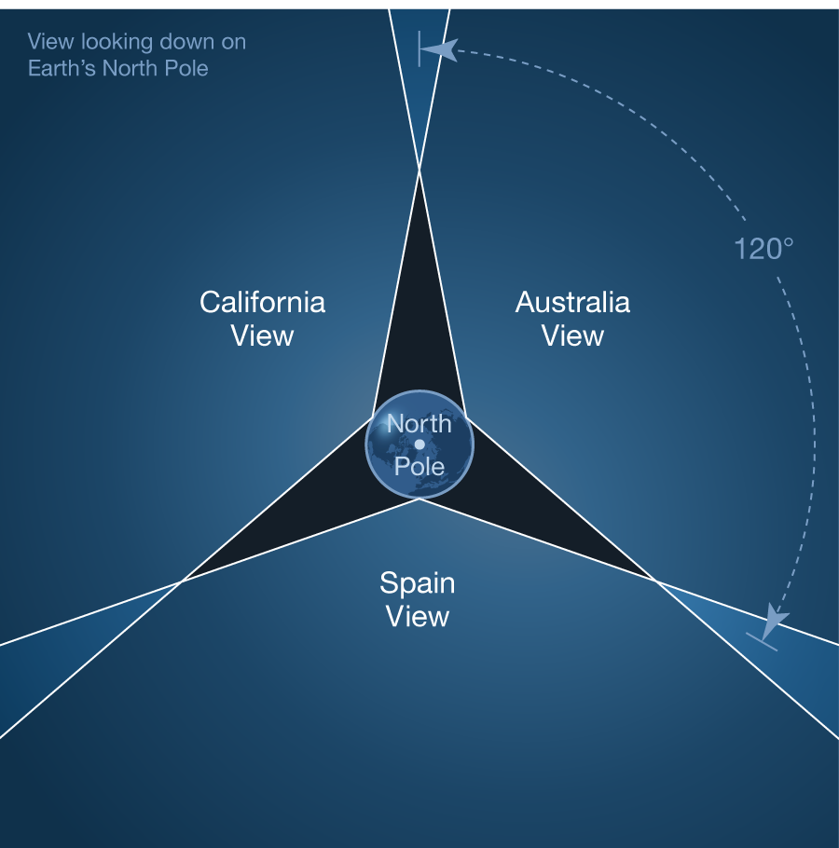
Deep Space Network (DSN)
NASA’s array of antennas to communicate with distant spacecraft
Operated by JPL
Modern missions using the DSN
  Psyche (2023)
  Europa Clipper (2024)
  Artemis II/III (2026/2027)
  Dragonfly (2028)
  ExoMars Rover (>2028)

Slide 5
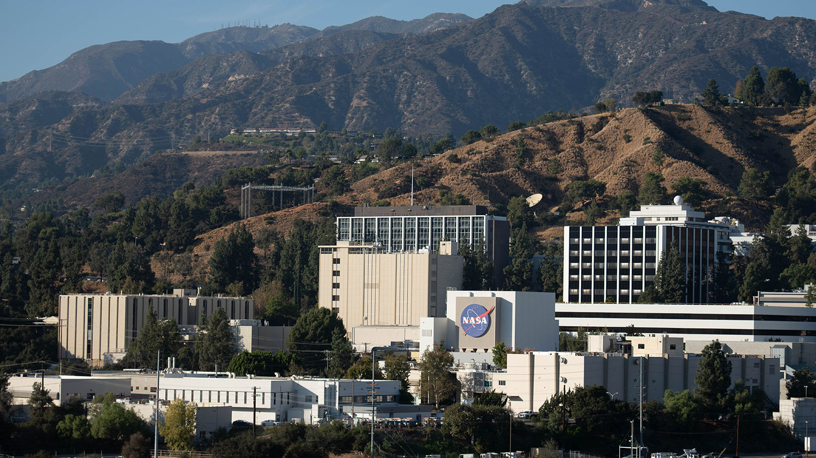
DSN Challenges
NASA is underfunded
  Current US Administration wants to cut 47% of NASA’s budget
  JPL forced to lay off workers
Currently oversubscribed
  Plans to expand the network capabilities
  Psyche
Operations Engineers

Slide 6
DSN Challenges
NASA is underfunded
  Current US Administration wants to cut 47% of NASA’s budget
  JPL forced to lay off workers
Currently oversubscribed
  Plans to expand the network capabilities
  Psyche
Operations Engineers
What can JPL do to keep up with an increase in DSN throughput without having the funding to hire more operations engineers?

Slide 7
TranAD+

Slide 8
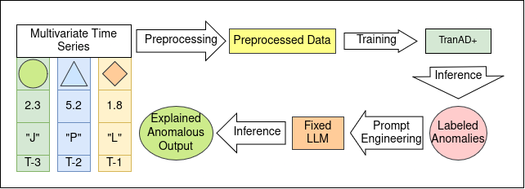
TranAD+ Pipeline
Deep learning model for automated time-series anomaly detection
Transformer-based
Self-supervised learning
Per-parameter labeling
Can be used as a backbone for automated discrepancy reports

Slide 9
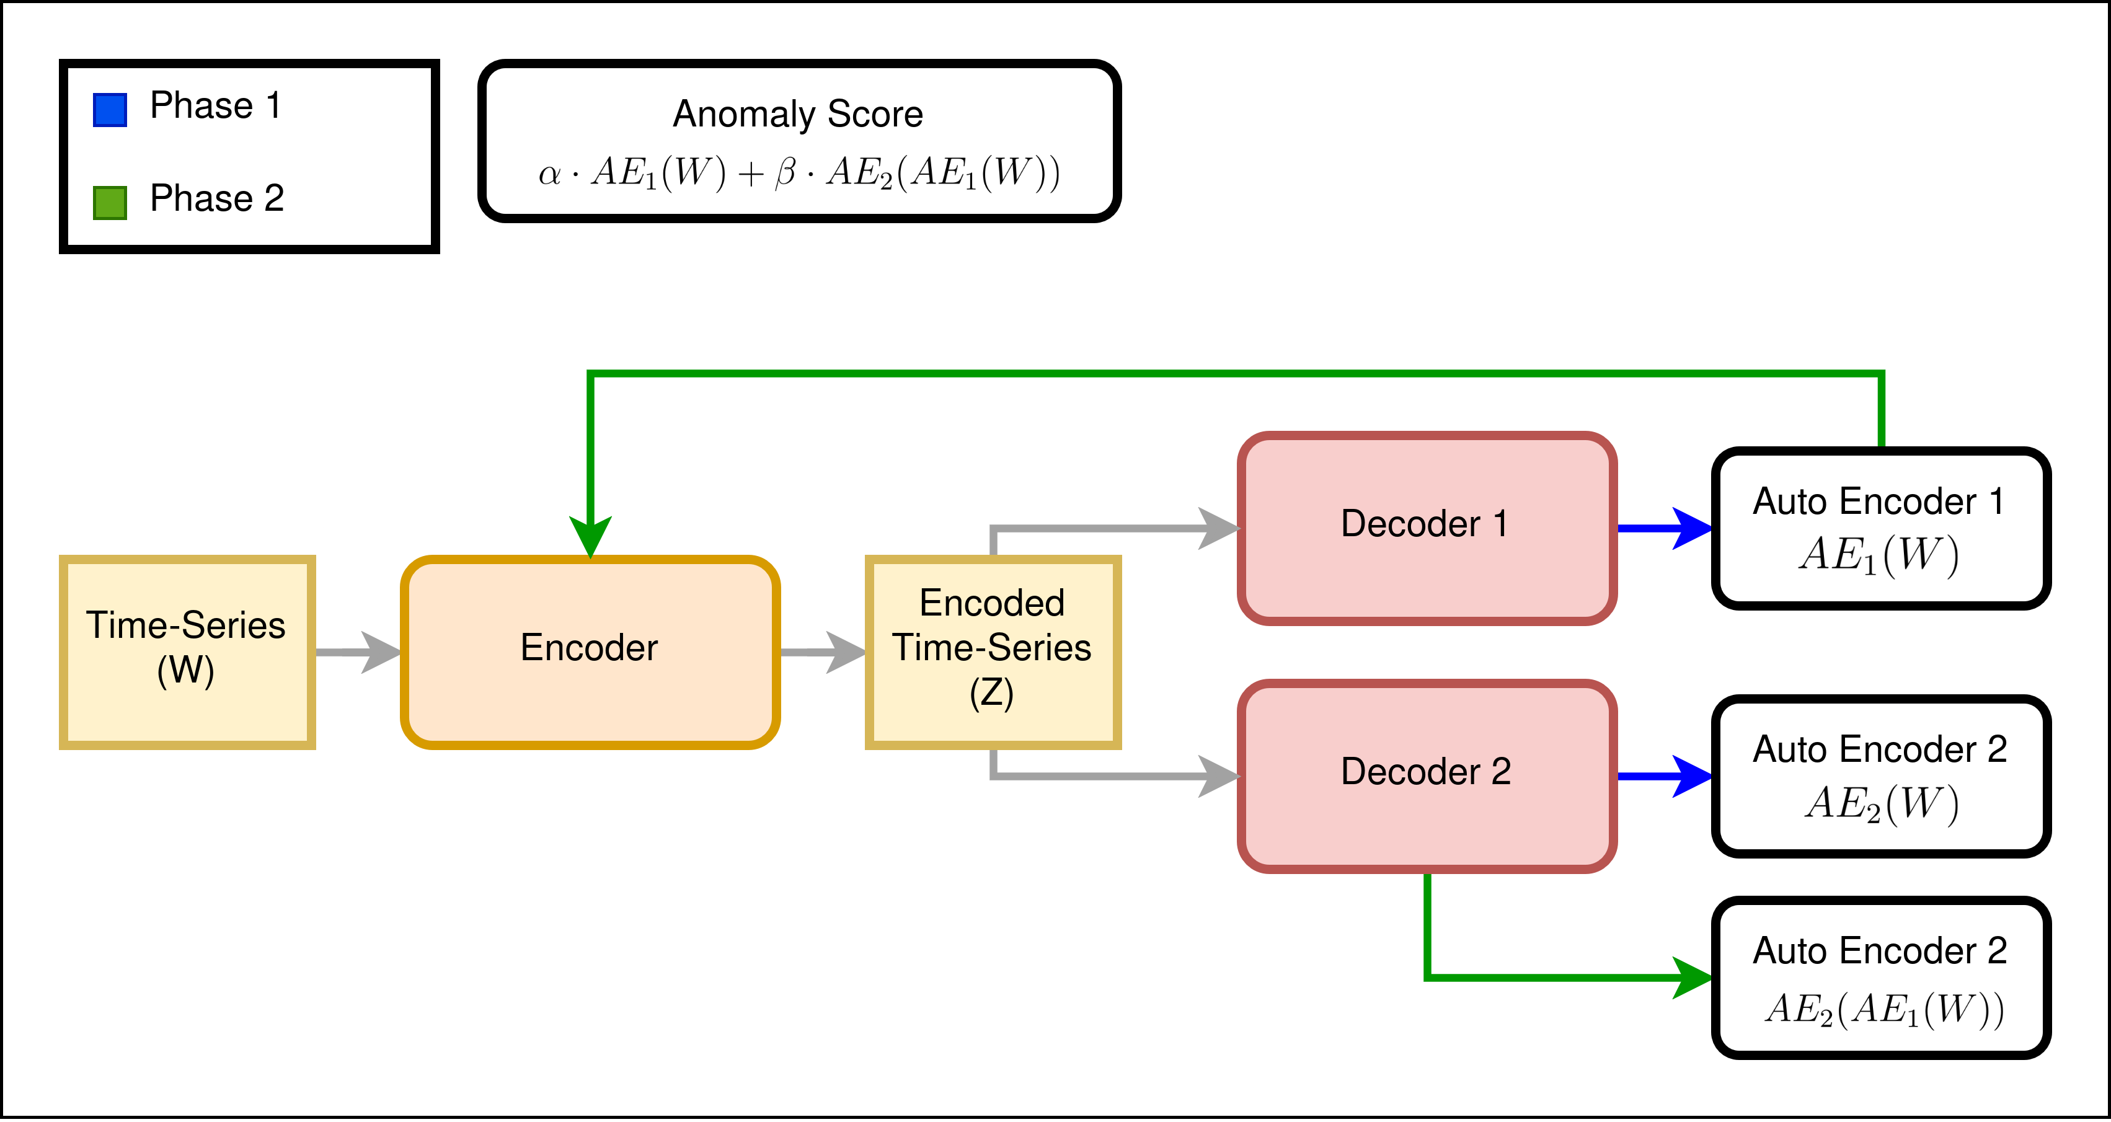
TranAD+ 2-Phase Training
Self-Supervised Training
  No labels required
Adversarial Auto-Encoder approach
  Similar to GANs
Final anomaly score is adjustable
  Tunable α and β:
    α > β: low detection sensitivity
    α < β: high detection sensitivity

Slide 10
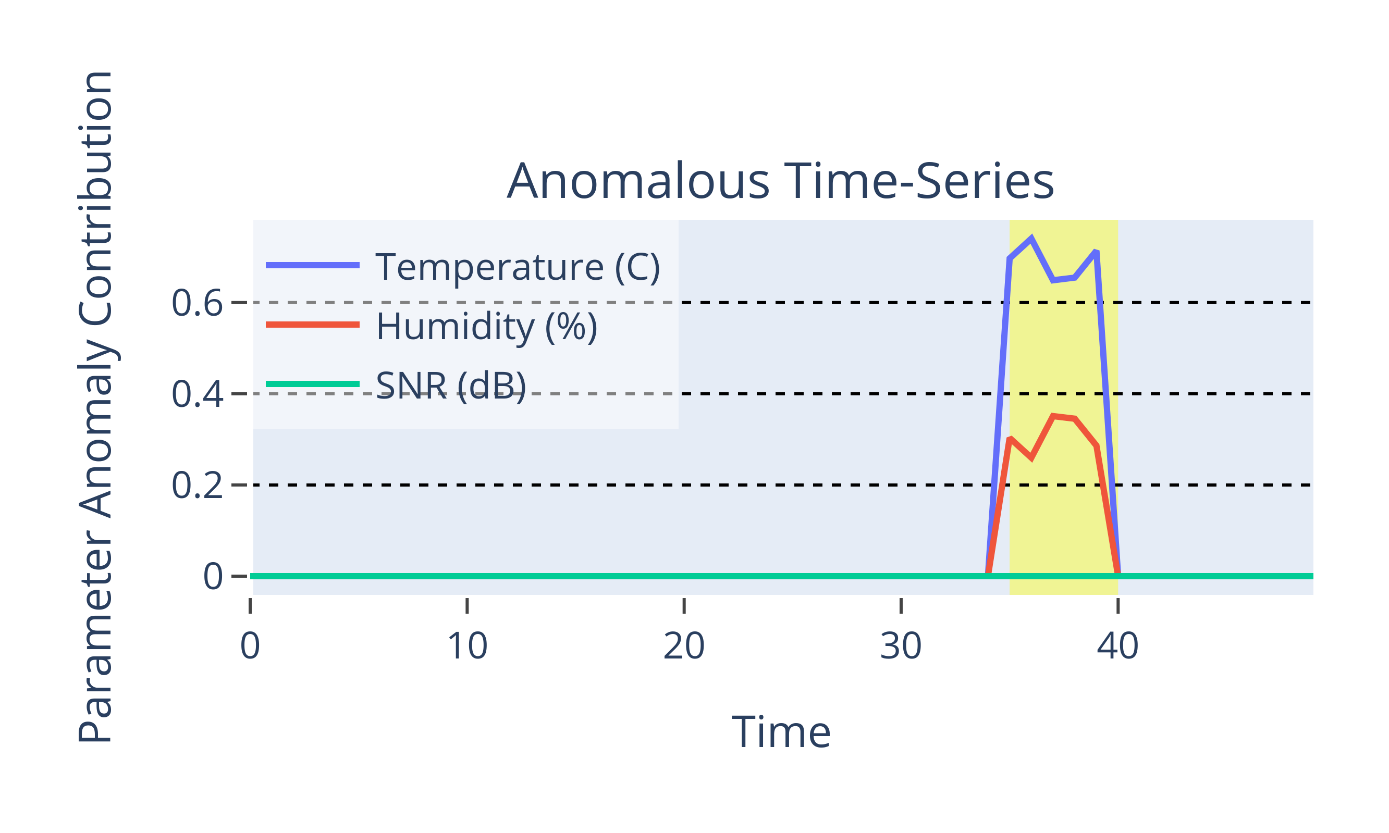
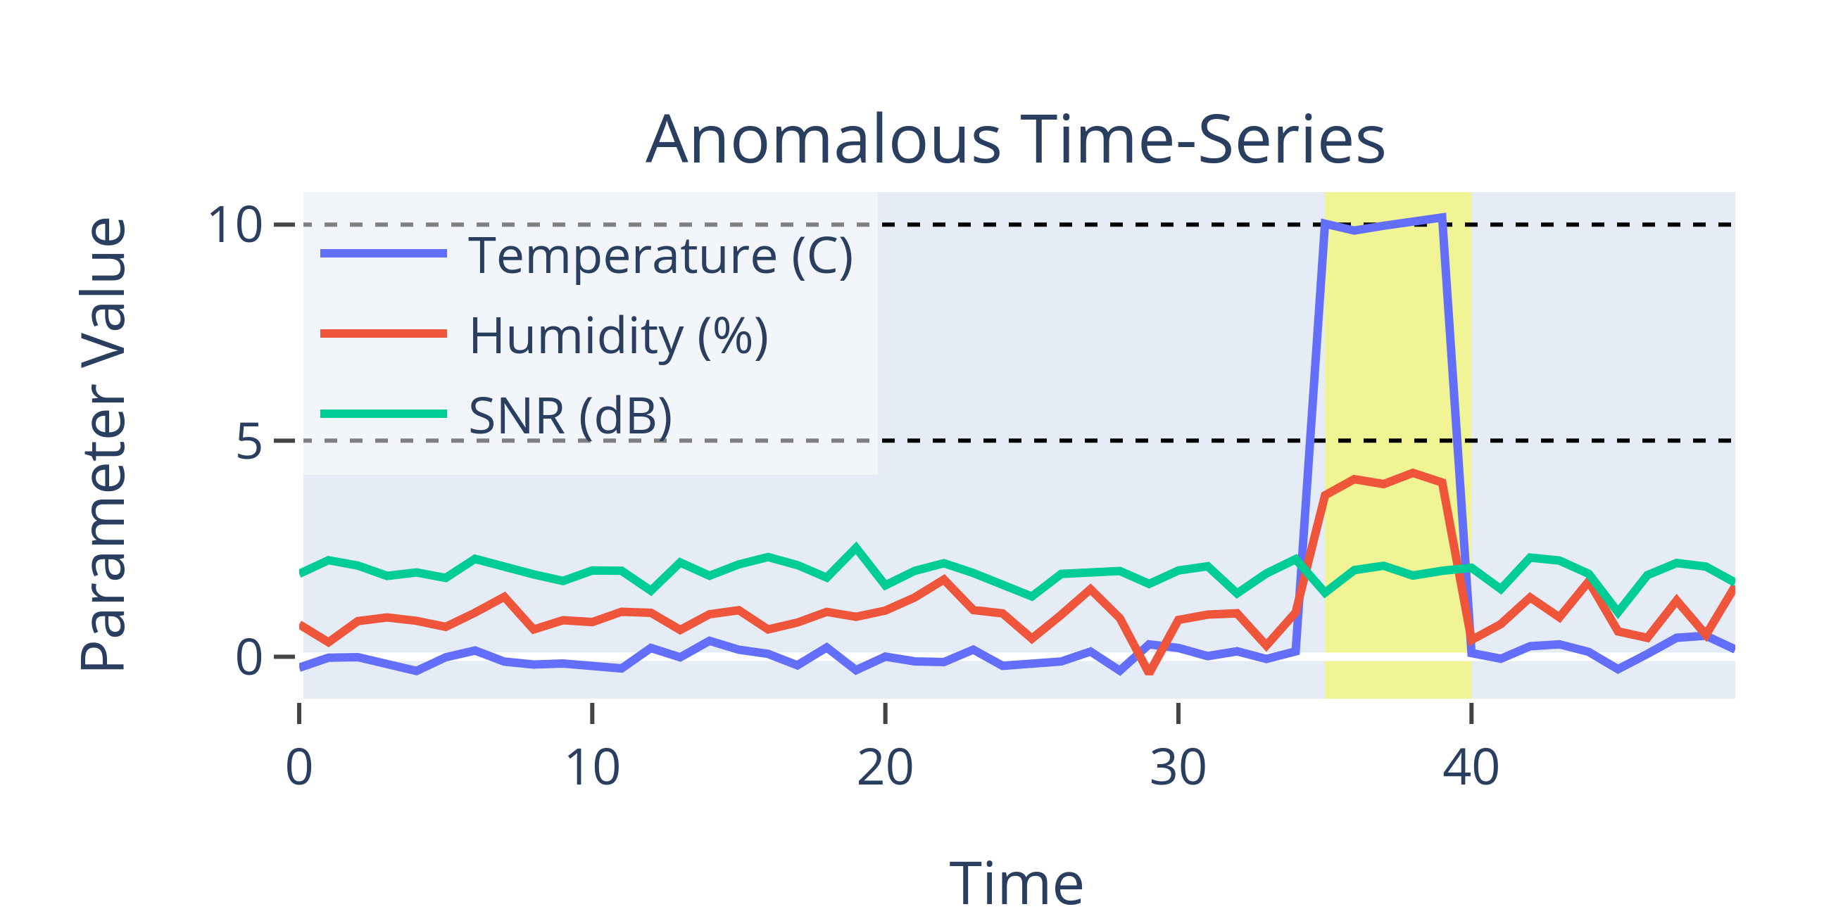
TranAD+ Inference
Per-Parameter Anomaly Contribution
Automatic Threshold Selection
  Peak-Over-Threshold (POT)
Labels ranges of time-series as anomalous

Slide 11
Datasets

Slide 12
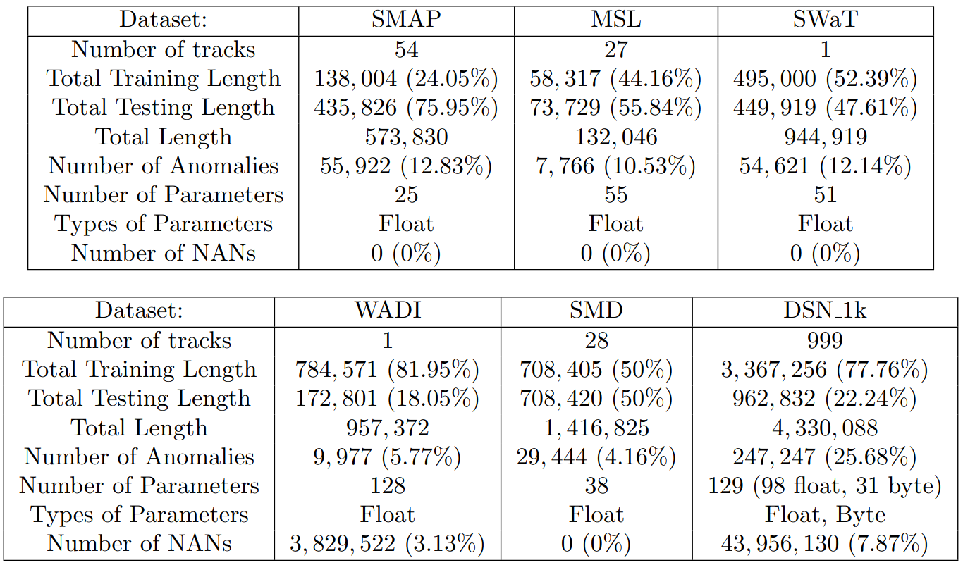
Datasets
Public Datasets
DSN_1k Dataset
  Larger than other publicly available dataset
  Labeled
  Mixed variable types
  Some missing information

Slide 13
Previous Work

Slide 14
Previous Work
Telemanom (2018)
  Tracks telemetry anomalies
OmniAnomaly (2019)
  Auto-Encoder with stochastic RNNs
  Introduces Peak-Over-Threshold (POT)
USAD (2020)
  Adversarial Auto-Encoder
  Uses POT
MTAD-GAT (2020)
  Graph attention model
  Uses POT
TranAD (2022)
  Transformer Anomaly Detection
  Uses POT

Slide 15
Results

Slide 16
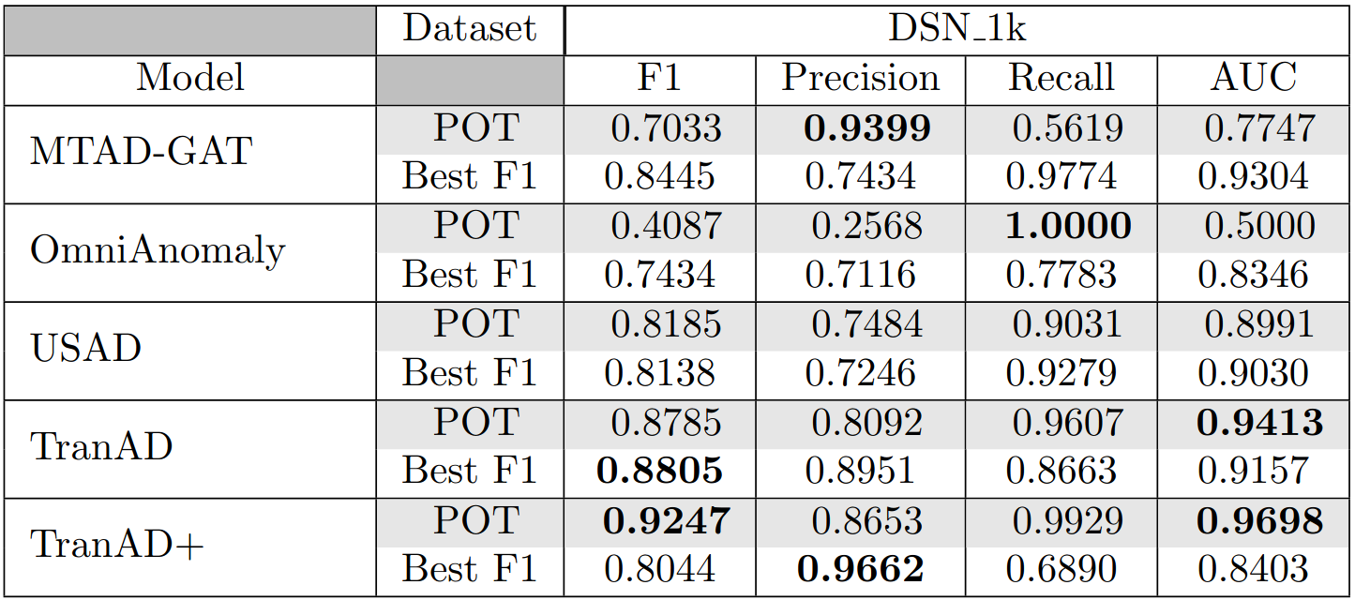
Results
TranAD+ outperforms all other tested models on DSN_1k dataset (shown)
TranAD+ also does best on:
  SMAP, SwaT, SMD
  (see paper)
TranAD+ is outperformed on:
  OmniAnomaly on WADI
  MTAD-GAT on MSL
  (see paper)

Slide 17
Downstream Applications

Slide 18
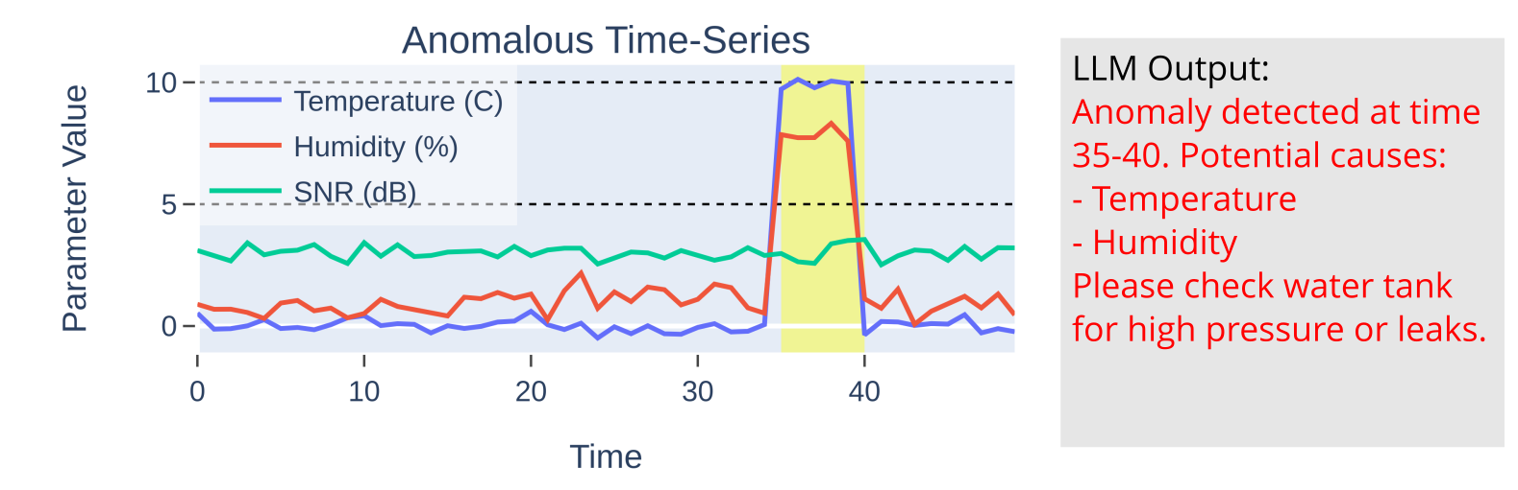
Applications
Pre-trained LLM can be used to explain anomalies
Prompt engineering to generate discrepancy reports
Increase anomaly detection and response times
Reduces operations costs
Allows space operations engineers to monitor more data

Slide 19
Future Directions
Better data pre-processing
  How to deal with NaNs and categorical data
TranAD Improvements
  Better automated threshold selection
  (replacing Peak-Over-Threshold)
  How to select detection parameters α and β
  Modifying architecture to be a foundation model
  (so we can train on a collection of time-series with different dimensions)

Slide 20
Awards

Slide 21
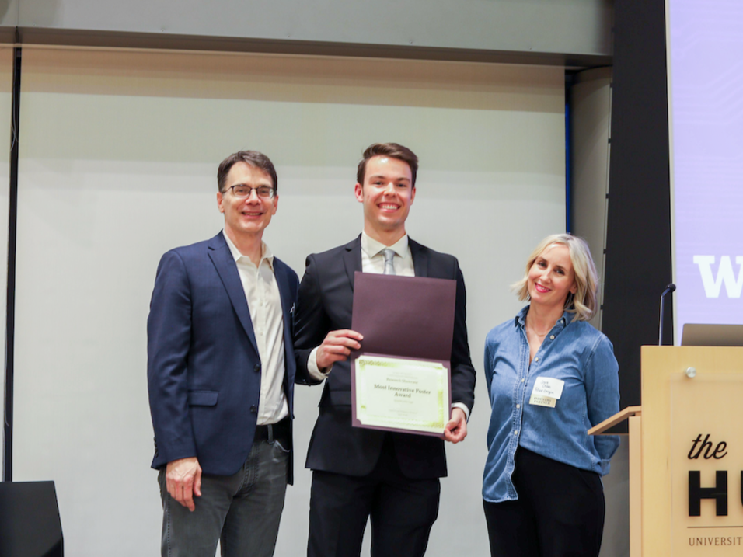
Awards
NSF GRFP Honorable Mention
UW ECE Research Showcase 2025
”Most Innovative Poster Award”

