Slide 1
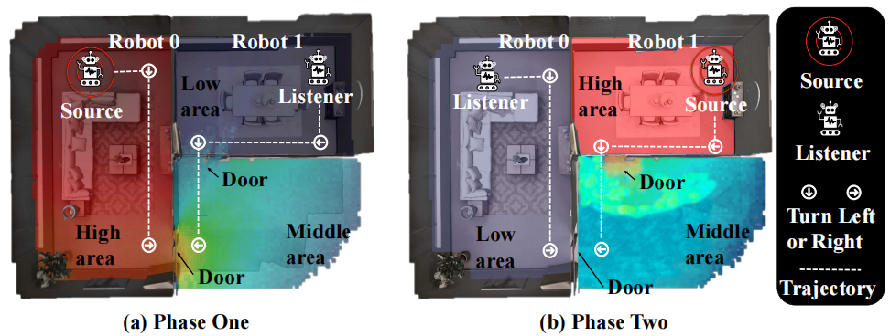
Measuring Acoustics with Collaborative Multiple Agents
Yinfeng Yu^{1,6}, Changan Chen², Lele Cao^{1,3}, Fangkai Yang⁴, Fuchun Sun^{1,5,*}
¹Tsinghua University ²UT Austin ³EQT ⁴Microsoft Research
⁵ THU-Bosch JCML Center ⁶Xinjiang University
This work aims to learn to measure environment acoustics with two collaborative robots.
∗Corresponding author: Fuchun Sun.

Slide 2
Content
Motivation
Challenges
Methodology
Experiments
Conclusions
Notes:
The content include

Slide 3
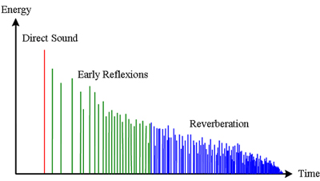
Motivation
Measuring is time-consuming due to the large number of samples to traverse
FAST-RIR [Ratnarajah et al., 2022b] relies on handcrafted features,
MESH2IR [Ratnarajah et al., 2022a] uses the scene’s mesh and source/listener locations to generate RIR while ignoring the measurement cost
Neural Acoustic Field [Luo et al., 2022] tries to learn the parameters of the acoustic field, but its training time and model storage cost grow linearly with the number of environments [Majumder et al., 2022].
Some work [Singh et al., 2021] suggests that storing the original RIR data of the sampled points is optional, and only the acoustic field parameters must be stored.
Schematic energetic room impulse response^{[1]}
RIR is short for room impulse response
[1] https://acoustics.org/pressroom/httpdocs/152nd/behler.html

Slide 4
Challenges
Challenge 1:
Given a limited number of action steps, it is challenging to model the acoustic field.
Challenge 2:
What are the evaluation metrics for collaborative RIR measurements? There are no such metrics existed before!

Slide 5
Contributions
We propose a new setting for planning RIR measuring under finite time steps and a solution to measure the RIR with two-agent cooperation in low resource situations;
We design a novel reward function for the multi-agent decomposition to encourage coverage of environment acoustics;
We design evaluation metrics for the collaborative measurement of RIR, and we experimentally verify the effectiveness of our model.

Slide 6
Task
Learn to measure environment acoustics with two collaborative robots.
The background color indicates sound intensity (``High'', ``Middle'' and ``Low'' areas).
Each step (one step per second) embodies three steps: 1) robot 0 emits a sound, and robot 1 receives the sound; 2) robot 1 emits the sound, and robot 0 receives the sound; 3) two robots make a movement following their learned policies.
This process repeats until reaching the maximum number of time steps.

Slide 7
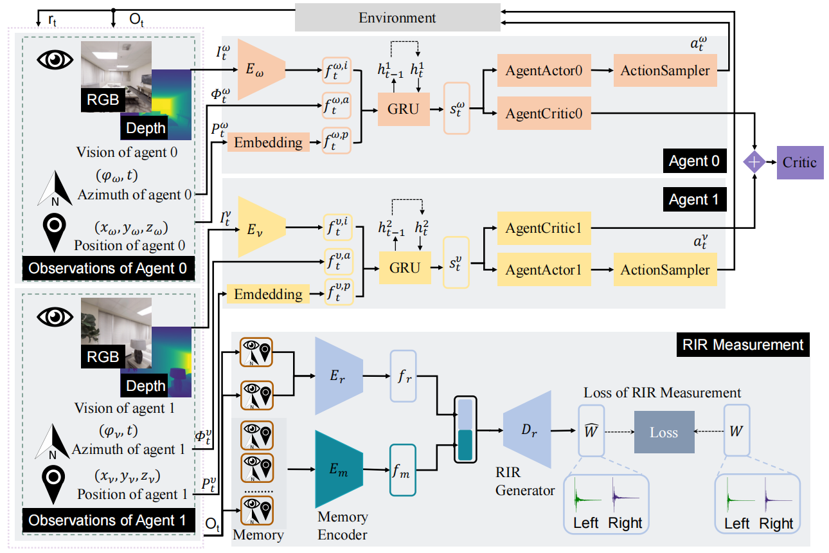
Methodology
The MACMA architecture: the agent 0 and the agent 1 first learn to encode observations as $s_{t}^{ω}$ and $s_{t}^{ν}$ respectively
using encoder $E_{ω}$ and $E_{ν}$ , which are fed to actor-critic networks to predict the next action $a_{t}^{ω}$ and $a_{t}^{ν}$.
The RIR measurement learns how to predict RIR $\hat{W_{t}}$ guided by ground truth RIR $W_{t}$.
Notes:
$s_t^\omega$
s subscript t superscript omega

Slide 8
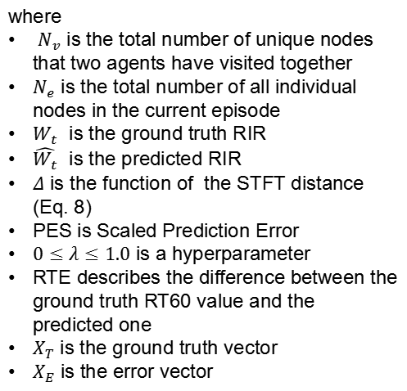
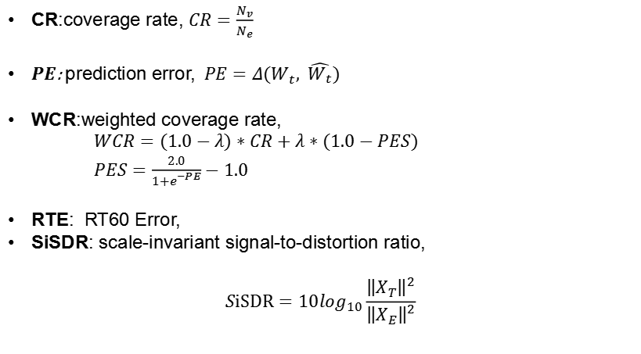
Experiments (1) : metrics
CR:coverage rate, $CR=\frac{N_{v}}{N_{e}}$
$PE$: prediction error, $PE=Δ(W_{t}, \hat{W_{t}})$
WCR:weighted coverage rate,
$WCR=(1.0−λ)∗CR+λ∗(1.0−PES)$
$PES=\frac{2.0}{1+e^{−PE}}−1.0$
RTE: RT60 Error,
SiSDR: scale-invariant signal-to-distortion ratio,
$$SiSDR=10\log_{10}\frac{{\left\|X_{T}\right\|}^{2}}{{\left\|X_{E}\right\|}^{2}}$$
where
$N_{v}$ is the total number of unique nodes that two agents have visited together
$N_{e}$ is the total number of all individual nodes in the current episode
$W_{t}$ is the ground truth RIR
$\hat{W_{t}}$ is the predicted RIR
$Δ$ is the function of the STFT distance (Eq. 8)
PES is Scaled Prediction Error
$0≤λ≤1.0$ is a hyperparameter
RTE describes the difference between the ground truth RT60 value and the predicted one
$X_{T}$ is the ground truth vector
$X_{E}$ is the error vector

Slide 9
Experiments (2) : dataset
We used the SoundSpaces dataset, including:
Replica
Matterport3D

Slide 10
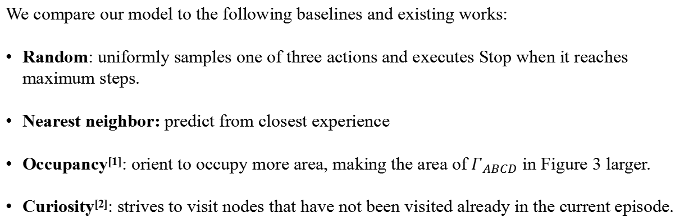
Experiments (3) : baselines
We compare our model to the following baselines and existing works:
Random: uniformly samples one of three actions and executes Stop when it reaches maximum steps.
Nearest neighbor: predict from closest experience
Occupancy^{[1]}: orient to occupy more area, making the area of $Γ_{ABCD}$ in Figure 3 larger.
Curiosity^{[2]}: strives to visit nodes that have not been visited already in the current episode.
[1] Ramakrishnan S K, Al-Halah Z, Grauman K. Occupancy anticipation for efficient exploration and navigation, ECCV 2020
[2] Pathak D, Agrawal P, Efros A A, et al. Curiosity-driven exploration by self-supervised prediction, ICML 2017
Notes:
$\Gamma_{A B C D}$

Slide 11
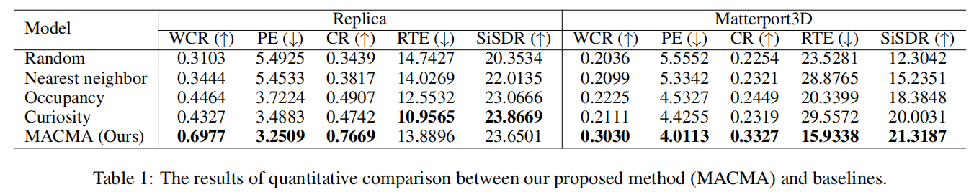
Experiments (4) : Quantitative comparison of the two datasets.
As a result, we can conclude that MACMA quantitatively outperforms baselines over both datasets.

Slide 12
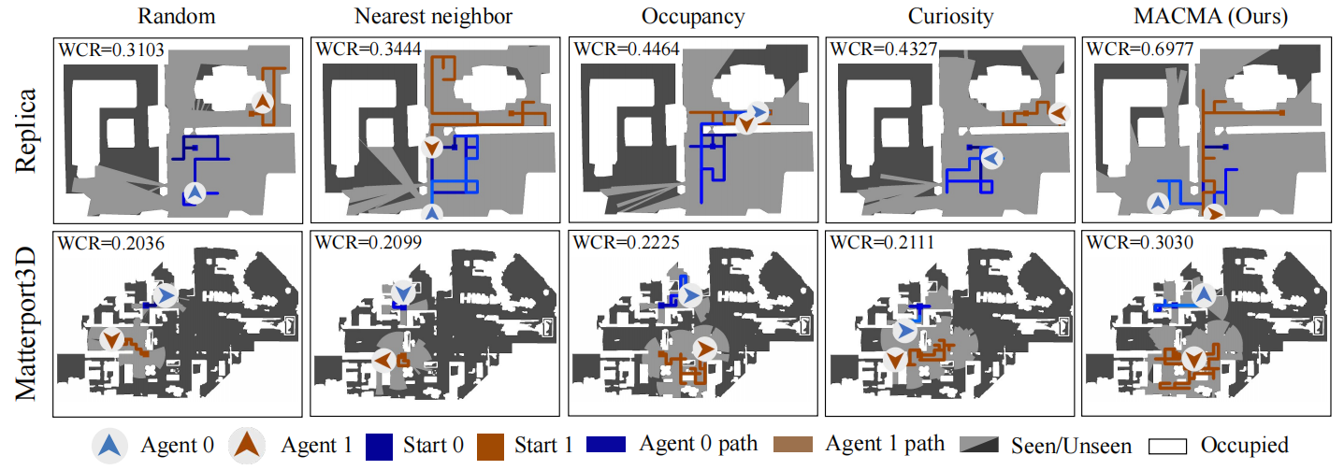
Experiments (5) : Qualitative comparison on exploration capability.
Visualization of the navigation trajectories by the end of a particular episode from Replica (top row) and Matterport3D (bottom row) dataset. Higher WCR values and bigger “seen” areas (colored in light-grey) indicate better performances.

Slide 13
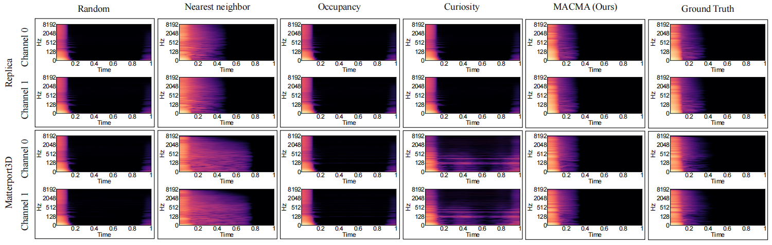
Experiments (6) : Qualitative comparison on RIR prediction.
Qualitative comparison of RIR prediction (Binaural RIR with channel 0 and channel 1) in spectrogram from Replica (top row) and Matterport3D (bottom row) dataset. Every column is the result of one model except last one. The last column is the ground truth of RIR.

Slide 14
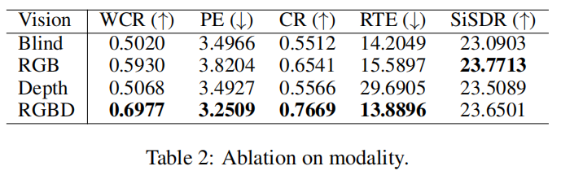
Experiments (7) : Ablation on modality.
As shown in Table 2, RGBD (vision with RGB images and Depth input) seems to be the best choice.

Slide 15
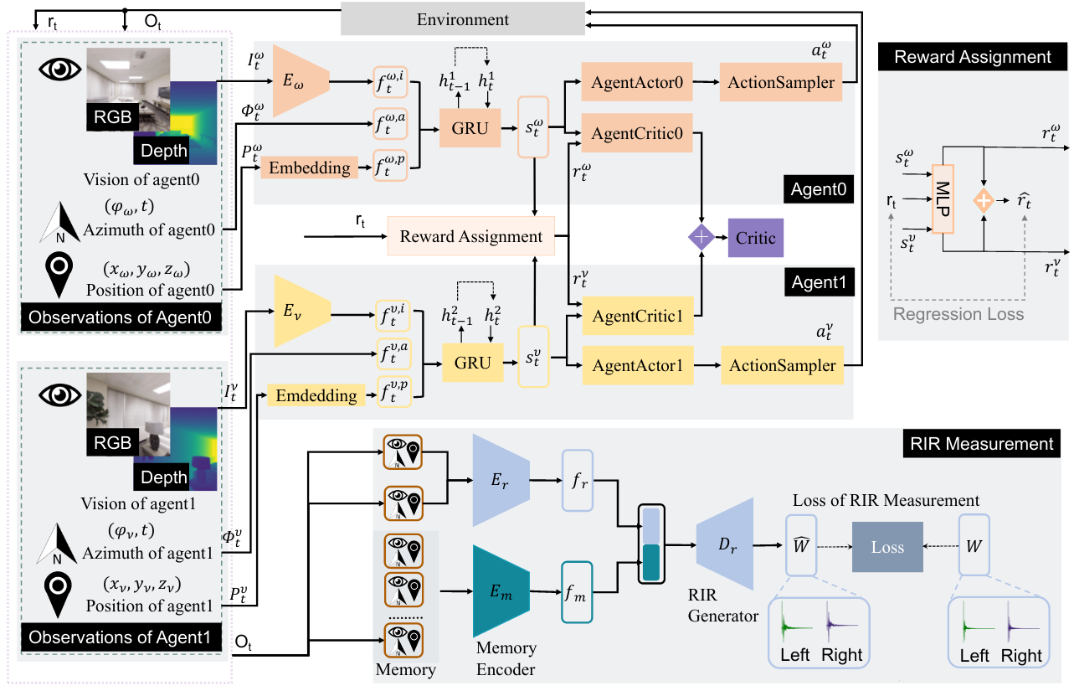
Experiments (8) : MACMA with Reward Assignment.
The MACMARA architecture: add Reward Assignment to MACMA, the reward assignment learns how to assign reward r_{t} given by the environment supervised by r_{t}.

Slide 16
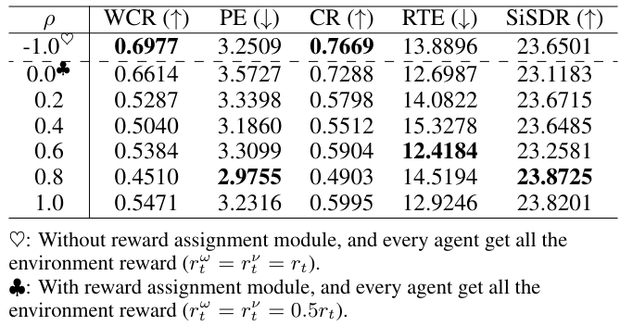
Experiments (9) : Experimental results of MACMARA.

Slide 17
Experiments (10) : more discussions
The dynamic relationship between modality importance and action selection
The dynamic relationship between modal importance and RIR measurement accuracy
Studies on memory size κ
Studies on the reward component
...
For more details, please refer to the origin paper.

Slide 18
Conclusion
This paper proposes a novel task where two collaborative agents learn to measure room impulse responses of an environment by moving and emitting/receiving signals in the environment within a given time budget.
To tackle this task, we design a collaborative navigation and exploration policy.
Our approach outperforms several other baselines on the environment's coverage and prediction error.
For more details, please refer to the origin paper.

Slide 19

Measuring Acoustics with Collaborative Multiple Agents
Yinfeng Yu^{1,6}, Changan Chen², Lele Cao^{1,3}, Fangkai Yang⁴, Fuchun Sun^{1,5,*}
¹Tsinghua University ²UT Austin ³EQT ⁴Microsoft Research
⁵ THU-Bosch JCML Center ⁶Xinjiang University
The project and code can be viewed at the following website:
https://yyf17.github.io/MACMA/index.html

Slide 20
Thanks for your attention!

