Slide 1


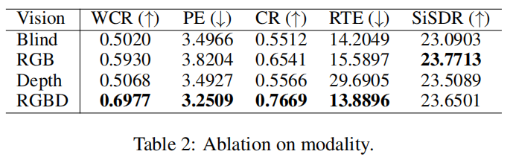
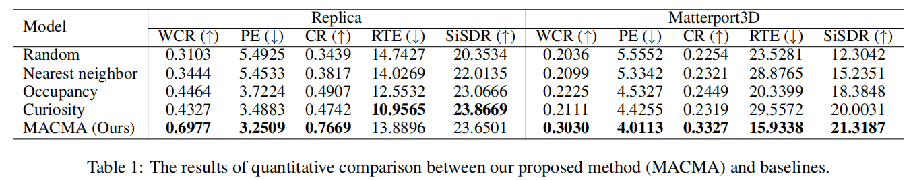
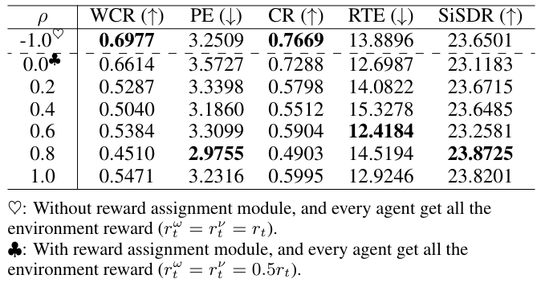
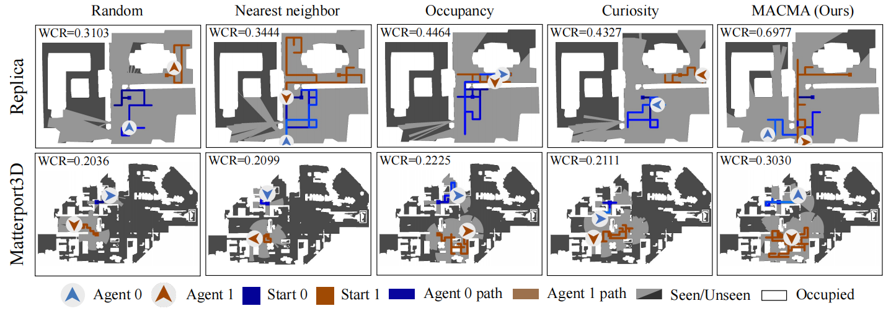
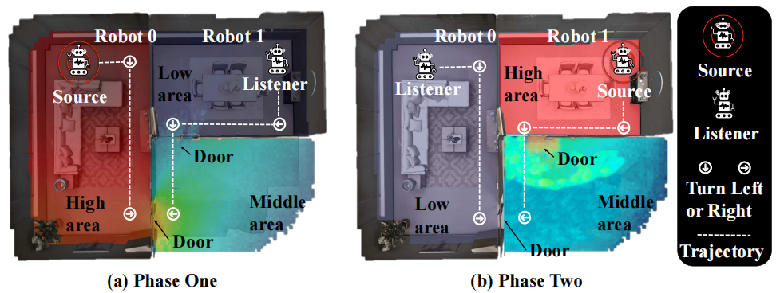
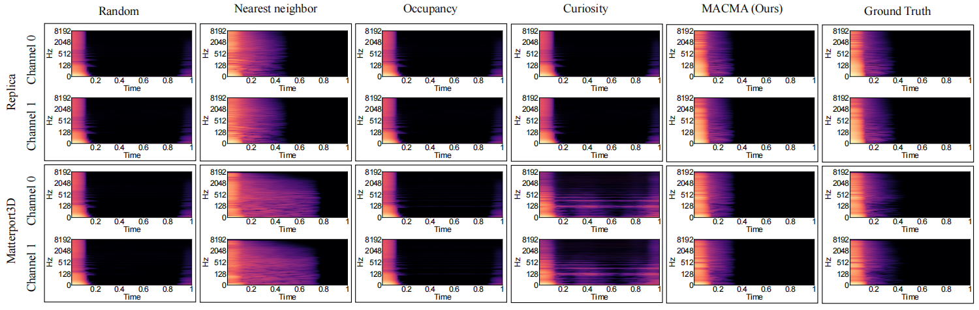
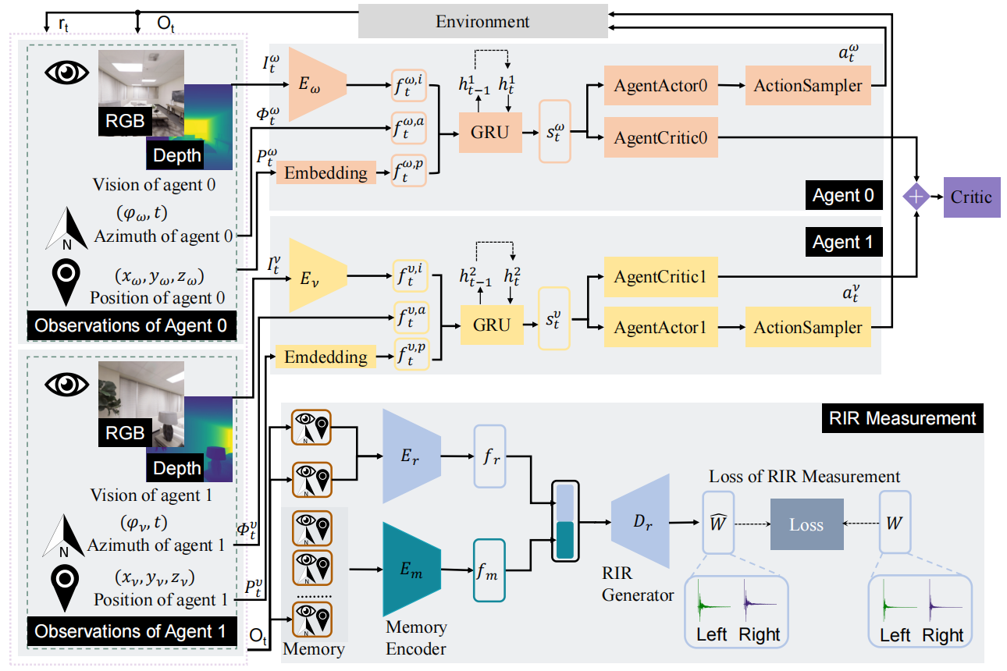

Measuring Acoustics with Collaborative Multiple Agents
Yinfeng Yu^{1,6}, Changan Chen², Lele Cao^{1,3}, Fangkai Yang⁴, Fuchun Sun^{1,5}
¹Tsinghua University ²UT Austin ³EQT ⁴Microsoft Research ⁵ THU-Bosch JCML Center ⁶Xinjiang University
Motivation
Results
Measuring is time-consuming due to the large number of samples to traverse
FAST-RIR [Ratnarajah et al., 2022b] relies on handcrafted features,
MESH2IR [Ratnarajah et al., 2022a] uses the scene’s mesh and source/listener locations to generate RIR while ignoring the measurement cost
Neural Acoustic Field (NAF) [Luo et al., 2022] tries to learn the parameters of the acoustic field, but its training time and model storage cost grow linearly with the number of environments [Majumder et al., 2022].
Some work [Singh et al., 2021] suggests that storing the original RIR data of the sampled points is optional, and only the acoustic field parameters must be stored.
As shown in Table 2, RGBD (vision with RGB images and Depth input) seems to be the best choice.
Contributions
As a result, we can conclude that MACMA quantitatively outperforms baselines over both datasets.
We propose a new setting for planning RIR measuring under finite time steps and a solution to measure the RIR with two-agent cooperation in low resource situations;
We design a novel reward function for the multi-agent decomposition to encourage coverage of environment acoustics;
We design evaluation metrics for the collaborative measurement of RIR, and we experimentally verify the effectiveness of our model.
Task
xxxxx
Experimental results of MACMA with Reward Assignment.
Conclusion
This paper proposes a novel task where two collaborative agents learn to measure room impulse responses of an environment by moving and emitting/receiving signals in the environment within a given time budget.
To tackle this task, we design a collaborative navigation and exploration policy.
Our approach outperforms several other baselines on the environment's coverage and prediction error.
Learn to measure environment acoustics with two collaborative robots.
The background color indicates sound intensity (``High'', ``Middle'' and ``Low'' areas).
Each step (one step per second) embodies three steps: 1) robot 0 emits a sound, and robot 1 receives the sound; 2) robot 1 emits the sound, and robot 0 receives the sound; 3) two robots make a movement following their learned policies.
This process repeats until reaching the maximum number of time steps.
Visualization of the navigation trajectories by the end of a particular episode from Replica (top row) and Matterport3D (bottom row) dataset. Higher WCR values and bigger “seen” areas (colored in light-grey) indicate better performances.
Neural network model
Project & Code
https://yyf17.github.io/MACMA/index.html
Qualitative comparison of RIR prediction (Binaural RIR with channel 0 and channel 1) in spectrogram from Replica (top row) and Matterport3D (bottom row) dataset. Every column is the result of one model except last one. The last column is the ground truth of RIR.
Notes:
It

