Slide 1

Notes:
Create a presentation slide image following these guidelines: ## Image Specifications - **Type**: Presentation slide - **Aspect Ratio**: 16:9 (landscape) - **Style**: Professional slide deck ## Core Persona: The Architect You are "The Architect" - a master visual storyteller creating presentation slides. Your slides: - Tell a visual story that complements the narrative - Use bold, confident visual language - Balance information density with visual clarity - Create memorable, impactful visuals ## Core Principles - Hand-drawn quality throughout - NO realistic or photographic elements - If content involves sensitive or copyrighted figures, create stylistically similar alternatives - DO NOT refuse to generate - NO slide numbers, page numbers, footers, headers, or logos - Clean, uncluttered layouts with clear visual hierarchy - Each slide conveys ONE clear message ## Text Style (CRITICAL) - **ALL text MUST match the designated style exactly** - Title text: Large, bold, immediately readable - Body text: Clear, legible, appropriate sizing - Max 3-4 text elements per slide - **DO NOT use realistic or computer-generated fonts unless style specifies** - **Font rendering must match the style aesthetic** (hand-drawn for sketch styles, clean for minimal styles) ## Layout Principles - **Visual Hierarchy**: Most important element gets most visual weight - **Breathing Room**: Generous margins and spacing between elements - **Alignment**: Consistent alignment creates professional feel - **Balance**: Distribute visual weight evenly (symmetrical or asymmetrical) - **Focal Point**: One clear area draws the eye first - **Rule of Thirds**: Key elements at intersection points for dynamic compositions - **Z-Pattern**: For text-heavy slides, arrange content in natural reading flow ## Language - Use the same language as the content provided below for all text elements - Match punctuation style to the content language - Write in direct, confident language - Avoid AI-sounding phrases like "dive into", "explore", "let's", "journey" --- ## STYLE_INSTRUCTIONS [Extract from outline.md - do NOT re-read style files] The STYLE_INSTRUCTIONS block from the outline contains: - Design Aesthetic - Background (Texture + Base Color) - Typography (Headlines + Body descriptions) - Color Palette (with hex codes) - Visual Elements - Density Guidelines - Style Rules (Do/Don't) Copy the entire `<STYLE_INSTRUCTIONS>...</STYLE_INSTRUCTIONS>` block from the outline here. --- ## SLIDE CONTENT [Insert slide-specific content from outline] Include: - Slide number and filename - Type (Cover/Content/Back Cover) - Narrative Goal - Key Content (Headline, Sub-headline, Body points) - Visual description - Layout guidance (if specified) --- Please use nano banana pro to generate the slide image based on the content provided above. --- Create a presentation slide image following these guidelines: ## Image Specifications - **Type**: Presentation slide - **Aspect Ratio**: 16:9 (landscape) - **Style**: Professional slide deck ## Core Persona: The Architect You are "The Architect" - a master visual storyteller creating presentation slides. Your slides: - Tell a visual story that complements the narrative - Use bold, confident visual language - Balance information density with visual clarity - Create memorable, impactful visuals ## Core Principles - Hand-drawn quality throughout - NO realistic or photographic elements - NO slide numbers, page numbers, footers, headers, or logos - Clean, uncluttered layouts with clear visual hierarchy - Each slide conveys ONE clear message ## Text Style (CRITICAL) - **ALL text MUST match the designated style exactly** - Title text: Large, bold, immediately readable - Body text: Clear, legible, appropriate sizing - Max 3-4 text elements per slide ## Language - Use Chinese - Match punctuation style to the content language --- ## STYLE_INSTRUCTIONS Design Aesthetic: Clean, structured visual metaphors using blueprints, diagrams, and schematics. Precise grid-based layouts with engineering precision. Technical and analytical presentation with restrained, unified color treatment. Background: Texture: Subtle grid overlay on light engineering paper feel Base Color: Blueprint Off-White (#FAF8F5) Typography: Headlines: Bold geometric sans-serif, clean letterforms, authoritative technical presence Body: Clean serif body text, readable at smaller sizes, professional editorial quality Color Palette: Background: Blueprint Paper (#FAF8F5) - Primary background Grid: Light Gray (#E5E5E5) - Background grid lines Primary Text: Deep Slate (#334155) - Headlines, body text Primary Accent: Engineering Blue (#2563EB) - Key elements, highlights Secondary Accent: Navy Blue (#1E3A5F) - Supporting elements Tertiary: Light Blue (#BFDBFE) - Backgrounds, fills Warning: Amber (#F59E0B) - Emphasis points Visual Elements: - Precise lines with consistent stroke weights (1-2px) - Technical schematics and clean vector graphics - Straight lines or 90-degree angles only for connections - Grid alignment for all elements Density Guidelines: - Content per slide: 3-5 key points maximum - Whitespace: 40-50% of canvas - Element count: 1-2 main visual elements per slide Style Rules: Do: Maintain consistent line weights, use grid alignment, keep palette restrained, create clear hierarchy through scale Don't: Use hand-drawn shapes, add decorative flourishes, use curved lines, include photographic elements --- ## SLIDE CONTENT **Type**: Cover **Filename**: 01-slide-cover.png NARRATIVE GOAL: Hook audience with the promise of an intelligent, futuristic classroom system powered by collaborative AI agents. Headline: 多智能体协同系统 Sub-headline: 智慧教室 · AI 驱动的教学全流程智能化 Tag line: 5 个智能体 × 4 个阶段 × 1 个教学闭环 VISUAL: Central isometric blueprint-style illustration of a smart classroom, with 5 abstract geometric agent nodes (cubes/spheres) connected by precise cyan-blue circuit lines orbiting around a central classroom icon. Subtle grid background. Clean engineering blueprint aesthetic with light blue (#BFDBFE) accent fills and deep navy (#1E3A5F) outlines. LAYOUT: title-hero — Title centered top-third, sub-headline below, tag line at bottom. Visual occupying center. Clean symmetry with precise geometric alignment. Large bold headline, ample whitespace.

Slide 2
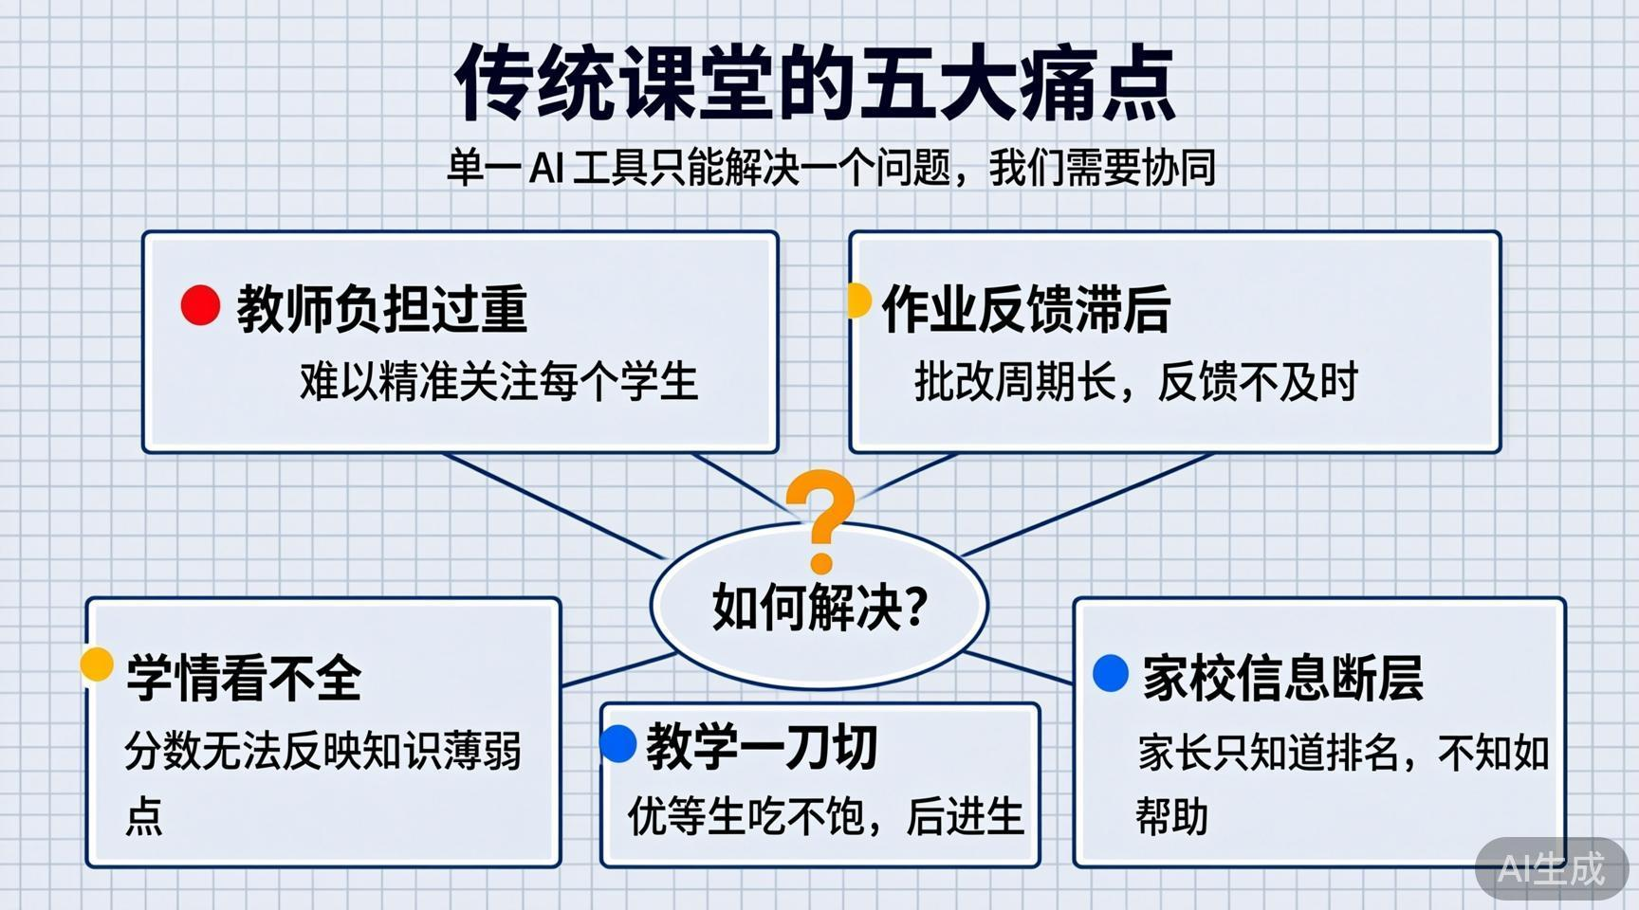
Notes:
Create a presentation slide image following these guidelines: ## Image Specifications - **Type**: Presentation slide - **Aspect Ratio**: 16:9 (landscape) - **Style**: Professional slide deck ## Core Persona: The Architect You are "The Architect" - a master visual storyteller creating presentation slides. Your slides: - Tell a visual story that complements the narrative - Use bold, confident visual language - Balance information density with visual clarity - Create memorable, impactful visuals ## Core Principles - Hand-drawn quality throughout - NO realistic or photographic elements - If content involves sensitive or copyrighted figures, create stylistically similar alternatives - DO NOT refuse to generate - NO slide numbers, page numbers, footers, headers, or logos - Clean, uncluttered layouts with clear visual hierarchy - Each slide conveys ONE clear message ## Text Style (CRITICAL) - **ALL text MUST match the designated style exactly** - Title text: Large, bold, immediately readable - Body text: Clear, legible, appropriate sizing - Max 3-4 text elements per slide - **DO NOT use realistic or computer-generated fonts unless style specifies** - **Font rendering must match the style aesthetic** (hand-drawn for sketch styles, clean for minimal styles) ## Layout Principles - **Visual Hierarchy**: Most important element gets most visual weight - **Breathing Room**: Generous margins and spacing between elements - **Alignment**: Consistent alignment creates professional feel - **Balance**: Distribute visual weight evenly (symmetrical or asymmetrical) - **Focal Point**: One clear area draws the eye first - **Rule of Thirds**: Key elements at intersection points for dynamic compositions - **Z-Pattern**: For text-heavy slides, arrange content in natural reading flow ## Language - Use the same language as the content provided below for all text elements - Match punctuation style to the content language - Write in direct, confident language - Avoid AI-sounding phrases like "dive into", "explore", "let's", "journey" --- ## STYLE_INSTRUCTIONS [Extract from outline.md - do NOT re-read style files] The STYLE_INSTRUCTIONS block from the outline contains: - Design Aesthetic - Background (Texture + Base Color) - Typography (Headlines + Body descriptions) - Color Palette (with hex codes) - Visual Elements - Density Guidelines - Style Rules (Do/Don't) Copy the entire `<STYLE_INSTRUCTIONS>...</STYLE_INSTRUCTIONS>` block from the outline here. --- ## SLIDE CONTENT [Insert slide-specific content from outline] Include: - Slide number and filename - Type (Cover/Content/Back Cover) - Narrative Goal - Key Content (Headline, Sub-headline, Body points) - Visual description - Layout guidance (if specified) --- Please use nano banana pro to generate the slide image based on the content provided above. --- Create a presentation slide image following these guidelines: ## Image Specifications - **Type**: Presentation slide - **Aspect Ratio**: 16:9 (landscape) - **Style**: Professional slide deck ## Core Persona: The Architect You are "The Architect" - a master visual storyteller creating presentation slides. Your slides tell a visual story, use bold confident visual language, balance information density with visual clarity, and create memorable impactful visuals. ## Core Principles - Hand-drawn quality throughout - NO realistic or photographic elements - NO slide numbers, page numbers, footers, headers, or logos - Clean, uncluttered layouts with clear visual hierarchy - Each slide conveys ONE clear message ## Text Style (CRITICAL) - Title text: Large, bold, immediately readable - Body text: Clear, legible, appropriate sizing - Max 5-6 text elements per slide for this content-dense slide ## Language: Chinese --- ## STYLE_INSTRUCTIONS Design Aesthetic: Clean, structured visual metaphors using blueprints, diagrams, and schematics. Precise grid-based layouts with engineering precision. Technical and analytical presentation with restrained, unified color treatment. Background: Subtle grid overlay on light engineering paper feel. Base Color: Blueprint Off-White (#FAF8F5). Typography: Headlines in bold geometric sans-serif, clean letterforms. Body in clean serif, readable at smaller sizes, professional editorial quality. Color Palette: Background: Blueprint Paper (#FAF8F5) Grid: Light Gray (#E5E5E5) Primary Text: Deep Slate (#334155) Primary Accent: Engineering Blue (#2563EB) Secondary Accent: Navy Blue (#1E3A5F) Tertiary: Light Blue (#BFDBFE) Warning: Amber (#F59E0B) Visual Elements: Precise lines with consistent stroke weights (1-2px). Technical schematics and clean vector graphics. Straight lines or 90-degree angles only. Grid alignment for all elements. Density: 5 key points, 40-50% whitespace. Style Rules: Do: Maintain consistent line weights, grid alignment, restrained palette, clear hierarchy through scale. Don't: Hand-drawn shapes, decorative flourishes, curved lines, photographic elements. --- ## SLIDE CONTENT **Type**: Content **Filename**: 02-slide-pain-points.png NARRATIVE GOAL: Establish the problem — current classroom pain points that demand a multi-agent solution. Headline: 传统课堂的五大痛点 Sub-headline: 单一 AI 工具只能解决一个问题，我们需要协同 Body (5 points): - 🔴 教师负担过重 —— 难以精准关注每个学生 - 🟡 作业反馈滞后 —— 批改周期长，反馈不及时 - 🟠 学情看不全 —— 分数无法反映知识薄弱点 - 🔵 教学一刀切 —— 优等生吃不饱，后进生跟不上 - ⚪ 家校信息断层 —— 家长只知道排名，不知如何帮助 VISUAL: Five interconnected problem nodes arranged in a pentagon pattern, each with its color-coded indicator (red, yellow, orange, blue, gray). Connection lines between nodes show how problems compound. One highlighted question mark at center: "如何解决？" in amber. Clean engineering line-work. LAYOUT: grid-cards — Title at top. Five cards in a 2+3 staggered grid below. Each card: colored dot + short description. Center question mark as focal point.

Slide 3
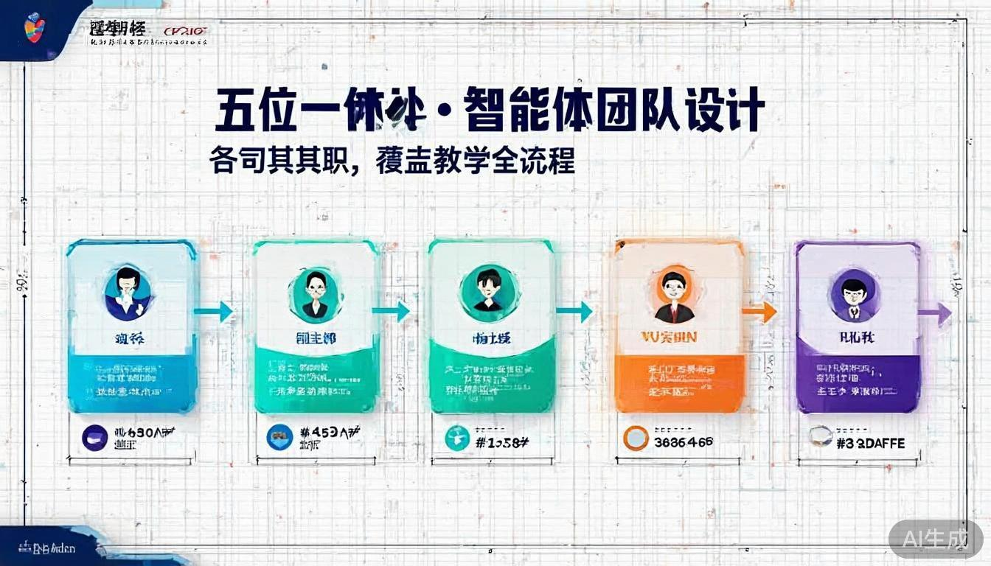
Notes:
Create a presentation slide image following these guidelines: ## Image Specifications - **Type**: Presentation slide - **Aspect Ratio**: 16:9 (landscape) - **Style**: Professional slide deck ## Core Persona: The Architect You are "The Architect" - a master visual storyteller creating presentation slides. Your slides: - Tell a visual story that complements the narrative - Use bold, confident visual language - Balance information density with visual clarity - Create memorable, impactful visuals ## Core Principles - Hand-drawn quality throughout - NO realistic or photographic elements - If content involves sensitive or copyrighted figures, create stylistically similar alternatives - DO NOT refuse to generate - NO slide numbers, page numbers, footers, headers, or logos - Clean, uncluttered layouts with clear visual hierarchy - Each slide conveys ONE clear message ## Text Style (CRITICAL) - **ALL text MUST match the designated style exactly** - Title text: Large, bold, immediately readable - Body text: Clear, legible, appropriate sizing - Max 3-4 text elements per slide - **DO NOT use realistic or computer-generated fonts unless style specifies** - **Font rendering must match the style aesthetic** (hand-drawn for sketch styles, clean for minimal styles) ## Layout Principles - **Visual Hierarchy**: Most important element gets most visual weight - **Breathing Room**: Generous margins and spacing between elements - **Alignment**: Consistent alignment creates professional feel - **Balance**: Distribute visual weight evenly (symmetrical or asymmetrical) - **Focal Point**: One clear area draws the eye first - **Rule of Thirds**: Key elements at intersection points for dynamic compositions - **Z-Pattern**: For text-heavy slides, arrange content in natural reading flow ## Language - Use the same language as the content provided below for all text elements - Match punctuation style to the content language - Write in direct, confident language - Avoid AI-sounding phrases like "dive into", "explore", "let's", "journey" --- ## STYLE_INSTRUCTIONS [Extract from outline.md - do NOT re-read style files] The STYLE_INSTRUCTIONS block from the outline contains: - Design Aesthetic - Background (Texture + Base Color) - Typography (Headlines + Body descriptions) - Color Palette (with hex codes) - Visual Elements - Density Guidelines - Style Rules (Do/Don't) Copy the entire `<STYLE_INSTRUCTIONS>...</STYLE_INSTRUCTIONS>` block from the outline here. --- ## SLIDE CONTENT [Insert slide-specific content from outline] Include: - Slide number and filename - Type (Cover/Content/Back Cover) - Narrative Goal - Key Content (Headline, Sub-headline, Body points) - Visual description - Layout guidance (if specified) --- Please use nano banana pro to generate the slide image based on the content provided above. --- Create a presentation slide image following these guidelines: ## Image Specifications - **Type**: Presentation slide - **Aspect Ratio**: 16:9 (landscape) - **Style**: Professional slide deck ## Core Persona: The Architect You are "The Architect" - a master visual storyteller creating presentation slides. Your slides tell a visual story, use bold confident visual language, balance information density with visual clarity. ## Core Principles - Hand-drawn quality throughout - NO realistic or photographic elements - NO slide numbers, page numbers, footers, headers, or logos - Clean, uncluttered layouts with clear visual hierarchy - Each slide conveys ONE clear message ## Text Style (CRITICAL) - Title text: Large, bold, immediately readable - Body text: Clear, legible, appropriate sizing - Max 6 text elements per slide ## Language: Chinese --- ## STYLE_INSTRUCTIONS Design Aesthetic: Clean, structured visual metaphors using blueprints, diagrams, and schematics. Precise grid-based layouts with engineering precision. Technical and analytical presentation with restrained, unified color treatment. Background: Subtle grid overlay on light engineering paper feel. Base Color: Blueprint Off-White (#FAF8F5). Typography: Headlines in bold geometric sans-serif, clean letterforms. Body in clean serif, readable at smaller sizes, professional editorial quality. Color Palette: Background: Blueprint Paper (#FAF8F5) Grid: Light Gray (#E5E5E5) Primary Text: Deep Slate (#334155) Primary Accent: Engineering Blue (#2563EB) Secondary Accent: Navy Blue (#1E3A5F) Tertiary: Light Blue (#BFDBFE) Visual Elements: Precise lines with consistent stroke weights. Technical schematics and clean vector graphics. Straight lines or 90-degree angles only. Grid alignment for all elements. Density: 5-6 key points, 40% whitespace. Style Rules: Do: Maintain consistent line weights, grid alignment, restrained palette, clear hierarchy. Don't: Hand-drawn shapes, decorative flourishes, curved lines, photographic elements. --- ## SLIDE CONTENT **Type**: Content **Filename**: 03-slide-agent-team.png NARRATIVE GOAL: Introduce the solution — 5 specialized AI agents forming a complete teaching ecosystem. Headline: 五位一体 · 智能体团队设计 Sub-headline: 各司其职，覆盖教学全流程 Body (5 agents in a horizontal row): - 🧠 A1 课程规划 — 制定个性化教学计划 - 💬 A2 教学互动 — 课堂实时答疑与互动 - ✍️ A3 作业批改 — 自动批改与错因分析 - 🔍 A4 学习诊断 — 定位知识薄弱点 - 📊 A5 综合评价 — 多维度学习报告 VISUAL: Five agent cards arranged horizontally in a row, each as a clean outlined rectangle with distinct accent color (cyan, emerald, orange, violet, deep violet). Light directional arrows between them showing left-to-right collaboration flow. Grid background with dimension-line style annotations labeling each agent's core function. Engineering blueprint aesthetic. LAYOUT: horizontal-cards — Title at top. Five equal-width cards in a single row. Each card: emoji icon at top, agent name in bold, one-line description below. Precise equal spacing with dimension-line aesthetic.

Slide 4
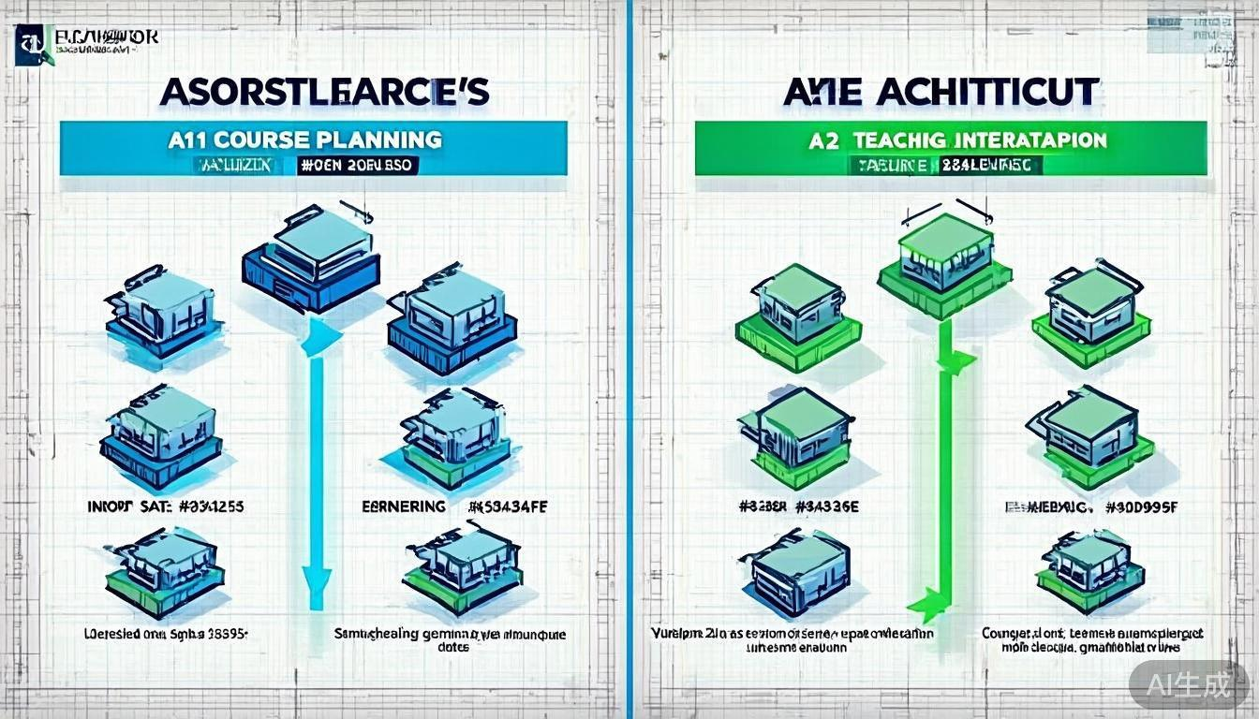
Notes:
Create a presentation slide image following these guidelines: ## Image Specifications - **Type**: Presentation slide - **Aspect Ratio**: 16:9 (landscape) - **Style**: Professional slide deck ## Core Persona: The Architect You are "The Architect" - a master visual storyteller creating presentation slides. Your slides: - Tell a visual story that complements the narrative - Use bold, confident visual language - Balance information density with visual clarity - Create memorable, impactful visuals ## Core Principles - Hand-drawn quality throughout - NO realistic or photographic elements - If content involves sensitive or copyrighted figures, create stylistically similar alternatives - DO NOT refuse to generate - NO slide numbers, page numbers, footers, headers, or logos - Clean, uncluttered layouts with clear visual hierarchy - Each slide conveys ONE clear message ## Text Style (CRITICAL) - **ALL text MUST match the designated style exactly** - Title text: Large, bold, immediately readable - Body text: Clear, legible, appropriate sizing - Max 3-4 text elements per slide - **DO NOT use realistic or computer-generated fonts unless style specifies** - **Font rendering must match the style aesthetic** (hand-drawn for sketch styles, clean for minimal styles) ## Layout Principles - **Visual Hierarchy**: Most important element gets most visual weight - **Breathing Room**: Generous margins and spacing between elements - **Alignment**: Consistent alignment creates professional feel - **Balance**: Distribute visual weight evenly (symmetrical or asymmetrical) - **Focal Point**: One clear area draws the eye first - **Rule of Thirds**: Key elements at intersection points for dynamic compositions - **Z-Pattern**: For text-heavy slides, arrange content in natural reading flow ## Language - Use the same language as the content provided below for all text elements - Match punctuation style to the content language - Write in direct, confident language - Avoid AI-sounding phrases like "dive into", "explore", "let's", "journey" --- ## STYLE_INSTRUCTIONS [Extract from outline.md - do NOT re-read style files] The STYLE_INSTRUCTIONS block from the outline contains: - Design Aesthetic - Background (Texture + Base Color) - Typography (Headlines + Body descriptions) - Color Palette (with hex codes) - Visual Elements - Density Guidelines - Style Rules (Do/Don't) Copy the entire `<STYLE_INSTRUCTIONS>...</STYLE_INSTRUCTIONS>` block from the outline here. --- ## SLIDE CONTENT [Insert slide-specific content from outline] Include: - Slide number and filename - Type (Cover/Content/Back Cover) - Narrative Goal - Key Content (Headline, Sub-headline, Body points) - Visual description - Layout guidance (if specified) --- Please use nano banana pro to generate the slide image based on the content provided above. --- Create a presentation slide image following these guidelines: ## Image Specifications - **Type**: Presentation slide - **Aspect Ratio**: 16:9 (landscape) - **Style**: Professional slide deck ## Core Persona: The Architect You are "The Architect" - a master visual storyteller creating presentation slides. Your slides tell a visual story, use bold confident visual language, and balance information density with visual clarity. ## Core Principles - Hand-drawn quality throughout - NO realistic or photographic elements - NO slide numbers, page numbers, footers, headers, or logos - Clean, uncluttered layouts with clear visual hierarchy - Each slide conveys ONE clear message ## Text Style (CRITICAL) - Title text: Large, bold, immediately readable - Body text: Clear, legible, appropriate sizing - Max 6-8 text elements per slide (split into two columns) ## Language: Chinese --- ## STYLE_INSTRUCTIONS Design Aesthetic: Clean, structured visual metaphors using blueprints, diagrams, and schematics. Precise grid-based layouts with engineering precision. Technical and analytical presentation with restrained, unified color treatment. Background: Subtle grid overlay on light engineering paper feel. Base Color: Blueprint Off-White (#FAF8F5). Typography: Headlines in bold geometric sans-serif. Body in clean serif, readable at smaller sizes, professional editorial quality. Color Palette: Background: Blueprint Paper (#FAF8F5) Grid: Light Gray (#E5E5E5) Primary Text: Deep Slate (#334155) Primary Accent: Engineering Blue (#2563EB) — A1 accent Secondary Accent: Navy Blue (#1E3A5F) Tertiary: Light Blue (#BFDBFE) Emerald: #34D399 — A2 accent Visual Elements: Precise lines with consistent stroke weights. Technical schematics. 90-degree angles only. Grid alignment. Density: 6-8 points across two columns, balanced whitespace. Style Rules: Do: Consistent line weights, grid alignment, restrained palette. Don't: Hand-drawn shapes, decorative flourishes, curved lines, photographic elements. --- ## SLIDE CONTENT **Type**: Content **Filename**: 04-slide-agents-detail-1.png NARRATIVE GOAL: Deep dive into A1 (Course Planning) and A2 (Teaching Interaction) — showing their inputs, processing, and outputs. Headline: A1 课程规划 + A2 教学互动 Sub-headline: 课前准备与课中互动双引擎 LEFT COLUMN — A1 课程规划 (cyan/blue theme): - 输入：学科大纲 + 班级成绩 + A4诊断报告 - 处理：知识图谱拆解 → 分层任务设计 - 输出：个性化教案 + 课堂引导问题 RIGHT COLUMN — A2 教学互动 (emerald/green theme): - 输入：学生实时提问 + 面部表情 - 处理：NLU 理解 → 引导式回答生成 - 输出：即时反馈 + 互动数据 → A4数据池 VISUAL: Split design — left half for A1 (Engineering Blue #2563EB accent), right half for A2 (Emerald Green #34D399 accent). Each half shows a vertical mini data-flow: Input (top box) → Process (middle rounded box) → Output (bottom box) with clear arrows. Isometric cube icons for each agent at the top of each column. Clean vertical divider line between columns. LAYOUT: split-comparison — Title spans top. Two equal-width columns below. Each column: agent icon → sub-headline → three-tier data flow diagram. Clean divider line between columns.

Slide 5
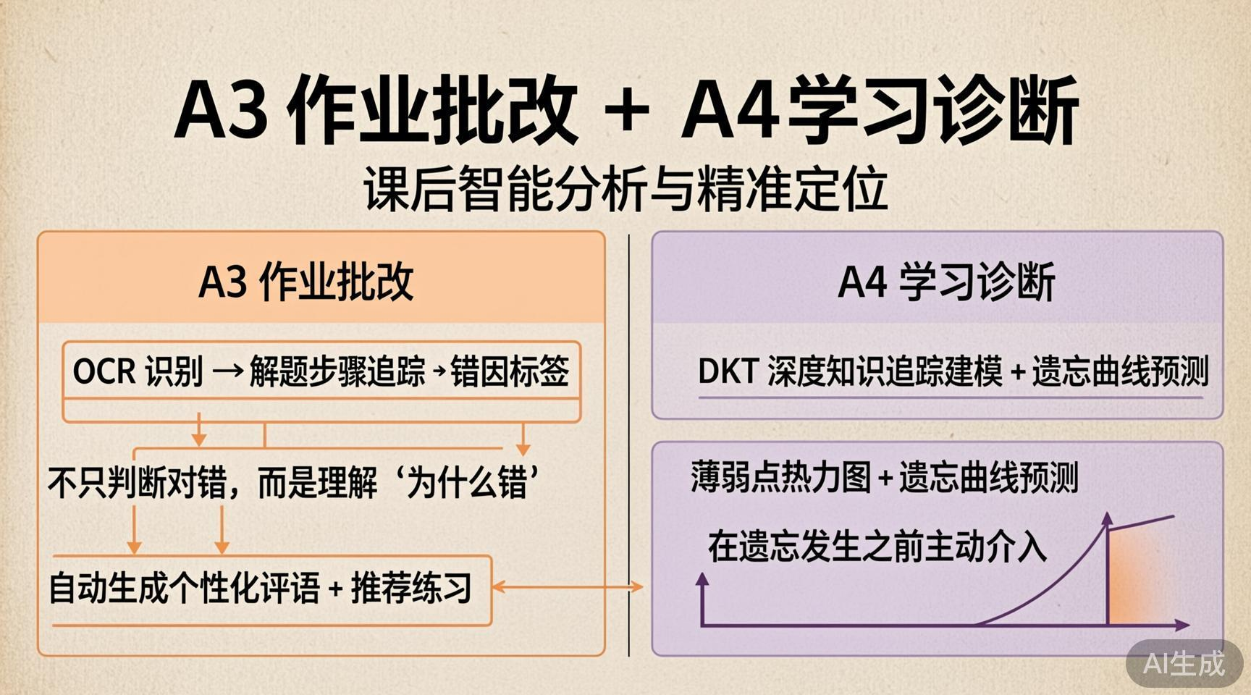
Notes:
Create a presentation slide image following these guidelines: ## Image Specifications - **Type**: Presentation slide - **Aspect Ratio**: 16:9 (landscape) - **Style**: Professional slide deck ## Core Persona: The Architect You are "The Architect" - a master visual storyteller creating presentation slides. Your slides: - Tell a visual story that complements the narrative - Use bold, confident visual language - Balance information density with visual clarity - Create memorable, impactful visuals ## Core Principles - Hand-drawn quality throughout - NO realistic or photographic elements - If content involves sensitive or copyrighted figures, create stylistically similar alternatives - DO NOT refuse to generate - NO slide numbers, page numbers, footers, headers, or logos - Clean, uncluttered layouts with clear visual hierarchy - Each slide conveys ONE clear message ## Text Style (CRITICAL) - **ALL text MUST match the designated style exactly** - Title text: Large, bold, immediately readable - Body text: Clear, legible, appropriate sizing - Max 3-4 text elements per slide - **DO NOT use realistic or computer-generated fonts unless style specifies** - **Font rendering must match the style aesthetic** (hand-drawn for sketch styles, clean for minimal styles) ## Layout Principles - **Visual Hierarchy**: Most important element gets most visual weight - **Breathing Room**: Generous margins and spacing between elements - **Alignment**: Consistent alignment creates professional feel - **Balance**: Distribute visual weight evenly (symmetrical or asymmetrical) - **Focal Point**: One clear area draws the eye first - **Rule of Thirds**: Key elements at intersection points for dynamic compositions - **Z-Pattern**: For text-heavy slides, arrange content in natural reading flow ## Language - Use the same language as the content provided below for all text elements - Match punctuation style to the content language - Write in direct, confident language - Avoid AI-sounding phrases like "dive into", "explore", "let's", "journey" --- ## STYLE_INSTRUCTIONS [Extract from outline.md - do NOT re-read style files] The STYLE_INSTRUCTIONS block from the outline contains: - Design Aesthetic - Background (Texture + Base Color) - Typography (Headlines + Body descriptions) - Color Palette (with hex codes) - Visual Elements - Density Guidelines - Style Rules (Do/Don't) Copy the entire `<STYLE_INSTRUCTIONS>...</STYLE_INSTRUCTIONS>` block from the outline here. --- ## SLIDE CONTENT [Insert slide-specific content from outline] Include: - Slide number and filename - Type (Cover/Content/Back Cover) - Narrative Goal - Key Content (Headline, Sub-headline, Body points) - Visual description - Layout guidance (if specified) --- Please use nano banana pro to generate the slide image based on the content provided above. --- Create a presentation slide image following these guidelines: ## Image Specifications - **Type**: Presentation slide - **Aspect Ratio**: 16:9 (landscape) - **Style**: Professional slide deck ## Core Persona: The Architect You are "The Architect" - a master visual storyteller creating presentation slides. Your slides tell a visual story, use bold confident visual language, and balance information density with visual clarity. ## Core Principles - Hand-drawn quality throughout - NO realistic or photographic elements - NO slide numbers, page numbers, footers, headers, or logos - Clean, uncluttered layouts with clear visual hierarchy ## Text Style (CRITICAL) - Title text: Large, bold, immediately readable - Body text: Clear, legible, appropriate sizing ## Language: Chinese --- ## STYLE_INSTRUCTIONS Design Aesthetic: Clean, structured visual metaphors using blueprints, diagrams, and schematics. Precise grid-based layouts with engineering precision. Background: Subtle grid overlay on light engineering paper feel. Base Color: Blueprint Off-White (#FAF8F5). Typography: Headlines in bold geometric sans-serif. Body in clean serif. Color Palette: Background: Blueprint Paper (#FAF8F5) Grid: Light Gray (#E5E5E5) Primary Text: Deep Slate (#334155) Accent Orange: #FB923C — A3 accent Accent Violet: #A78BFA — A4 accent Tertiary: Light Blue (#BFDBFE) Visual Elements: Precise lines, consistent stroke weights. Technical schematics. 90-degree angles. Grid alignment. Density: Balanced, 6-8 points across two columns. Style Rules: Do: Consistent line weights, grid alignment, restrained palette. Don't: Hand-drawn shapes, decorative flourishes, curved lines, photographic elements. --- ## SLIDE CONTENT **Type**: Content **Filename**: 05-slide-agents-detail-2.png NARRATIVE GOAL: Deep dive into A3 (Homework Grading) and A4 (Learning Diagnosis) — the after-class analysis engine. Headline: A3 作业批改 + A4 学习诊断 Sub-headline: 课后智能分析与精准定位 LEFT COLUMN — A3 作业批改 (orange #FB923C theme): - OCR 识别 → 解题步骤追踪 → 错因标签 - 不只判断对错，而是理解"为什么错" - 自动生成个性化评语 + 推荐练习 RIGHT COLUMN — A4 学习诊断 (violet #A78BFA theme): - DKT 深度知识追踪建模 - 薄弱点热力图 + 遗忘曲线预测 - 在遗忘发生之前主动介入 VISUAL: Split design — left half A3 (orange accent), right half A4 (violet accent). A3 side: step-tracking diagram showing OCR → Steps → Error Tags as connected nodes. A4 side: abstract heatmap visualization and Ebbinghaus forgetting curve with highlighted intervention point marked with amber dot. Clean vertical divider between columns. LAYOUT: split-comparison — Same two-column structure as previous slide for visual consistency. Title at top. Two equal columns with sub-headers, key points, and mini-diagrams.

Slide 6
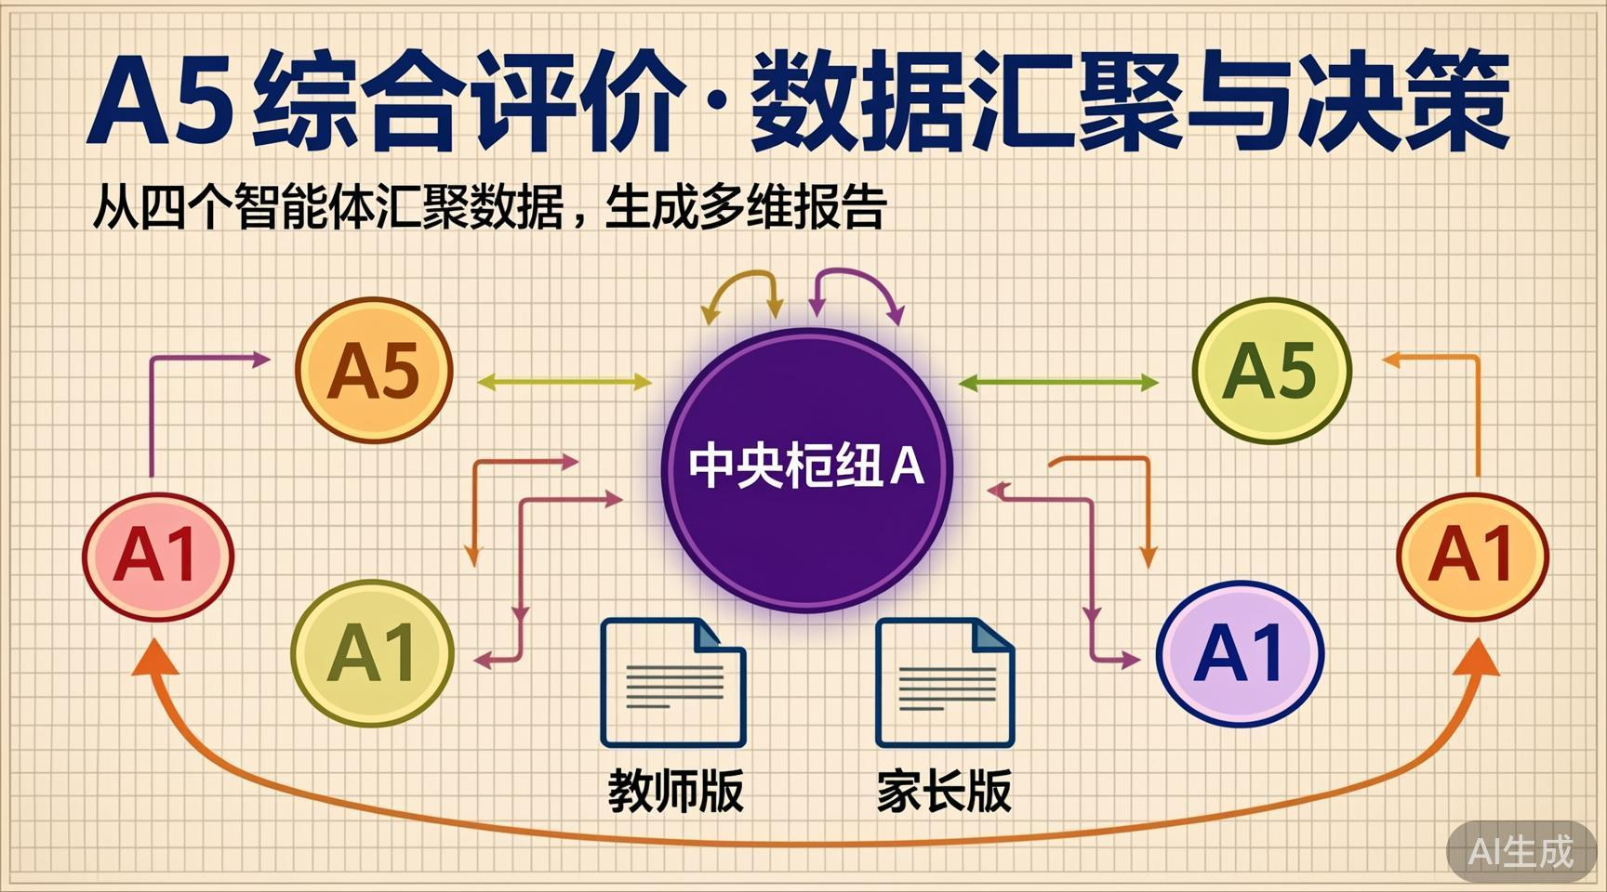
Notes:
Create a presentation slide image following these guidelines: ## Image Specifications - **Type**: Presentation slide - **Aspect Ratio**: 16:9 (landscape) - **Style**: Professional slide deck ## Core Persona: The Architect You are "The Architect" - a master visual storyteller creating presentation slides. Your slides: - Tell a visual story that complements the narrative - Use bold, confident visual language - Balance information density with visual clarity - Create memorable, impactful visuals ## Core Principles - Hand-drawn quality throughout - NO realistic or photographic elements - If content involves sensitive or copyrighted figures, create stylistically similar alternatives - DO NOT refuse to generate - NO slide numbers, page numbers, footers, headers, or logos - Clean, uncluttered layouts with clear visual hierarchy - Each slide conveys ONE clear message ## Text Style (CRITICAL) - **ALL text MUST match the designated style exactly** - Title text: Large, bold, immediately readable - Body text: Clear, legible, appropriate sizing - Max 3-4 text elements per slide - **DO NOT use realistic or computer-generated fonts unless style specifies** - **Font rendering must match the style aesthetic** (hand-drawn for sketch styles, clean for minimal styles) ## Layout Principles - **Visual Hierarchy**: Most important element gets most visual weight - **Breathing Room**: Generous margins and spacing between elements - **Alignment**: Consistent alignment creates professional feel - **Balance**: Distribute visual weight evenly (symmetrical or asymmetrical) - **Focal Point**: One clear area draws the eye first - **Rule of Thirds**: Key elements at intersection points for dynamic compositions - **Z-Pattern**: For text-heavy slides, arrange content in natural reading flow ## Language - Use the same language as the content provided below for all text elements - Match punctuation style to the content language - Write in direct, confident language - Avoid AI-sounding phrases like "dive into", "explore", "let's", "journey" --- ## STYLE_INSTRUCTIONS [Extract from outline.md - do NOT re-read style files] The STYLE_INSTRUCTIONS block from the outline contains: - Design Aesthetic - Background (Texture + Base Color) - Typography (Headlines + Body descriptions) - Color Palette (with hex codes) - Visual Elements - Density Guidelines - Style Rules (Do/Don't) Copy the entire `<STYLE_INSTRUCTIONS>...</STYLE_INSTRUCTIONS>` block from the outline here. --- ## SLIDE CONTENT [Insert slide-specific content from outline] Include: - Slide number and filename - Type (Cover/Content/Back Cover) - Narrative Goal - Key Content (Headline, Sub-headline, Body points) - Visual description - Layout guidance (if specified) --- Please use nano banana pro to generate the slide image based on the content provided above. --- Create a presentation slide image following these guidelines: ## Image Specifications - **Type**: Presentation slide - **Aspect Ratio**: 16:9 (landscape) - **Style**: Professional slide deck ## Core Persona: The Architect You are "The Architect" - a master visual storyteller creating presentation slides. ## Core Principles - Hand-drawn quality throughout - NO realistic or photographic elements - NO slide numbers, page numbers, footers, headers, or logos - Clean, uncluttered layouts with clear visual hierarchy ## Text Style (CRITICAL) - Title text: Large, bold, immediately readable - Body text: Clear, legible, appropriate sizing ## Language: Chinese --- ## STYLE_INSTRUCTIONS Design Aesthetic: Clean, structured visual metaphors using blueprints, diagrams, and schematics. Precise grid-based layouts with engineering precision. Background: Subtle grid overlay on light engineering paper feel. Base Color: Blueprint Off-White (#FAF8F5). Typography: Headlines in bold geometric sans-serif. Body in clean serif. Color Palette: Background: Blueprint Paper (#FAF8F5) Grid: Light Gray (#E5E5E5) Primary Text: Deep Slate (#334155) Primary Accent: Deep Violet (#7C3AED) — A5 main Secondary Accent: Navy Blue (#1E3A5F) Tertiary: Light Blue (#BFDBFE) Amber: #F59E0B — highlight Visual Elements: Precise lines, 90-degree connections. Hub-and-spoke diagram. Grid alignment. Density: Balanced, 5 key points. Style Rules: Do: Consistent line weights, grid alignment, restrained palette. Don't: Hand-drawn, decorative, curved lines, photographic. --- ## SLIDE CONTENT **Type**: Content **Filename**: 06-slide-agent-a5.png NARRATIVE GOAL: Show A5 (Comprehensive Evaluation) as the integration hub — collecting from all agents and producing actionable reports. Headline: A5 综合评价 · 数据汇聚与决策 Sub-headline: 从四个智能体汇聚数据，生成多维报告 Key points: - 汇聚 A1~A4 全部输出数据 - 多维度融合：知识掌握 × 学习态度 × 进步趋势 - 输出双版本：👨‍🏫 教师版（专业深度）+ 👨‍👩‍👧 家长版（通俗易懂） - 核心能力：提前 2 周预警可能掉队的学生 - 反馈闭环：趋势数据 → A1 → 下一周期优化 VISUAL: Hub-and-spoke diagram — A5 at center as a large highlighted node with deep violet accent and subtle glow. A1-A4 as four satellite nodes (cyan, green, orange, light violet) connected by precise data-flow arrows pointing inward. Below the hub, two document-like rectangles representing teacher/parent reports. A curved feedback arrow (amber) looping from the reports back toward an A1 icon on the left. All on grid background with engineering precision. LAYOUT: hub-spoke — Large central A5 node. Four satellite nodes at corners. Arrows pointing inward. Output documents below center. Feedback loop arrow at bottom.

Slide 7
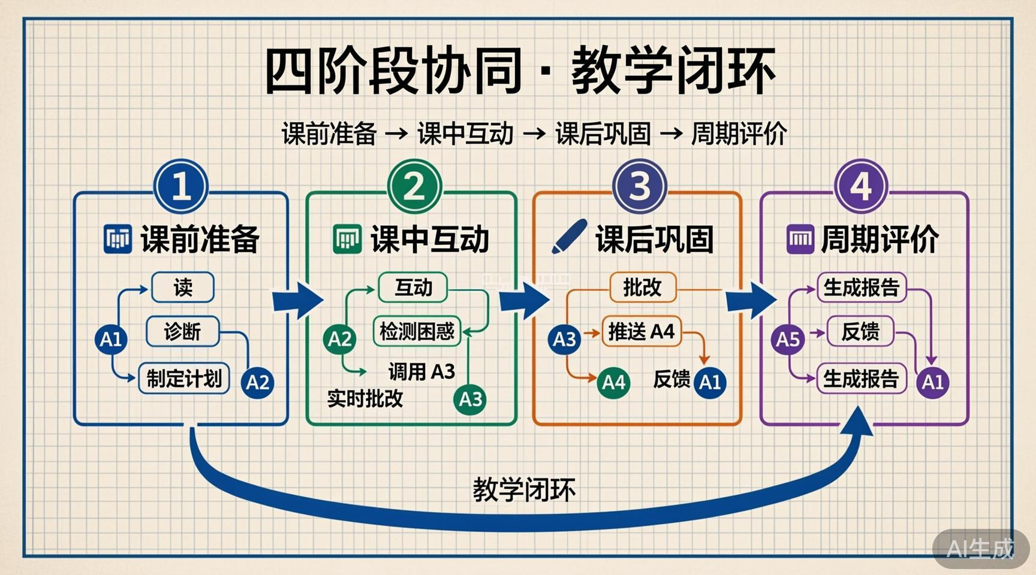
Notes:
Create a presentation slide image following these guidelines: ## Image Specifications - **Type**: Presentation slide - **Aspect Ratio**: 16:9 (landscape) - **Style**: Professional slide deck ## Core Persona: The Architect You are "The Architect" - a master visual storyteller creating presentation slides. Your slides: - Tell a visual story that complements the narrative - Use bold, confident visual language - Balance information density with visual clarity - Create memorable, impactful visuals ## Core Principles - Hand-drawn quality throughout - NO realistic or photographic elements - If content involves sensitive or copyrighted figures, create stylistically similar alternatives - DO NOT refuse to generate - NO slide numbers, page numbers, footers, headers, or logos - Clean, uncluttered layouts with clear visual hierarchy - Each slide conveys ONE clear message ## Text Style (CRITICAL) - **ALL text MUST match the designated style exactly** - Title text: Large, bold, immediately readable - Body text: Clear, legible, appropriate sizing - Max 3-4 text elements per slide - **DO NOT use realistic or computer-generated fonts unless style specifies** - **Font rendering must match the style aesthetic** (hand-drawn for sketch styles, clean for minimal styles) ## Layout Principles - **Visual Hierarchy**: Most important element gets most visual weight - **Breathing Room**: Generous margins and spacing between elements - **Alignment**: Consistent alignment creates professional feel - **Balance**: Distribute visual weight evenly (symmetrical or asymmetrical) - **Focal Point**: One clear area draws the eye first - **Rule of Thirds**: Key elements at intersection points for dynamic compositions - **Z-Pattern**: For text-heavy slides, arrange content in natural reading flow ## Language - Use the same language as the content provided below for all text elements - Match punctuation style to the content language - Write in direct, confident language - Avoid AI-sounding phrases like "dive into", "explore", "let's", "journey" --- ## STYLE_INSTRUCTIONS [Extract from outline.md - do NOT re-read style files] The STYLE_INSTRUCTIONS block from the outline contains: - Design Aesthetic - Background (Texture + Base Color) - Typography (Headlines + Body descriptions) - Color Palette (with hex codes) - Visual Elements - Density Guidelines - Style Rules (Do/Don't) Copy the entire `<STYLE_INSTRUCTIONS>...</STYLE_INSTRUCTIONS>` block from the outline here. --- ## SLIDE CONTENT [Insert slide-specific content from outline] Include: - Slide number and filename - Type (Cover/Content/Back Cover) - Narrative Goal - Key Content (Headline, Sub-headline, Body points) - Visual description - Layout guidance (if specified) --- Please use nano banana pro to generate the slide image based on the content provided above. --- Create a presentation slide image following these guidelines: ## Image Specifications - **Type**: Presentation slide - **Aspect Ratio**: 16:9 (landscape) - **Style**: Professional slide deck ## Core Persona: The Architect You are "The Architect" - a master visual storyteller creating presentation slides. Bold, confident visual language. Memorable, impactful visuals. ## Core Principles - Hand-drawn quality throughout - NO realistic or photographic elements - NO slide numbers, page numbers, footers, headers, or logos - Clean, uncluttered layouts with clear visual hierarchy ## Text Style (CRITICAL) - Title text: Large, bold, immediately readable - Body text: Clear, legible, appropriate sizing ## Language: Chinese --- ## STYLE_INSTRUCTIONS Design Aesthetic: Clean, structured visual metaphors using blueprints, diagrams, and schematics. Precise grid-based layouts with engineering precision. Background: Subtle grid overlay. Base Color: Blueprint Off-White (#FAF8F5). Typography: Headlines bold geometric sans-serif. Body clean serif. Color Palette: Background: Blueprint Paper (#FAF8F5) Grid: Light Gray (#E5E5E5) Primary Text: Deep Slate (#334155) Phase 1 Cyan: #22D3EE Phase 2 Emerald: #34D399 Phase 3 Amber: #F59E0B Phase 4 Violet: #A78BFA Loop Arrow: Navy (#1E3A5F) Visual Elements: Precise lines, 90-degree connections. Pipeline blocks with clear arrows. Engineering precision. Density: 4 phase blocks, balanced. Style Rules: Do: Consistent line weights, grid alignment. Don't: Curved lines, decorative elements. --- ## SLIDE CONTENT **Type**: Content **Filename**: 07-slide-collaboration.png NARRATIVE GOAL: Show the full 4-phase collaboration flow — the complete teaching cycle. Headline: 四阶段协同 · 教学闭环 Sub-headline: 课前准备 → 课中互动 → 课后巩固 → 周期评价 Body (4 phases in horizontal pipeline): Phase 1 📋 课前准备 (Cyan #22D3EE): A1 读 A4 诊断 → 制定计划 → 同步 A2 Phase 2 💬 课中互动 (Emerald #34D399): A2 互动 → 检测困惑 → 调用 A3 实时批改 Phase 3 ✍️ 课后巩固 (Amber #F59E0B): A3 批改 → 推送 A4 → A4 诊断 → 反馈 A1 Phase 4 📊 周期评价 (Violet #A78BFA): A5 汇聚全数据 → 生成报告 → 反馈 A1 VISUAL: Four-phase horizontal pipeline with large numbered phase blocks (1-4) connected by bold directional arrows. Each phase block has a distinct border color matching its phase. Within each block, mini agent labels (A1, A2, etc.) as small geometric badges. A large sweeping curved "loop-back" arrow in navy blue elegantly connects Phase 4 back to Phase 1 with the annotation "教学闭环". Grid background. LAYOUT: pipeline-horizontal — Title and subtitle at top. Four connected phase blocks in a horizontal row across the middle with arrow connectors between them. Large curved return arrow below looping from right to left.

Slide 8
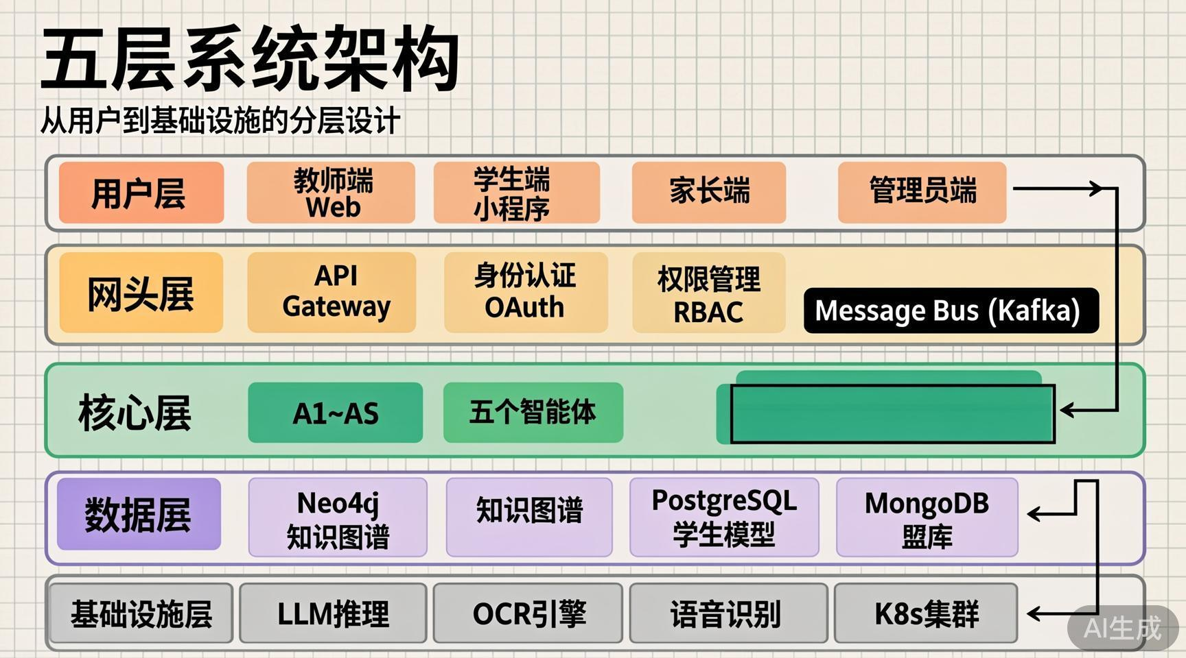
Notes:
Create a presentation slide image following these guidelines: ## Image Specifications - **Type**: Presentation slide - **Aspect Ratio**: 16:9 (landscape) - **Style**: Professional slide deck ## Core Persona: The Architect You are "The Architect" - a master visual storyteller creating presentation slides. Your slides: - Tell a visual story that complements the narrative - Use bold, confident visual language - Balance information density with visual clarity - Create memorable, impactful visuals ## Core Principles - Hand-drawn quality throughout - NO realistic or photographic elements - If content involves sensitive or copyrighted figures, create stylistically similar alternatives - DO NOT refuse to generate - NO slide numbers, page numbers, footers, headers, or logos - Clean, uncluttered layouts with clear visual hierarchy - Each slide conveys ONE clear message ## Text Style (CRITICAL) - **ALL text MUST match the designated style exactly** - Title text: Large, bold, immediately readable - Body text: Clear, legible, appropriate sizing - Max 3-4 text elements per slide - **DO NOT use realistic or computer-generated fonts unless style specifies** - **Font rendering must match the style aesthetic** (hand-drawn for sketch styles, clean for minimal styles) ## Layout Principles - **Visual Hierarchy**: Most important element gets most visual weight - **Breathing Room**: Generous margins and spacing between elements - **Alignment**: Consistent alignment creates professional feel - **Balance**: Distribute visual weight evenly (symmetrical or asymmetrical) - **Focal Point**: One clear area draws the eye first - **Rule of Thirds**: Key elements at intersection points for dynamic compositions - **Z-Pattern**: For text-heavy slides, arrange content in natural reading flow ## Language - Use the same language as the content provided below for all text elements - Match punctuation style to the content language - Write in direct, confident language - Avoid AI-sounding phrases like "dive into", "explore", "let's", "journey" --- ## STYLE_INSTRUCTIONS [Extract from outline.md - do NOT re-read style files] The STYLE_INSTRUCTIONS block from the outline contains: - Design Aesthetic - Background (Texture + Base Color) - Typography (Headlines + Body descriptions) - Color Palette (with hex codes) - Visual Elements - Density Guidelines - Style Rules (Do/Don't) Copy the entire `<STYLE_INSTRUCTIONS>...</STYLE_INSTRUCTIONS>` block from the outline here. --- ## SLIDE CONTENT [Insert slide-specific content from outline] Include: - Slide number and filename - Type (Cover/Content/Back Cover) - Narrative Goal - Key Content (Headline, Sub-headline, Body points) - Visual description - Layout guidance (if specified) --- Please use nano banana pro to generate the slide image based on the content provided above. --- Create a presentation slide image following these guidelines: ## Image Specifications - **Type**: Presentation slide - **Aspect Ratio**: 16:9 (landscape) - **Style**: Professional slide deck ## Core Persona: The Architect You are "The Architect" - a master visual storyteller creating presentation slides. Bold, confident visual language. ## Core Principles - Hand-drawn quality throughout - NO realistic or photographic elements - NO slide numbers, page numbers, footers, headers, or logos - Clean, uncluttered layouts with clear visual hierarchy ## Text Style (CRITICAL) - Title text: Large, bold, immediately readable - Body text: Clear, legible, appropriate sizing ## Language: Chinese --- ## STYLE_INSTRUCTIONS Design Aesthetic: Clean, structured visual metaphors using blueprints, diagrams, and schematics. Precise grid-based layouts with engineering precision. Background: Subtle grid overlay. Base Color: Blueprint Off-White (#FAF8F5). Typography: Headlines bold geometric sans-serif. Body clean serif. Color Palette: Background: Blueprint Paper (#FAF8F5) Grid: Light Gray (#E5E5E5) Primary Text: Deep Slate (#334155) Layer 1 Border: #22D3EE (cyan, user layer) Layer 2 Border: #F59E0B (amber, gateway layer) Layer 3 Border: #34D399 (emerald, engine layer - CORE) Layer 4 Border: #A78BFA (violet, data layer) Layer 5 Border: #94A3B8 (slate, infrastructure) Visual Elements: Precise lines, 90-degree connections. Layered stack. Component rectangles. Engineering precision. Density: 5 layers with sub-components, balanced whitespace. Style Rules: Consistent line weights, grid alignment. No curved lines. --- ## SLIDE CONTENT **Type**: Content **Filename**: 08-slide-architecture.png NARRATIVE GOAL: Present the technical architecture — 5-layer design showing how the system is built. Headline: 五层系统架构 Sub-headline: 从用户到基础设施的分层设计 5 Layers (top to bottom): Layer 1 用户层 (Cyan border): 教师端 Web + 学生端小程序 + 家长端 + 管理员端 Layer 2 网关层 (Amber border): API Gateway + 身份认证 OAuth + 权限管理 RBAC Layer 3 引擎层 ⚡核心 (Emerald border, thicker): A1~A5 五个智能体 + Message Bus (Kafka) Layer 4 数据层 (Violet border): Neo4j 知识图谱 + PostgreSQL 学生模型 + MongoDB 题库 Layer 5 基础设施 (Slate border): LLM推理 + OCR引擎 + 语音识别 + K8s集群 VISUAL: Top-to-bottom layered architecture. Five horizontal layers stacked vertically, each with a distinct border color and label. Layer 3 (Agent Engine) has a thicker border and subtle highlight to mark it as the core. Within each layer, small labeled rectangles represent components. Vertical dotted connection lines traverse the layers showing cross-layer communication. The word "Kafka" appears as a horizontal message bus bar within Layer 3. Clean, minimal, blueprint aesthetic. LAYOUT: layered-stack — Title top. Five horizontal layer rows below. Each row: colored left border bar + layer name label + component rectangles. Layer 3 highlighted. Vertical dotted lines connecting components across layers.

Slide 9
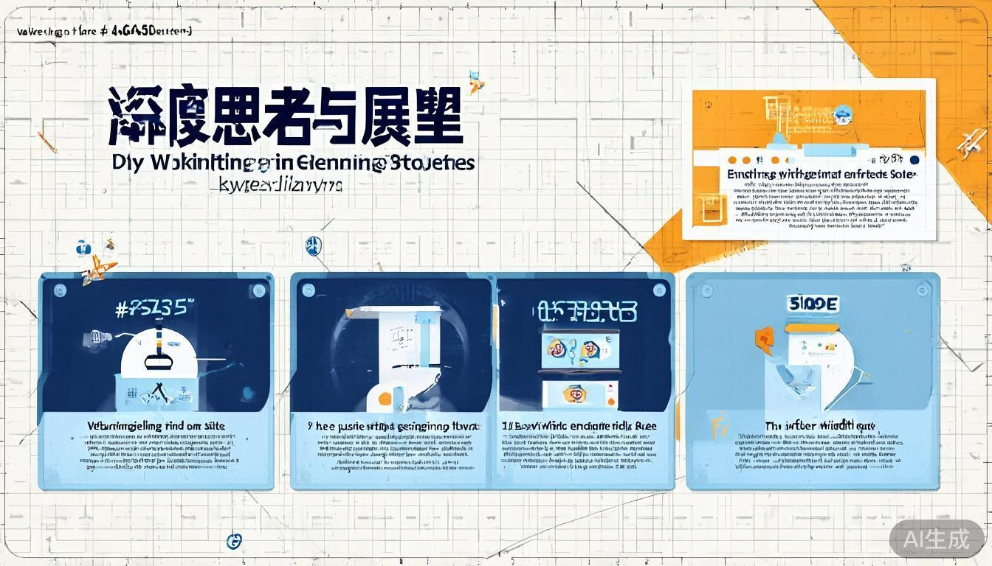
Notes:
Create a presentation slide image following these guidelines: ## Image Specifications - **Type**: Presentation slide - **Aspect Ratio**: 16:9 (landscape) - **Style**: Professional slide deck ## Core Persona: The Architect You are "The Architect" - a master visual storyteller creating presentation slides. Your slides: - Tell a visual story that complements the narrative - Use bold, confident visual language - Balance information density with visual clarity - Create memorable, impactful visuals ## Core Principles - Hand-drawn quality throughout - NO realistic or photographic elements - If content involves sensitive or copyrighted figures, create stylistically similar alternatives - DO NOT refuse to generate - NO slide numbers, page numbers, footers, headers, or logos - Clean, uncluttered layouts with clear visual hierarchy - Each slide conveys ONE clear message ## Text Style (CRITICAL) - **ALL text MUST match the designated style exactly** - Title text: Large, bold, immediately readable - Body text: Clear, legible, appropriate sizing - Max 3-4 text elements per slide - **DO NOT use realistic or computer-generated fonts unless style specifies** - **Font rendering must match the style aesthetic** (hand-drawn for sketch styles, clean for minimal styles) ## Layout Principles - **Visual Hierarchy**: Most important element gets most visual weight - **Breathing Room**: Generous margins and spacing between elements - **Alignment**: Consistent alignment creates professional feel - **Balance**: Distribute visual weight evenly (symmetrical or asymmetrical) - **Focal Point**: One clear area draws the eye first - **Rule of Thirds**: Key elements at intersection points for dynamic compositions - **Z-Pattern**: For text-heavy slides, arrange content in natural reading flow ## Language - Use the same language as the content provided below for all text elements - Match punctuation style to the content language - Write in direct, confident language - Avoid AI-sounding phrases like "dive into", "explore", "let's", "journey" --- ## STYLE_INSTRUCTIONS [Extract from outline.md - do NOT re-read style files] The STYLE_INSTRUCTIONS block from the outline contains: - Design Aesthetic - Background (Texture + Base Color) - Typography (Headlines + Body descriptions) - Color Palette (with hex codes) - Visual Elements - Density Guidelines - Style Rules (Do/Don't) Copy the entire `<STYLE_INSTRUCTIONS>...</STYLE_INSTRUCTIONS>` block from the outline here. --- ## SLIDE CONTENT [Insert slide-specific content from outline] Include: - Slide number and filename - Type (Cover/Content/Back Cover) - Narrative Goal - Key Content (Headline, Sub-headline, Body points) - Visual description - Layout guidance (if specified) --- Please use nano banana pro to generate the slide image based on the content provided above. --- Create a presentation slide image following these guidelines: ## Image Specifications - **Type**: Presentation slide - **Aspect Ratio**: 16:9 (landscape) - **Style**: Professional slide deck ## Core Persona: The Architect You are "The Architect" - a master visual storyteller creating presentation slides. Bold, confident visual language. Memorable, impactful visuals. ## Core Principles - Hand-drawn quality throughout - NO realistic or photographic elements - NO slide numbers, page numbers, footers, headers, or logos - Clean, uncluttered layouts with clear visual hierarchy ## Text Style (CRITICAL) - Title text: Large, bold, immediately readable - Body text: Clear, legible, appropriate sizing ## Language: Chinese --- ## STYLE_INSTRUCTIONS Design Aesthetic: Clean, structured visual metaphors using blueprints, diagrams, and schematics. Precise grid-based layouts with engineering precision. Background: Subtle grid overlay. Base Color: Blueprint Off-White (#FAF8F5). Typography: Headlines bold geometric sans-serif. Body clean serif. Color Palette: Background: Blueprint Paper (#FAF8F5) Grid: Light Gray (#E5E5E5) Primary Text: Deep Slate (#334155) Primary Accent: Engineering Blue (#2563EB) Navy: #1E3A5F Amber Highlight: #F59E0B Card fills: Light Blue (#BFDBFE) at low opacity Visual Elements: Precise lines, grid alignment. 2×2 card grid. Clean geometric icons. Density: 4 cards in 2×2 grid. Balanced. Style Rules: Do: Grid alignment, consistent spacing, restrained palette. Don't: Decorative elements, curved lines. --- ## SLIDE CONTENT **Type**: Content **Filename**: 09-slide-reflection.png NARRATIVE GOAL: Share key insights — what makes this system special and why multi-agent matters. Headline: 深度思考与展望 Sub-headline: 为什么未来属于多智能体协同 4 insight cards in 2×2 grid: Card 1 (top-left): Icon: 💡 Title: 什么是智能体？ Text: 感知环境、自主决策、执行行动的 AI 实体，能调用工具并与其他 Agent 协作 Card 2 (top-right, with amber highlight/accent border): Icon: 🌟 Title: 最喜欢的特性 Text: "遗忘曲线预测 + 主动干预" — 在遗忘发生之前就介入，而非事后补救 Card 3 (bottom-left): Icon: 🔗 Title: 为什么需要协同？ Text: 单一 AI 有边界；多 Agent 各司其职、相互校验、即插即用、独立升级 Card 4 (bottom-right): Icon: 🚀 Title: 未来展望 Text: 因材施教从理念变为现实，优质教育资源普惠每一个学生 VISUAL: 2×2 grid of clean rectangular cards with rounded corners. Each card has a large icon at top, bold title in Navy (#1E3A5F), and 1-2 lines of descriptive text in Deep Slate (#334155). The top-right card (favorite feature) has an amber (#F59E0B) left-border accent and subtle warm glow to make it stand out. Cards have light blue (#BFDBFE) subtle fill. Precise equal spacing with grid alignment. LAYOUT: grid-cards — Title and subtitle at top. 2×2 card grid below. Each card: icon + bold title + description. Top-right card highlighted. Clean engineering aesthetic.

Slide 10

Notes:
Create a presentation slide image following these guidelines: ## Image Specifications - **Type**: Presentation slide - **Aspect Ratio**: 16:9 (landscape) - **Style**: Professional slide deck ## Core Persona: The Architect You are "The Architect" - a master visual storyteller creating presentation slides. Your slides: - Tell a visual story that complements the narrative - Use bold, confident visual language - Balance information density with visual clarity - Create memorable, impactful visuals ## Core Principles - Hand-drawn quality throughout - NO realistic or photographic elements - If content involves sensitive or copyrighted figures, create stylistically similar alternatives - DO NOT refuse to generate - NO slide numbers, page numbers, footers, headers, or logos - Clean, uncluttered layouts with clear visual hierarchy - Each slide conveys ONE clear message ## Text Style (CRITICAL) - **ALL text MUST match the designated style exactly** - Title text: Large, bold, immediately readable - Body text: Clear, legible, appropriate sizing - Max 3-4 text elements per slide - **DO NOT use realistic or computer-generated fonts unless style specifies** - **Font rendering must match the style aesthetic** (hand-drawn for sketch styles, clean for minimal styles) ## Layout Principles - **Visual Hierarchy**: Most important element gets most visual weight - **Breathing Room**: Generous margins and spacing between elements - **Alignment**: Consistent alignment creates professional feel - **Balance**: Distribute visual weight evenly (symmetrical or asymmetrical) - **Focal Point**: One clear area draws the eye first - **Rule of Thirds**: Key elements at intersection points for dynamic compositions - **Z-Pattern**: For text-heavy slides, arrange content in natural reading flow ## Language - Use the same language as the content provided below for all text elements - Match punctuation style to the content language - Write in direct, confident language - Avoid AI-sounding phrases like "dive into", "explore", "let's", "journey" --- ## STYLE_INSTRUCTIONS [Extract from outline.md - do NOT re-read style files] The STYLE_INSTRUCTIONS block from the outline contains: - Design Aesthetic - Background (Texture + Base Color) - Typography (Headlines + Body descriptions) - Color Palette (with hex codes) - Visual Elements - Density Guidelines - Style Rules (Do/Don't) Copy the entire `<STYLE_INSTRUCTIONS>...</STYLE_INSTRUCTIONS>` block from the outline here. --- ## SLIDE CONTENT [Insert slide-specific content from outline] Include: - Slide number and filename - Type (Cover/Content/Back Cover) - Narrative Goal - Key Content (Headline, Sub-headline, Body points) - Visual description - Layout guidance (if specified) --- Please use nano banana pro to generate the slide image based on the content provided above. --- Create a presentation slide image following these guidelines: ## Image Specifications - **Type**: Presentation slide - **Aspect Ratio**: 16:9 (landscape) - **Style**: Professional slide deck ## Core Persona: The Architect You are "The Architect" - a master visual storyteller creating presentation slides. Memorable, impactful closing visuals. ## Core Principles - Hand-drawn quality throughout - NO realistic or photographic elements - NO slide numbers, page numbers, footers, headers, or logos - Clean, uncluttered layouts with clear visual hierarchy ## Text Style (CRITICAL) - Title text: Large, bold, immediately readable - Body text: Clear, legible - Minimal text — maximum impact ## Language: Chinese --- ## STYLE_INSTRUCTIONS Design Aesthetic: Clean, structured visual metaphors using blueprints. Precise grid-based layouts with engineering precision. Background: Subtle grid overlay. Base Color: Blueprint Off-White (#FAF8F5). Typography: Headlines bold geometric sans-serif. Body clean serif. Color Palette: Background: Blueprint Paper (#FAF8F5) Grid: Light Gray (#E5E5E5) at reduced opacity Primary Text: Navy Blue (#1E3A5F) — quote Accent Line: Engineering Blue (#2563EB) Agent icons: Subtle multi-color (cyan, emerald, orange, violet) at low opacity Visual Elements: Precise lines. Five small geometric agent icons. Thin accent line. Generous negative space. Density: Minimal — one quote, one CTA line. 70% whitespace. Style Rules: Do: Large margins, centered composition, strong negative space. Don't: Clutter, multiple elements, decorative flourishes. --- ## SLIDE CONTENT **Type**: Back Cover **Filename**: 10-slide-back-cover.png NARRATIVE GOAL: Memorable closing that reinforces the core message and invites questions. Headline (large centered quote): 「走出去，才能看到更大的世界」 Sub-headline: 多智能体协同，让因材施教从理念变为现实 CTA: 谢谢！欢迎交流与提问 🙋 VISUAL: Clean, minimal closing composition. Central quote in large Navy (#1E3A5F) text, with a thin Engineering Blue (#2563EB) horizontal accent line directly underneath. Five small abstract geometric agent icons (simplified squares/circles in cyan, green, orange, light violet, deep violet) arranged in a gentle arc above the quote, subtly connected by thin lines. Grid background at reduced opacity with generous white space. The overall feel is elegant, confident, and memorable — like the final blueprint sheet of a well-designed system. LAYOUT: centered-statement — Everything centered vertically and horizontally. Agent icons in an arc above. Quote in large text at center. Thin accent line below quote. Sub-headline below line. CTA at bottom. Maximum negative space for impact.

