Slide 1
C++ Programming
Polymorphism
Kosmas O Kosmopoulos MSc, MBA, FHEA
Honorary Lecturer, UCL – Senior Lecturer, University of Westminster– Assistant Professor HULT international Business School

Slide 2
Outline
Polymorphism Concepts
Virtual Functions
Operator Overloading

Slide 3
Why Polymorphism
Design and implement systems that are easily extensible.
  New classes can be added with little or no modification to the general portions of the program, as long as the new classes are part of the inheritance hierarchy that the program processes generally.
  The only parts of a program that must be altered to accommodate new classes are those that require direct knowledge of the new classes that you add to the hierarchy

Slide 4
Polymorphism
Polymorphism enables you to deal in generalities and let the execution-time environment concern itself with the specifics.
You can direct a variety of objects to behave in manners appropriate to those objects without even knowing their types—as long as those objects belong to the same inheritance hierarchy and are being accessed off a common base-class pointer or a common base-class reference.

Slide 5
Polymorphism
Polymorphism promotes extensibility: Software written to invoke polymorphic behavior is written independently of the specific types of the objects to which messages are sent.
New types of objects that can respond to existing messages can be incorporated into such a system without modifying the base system.
Only client code that instantiates new objects must be modified to accommodate new types.

Slide 6
Virtual Functions
Run time polymorphism is implemented in C++ with virtual functions.
C++ virtual function is a member function of a class, whose functionality can be over-ridden in its derived classes.
C++ virtual function is,
  A member function of a class
  Declared with virtual keyword
  Usually has a different functionality in the derived class.
  A function call is resolved at run-time
To declare a virtual function virtual keyword is put at the start of normal function declaration.

Slide 7
Virtual Functions – Polymorphic class
A virtual function is a member function that is declared within the base class and redefined by a derived class. When a class containing a virtual function is inherited ,the derived class redefines the virtual function to fit its needs.
A virtual function is a member function you may redefine for other derived classes, and can ensure that the compiler will call the redefined virtual function for an object of the corresponding derived class, even if you call that function with a pointer or reference to a base class of the object.
You declare a function with the keyword virtual if you want the compiler to use dynamic binding for that specific function.
A class that declares or inherits a virtual function is called a polymorphic class

Slide 8
Destructors and Virtual Destructors
The constructor has the special job of putting an object together piece-by-piece, first by calling the base constructor, then the more derived constructors in order of inheritance (it must also call member-object constructors along the way).
Similarly, the destructor has a special job: it must disassemble an object that may belong to a hierarchy of classes. To do this, the compiler generates code that calls all the destructors, but in the reverse order that they are called by the constructor.
The destructor starts at the most-derived class and works its way to the base class destructor . The proper hierarchy of constructor and destructor calls is automatically generated by the compiler
When an object is created with instantiating the derived class like [baseclass* bclass =new derivedclass() ] when you delete the base class pointer it calls the derived class destructor also so it leaves no chance for memory leak. If we do not declare the base class destructor as virtual ,only the base class destructor would be called when we say (delete bclass)

Slide 9
Virtual Base class - Example
Consider a situation where 3 kinds of inheritance are involved: multilevel, hierarchical and multilevel
student
internalexams
externalmarks
marks

Slide 10
Virtual Base class
In this case the marks class has 2 direct base classes namely internalexams and externalexams ,which themselves have a common base class :student. The class marks inherits the traits of student class via two separate paths: first from internalmarks and second from externalmarks . Student is called the indirect base class. This means that marks class will have duplicate sets of the members inherited from “student “ class . This introduces ambiguity and must be avoided . The duplication of inherited members due to these multiple paths can be avoided by making the common base class as virtual class .i.e:
class student
{
};
class internalmarks: public virtual student
{
};
class externalmarks: virtual public student
{
};
Class marks: public internalmarks, public exernalmarks
{//only one copy of student will be inherited
};

Slide 11
Virtual Destructor
The problem occurs when you want to delete a pointer of this type for an object that has been created on the heap with new. If the pointer is to the base class, the compiler can only know to call the base-class version of the destructor during delete.
Forgetting to make a destructor virtual in a base class is a bug because it often doesn’t directly affect the behavior of your program, but it can quietly introduce a memory leak.
Without a virtual destructor the proper destructor may not be called

Slide 12
Why are there no virtual constructors?
Declaring something virtual in C++ means that it can be overridden by a sub-class of the current class, however the constructor is called when the object is created, at that time you can not be creating a sub-class of the class you must be creating the class so there would never be any need to declare a constructor virtual
Basically the virtual table will be constructed inside the constructor at the compilation time, this is table will contain the information about the all virtual functions present in side the class.
A virtual table is nothing but an array of pointers to the virtual functions. The entries in the virtual table are changed at run time to point to the correct function. A constructor can not be virtual because at the time when constructor is invoked the virtual table would not be available in the memory. Hence we can not have virtual constructor, (this is first time when we are invoking the constructor), Vtable is unique for the class

Slide 13
Why are there no virtual constructors?
The reason is that a virtual function is a function whose behavior depends on the type of the object that it's called for. A virtual call is a mechanism to get work done given partial information. In particular, "virtual" allows us to call a function knowing only an interfaces and not the exact type of the object. To create an object you need complete information. In particular, you need to know the exact type of what you want to create. Consequently, a "call to a constructor" cannot be virtual.
A virtual function is a function whose behavior depends on the type of the object that it's called for. Because constructors don't act on objects, but instead create them, a virtual constructor is not needed. A virtual call is a mechanism to get work done given partial information. In particular, "virtual" allows us to call a function knowing only an interfaces and not the exact type of the object. To create an object you need complete information. In particular, you need to know the exact type of what you want to create.

Slide 14
What is Run Time Type Identification (RTTI)
In polymorphic languages like C++ , there can be situations in which the type of the object is unknown at compile time,because the precise nature of that object is not known till the program is executed.
Since the base class pointer may be used to point to the objects of base class or the objects of derived classes, it is not always possible to know in advance what type of object will be pointed to by the base class pointer at a given moment in time.
This determination can be done at run time using RTTI

Slide 15
Operator Overloading
Every technical field has developed ashorthand notation to make convenient the presentation and discussion involving frequently used concepts. For example, because of long acquaintance, x+y*z
is clearer to us than multiply y by z and add the result to x
C++ supports a set of operators for its built-in types.
Most concepts for which operators are conventionally used are not built-in types in C++, so they must be represented as user-defined types.
  For example, if you need complex arithmetic, matrix algebra, logic signals, or character strings in C++, you use classes to represent these notions.

Slide 16
Operator Overloading
How to enable C++’s operators to work with class objects—a process called operator overloading
One example of an overloaded operator built into C++ is <<, which is used both as the stream insertion operator and as the bitwise left-shift operator
Similarly, >> also is overloaded; it’s used both as
  the stream extraction operator—defined via operator overloading in the C++ Standard Library—and
  the bitwise right-shift operator—defined as part of the C++ language.
Notes:
Extension of operations from built-ins to our own classes
Should only be used when meaning of operations is clear
For example use in mixed-mode (with literals and built-ins) is good example
String class has overloads defined
Coding can be more natural
Overloading tends to be for the benefit of client user rather than class designer

Slide 17
Operators and operands
An operator is applied to operands: ( 4 + 4)
There are different types of operators according to the number of arguments (operands), precedence (will be evaluated first, so * and / are evaluated before + and - )
Unary operators : 1 operand, includes (increment, decrement, address, indirection, positive, negative, negation, sizeof)
Binary operators : 2 operands, formed using infix notion, keyword operator is removed, include assignment, the arithmetic operations, and the relation operations
in C/C++ there is a single ternary operator - the 3 operand operator: ( ? : )

Slide 18
Mathematical properties of expressions
Commutative binary operations: addition / multiplication. Y+Z == Z+Y. Meaning the order of the terms can change without affecting the result
Associative binary operations. Meaning the order of the operations computed will not affect the result so (5+2)+1 = 5+(2+1)=8. As with commutative operations addition and multiplication of numbers are associative
Subtraction, division and exponentiation are not associative or commutative
The associative and commutative properties are relevant as our own classes interact with existing (built-in) objects using commutative or associative operations

Slide 19
Operator Overloading Is Not Automatic
Operator overloading is not automatic—you must write operator-overloading functions to perform the desired operations.
An operator is overloaded by writing a non-static member function definition or non-member function definition as you normally would, except that the function name starts with the keyword operator followed by the symbol for the operator being overloaded.
  For example, the function name operator+ would be used to overload the addition operator (+) for use with objects of a particular class (or enum).
When operators are overloaded as member functions, they must be non-static, because they must be called on an object of the class and operate on that object.

Slide 20
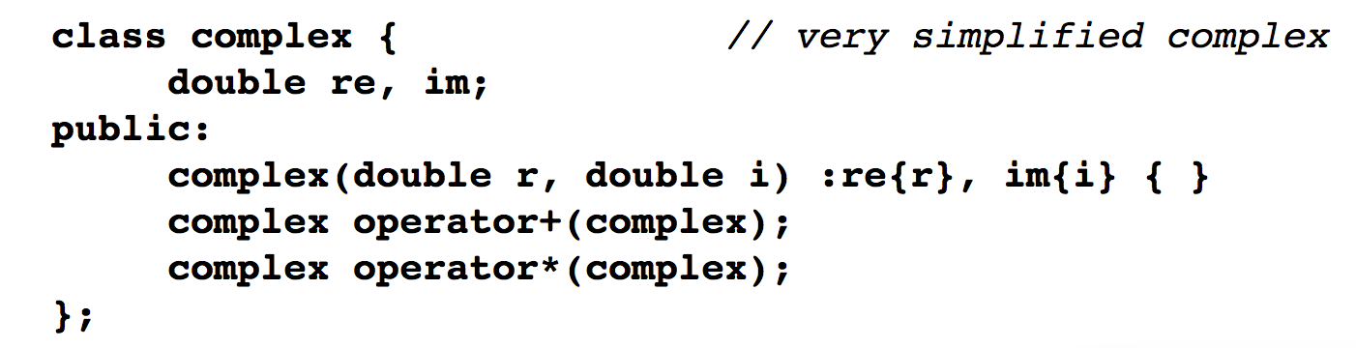
Example
simple implementation of the concept of complex numbers.
A complex is represented by a pair of double-precision floating-point numbers manipulated by the operators + and *.
complex::operator+() and complex::operator*() are defined to provide meanings for + and *, respectively.
For example, if b and c are of type complex, b+c means b.operator+(c).

Slide 21
Example
We can now approximate the conventional interpretation of complex expressions:
void f()
{
complex a = complex{1,3.1};
complex b {1.2, 2};
complex c {b};
a = b+c;
b = b+c*a;
c = a*b+complex(1,2);
}

Slide 22
Operators with our own classes
operator keyword followed by operator to define:
  operator+ to define/overload plus operator. Creating a fresh object summing two existing operands.
  operator+= to overload compound assignment. To modify the left sided operand by adding the right operand.
  operator« to overload the ostream insertion operation, to insert right operand onto channel (left operand)
  operator » to overload istream extraction operator, to extract into right operand from channel (left operand)
in code keyword operator can be dropped, just use operator itself...so
arithmeticThing.operator+= 10 equivalent to
arithmeticThing += 10

Slide 23
Rules
Related operators, like + and +=, must be overloaded separately.
When overloading (), [], -> or any of the assignment operators, the operator overloading function must be declared as a class member.
  For all other overloadable operators, the operator overloading functions can be member functions or non-member functions.

Slide 24
Binary (two operands)
A binary operator can be overloaded as a non-static member function with one parameter or as a non-member function with two parameters (one of those parameters must be either a class object or a reference to a class object).
The existing function definitions, overloads, conversions and promotions are used to determine specifically which operation is called.
  a binary operator can be either a non-static member function, taking a single argument or a non-member function taking two arguments
  for binary operator @, aa@bb can be interpreted as aa.operator@(bb) i.e. as member for object aa or operator@(aa,bb) i.e. as a global scoped to class aa (or bb)
  As mentioned if both are defined promotions, conversions and overloaded resolution determines which function is called
  As a non-member function, binary operator < must take two arguments—one of which must be an object (or a reference to an object) of the class.

Slide 25
Binary operator +
class X {
public :
void operator +(int); //member
X(int); //cons
} ;
//globals
void operator +(X,X);
void operator +(X, double);
void f(X a) {// enumerate member/global calls
a + 1 ; // a.operator +(1)
1 + a ; //:: operator +(X(1) , a)
a + 1 . 0 ; //::operator +(a , 1.0)
}
Stroustrup: C++ Prog. Lang. 4rd Ed. p530

Slide 26
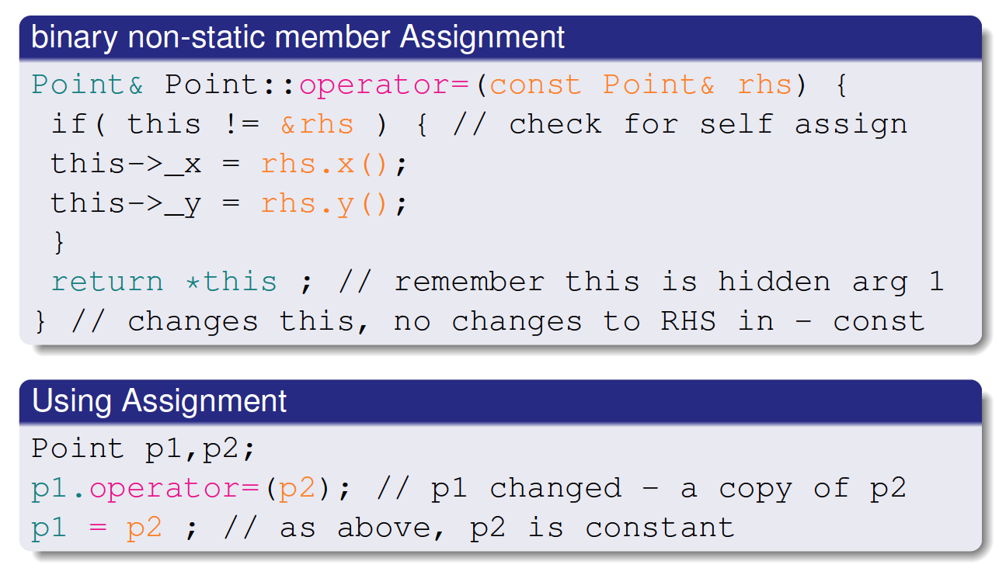
Anatomy of binary operator

Slide 27
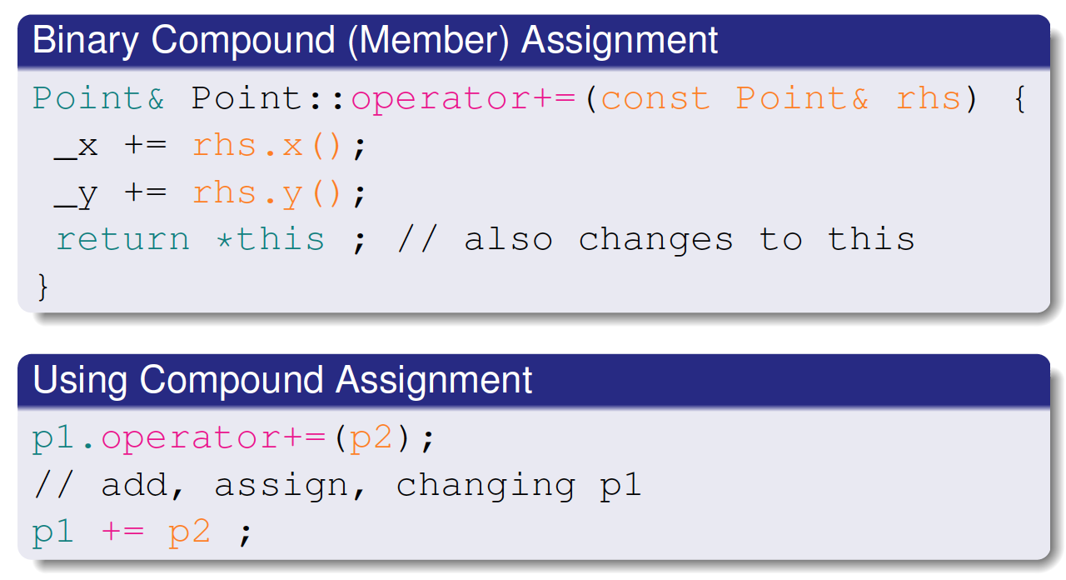
Compound assignment

Slide 28
Operator types
a unary operator either prefix or postfix can be defined as a non-static member function with no arguments or a non-member function with a single argument
for prefix unary operator @, @aa can be interpreted as aa.operator@() or operator@(aa)
for postfix unary operator @, aa@ can be interpreted as aa.operator@(int) or operator@(aa,int)
here int is used to indicate that the function is used for postfix application of ++ or -
if both are defined special rules determines which function is called - See section 13.3 Overload resolution N3337.pdf (pp 276-278)

Slide 29
Overloading Unary Operators
A unary operator for a class can be overloaded as a non-static member function with no arguments or as a non-member function with one argument that must be an object (or a reference to an object) of the class.
A unary operator such as ! may be overloaded as a non-member function with one parameter.

Slide 30
Overloading the Increment and Decrement Operators
The prefix and postfix versions of the increment and decrement operators can all be overloaded.
To overload the increment operator to allow both prefix and postfix increment usage, each overloaded operator function must have a distinct signature, so that the compiler will be able to determine which version of ++ is intended.
The prefix versions are overloaded exactly as any other prefix unary operator would be.

Slide 31
Unary Operators
class X {
public : // members with implicit this
X operator &( ); // prefix unary address-of
X operator &(X) ; // binary and
X operator ++(int); // posfix increment
X operator + + ( ) ; // prefix increment
} ;
// globals
X operator -(X) ; // prefix unary minus
X operator - (X,X ) ; // binary minus
X operator --(X&, int ); // postfix decrement
Stroustrup: C++ Prog. Lang. 4rd Ed. p.530/1

Slide 32
Overloading the Binary Stream Insertion and Stream Extraction Operators
You can input and output fundamental-type data using the stream extraction operator >> and the stream insertion operator <<.
The C++ class libraries overload these binary operators for each fundamental type, including pointers and char * strings.
You can also overload these operators to perform input and output for your own types.

Slide 33
Input and output of user defined classes
Programmers may chose to overload stream input and output operations
  cin » myint will extract into myint, from the cinput channel
  cout « myint will insert onto the output channel the content of myint
  cin » mypoint will extract a point from cin
  cout « mypoint will insert a point to onto cout
Form of extraction is like:
  cin.operator»(mypoint) ; // not correct C++
Form of insertion is like:
  cout.operator«(mypoint) ; // not correct C++
implies adding to cin/cout new operators...

Slide 34
Members and user defined types
Some operators have to be members, for example operator=() and operator->() as the left hand operand must be a class object type
Minimizing the number of functions, directly manipulating the object - Stroustrup recommends only defining operators that inherently modify the value of their first argument, as members.
So compound assignments +=, -=, *= etc. should also be members as the expected behaviour is that the left hand operand is modified
For user-defined member operator, the left hand operand must be an object of the class for which the member is defined. (The this pointer is passed as a hidden argument to all non-static member functions, and is available as a local variable within each function)
As an alternatively, for operators used ’symmetrically’ i.e. juxtaposed with built-ins, there can be conversions of either operand, the operator should be a global (non-member) function

