Slide 1
CU1 state cleanup of J=1 on the SPB setup
Yuanhang Yang — CeNTREX group meeting

Slide 2
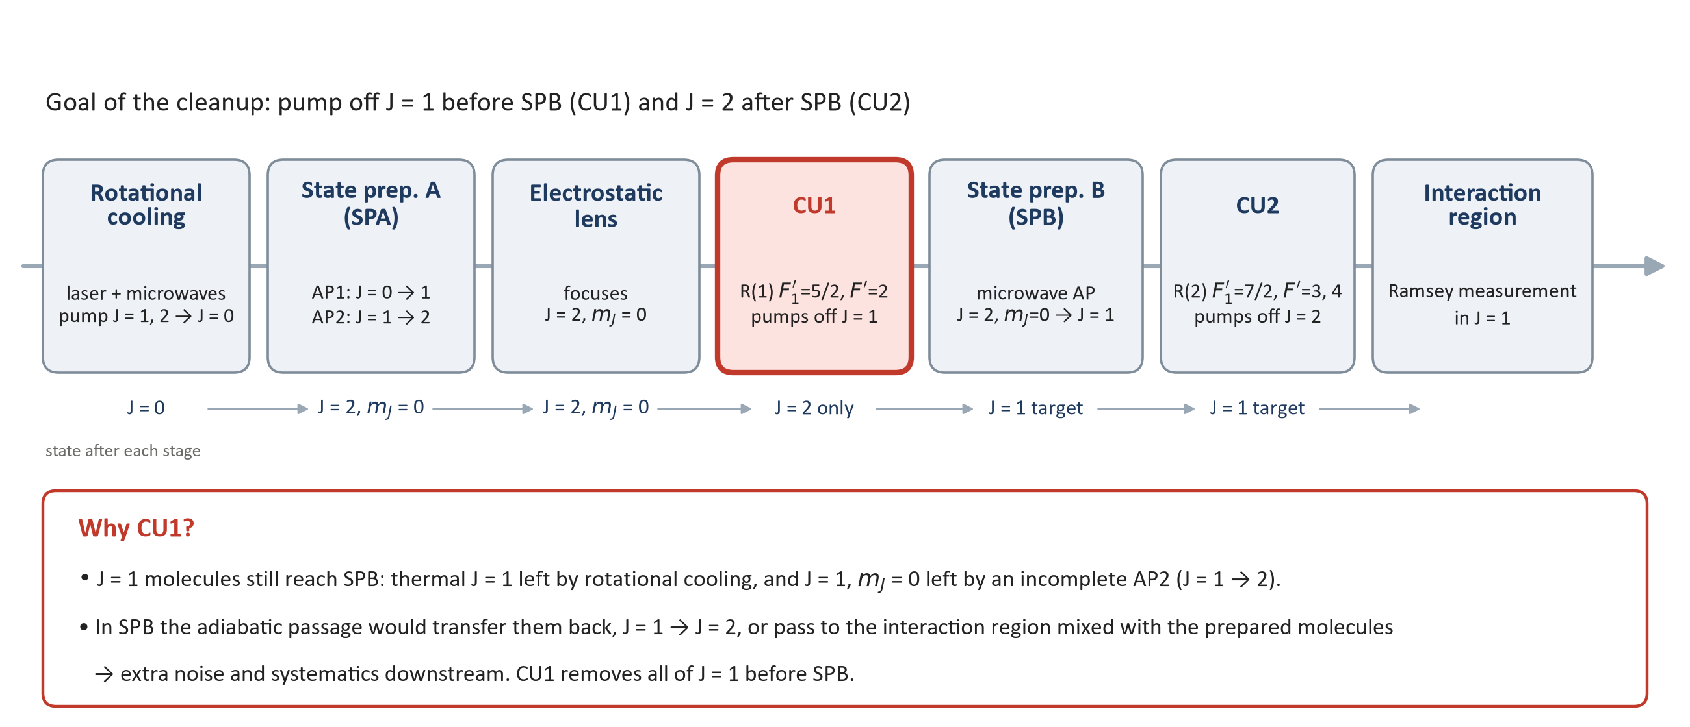
CU1 in the CeNTREX beamline

Slide 3
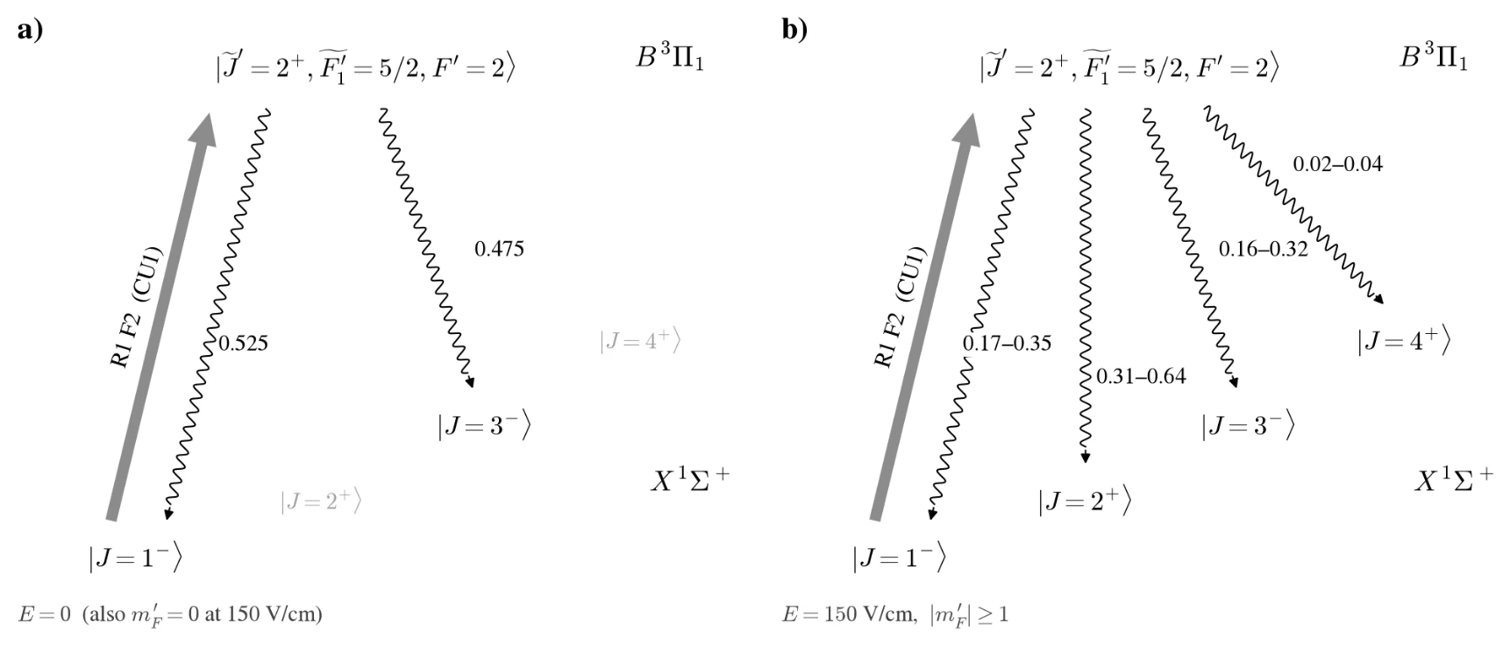
CU1 excited-state decay branching
Decay branching of the CU1 excited level to the X-state J levels (v = 0), from centrex-tlf B-state eigenstates (J' = 1–4). In b) the Ω-doublet is Stark-mixed; ranges cover the two mixed eigenstates of each |mF'|. Vibrational branching not included.

Slide 4
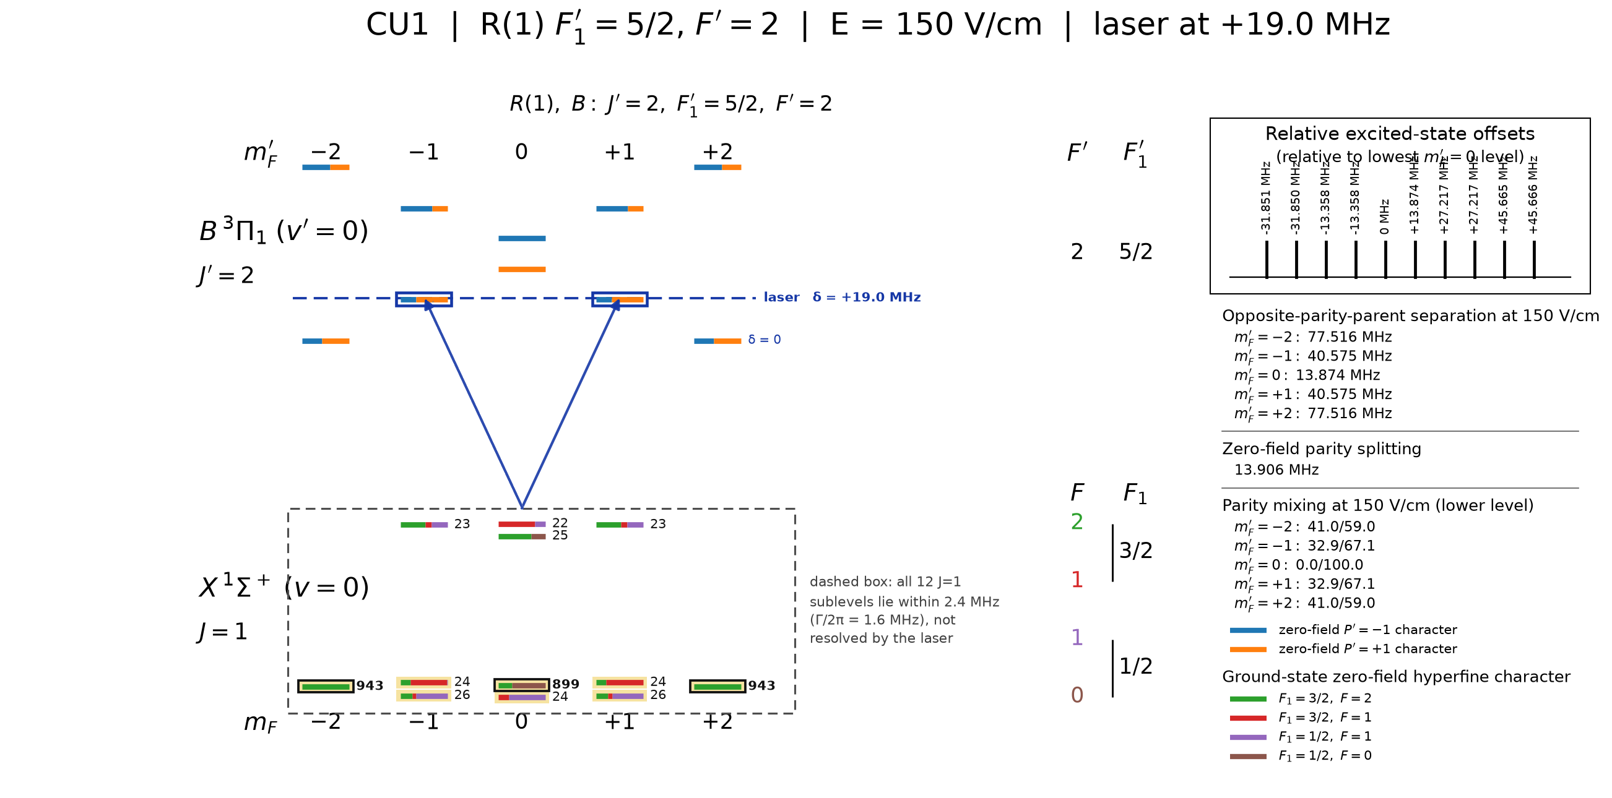
CU1 idea: 1 laser + 1 polarization switching EOM
Number next to each J=1 sublevel: population left in J=1 after CU1 for a molecule starting there, in units of 1e-4 (80 mW, +19.0 MHz, 4.8 cm beam, on axis). Bold outline: more than twice the average.

Slide 5
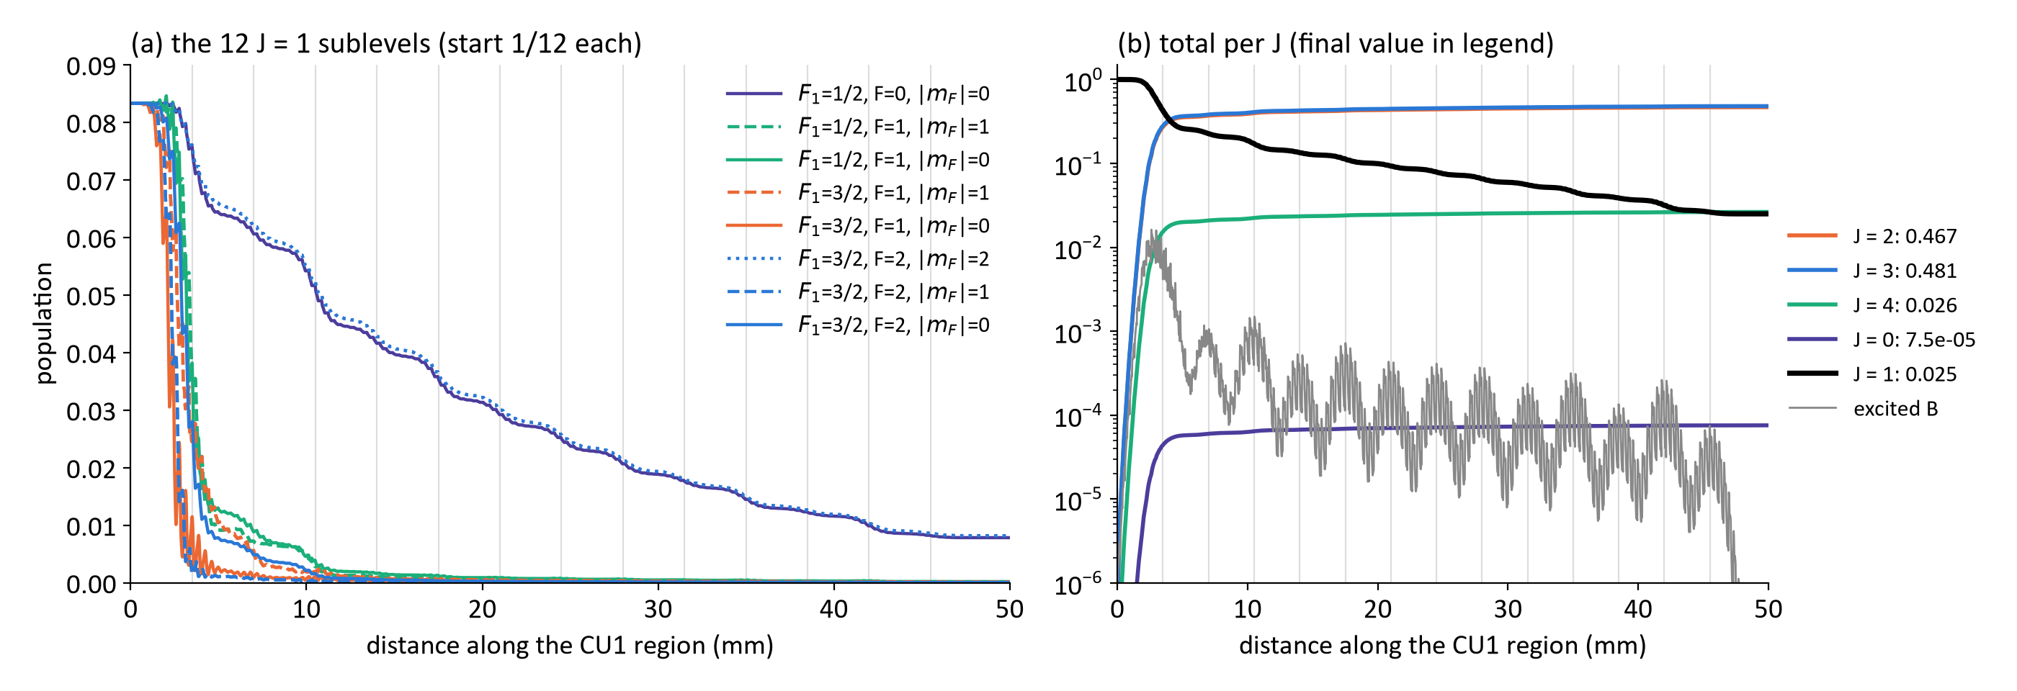
Cleanup example
Simulation, one molecule on the beam axis (vx = 0, y0 = 0), uniform start in J = 1: +19.0 MHz, 80 mW, 4.8 cm beam, 13 passes (grey lines, 10 % loss each), X/Z switching at 0.5 MHz, E = 150 V/cm, vz = 184 m/s
• The first 3 passes empty 9 of the 12 sublevels. The 3 left (F₁=1/2 F=0 and F₁=3/2 F=2 |mF|=2) are 1.7–1.9 MHz off resonance at +19 MHz, so each pass removes only part → 2.5 % left in J = 1 after 13 passes.
• Pumped molecules end in J = 3 (48 %) and J = 2 (47 %), 2.6 % in J = 4; ≈ 1.5 photons per molecule.

Slide 6
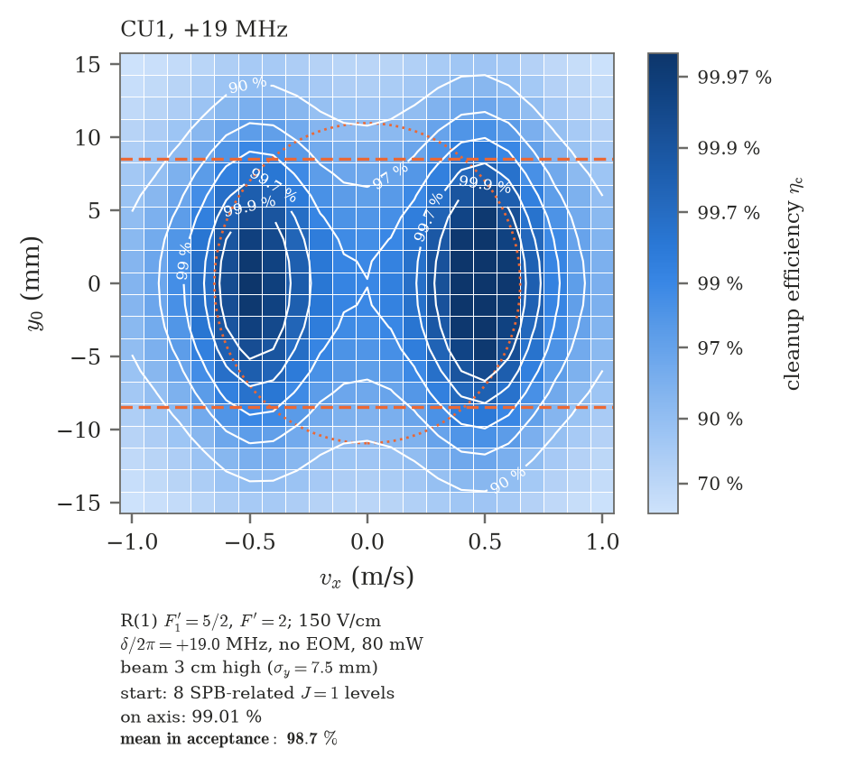
CU1 simulation result
Included:
Multipass opposite Doppler
Molecule size + velocity distribution after lens
Current detection laser size
Dashed orange: detection acceptance |y0| ≤ 8.5 mm (detection laser 1.7 cm high).
Dotted orange: 1σ of the molecule distribution at CU1 after the lens (σvx = 0.65 m/s, σy = 10.95 mm).
Pre-test assumptions: σvx = 0.65 m/s, 13 passes with 10 % loss per pass, vz = 184 m/s.

Slide 7
Summary
• Shot-alternating CU1 shutter (10 open + 10 closed per burst) → remaining fraction measured directly, no off-resonance reference
• Best result: remaining 0.026 [0.024, 0.028] → efficiency 97.4 ± 0.2 % (CU1 50 mW, NLTL 2466.0, RC on P(2) F'=2, multipass alignment C, 2000 shots)
• Improvements: RC F'=1 → F'=2, multipass realignment (more passes), set point moved to the measured optimum NLTL 2466.0: 0.099 → 0.026
• Power dependence: remaining ∝ exp(−k·P^0.45) — slow, √P-like → inhomogeneous (Doppler) broadening, not a hard floor
• Det2 Doppler scan: detected J=1 has σ_vx = 1.28 ± 0.03 m/s (lens sim. 1.37 m/s), 2× wider than assumed in the old model
• CU1 model with the measured v_x reproduces the power scan (power scale s = 1.14 ± 0.03); residual is from |v_x| > 1 m/s
• Real experiment (8 m, 2 cm aperture → |v_x| ≤ 0.22 m/s): model predicts ≈ 3×10⁻⁴ remaining (99.97 %)
• Q(1) F₁'=1/2 F'=1 detection (all J=1 levels, RC on P(2) F'=1): 95.1 ± 0.4 % — lower likely because of the inefficient cleanup of other sublevels which the Q transition can see
2

Slide 8
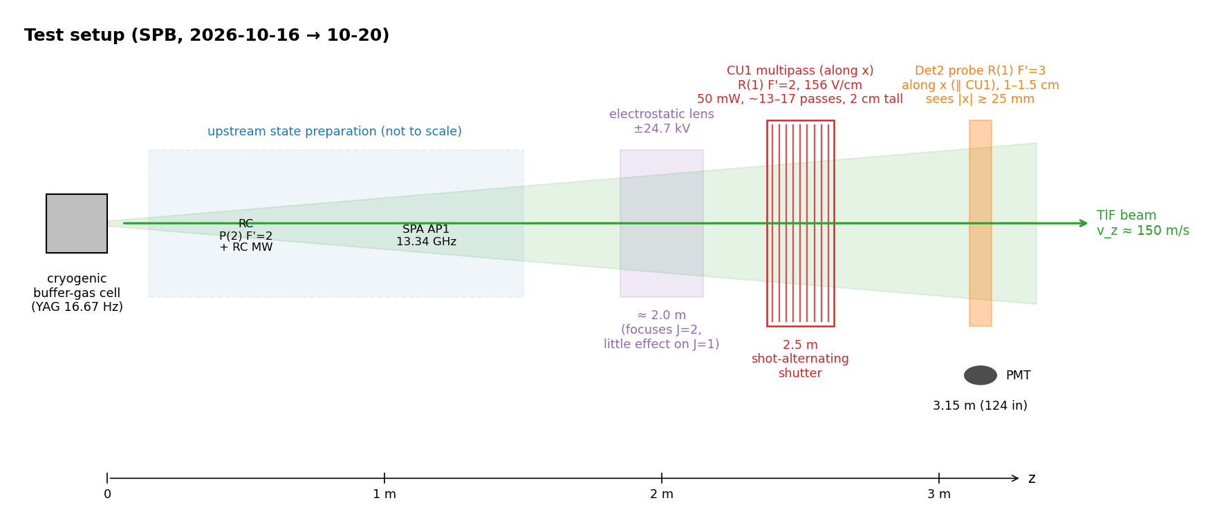
Test setup
3

Slide 9
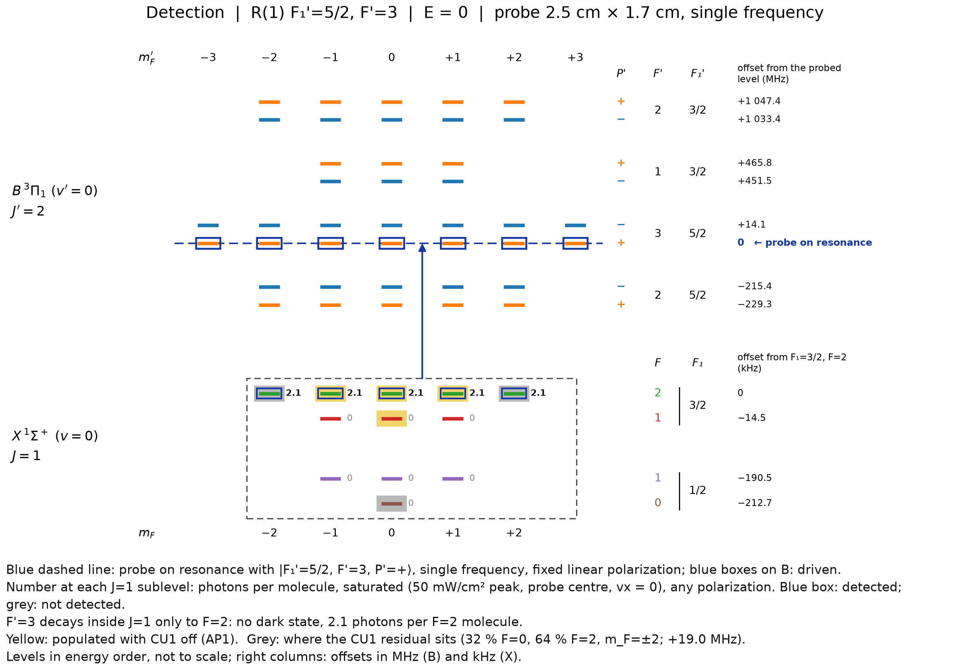
CU1 detection 1 (R1F3)
Condition:
  RC on P2F1 later P2F2
  SPA J=0 -> J=1 on, J=1 -> J=2 off
  SPB HV on, MW off
Only triplet states are detected
5

Slide 10
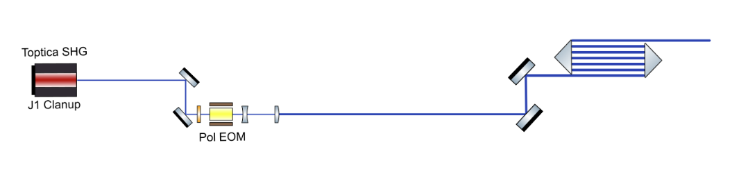
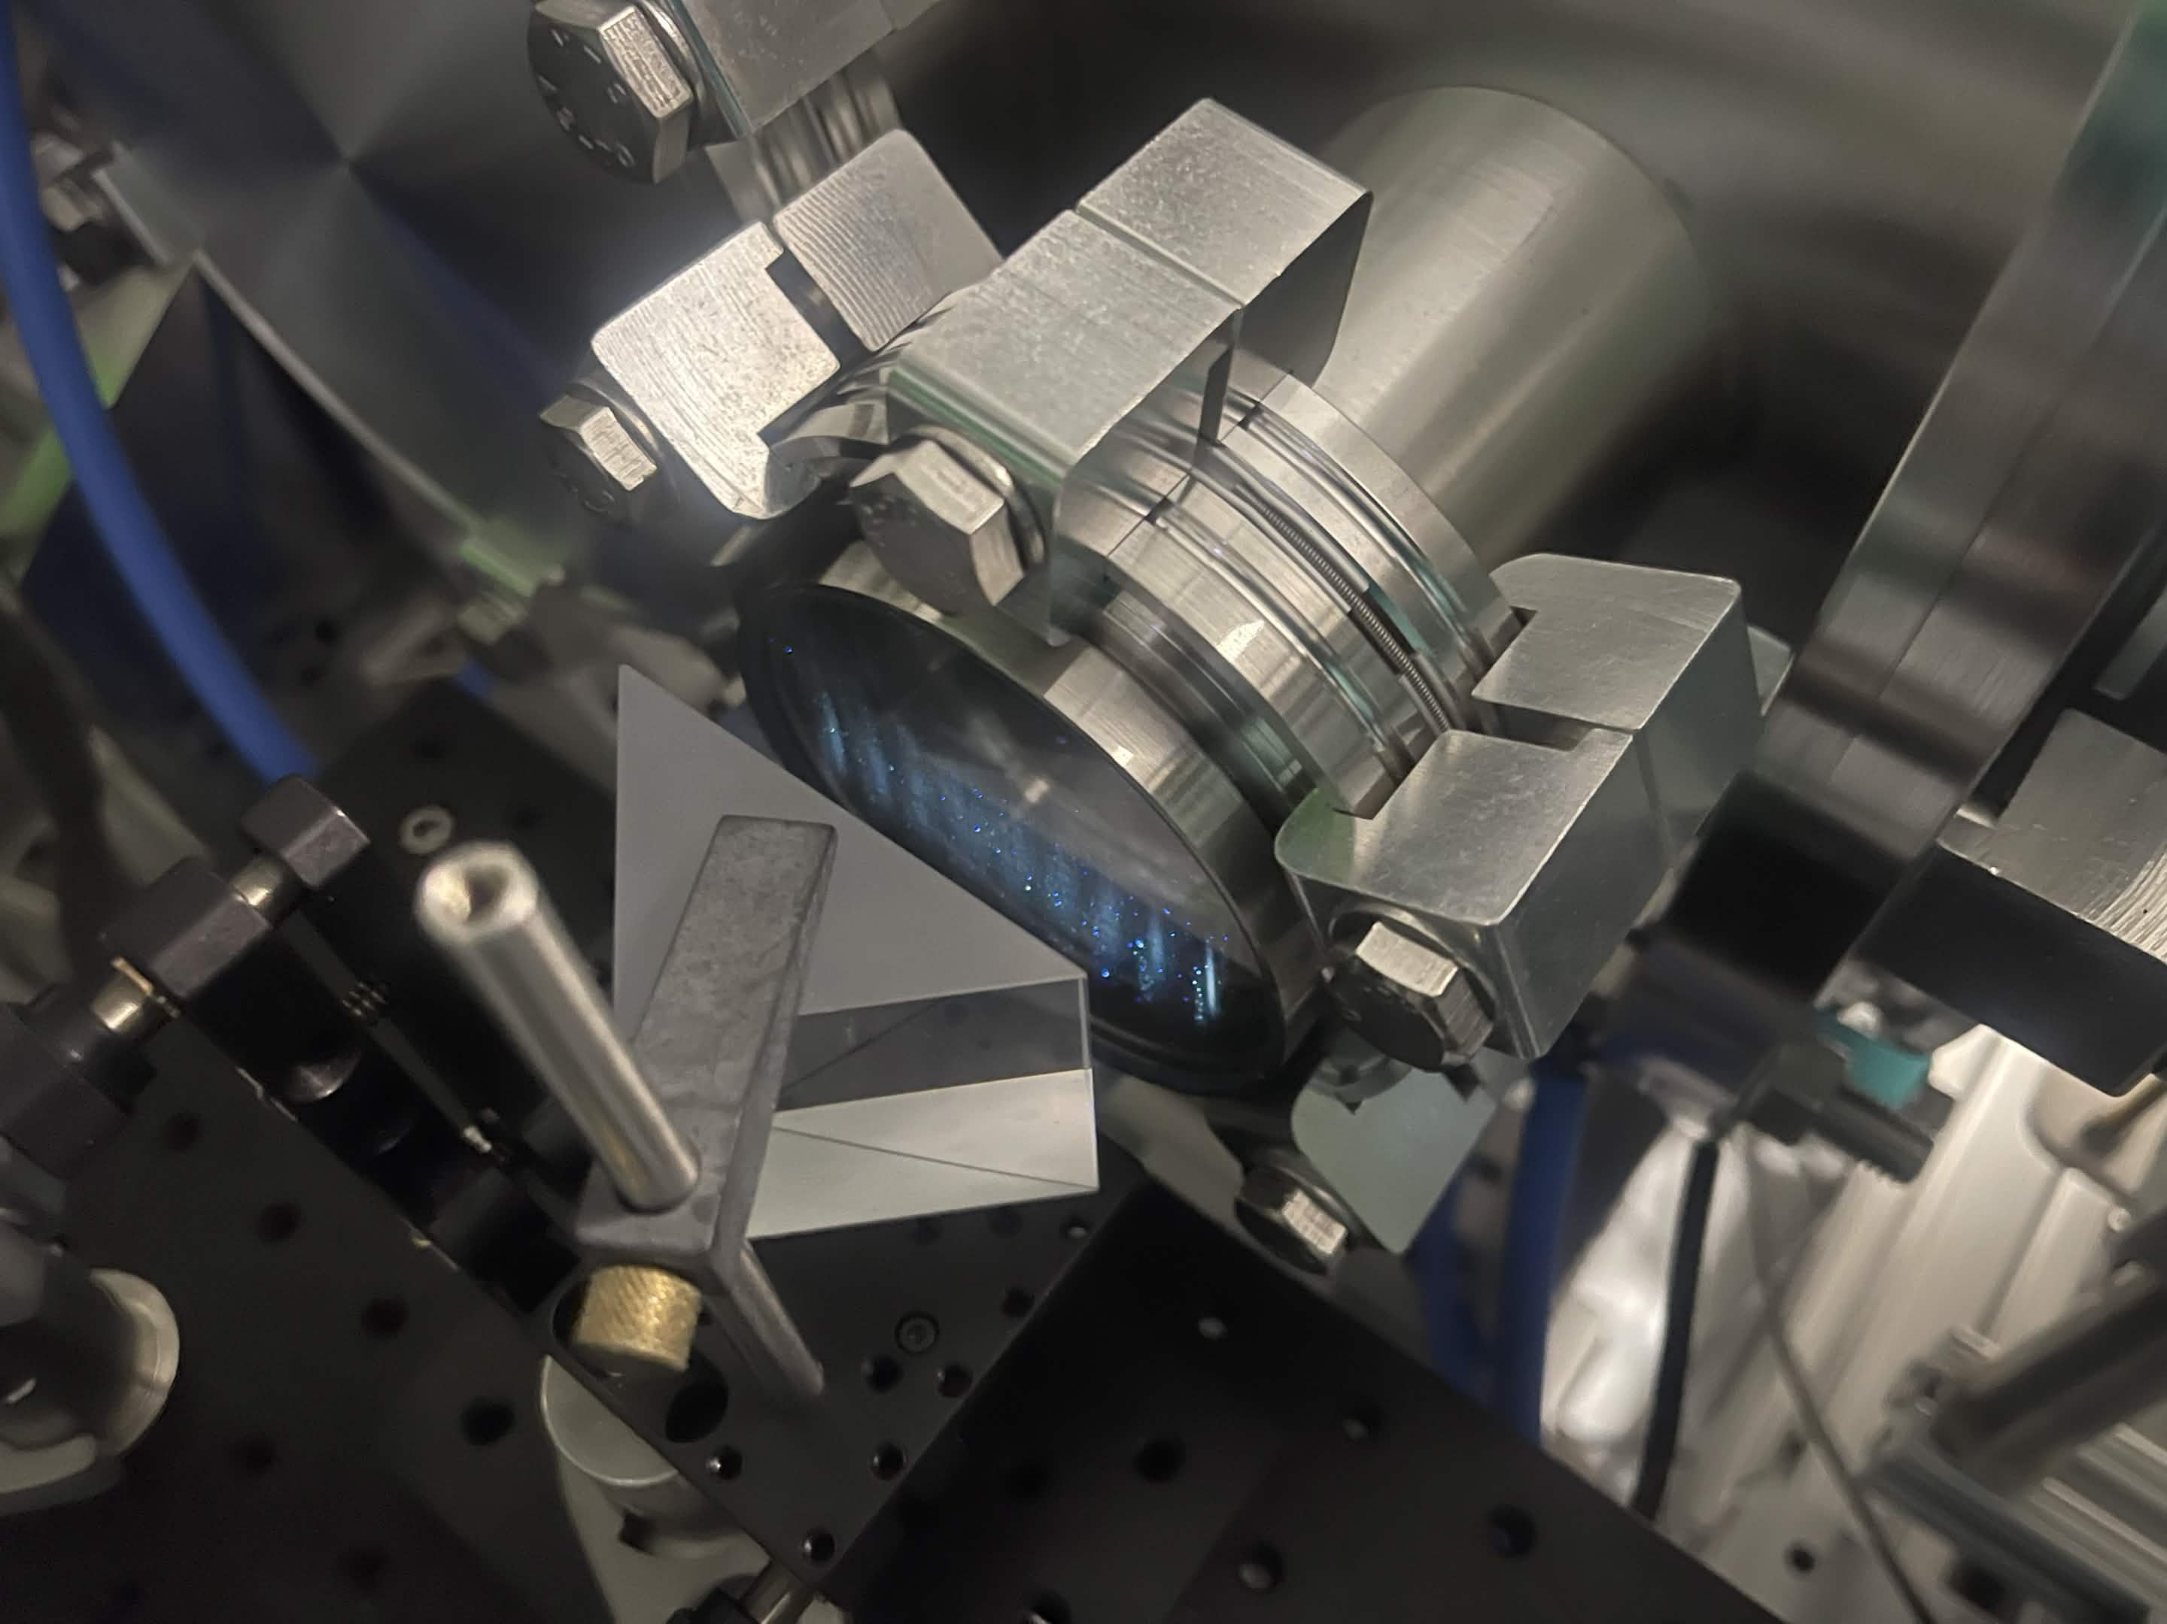
CU1 optical layout (simplified)

Slide 11
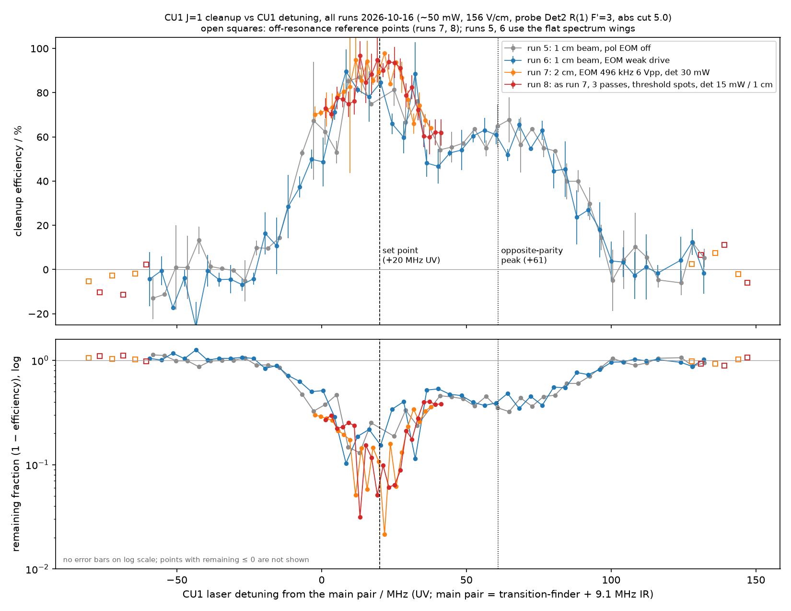
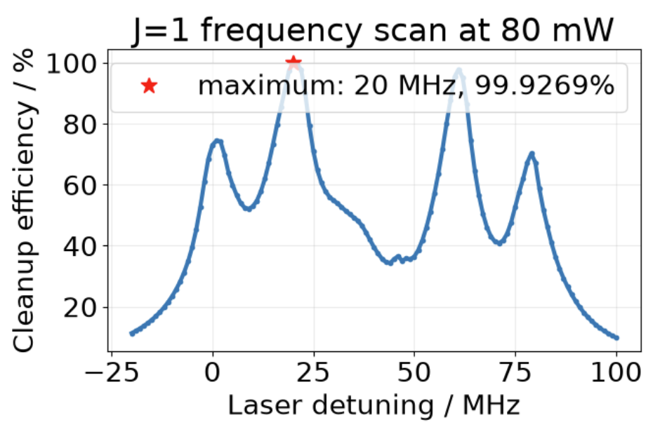
CU1 spectrum (2026-10-16, before the shutter)
• Set point: +20 MHz UV from the main pair (simulated 99.9 % peak)
• Opposite-parity peak at +61 MHz; old off-resonance reference sat on CU1 wings → biased
• Motivated the shutter: a true CU1-blocked reference on alternate shots
5

Slide 12
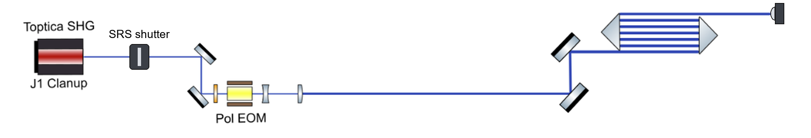
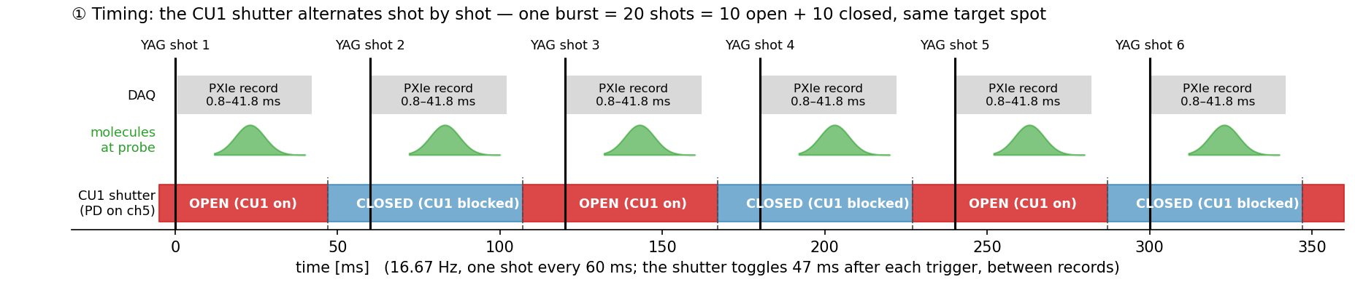
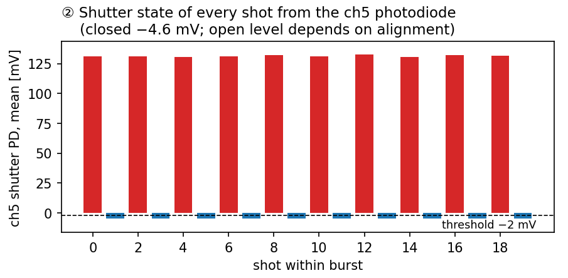
Measurement method: shot-alternating shutter
• SR475 shutter after the SHG blocks CU1 on every other YAG shot (PulseBlaster 16.67 Hz profile)
• Closed shots in the same burst give the J = 1 signal without CU1 → no off-resonance reference needed
• Each shot is tagged open / closed from the shutter photodiode on PXIe ch5 (threshold −2 mV)
4

Slide 13
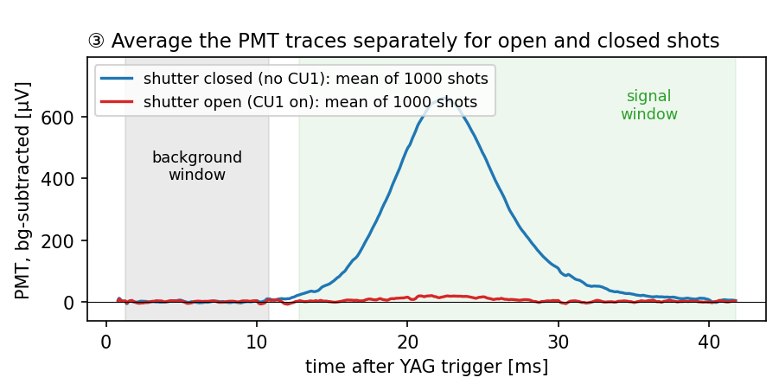
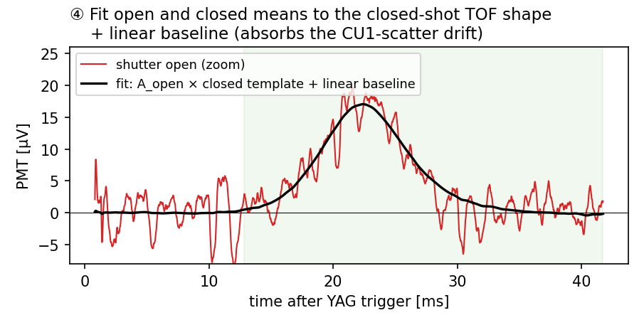
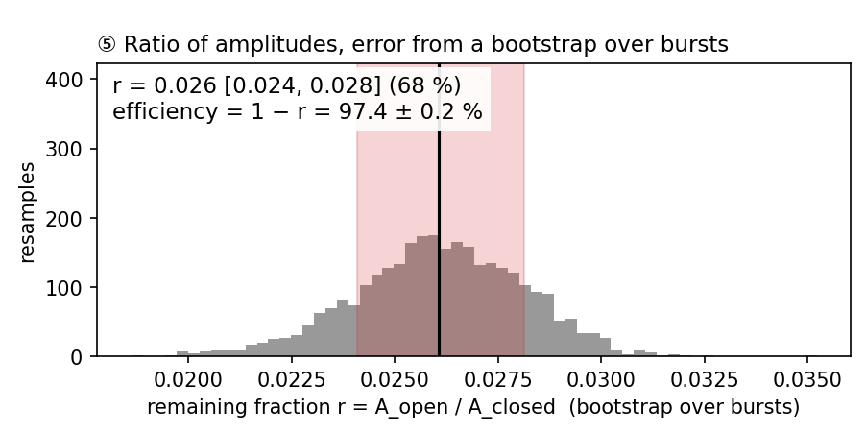
Measurement method: open / closed shot analysis
• Open and closed shots share spot, source and absorption drifts → cancel in r = A_open / A_closed
• Template fit (closed TOF shape + linear baseline) removes the CU1-scatter drift
• Error from a bootstrap over the 100 bursts: r = 0.026 [0.024, 0.028] → efficiency 97.4 ± 0.2 %
Data: alignment C, NLTL 2466.0, 50 mW, 2026-10-19

Slide 14
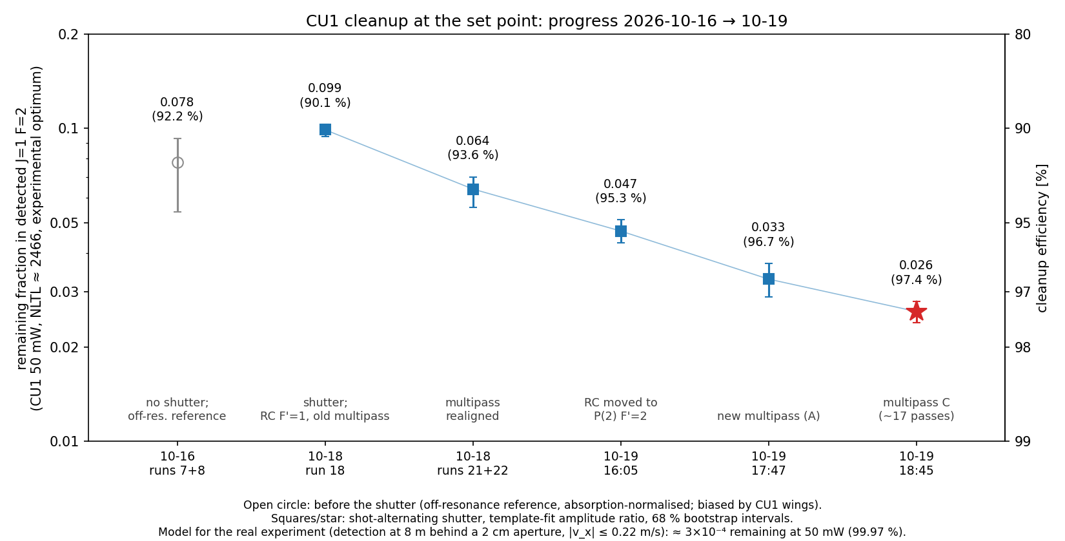
Progress at the set point
Major alignment improvements
Cross alignment laser: CU1 beam, detection beam and chamber centre at the same height
Multipass: 13 → 17 passes
Reflected beam overlapped with the incoming beam → CU1 laser ⊥ molecular beam
• 0.099 (run 18) → 0.064 (multipass realigned) → 0.047 (RC on P(2) F'=2) → 0.033 → 0.026 (multipass C, ~17 passes)
6

Slide 15
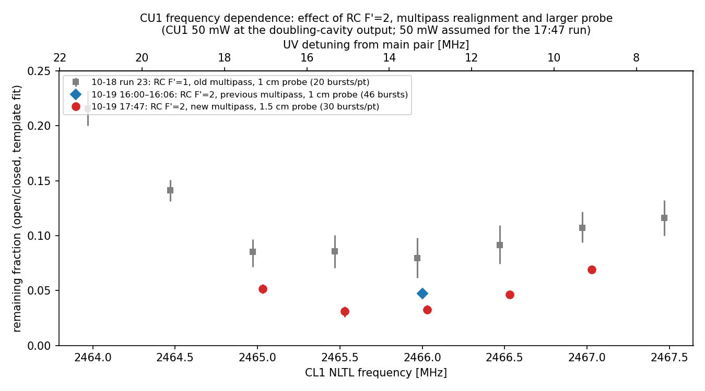
Frequency dependence: RC F'=2 and multipass
• Optimum at NLTL 2465.5–2466.0 (handoff prediction NLTL ≈ 2464.5; the offset is not yet understood)
• RC F'=2 (≈ 4.9× more J=1 signal) and the realigned multipass lower the whole curve; probe size (1 → 1.5 cm) does not change it
7

Slide 16
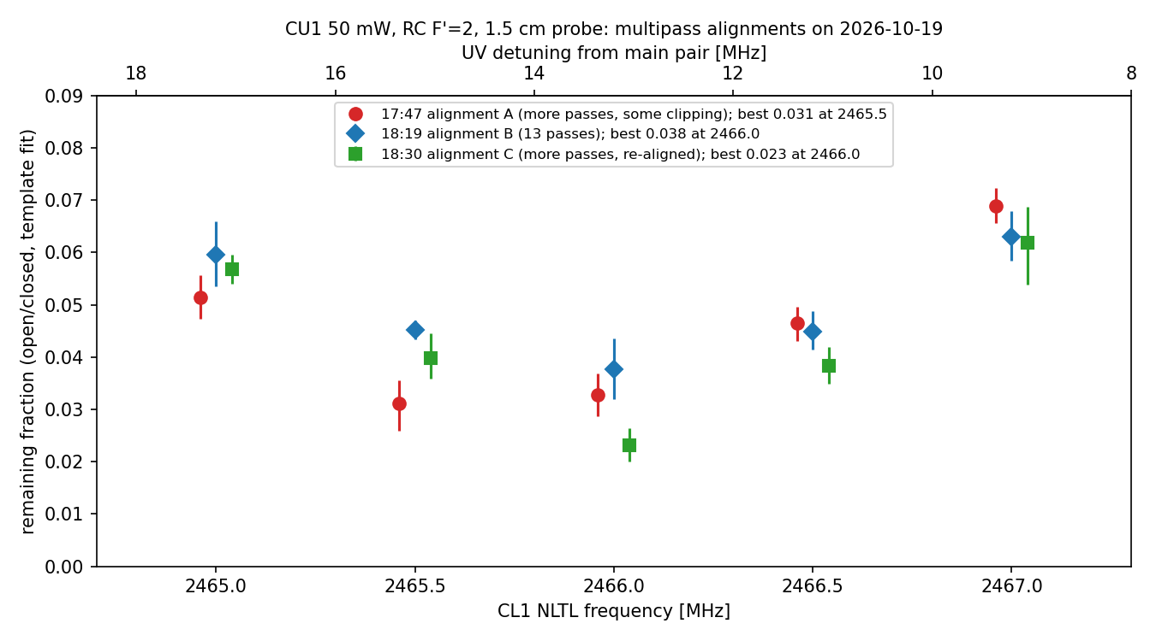
Multipass alignment matters
• A (more passes, some clipping) and C (re-aligned, ~17 passes) beat B (13 clean passes)
• Alignment is hard to reproduce — each attempt scored by a 30–40-burst quick check (±0.005)
8

Slide 17
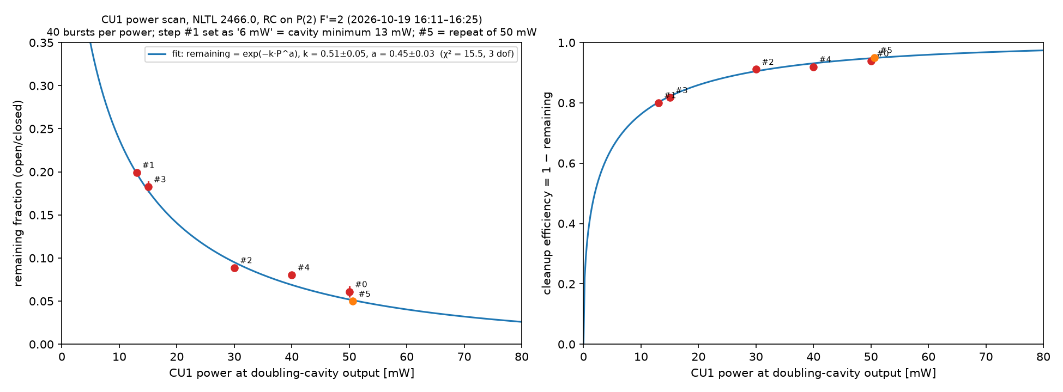
CU1 power dependence (RC F'=2, 13 passes)
• remaining = exp(−k·P^a), a = 0.45 ± 0.03 — far from the a = 1 of a homogeneous ensemble
• Powers at the doubling-cavity output (minimum 13 mW); 45 mW reaches the multipass entrance at 50 mW
9

Slide 18
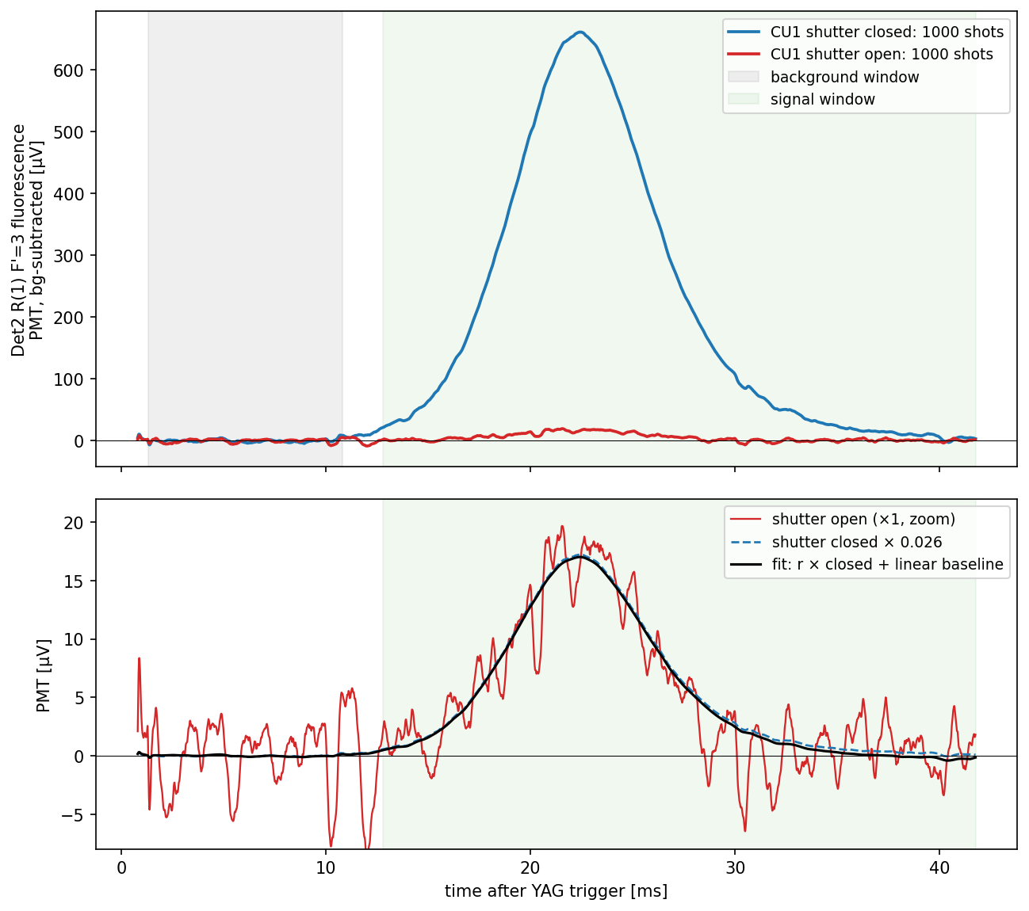
Final result: 97.4 ± 0.2 %
2026-10-19, 18:45–18:48 — CU1 at the set point, alignment C
CU1
R(1) F1'=5/2, F'=2 in 156 V/cm (e11/e12 = ±1250 V)
NLTL 2466.0 MHz → 275855.3799 GHz IR
50 mW at doubling-cavity output (45 mW at multipass entrance)
2 cm tall, prism multipass (alignment C, ~17 passes), pol. EOM on
SR475 shutter alternating shot by shot, state on PXIe ch5
Upstream
RC on P(2) F1'=3/2, F'=2 + RC MW; lens ±24.7 kV
SPA AP1 on, AP2 off; SPB HV on, SPB MW off
Probe
Det2 R(1) F1'=5/2, F'=3, 1.5 cm tall, along x (∥ CU1)
Data
100 bursts × 20 shots = 2000 shots (1000 open + 1000 closed)
20 target spots, 2.7 min
Analysis
r = A_open / A_closed (mean traces fitted to closed template + linear baseline)
68 % bootstrap over bursts; block bootstrap [0.024, 0.029]
window integral 12.8–41.8 ms: 0.024 [0.019, 0.029]
CU1 cleanup efficiency 97.4 ± 0.2 %
remaining fraction 0.026 [0.024, 0.028]
10

Slide 19
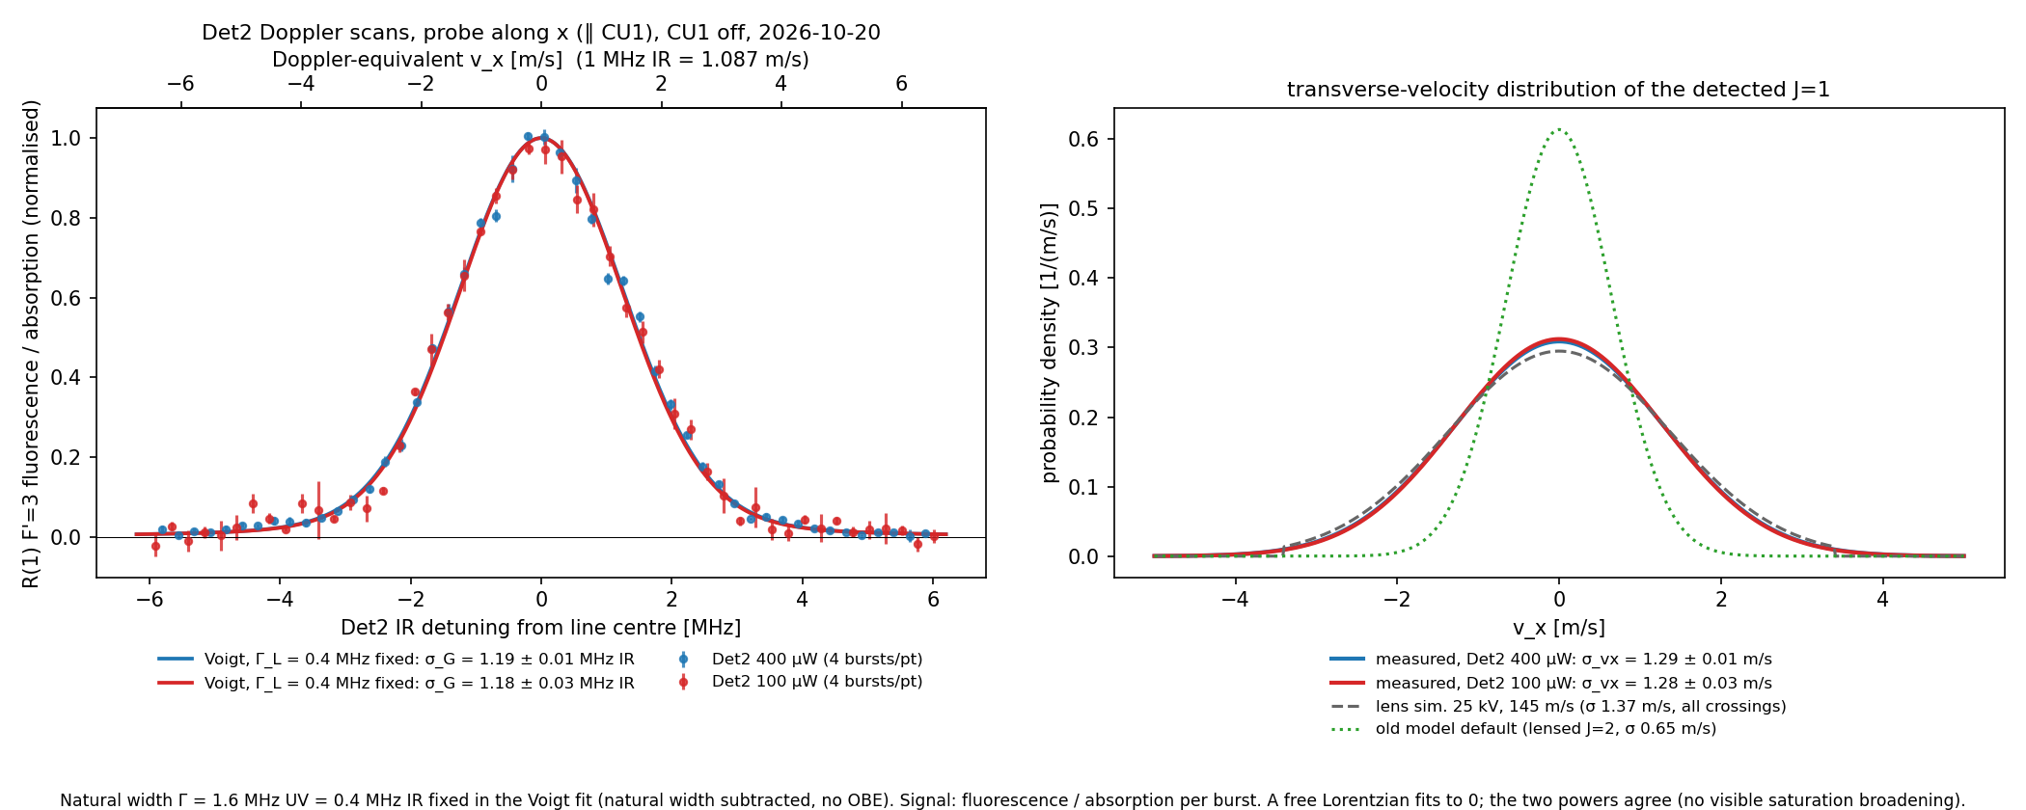
Det2 Doppler scan: v_x of the detected J=1
• Fluorescence / absorption, Voigt with the natural width (0.4 MHz IR) fixed: σ_vx = 1.29 (400 µW), 1.28 m/s (100 µW)
• Two powers agree → no visible saturation broadening; agrees with the lens simulation (1.37 m/s)
11

Slide 20
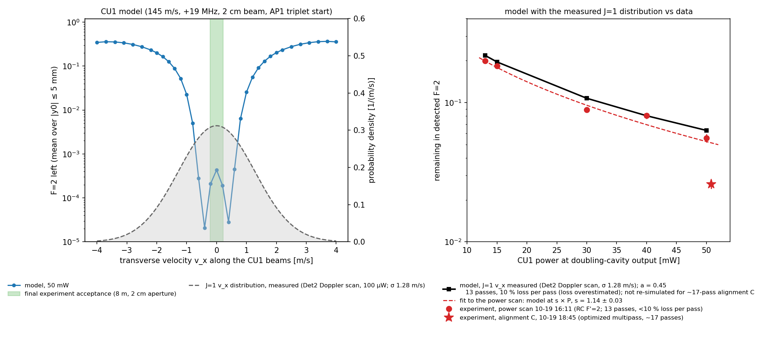
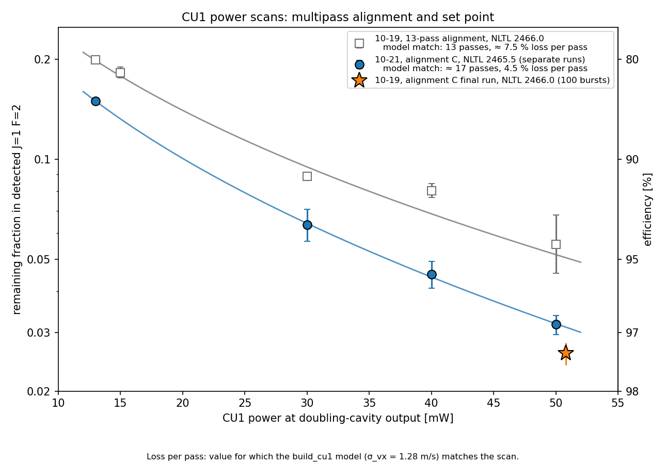
CU1 model with the measured v_x vs data
• Measured σ_vx = 1.28 m/s: model matches the power scan with s = 1.14 ± 0.03 (old σ 0.65 needed s = 0.24)
• Residual dominated by |v_x| > 1 m/s; inside the real-experiment acceptance (green) ≈ 3×10⁻⁴ at 50 mW
12

Slide 21
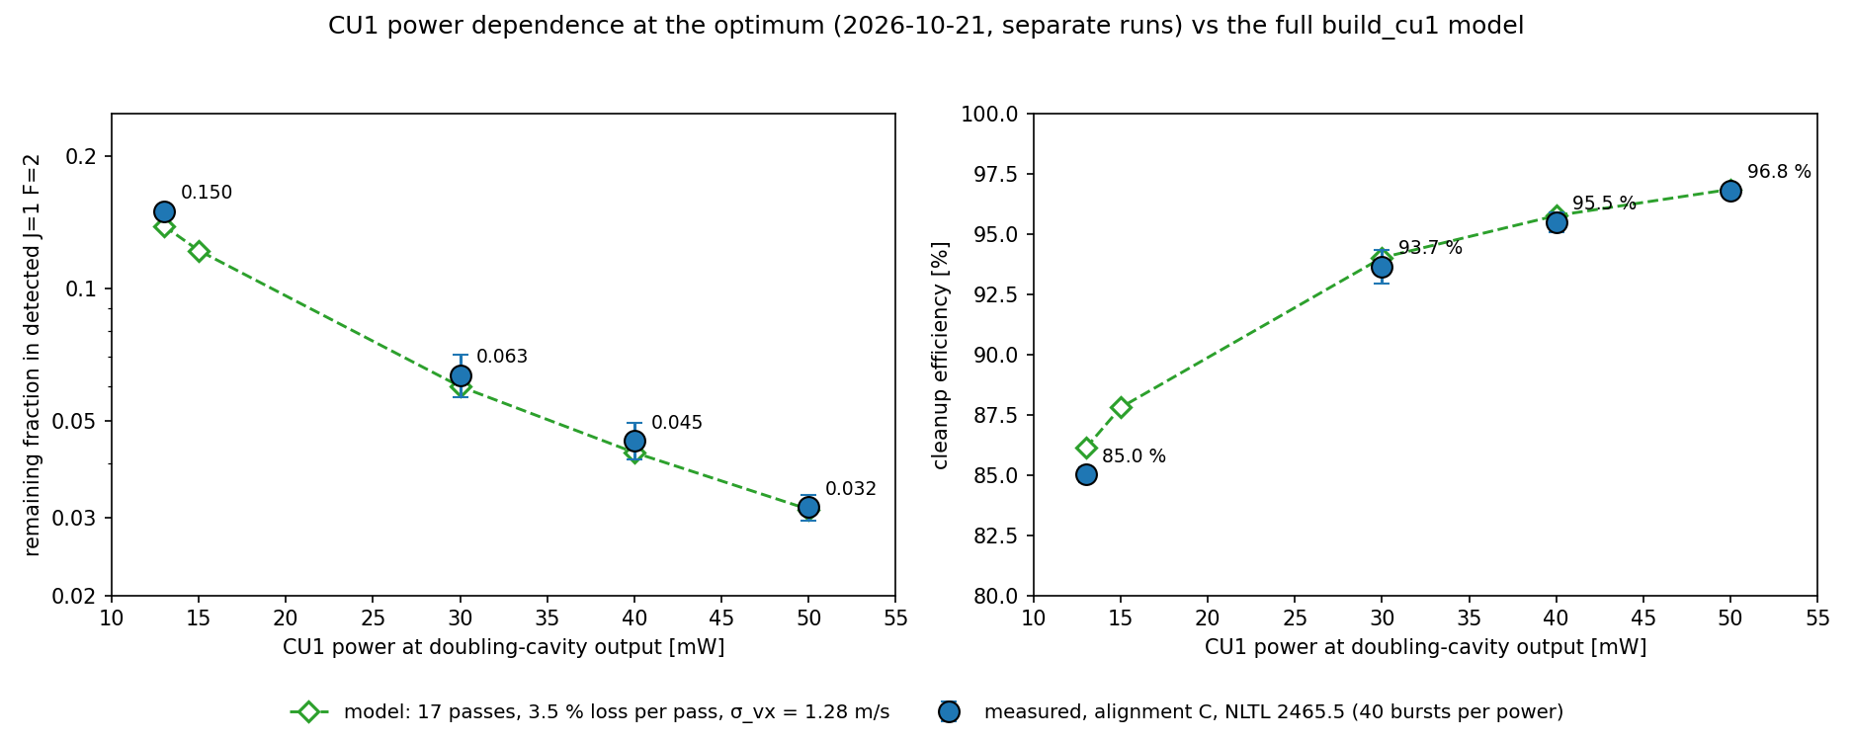
CU1 power dependence at the optimum vs the full model (2026-10-21)
• Separate quick-check runs at CU1 NLTL 2465.5 (the 10-21 optimum), 40 bursts per power, R(1) F'=3 detection, RC on P(2) F'=2
• Full build_cu1 simulation, 17 passes, 3.5 % loss per pass, measured σ_vx = 1.28 m/s: agrees within 5 % at 30–50 mW (13 mW: +8 %)
13

Slide 22
CU1 power scans: multipass alignment and set point
• Loss per pass = value for which the build_cu1 model matches each scan: 13-pass alignment ≈ 7.5 %, alignment C (~17 passes) ≈ 4.5 %
• Alignment C at the optimum reaches 96.8 % at 50 mW (10-21), 97.4 % on 10-19
14

Slide 23
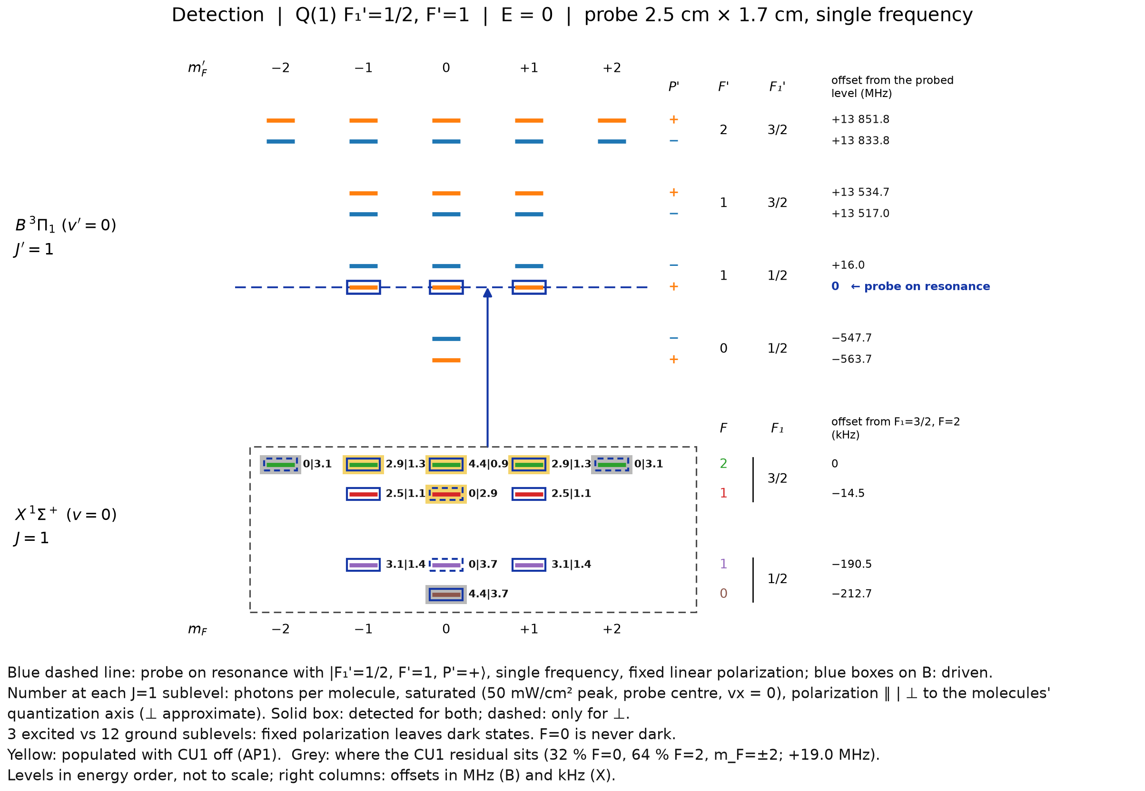
CU1 detection 2 (Q1F1)
Condition:
  RC on P2F1 later P2F2
  SPA J=0 -> J=1 on, J=1 -> J=2 off
  SPB HV on, MW off
All states are detected
5

Slide 24
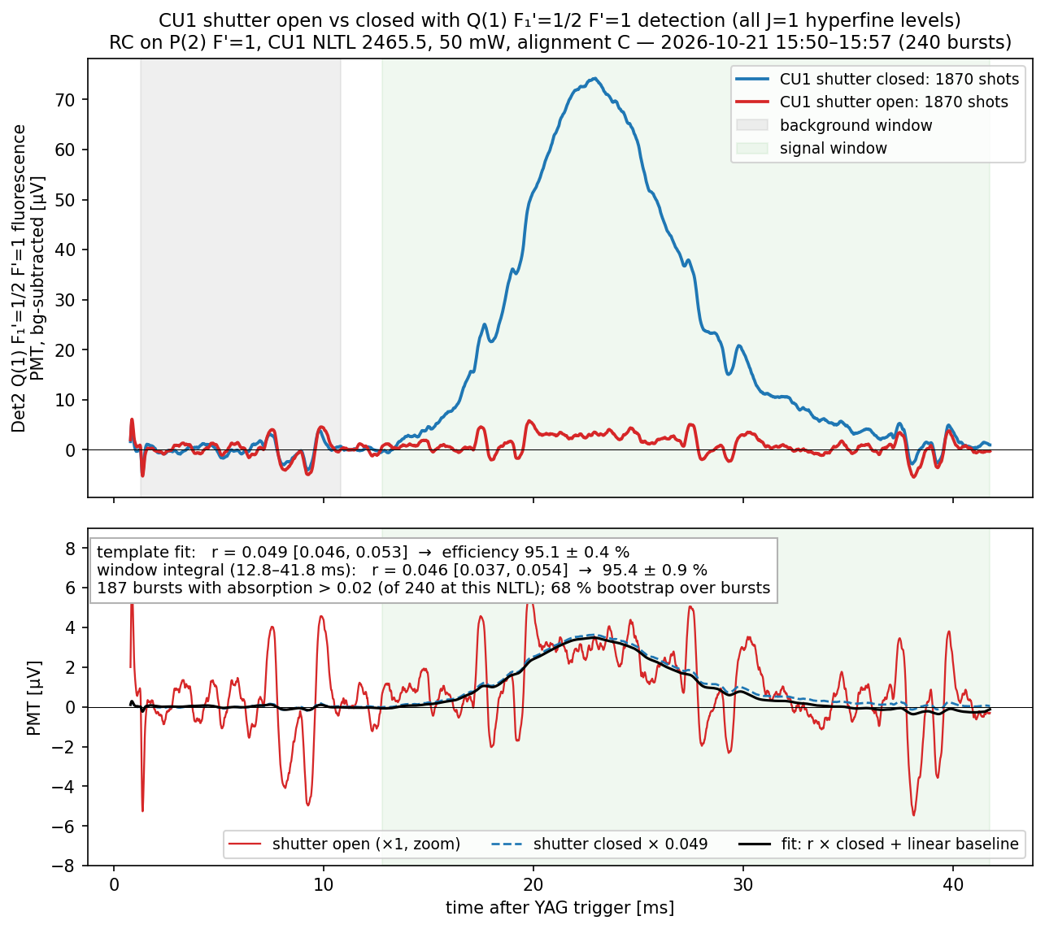
CU1 efficiency with Q(1) detection: 95.1 ± 0.4 %
2026-10-21 15:50–15:57 — RC on P(2) F'=1 (final configuration), CU1 NLTL 2465.5, 50 mW, alignment C, 240 bursts
• Template fit: r = 0.049 [0.046, 0.053] → 95.1 ± 0.4 %
• Window integral (12.8–41.8 ms): r = 0.046 [0.037, 0.054] → 95.4 ± 0.9 %
• Independent of the absorption cut (0–0.07): r = 0.049–0.053
• Same day with R(1) F'=3 (F=2 only): r ≈ 0.03 (≈ 97 %)
Note: efficiency lower likely because of the inefficient cleanup of other sublevels which the Q transition can see
• Weird 100Hz noise detected
16

Slide 25
Conclusions, next steps and to-do
Conclusions
• CU1 cleans 97.4 ± 0.2 % of the detected J=1 (F=2) in this test geometry
• The residual is explained by molecules with |v_x| > 1 m/s that the wide test probe accepts; the model with the measured v_x needs no tuning
• For the real experiment (|v_x| ≤ 0.22 m/s) the model predicts 99.97 %
Next steps
• To-do: find the source of the trigger-locked 100 Hz spikes on both PMTs (present since 10-17, also with the CU1 shutter closed) — test SR474 off / shutter head unplugged / Det2 blocked (see backup)
17

Slide 26
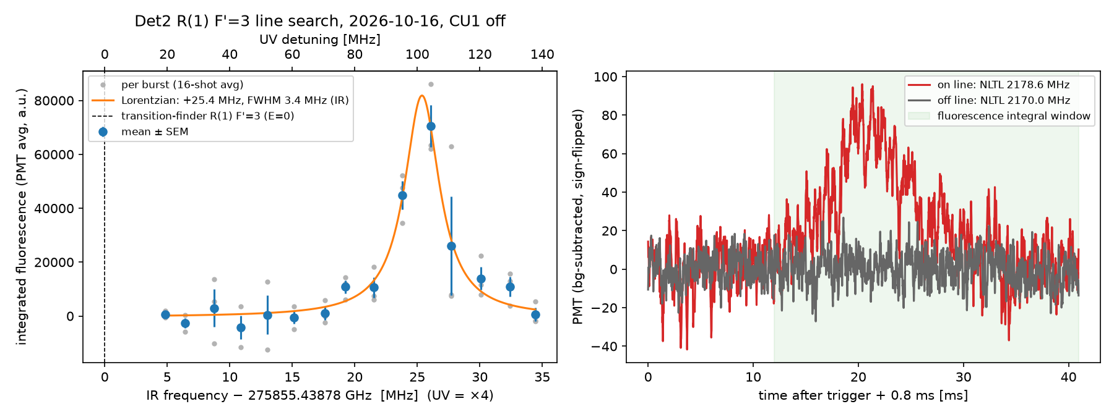
Backup: Det2 R(1) F'=3 line search
20

Slide 27
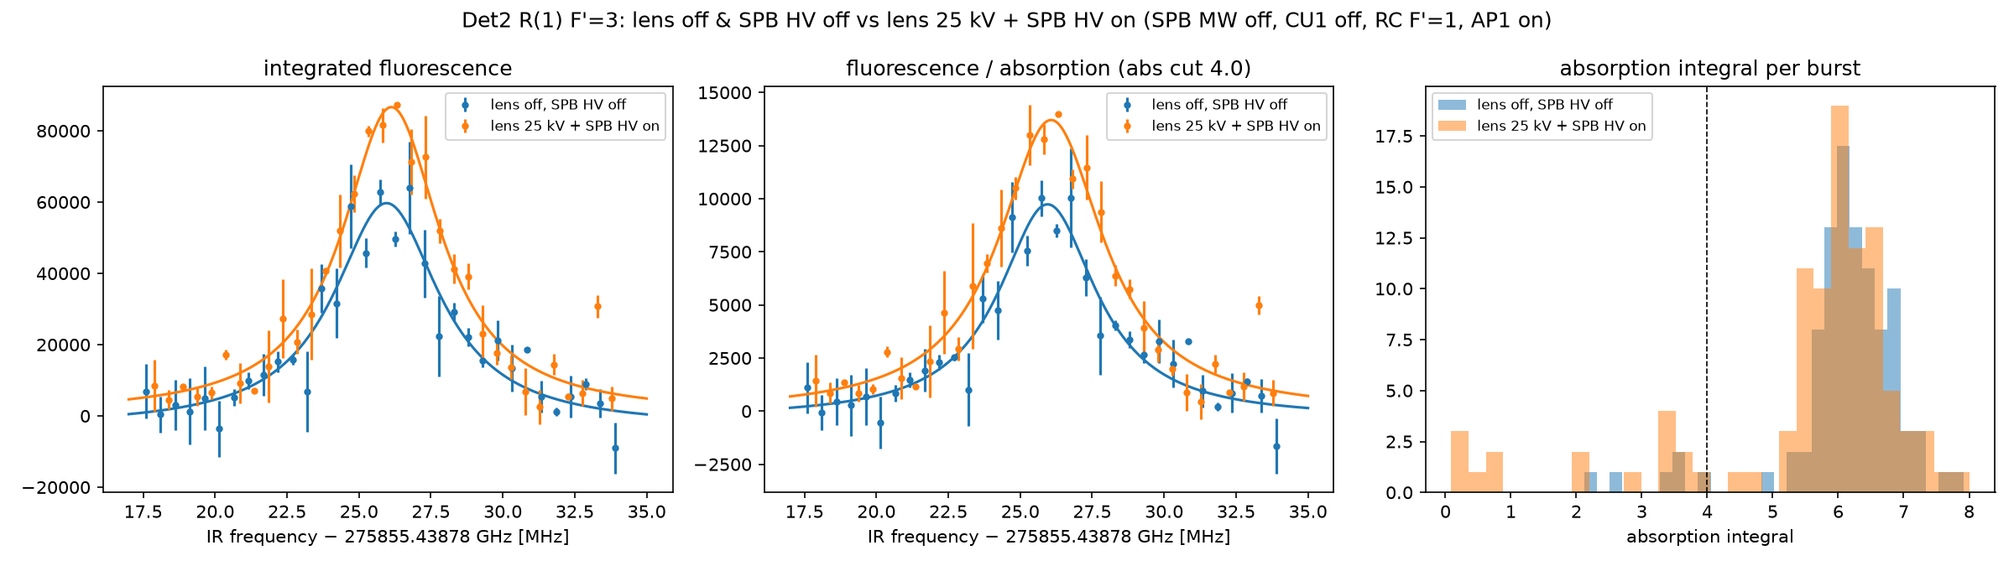
Backup: Lens on/off difference
20

Slide 28
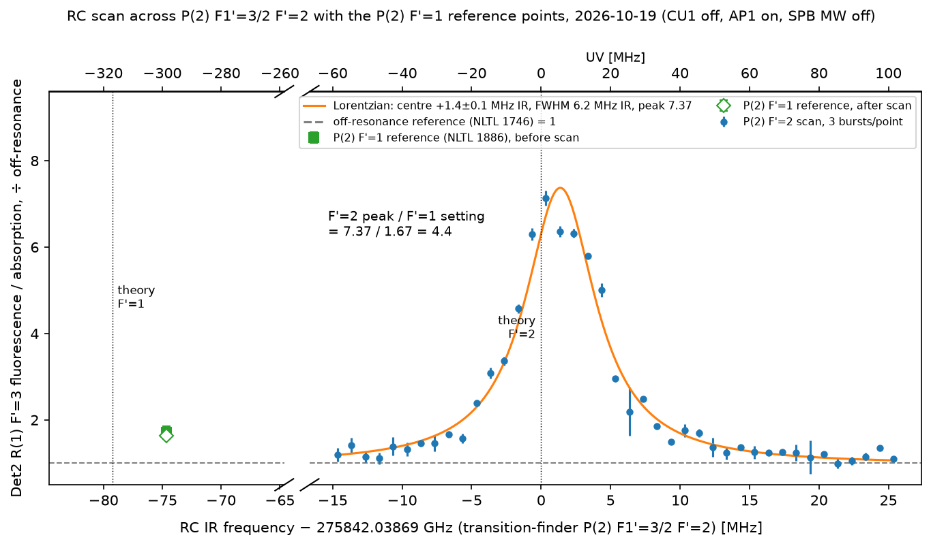
Backup: RC P(2) F'=2 line
18

Slide 29
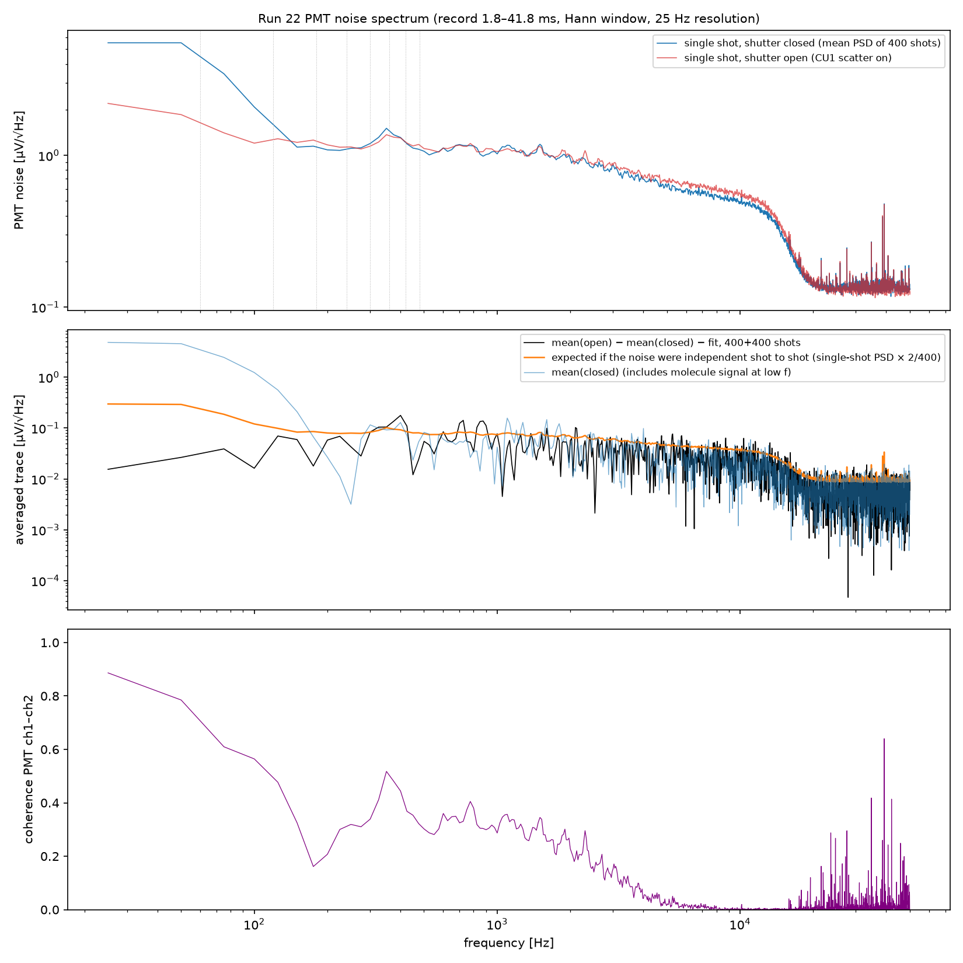
Backup: PMT noise spectrum (mostly white, ~1 µV/√Hz; trigger-locked 100 Hz spikes: see the last backup slides)
19

Slide 30
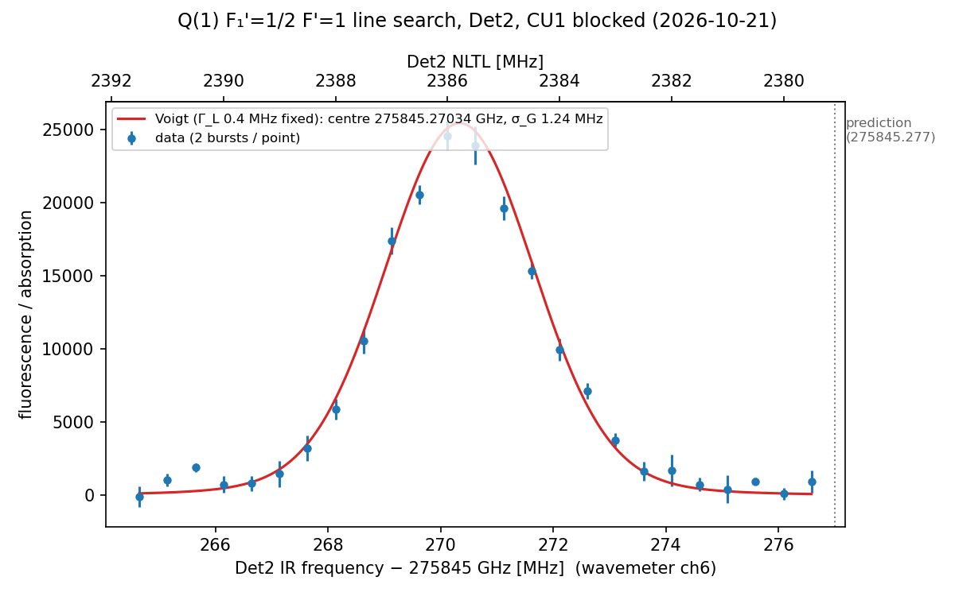
Backup: Det2 Q(1) F₁'=1/2 F'=1 line search
21

Slide 31
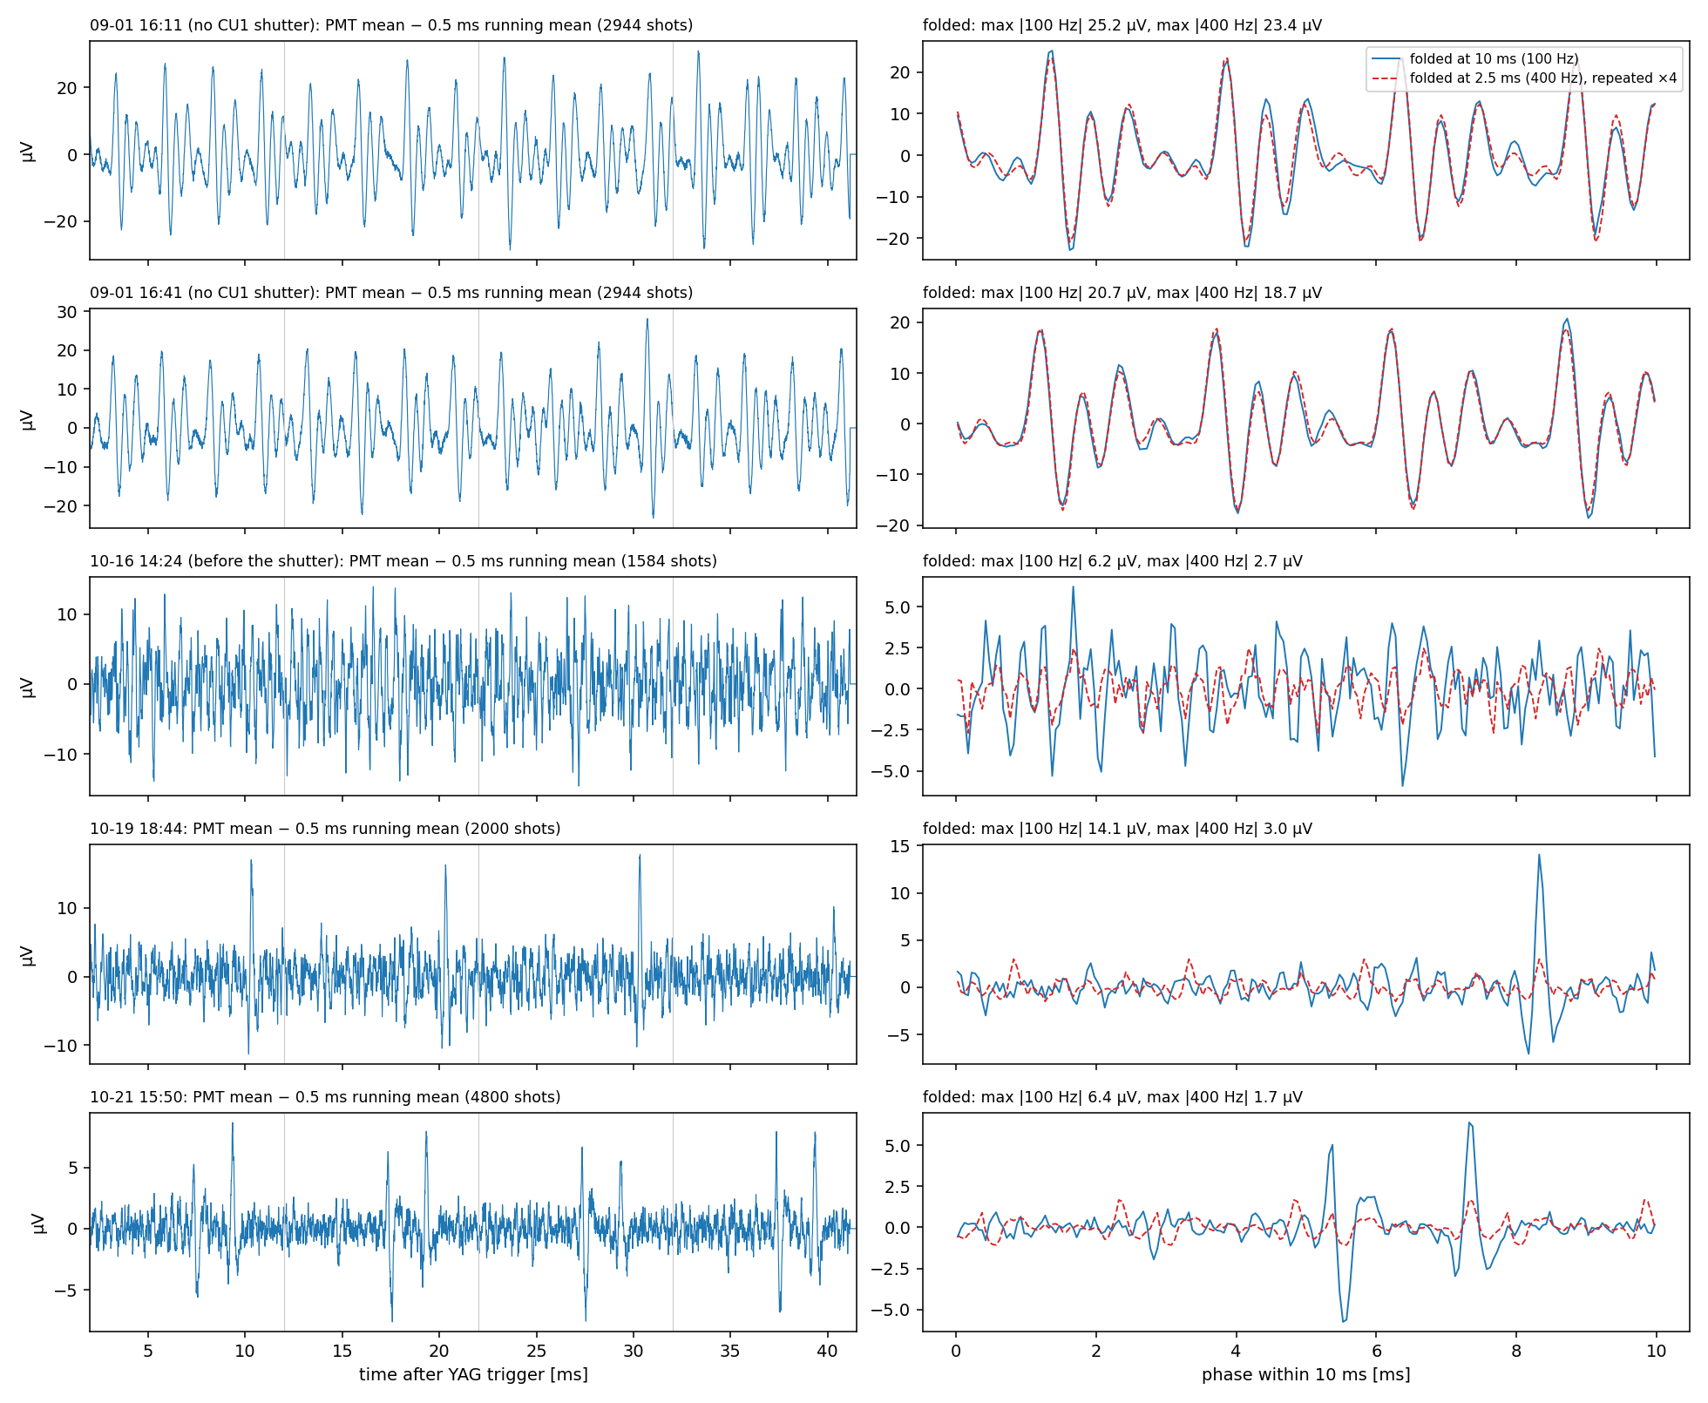
Backup: periodic PMT noise, 09-01 (≈ 400 Hz) vs October (100 Hz spikes)
24

Slide 32
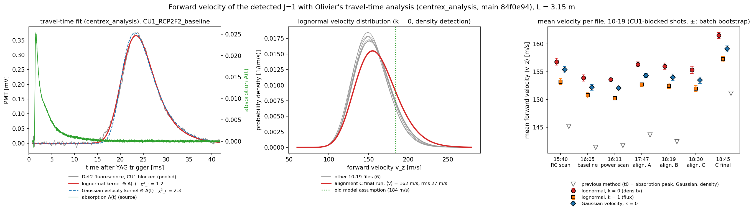
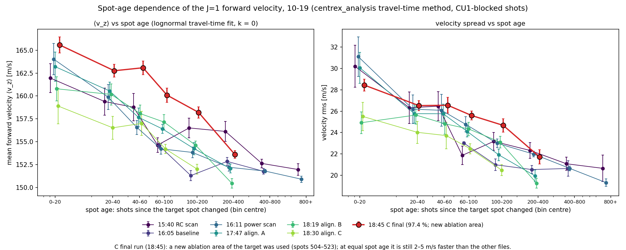
Backup: Velocity analysis
24

