Slide 1
The Battle of Neighborhood - Bronx, New York
Yiting(Amber) Li

Slide 2
Background
As the COVID-19 pandemic attack the U.S. economy, it provides the best time to put house on the market due to low inventory and high demand. The low interest rate has attract investors heating up the housing market. However, it is difficult for unfamiliar investor to collect housing information.

Slide 3
Business Problem
In this scenario, a newly-formed real estate company, ABC inc., is searching for investors who are inexperienced with the real estate market in Bronx. The company's goal is to collect information to attract new investors and assist new investor to make a profitable purchase.
The Company's plan is to use clustering method to classify neighborhoods in Bronx and recommending suitable price and venues for their new investors.

Slide 4
How We Solve It?
We plan to cluster Bronx’s neighborhoods for recommending suitable price and venues to their investors

Slide 5
Data Selection
•The data of real estate price comes from the link (https://www1.nyc.gov/site/finance/taxes/property-rolling-sales-data.page)
•Foursquare API

Slide 6

Methodology
In this case, I'll use data cleaning methods from IBM data science class and KNN and K Means clustering for modeling. The specific process is shown below

Slide 7
Result

Slide 8
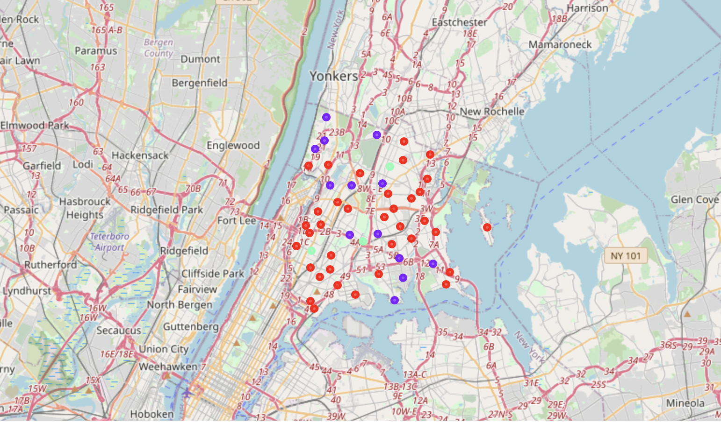
Result
Map of Clustering

Slide 9
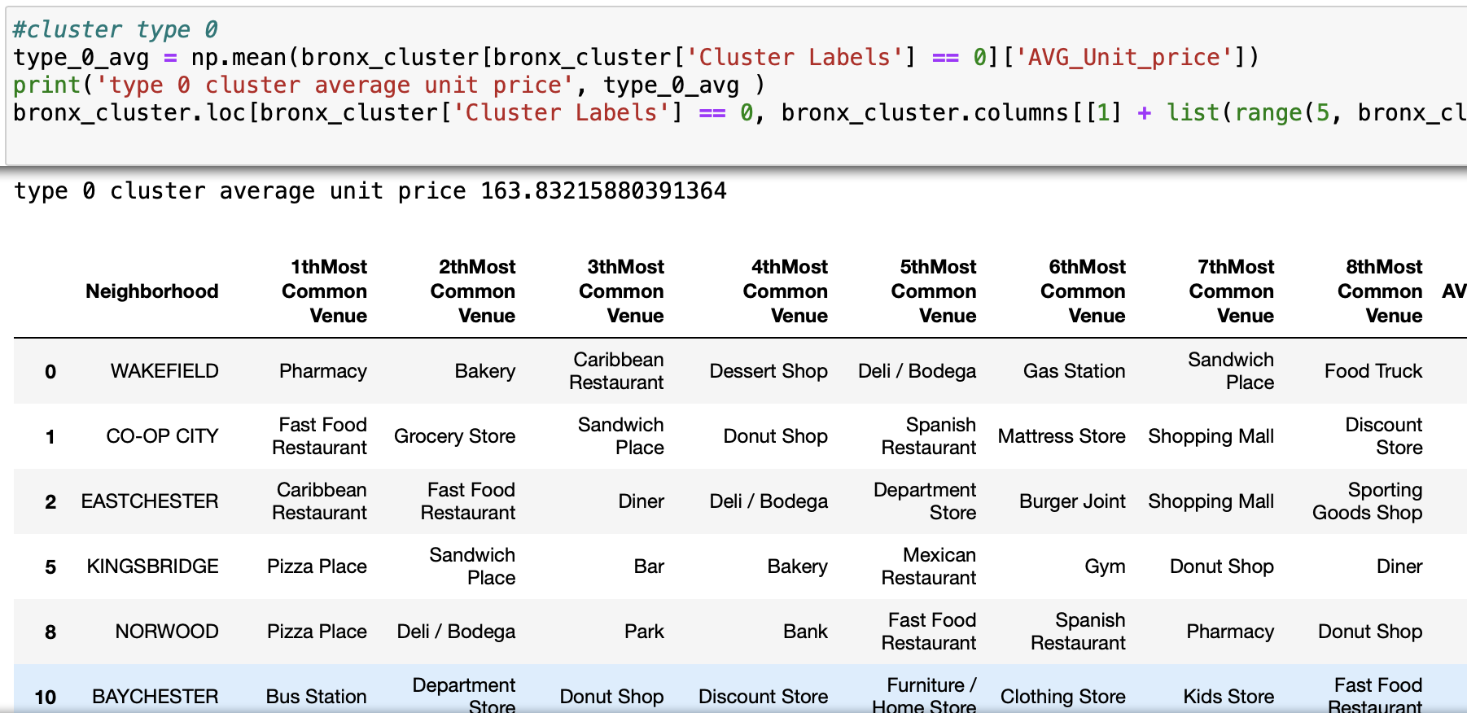
Cluster 0

Slide 10
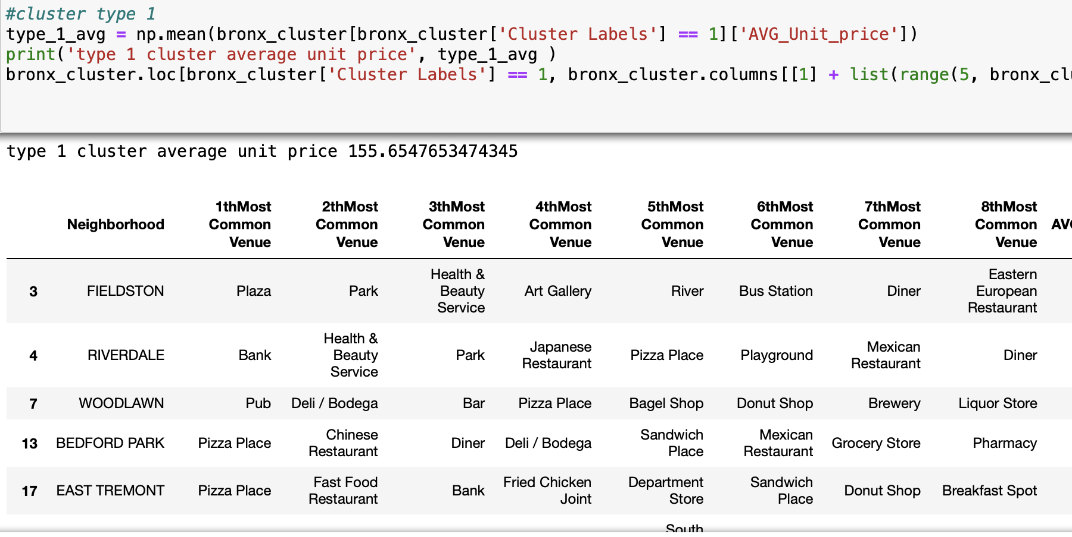
Cluster 1

Slide 11
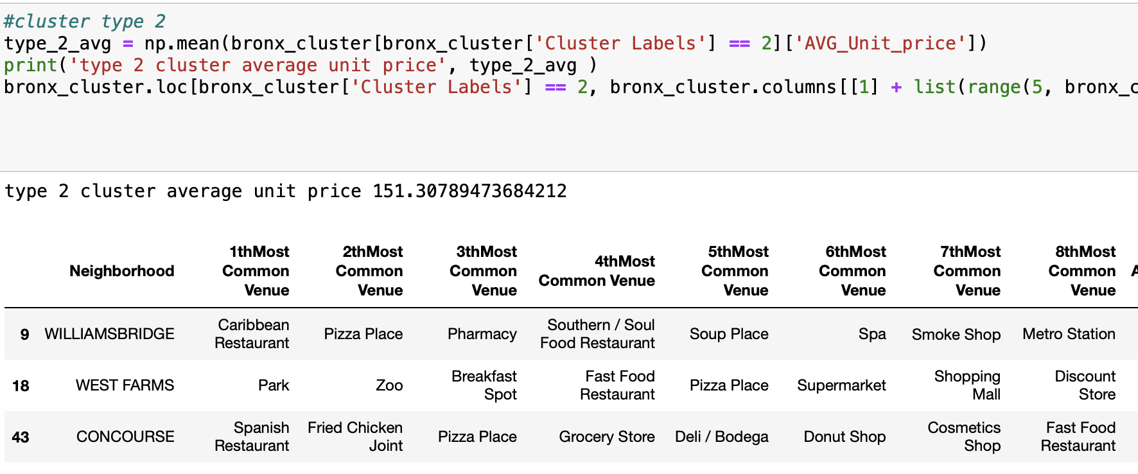
Cluster 2

Slide 12
Conclusion
The major business problem in this project is to process and visualize data in order to help the investors to make their investment decision on real estate market. To achieve this goal, we successfully process the real estate price and calculate their average price of each neighborhood and sort it ascendingly. The result of housing price is shown above that is efficient for investors to make their decision.
Venue is another aspect that considered by house buyer. Our project successfully separate the neighborhoods based on their venues to 3 patterns and I believe it will help home buyers for their decision making. For instance, people who consider the apartment near park is more profitable would choose the apartment in cluster 2 which has Fast Food as its most common venue. Therefore, I believe the current real estate market in Bronx is highly diverse and it fits investors with different appetites.

