Slide 1
Bitcoin Price Analysis - Data Mining Course Project
Yulong Yang
Yaqin Tang

Slide 2

Background
What is Bitcoin?
A form of digital currency;
Created and held electronically in 2009;
Decentralized, no middle bank;
No physical printed version;
Anonymous;
and more …
Notes:
http://money.cnn.com/infographic/technology/what-is-bitcoin/
http://www.coindesk.com/information/what-is-bitcoin/

Slide 3
Motivation
Why this topic?
The price of a Bitcoin can unpredictably increase or decrease over a short period of time due to its young economy, novel nature, and sometimes illiquid markets.
Objective
To see if common algorithms that work well on regular price prediction still work on BTC price.

Slide 4
Datasets
Source of the datasets
official website?
Retrieve data from 2013 to 2015;
Which attributes used
@ATTRIBUTE Date
@ATTRIBUTE Price
==> time series forecast!

Slide 5
Algorithms
Traditional way:
Bayesian Curve Fitting;
Support Vector Machine (SVM);
Moving Average Trend Classifier;
Google Trend Analysis
Sentimental Analysis

Slide 6
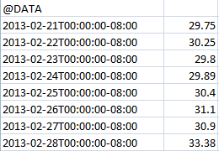
Data Preprocessing
Sort the data based on time;
Sample the data daily:
Original data is every 10 minutes;
Choose the close price each day.

Slide 7
Algorithms
Bayesian Curve Fitting
A statistical technique to learn the pattern of previous datasets and make prediction for future values based on the model learned.
Support Vector Machine (SVM)

Slide 8
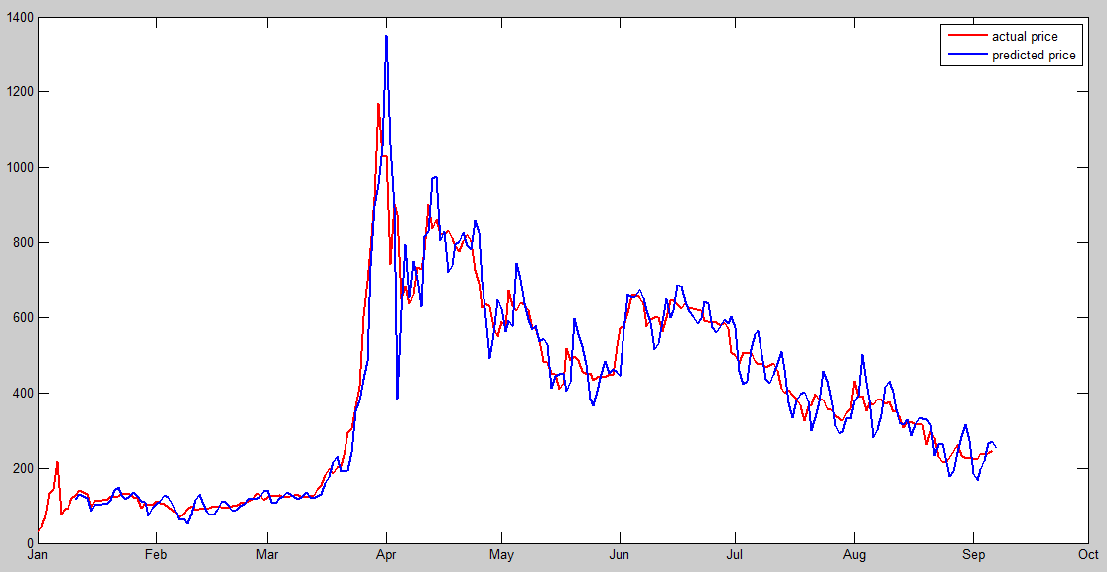
Algorithms
Bayesian Curve Fitting

Slide 9
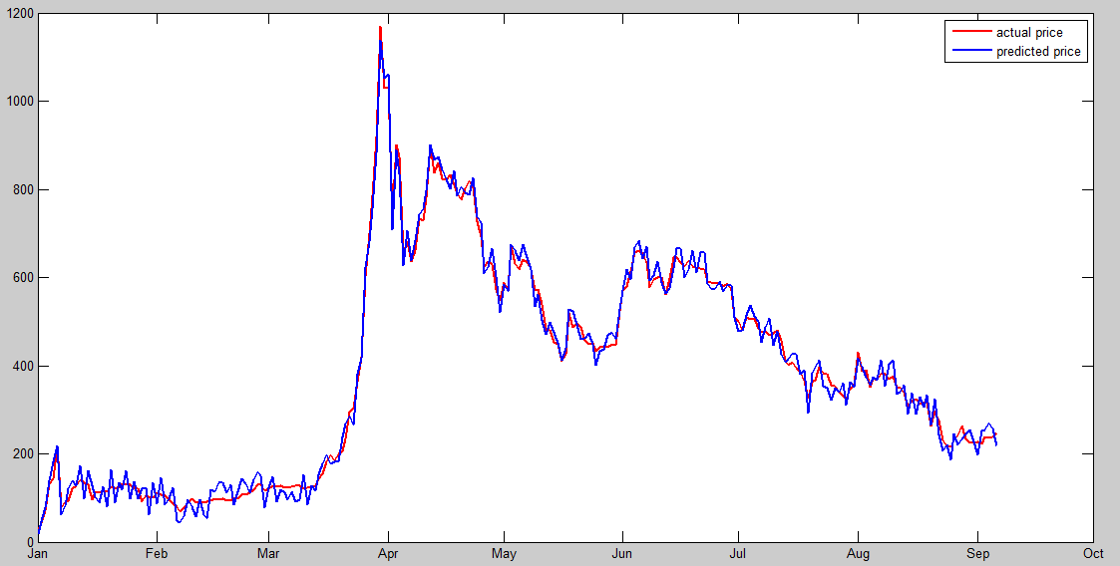
Algorithms
Support Vector Machine (SVM)

Slide 10
Evaluation
Mean square error rate
Relative mean square error rate
Algorithms | MSE | RMSE
Bayesian | 80.0633 | 0.2310
SVM | 38.3960 | 0.1775
Google stock | 16.7943 | 0.0307
Bitcoin price is fluctuating, thus RMSE is not as good as that of a traditional stock price prediction.

Slide 11
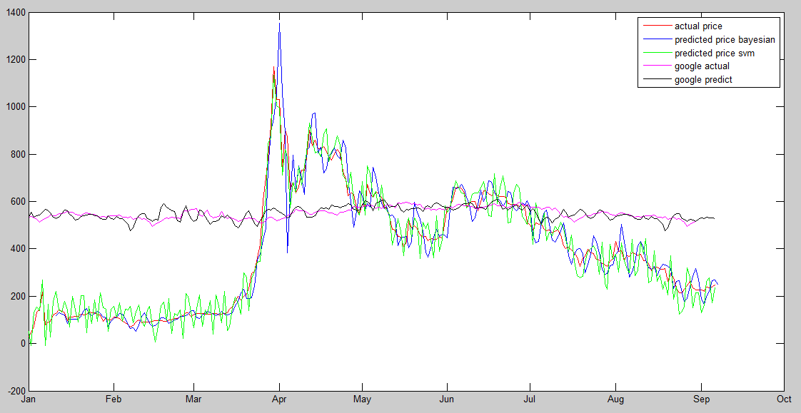
Comparisons
Apply the algorithm to stock price and compare
Bitcoin price
Google stock price

Slide 12
Algorithms
Moving Average Trend Classifier
Based on previous prediction values, by further comparing the average value of current window and the average of the next period, we can tell the trend for a particular day;
Use weighted average to indicate the trend weekly and monthly.

Slide 13
Evaluation
Confusion Matrix (weekly trend classifier)
Bayesian Based | Predicted Class
Actual Class |  | C_IN | C_DE
 | C_IN | 44 | 1
 | C_DE | 4 | 1
SVM Based | Predicted Class
Actual Class |  | C_IN | C_DE
 | C_IN | 47 | 1
 | C_DE | 1 | 1
TPR = 0.9778; FPR = 0.8 TPR = 0.9792; FPR = 0.5

Slide 14
Algorithm
New ways to do Bitcoin price analysis?
Google trend
Sentimental analysis

Slide 15
Conclusion
SVM outperforms Bayesian curve fitting in terms of large number of datasets;
These traditional method to analyze Bitcoin price is not as good as analysis for the stock market;
??? Other???
Future work

