Slide 1
Bitcoin Price Analysis - Data Mining Course Project
Yulong Yang
Yaqin Tang

Slide 2

Background
What is Bitcoin?
A form of digital currency;
Created and held electronically in 2009;
Decentralized, no middle bank;
No physical printed version;
Anonymous;
and more …
Notes:
http://money.cnn.com/infographic/technology/what-is-bitcoin/
http://www.coindesk.com/information/what-is-bitcoin/

Slide 3
Motivation

Slide 4

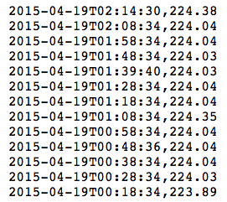
Datasets
Bitcoin historical price data
BTC - USD
==> time series forecast!

Slide 5
Algorithms
Traditional way:
Bayesian Curve Fitting;
Support Vector Machine (SVM);
Moving Average Trend Classifier;
Google Trend Analysis
Sentimental Analysis

Slide 6
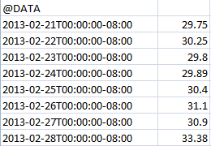
Data Preprocessing
Sort the data based on time;
Sample the data daily:
Original data is every 10 minutes;
Choose the close price each day.

Slide 7
Algorithms
Bayesian Curve Fitting
A statistical technique to learn the pattern of previous datasets and make prediction for future values based on the model learned.
Support Vector Machine (SVM)

Slide 8
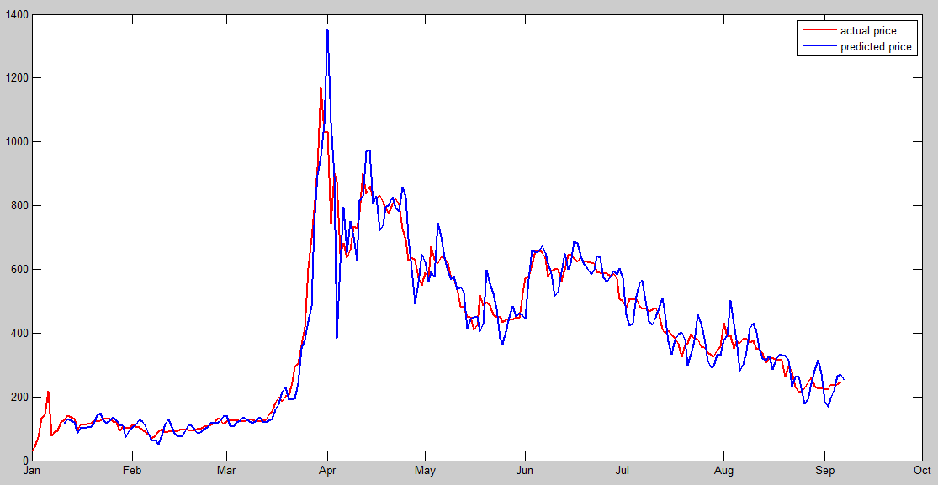
Algorithms
Bayesian Curve Fitting

Slide 9
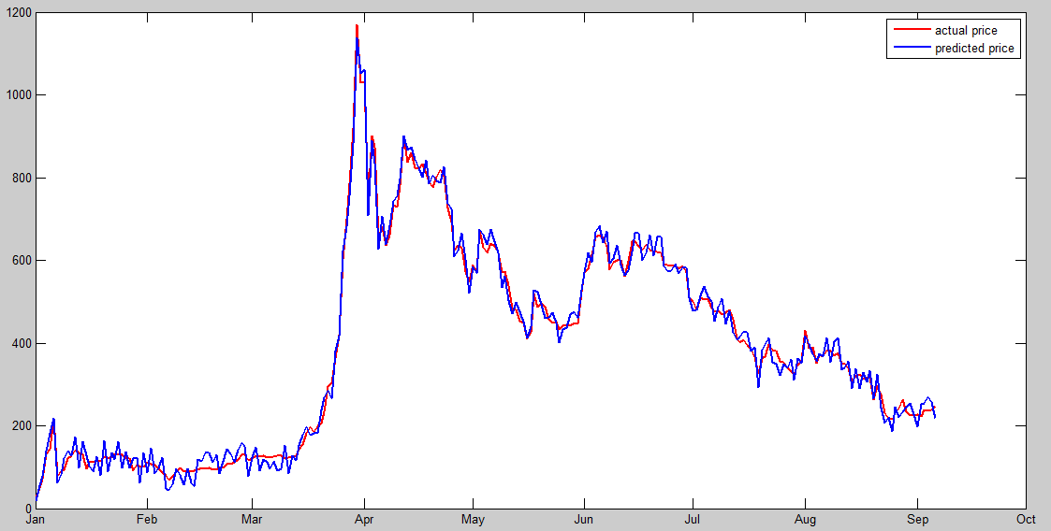
Algorithms
Support Vector Machine (SVM)

Slide 10
Evaluation
Mean square error rate
Relative mean square error rate
Algorithms | MSE | RMSE
Bayesian | 80.0633 | 0.2310
SVM | 38.3960 | 0.1775
Google stock | 16.7943 | 0.0307
Bitcoin price is fluctuating, thus RMSE is not as good as that of a traditional stock price prediction.

Slide 11
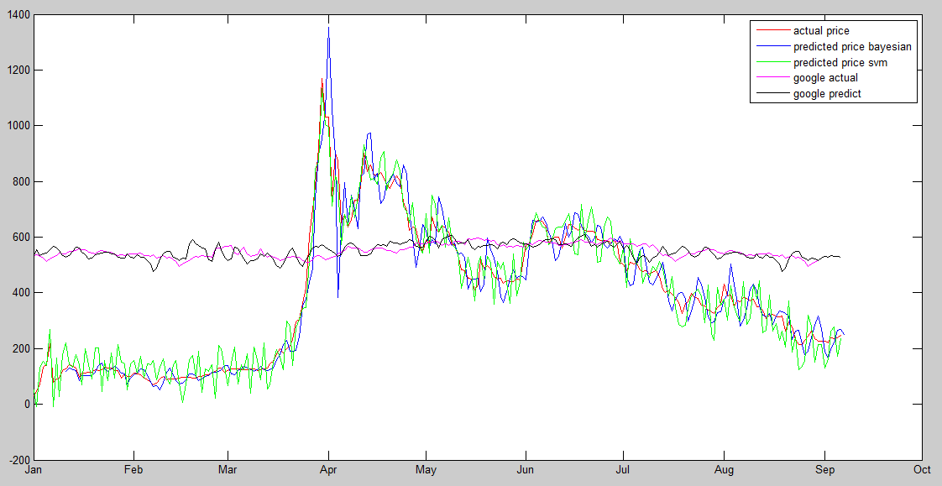
Comparisons
Apply the algorithm to stock price and compare
Bitcoin price
Google stock price

Slide 12
Algorithms
Moving Average Trend Classifier
Based on previous prediction values, by further comparing the average value of current window and the average of the next period, we can tell the trend for a particular day;
Use weighted average to indicate the trend weekly and monthly.

Slide 13
Evaluation
Confusion Matrix (weekly trend classifier)
Bayesian Based | Predicted Class
Actual Class |  | C_IN | C_DE
 | C_IN | 44 | 1
 | C_DE | 4 | 1
SVM Based | Predicted Class
Actual Class |  | C_IN | C_DE
 | C_IN | 47 | 1
 | C_DE | 1 | 1
TPR = 0.9778; FPR = 0.8 TPR = 0.9792; FPR = 0.5

Slide 14
Algorithm
New ways to do Bitcoin price analysis?
Google search trend
News Sentimental analysis

Slide 15
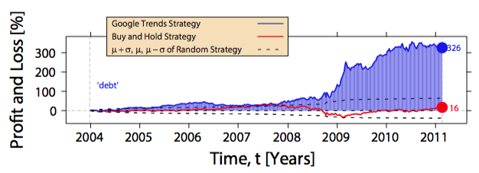
Google trend analysis
Inspired by previous work (Tobias Preis 2013)
Investment is a 2-step process
Gather information (via Google search)
Invest
Google search volume ⬄ Stock price

Slide 16
Google trend analysis
Same works for Bitcoin too?
Data source
Google search interest index (SI): 0-100
Keyword: bitcoin
Bitcoin price data
Preprocessing
Sampled price data to be weekly to align with search data
Only used data of 2012-2015 as earlier search data is too small

Slide 17
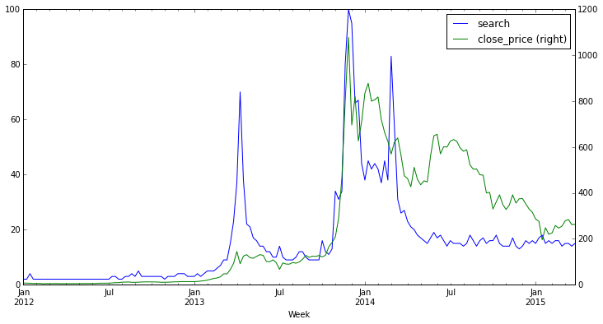
Google trend analysis
Same works for Bitcoin too?
Correlation 0.73, very high!

Slide 18
Google trend analysis
Algorithm
Scenario: to predict if price of next week will rise or fall
Given historical data
For week i
SI of week i > average of SI of previous t weeks => predict price to fall (-)
Otherwise, predict price to rise (+)

Slide 19
Google trend analysis
Results
Use data of 2012-2015, 173 data points
Correct prediction: 42.4%
Worse than random guess!
Reason
Different metric: SI is normalized while search volume is not
Different investment logic

Slide 20
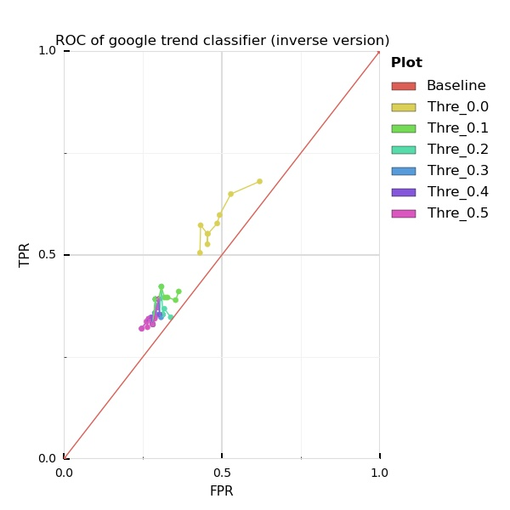
Google trend analysis
Results

Slide 21
News sentiment analysis
Make prediction/decisions of investing Bitcoin based on sentiment analysis of Bitcoin-related news

Slide 22
News sentiment analysis
Data source
Bitcoin price data 2012
341 pieces of news headline with keyword ‘bitcoin’ from New York Times
Preprocessing
Down-sampling price data
Interpolate news data into the price data

Slide 23
News sentiment analysis
Data source
Bitcoin price data 2012
341 pieces of news headline with keyword ‘bitcoin’ from New York Times
Preprocessing
Re-sampling price data to 12h interval
Interpolate news data into the price data
Calculate price change (12h) after each news occurs

Slide 24
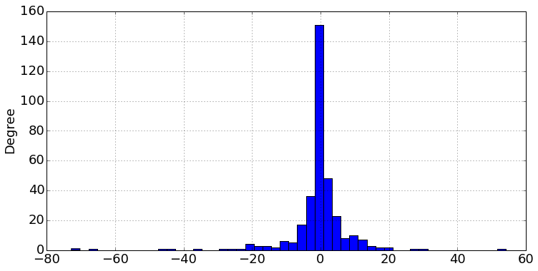
News sentiment analysis

Slide 25
Conclusion
SVM outperforms Bayesian curve fitting in terms of large number of datasets;
These traditional method to analyze Bitcoin price is not as good as analysis for the stock market;
More care needs to be taken to analyze Bitcoin market
Future work

