Slide 1
ASP.NET MVC
Yogesh Yadav

Slide 2
What is MVC?
The MVC pattern is 30+ years old!
It is a powerful and elegant means of separating concerns
It makes it easier to test application
It promotes parallel development thanks to the loose coupling between the three main components

Slide 3
MVC on the web today
Ruby on Rails
Django and Python
Spring, Struts and Java
Zend Framework and PHP
MonoRail
…

Slide 4
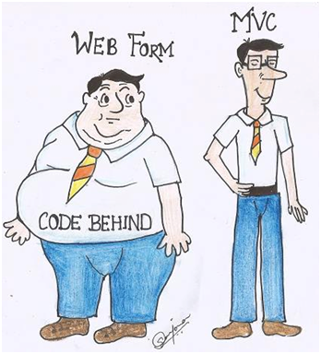
Comparison with ASP.NET web forms

Slide 5
What web forms does well
Represent a Page as control tree
Give these server-side controls events like their desktop counterparts
Hide as much HTTP and HTML as is reasonable
Make state management as transparent as possible

Slide 6
Where web forms doesn’t fit
ViewState is powerful, but it has its drawbacks (weight,…)
Page life cycle can be a nightmare
Limited control over HTML
Client IDs and the ctl00$ContentPlaceHolder1$UserControl1$TextBox1 syndrome
It’s nearly impossible to run a Web Form through its life cycle outside IIS

Slide 7
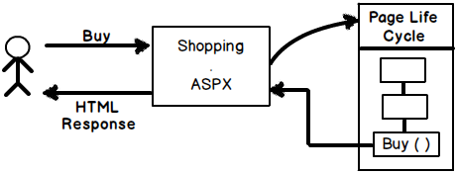
Web Form Request

Slide 8
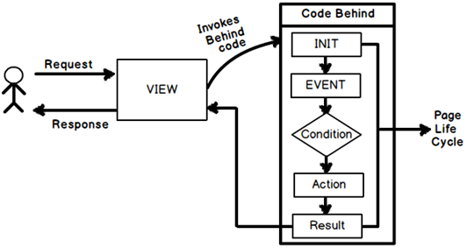
View Based Request

Slide 9
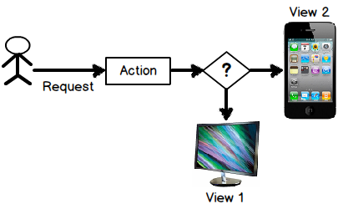

Slide 10
Should you fear ASP.NET MVC?
ASP.NET MVC is built on top of ASP.NET
ASP.NET MVC is not a replacement for anything
It is just an alternative
It’s a totally different approach
Embrace the web
User/SEO friendly URLs, HTML 5, SPA
Adopt REST concepts
Uses MVC pattern
Conventions and Guidance
Separation of concerns
View Engine

Slide 11
ASP.NET Core
ASP.NET WebForms
ASP.NET
MVC
Presentation
ASP.NET
Caching
.NET
Globalization
Pages
Controls
Master Pages
Runtime
Profile
Roles
Membership
Routes
Handlers
Etc...
11

Slide 12
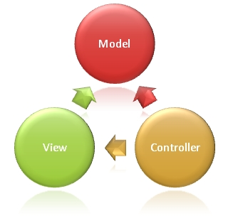
The MVC pattern
Model
objects are the parts of the application that implement the logic for the application’s data domain
View
components that display the application’s user interface
Controller
components that handle user interaction, work with the model, and ultimately select a view to render

Slide 13
Model
Business logic and validation of the application’s data domain
Totally independant from the views or the controllers
Model state can be stored in memory, database, XML files,…

Slide 14
View
Application’s user interface using data from the model
No interaction with the models or the controllers
Views can be strongly typed
Almost no code

Slide 15
Controller
Handle user interaction
Query the model
Select the right view to render

Slide 16
MVC Flow
Request
Controller
Step 1
Incoming request directed to Controller

Slide 17

MVC Flow
Controller
Model
Step 2
Controller processes request and forms a data Model

Slide 18

MVC Flow
Controller
View
Step 3
Model is passed to View

Slide 19
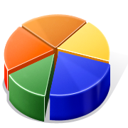
MVC Flow
Controller
View
Step 4
View transforms Model into appropriate output format

Slide 20
MVC Flow
Controller
View
Response
Step 5
Response is rendered

Slide 21
MVC Pattern in ASP.NET MVC
HTTP Request
/Users/Niki
Web server
ASP.NET MVC Routing engine
Select controller and invoke action (method)
User
Controller
(C# class)
HTTP Response
(HTML, File, JSON, …)
Select view & pass data (model)
CRUD model
View engine
(Razor)
Model (POCO)
Use model data

Slide 22

ASP.NET MVC ROUTING

Slide 23
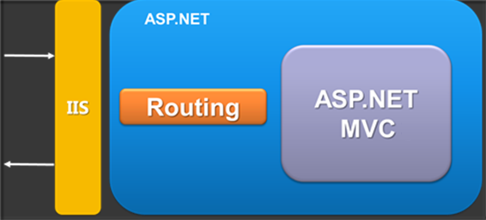
ASP.NET MVC ROUTING
Mapping between patterns and a combination of controller + action + parameters
Routes are defined as a global list of routes
System.Web.Routing.RouteTable.Routes
Greedy algorithm
the first match wins

Slide 24
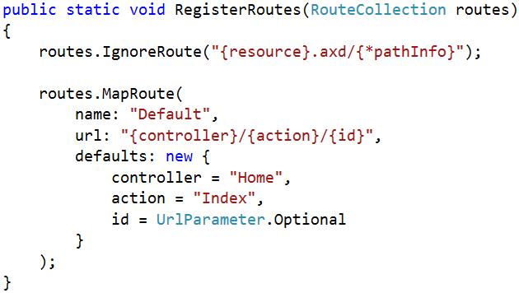
Register routes
In Global.asax in the Application_Start() there is RouteConfig.RegisterRoutes(RouteTable.Routes);
RoutesConfig class is located in /App_Start/ in internet applications template by default
Routes to ignore
The [*] means all left
Route name
Route pattern
Default parameters

Slide 25
Routing Examples
http://localhost/Products/ById/3
Controller: Products
Action: ById
Id: 3

Slide 26
Routing Examples
http://localhost/
Controller: Home
Action: Index
Id: 0 (optional parameter)
26

Slide 27
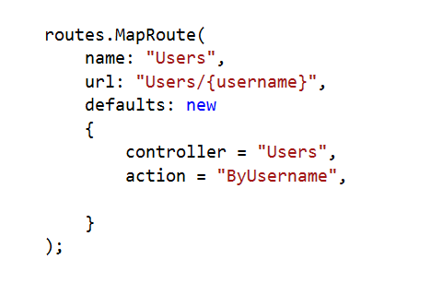
Custom Route
?
http://localhost/Users
Result: 404 Not Found
27

Slide 28
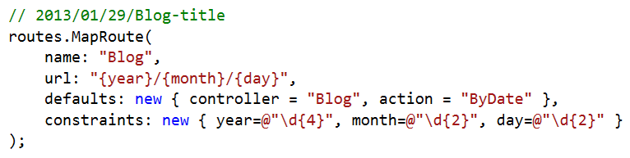
Route Constraints
Constraints are rules on the URL segments
All the constraints are regular expression compatible with class Regex
Defined as one of the routes.MapRoute(…) parameters
28

Slide 29
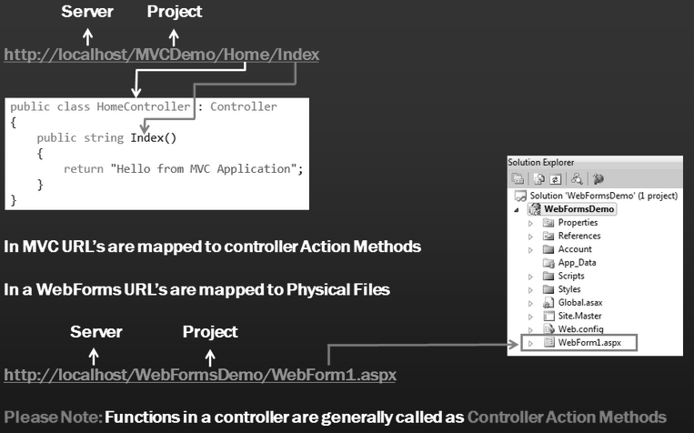
MVC Application

Slide 30
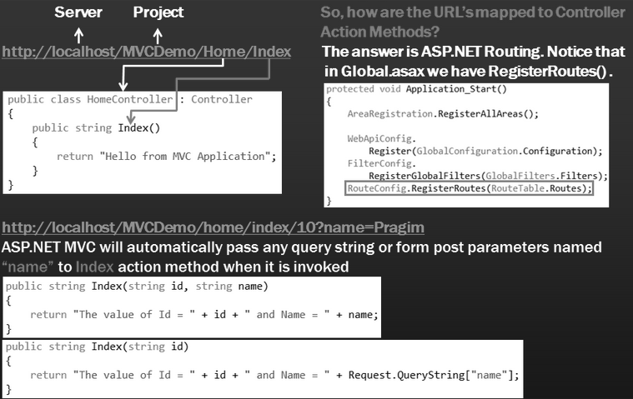
Controller in MVC Application

Slide 31
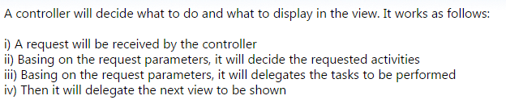
Controller

Slide 32
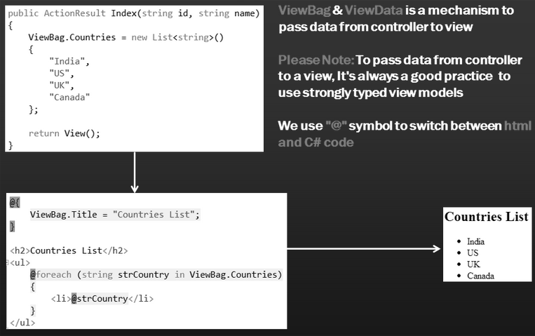
View in MVC Application

Slide 33
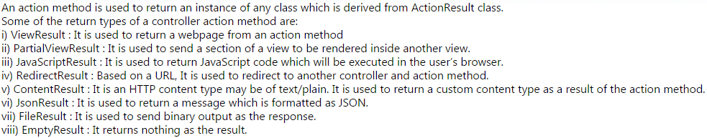
Action Method Return

Slide 34
Convention used by MVC to find views
Notice that, the Index() action method does not specify the name of the view. So, 1. How does asp.net mvc know, which view to use 2. What locations does asp.net mvc search
public ActionResult Index()
{
return View();
}

Slide 35
The view 'Index' or its master was not found or no view engine supports the searched locations. The following locations were searched: ~/Views/Employee/Index.aspx ~/Views/Employee/Index.ascx ~/Views/Shared/Index.aspx ~/Views/Shared/Index.ascx ~/Views/Employee/Index.cshtml ~/Views/Employee/Index.vbhtml ~/Views/Shared/Index.cshtml ~/Views/Shared/Index.vbhtml So, from the error message, it should be clear that, MVC looks for a view with the same name as that of the controller action method in the following locations 1. Views/Shared 2. Views/FolderNameMatchingControllerName

Slide 36
Please note that, the view extension can be any of the following a).cshtml b).vbhtml c).aspx d).ascx
If I have all of the following files in "Views/Employee" folder, then MVC picks up "Index.aspx" a) Index.aspx b) Index.cshtml c) Index.vbhtml d) Index.ascx

Slide 37
If you want to use "Index.cshtml" instead, then specify the full path as shown below. public ActionResult Index() { var employees = db.Employees.Include("Department"); return View("~/Views/Employee/Index.cshtml", employees.ToList()); } If you specify only the name of the view along with it's extension as shown below, you will get an error. return View("Index.cshtml", employees.ToList()); If you want to use a view name which is not inside the views folder of the current controller, then specify the full path as shown below. public ActionResult Index() { var employees = db.Employees.Include("Department"); return View("~/Views/Home/Index.aspx", employees.ToList()); } Please note that asp.net mvc 1. Is all about convention over configuration 2. Views folder contains one folder for each controller and a "Shared" folder 3. Shared folder is used to store views shared between controllers. Master and Layout pages are stored in "Shared" folder.

Slide 38
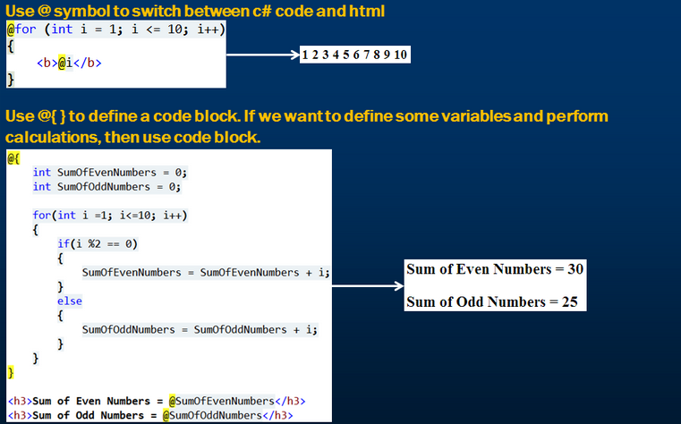
Razor view syntax

Slide 39
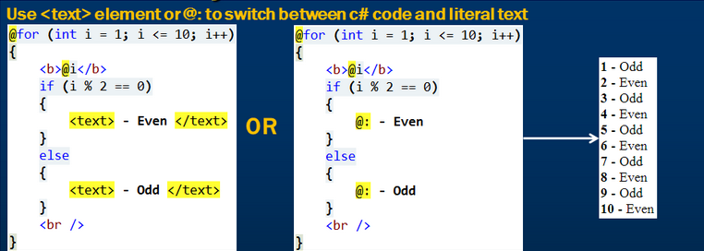
Razor view syntax

Slide 40
View Engines
Out of the box ASP.NET offers the following 2 View engines
1. ASPX
2. Razor
1. what is the difference between Razor and ASPX view engines?
It mostly, boils down to the syntax. otherwise there are no major differences between the two. In ASPX view engine, the server side script is wrapped between <% %>, where as in RAZOR we use @. Personally I prefer using RAZOR views, as it is very easy to switch between HTML and Code. Depending on the programming language you have chosen, RAZOR views have the extensions of .CSHTML or .VBHTML, where as ASPX views has extensions of .ASPX

Slide 41
2. Is it possible, to have both RAZOR and ASPX views in one application?
Yes, When you right click on any controller action method, and select "Add View" from the context menu, you will have the option to choose the view engine of you choice from the "Add View" dialog box.
3. Is it possible, to use a third party view engine with asp.net MVC?
ASP.NET MVC is designed with extensibility in mind. So, it's very easy to inculde third party view engine well.

Slide 42
Custom View Engine
In addition to the 2 view engines(ASPX & RAZOR), there are several custom view engines that can be used with asp.net mvc. The following are a few of these custom view engines. 1. Spark 2. NHaml 3. SharpDOM 4. Brail etc....
If you want to use Spark as the view engine for your asp.net mvc 4 project, then install Spark.Web.Mvc4 using NuGet Package Manager.

Slide 43
Add Spark View Engine
Step 1: Navigate to the following path and create a folder with name="Spark". Spark specific templates must be copied into "Spark" folder. C:\Program Files (x86)\Microsoft Visual Studio 10.0\Common7\IDE\ItemTemplates\CSharp\Web\MVC 4\CodeTemplates\AddView
Step 2: Create an xml file with in "Spark" folder. The name of the XML file must be"ViewEngine.xml" and must contain the following xml content. <?xml version="1.0" encoding="utf-8" ?> <ViewEngine DisplayName="Spark" ViewFileExtension=".spark" DefaultLayoutPage="~/Views/Shared/_Layout.spark" PartialViewFileExtension=".spark" />

Slide 44
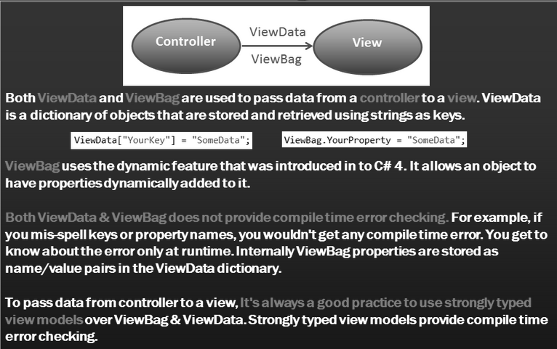
ViewBag vs ViewData

Slide 45
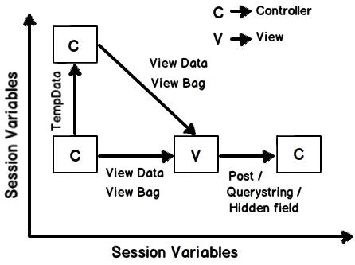
Data Manage

Slide 46
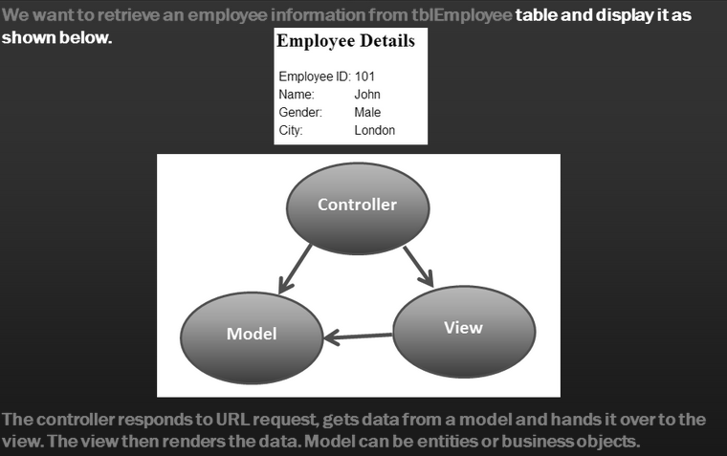
Model in MVC Application

Slide 47
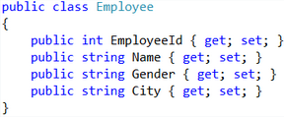
Data Access in MVC Application
The Controller responds to URL request, gets data from a model and hands it over to the view. The view then renders the data. Model can be entities or business objects.
Retrieving data from a database table tblEmployee using entityframework. Here business object as our model.
Step 1. Install entity framework using nuget package manager.
Step 2. Add EmployeeContext.cs class file to the Model folder.
Step 3. Add a connection string, to the web.config file, in the root directory

Slide 48
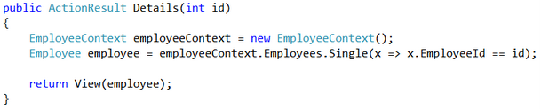
Step 4: Map "Employee" model class to the database table, tblEmployee using "Table" attribute.
Step 5 : Make the required changes to "Index()" action method in "Home Controller"
Step 6: Add in global.asax in Application_Start()
Database.SetInitializer<MVCModel.Models.EmployeeContext>(null);

Slide 49
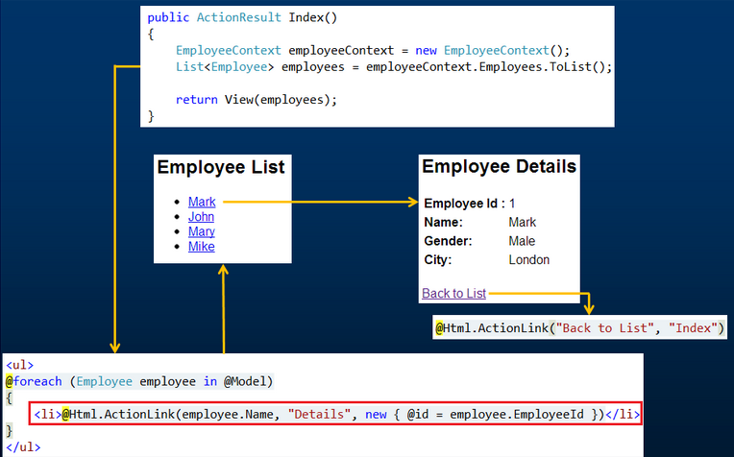
Generating Hyperlinks

Slide 50
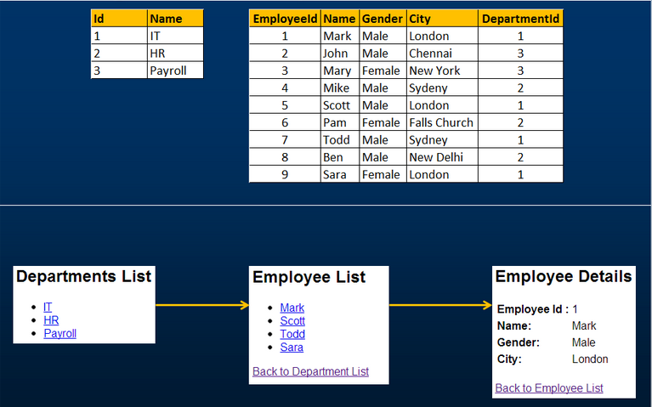
Working with multiple table

Slide 51
Question

Slide 52
How do I live without ViewState in MVC?
We know, web is stateless. Web Controls are gone in MVC. There are no events firing on the server side. This is replaced by two different mechanisms--URLs and POSTing form data. Proper use of these will replace your need for the ViewState.
Suppose In a conventional ASP.NET web application, you would place a LinkButton on your webpage that would perform function X. ASP.NET would stick lots of ViewState. when the user clicks on the button and "posts back" to the website (by submitting a form nobody knows existed), ASP.NET reconstructs what happened and determines a particular button event handler must be executed.

Slide 53
In MVC, you construct your link to access a particular route. The route describes what the user wishes to do--/Users/Delinquent/Index. The routing system in MVC determines which Controller will handle this route and which method on that controller will execute. Any additional information can be transmitted to the controller method by URL query string values.
So you "maintain" state via query strings and form POST values. You'll find that, in fact, there isn't that much state to maintain in the end. In fact, having to maintain lots of state is a good indication that your design is lacking or that you're trying to do something that doesn't fit a website model.

