Slide 1
Distributed Software Engineering
Security
David A. Wheeler
SWE 622 George Mason University

Slide 2
this lecture security
requirements and concerns
secure channels
confidentiality, integrity, authentication
access control
key distribution, signatures
security design & implementation basics
credits: Kevin Mills, Shawn Butler

Slide 3
security requirements
confidentiality
prevent information disclosures to unauthorized entities
integrity
protect against unauthorized or malicious modification or destruction of assets
availability
protect against denial-of-service attacks
non-repudiation
prevent entities from denying their role in actions or communications

Slide 4
security has tradeoffs
suppose you just moved to a new house
do you change the locks?
do you hire a 24/7 security guard?
how much added protection?
cost?
required infrastructure?
do you leave the door unlocked?
nothing worth stealing
you trust the neighborhood is safe
Notes:
What’s the threats?
What assets do I have?
Against what?
How much do I want to invest?

Slide 5
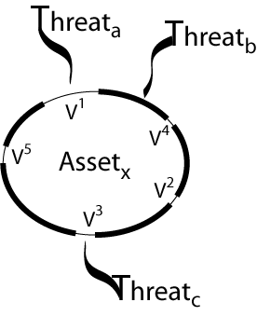
security is about managing risk
security architecture:
set of mechanisms and policies incorporated in a system for purposes of mitigating the risks from threats
threat: potential event that could compromise a security requirement
attack: realization of a threat
vulnerability: a characteristic or flaw in system design or implementation, or in the security procedures, that, if exploited, could result in a security compromise
Notes:
Managing Risk
Threat – Potential event
Threat agent – event agent
Attack – actual happen. It has happened.
Vulnerability – attacker uses it.

Slide 6
security has costs and benefits
deciding how much to protect
benefit of security, for all threats:
expected losses in case of attack, times
chances of attack
acquisition
engagement
cost of security
development & maintenance
complex software
infrastructure
product licensing
bigger &/or dedicated machines (e.g., firewalls)
degraded performance
encryption, authentication, authorization…
point of view of an attacker
benefit of a successful attack
cost of initiating the attack
potential (civil) penalties
Notes:
Encryption cost is ver low these days.
CPU built-in encryption.

Slide 7
choose security solutions based on cost/benefit analysis
deciding how much to protect
benefit of security, for all threats:
expected losses in case of attack, times
chances of attack
acquisition
engagement
mechanism 1
cost
effectiveness
?
ex: cost $30k, 60% effective
mechanism 2
ex: cost $50k, 90% effective
ex: losses $200k
chances 50%
benefit $100k
mechanism 3
ex: cost $5k, 50% effective
nagging question: can you ever think of all threats?
Notes:
Cost vs effectiveness

Slide 8
security solutions are organized around the concerns
protection
secure channels
authentication
communicating parties are who they say they are
confidentiality and integrity:
third parties cannot interfere in the communication
access control
authorization
which entities can access which assets and operations
accountability
always knowing who did what
non-repudiation
entities cannot get away with denying actions
detection
recovery
Notes:
Accountability – Ex) login
Recovery – restore from backup

Slide 9
outline
requirements and concerns
secure channels
encryption
confidentiality
integrity
authentication
access control

Slide 10
three fundamental tools: symmetric & asymmetric encryption, hashing
symmetric encryption, aka shared secret key
M = D_{K} (E_{K} (M))
M is the data, D is decrypt, E is encrypt, and k is the key
computationally efficient
asymmetric encryption, aka public key/private key
M=D_{K}⁻ (E_{K}⁺ (M))=D_{K}⁺ (E_{K}⁻ (M))
K⁺ is public key, and k⁻ is private key
computationally expensive
hashing & MACs
S = H(M), or S = MAC_{K} (M)
S, aka digest, is a unique representation of data such that change to the data will change the representation
fixed size and independent of size of M
collision resistant (both weak and strong)
computationally efficient
Notes:
Shared secret key – Very fast
Public key/private key - slow
S – digest

Slide 11
confidential communication with symmetric encryption: key is shared among trusted peers, but kept from others
plaintext P
ABCDE…
cyphertext C
K%U@Y…
body of message is encrypted with E_{K}, not header (routing)
network may have its own encryption with a different key
E_{K}(P)
secret Key K
encryption may be supported by hardware or software
DES and Triple DES
IDEA
XOR
Advanced Encryption Standard (AES)
D_{K}(C)
plaintext P
ABCDE…
cyphertext C
K%U@Y…
secret Key K
Notes:
These days - AES

Slide 12
confidential communication with asymmetric encryption: each node makes its public key available to all
cyphertext C
K%U@Y…
plaintext P
ABCDE…
when a node B wants to send a message to node A, it obtains A’s public key and uses K⁺_{A} to encrypt the message
only A can decrypt the message using its private key K⁻_{A}
E_{K}⁺_{A}(P)
K⁺_{A}
K⁻_{A}
plaintext P
ABCDE…
D_{K}⁻_{A}(P)
examples of algorithms
RSA (Rivest, Shamir & Adleman)
Diffie-Hellman
DSS (Digital Signature Standard)
Elliptic-Curve
cyphertext C
K%U@Y…
node A
Notes:
RSA– most common

Slide 13
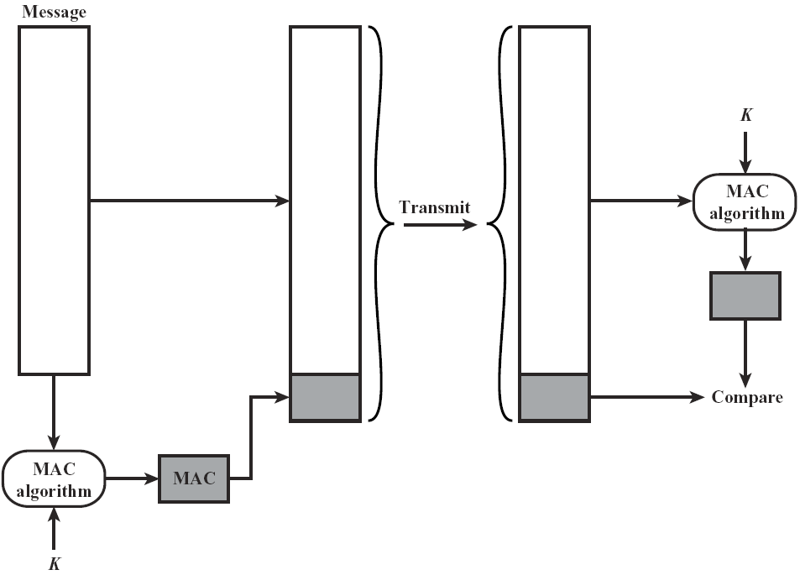
integrity verification based on shared secret key
malicious interceptor changes contents
discard message if comparison fails
MAC: message “authentication” code, aka digest
computed similarly to cryptographic hash functions
Notes:
Message -> Mac algorithm -> digest -> send -> other MAC receives -> use digest -> COMPARE these 2 if not match, toss it(throw it out).

Slide 14
integrity verification works complementarily or alternatively to confidentiality
does integrity verification work if messages are sent in the clear?
in which circumstances would you want to send messages in the clear?
read vs. tamper
performance
what if messages are encrypted,
why would you want to add a MAC to an already encrypted message?
Notes:
This provides integrity.
Not authentication/security.

Slide 15
authentication and integrity verification cannot be separated
the story so far:
encryption assures that only the communicating parties understand the contents of a message
integrity verification assures the receiver that the message was not modified in transit
but, how good is that if the receiver can’t be sure of who sent the message?
integrity requires authentication
conversely, how good is it if the receiver is sure of who sent the message, but can’t be sure it wasn’t tampered with
authentication requires integrity
Notes:
Authentication and integrity TOGETHER. Think about the example from book.

Slide 16
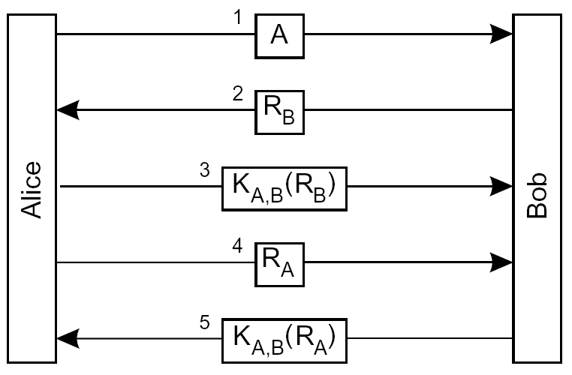
authentication based on a shared secret key
signal intention to communicate
each party challenges the other to show it knows the secret shared key
assumption: nobody else but A and B could have used K_{A,B}
should or could Alice encrypt the first message?
hint: would Bob know how to decrypt it?
could this protocol be optimized?

Slide 17
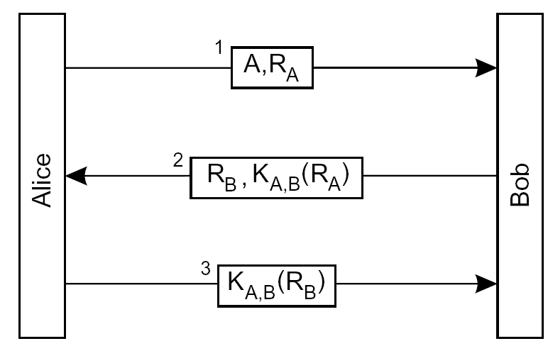
authentication based on a shared secret key
could this protocol be optimized?
piggyback challenges and replies
Notes:
Optimized method from previous slide.

Slide 18
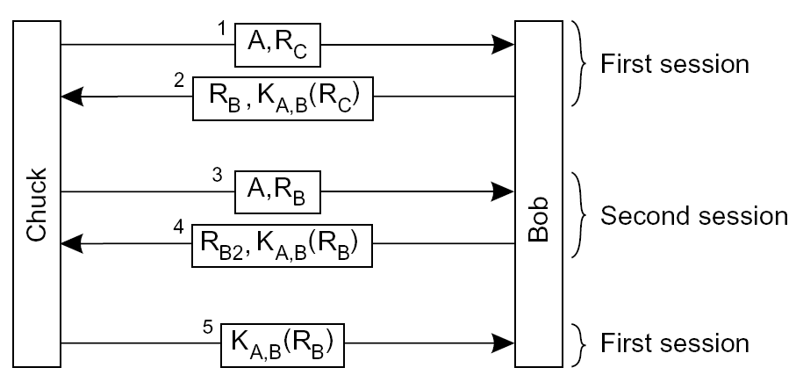
it is hard to design authentication protocols that work
Chuck could trick Bob into revealing the answer to the challenge by starting a second session (aka replay attack)

Slide 19
it is hard to design authentication protocols that work
so why does the first protocol work?
do not give away information unless you know to whom you are giving it
always use different challenges

Slide 20
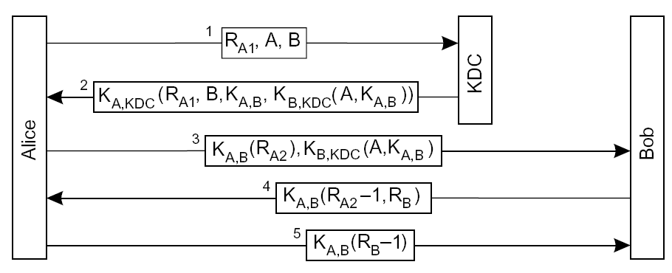
authentication can be facilitated by a trusted third party
Needham-Schroeder
each peer holds a secret key shared with the Key Distribution Center (KDC)
1 is in the clear – why?
each challenge is a nonce (used only once)
in 2, R_{A1} being encrypted with K_{A,KDC} authenticates the KDC to A
2 containing B prevents a man in the middle attack where Chuck could modify 1 to R_{A1},A,C and lead Alice to think she is talking to Bob
3 containing R_{A2} and 4 containing R_{A2}-1 authenticates B to A: the modification prevents replay; 5 authenticates A to B
having a new key issued by the KDC for each session limits cryptanalysis attacks
Notes:
KDC

Slide 21
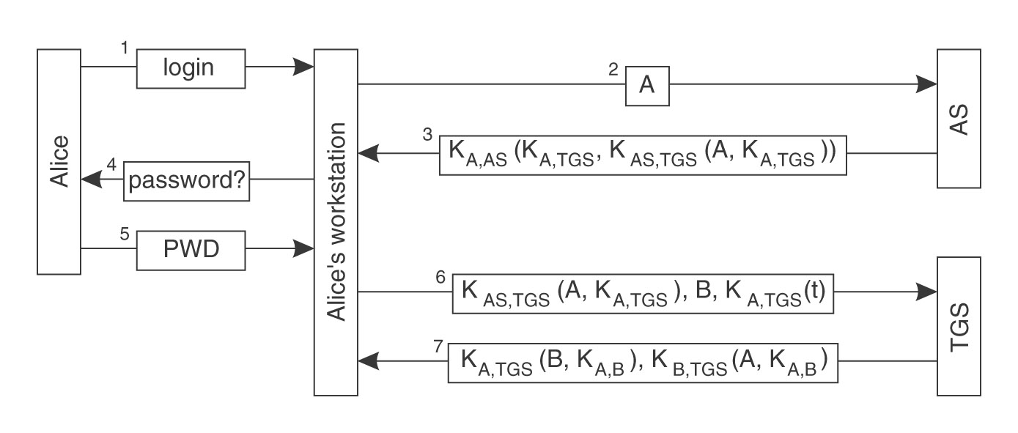
authentication facilitated by trusted third parties example: Kerberos
Alice’s pwd is used to generate (by hashing) the shared key K_{A,AS}
3 containing K_{AS,TGS}(A,K_{A,TGS}) allows A to authenticate with TGS
3 containing a session key K_{A,TGS} allows A to exchange confidential information with the TGS
6 containing an encrypted timestamp limits replay attacks
7 corresponds to message 2 in the Needham-Schroeder protocol
Notes:
Kerberos
AS - Authentication service
TGS - T Granking service?

Slide 22
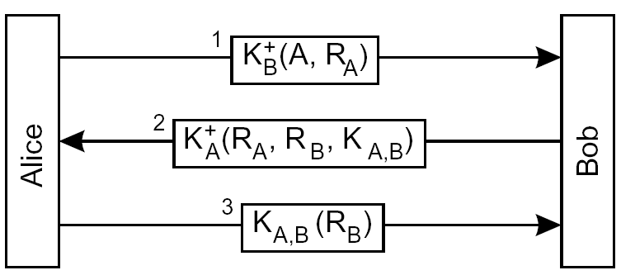
authentication is much simpler with asymmetric encryption
only B can decrypt A’s nonce using B’s private key
only A can decrypt B’s reply using A’s private key
2 containing R_{A} authenticates B with A
3 containing R_{B} encrypted with the session key generated by B authenticates A with B
K⁺_{B} is B’s public key
assumes peers have each other’s public key available
assumes that public keys are not forged
nagging question: how can public keys be obtained in a secure way?
Notes:
NOW Asymmetric
Public key is much simpler.

Slide 23
outline
requirements and concerns
secure channels
access control
key distribution
signatures

Slide 24
chicken and egg…
all secure channel protocols seen above assume that various keys are available
but wouldn’t we need a secure channel to establish and distribute keys in the first place?
… and wouldn’t that secure channel require keys?
possible solutions are:
distribute the keys off-line (out-of-band)
or…

Slide 25
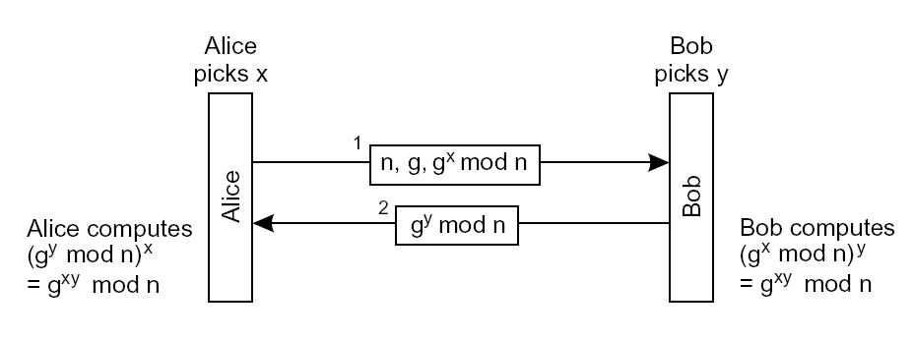
secret shared keys can be established over an unsecured channel
Diffie-Hellman
it is computationally infeasible to lift x out of g^{x} mod n, even given n and g
only Alice knows x, only Bob knows y
Alice computes the shared key, g^{xy} mod n, given x and Bob’s message, Bob does the same, given y and Alice’s message
others can listen to g^{x} mod n and g^{y} mod n, but still can’t assemble the shared key g^{xy} mod n
Notes:
Diffie-Hellman
Each person has the private key they can communicate

Slide 26
dynamically establishing a secret shared key assumes the two parties are already authenticated with each other
Diffie-Hellman
Alice needs to be certain she’s really talking to Bob
past authentication, Diffie-Hellman can be used to establish a session key recall: symmetric encryption is more efficient than asymmetric
the problem of how to distribute keys for authentication remains…

Slide 27
using symmetric encryption for authentication brings up scalability issues
in a system with N nodes, each node needs to keep track of N-1 pair-wise symmetric keys the number of distinct keys in the system is ~N ²
with asymmetric encryption each node has one public key that everyone else uses the number of distinct keys in the system is ~N
by their very nature, public keys don’t need to be kept confidential, but how can a node be certain that a public key really belongs to the peer it wants to address, and not to a malicious interceptor
the problem becomes: how to certify the authenticity of public keys

Slide 28
certification authorities distribute certified public keys
a CA stores and makes available pairs <public key, peer identifier>
these pairs are signed with the CA’s private key K⁻_{CA}
a node that wants to talk to A requests the pair <K⁺_{A},A> and verifies the certificate using the CA’s public key K⁺_{CA}
often, an expiration is also associated to the public keys distributed this way same as Kerberos’ tickets
public keys of various CAs are built into most web browsers and shipped with the binaries
how does signing work?
Notes:
CA.
In web browser – this is built-in. Public keys of various CAs.
Web browser – https ask to server and get key and authority.

Slide 29
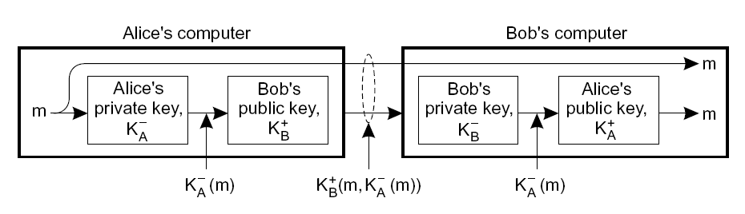
signing is based on the properties of asymmetric encryption
a possible signature is the message encrypted with Alice’s private key: K⁻_{CA}
the message and signature are sent protected by Bob’s public key
Bob decrypts the signature with Alice’s public key and compares it to the original message: if they match, only Alice could have used her private key to create the signature
however asymmetric encryption and decryption of the whole message is expensive
Notes:
SIGNING - typical way
Too soft

Slide 30
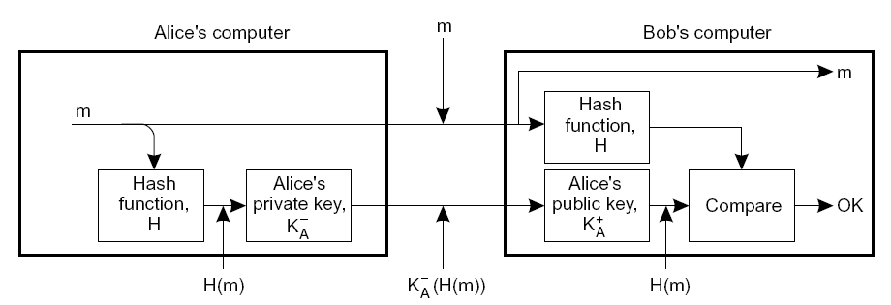
signing can be made more efficient by combining it with hashing
Alice may sign only the message digest
Bob also computes the digest (needs to share a key with Alice for that)
Bob decrypts the signature with Alice’s public key and compares it to the digest he computed
Notes:
Hash function – fast.
COMPARE.
Verify this message is from Alice.

Slide 31
signing serves two purposes: certification of origin & non-repudiation
when a recipient receives a signed message it can be certain of the origin
because no one else could have used the private key to produce the signature, the originator cannot deny producing the message
because of the properties of encryption (used for signing) a signature supports verifying message integrity

Slide 32
discussion
user A wishes to send a 500Kb message m to user B such that
only B can read it
authenticated as coming from user A
can be encrypted/decrypted within 15 seconds
suppose
public key algorithm can encrypt messages at 1Kbps
symmetric key algorithm can encrypt/decrypt at 1Mbps
no symmetric keys are initially shared
256 bit hashing algorithm can process messages at 100Kbps
size of both A’s id, and symmetric key is 256 bits
how should m be formatted?
Notes:
Asymmetric message – too slow
Asymmetric key
Encryption -
Send key (not message) and use key (from the other side) then decrypt
Authentication -
Hashing algorithm function
Encryption with user’s private key,
Then receiving person will decrypt with public key.

Slide 33
Security design & implementation basics

Slide 34
Saltzer and Schroeder design principles (1)
Least privilege
Each user and program should operate using fewest privileges possible
Limits the damage from an accident, error, or attack
Reduces number of potential interactions among privileged programs
Unintentional, unwanted, or improper uses of privilege less likely
Extend to the internals of a program: only smallest portion of program which needs those privileges should have them
Economy of mechanism/Simplicity
Protection system's design should be simple and small as possible
“techniques such as line-by-line inspection of software and physical examination of hardware that implements protection mechanisms are necessary. For such techniques to be successful, a small and simple design is essential.‘”
Aka “KISS” principle (``keep it simple, stupid'')
Notes:
Design principle (1970)
Lease privileg
Give less privilege
Simple

Slide 35
Saltzer and Schroeder design principles (2)
Open design
The protection mechanism must not depend on attacker ignorance
Instead, the mechanism should be public
Depend on secrecy of relatively few (and easily changeable) items like passwords or private keys
An open design makes extensive public scrutiny possible
Makes it possible for users to convince themselves system is adequate
Not realistic to maintain secrecy for distributed system
Decompilers/subverted hardware quickly expose implementation “secrets”
Even if you pretend that source code is necessary to find exploits (it isn't), source code has often been stolen and redistributed
This is one of the oldest and strongly supported principles, based on many years in cryptography
Kerckhoffs's Law: “A cryptosystem should be designed to be secure if everything is known about it except the key information”
Claude Shannon (inventor of information theory) restated Kerckhoff's Law as: “[Assume] the enemy knows the system”
Notes:
Open design
Mechanism should be public.
Easily changeable
Do not depend on secret design

Slide 36
Saltzer and Schroeder design principles (3)
Complete mediation (“Non-bypassable”)
Every access attempt must be checked; position the mechanism so it cannot be subverted. For example, in a client-server model, generally the server must do all access checking because users can build or modify their own clients
Fail-safe defaults (e.g., permission-based approach)
The default should be denial of service, and the protection scheme should then identify conditions under which access is permitted
Separation of privilege
Ideally, access to objects should depend on more than one condition, so that defeating one protection system won't enable complete access
Notes:
Non-bypassable
Web server security -> send JavaScript to client that gets the value.
Fail-safe
Denial service.
Separation of privilege
2 factor authentication

Slide 37
Saltzer and Schroeder design principles (4)
Least common mechanism (“limit shared things”)
Minimize the amount and use of shared mechanisms (e.g. use of the /tmp or /var/tmp directories)
Shared objects provide potentially dangerous channels for information flow and unintended interactions
Psychological acceptability / Easy to use
The human interface must be designed for ease of use so users will routinely and automatically use the protection mechanisms correctly
Mistakes will be reduced if the security mechanisms closely match the user's mental image of his or her protection goals
Notes:
Lease Common mechanism
Limit what’s shared.
Ex) components – minimized what’s shared
Easy to use

Slide 38
Other security design & implementation basics (1)
Minimize “attack surface”
Key application of least privilege – no interface, no problem
Do users need direct access to database? Maybe not
Rigorously validate input - restrict input to a whitelist
Whitelist = narrowly identifies what is allowed; all other things forbidden – do this
Blacklist = list of what is forbidden (all other things permitted) – do not use blacklists (in general)
Notes:
Minimize ‘attack surface’
Do not open the ports if not needed
Restrict input to a whitelist.
Start from al forbidden, then start from smallest permission. (WhiteList)

Slide 39
Other security design & implementation basics (2)
Know common mistakes & how to avoid them
SQL injection vulnerability – use prepared statements
Buffer overflows – select languages / libraries to eliminate/reduce risk
Cross-site scripting – encode responses
Don’t create your own crypto algorithms/protocols
Password database? Use salted hashes with key-stretching
Prevent, detect, contain, respond
Prevention best, but attackers resourceful
Also work to detect / contain /respond to reduce damage of successful attack
Take a course in secure design & implementation (ISA/SWE 681)
Notes:
Contain/respond

