Slide 1
Distributed Software Engineering
Mobility and Dynamic Adaptation
David A. Wheeler
SWE 622 George Mason University

Slide 2
outline
Mobility
Remote evaluation
Code on demand
Mobile agent
Adaptation
reasons for adaptation
making software adaptive
self-adaptive software

Slide 3
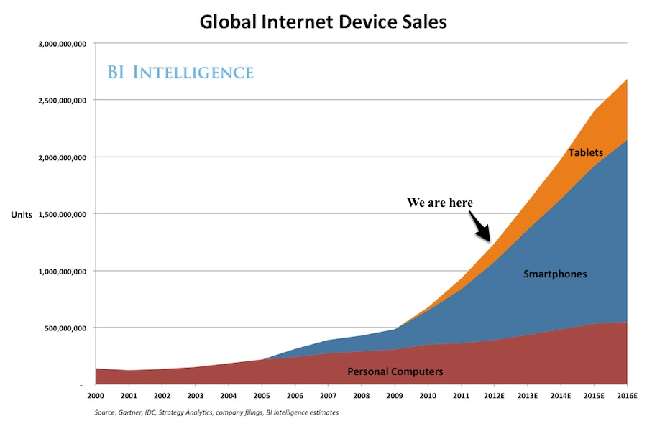
Major trends in Computing
Date of data
Notes:
Old slide
Mobile > tablets

Slide 4
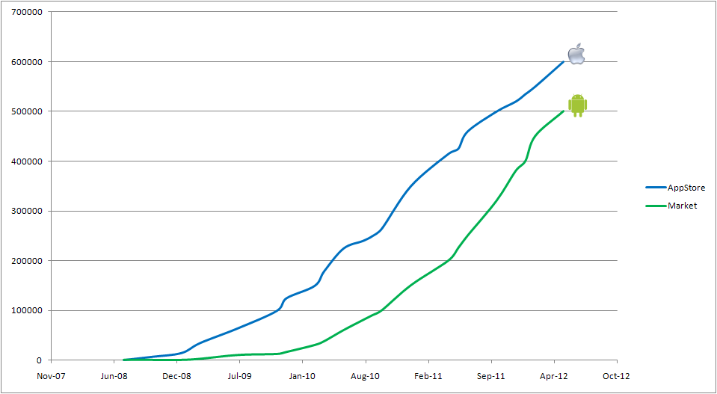
Mobile Apps: AppStore vs. Market

Slide 5
Evolution of Computing
Personal Computing - PC
Distributed Computing - LAN, WAN, Grid
Web Computing - WWW
Mobile Computing - PDAs, Cell Phones, SmartPhones
Pervasive Computing - !!!

Slide 6
Mobile Computing Characteristics
No fixed network structure
Temporary (?) loss of network connectivity
Nodes may come and go
Processes may move among nodes
Programs may evolve and change structure
Ad-hoc Resource Discovery
Scarce Resources
Low Battery Power
Slower CPU Speed
Smaller amount of Memory
Frequent and unannounced changes in the environment
Notes:
Ex: Smartphone
Move around
Scarce resource – mass CPU & RAM
Slower CPU speed (compare to other device and machines)

Slide 7
Constants are now Variables
Location
Environment
Connectivity
Bandwidth
I/O devices
Security Domain

Slide 8
What is mobility?
Physical
Movement of hosts in physical space: room, building, country, world, galaxy.
Location in physical world.
Logical
Movement of code & state among hosts
Move code, not just data
Location in network.
This lecture is about logical mobility
Notes:
Logical***

Slide 9
Mobile Code Technology
Motivation
local and remote interaction have different semantics in terms of latency, access to memory, partial failure and concurrency
The idea
distributed systems can dynamically change and move the execution units (software components)
Two classes of mobility
Weak mobility
Send some code to be executed remotely, start at “beginning”
Link and execute code downloaded from a remote location
E.g., Java Applets, client-side Javascript. Easier to implement!
Strong mobility
Execution units move among locations carrying their execution state with them (not just “start at the beginning”)
E.g., software agents, virtual machine migration
Notes:
Movement of code – mobile code
Move the data and move your code to same location(distribute) and make them faster. Ex: Hadoop & sparks
Moving code from server to browser (to your computer/browser)
execution state - Process, thread
Implementing cloud – strong mobility.
Strong mobility – super fast.
Pause the process, copy over to other server, then continue.
After that, it keeps the changes then send.
Send code snippet to cloud, then all cloud distributed system run. (Many)

Slide 10
Another way to group mobile code: Who’s the Initiator?
Receiver-initiated: Migration initiated by target machine (where code will run)
E.g., Java applets, client-side Javascript
Sender-initiated: Migration initiated by machine where code currently resides or is being executed
E.g., many process migration systems
Notes:
Receiver-Init
Client-side JavaScript
Sender-init
Send code out. Ask here is code run it.

Slide 11
Other differentiators…
If weak mobility (can only “start at beginning”):
Execute within same process?
Execute in different process?
If strong mobility, options:
Migrate process: Moving a running process?
Remote cloning: Create exact copy of process in parallel on remote machine (as a process “fork”)?
Notes:
Strong mobility – move stuff around. MOVE.
Harder to implement strong.> weak

Slide 12
From Technology to Design Paradigms
Abstract away from mobile code technology
Location, and mobility of both code and components should be taken into account at the design level
“Architectural styles” that employ some form of code mobility
Code On Demand
Remote Evaluation
Mobile Agent

Slide 13
Architectural Abstractions
Components
Resource components (Data, devices, code)
Computational components
Execution state
Private data
Bindings to other components (e.g., code)
Interactions
Sites
Support execution
Support cheap interaction
X
Site Y
Notes:
Architecture

Slide 14
Mobile Code Design Paradigms
Interaction patterns that define the coordination and relocation of components needed to perform a service
Service can be carried out when:
resources
know-how
computational component responsible for execution are at the same location
X
Site Y
Notes:
Interaction

Slide 15
A chocolate cake
Two friends Louise and Christine will cooperate in order to prepare a chocolate cake
To prepare the cake (the result of the service) Louise and Christine need
a recipe (the know-how)
some ingredients (resource that can be moved)
an oven to bake the cake (a resource that cannot be moved)
a person to mix the ingredients following the recipe (a computational component responsible for execution of the code).
To prepare the cake all these elements must be located in the same house at the same time.
Notes:
Recipe – code
Resource – move around
Database (very big size) – can’t move around
A person – CPU

Slide 16
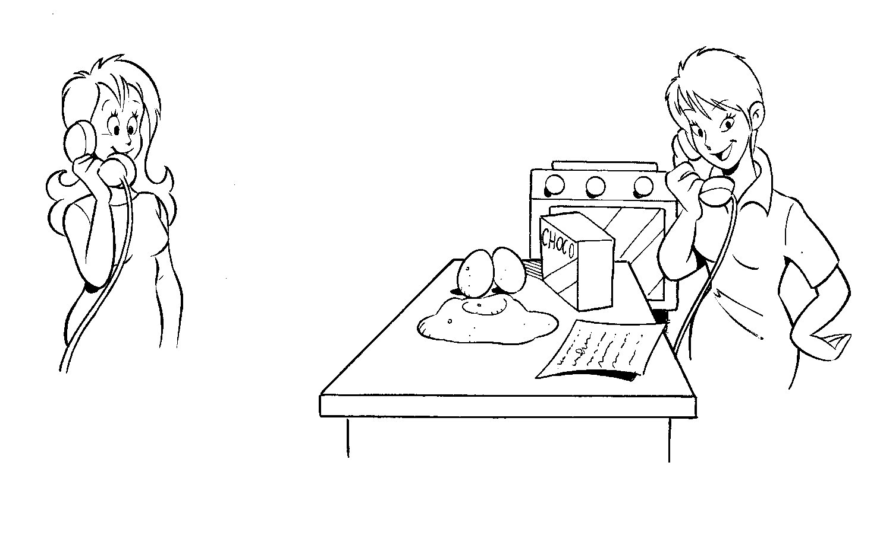
Client-Server
PLEASE, MAKE ME
A CHOCOLATE CAKE
A
Request
B
Reply
Site A
Site B
Notes:
*Easy to understand

Slide 17
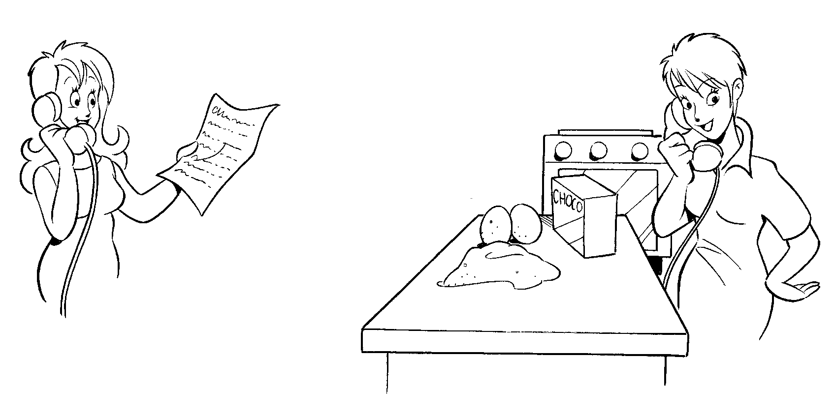
Remote Evaluation
PLEASE, MAKE ME A CHOCOLATE CAKE.
HERE IS THE RECIPE:
TAKE TWO EGGS...
A
Request
B
Reply
Site A
Site B
Notes:
Sending code
Cloud service – SiteB
Send code and get reply

Slide 18
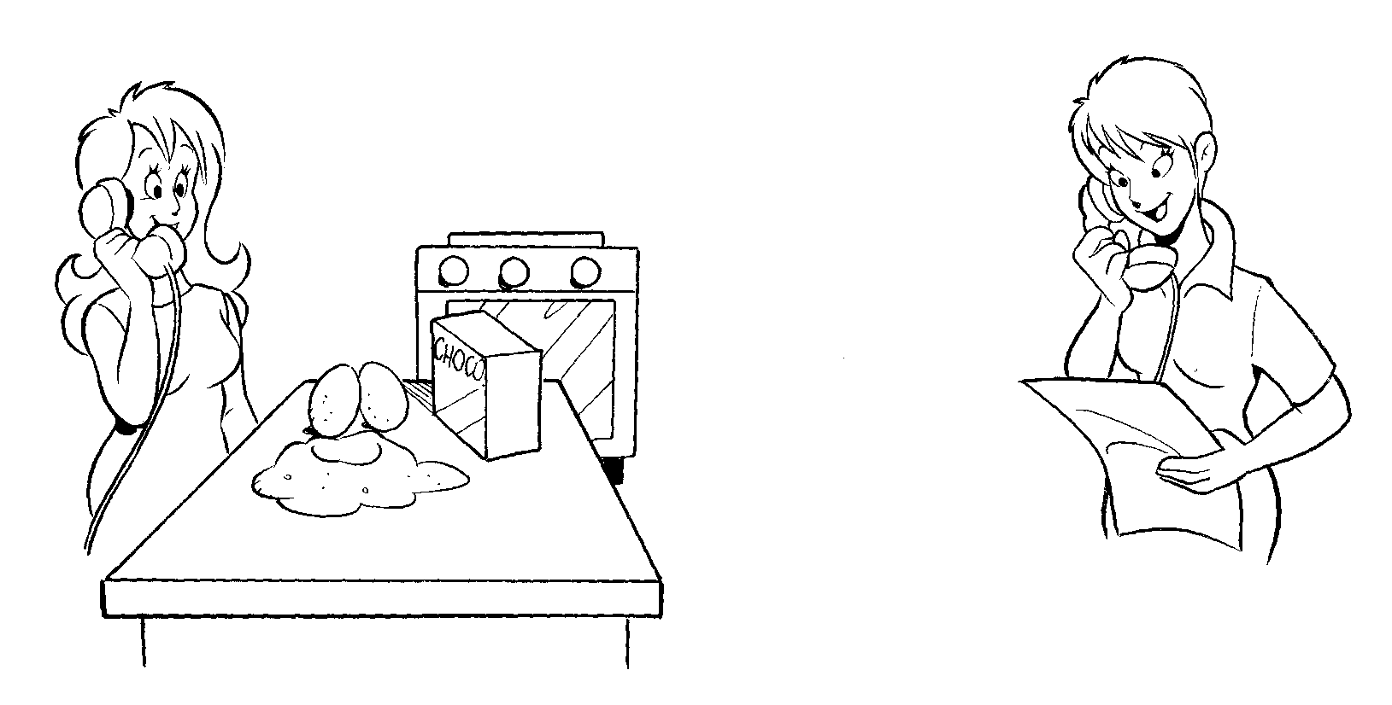
Code On Demand
PLEASE, TELL ME THE RECIPE
A
Request
B
Reply
Site A
Site B
Notes:
Asking for code
Less common these days
JavaScript (client-side)
You have data and request JavaScript code.

Slide 19
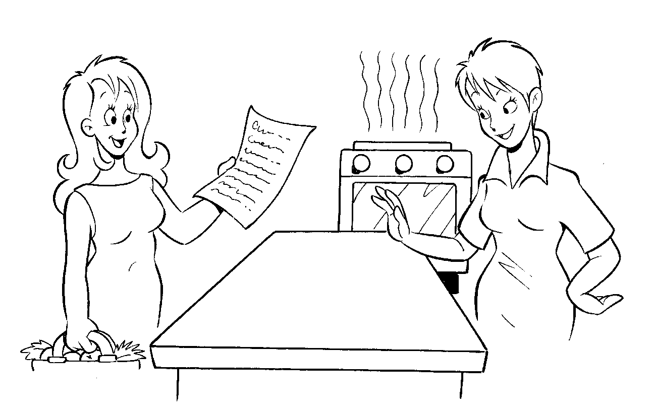
Mobile Agent
HERE I AM!
CAN I USE YOUR OVEN?
A
Move
Site A
Site B
Notes:
Less common
Problem– security

Slide 20
Why to Use Code Mobility?
Deployment and upgrade of distributed applications
REV and MA: “maintenance agents” go across the network to detect the current configuration/settings, and remove/install components
COD: lazy and automated propagation of changes
Customization of services
Service interfaces are usually defined statically and a priori
A server can be customized according to the specification of the code sent to it
E.g., sending a Postscript to a printer server
Support for disconnected operations
Code mobility to decrease network traffic, or in anticipation of network disconnection
Notes:
Why use?
COD – code on demand
Example of Client-size javascript
Download JavaScript now, if later, disconnected, you still have the code.

Slide 21
How to Use Code Mobility?
There is no “universally best” paradigm: client-server may still be the right answer
Trade-offs have to be analyzed on a case-by-case basis
How to evaluate the best solution?
In general, with respect to network traffic:
Mobile agent is bad if they gather data from one hop to the next
Remote evaluation and code on demand can be bad if the size of the code is larger than the size of the results
Client-server is bad if the size of the result (or exchanged messages) are very large
Notes:
NETWORK TRAFFIC
Mobile agent – security problem
Data getting bigger problem
Small code to big dataset – good
Big code to small dataset – bad

Slide 22
Requirements for Mobility
Dynamic Reconfiguration
Adaptivity
Asynchronous Interaction
Context-Awareness
Lightweight Middleware
Notes:
Javascript – why need dynamic reconfiguration because everyone has different browser

Slide 23
Code Mobility in Real World
Code mobility is daily reality
Client-side Javascript (weak)
Some use: Java Applets (weak)
Virtual machine migration in a cloud (strong)
But code mobility has not become as widespread as once envisioned
Many approaches, e.g., ActiveX, disappearing
Two important reasons:
Networks have become much more capacious and capable
More importantly, there has often been a lack of support for security concerns
Notes:
Client-side javascript again – WEAK
Why?
Networks gotten better / faster

Slide 24
Virus!!!
[June 23, 2004]
Mobile Computing Security Through Obscurity
Last week, Kaspersky Labs announced the discovery of the first virus to infect mobile phones. The virus, which Kaspersky named Cabir, affects mobile phones that use the Symbian OS. The virus is relatively harmless--its only purpose is to propagate itself, and it does so only to other phones that have Bluetooth enabled and are broadcasting their presence. However, Denis Zenkin, head of Corporate Communications at Kaspersky Labs, said that sooner or later, more malicious forms of mobile phone malware that will possibly destroy or steal data will begin to spread.
http://www.windowsitpro.com/Article/ArticleID/43071/43071.html

Slide 25
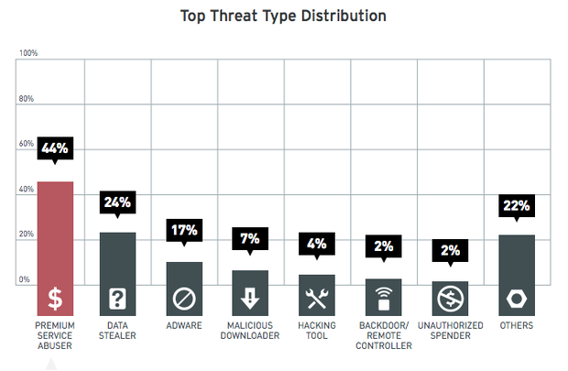
App malware is now standard ☹

Slide 26
Unavoidable Issues
Security
Trust
Privacy
Notes:
Security =>
Confidentially
Integrity
Protect data
Privacy =>
Not reveal identity

Slide 27
outline
Mobility
Remote evaluation
Code on demand
Mobile agent
Adaptation
reasons for adaptation
making software adaptive
self-adaptive software

Slide 28
An example scenario
consider a speech recognizer with two possible configurations:
local computation
average latency 3s
ship utterance to server
average latency 500ms + network latency
How to decide among the two?
utterance
text
Notes:
Where should I put speech recognizer?
Local vs server (latency)

Slide 29
Simple analysis
consider a speech recognizer with two possible configurations:
local computation
average latency 3s
ship utterance to server
average latency 500ms + network latency
utterance
latency
text
3s
local
server
latency is
one aspect of QoS
500ms
local is better
network latency
Notes:
Here we only care TIME

Slide 30
Quality of Service (QoS) often involves tradeoffs
consider a language translator with alternative computation strategies:
sophisticated algorithms over large dictionaries
high quality translation
efficient algorithms over most common instances
fast translation
latency
+
+
how to decide among possible computation strategies?
+
+
+
translation accuracy
Notes:
TRADEOFFs
Faster – but less quality
Slower – better quailty

Slide 31
user plays a key role in determining the configuration of services
consider language translation, does the user need:
text-to-text translation
speech-to-speech translation
translation
sp. recognition
sp. synthesis
how to decide among possible service configurations?
translation

Slide 32
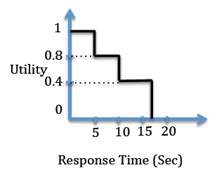
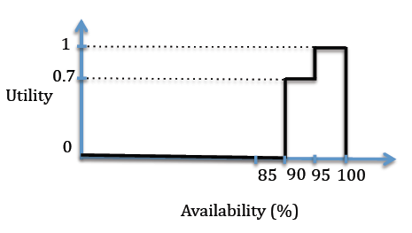
Utility functions allow us to reason about the tradeoffs between configurations
You are given a choice of 4 services that you have discovered: S1, S2, S3, and S4. Assuming all 4 services provide the same functionality, which service is optimal with respect to two quality attributes of availability and response time?
S1, availability 92%, response time = 12sec
S2, availability 97%, response time = 15sec
S3, availability 87%, response time = 3sec
S4, availability 97%, response time = 7sec
OverallUtility(S) = ResponseUtility(S) + AvailabilityUtility(S)
What is the optimal service?
Notes:
+ here is not adding, more like combination

Slide 33
user context plays a key role in determining how and where to deploy services
current solutions
remote computing (remote shells, PC anywhere…)
mobile computing (single personal device)
manual recovery of services and state
code mobility
ubiquitous computing

Slide 34
Dynamic adaptation
Many decisions cannot be made at design-time
The distributed system may have to dynamically adapt
Reasons for adaptation:
user requirements
services
QoS preferences…
user context
location
social activity…
service availability
fault detection
load balancing
recovery…
resource availability
CPU
battery
bandwidth…
c₂
c₁
c₃

Slide 35
Making software adaptive
Software may provide a QoS API for controlling the trade-offs
getQoSspecs defines the space of QoS tradeoffs
example: adaptive translator QoS specs relate <latency (ms), accuracy (%)>
<200, 35>
<500, 60>
<…>
<3000, 95>
with possible different encodings (type of returned data)
setQoS(…)
set desired QoS levels example: setQoS(500,60), or just setLatency(500)

Slide 36
QoS API needs to account for resource availability
getQoSspecs defines the space of QoS tradeoffs
how much QoS vs. how much resources
example: screen brightness vs. battery duration QoS specs relate <brightness (%), duration (m), charge (%)>
<50, 150, 100>
<50, 60, 50>
<…>
<100, 120, 100>
<100, 55, 50>
Reliance on customizable software components

Slide 37
A second example: A fleet of unmanned vehicles
Consider a space exploration mission
Several autonomous Mars rovers are moving around a field on Mars, communicating with each other and to the orbiting satellites
Unexpected event happens
A MARS rover gets stuck
A MARS rover runs out of battery
A Mars rover’s long-range radio fails
What can be done?

Slide 38
Self-adaptive software, aka, Autonomic Computing
Many software systems are highly distributed, embedded, and long lived → need self-adaptive software
Important questions:
Under what conditions does the system undergo adaptation?
Should the system be open-adaptive or closed-adaptive?
What type of autonomy must be supported?
What kind of information must be collected?
How often is adaptation considered?
What is the performance impact?

Slide 39
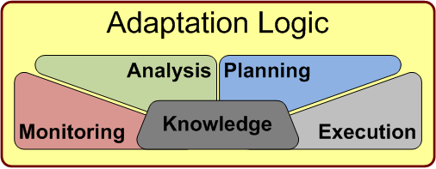

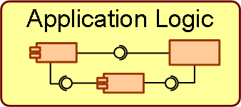

MAPE-K framework
MAPE-K loop: Monitoring, Analysis, Planning, and Execution - Knowledge
Specifies Objectives
Is monitored
Is monitored
Manages
Uses
Interacts
Notes:
Don’t care how to get there, but complete your objectives

Slide 40
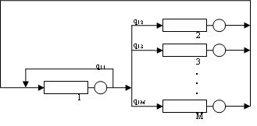
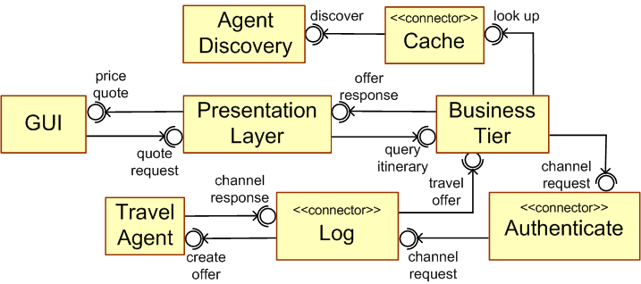
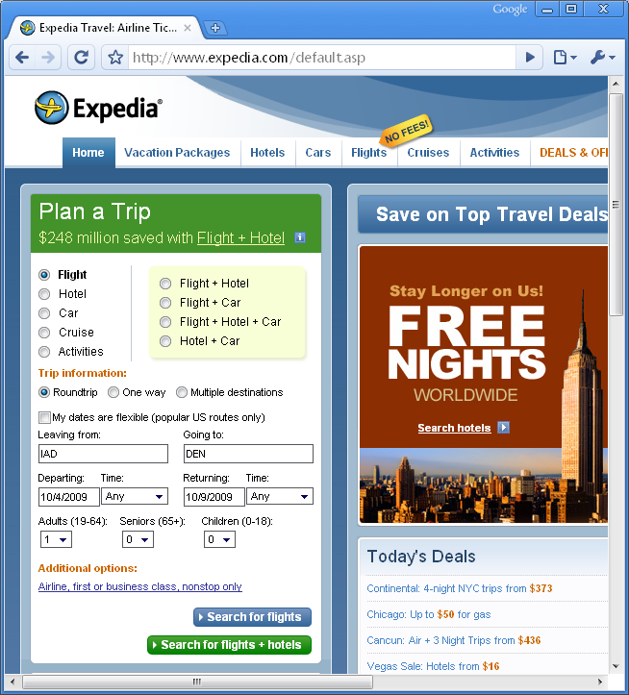
Engineering Self-Adaptive Software
Analyze
Plan
Traffic Spike
Monitor
Execute
Predictive Analytical Models
Cyber Attack
Architectural Models
Internal Failures

