Slide 1
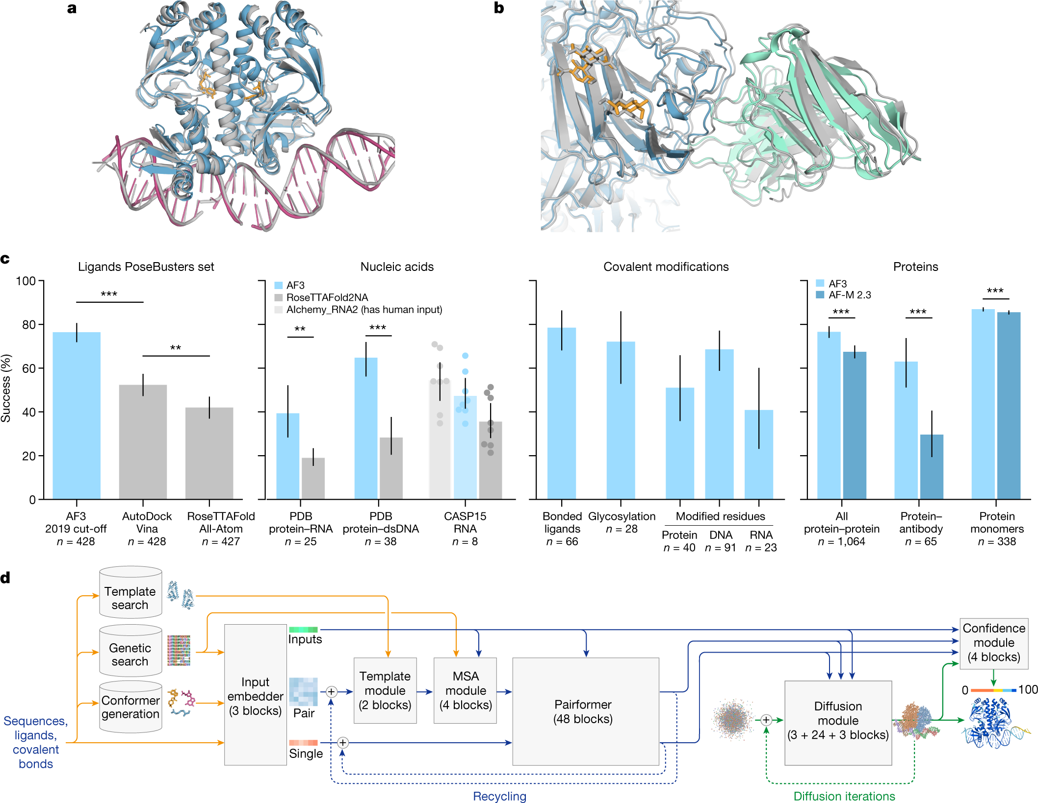
Notes:
fig.1 a,b, Example structures predicted using AF3. a, Bacterial CRP/FNR family transcriptional regulator protein bound to DNA and cGMP (PDB 7PZB; full-complex LDDT⁴⁷, 82.8; global distance test (GDT)⁴⁸, 90.1). b, Human coronavirus OC43 spike protein, 4,665 residues, heavily glycosylated and bound by neutralizing antibodies (PDB 7PNM; full-complex LDDT, 83.0; GDT, 83.1). c, AF3 performance on PoseBusters (v.1, August 2023 release), our recent PDB evaluation set and CASP15 RNA. Metrics are as follows: percentage of pocket-aligned ligand r.m.s.d. < 2 Å for ligands and covalent modifications; interface LDDT for protein–nucleic acid complexes; LDDT for nucleic acid and protein monomers; and percentage DockQ > 0.23 for protein–protein and protein–antibody interfaces. All scores are reported from the top confidence-ranked sample out of five model seeds (each with five diffusion samples), except for protein–antibody scores, which were ranked across 1,000 model seeds for both models (each AF3 seed with five diffusion samples). Sampling and ranking details are provided in the Methods. For ligands, n indicates the number of targets; for nucleic acids, n indicates the number of structures; for modifications, n indicates the number of clusters; and for proteins, n indicates the number of clusters. The bar height indicates the mean; error bars indicate exact binomial distribution 95% confidence intervals for PoseBusters and by 10,000 bootstrap resamples for all others. Significance levels were calculated using two-sided Fisher’s exact tests for PoseBusters and using two-sided Wilcoxon signed-rank tests for all others; ***P < 0.001, **P < 0.01. Exact P values (from left to right) are as follows: 2.27 × 10⁻¹³, 2.57 × 10⁻³, 2.78 × 10⁻³, 7.28 × 10⁻¹², 1.81 × 10⁻¹⁸, 6.54 × 10⁻⁵ and 1.74 × 10⁻³⁴. AF-M 2.3, AlphaFold-Multimer v.2.3; dsDNA, double-stranded DNA. d, AF3 architecture for inference. The rectangles represent processing modules and the arrows show the data flow. Yellow, input data; blue, abstract network activations; green, output data. The coloured balls represent physical atom coordinates.

Slide 2
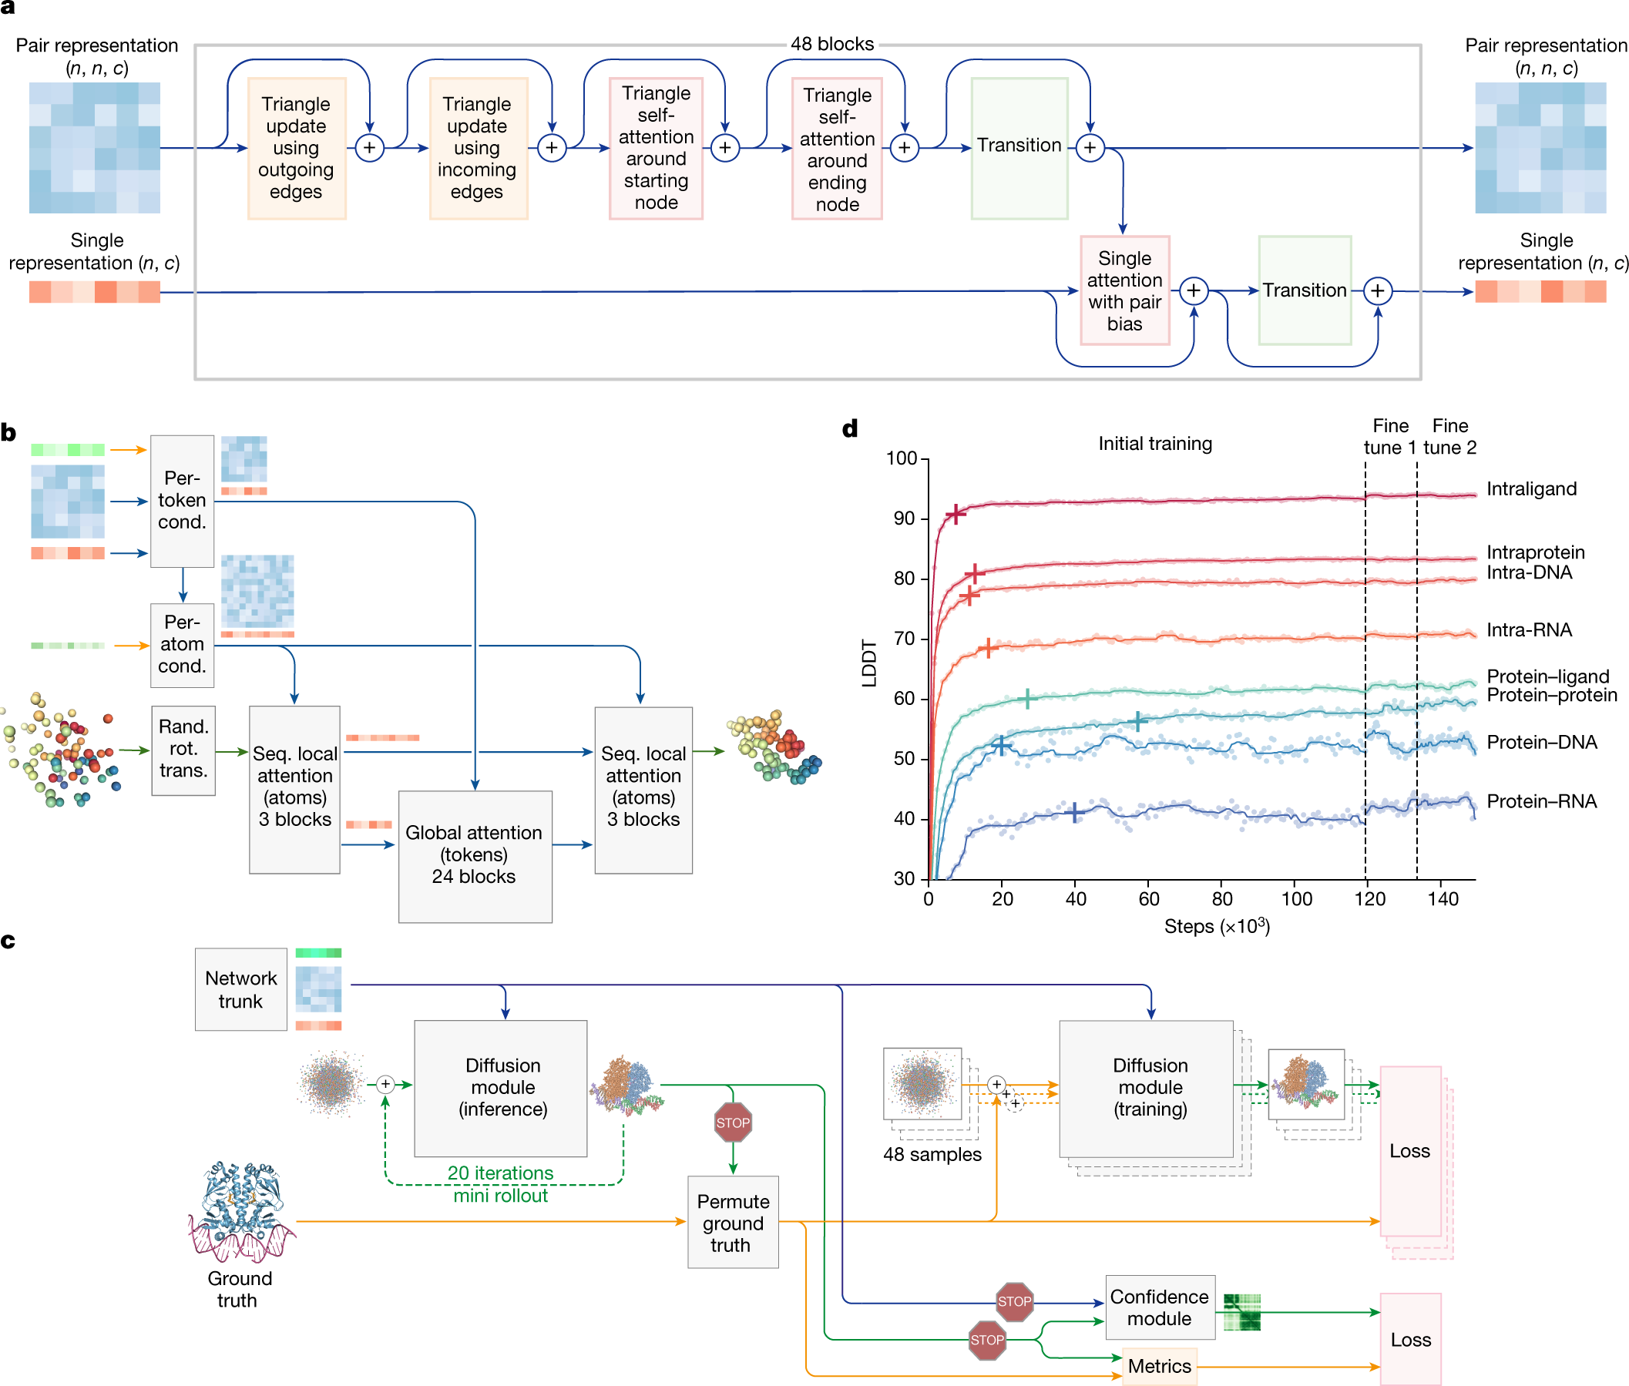
Notes:
fig.2 a, The pairformer module. Input and output: pair representation with dimension (n, n, c) and single representation with dimension (n, c). n is the number of tokens (polymer residues and atoms); c is the number of channels (128 for the pair representation, 384 for the single representation). Each of the 48 blocks has an independent set of trainable parameters. b, The diffusion module. Input: coarse arrays depict per-token representations (green, inputs; blue, pair; red, single). Fine arrays depict per-atom representations. The coloured balls represent physical atom coordinates. Cond., conditioning; rand. rot. trans., random rotation and translation; seq., sequence. c, The training set-up (distogram head omitted) starting from the end of the network trunk. The coloured arrays show activations from the network trunk (green, inputs; blue, pair; red, single). The blue arrows show abstract activation arrays. The yellow arrows show ground-truth data. The green arrows show predicted data. The stop sign represents stopping of the gradient. Both depicted diffusion modules share weights. d, Training curves for initial training and fine-tuning stages, showing the LDDT on our evaluation set as a function of optimizer steps. The scatter plot shows the raw datapoints and the lines show the smoothed performance using a median filter with a kernel width of nine datapoints. The crosses mark the point at which the smoothed performance reaches 97% of its initial training maximum.

Slide 3
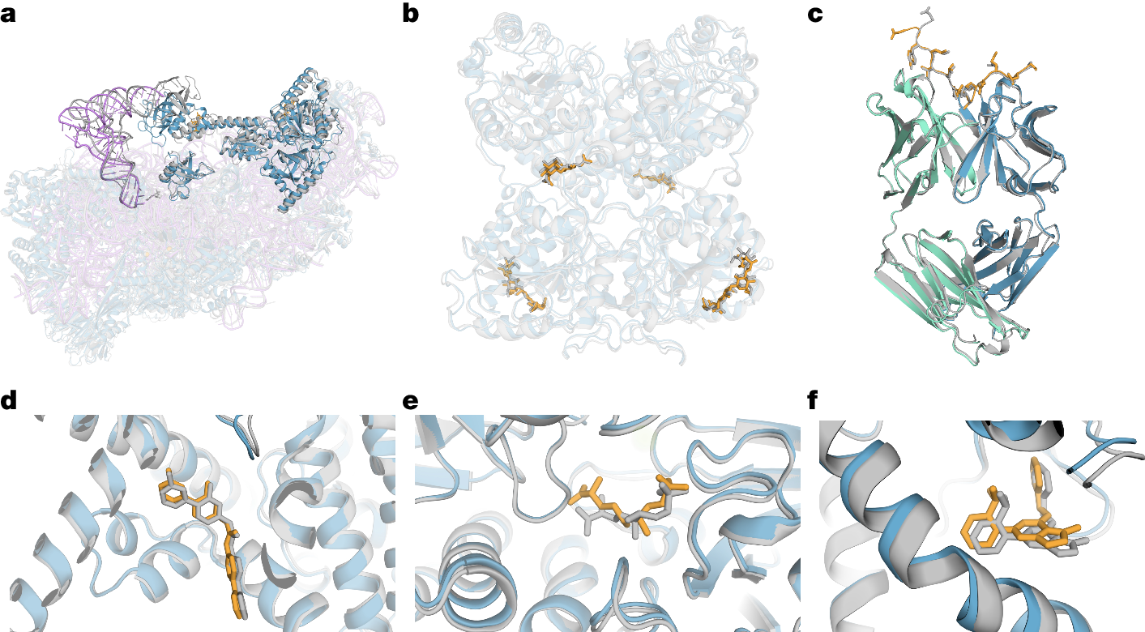
Notes:
fig.3 Selected structure predictions from AF3. Predicted protein chains are shown in blue (predicted antibody in green), predicted ligands and glycans in orange, predicted RNA in purple and the ground truth is shown in grey. a, Human 40S small ribosomal subunit (7,663 residues) including 18S ribosomal RNA and Met-tRNA_{i}^{Met} (opaque purple) in a complex with translation initiation factors eIF1A and eIF5B (opaque blue; PDB 7TQL; full-complex LDDT, 87.7; GDT, 86.9). b, The glycosylated globular portion of an EXTL3 homodimer (PDB 7AU2; mean pocket-aligned r.m.s.d., 1.10 Å). c, Mesothelin C-terminal peptide bound to the monoclonal antibody 15B6 (PDB 7U8C; DockQ, 0.85). d, LGK974, a clinical-stage inhibitor, bound to PORCN in a complex with the WNT3A peptide (PDB 7URD; ligand r.m.s.d., 1.00 Å). e, (5S,6S)-O7-sulfo DADH bound to the AziU3/U2 complex with a novel fold (PDB 7WUX; ligand r.m.s.d., 1.92 Å). f, Analogue of NIH-12848 bound to an allosteric site of PI5P4Kγ (PDB 7QIE; ligand r.m.s.d., 0.37 Å).

Slide 4
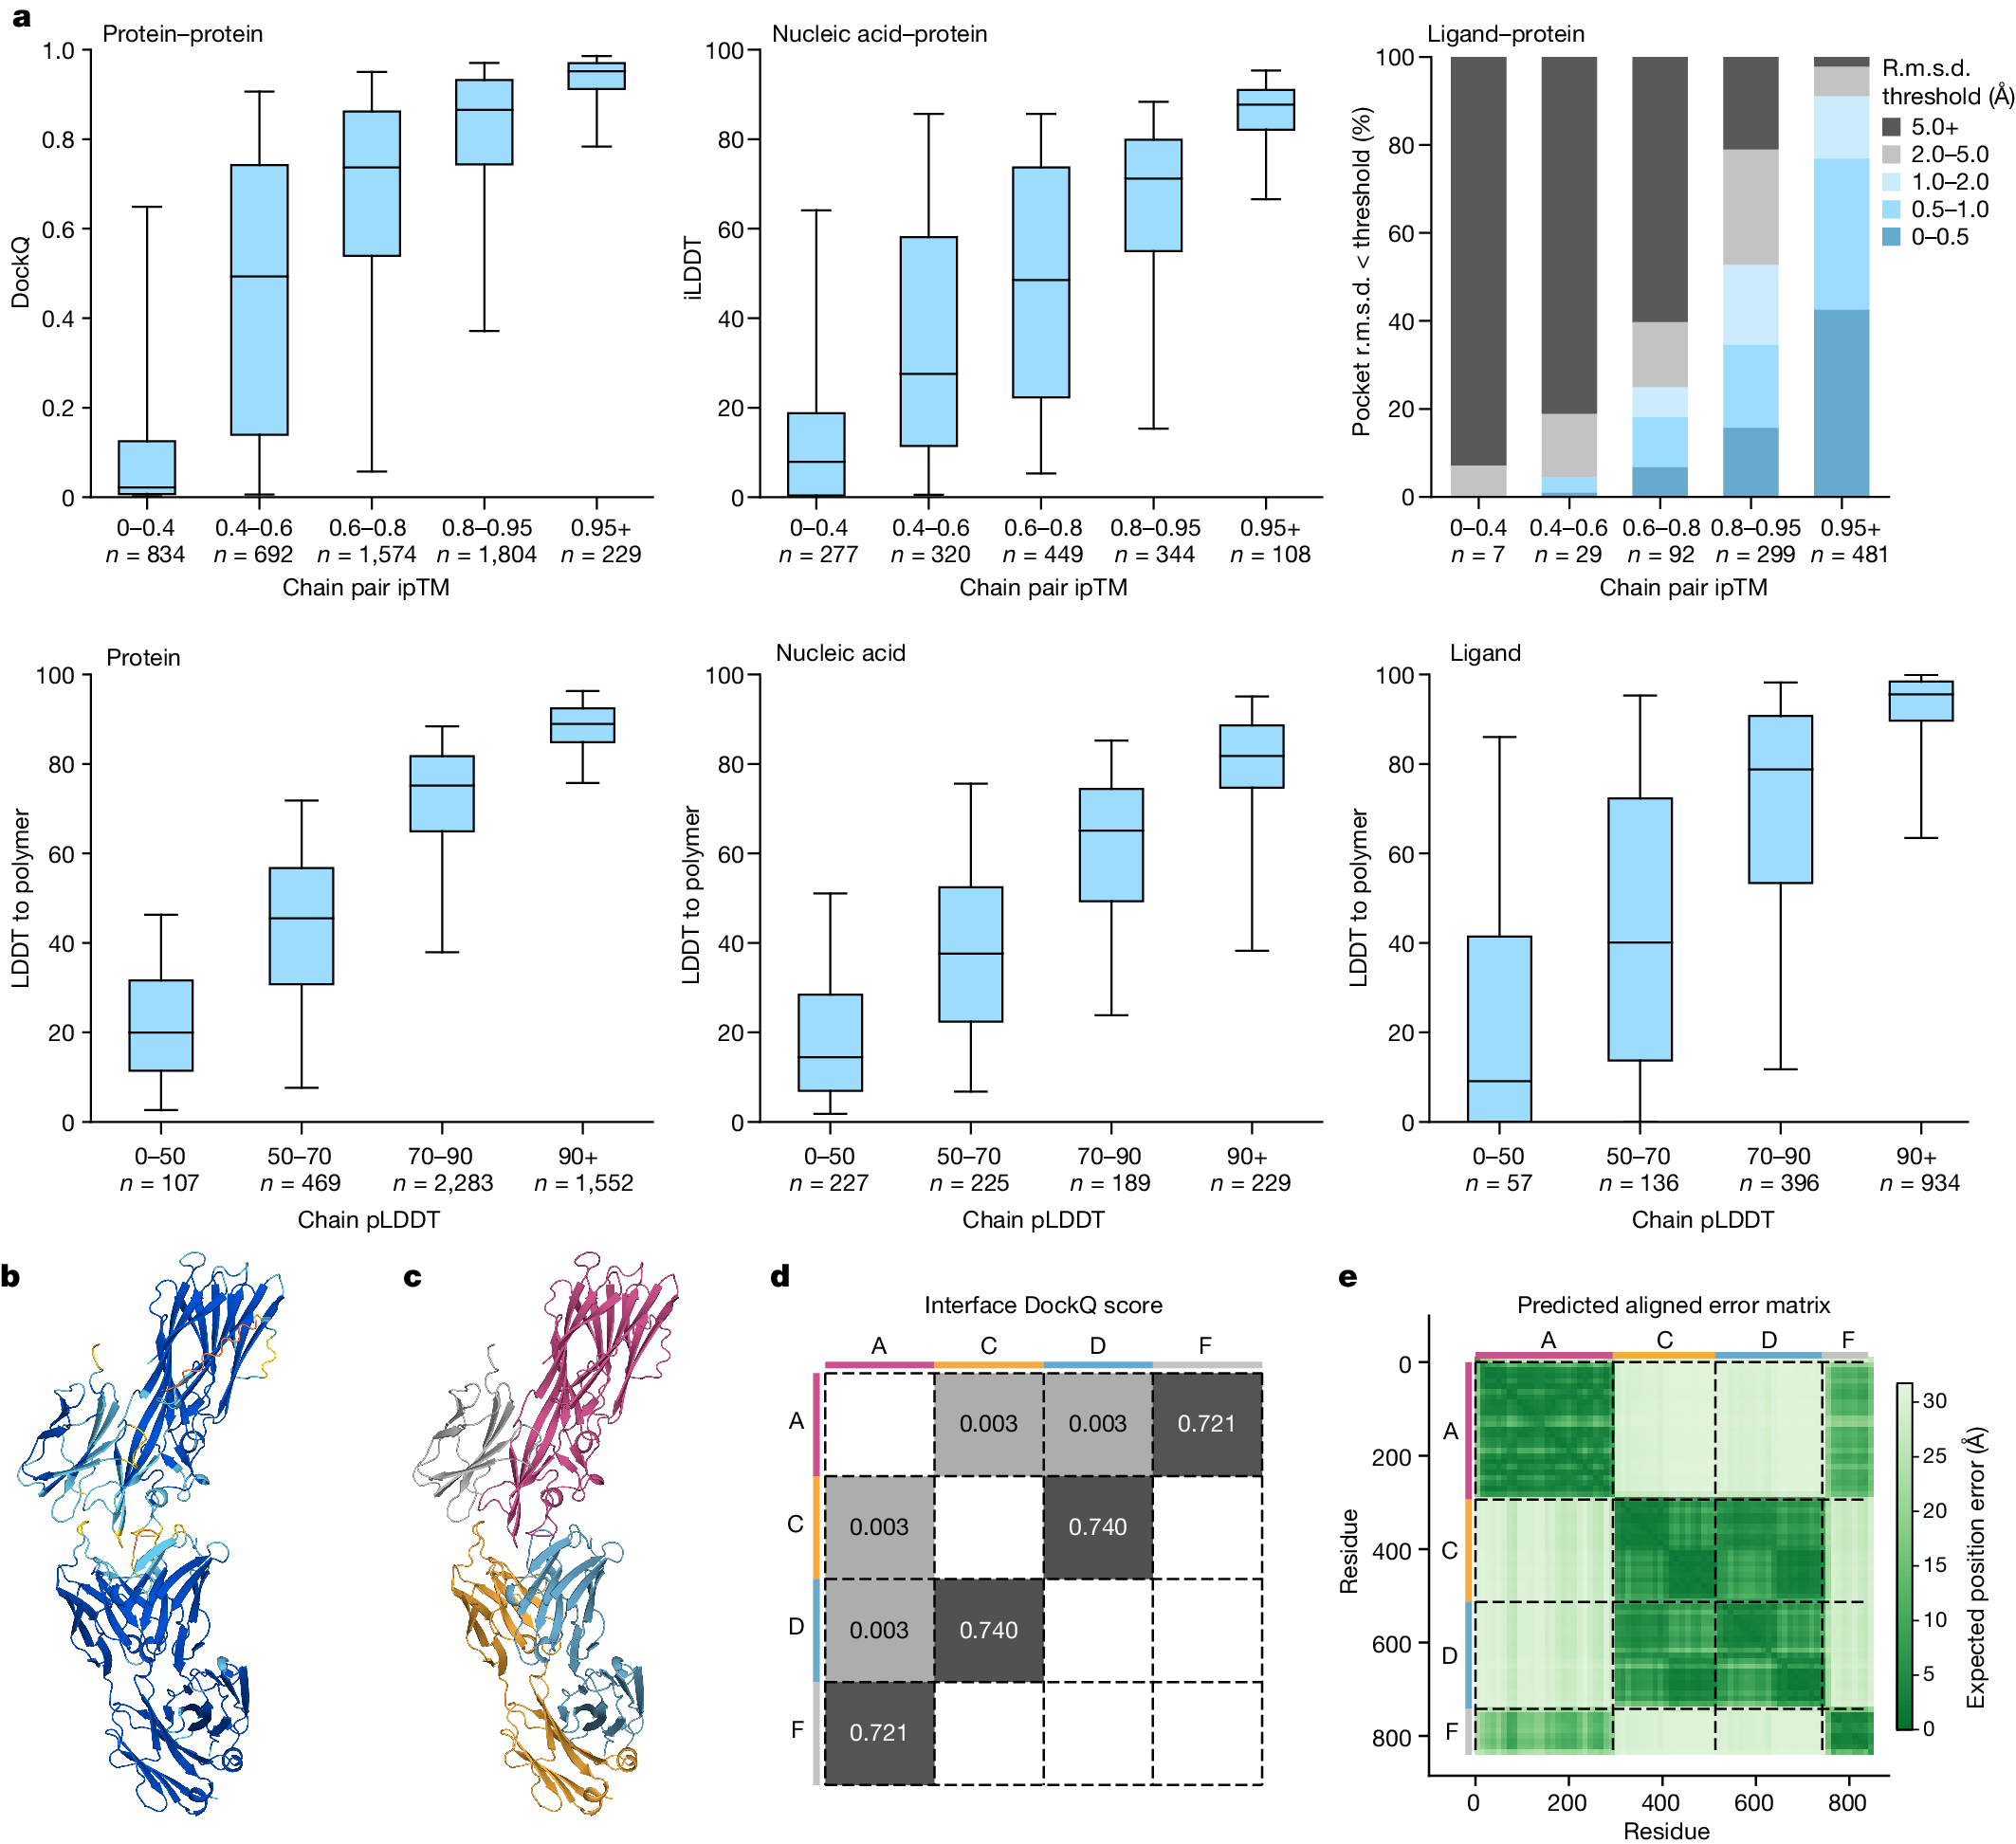
Notes:
Fig. 4: AF3 confidences track accuracy.
a, The accuracy of protein-containing interfaces as a function of chain pair ipTM (top). Bottom, the LDDT-to-polymer accuracy was evaluated for various chain types as a function of chain-averaged pLDDT. The box plots show the 25–75% confidence intervals (box limits), the median (centre line) and the 5–95% confidence intervals (whiskers). n values report the number of clusters in each band. b, The predicted structure of PDB 7T82 coloured by pLDDT (orange, 0–50; yellow, 50–70; cyan, 70–90; and blue, 90–100). c, The same prediction coloured by chain. d, DockQ scores for protein–protein interfaces. e, PAE matrix of same prediction (darker is more confident), with chain colouring of c on the side bars. The dashed black lines indicate the chain boundaries.

Slide 5
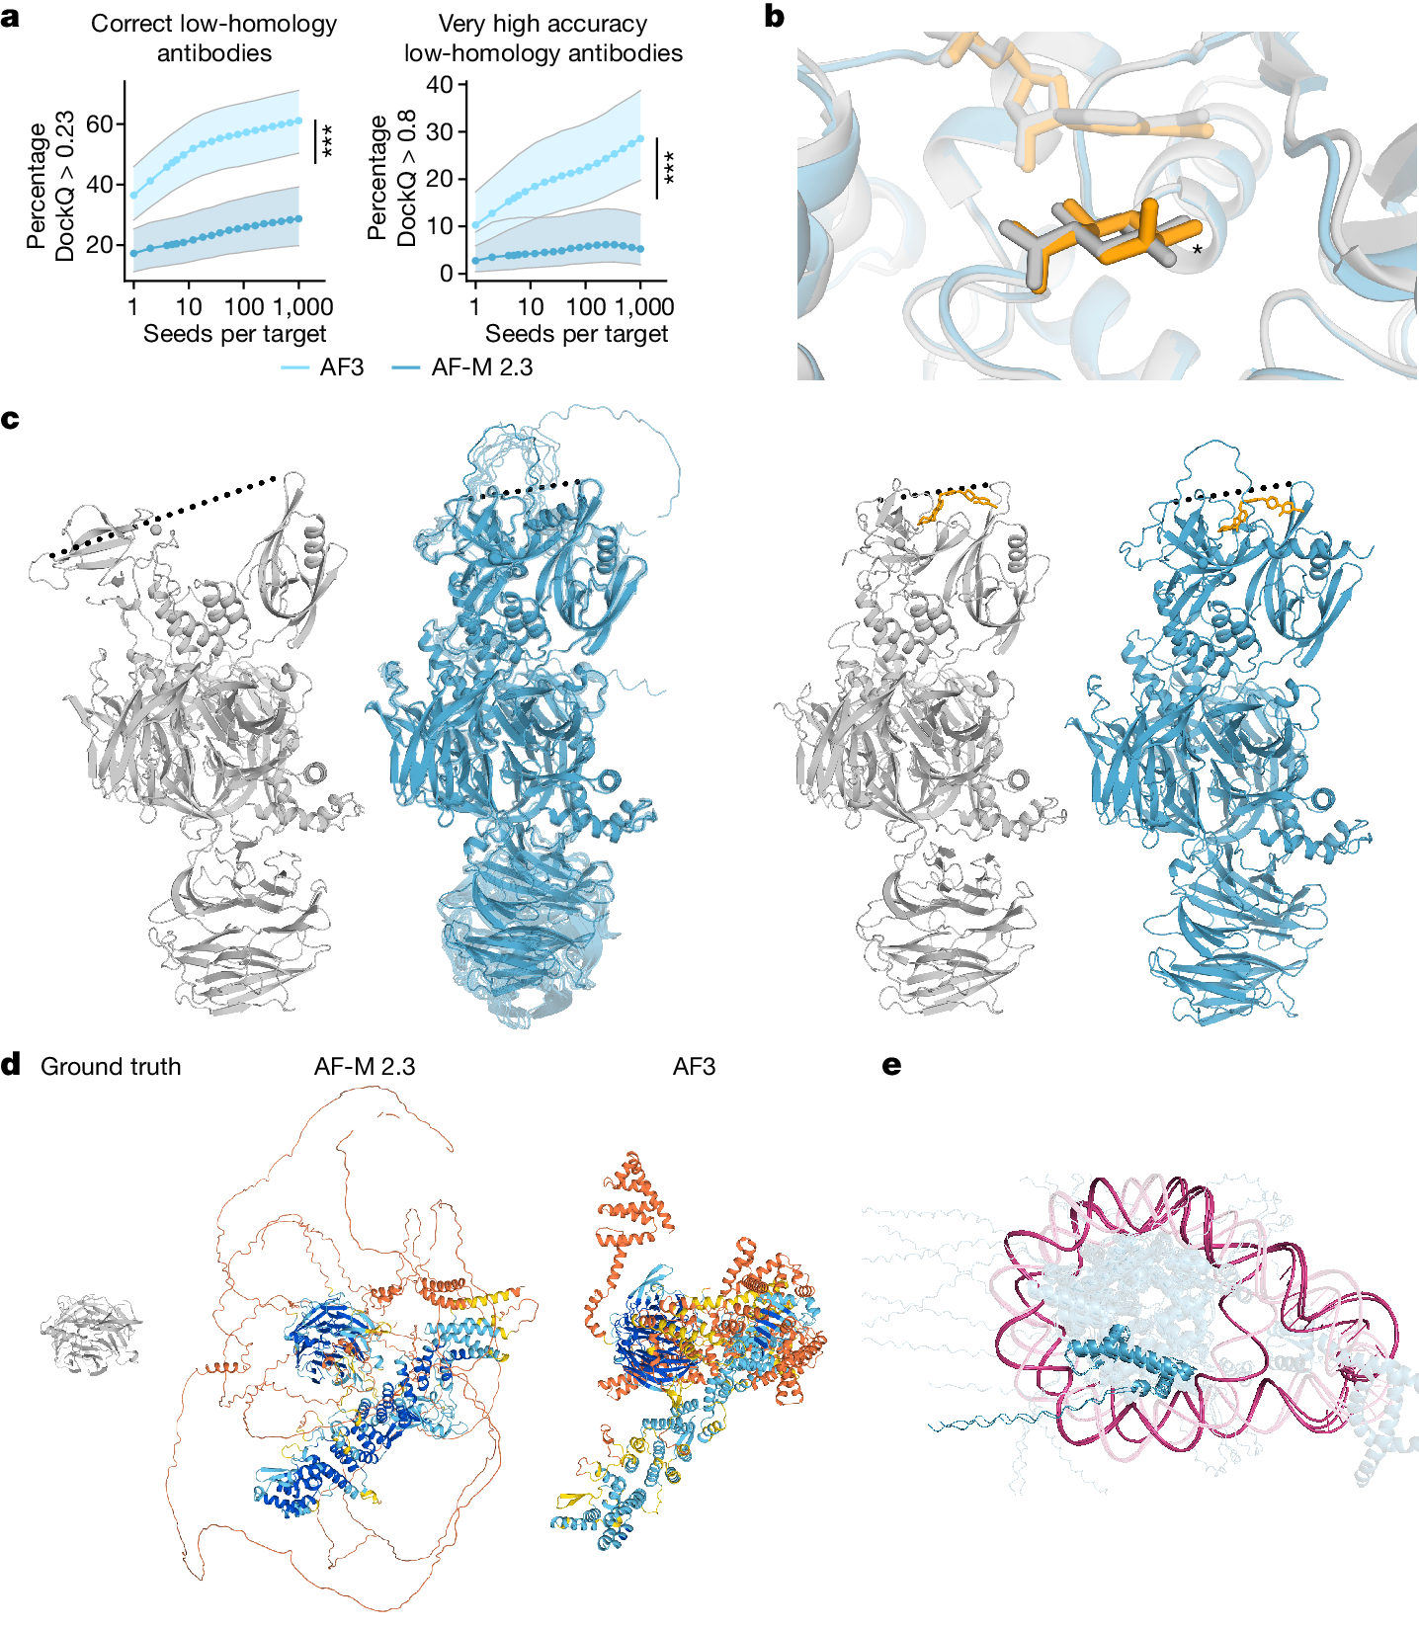
Notes:
Fig. 5: Model limitations.
a, Antibody prediction quality increases with the number of model seeds. The quality of top-ranked, low-homology antibody–antigen interface predictions as a function of the number of seeds. Each datapoint shows the mean over 1,000 random samples (with replacement) of seeds to rank over, out of 1,200 seeds. Confidence intervals are 95% bootstraps over 10,000 resamples of cluster scores at each datapoint. Samples per interface are ranked by protein–protein ipTM. Significance tests were performed using by two-sided Wilcoxon signed-rank tests. n = 65 clusters. Exact P values were as follows: 2.0 × 10⁻⁵ (percentage correct) and P = 0.009 (percentage very high accuracy). b, Prediction (coloured) and ground-truth (grey) structures of Thermotoga maritima α-glucuronidase and beta-d-glucuronic acid—a target from the PoseBusters set (PDB: 7CTM). AF3 predicts alpha-d-glucuronic acid; the differing chiral centre is indicated by an asterisk. The prediction shown is top-ranked by ligand–protein ipTM and with a chirality and clash penalty. c, Conformation coverage is limited. Ground-truth structures (grey) of cereblon in open (apo, PDB: 8CVP; left) and closed (holo mezigdomide-bound, PDB: 8D7U; right) conformations. Predictions (blue) of both apo (with 10 overlaid samples) and holo structures are in the closed conformation. The dashed lines indicate the distance between the N-terminal Lon protease-like and C-terminal thalidomide-binding domain. d, A nuclear pore complex with 1,854 unresolved residues (PDB: 7F60). The ground truth (left) and predictions from AlphaFold-Multimer v.2.3 (middle) and AF3 (right) are shown. e, Prediction of a trinucleosome with overlapping DNA (pink) and protein (blue) chains (PDB: 7PEU); highlighted are overlapping protein chains B and J and self-overlapping DNA chain AA. Unless otherwise stated, predictions are top-ranked by our global complex ranking metric with chiral mismatch and steric clash penalties (Supplementary Methods 5.9.1).

