Slide 1



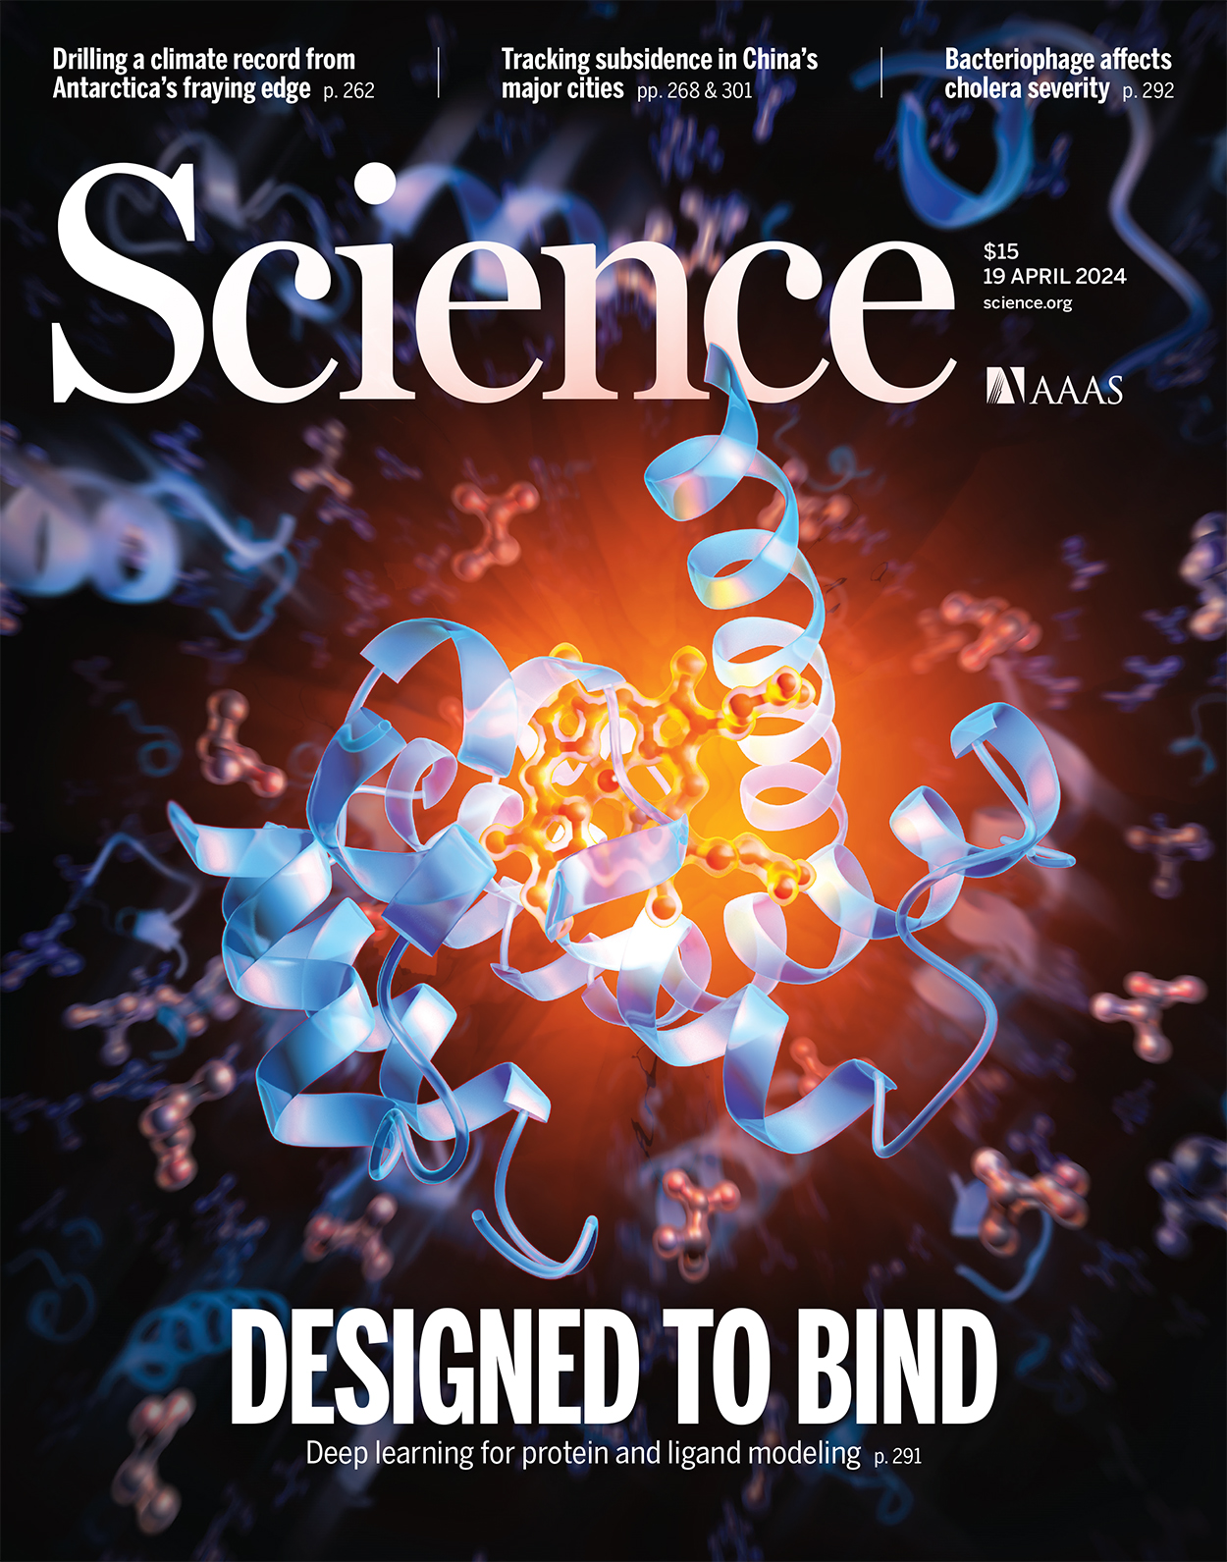
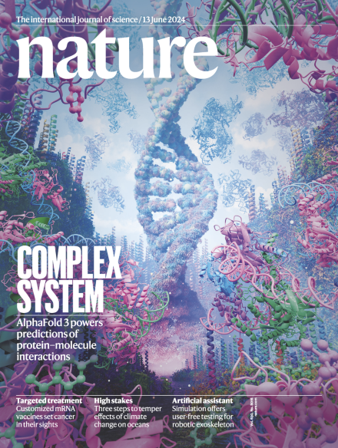
https://scholar.google.com/citations?user=a5goOh8AAAAJ&hl=en
https://deepmind.google/discover/blog/demis-hassabis-john-jumper-awarded-nobel-prize-in-chemistry/?_gl=1*h0sbpx*_up*MQ..*_ga*NDgyMTY0NTcyLjE3MzI2MDM2NTk.*_ga_LS8HVHCNQ0*MTczMjYwMzY1OC4xLjAuMTczMjYwMzc0NS4wLjAuMA..
https://www.ipd.uw.edu/david-baker/

