Slide 1
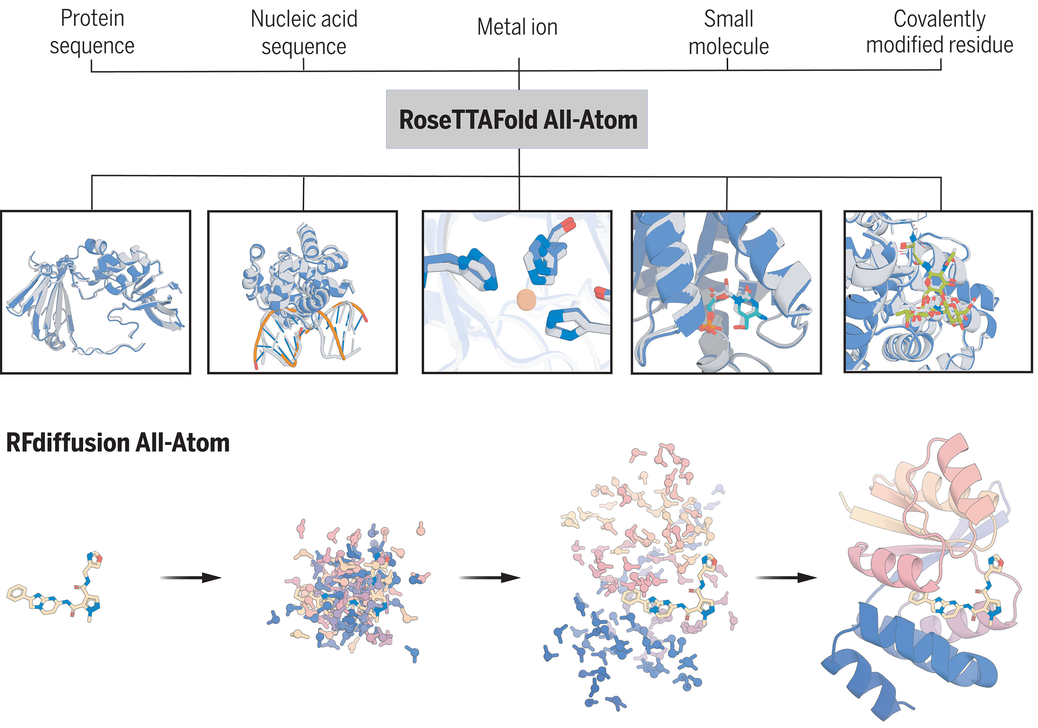
Notes:
Prediction and design of biomolecular assemblies.
RFAA enables the prediction of biomolecular assemblies, including proteins, nucleic acids, metals, small molecules, and covalent modifications (top). RFdiffusionAA builds de novo proteins around small molecules of interest (bottom).

Slide 2
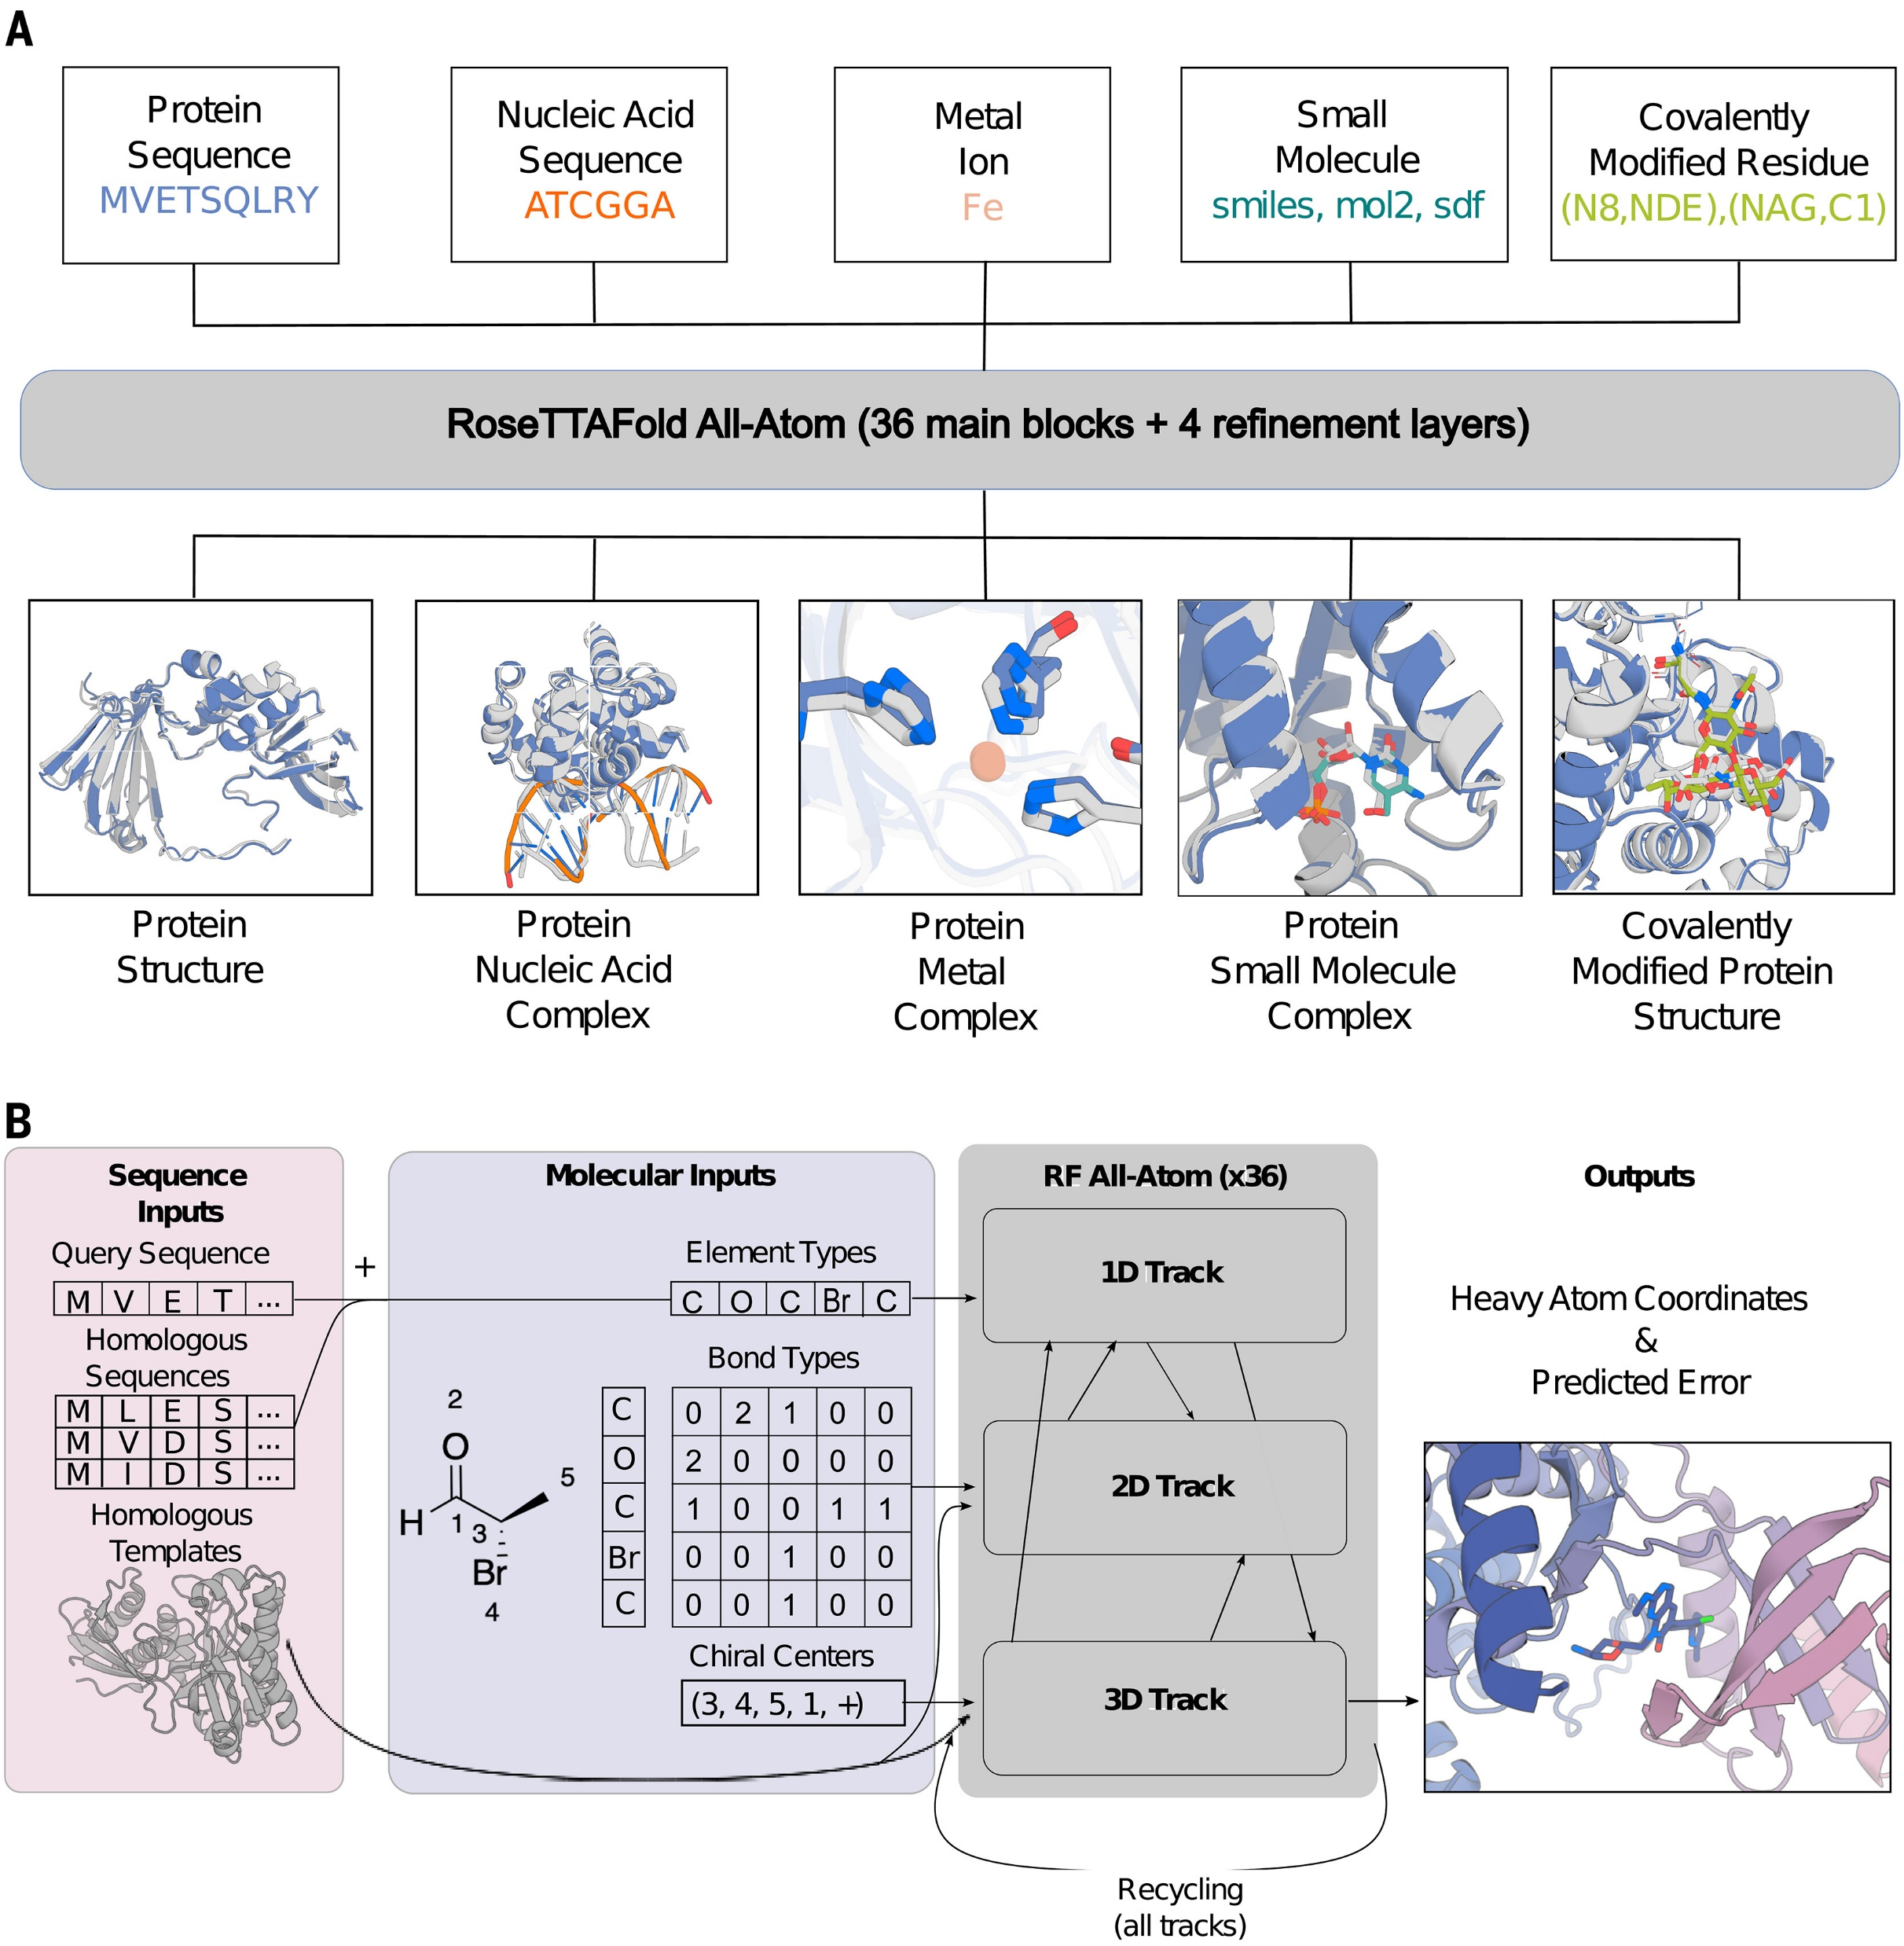
Notes:
Fig. 1. General biomolecular modeling with RFAA.
(A) RFAA takes input information about the molecular composition of the biomolecular assembly to be modeled, including protein amino acid and nucleic acid base sequences, metal ions, small molecule–bonded structure, and covalent bonds between small molecules and proteins. (B) Processing of molecular input information. Small-molecule information is parsed into element types (46 possible types), bond types, and chiral centers. Covalent bonds between proteins and small molecules are provided as a separate token in the bond adjacency matrix. The three-track architecture mixes 1D, 2D, and 3D information and predicts all-atom coordinates and model confidence. Single-letter abbreviations for amino acid residues in the figures are as follows: A, Ala; C, Cys; D, Asp; E, Glu; F, Phe; G, Gly; H, His; I, Ile; K, Lys; L, Leu; M, Met; N, Asn; P, Pro; Q, Gln; R, Arg; S, Ser; T, Thr; V, Val; W, Trp; and Y, Tyr.

Slide 3
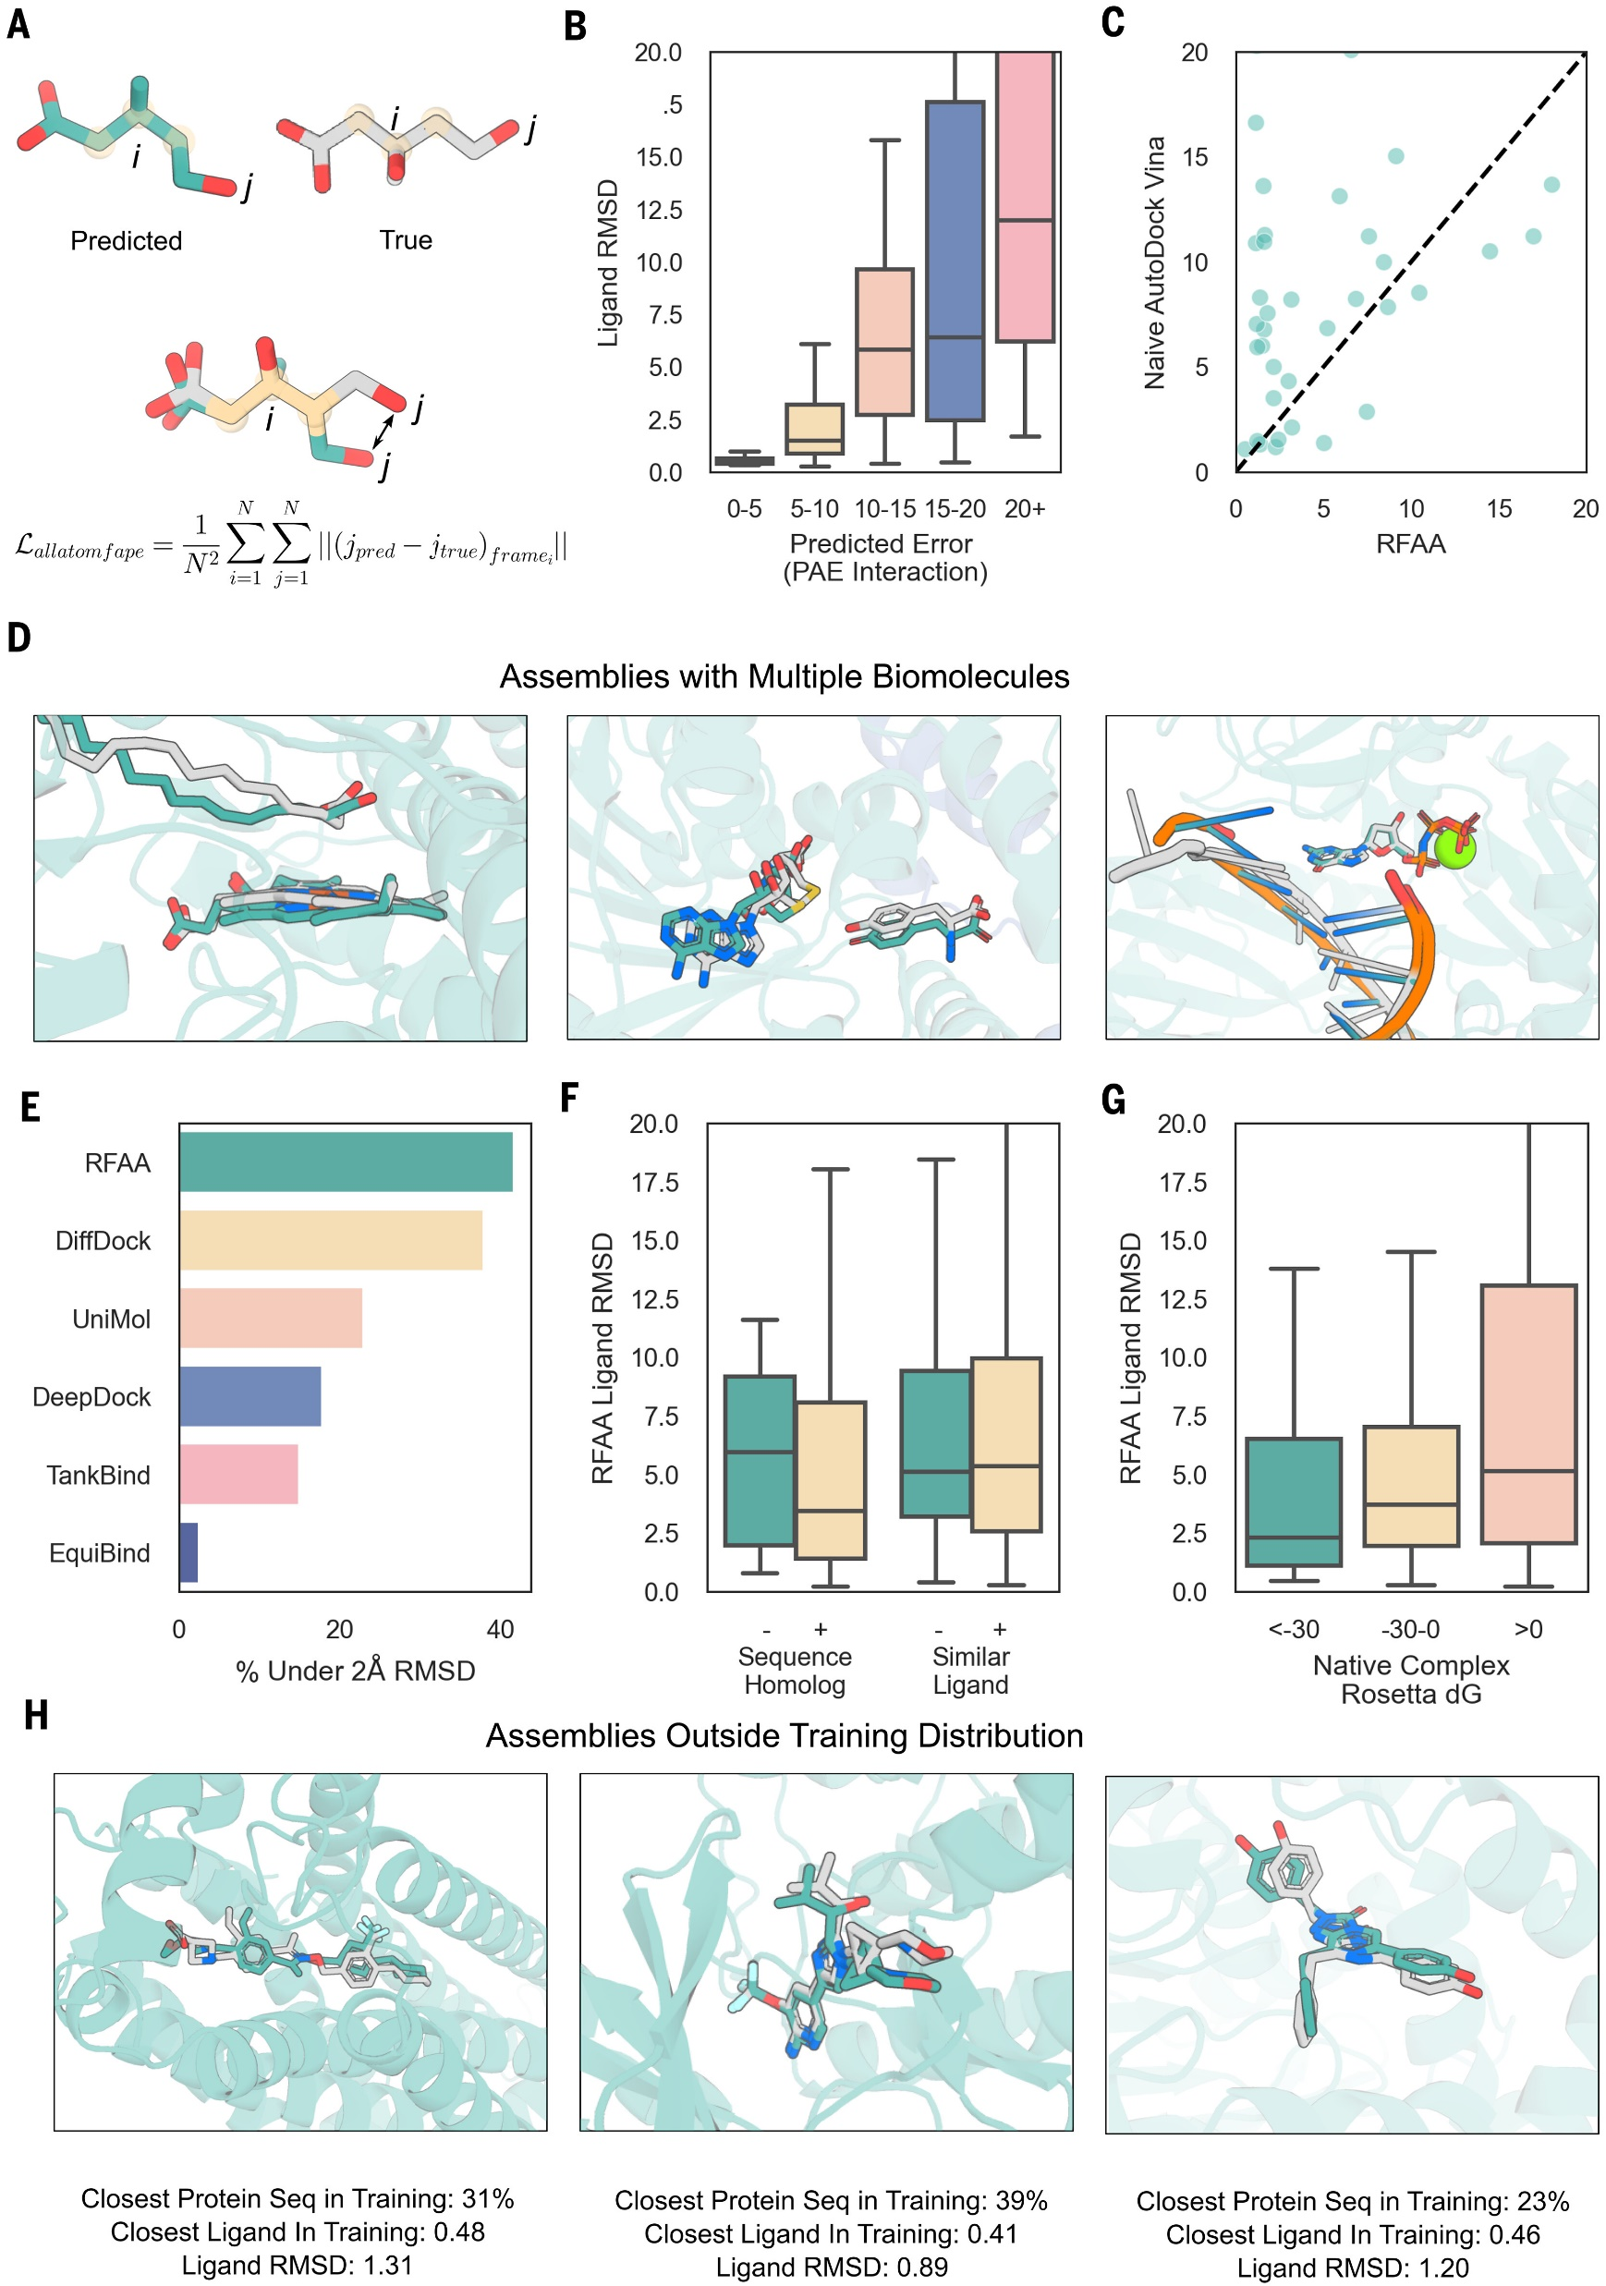
Notes:
Fig. 2. RFAA can accurately predict protein–small molecule complex structures.
(A) Every “atom” node is assigned a local coordinate frame based on the identities of its neighbors. To compute the main loss in the network, we aligned each atom’s coordinate frame in the predicted and true structures and measured the error over all the other atoms. (B) Model accuracy correlates with error predictions. Structures and corresponding error predictions were generated for CAMEO targets (05/20/23 to 7/29/23; 261 protein–small molecule interfaces). Ligand RMSD was computed by CAMEO organizers. (C) RFAA outperforms AutoDock Vina on CAMEO targets (week 8/12/23 to 09/02/23; 149 protein–small molecule interfaces). Both servers had to model the protein and find pockets for all ligands present in the solved structure and the correct docks for all ligands. The ligand RMSD for both servers was computed by CAMEO organizers; the AutoDock Vina server was set up by CAMEO organizers. (D) Three examples of successful predictions with multiple biomolecules. Shown from left to right are fatty acid decarboxylase (PDB ID 8D8P; seq ID 34%; from CAMEO) with a heme cofactor and a lipid substrate; a dimeric tyrosine methyltransferase (PDB ID 7UX8; seq ID 28%; CASP15 target: T1124) with an S-adenosyl homocysteine and tyrosine interaction; and a DNA polymerase (PDB ID 7U7W; seq ID 100%) bound to DNA, a nucleotide, and a metal ion (31, 66, 67). The following color scheme is used in all panels: Predicted protein structure (aligned to native) is indicated in transparent teal, predicted ligand conformation in teal, and native ligand conformation in gray. (E) Comparison to other deep learning–based docking methods. In this case, each method was applied in their respective training regime. For RFAA, this meant only having sequence and minimal atomic graph inputs, whereas for other methods, this involved providing the bound crystal structure. The ligand RMSD was computed using the PoseBusters suite, and a single example present in our training set was removed for all methods that were compared. (F) Comparison of RFAA predictions on recently solved PDB proteins that are new compared with the training set (homolog <1 BLAST e-value, similar ligand >0.5 Tanimoto similarity). Each set is clustered based on sequence or ligand similarity, and a random cluster representative is chosen for each. (G) Comparison of RFAA prediction accuracy to Rosetta ΔG energy estimates for the native complex (more than 940 cases that were successfully processed by Rosetta). RFAA makes more-accurate predictions for native complexes with low Rosetta energy. (H) Three examples of successful predictions with low similarity to the training set. Shown from left to right are G protein–coupled S1P receptor (PDB ID 7EW1; seq ID 31%), complex of DLK bound to an inhibitor (PDB ID 8OUS; seq ID 39%), and a Renilla luciferase bound to an azacoelenterazine (non-native substrate; PDB ID 7QXR; seq ID 23%) (68–70). In (B), (F), and (G), boxplots cut off at 20 Å for clarity; the center line represents the median, box limits are upper and lower quartiles, and whiskers are minimum and maximum values. The color scheme is the same as that in (D).

Slide 4
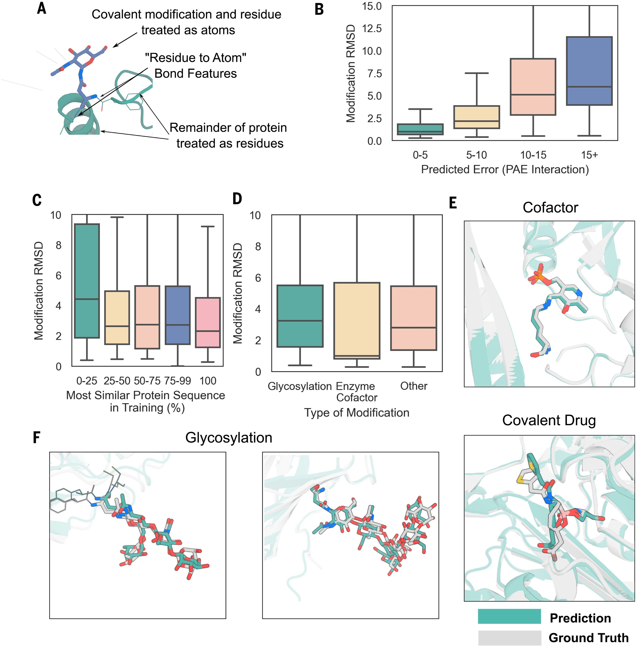
Notes:
Fig. 3. Accurate prediction of protein covalent modifications.
(A) Schematic describing how RFAA models covalent modifications to proteins. The chemical moiety that modifies the residue and the residue are modeled as atom nodes, and the rest of the protein is modeled as residues (with multiple sequence alignment and template inputs). (B) Model accuracy correlates with predicted error on a set of 938 recently solved structures with covalent modifications. Modification RMSD was computed by aligning the protein structure within 10 Å and computing RMSD over the modified residue and chemical modification. The boxplot is cut off at 15 Å for clarity. (C) Comparison of sequence identity to the training set and model accuracy. Models are generally accurate even with low sequence homology to the training set. (D) Comparison of model accuracy for different types of covalent modifications. (E) Shown at the top is an example of a successfully predicted covalently linked enzyme cofactor (PDB ID 7P3T; seq ID 28%), which is a structure of an (R)-selective amine transaminase. Shown at the bottom is an example of a covalently bound drug candidate (PDB ID 7TI1; seq ID 27%), which is a β-lactamase enzyme bound to cyclic boronic acid inhibitor (71, 72). (F) Accurate predictions of glycans on the N-acetylglucosamine-1-phosphotransferase (GNPT) gamma subunit (PDB ID 7S69; no BLAST hits) (right) and human sperm TMEM95 ectodomain (PDB ID 7UX0; seq ID 26%) (left) (41, 42). For the boxplots in (B) to (D), the center line represents the median, box limits are upper and lower quartiles, and whiskers are minimum and maximum values. In (E) and (F), predicted protein structure is indicated in transparent teal, native structure in transparent gray, predicted covalent modification in teal, and native covalent modification in gray.

Slide 5
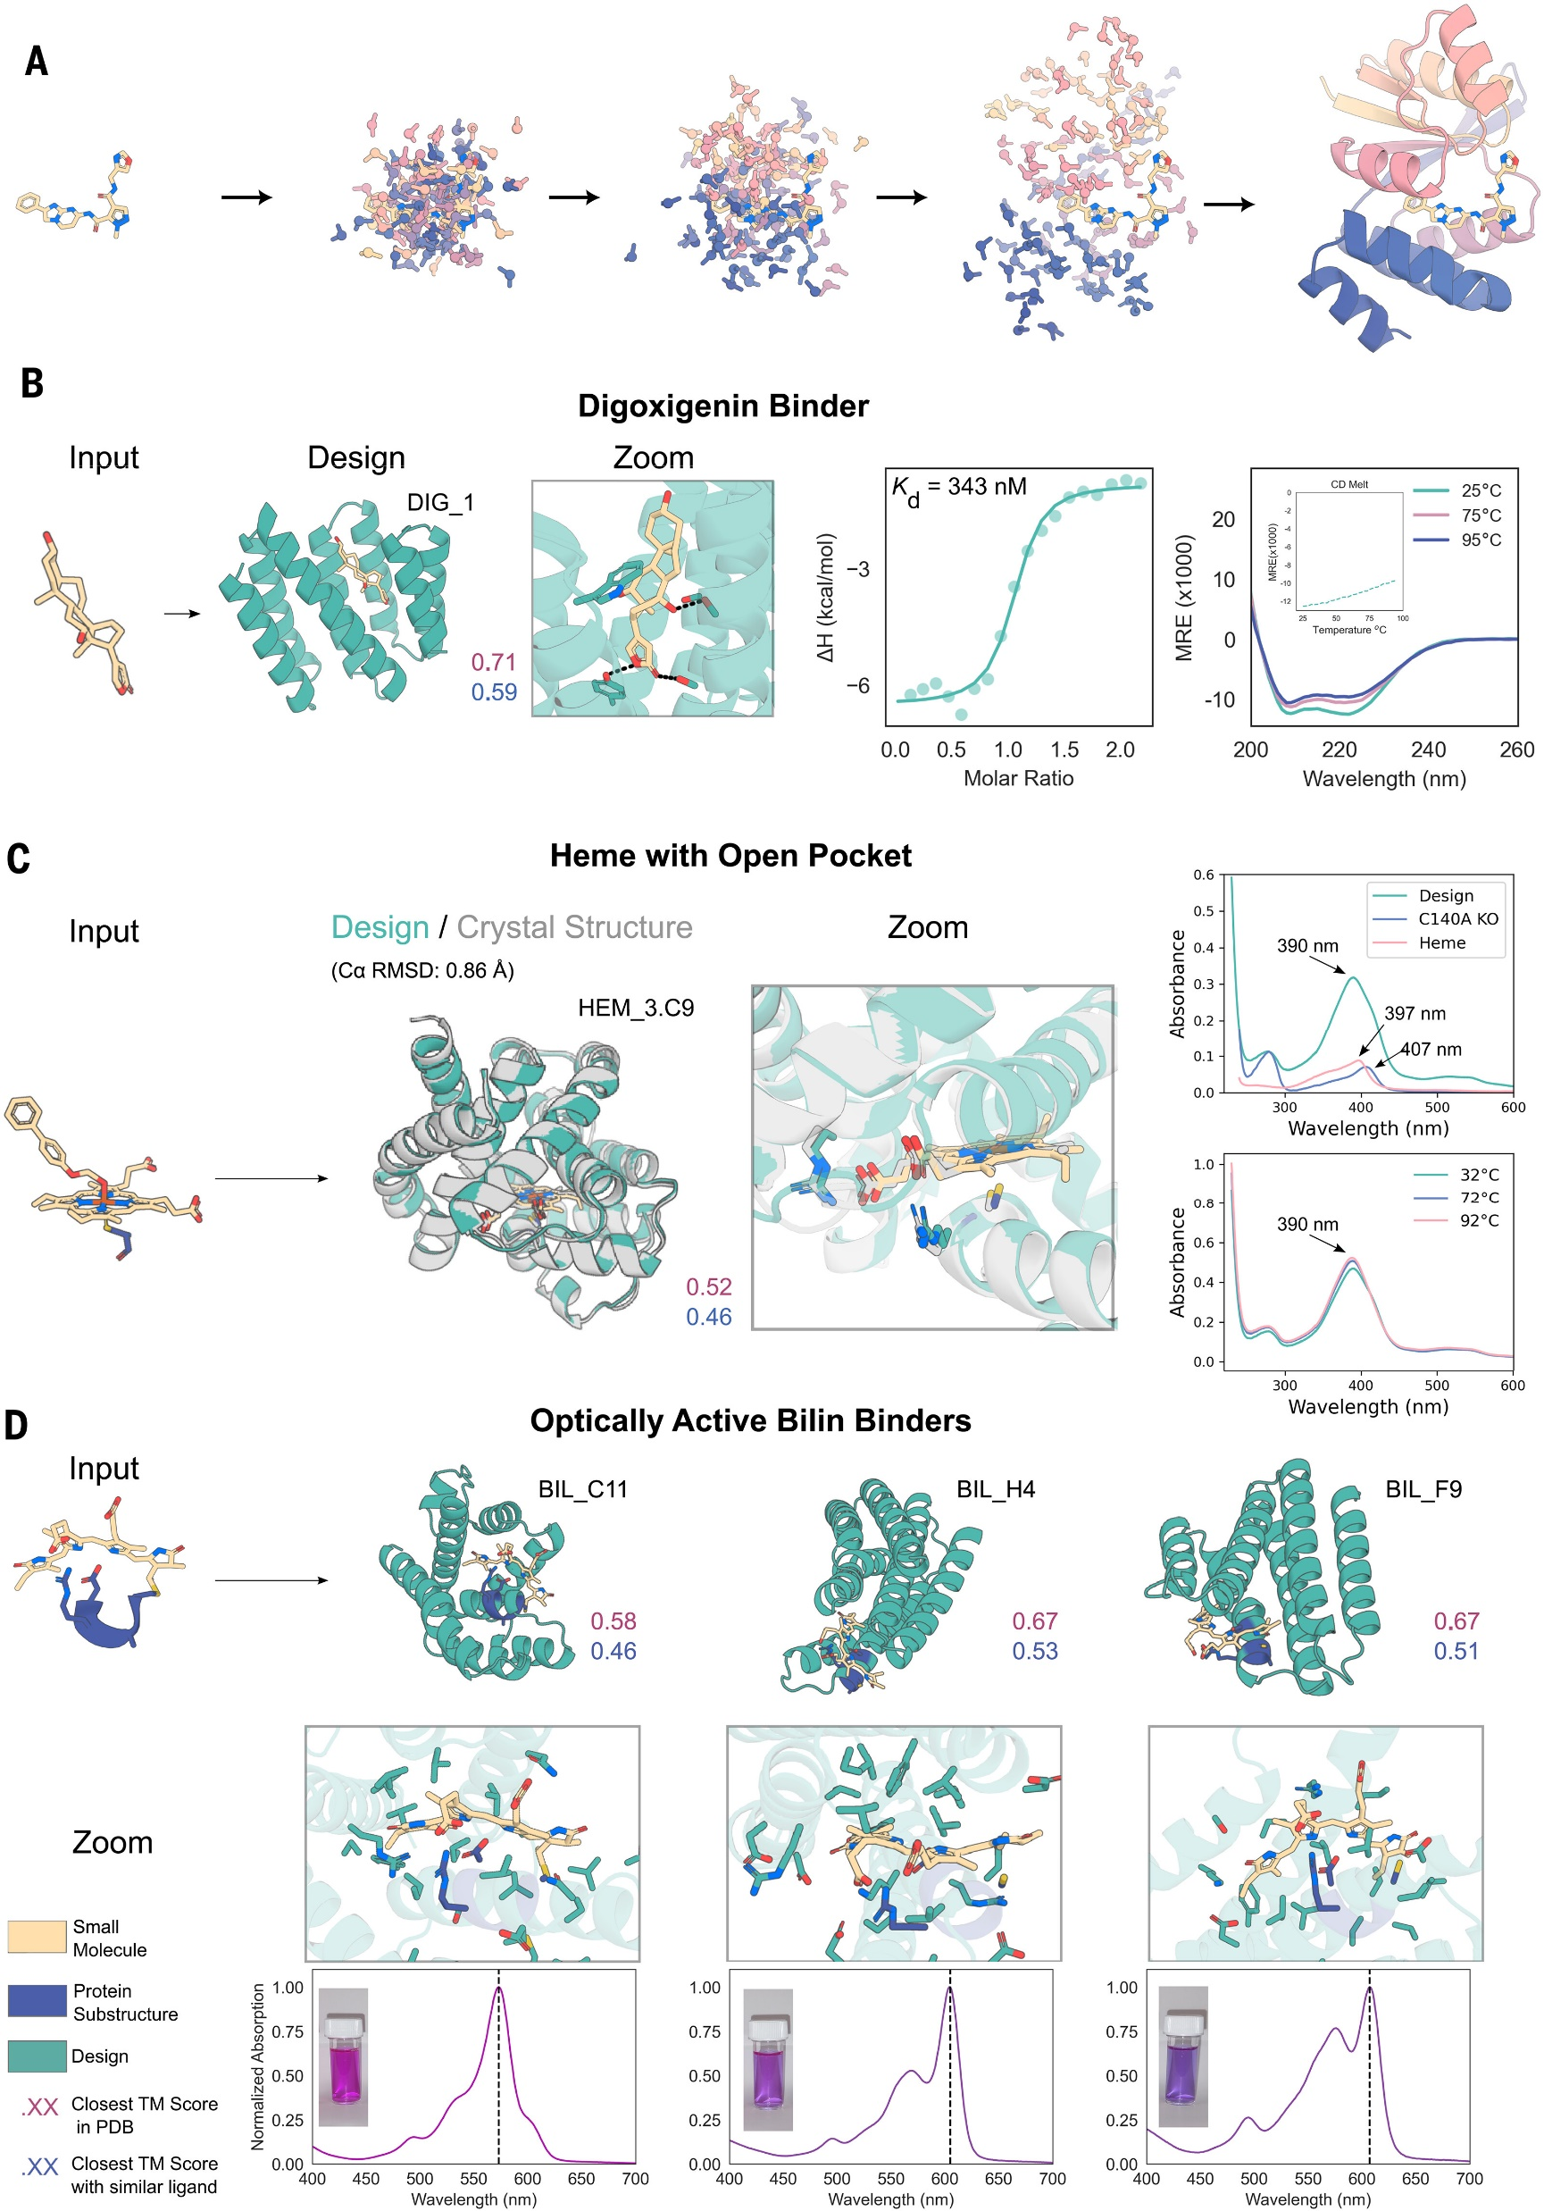
Notes:
Fig. 4. Experimental characterization of binders designed with RFdiffusionAA.
The following color scheme is used in all panels: The input ligand is indicated in yellow, input protein motif in blue, and diffused protein in teal; purple text indicates the closest TM score to any protein in the training set, and blue text indicates the closest TM score to any protein in the training set that has a similar ligand bound (Tanimoto similarity >0.5). (A) Schematic depicting the random initialization of residues surrounding a small molecule and progressive denoising by RFdiffusionAA. (B) Characterization of dioxigenin binder design. Shown from left to right are the input motif to RFdiffusionAA, the designed protein, a zoomed-in view of the binding-site side chains, isothermal calorimetry (ITC) measuring binding affinity (K_{d} = 343 nM), and a circular dichroism (CD) trace (26 μM protein concentration; the inset is a CD melt showing intensity at 220 nm across a broad range of temperatures). ΔH, enthalpy of binding; MRE, molar ellipticity. (C) Characterization of heme binding designs. Shown from left to right are the input motif to RFdiffusionAA, the designed protein aligned to its crystal structure (PDB ID 8VC8), a zoomed-in view of the binding site, and UV-Vis spectra showing that the designed protein matches the expected spectra for penta-coordinated heme and that mutating cysteine to alanine abolishes binding (top) and that the designed protein retains heme binding at temperatures up to 90°C (bottom). (D) Characterization of bilin binding designs. Row 1, left to right, shows the input motif to RFdiffusionAA and three designs with different predicted structural topologies. Row 2, left to right, shows a zoomed-in view of binding sites for each design. Row 3, left to right, shows normalized absorption spectra for the three designs. The designs have a range of maximum absorption wavelengths and hence different colors in solution (insets).

