Slide 1
Business Application of Predictive Analytics
Yiran Yu _ CSC9010

Slide 2
• Topic Review
• Problem statement
Data Description & Setup
Algorithm Explanation
Results

Slide 3
Predictive Analytics
1. Define our dataset
2. Qualify our information
3. Know what we want to predict
4. Test my algorithm
5. Apply our model

Slide 4
Predictive Analytics in Business
Businesses need to invest in forecasting, minimizing inefficiencies.
Customer segmentation, Risk assessment, Sales forecasting, Financial modeling, Market analysis

Slide 5
Problem statement
The relationship between advertising cost and advertising clicks, and this relationship can be used to predict the results of advertising clicks.

Slide 6
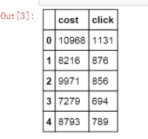
Data Description & Setup
Collect a total of 25 days of webpage ad cost and click volume data.
cost_and_click=pd.DataFrame(pd.read_excel('cost_and_click.xlsx'))

Slide 7
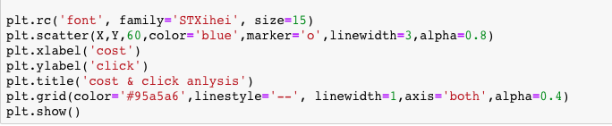
Data Setup
Set the independent and dependent variables of the model :
Cost −> X
Click −> Y
scatter plot :

Slide 8
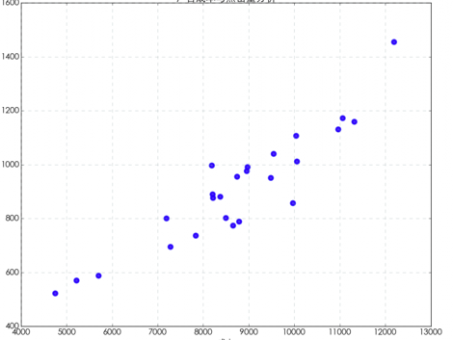
scatter plot

Slide 9

Algorithm Explanation
1. Split data into training and test sets
uses a random method to extract 40% from 25 records as a test set and 60% as training set data
2. Substitution linear regression model

Slide 10


Algorithm Explanation
3. Calculate the key parameters of the model
Compute slope b1, intercept bo and
Decision Coefficient R Square.

Slide 11
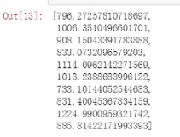
Algorithm Explanation
4. Use the test set to evaluate the model

Slide 12

Results
1. Clicks on the ad increases as the cost of the ad increases.
2. Get the regression model
#set cost as 20000
clf.predict(20000)

Slide 13
Conclusion
Predictive analytics is most importantly it allows businesses to identify future outcomes and act upon them before the impact is too great or the opportunity is missed.
Regression modeling is a tool for predictive analytics.

Slide 14
REFERENCE
https://www.gutcheckit.com/blog/predictive-analytics-regression-models-explained/
http://bluewhale.cc/2016-09-02/python-linear-regression-in-scikit-learn.html#ixzz4cU9ST86q
https://www.data.gov

Slide 15
Thank you!

