Slide 1
Effect of Perioperative Gabapentin Use on Postsurgical Pain in Patients Undergoing Head and Neck Mucosal Surgery
Yan Yang
Apr 26, 2018

Slide 2
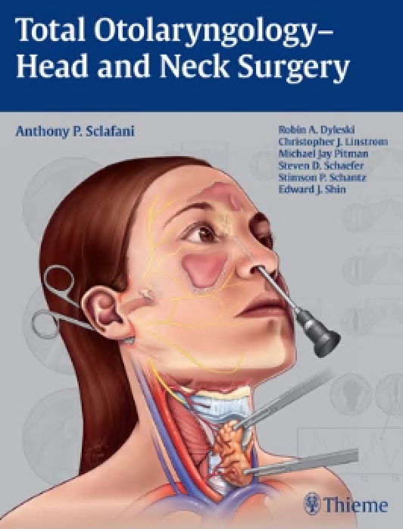


Background
Otolaryngology patients often undergo painful and functionally debilitating operations of the head and neck because of the neuroanatomy of this region. As a result, they are at increased risk for developing persistent postsurgical pain, dysphagia, and other complications.
Notes:
[,otə,lærɪŋ‘gɑlədʒi] 耳鼻喉
Debilitating 衰弱
Neuroanatomy 神经解剖学
Dysphagia 吞咽困难 [dɪs'fedʒɪə]

Slide 3
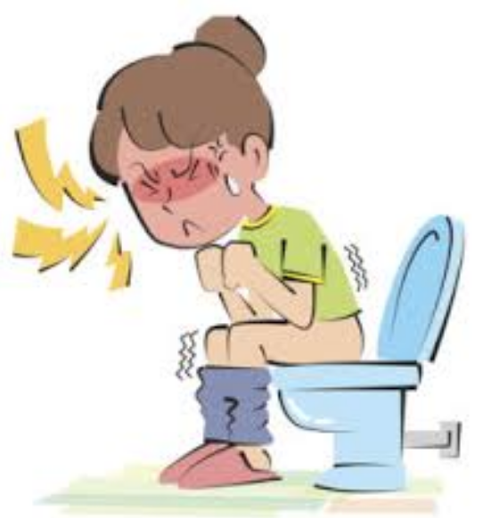


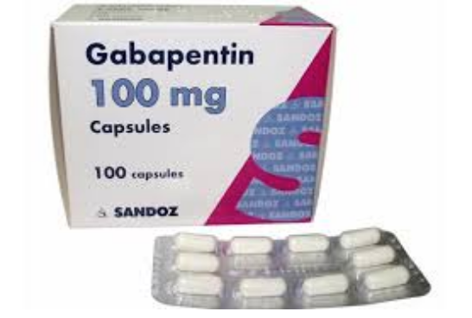
Background
Narcotic medications used to treat postsurgical pain are associated with constipation, nausea, and long-term addiction.
Multimodal therapy, a widely accepted practice within pain management, uses nonnarcotic medications to improve pain and decrease narcotic requirements.
Gabapentin, a medication that targets neuropathic pain, has been investigated as a postoperative pain adjunct.

Slide 4
Study Objectives
The goal of this study is to investigate gabapentin use in patients undergoing larger head and neck mucosal operations associated with significant risk of postoperative pain and dysphagia.
Notes:
uses nonnarcotic medications to improve pain and decrease narcotic requirements.
Optimizing pain control to improve recovery and avoid overuse of narcot- ics is an important postoperative goal.

Slide 5




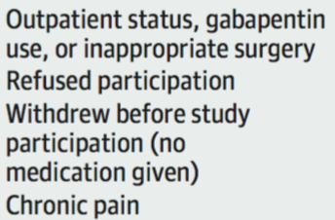

Study Design
Adults undergoing head and neck mucosal surgery from July 25, 2016, through June 19, 2017, were included in this double-blinded, placebo-controlled randomized clinical trial and randomized to receive gabapentin, 300 mg twice daily, or placebo before surgery and up to 72 hours after surgery.(3 days including the day of surgery. )

Slide 6
Sample Size Estimation
Sample size calculations were based on a study of the use of gabapentin in patients undergoing tonsillectomy. With use of relevant estimates from that study, it was determined that approximately 46 individuals per group (92 total) were sufficient to detect a difference of 20% or greater in mean morphine dose between the placebo and gabapentin groups (effect size d = 0.6) with an 80% power and a 2-sided α threshold value of .05.
Assuming a 20% drop out rate, 116 subjects will be enrolled in this study.

Slide 7
MAIN OUTCOMES
The primary study endpoint is postoperative narcotic consumption. Average daily narcotic use from postoperative admission to the last dose of pain medication on POD 2, or the day of discharge, whichever comes sooner, will be calculated.
The secondary endpoints include (a) subject satisfaction with pain control, (b) VAS pain scores, (c) patient baseline pain perceptions (d) hospital length of stay, and (e) potential side effects of the medication.
Notes:
Subjective pain scores were captured using the VAS with resting, coughing, and swallowing motions.

Slide 8
Handling of Missing Values
For the subjects who do not complete the trial, we would use the last observation carried forward (LOCF) method.

Slide 9
Statistical Analysis
Descriptive statistics were used to describe demographic, clinical, and treatment data between groups. Absolute and percentage differences, along with 95% CIs around the differences, were calculated to compare the gabapentin and placebo groups. Intention-to-treat analysis was performed, and safety analysis for adverse effects was undertaken after 50% enrollment was achieved and again at study completion.
The primary endpoints will be analyzed using independent samples t-test, and chi square test for categorical variables will be used to compare distribution of characteristics between treatment groups to ensure successful randomization.
The secondary endpoint will be analyzed by categorical data analysis and ANCOVA.

Slide 10
thank you!
Reference：
https://jamanetwork.com/journals/jamaotolaryngology/fullarticle/2678656

