Slide 1
Extend the intuitionistic logic - Nature Deduction, with Kolmogorov double negation
Yantian Yin, Yifei Che

Slide 2
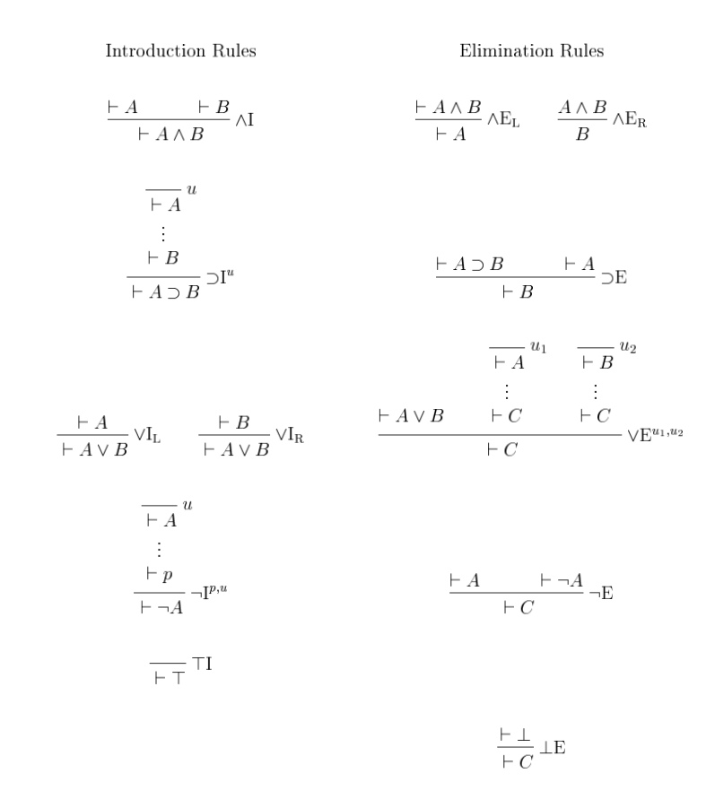
Motivation: Extending Intuitionistic ND to Classical Logic
Missing Excluded Middle: Intuitionistic logic does not assume that every proposition satisfies A ∨ ¬A.
Our Aim:
Introduce a rule (via double negation) to bridge this gap.
Extend Natural Deduction (ND) to a classical system (KND).
Demonstrate that classical logic and intuitionistic logic are “the same” by Proving that the excluded middle is admissible through soundness and completeness of KND relative to ND.
No exclude middle.
Can't prove A ∨ ¬A directly

Slide 3
Objective
Extend ND to KND and make KND classical.
Define the ktrans that translates context between ND and KND
Add inference rule to help with our prove
ND:¬¬X, ¬¬¬R. (could be ¬¬I and ¬¬¬E but we stick with the notation of the paper by Chad E. Brown 1998)
KND: ¬¬k
Prove soundness
Prove decomposability
Prove completeness

Slide 4
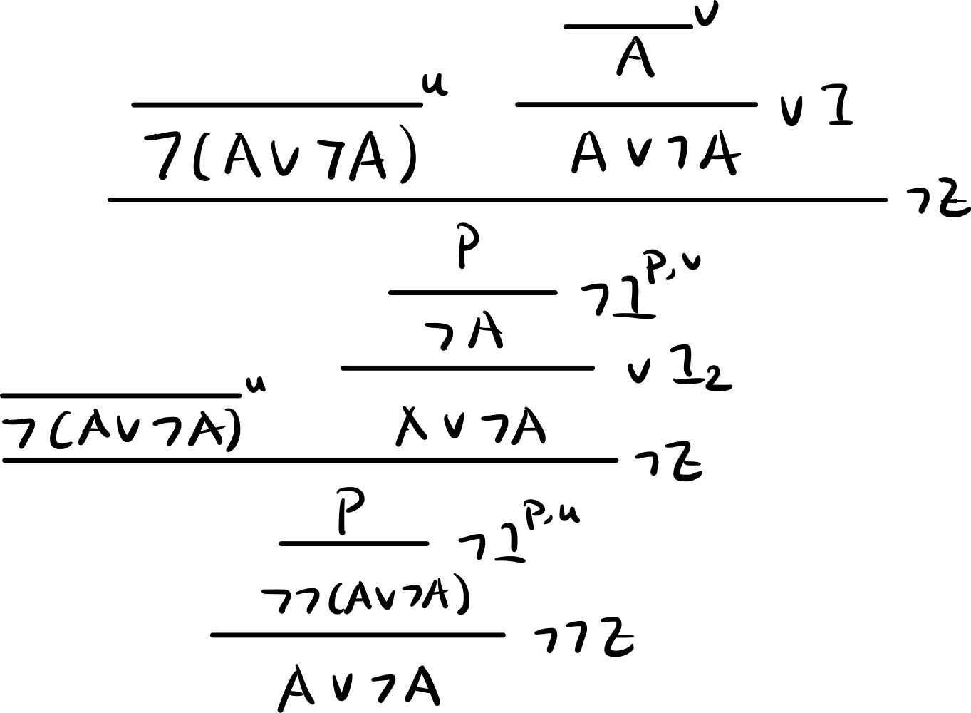
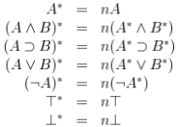
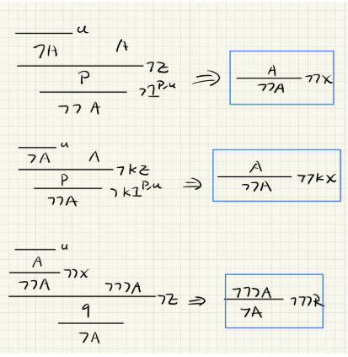
How we achieve our objectives
ND->KND
by adding the Kolmogorov double negation elimination rule to embed the exclude middle property.
Ktrans
We define the translation as the right side and apply recursively
Inference rule
We prove each of them on paper.

Slide 5
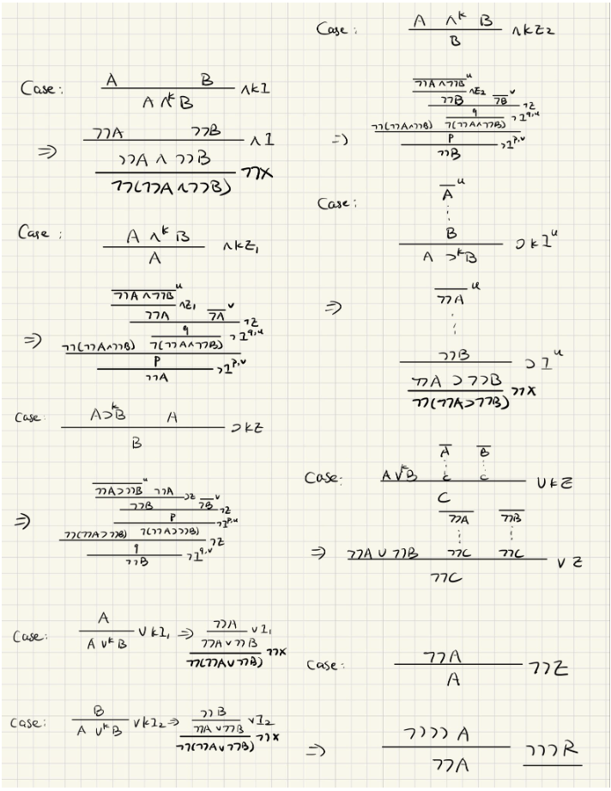
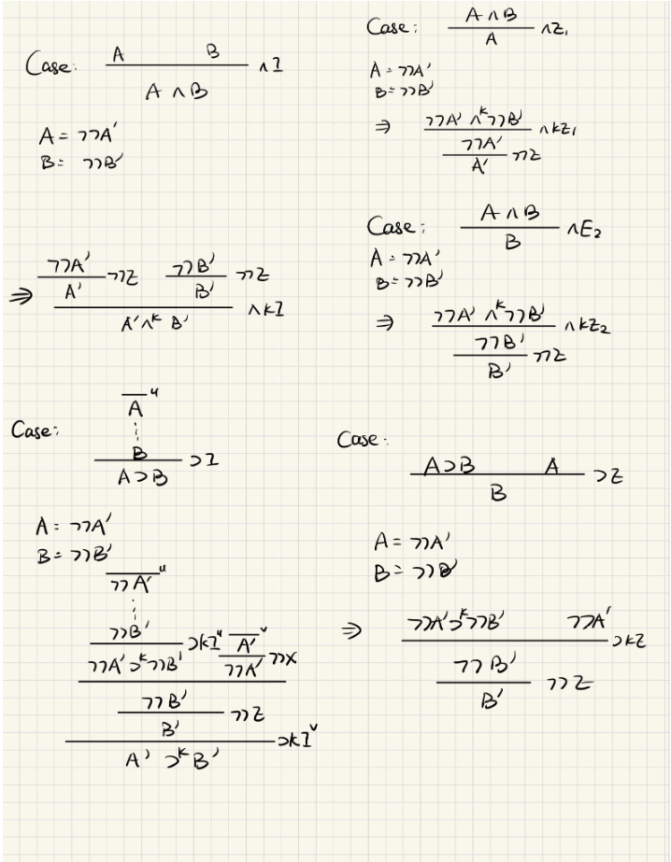
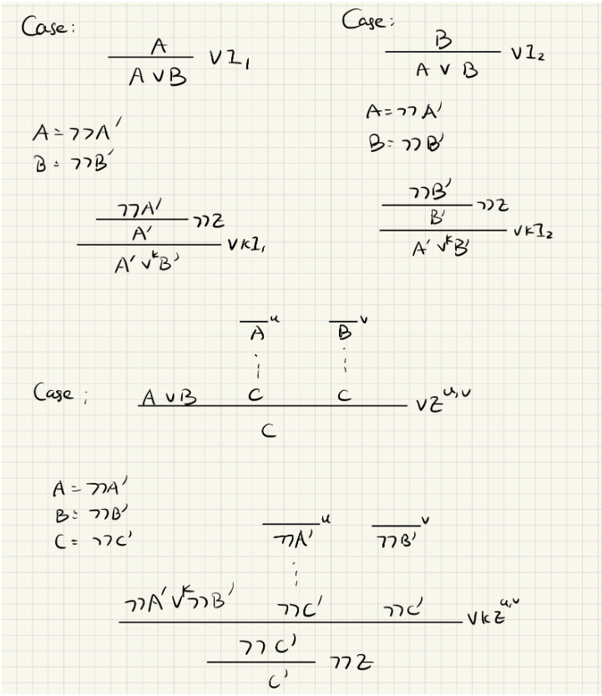
Soundness
We are able to prove soundness with out any lemma directly
Completeness
For completeness, we assume the decomposability

Slide 6
Currently working on
Decomposability: for each A there exists a C such that A = ¬C
If proven, complete our completeness prove
Excluded middle:
Show that for any formula A in KND we can prove (A or ¬A)* in ND
Beluga implementations

Slide 7
Timeline and overall spilt up of work
We are only a group of 2 so we do everything together.
Yantian Yin:
On paper proof, documentation making and PPT making.
Gufei Che:
Beluga code implementation.
Future timeline
Week of March 31
Implement the decomposability and beluga code for ND, KND, Ktrans, and Decomp.
Week of April 7
Implement soundness and completeness in Beluga
Week of April 14
Prepare the anonymous YouTube video and the extended abstract pages

