Slide 1

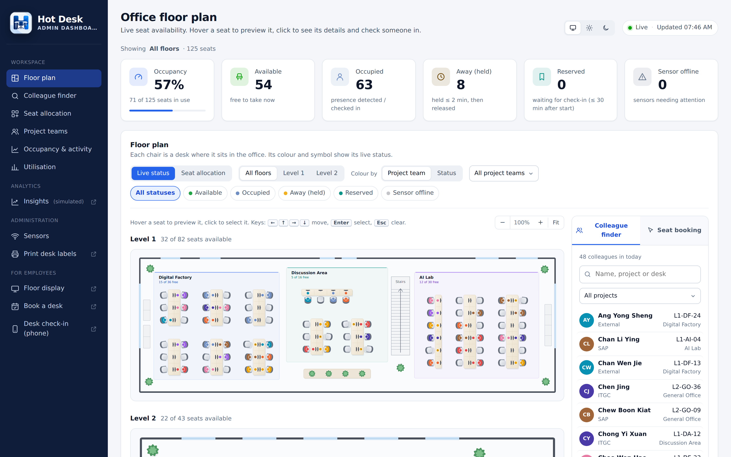




Hot Desk Monitor: live desk availability
Sensors and QR check-in show which of DIC Annex’s 125 hot desks are free, and free them up automatically when people leave.
Detect who is at each desk
Under-desk sensors via TTN or ChirpStack, plus a QR code on every desk to check in
Free desks automatically
Released 20 min after people leave; check-ins last 3 hours unless renewed
Book and find
Reserve a slot ahead, book seats for a team, find colleagues on the floor display
Manage and plan
Live dashboard by project team, utilisation and capacity insights; runs on AWS
Admin dashboard (demo data): live floor plan coloured by project team, with the colleague finder
125 desks on 2 floors
8 project teams
20 min auto-release
3 h default check-in
Notes:
Hot Desk Monitor shows, live, which of the 125 hot desks at DIC Annex are free, and frees desks up automatically.
Detection: under-desk presence sensors report through TTN or ChirpStack; every desk also has a QR label for check-in, so desks without sensors still work.
Auto-release: a desk is held for 20 minutes after the person leaves, then becomes available. Check-ins last 3 hours by default and can be renewed by scanning again.
Employees can reserve a slot ahead, team leads can book several seats, and the floor display helps people find colleagues.
Admins get a live dashboard coloured by project team (8 teams), utilisation by zone and team, and capacity insights. It deploys to AWS from GitHub and can be demoed in GitHub Codespaces.

