Slide 1
How to size your bets?
Kelly Criterion and its application to evaluate the performance of trading strategies

Slide 2
Coin Tossing Game
Toss a coin, head wins, tail loses, 50%head, 50%tail
If win, you double your bet
If lose, you lose what you bet on
Assume you always bet fixed percentage of your capital, and you play n (can be a very big number) times
What is the optimal size of your bet which maximizes your gains?

Slide 3
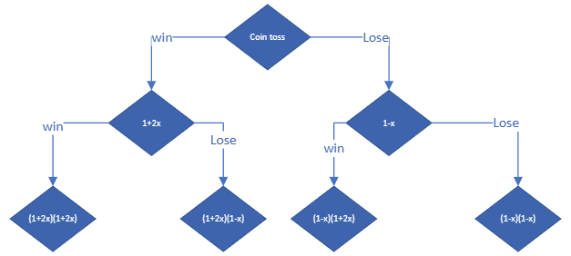
X is a percentage of your capital for each bet

Slide 4


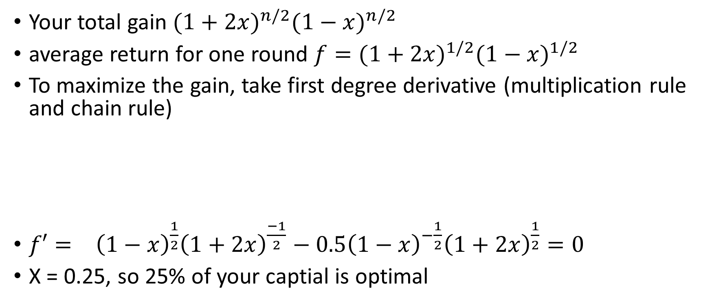
Gain after play n rounds
Your total gain ${(1+2x)}^{n/2}{(1−x)}^{n/2}$
average return for one round ${f=(1+2x)}^{1/2}{(1−x)}^{1/2}$
To maximize the gain, take first degree derivative (multiplication rule and chain rule)
${f′=}^{}{\left(1−x\right)}^{\frac{1}{2}}{\left(1+2x\right)}^{\frac{−1}{2}}−{0.5\left(1−x\right)}^{−\frac{1}{2}}{\left(1+2x\right)}^{\frac{1}{2}}=0$
X = 0.25, so 25% of your captial is optimal

Slide 5
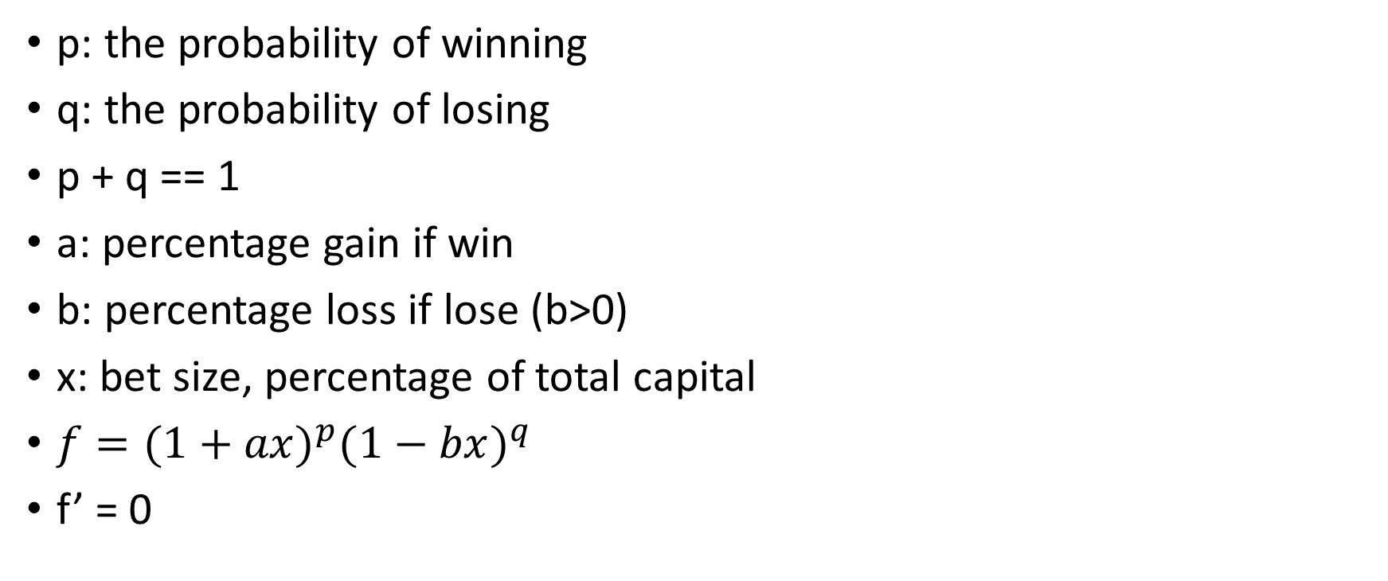
Now let’s generalize this problem
p: the probability of winning
q: the probability of losing
p + q == 1
a: percentage gain if win
b: percentage loss if lose (b>0)
x: bet size, percentage of total capital
${f=(1+ax)}^{p}{(1−bx)}^{q}$
f’ = 0

Slide 6
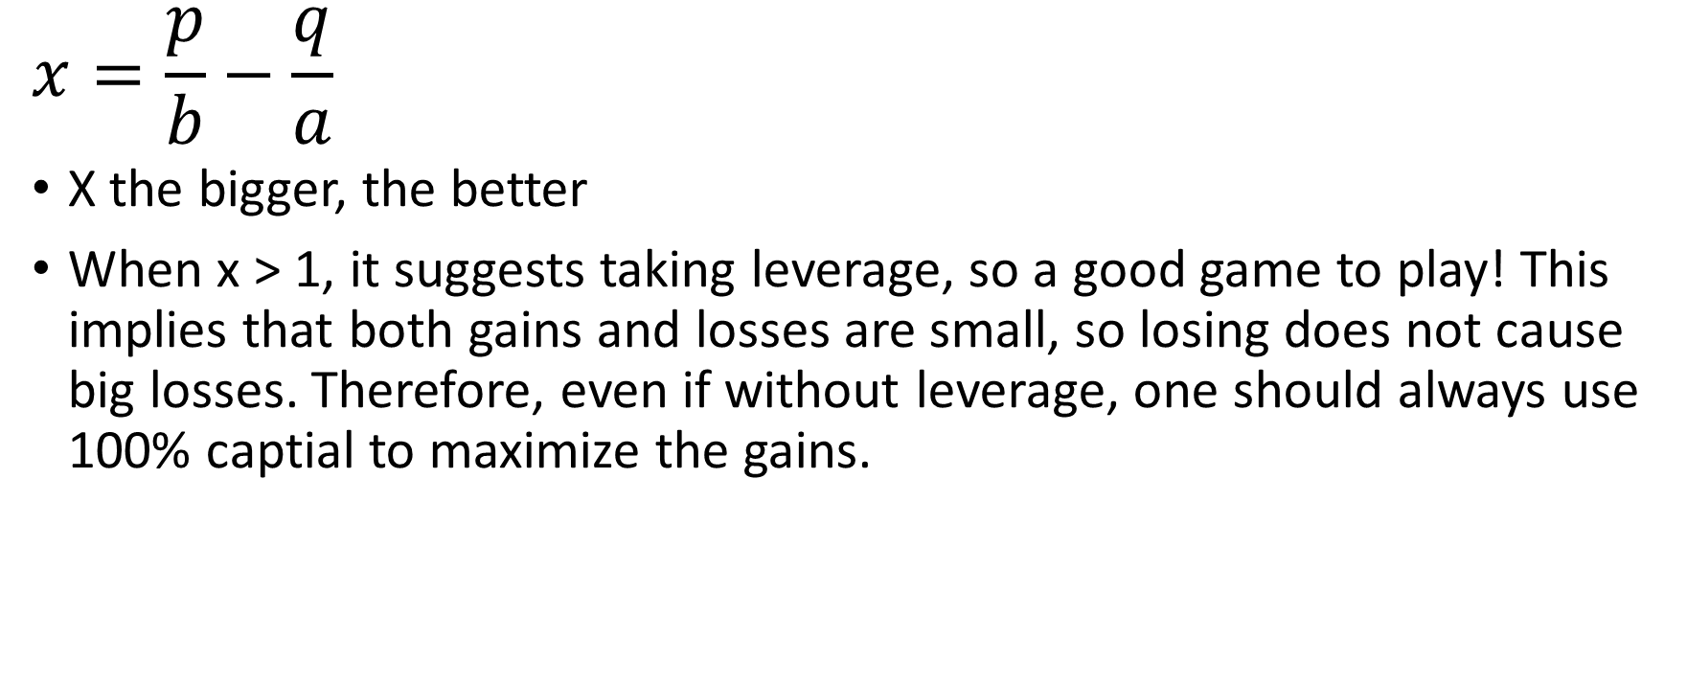
Our final result, the optimal bet size
$$x=\frac{p}{b}−\frac{q}{a}$$
X the bigger, the better
When x > 1, it suggests taking leverage, so a good game to play! This implies that both gains and losses are small, so losing does not cause big losses. Therefore, even if without leverage, one should always use 100% captial to maximize the gains.

Slide 7
How to apply Kelly criterion to evaluate the performance of the higherHigh strategy
Calculate the average losses and gains(simple arithmetic means) for each transaction => a, b
Calculate the probabilities of losses and gains (number of transactions of gains/losses devided by total number of transactions ) => p, q
Derive x from a,b,p,q
The strategies with the biggest x is the best

Slide 8
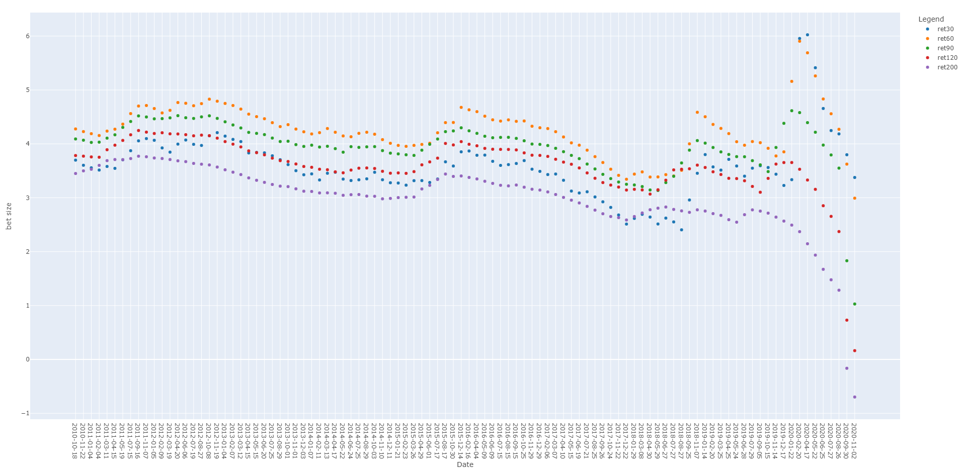
Apply to higherHigh&lowerLow strategy

Slide 9
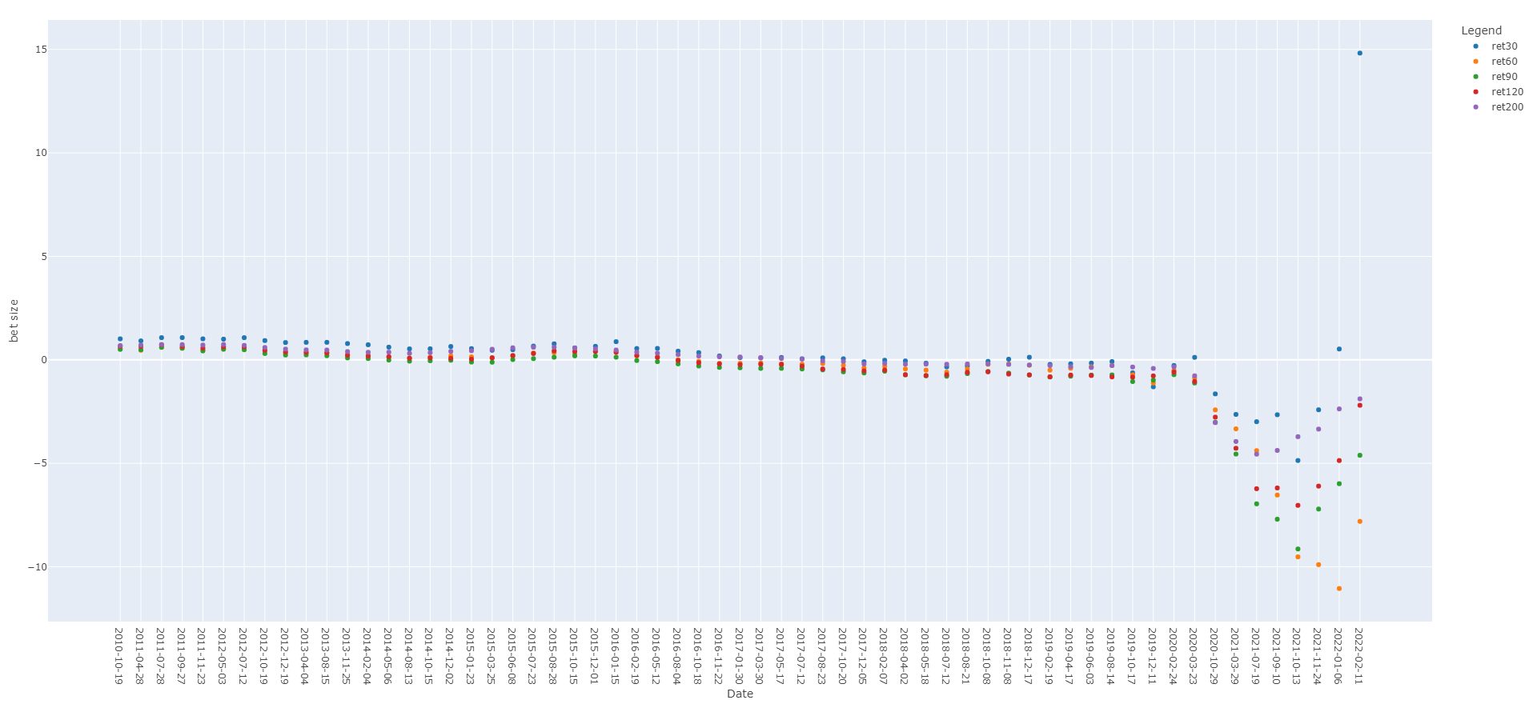

Slide 10
Conclusion
HigherHigh is better than LowerLow
In higherHigh, buy and hold 60-day is better
LowerLow, buy and hold 30-day is better, so seems to be some short-term trend reversal

