Slide 1
Why equal weight is better?
What should you do when you picked multiple stocks and cannot narrow down to a single stock?
Geometric mean < arithmetic mean

Slide 2
Stock A up 10%, stock B up 50%
Alice: equal weight
Bob: all in by randomly pick one stock
Carol: 1:4 weight ratio, randomly allocated to A and B

Slide 3
Return for one round
Investor | return | Expected return
Alice (equal weight) | 0.1*0.5 + 0.5*0.5 = 30% | 0.1*0.5 + 0.5*0.5 = 30%
Bob (all in by randomly pick one stock) | 10% or 50% | 0.1*0.5 + 0.5*0.5 = 30%
Carol (1:4 weight ratio, randomly allocated to A and B) | 0.1*0.8 + 0.5*0.2 = 18% or 0.1*0.2 + 0.5*0.8 = 42% | 0.1*0.5 + 0.5*0.5 = 30%

Slide 4
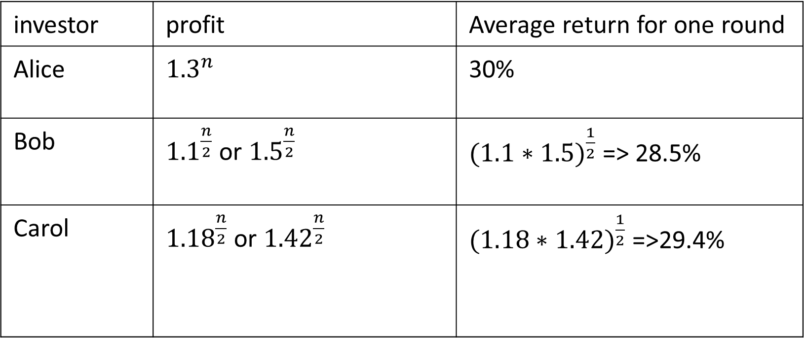
Play "n" rounds, n is a big number
investor | profit | Average return for one round
Alice | $${1.3}^{n}$$ | 30%
Bob | ${1.1}^{\frac{n}{2}}$or ${1.5}^{\frac{n}{2}}$ | ${(1.1∗1.5)}^{\frac{1}{2}}$=> 28.5%
Carol | ${1.18}^{\frac{n}{2}}$or ${1.42}^{\frac{n}{2}}$ | ${(1.18∗1.42)}^{\frac{1}{2}}$ =>29.4%

Slide 5
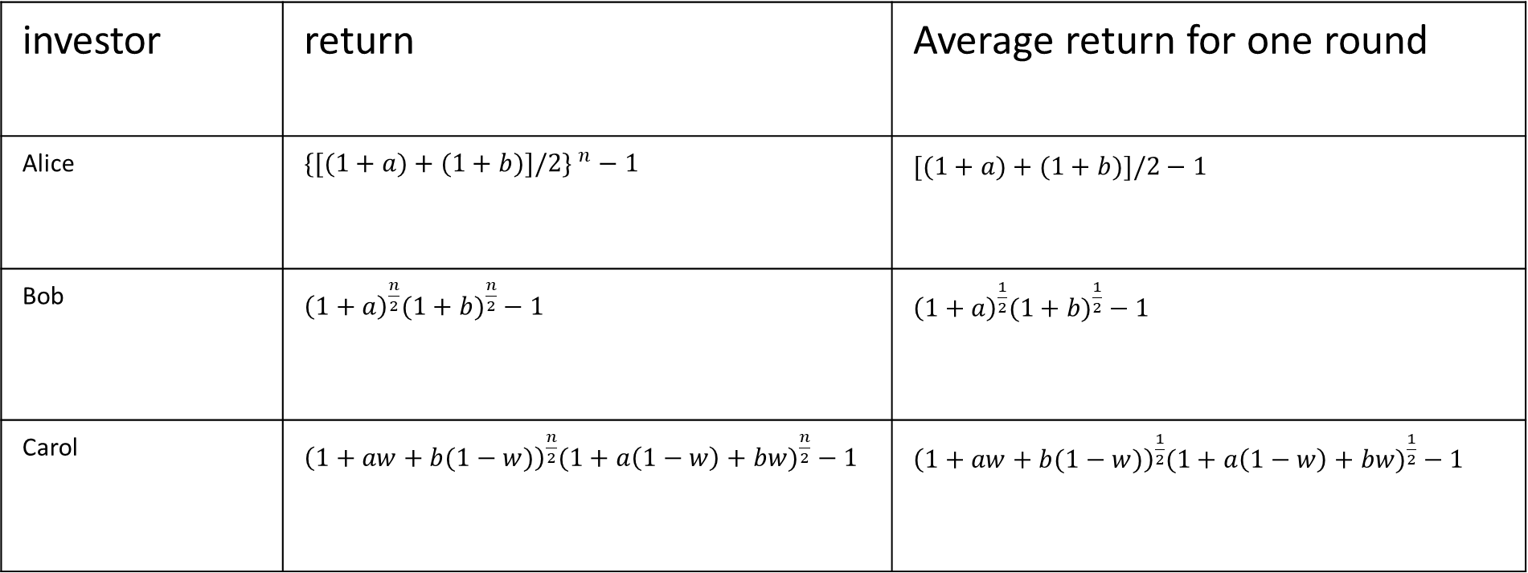
Generalize the problem
investor | return | Average return for one round
Alice | $$\{[({1+a)+(1+b)]/2\} }^{n}−1$$ | $$[({1+a)+(1+b)]/2−1 }^{}$$
Bob | ${\left(1+a\right)}^{\frac{n}{2}}({1+b)}^{\frac{n}{2}}−1$ | ${\left(1+a\right)}^{\frac{1}{2}}({1+b)}^{\frac{1}{2}}−1$
Carol | ${\left(1+aw+b(1−w)\right)}^{\frac{n}{2}}({1+a\left(1−w\right)+bw)}^{\frac{n}{2}}−1$ | ${\left(1+aw+b(1−w)\right)}^{\frac{1}{2}}({1+a\left(1−w\right)+bw)}^{\frac{1}{2}}−1$
a: return of stock A; b return of stock b; w: weight allocated to A

Slide 6

We know $({xy)}^{\frac{1}{2}}≤\frac{x+y}{2}$
So Alice’s return is always >= Bob’s and Carol

Slide 7
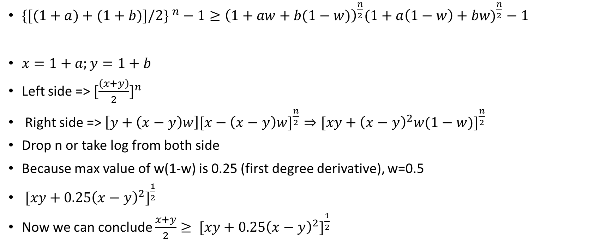
Is Alice better than Carol?
$\{[({1+a)+(1+b)]/2\} }^{n}−1≥{\left(1+aw+b(1−w)\right)}^{\frac{n}{2}}({1+a\left(1−w\right)+bw)}^{\frac{n}{2}}−1$
${x=1+a;y=1+b}^{}$
Left side => ${[\frac{\left(x+y\right)}{2}]}^{n}$
Right side => ${\left[y+\left(x−y\right)w\right][x−\left(x−y\right)w]}^{\frac{n}{2}}⇒{[xy+{\left(x−y\right)}^{2}w(1−w)]}^{\frac{n}{2}}$
Drop n or take log from both side
Because max value of w(1-w) is 0.25 (first degree derivative), w=0.5
${ [xy+{0.25\left(x−y\right)}^{2}]}^{\frac{1}{2}}$
Now we can conclude ${\frac{x+y}{2}≥ [xy+{0.25\left(x−y\right)}^{2}]}^{\frac{1}{2}}$

Slide 8

Alice is always no worse than Bob and Carol
And this applies to n assets, because ${(x_{1}∗x_{2}… ∗x_{n})}^{\frac{1}{n}}<(x_{1}+x_{2}…+x_{n})/n$

