Slide 1
Battle of Neighborhoods – Exploring Restaurants in Columbus

Slide 2

Background
Columbus became the14th largest city in the US;
Columbus is rapidly gaining a reputation as one of America's up-and-coming culinary destinations
Huge potential for restaurant business

Slide 3
Business problem
An investor form Japan would like to invest in the restaurant business; he is interested in investing Japanese restaurant in Columbus and nearby cities.
Questions:
What is the competitiveness of Japanese restaurants in these cities?
Which cities have a potential market for Japanese restaurants?

Slide 4
Data
Ohio data that contains lists of cities and coordinates
A list of cities: https://en.wikipedia.org/wiki/List_of_cities_in_Ohio
Coordinates: https://raw.githubusercontent.com/yywang118/Coursera-Capstone/master/OHIO_location.csv
Restaurants in each city from Franklin County in Ohio.
Data source: Fousquare API
Description: Use API to get all the venues in each city.

Slide 5
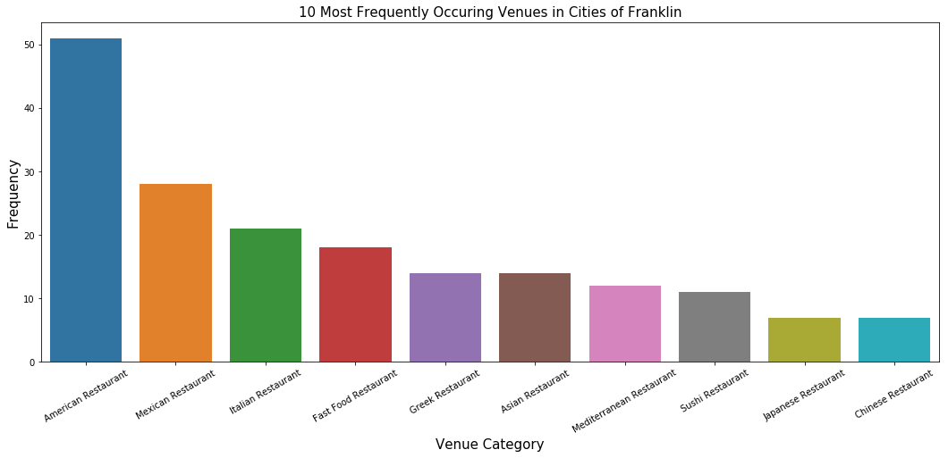
Ten most common restaurants

Slide 6
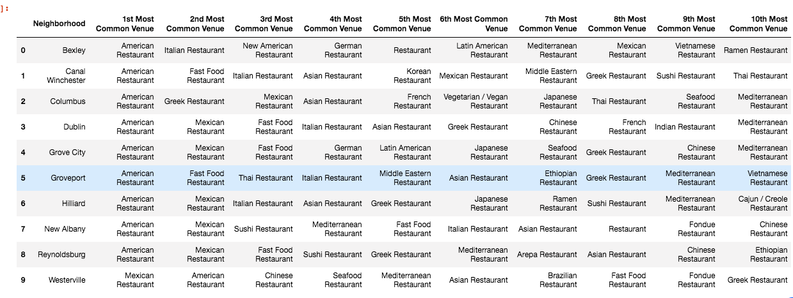
Most common restaurant by city

Slide 7
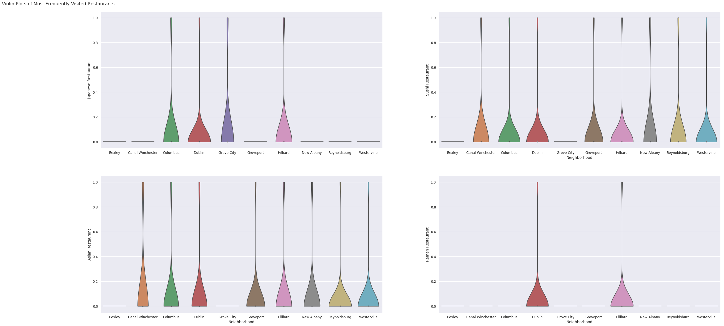
Violin plots of the Japanese restautants by city

Slide 8
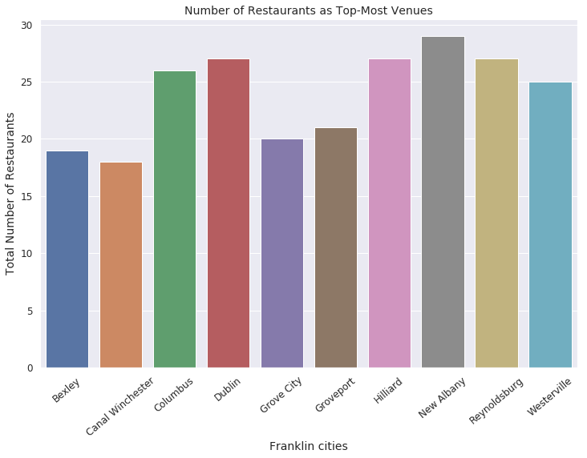
Total number of restaurants by city

Slide 9
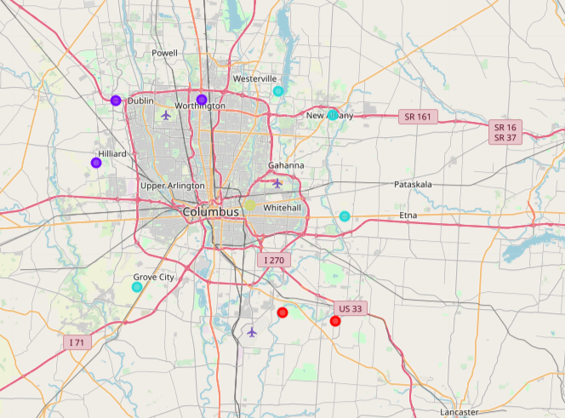
K-means clustering

Slide 10
Conclusion
Bexley and Grove city have the smallest number of Japanese style restaurants, which might be the least competitive;
Columbus has the largest population
Other factor to consider: land price

