Slide 1
ALPHASWAP
AI-Powered DeFi Trading Agent on BNB Smart Chain
BNB Hack 2026 정승연 Charles

Slide 2
THE PROBLEM
Rule-Based Bots Are Blind
"Buy when RSI < 30" — but what if whales are
dumping BNB to exchanges at the same time?
Single-indicator rules can't handle conflicting signals.
No On-Chain Transparency
Existing bots execute trades with zero auditability.
Users can't verify why a trade was made.
No on-chain record of AI decision-making.
High Gas = Impractical AI Agents
AI agents need frequent analysis + execution.
On Ethereum: $5+ per tx. Recording AI reasoning
on-chain? Economically impossible.
Manual Trading Fatigue
Crypto markets run 24/7. Humans can't monitor
indicators, whale movements, and price action
around the clock.

Slide 3
THE SOLUTION
AlphaSwap — AI that thinks like a trader, executes like a bot, records like a blockchain.
AI Confluence Analysis
Claude AI synthesizes 5 indicators
+ on-chain whale data into a
holistic BUY / SELL / HOLD judgment.
RSI + MACD + MA + Bollinger + Whale
Autonomous Execution
Every interval seconds: analyze
market, decide, and execute
— fully automated.
Users deposit to Vault, AI trades on
their behalf.
On-Chain Transparency
Every trade + AI reasoning stored
on-chain in TradeRegistry.
Anyone can audit why a trade
was made. Full accountability.

Slide 4
HOW IT WORKS
Every interval seconds — fully automated pipeline
1
Data Collection
2
Technical Indicators
3
AI Analysis
4
Auto-Execute
PancakeSwap V3 slot0()
Binance 1H OHLCV (41 days)
BSCScan whale detection
RSI(14) · MACD(12/26/9)
SMA(20/50/200) · EMA(12/26)
Bollinger Bands(20, 2σ)
Claude evaluates confluence
of all indicators + whale data
→ BUY/SELL/HOLD + confidence
Confidence ≥ 70% → swap via
Vault contract on BSC Testnet
Trade recorded on-chain
→
→
→

Slide 5
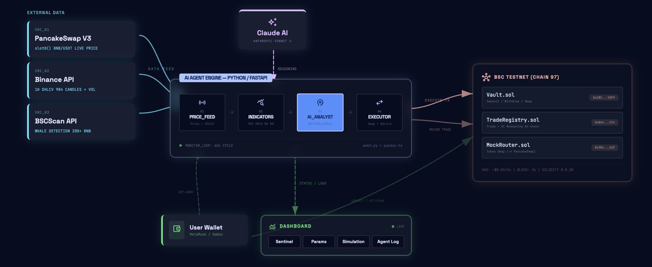

ARCHITECTURE

Slide 6
WHY BNB SMART CHAIN
$0.03 / tx
Low Gas = AI Agent Viability
On Ethereum that's $5+/tx. BSC makes AI agents economically viable.
Fast Block Time
3 sec
Signal → execution in one block.
AI decisions are acted on immediately.
PancakeSwap Native
slot0()
Direct price reads from PancakeSwap V3.
Deepest BNB/USDT liquidity on any DEX.
Rich On-Chain Data
BSCScan
Whale transfer detection via BSCScan API.
Exchange flow analysis for market sentiment.

Slide 7
KEY DIFFERENTIATOR
Not a rule-based bot — AI holistic judgment
Traditional Bot
if RSI < 30: BUY
if RSI > 70: SELL
RSI says buy, but whales are dumping?
Bot buys anyway. Gets rekt.
AlphaSwap AI
"RSI at 32 suggests oversold, but 3 whale
transfers are depositing large BNB to
exchanges — signaling sell pressure.
MACD histogram still expanding negative.
Safer to delay the buy entry."
→ HOLD (confidence 45%)

Slide 8
ROADMAP
Phase 1
Phase 2
Phase 3
Phase 4
Phase 5
Hackathon MVP
On-Chain Expansion
Multi-Pair + Mainnet
Account Abstraction
Strategy Marketplace
• BNB/USDT single pair
• 1H indicators + whale detection
• BSC Testnet + simulation demo
• PancakeSwap pool event parsing
• Network gas utilization
• CAKE APR data integration
• Multiple trading pairs
• PancakeSwap V3 mainnet
• Backtesting engine
• ERC-4337 Paymaster
• Gas fees paid in USDT
• Seamless UX
• Copy trading
• Strategy sharing
• Multi-chain expansion
← WE ARE HERE

Slide 9
ALPHASWAP
AI Thinks. BSC Executes. On-Chain Verifies.
https://github.com/yyxcn/AlphaSwap

