Slide 1
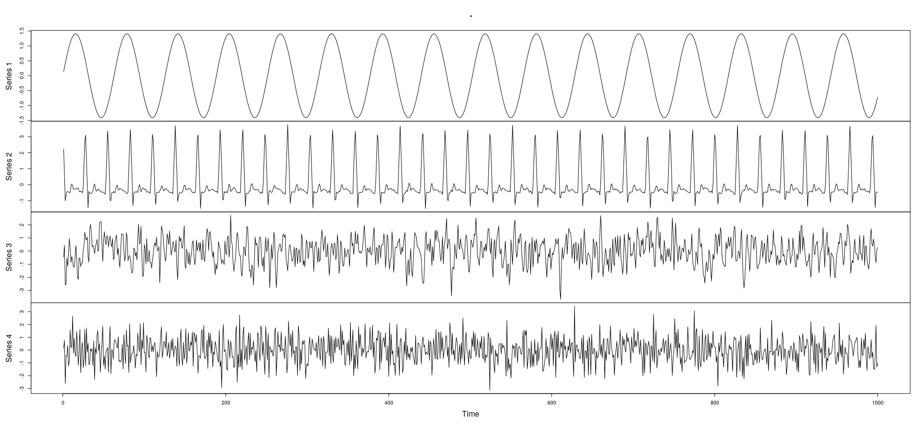




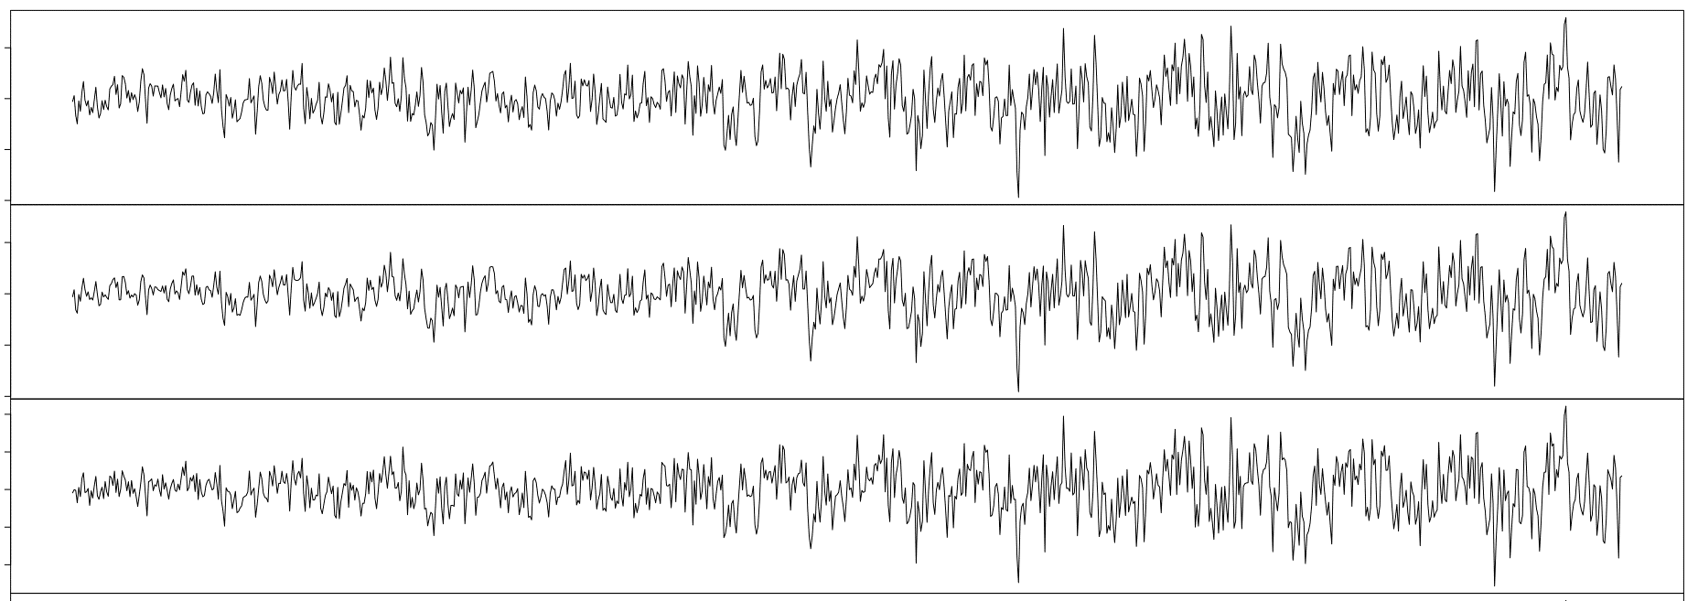
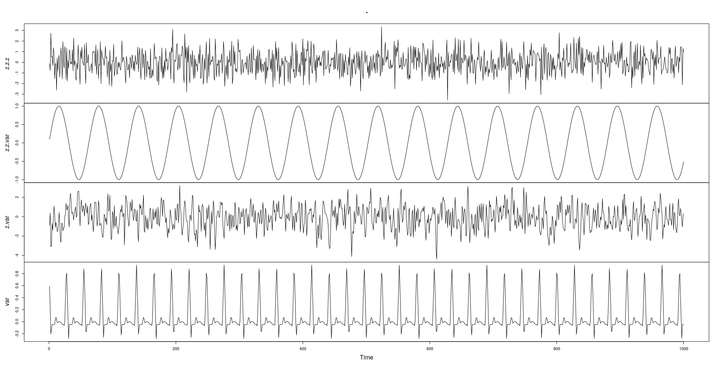
Source Signals
3
3
1
3
3
Blackbox
(Unknown)
Recording
Equipment
1
Moving 0.13 m/s
1
2
1
Moving 0.1 m/s
2
2
2
Moving 0.07 m/s
(composed of 3 slowly-moving microphones)
Captured
Mixture
How to
Restore?

Slide 2
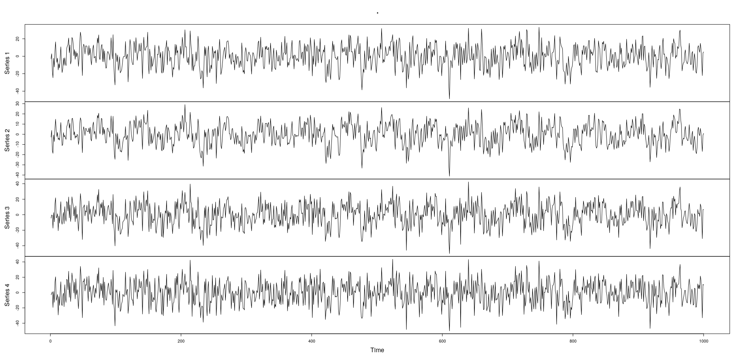
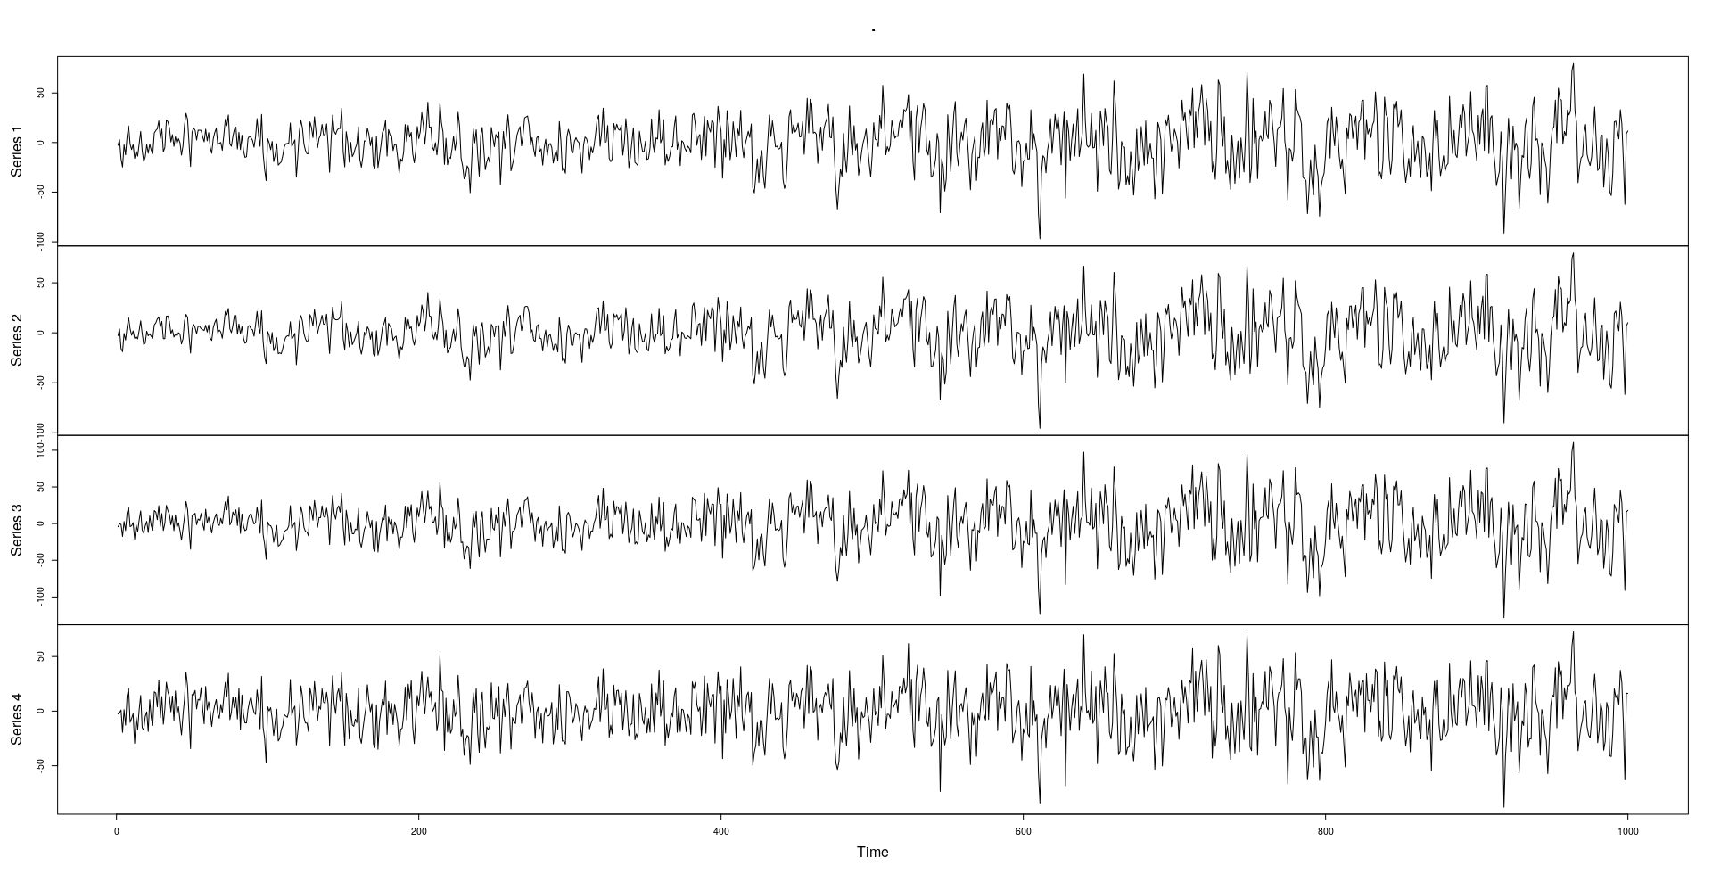

Slide 3
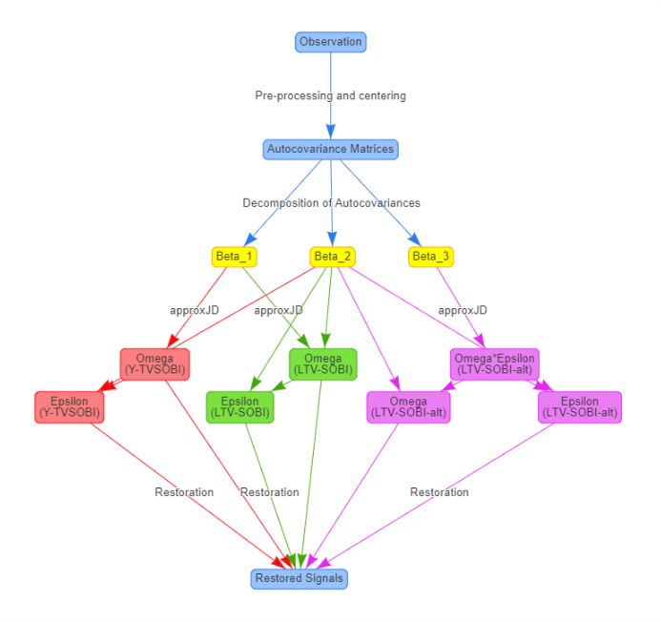










Observation
Pre-processing and centering
Autocovariance Matrices
Decomposition of Autocovariances
$$\hat{β_{1}}$$
$$\hat{β_{2}}$$
$$\hat{β_{3}}$$
$$\hat{Ω_{0}}$$
Y-TVSOBI
$$\hat{Ω_{0}}$$
LTV-SOBI
$$(\hat{Ω_{0}ε})$$
LTV-SOBI-alt
$$\hat{ε}$$
Y-TVSOBI
$$\hat{ε}$$
LTV-SOBI
$$\hat{Ω_{0}}$$
LTV-SOBI-alt
$$\hat{ε}$$
LTV-SOBI-alt
Restoration (inverse of mixing)
Restored Signal

Slide 4

Fixed $Ω_{0}=Ω_{sim}$
Given $ε$ = ${10}^{4}M$ (or ${10}^{5}M)$
Observed Mixtures
(of different lengths)
Given
Sample
Rates
Simulated true signal and mixture
Simulation Algorithm
(ECG + SIN + AR/MA)
Corresponding True Signals
(of different lengths)
Performance Metrics
Repeat many times
Report Overall Performance
Restored Signals
(from different algorithms)
Apply all LTV-SOBI algorithms

