Slide 1
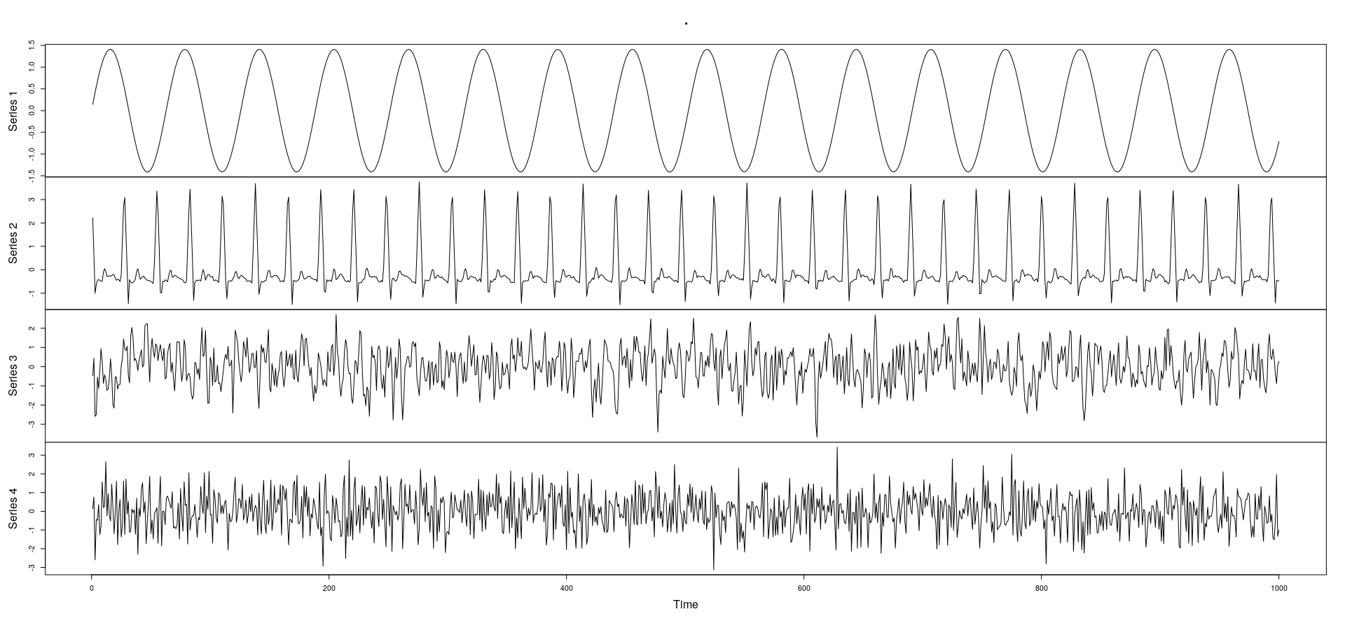




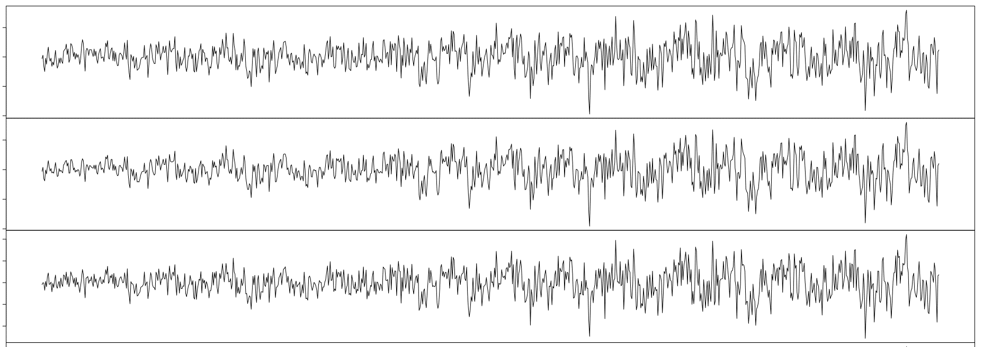
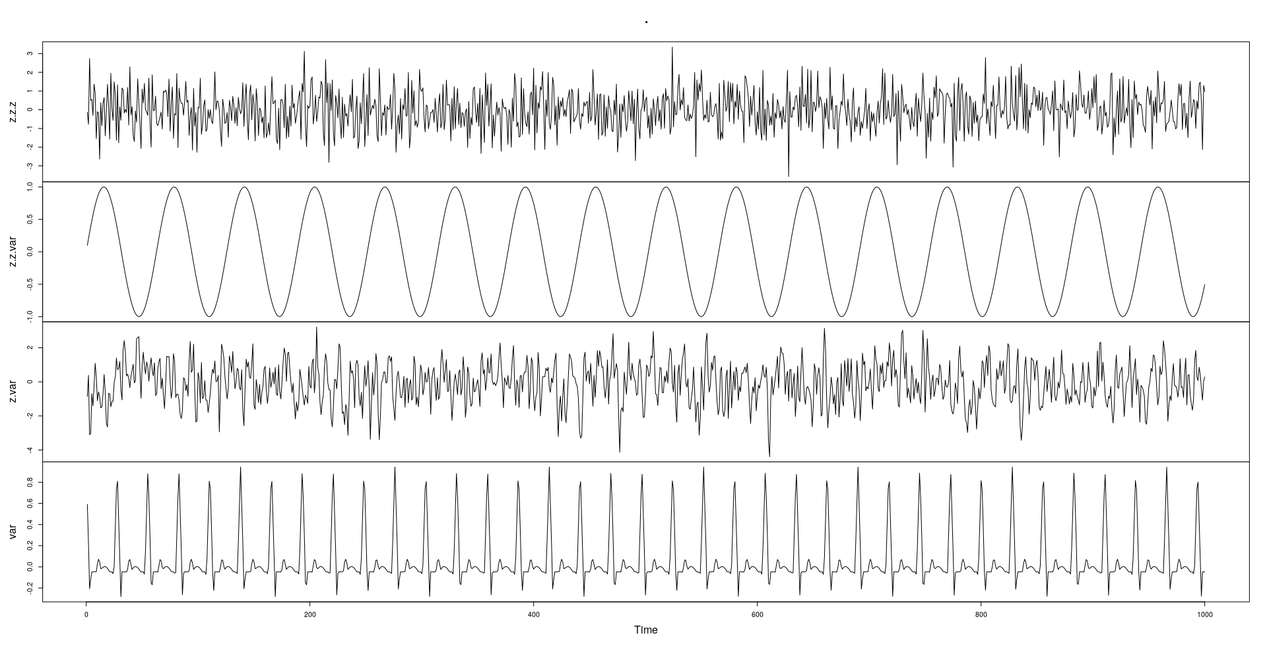
Source Signals
3
3
1
3
3
Blackbox
(Unknown)
Recording
Equipment
1
Moving 0.13 m/s
1
2
1
Moving 0.1 m/s
2
2
2
Moving 0.07 m/s
(composed of 3 slowly-moving microphones)
Captured
Mixture
How to
Restore?

Slide 2
