Slide 1
⚓
AnchorClaim
Automated demurrage audit & on-chain settlement for shipping
⚓
NTU InnovateX Hackathon 2026 · Submission Deck
Track 1 — Payments & Financial Infrastructure · Track 2 — AI Agents & Real-World Use Cases
Notes:
AnchorClaim — automated demurrage audit and on-chain settlement for shipping. Our submission deck for NTU InnovateX 2026, covering both the payments and AI-agent tracks.

Slide 2
PROBLEM STATEMENT
Demurrage is billed daily but settled in months
When a vessel stays in port beyond its allowed laytime, the charterer owes demurrage — large daily penalties. Today those claims are reconciled by hand: staff match PDF charter parties against paper port logs, line by line. Money stays frozen for weeks.
$10k–30k
Weeks–months
$5B+
per day, per vessel
to settle one claim
disputed each year
The bottleneck isn't the arithmetic — it's manual reconciliation and trapped capital.
⚓ AnchorClaim
Problem
2
Notes:
Demurrage runs ten to thirty thousand dollars a day per vessel. Claims are reconciled by hand and take weeks to months; billions are disputed yearly. The bottleneck is manual reconciliation and frozen capital, not the math.

Slide 3
SOLUTION OVERVIEW
An AI agent that audits the claim, and escrow that settles it
1
2
3
Escrow
→
AI audit
→
Settle
Charterer & owner lock freight + a deposit into an on-chain escrow vault (USDC).
Voyage Sentinel parses the charter party, reads AIS/port logs, deducts contractual suspension time.
Agent computes demurrage, writes an on-chain attestation; the contract auto-pays and releases balance.
Track 1 = escrow & settlement rail. Track 2 = the agent that reads contracts and decides.
⚓ AnchorClaim
Solution
3
Notes:
Three steps. Both parties lock freight and a deposit into escrow. The Voyage Sentinel agent parses the charter party, reads AIS and port logs, deducts suspension time. It computes demurrage, writes an attestation, and the contract auto-settles. Steps one and three are payments; step two is the AI agent.

Slide 4
PRODUCT CONCEPT
One console for the whole claim lifecycle
Fleet & search
Guided audit
Laytime breakdown
Browse voyages; filter by vessel, IMO or port as you type.
Watch the agent parse, cross-check, compute and settle — step by step.
Visual bar splits counted laytime, excess, and excluded time.
Verifiable settlement
Dispute guardrail
Instant cache
Every result carries an evidence hash written on-chain.
Inconsistent records are held for manual review, never auto-paid.
Analyzed voyages are cached and served instantly on repeat views.
⚓ AnchorClaim
Product concept
4
Notes:
The product is a single console for the whole claim lifecycle: browse and search the fleet, run a guided step-by-step audit, see the laytime breakdown, get verifiable on-chain settlement, a dispute guardrail that holds inconsistent records, and an instant cache for repeat views.

Slide 5
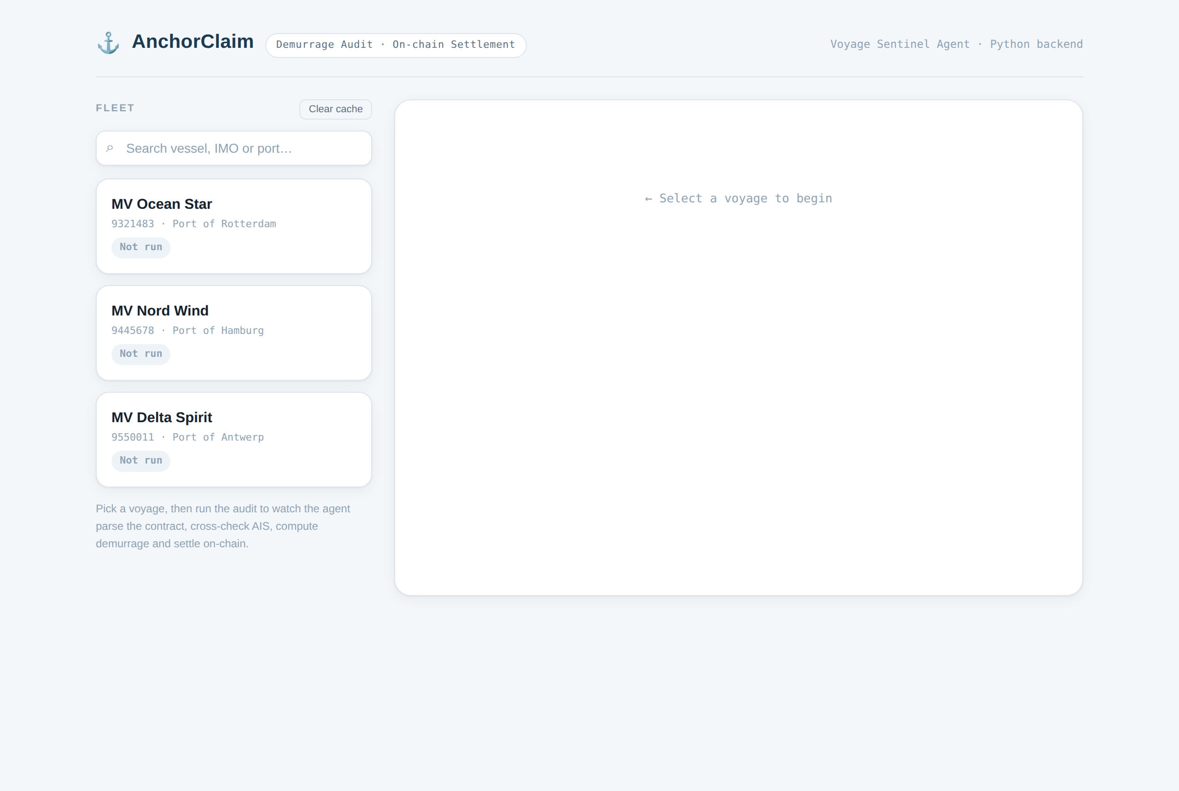
SCREENSHOTS
Home — fleet list, search, and cached status
Live product UI · search filters the fleet in real time
Notes:
This is the live home screen: the fleet list on the left with search by vessel, IMO or port, and a cached badge on voyages already analyzed.

Slide 6
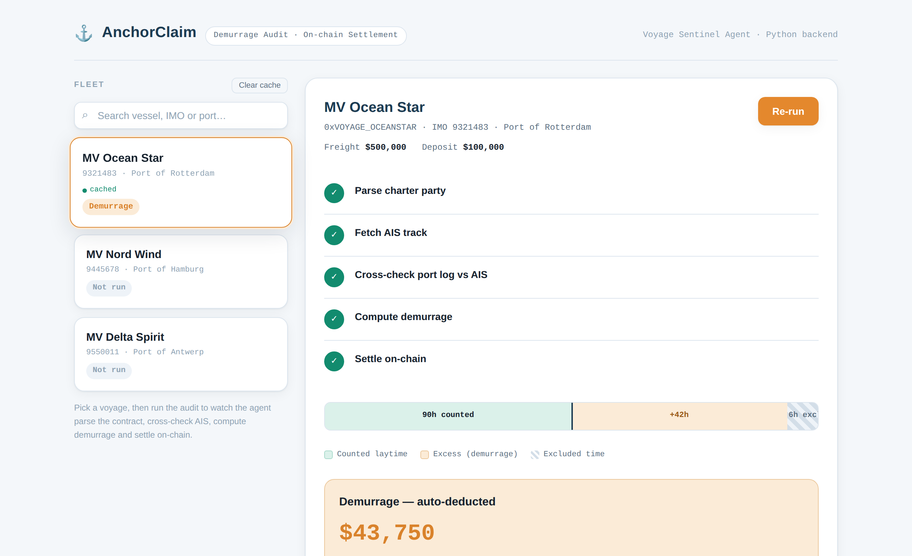
SCREENSHOTS
Audit result — demurrage computed & settled
MV Ocean Star · 42h excess after 6h weather exclusion · $43,750
Notes:
The audit result screen: five completed steps, the laytime bar splitting counted, excess and excluded hours, and the forty-three-thousand-seven-fifty demurrage with an on-chain evidence hash.

Slide 7
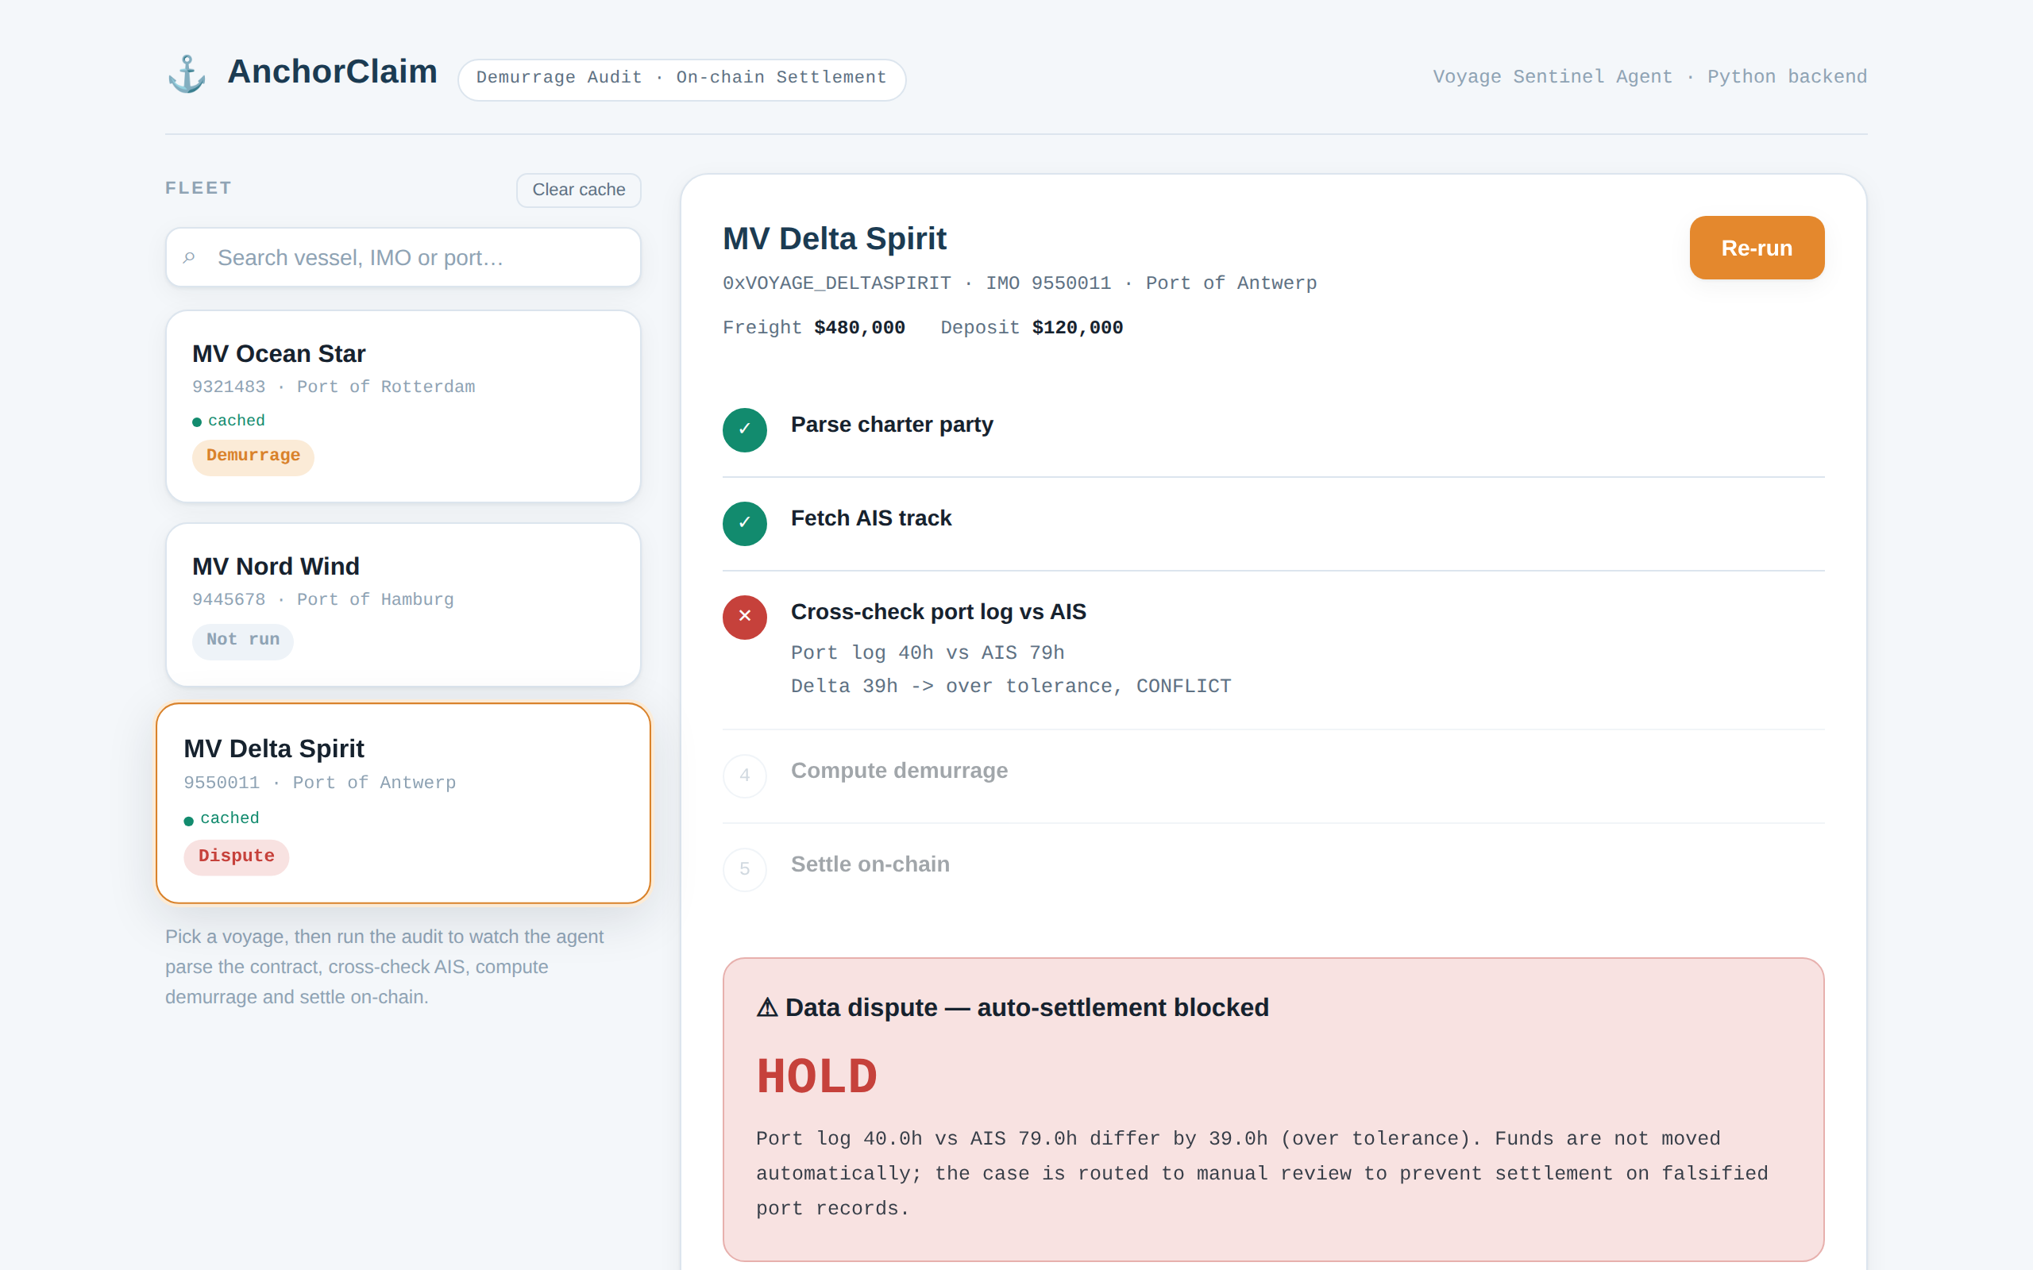
SCREENSHOTS
Dispute guardrail — settlement blocked for review
Port log 40h vs AIS 79h → HOLD, routed to manual review
Notes:
When the port log and AIS disagree beyond tolerance — forty versus seventy-nine hours — the agent stops at cross-check, refuses to auto-settle, and routes to manual review. It won't pay out on falsified records.

Slide 8
PROTOTYPE STATUS
A working prototype, not a mockup
Working end-to-end today
Next / optional wiring
✓
Contract parsing (local LLM + regex fallback)
Live AIS feed
✓
Demurrage engine with suspension deduction
aisstream.io WebSocket collector (built; needs key)
✓
AIS cross-check & dispute detection
Real LLM parse
ollama pull qwen2.5, set MODEL
✓
Escrow smart contract (Solidity)
On-chain settle
✓
Flask API serving the audit engine
deploy escrow to Base Sepolia, set .env
✓
Live web console — real API, no mocked numbers
Multi-tenant
✓
Persistent cache across restarts
per-charterer voyages & auth
⚓ AnchorClaim
Prototype
8
Notes:
This is a working prototype, not a mockup. Everything on the left runs end to end today — parsing, the demurrage engine, AIS cross-check, the escrow contract, the Flask API, and a live console driven by the real API. On the right is optional wiring: a live AIS key, real LLM parsing, on-chain deployment, and multi-tenant support.

Slide 9
ARCHITECTURE NOTES
How it works
INPUTS
Charter Party (PDF)
Statement of Facts
AIS / GPS track
↓
AGENT
Voyage Sentinel Agent
• Parse clauses
• Cross-check AIS
• Compute demurrage
↓
SETTLEMENT
Escrow Vault
On-chain Attestation
Auto payout
↓
STACK
Flask API + web console
Ollama (LLM)
Solidity · Base · USDC
⚓ AnchorClaim
Architecture
9
Notes:
Three layers. Inputs: charter party, statement of facts, AIS track. The agent parses clauses, cross-checks AIS, computes demurrage. Settlement: escrow vault, on-chain attestation, auto payout. The stack is a Flask API and web console, a local Ollama model, and a Solidity contract on Base with USDC.

Slide 10
ARCHITECTURE NOTES
Design decisions that matter
Contract-driven, not formulaic
The agent extracts the suspension clause and deducts only what the contract allows (weather, strikes, congestion). A naive tool would over-bill by ignoring exclusions.
Fraud-resistant by construction
Port logs are cross-checked against independent AIS data; a delta beyond tolerance blocks auto-settlement rather than paying out on a bad record.
Verifiable evidence on-chain
Each settlement writes a hash of the audit evidence (contract + SoF + AIS) to the escrow contract, so any party can verify what the payout was based on.
Graceful degradation
LLM and chain are optional: regex-parse and mock-settle fallbacks let the full pipeline run offline for demos and CI.
⚓ AnchorClaim
Architecture
10
Notes:
Four design decisions: it's contract-driven not formulaic, so it reads exclusions; it's fraud-resistant, cross-checking port logs against AIS; it writes verifiable evidence on-chain; and it degrades gracefully with regex and mock fallbacks so it runs offline.

Slide 11
DEMO
Demo walkthrough (60 seconds)
Live at http://localhost:8788 · see /demo for a screen recording
00:00
Open the console
Fleet of three voyages loads; search filters instantly.
00:10
Select MV Ocean Star
Contract terms, freight and deposit shown.
00:15
Run audit
Agent parses clause → fetches AIS → cross-checks → computes.
00:35
See the verdict
42h excess after 6h weather exclusion → $43,750, evidence hash.
00:45
Try MV Delta Spirit
Port log vs AIS conflict → HOLD, routed to review.
00:55
Re-open Ocean Star
Served instantly from cache.
⚓ AnchorClaim
Demo
11
Notes:
A sixty-second walkthrough: open the console, search, select Ocean Star, run the audit and watch the four agent stages, see the forty-three-seven-fifty verdict with evidence hash, then try Delta Spirit for the dispute hold, and re-open Ocean Star to show the instant cache.

Slide 12
TOOLS, APIS & INFRASTRUCTURE
What we built on
Base (L2)
USDC
Solidity + OpenZeppelin
Ollama
Low-fee chain for USDC settlement
Stablecoin settlement asset
Escrow contract (ReentrancyGuard, Ownable)
Local LLM for charter-party parsing
aisstream.io
Flask (Python)
web3.py
Vanilla JS / HTML
Live vessel AIS position feed
API + static UI host
Contract calls from the agent
Zero-dependency web console
Sponsor/infra note: settlement targets Base + USDC; swap-in ready for other EVM chains and stablecoins.
⚓ AnchorClaim
Tools & infrastructure
12
Notes:
What we built on: Base as the low-fee settlement chain with USDC, a Solidity escrow using OpenZeppelin, Ollama for local contract parsing, aisstream for live AIS, Flask for the API and UI, web3.py for contract calls, and a zero-dependency vanilla JS front end. Settlement targets Base and USDC but is swap-in ready for other EVM chains.

Slide 13
From weeks of manual reconciliation
to seconds of verifiable settlement.
⚓
AnchorClaim · Voyage Sentinel Agent · NTU InnovateX 2026
Thank you — questions welcome
Notes:
To close: AnchorClaim takes demurrage from weeks of manual reconciliation to seconds of verifiable, on-chain settlement. Thank you — questions welcome.

