Slide 1
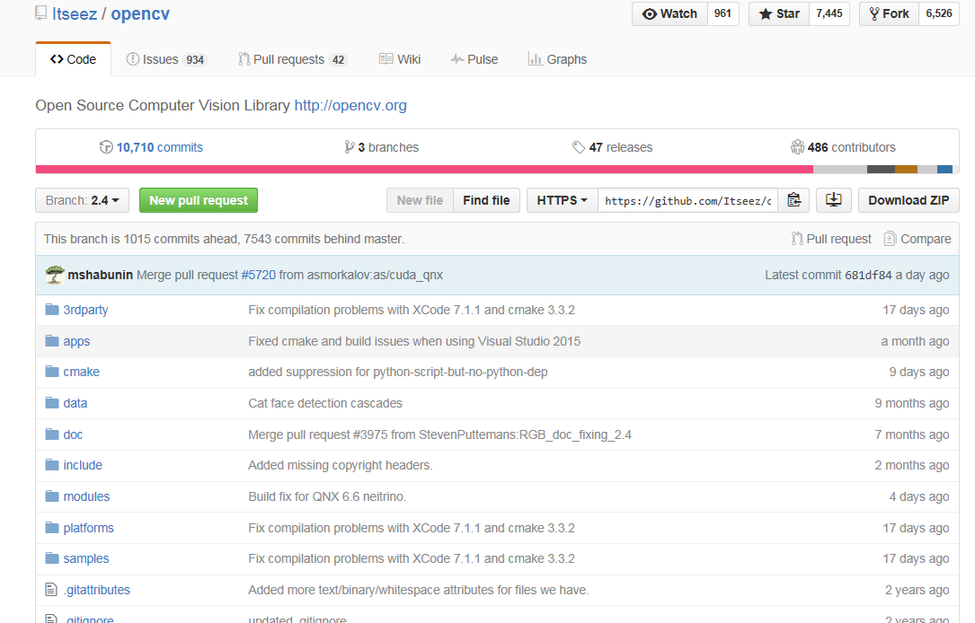
Download OpenCV
Download Opencv(branch 2.4) from Github

Slide 2
Build OpenCV2.4.12
OpenCV 2.4. 12 does not has a pre-built version, only source code.
Based on the tutorial on the website, I found that all the tutorials only introduced how to build OpenCV with installed version. So I download OpenCV 2.4.11.exe to try to build first

Slide 3
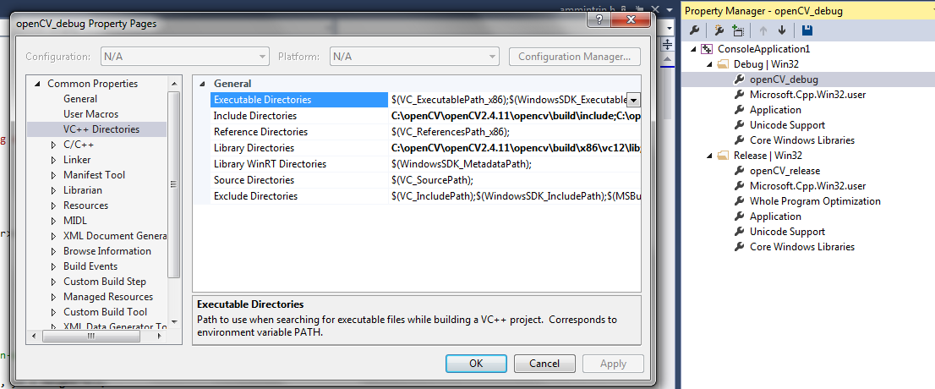
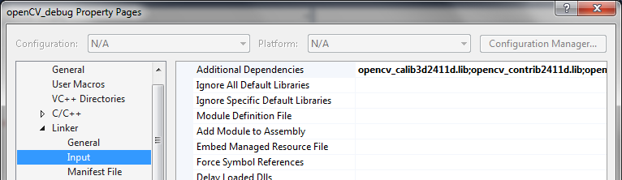
Create a ConsoleApplication solution

Slide 4
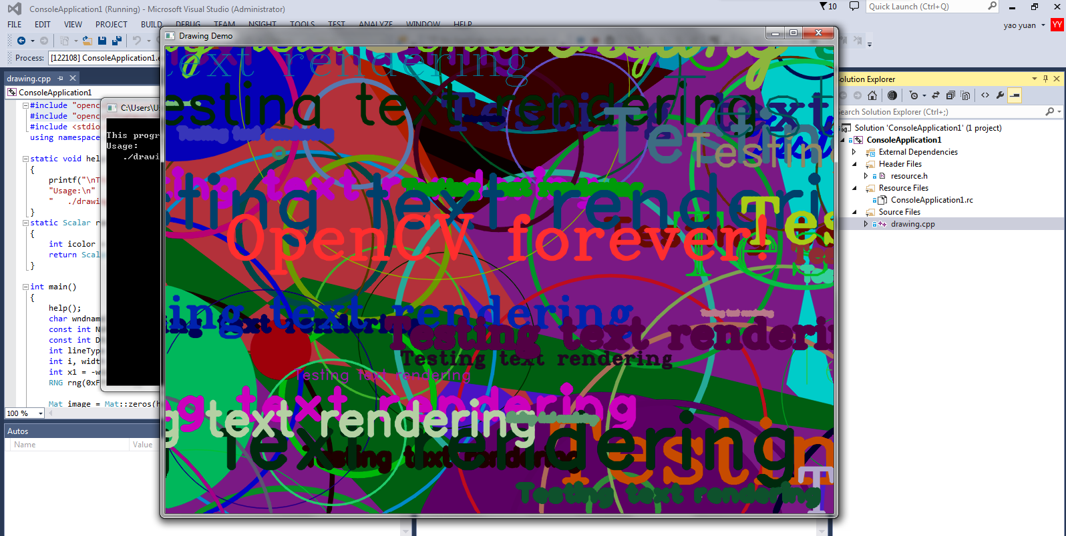
Run an example

Slide 5
Download Cmake
Download Cmake latest version 3.4.0
I tried to use cmake to make OpenCV project files based on source code of OpenCV 2.4.11 first.
Generate the OpenCV.sln and Open the solution to build.
But Failed with many error messages

Slide 6
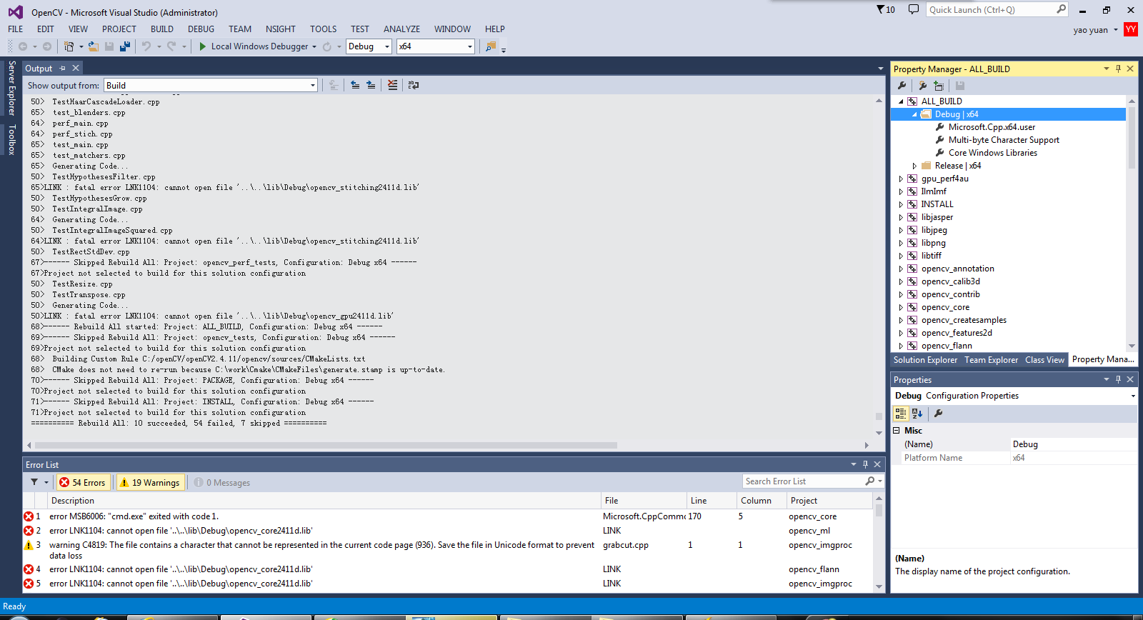
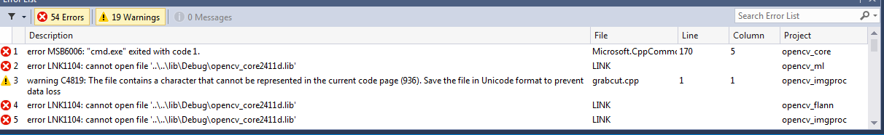

Slide 7
Cmake the OpenCV 2.4.12
There are a few error messages with the project below:
opencv_cudawarping
opencv_cudaarithm
opencv_cudacudalegacy
opencv_cudaimgproc
opencv_cudafilters
opencv_stitching
opencv_python2

Slide 8
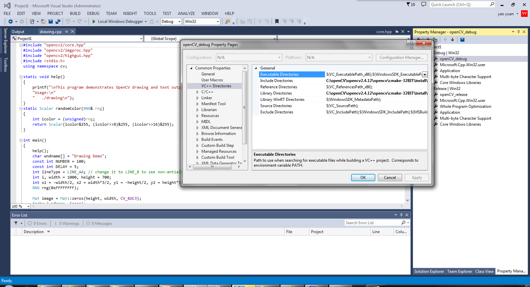
Create an example

Slide 9
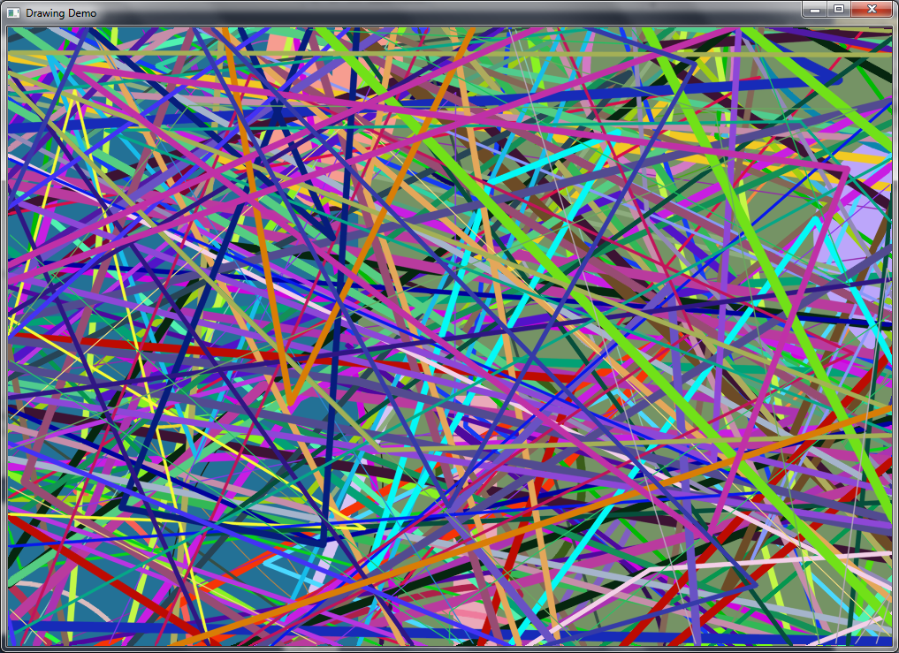

Slide 10
Python Import OpenCV
Followed by the tutorials from website, need to download numpy.
Download numpy with python2.7 version
Revise the regidit value to install numpy
Goto opencv/build/python/2.7 folder.
Copy cv2.pyd to C:/Python27/lib/site-packeges

Slide 11
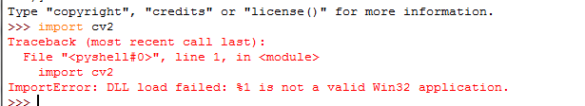

Check the import
Faild
The problem is that the installed Python 2.7 are 64bit but numpy only support 32bit.
Numpy does not has an official 64bit version
I downloaded and installed a 64bit numpy from

Slide 12
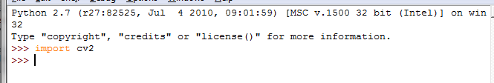
Check the import
Still Failed with the same error message
So I downloaded a 32bit python 2.7 and try again
Successful !

Slide 13
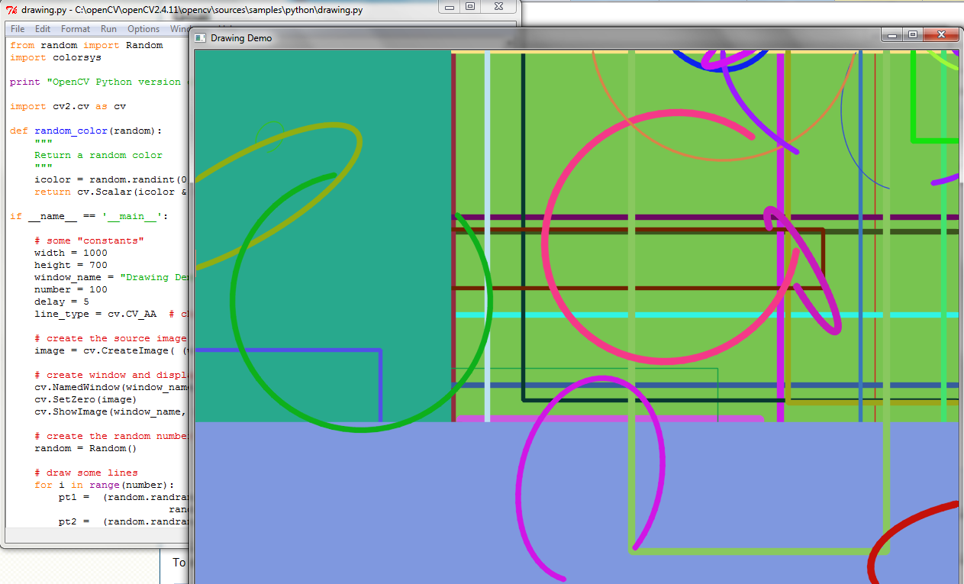
Run a example

Slide 14
Git address
https://github.com/yyyaoyyyao/OpenCV.git

