Slide 1
Advanced Programming
Lab 10, Class(2): operator overloading
廖琪梅，王大兴, 于仕琪，王薇

Slide 2
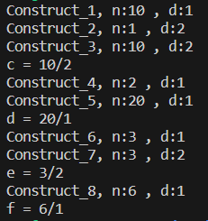
Exercise 1
Modify the code(rational.h) so that the program runs as shown in the screenshot on the right and explain the output where each constructor is run.
// rational.h
#pragma once
#include <iostream>
class Rational{
private:
staticint id;
int numerator;
int denominator;
public:
Rational(int n=0, int d=1): numerator(n), denominator(d){
std::cout<<"Construct_"<<id<<", n:"<<numerator<<" , d:"<<denominator<<std::endl;
}
int getN() const { return numerator; }
int getD() const { return denominator; }
friend std::ostream & operator<<(std::ostream& os, const Rational&rhs){
os<<rhs.numerator<<"/"<<rhs.denominator;
returnos;
}
};
int Rational::id=0;
const Rational operator*(constRational&lhs, const Rational&rhs){
return Rational(lhs.getN()*rhs.getN(), lhs.getD()*rhs.getD() );
}
#include <iostream>
#include "rational.h"
using namespace std;
int main(){
Rational a=10;
Rational b(1,2);
Rational c=a*b;
cout<<"c = "<<c<<endl;
Rational d=2*a;
cout<<"d = "<<d<<endl;
Rational e=b*3;
cout<<"e = "<<e<<endl;
Rational f=2*3;
cout<<"f = "<<f<<endl;
return0;
}

Slide 3
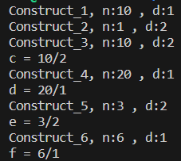
Exercise 2
Please modify the code(rational.h) in Exercise 1 to the program runs as shown in the screenshot. Explain what modifications have been made and why.
// rational.h
#pragma once
#include <iostream>
class Rational{
private:
staticint id;
int numerator;
int denominator;
public:
Rational(int n=0, int d=1): numerator(n), denominator(d){
std::cout<<"Construct_"<<id<<", n:"<<numerator<<" , d:"<<denominator<<std::endl;
}
int getN() const { return numerator; }
int getD() const { return denominator; }
friend std::ostream & operator<<(std::ostream& os, const Rational&rhs){
os<<rhs.numerator<<"/"<<rhs.denominator;
returnos;
}
};
int Rational::id=0;
const Rational operator*(constRational&lhs, const Rational&rhs){
return Rational(lhs.getN()*rhs.getN(), lhs.getD()*rhs.getD() );
}
#include <iostream>
#include "rational.h"
using namespace std;
int main(){
Rational a=10;
Rational b(1,2);
Rational c=a*b;
cout<<"c = "<<c<<endl;
Rational d=2*a;
cout<<"d = "<<d<<endl;
Rational e=b*3;
cout<<"e = "<<e<<endl;
Rational f=2*3;
cout<<"f = "<<f<<endl;
return0;
}

Slide 4
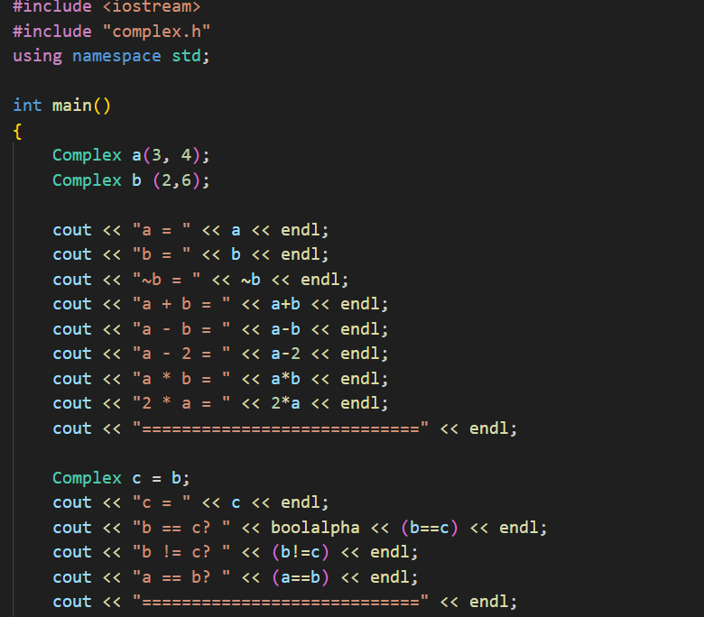
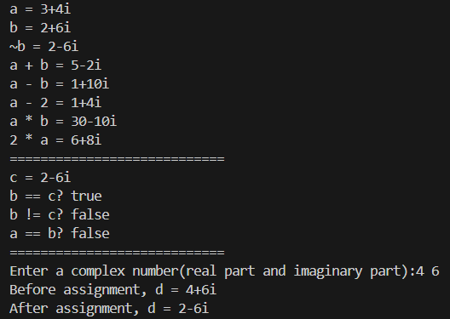
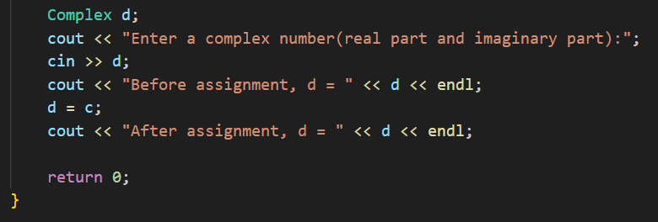
Exercise 3
Continue to improve the Complex class and add more operations for it, such as: -, *, ~, ==, != etc. Make the following program run correctly.
Note that you have to overload the << and >> operators. Use the references to objects and const whenever warranted.
The sample should run as follows:

