Slide 1
Advanced Programming
Lab 11, dynamic memory in classes
廖琪梅，王大兴，于仕琪，王薇

Slide 2
Exercise:
#include <iostream>
#include <memory>
using namespace std;
int main()
{
double *p_reg = new double(5);
shared_ptr<double> pd;
pd = p_reg;
pd = shared_ptr<double>(p_reg);
cout << "*pd = " << *pd << endl;
shared_ptr<double> pshared = p_reg;
shared_ptr<double> pshared(p_reg);
cout << "*pshred = " << *pshared << endl;
string str("Hello World!");
shared_ptr<string> pstr(&str);
cout << "*pstr = " << *pstr << endl;
return 0;
}
1. Could the program be compiled successfully? Why? Modify the program until it passes the compilation. Then run the program. What will happen? Explain the result.

Slide 3
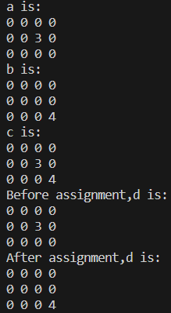
Exercise:
2. Create a class Matrix to describe a matrix. The element type is float. One member of the class is a pointer(or a smart pointer) who points to the matrix data.
The two matrices can share the same data through a copy constructor or a copy assignment.
The following code can run smoothly without memory problems.
class Matrix{...};
Matrix a(3,4);
Matrix b(3,4);
Matrix c = a + b;
Matrix d = a;
d = b;

