Slide 1
Account Abstraction (AA)
- 계정 추상화 with ERC4337
using
Alchemy Bundler & Simple Contract Account

Slide 2
ERC-4337: Account Abstraction Using Alt Mempool
Transaction 전송
EOA
EOA
Transaction
provider
validator
blockchain
AA
EOA
userOp
bundler
Entry Point
S_C_A
blockchain
Mempool
bundler
Alchemy
Simple Contract Account
blockchain
Polygon
Mumbai

Slide 3
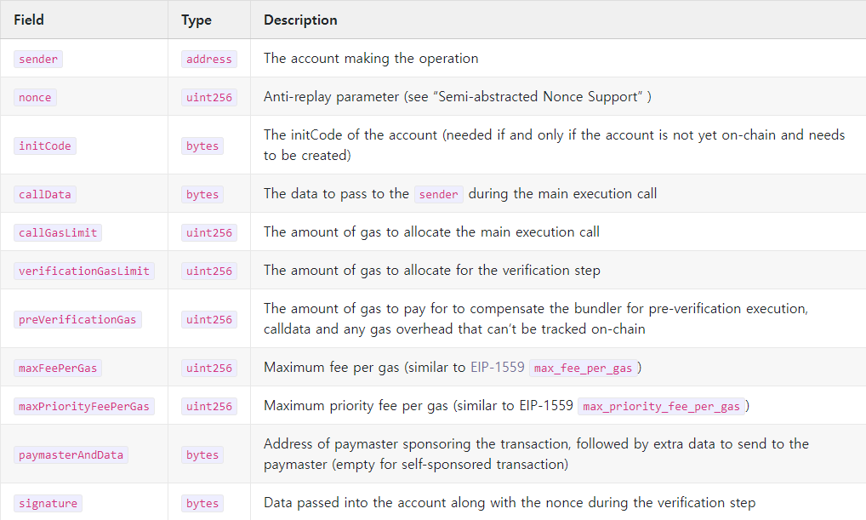
ERC-4337: Account Abstraction Using Alt Mempool
userOperation

Slide 4
ERC-4337: Account Abstraction Using Alt Mempool
Simple Account Factory
AA
init code
S.A.F address
+ interface(createAccount)
+
address EOA account +
uint256 salt
Entry Point
balanceOf(S_C_A Address)
getNonce(S_C_A Address, key)
nonceSequenceNumber(S_C_A Address, key)
addStake(payableAmount, unstakeDelaySec)
depositTo(payableAmount, account)
handleOps(ops[], beneficiary)
withdrawStake()
withdrawTo()
SimpleAccountFactory
getAddress(owner, salt)
createAccount(owner, salt)
SimpleContractAccount
execute(dest, value, func)
createAccount(owner, salt)

Slide 5
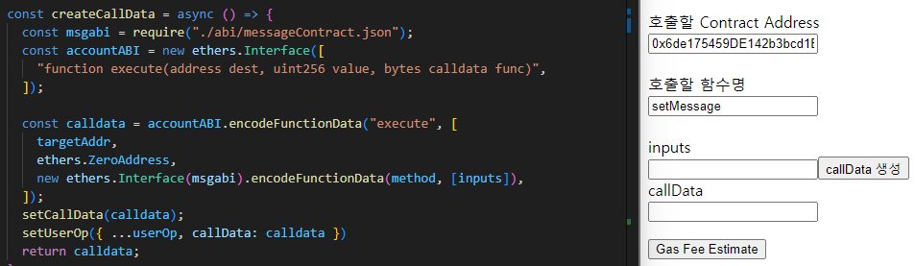
ERC-4337: Account Abstraction Using Alt Mempool
userOperation - callData
User Operation
callData -> EntryPoint - handleOps()
Simple Contract Account – execute()
to Destination Contract

Slide 6
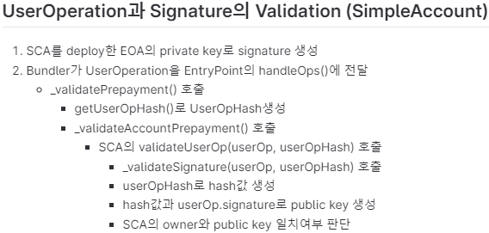
ERC-4337: Account Abstraction Using Alt Mempool
Validation
AA
EOA
userOp
bundler
entry point
S_C_A
blockchain
EOA
userOp
EOA
userOp

Slide 7
ERC-4337: Account Abstraction Using Alt Mempool
https://xangle.io/research/detail/1219

