Slide 1





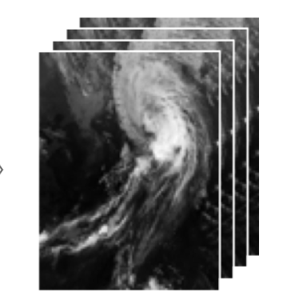





Deep Learning VM
USER 1
data
USER 2
K80
P100
ssh
ssh
http://localhost:8888
http://localhost:8889

