Slide 1



UZH.ai Hackathon
RepRadar
Listen closely.
Decide confidently.
A farmer’s question.
A team’s next decision.
Syngenta challenge concept · Synthetic-data demonstration
01
Notes:
20 seconds. Presenter 7.
It is 08:12 in Basel. Maya, a Corporate Affairs colleague, sees a question from a farmer thousands of kilometres away in China. A shared headline has left him unsure about next season. This fictional story is where RepRadar begins.
Sources and assumptions:
Challenge brief supplied by the team. Logo supplied by user. RepRadar mark is the project’s editable SVG radar-and-leaf symbol, created for this prototype. Green, turquoise, gold and magenta connect the website and deck. Headings use Poppins, which appears in the Syngenta Group website CSS; font licensed under SIL OFL from https://github.com/google/fonts/tree/main/ofl/poppins . Styling reference: https://www.syngentagroup.com/ accessed 23 October 2026. Field image: Ivan Bandura, Unsplash, https://unsplash.com/photos/aerial-photography-of-green-farm-field-hdD1ZP1PzqI . Illustrative background, not a Syngenta site.

Slide 2

RepRadar
WHY / FICTIONAL ROLE-PLAY
08:12 in Basel. A question arrives from China.
“A headline says some products
are already banned. Do I need
to change my plans for
next season?”
LIN
Farmer in China
Needs practical clarity
MAYA
Corporate Affairs, Basel
Needs a checked response
The missing link: what applies to Lin’s crop, product and location?
Fictional personas and policy scenario. A European proposal does not establish a restriction in China.
CRITERIA / Problem–solution fit · Human-centered & responsible
02
Notes:
45 seconds. Presenter 3.
[Presenter 3 plays Lin, calmly, for about 12 seconds.] ‘I saw a headline saying some products are already banned. I grow crops in China. Do I need to change my plans for next season? Could a local adviser help me check?’ [Presenter 1 plays Maya for about 12 seconds.] ‘Our local team needs an answer. But which source is correct? Does this European proposal apply to his situation? What can I responsibly say?’ [Narrator.] This is a fictional public-forum signal. A translation alone cannot answer it. Maya needs evidence, local expertise and a decision she can explain.
Sources and assumptions:
Synthetic scenario inspired by the user’s proposed farmer-to-employee storytelling.
Lin and Maya are fictional personas. The policy proposal and forum post are synthetic. Lin is not a real identified farmer. Do not perform an accent or suggest that one farmer represents China.

Slide 3
RepRadar
WHY / PROBLEM & STAKEHOLDER NEEDS
Maya has the signals. She still needs the context.
Syngenta works in crop protection and seeds.
Corporate Affairs connects the business with people, public debate and policy.
01
Three disconnected fragments
A European proposal, an English ban headline and a Chinese planning question.
02
One missing local answer
Which crop, product and market? A translation cannot establish applicability.
03
A time-sensitive handoff
Maya must find the right local expert and coordinate a responsible reply.
CRITERIA / Problem–solution fit
03
Notes:
45 seconds. Presenter 1.
Syngenta works in crop protection and seeds. Corporate Affairs helps the organization understand stakeholder concerns and coordinate its response. Maya has three fragments: a European proposal, an English repost calling it a ban, and Lin’s Chinese planning question. Each source answers a different question. An alert tells her that something is happening, but it does not establish what applies locally or who should act. The risk is an unsupported generic answer, or a long silence while colleagues reconstruct the same context.
Sources and assumptions:
Company context: https://www.syngenta.ch/ accessed 22 October 2026. Corporate Affairs remit: supplied challenge photo. Problem statements and approximate target-user assumption: team whiteboard and coach feedback, not formal user-research findings.

Slide 4
RepRadar
HOW / HUMAN-CENTERED PRINCIPLES
Lin needs clarity. Maya needs control.
01
Hear the actual need
Preserve the request for practical help, even when a post has low reach.
02
Check before responding
Separate the shared headline from verified scope and local context.
03
Keep a human owner
Maya chooses the next step. Local specialists review technical guidance.
Design goal: help people respond calmly, with clearer information and control.
CRITERIA / Human-centered & responsible
04
Notes:
35 seconds. Presenter 6.
Lin needs guidance relevant to his situation. Maya needs evidence she can inspect, a route to the right local colleague, and control over the reply. That is our human-centered design brief. The system makes uncertainty visible and helps her choose a next step. It must not infer Chinese product restrictions from a European headline. Local experts verify the technical advice, and Maya keeps control of the response.
Sources and assumptions:
Principles derived from challenge criteria, coach feedback and team whiteboard. Reduced burden is a hypothesis to test, not a measured result.
Team reference: Rep_Radar_Hackathon_Pitch_Human_Aspect.pptx, slide 7. The existing story and workflow are retained; this is a design goal, not a measured outcome.

Slide 5
RepRadar
WHAT / SOLUTION & USER JOURNEY
One question, carried through the whole workflow
01
02
03
04
Listen
Interpret
Decide
Review
Read Lin’s words
and the headline.
Check the proposal
and missing local scope.
Use role-specific sources
to compare next steps.
Assign the local owner.
Record why and when.
Maya’s decision: verify locally, assign the response owner, and set the next update.
CRITERIA / Problem–solution fit · Originality
05
Notes:
35 seconds. Presenter 2.
RepRadar follows the same question through four steps. Listen: read Lin’s original wording and the translation. Interpret: compare the headline with the proposal and identify what remains unknown. Decide: retrieve role-specific guidance and compare three actions using Maya’s priorities. Review: assign a local owner, edit the action and record the reason. The dashboard gives her an overview first, with more detail when she needs it. Let us follow that journey now.
Sources and assumptions:
Working prototype: components/RepRadar.tsx. Role-scoped knowledge: lib/data.ts and lib/engine.ts.

Slide 6
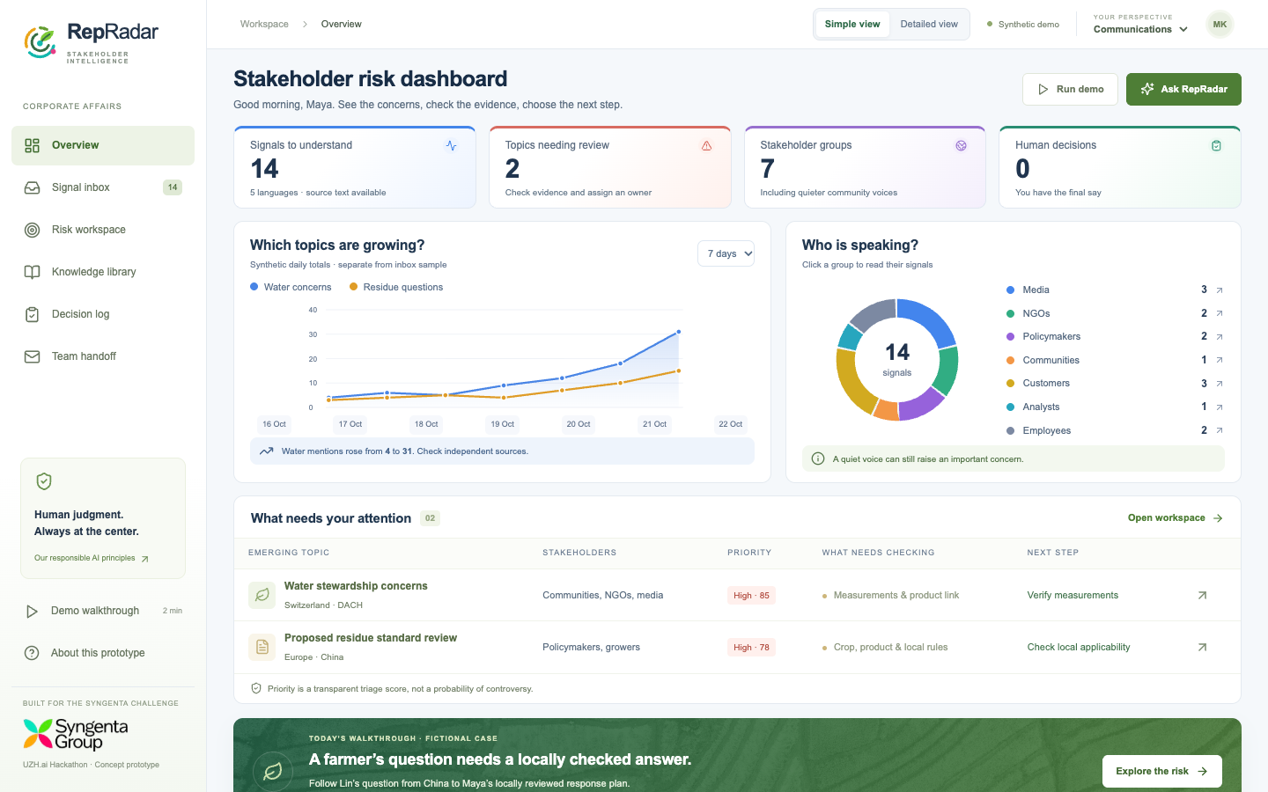
RepRadar
WHAT / TWO-MINUTE WALKTHROUGH
Live demo: help Maya answer Lin
Open live demo
repradar-phi.vercel.app
1 Read the dashboard
Open Lin’s original question
2 Check the evidence
Ask the role-specific assistant
3 Record a human decision
Prepare the team handoff
CRITERIA / Pitch & Q&A · Problem–solution fit
06
Notes:
120 seconds. Presenter 4.
Click Open live demo to open the public website in the default browser. 0:00–0:15: show the dashboard’s KPI cards, trend, stakeholder groups and two priority topics. 0:15–0:30: Run demo, Start with the signals, inspect Lin’s Chinese question. 0:30–0:45: open Risk workspace; explain the unverified local applicability and three response options. 0:45–1:10: Ask RepRadar how to respond to Lin; inspect KB-02 and the fixed evidence boundary. Say: This public version retrieves source excerpts; local Qwen3 can generate an explanation from the same evidence. 1:10–1:40: review an option, edit the action, assign Maya and the China colleague, add the rationale and record the decision. 1:40–2:00: open Prepare team handoff; show the editable Outlook draft and ERP export. No email is sent. Switch back to PowerPoint with Command-Tab on Mac or Alt-Tab on Windows. The role-switch, feedback loop and remaining controls are available for Q&A, mapped in slides 16–17. If the server is unavailable, use slide 14.
Sources and assumptions:
Screenshot from the delivered prototype, synthetic data. Full demo script is in docs/PITCH_SCRIPT.md.
Demo hyperlink: https://repradar-phi.vercel.app . Public version uses source excerpts, no paid model. Local Qwen3 runs separately through Ollama.

Slide 7
RepRadar
WHAT / AI ARCHITECTURE
Role-specific RAG and a human review boundary
Stage | Working prototype | Pilot extension
Signals | Multilingual synthetic records | Licensed feeds, redaction, deduplication
Interpretation | Authored agent perspectives | Media, regulatory and local-language agents
Knowledge | Role-filtered retrieval (RAG context) | Permission-filtered hybrid / vector retrieval
Recommendations | Ranking; optional local Qwen3 | Evaluated generation with source tracing
Decision | Human review + Outlook / CSV | SSO, mailbox and ERP connectors
Context: reviewed policies, agricultural knowledge, historical cases and expert interviews.
CRITERIA / Feasibility · Originality
07
Notes:
55 seconds. Presenter 4.
Our prototype separates evidence from generation. First, it filters knowledge by role and scenario, then retrieves relevant passages using a lightweight lexical search. The public website shows those source excerpts. On the laptop, Qwen3 through Ollama can turn the same evidence into an explanation with citations. This adds context without retraining the model. Risk scoring and action ranking use transparent weights that the employee can change. The media, language and regulatory perspectives are authored examples today. A pilot would add licensed feeds, evaluated agents and document permissions. The key boundary is human review: an explanation becomes a recorded recommendation, never an automatically published response.
Sources and assumptions:
Implementation: lib/engine.ts, app/api/chat/route.ts. Historical and expert documents in this demo are fictional. The laptop runs local Qwen3 through Ollama. Enterprise model hosting, vector search, agent orchestration and permissions are proposed pilot work.

Slide 8
RepRadar
HUMAN FACTORS / RESPONSIBLE AI
Maya can disagree. Lin’s context stays visible.
01
Agency
Maya can edit, reject or defer. Every decision needs a reason and owner.
02
Cultural meaning
Read Lin’s actual question. A local colleague checks meaning and technical scope.
03
Privacy and fairness
Use licensed or consented sources. Avoid profiling people. Include quieter voices.
Pilot safeguards: SSO, document permissions, retention rules and an approved model environment.
CRITERIA / Human-centered & responsible
08
Notes:
55 seconds. Presenter 6.
Here is the human-centered test: can Maya disagree with the system, and does Lin’s actual need survive the process? She can inspect the original, change priorities and reject the suggested action. The local colleague checks language and technical context. One worried farmer must not disappear because the post has low reach. We also avoid turning a public question into an individual profile. Production requires permitted sources, personal-data minimization, identity, document permissions and an approved model environment. Maya coordinates the response; qualified colleagues own technical advice.
Sources and assumptions:
Concrete controls exist in the prototype. Authentication, secure audit, private hosting and independent fairness evaluation remain pilot requirements. No legal compliance certification is claimed.

Slide 9
RepRadar
LEARNING / CONTROLLED IMPROVEMENT
The story continues after the decision
01
02
03
04
Decision
Outcome
Curator review
Knowledge update
Maya assigns a China
owner and review time.
The local team checks
whether the reply helped.
A curator checks
the observed lesson.
The next team retrieves
the approved lesson.
Outcome follow-up is a proposed workflow. The demo records decisions and reviewed lessons locally.
CRITERIA / Human-centered & responsible · Originality
09
Notes:
45 seconds. Presenter 5.
We return to the same case after the decision. In the proposed operating workflow, the China colleague contacts Lin through an approved channel and checks whether the explanation answered his question. The reviewer records the observed outcome, including anything that did not work. A curator then decides whether a lesson is suitable for future retrieval. In the demo, these reflection and approval steps work locally, but no real contact or outcome has occurred. The reusable lesson might be to check jurisdiction and product context before offering a regional answer. Clicking approve never counts as proof of success.
Sources and assumptions:
Implementation: Decision log, lessonDocs() and role/scenario filtering. Browser-local learning is excluded from connected server-side LLM context until a trusted repository exists.

Slide 10
RepRadar
FEASIBILITY / ADOPTION & COST
A six-week pilot with ten Corporate Affairs colleagues
1–2
Co-design the workflow
Two regions, two topics. Interview employees and establish the current baseline.
3–4
Run in shadow mode
Compare alerts with expert review. No autonomous publication.
5–6
Evaluate and decide
Review usability, missed concerns and citation quality before wider adoption.
Illustrative operating budget: about CHF 3.4k/month, plus integration and setup.
Planning assumptions, not a vendor quote. Human review and data access dominate this example.
CRITERIA / Feasibility
10
Notes:
60 seconds. Presenter 7.
We would test this journey with ten Corporate Affairs colleagues in two regions over six weeks. First, interview employees and establish how they handle comparable questions today. Then run in shadow mode with local reviewers. Finally, compare briefing time, citation support, missed concerns and perceived control. Proposed gates include every decision having an owner and rationale, no unauthorized publication, at least 95 percent citation support and 30 percent lower median briefing time without worse missed-concern performance. These are proposed targets. The illustrative monthly operating budget is about CHF 3.4k plus setup, with data and human review dominating this example.
Sources and assumptions:
Pilot scope, gates and costs are planning assumptions, not measured outcomes or supplier quotes. Detailed arithmetic is in appendix slide 13.

Slide 11
RepRadar
EVALUATION / CHALLENGE FIT
One complete story demonstrates the five criteria
Criterion | Evidence in the proposal
Problem–solution fit | Dashboard → scoped evidence → response plan → Outlook handoff
Feasibility | Local Qwen3, editable draft / CSV, six-week regional pilot
Originality | Local context + role-specific RAG + preferences + reviewed lessons
Human-centered & responsible | Simple view, quieter voices, visible uncertainty, edit / reject / review
Pitch & Q&A | The same farmer, employee and question from opening to closing
Value to test: less briefing effort and better-supported decisions, with human control intact.
CRITERIA / All five evaluation criteria
11
Notes:
45 seconds. Presenter 7.
Here is how the concrete demo meets the five categories. Fit: the dashboard and role-specific evidence help Maya coordinate a real Corporate Affairs task. Feasibility: local Qwen3, an Outlook compose link and a CSV export work today, within a bounded pilot proposal. Originality: local language context, domain knowledge, employee preferences and reviewed lessons form one decision workflow. Human-centered responsibility: simple and detailed views, quieter voices, visible unknowns and the ability to edit or reject preserve employee control. Pitch quality: Lin’s concern travels from the opening scene through the live demonstration to an accountable next step. The appendix maps the remaining demo controls to the criteria without extending the ten-minute main pitch.
Sources and assumptions:
Five exact judging categories from the user-supplied evaluation photo. This is evidence mapping, not self-awarded numeric scores.

Slide 12

RepRadar
Back to Lin.
A clear next step.
A plan to verify. A local owner.
A scheduled update, with human review.
Our ask
One sponsor. Ten colleagues.
Two regions. Six weeks.
Listen closely. Decide confidently.
12
Notes:
40 seconds. Presenter 7.
Let us return to Lin. His question was simple: ‘What does this mean for my next season?’ By the end of our demo, Maya has replaced a vague alert with a recorded plan: verify the source and local applicability, assign a China response owner, and set the next update. The actual reply still needs local approval, and the outcome will be checked afterward. That is the value we want to test: a clear, accountable path to an answer. Our ask is one sponsor, ten colleagues and six weeks. RepRadar: listen closely, decide confidently.
Sources and assumptions:
Pilot scope is a proposal. Background photo attribution as slide 1.

Slide 13
RepRadar
APPENDIX / COST MODEL
Pilot economics: assumptions you can change
Monthly item | Assumption | CHF / month
Model inference | 2,200 requests × 8k input / 1k output tokens | 79.20
Application hosting | Illustrative allowance | 300.00
Data access | Illustrative licensed-source allowance | 1,000.00
Human review | 20 hours × CHF 100/hour | 2,000.00
Operating total | Excludes setup, legal work and local-model hardware | 3,379.20
Token rate assumptions: CHF 3/M input and CHF 12/M output. These are hypothetical rates.
CRITERIA / Feasibility
13
Notes:
0 seconds. Presenter 7.
Arithmetic: 10 users × 10 requests/day × 22 working days = 2,200 requests/month. Input tokens: 2,200 × 8,000 = 17.6 million at assumed CHF 3 per million = CHF 52.80. Output tokens: 2,200 × 1,000 = 2.2 million at assumed CHF 12 per million = CHF 26.40. Total inference CHF 79.20. Add hosting 300, data 1,000 and human review 2,000 = CHF 3,379.20. This is a planning model, not current provider pricing, and excludes integration, legal review, taxes and local-model infrastructure. Actual costs depend on source licenses and workload.
Sources and assumptions:
All figures are explicit assumptions. No external vendor price is represented.

Slide 14
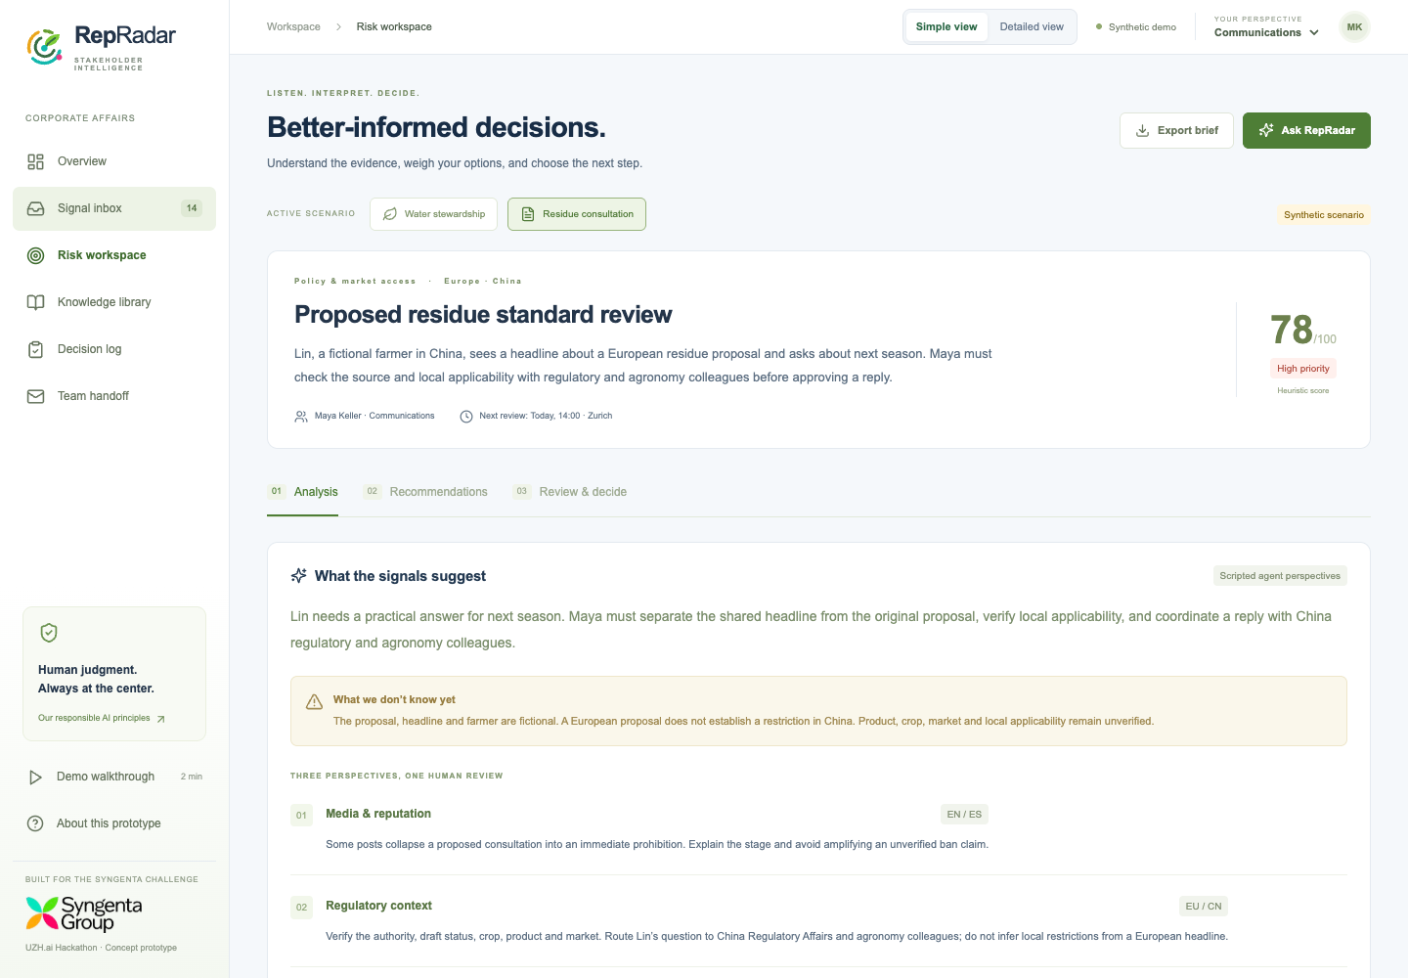
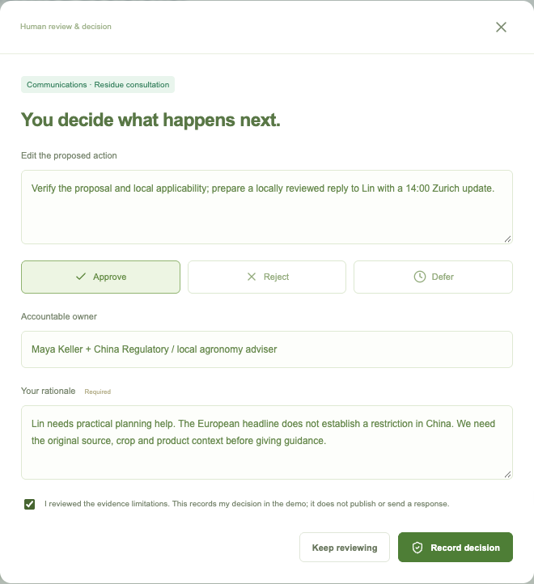
RepRadar
APPENDIX / OFFLINE FALLBACK
Demo backup: Maya’s response plan for Lin
CRITERIA / Pitch & Q&A
14
Notes:
0 seconds. Presenter 4.
If the live site is unavailable, these screenshots show the same residue scenario and recorded response plan for Lin’s question. Explain the missing applicability evidence, the China owner and the rationale. No external reply has been sent. Keep the story continuous instead of switching to the unrelated water scenario.
Sources and assumptions:
Screenshots captured from this delivered prototype with synthetic data.

Slide 15
RepRadar
APPENDIX / Q&A
Questions we expect
Q
Does it predict controversy?
It prioritizes early signals. Validated probability forecasts need labelled history.
Q
Why not use a generic chatbot?
Role-filtered sources, original language and a recorded decision give the work structure.
Q
Is it ready for internal data?
The demo uses synthetic data. Identity, permissions and approved hosting come first.
Next validation: local users, source coverage, false alarms, missed concerns and employee trust.
CRITERIA / Pitch & Q&A
15
Notes:
0 seconds. Presenter 7.
Additional answers. Self-learning means approved knowledge updates, not uncontrolled reinforcement learning. Agent diversity is a proposed architecture with local review, not evidence that multiple agents automatically remove bias. We cannot promise complete public coverage. Social volume can underrepresent communities. The demo has no production authentication. Costs are scenario assumptions. The company’s exact Corporate Affairs headcount remains unverified. The distinctive contribution is the complete decision workflow, not a claim to have invented RAG or sentiment analysis.
Sources and assumptions:
Primary context: https://www.syngenta.ch/ . Challenge criteria and whiteboard supplied by user. Implementation limitations documented in README.md.

Slide 16
RepRadar
APPENDIX / FUNCTIONALITY & CRITERIA
Demo coverage: understand the concern
What the employee can do | Why it matters | Evaluation criterion
Scan the dashboard | Overview plus sentiment, languages, risk drivers and source / review charts | Fit · Human-centered
Filter and inspect signals | Search, group / language filters, original text, translation and review notes | Fit · Human-centered
Inspect risk and uncertainty | Visible factors, editable weights, evidence gaps and a simulated new signal | Originality · Human-centered
Inspect role-specific knowledge | Document IDs, versions, owners and role / scenario filtering | Fit · Feasibility
Ask RepRadar in EN / ZH | Source excerpts online; local Qwen3 option, chat context and source links | Originality · Feasibility
Sentiment, translations and agent perspectives are authored demo examples; live ingestion is a pilot step.
CRITERIA / Problem–solution fit · Feasibility · Originality · Human-centered & responsible
16
Notes:
0 seconds. Presenter 4.
This appendix maps every discovery and analysis capability to the judges’ criteria. The main dashboard has a simple default and an immediately visible detailed view with sentiment, language coverage, risk drivers, source counts and human-review progress. The header stays visible while scrolling. Sentiment, channel, review status, stakeholder and language charts open filtered inbox records. Risk driver charts open the corresponding risk workspace. The trend is a separate synthetic aggregate, not a claim that the 14 examples are a complete live stream. Source details preserve the original, translation and employee annotations. A simulated new signal changes the overview and water momentum. Risk scores are normalized heuristics and editable weights reveal priorities. Role and scenario filtering controls relevance; it is not production authorization. The knowledge library displays synthetic documents with owners and versions. Qwen3 generates answers locally from retrieved evidence, with source links, conversation context and an excerpt fallback. It has no live news feed. The media, regional language and regulatory perspective cards are authored examples.
Sources and assumptions:
Criteria use the five exact categories from the supplied evaluation photo. Fit abbreviates Problem–solution fit; Human-centered abbreviates Human-centered & responsible. Implementation: components/DashboardCharts.tsx, components/DetailedInsights.tsx, components/RepRadar.tsx, lib/engine.ts, app/api/chat/route.ts.

Slide 17
RepRadar
APPENDIX / FUNCTIONALITY & CRITERIA
Demo coverage: decide, coordinate and learn
What the employee can do | Why it matters | Evaluation criterion
Compare three next steps | Change evidence, trust and speed preferences; inspect the ranking | Originality · Human-centered
Edit, approve, reject or defer | Own the action, record a rationale and acknowledge evidence limits | Fit · Human-centered
Prepare a team handoff | Editable Outlook compose link, copied brief or reviewed ERP CSV | Fit · Feasibility
Keep an accountable record | Decision log, export and browser-local persistence | Feasibility · Human-centered
Review outcomes and lessons | Capture feedback; curator approval before role-specific reuse | Originality · Human-centered
Rehearse and recover | Guided walkthrough, reset, source fallback and deck screenshots | Feasibility · Pitch & Q&A
Outlook: human sends. ERP: CSV export. Learning: curated retrieval, not model retraining.
17
CRITERIA / Problem–solution fit · Feasibility · Originality · Human-centered & responsible
Notes:
0 seconds. Presenter 6.
These controls make the team’s handwritten workflow tangible: continuous monitoring, alert, human decision, response preparation and reviewed learning. Employees compare three actions by explicit preference weights. A decision requires a responsible owner and rationale. Approval records a plan, not publication. Team handoff carries uncertainty and the latest decision into an editable Microsoft 365 compose link, copyable brief or CSV export for later mapping to an ERP. No enterprise permissions are needed for the compose link; there is no mailbox reading or live ERP synchronization. A review checkbox resets when the handoff is edited. History is browser-local, with export and reset controls. A lesson is usable only after explicit curator approval, within its role and scenario; it remains local retrieval context rather than automatic LLM retraining. Model status, guided walkthrough and fallback screenshots support the pitch.
Sources and assumptions:
Criteria from the supplied evaluation photo; workflow from the supplied whiteboard. Implementation: components/TeamHandoff.tsx, lib/handoff.ts, lessonDocs() and local storage in components/RepRadar.tsx.

