Slide 1

Object Detection and Classification Using CNNs
YUANYI ZHANG, TAIMING CHEN, YILING LIU

Slide 2
Problem Statement
Objective:
Develop a CNN to detect and classify five object categories:
person, car, bird, traffic light, cell phone.
Dataset: COCO (Common Objects in Context).
Motivation:
Enable real-time decision-making in complex environments.
Applications:
Surveillance and security.
Autonomous driving.
Wildlife and environmental monitoring.

Slide 3
Dataset
COCO Dataset Features:
Over 200,000 images across 80 categories.
Category name and its category id.
Bounding boxes’ coordinates and segmentation maps.
Used a subset of 5 classes.
Images for training per class:
‘person’: 7000 (manualy set)
‘car’: 6000 (manualy set)
‘bird’: 3237
‘traffic light’: 4139
‘cell phone’: 4803

Slide 4
Proposed Model Architecture (U-Net)
Features:
Convolutional Layers: Extract features from images.
Pooling Layers: Reduce spatial dimensionality.
Downsampling Path: 2 convolutional blocks with maxpooling layers to reduce dimensionality and capture abstract features.
Bottleneck Layer: Serves as bridge between downsampling path and the upsampling path.
Upsampling Layers: Restore spatial dimensions and combines low-level details with high-level features.
Output Layer: a 2D convolution layer with a softmax activation for multi-class segmentation
Optimization Techniques:
Adam optimizer with a default learning rate of 0.001.
Combined loss function:
Sparse categorical cross-entropy for multi-class classification.
Accuracy as the evaluation matric

Slide 5
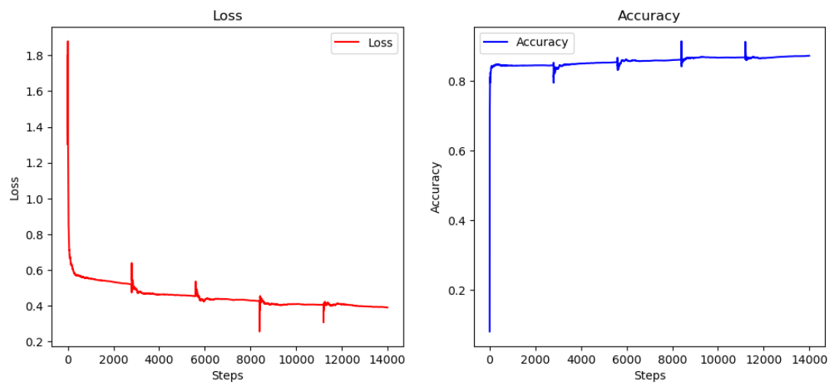
Training Performance

Slide 6
Expected Outcomes
Performance Metrics:
Classification Accuracy: Target = 86.82%.
Segmentation Quality: Visual verification using segmentation masks.
Challenges Addressed:
Detecting different objects in cluttered scenes.
Balancing limited images per category before training.

Slide 7
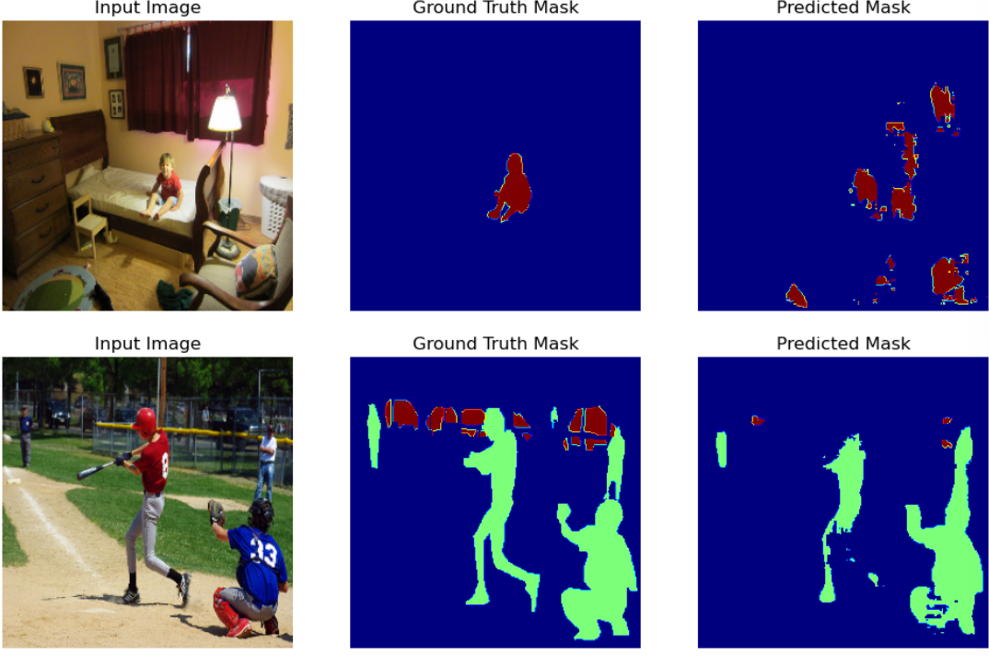
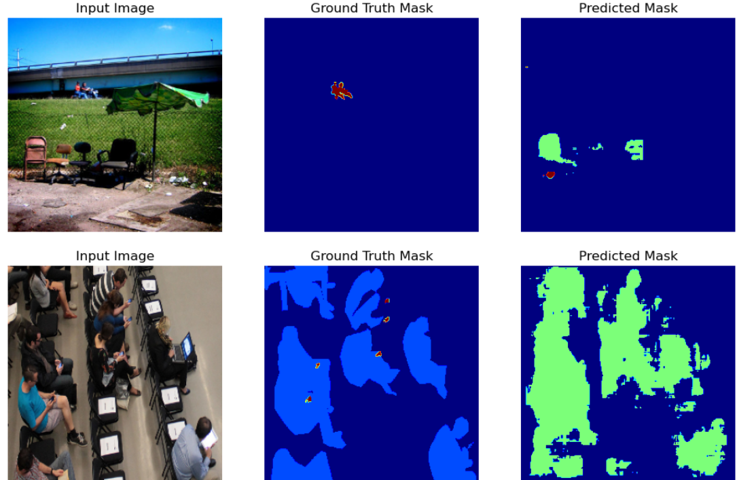
Segmentation Result

Slide 8
Challenges and Improvements
Current Challenge:
Enhance segmentation performance for small objects.
Future Directions:
Refine model accuracy and improve model segmentation performance.
Introduce attention mechanisms for better focus on key areas.
Experiment with advanced architectures (e.g., YOLO, Faster R-CNN).
Increase dataset diversity with synthetic data augmentation.

Slide 9
Thank you

