Slide 1
Trust Evaluation in Mobile Devices: An Empirical Study

Slide 2
Trust Evaluation Metrics Based on Technological Parameters
Anomalous misbehavior may be due to malicious exploit of an application, the operating system, or the hardware.
Metrics that could be obtained without inspection of app source or binary to inspect app behavior (easy to collect)
battery voltage
CPU usage
network usage

Slide 3
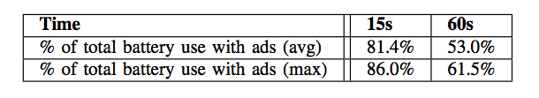
I: Battery Voltage
Battery voltage is a proxy metric for the amount of remaining energy in the battery
Resolution of readings only allows for coarse, averaged measurements under general, non-lab conditions
Experiment, the battery voltage measured with and without video ads
The battery voltages were used to deduce the current being drawn from the battery (data reported in units of current)

Slide 4
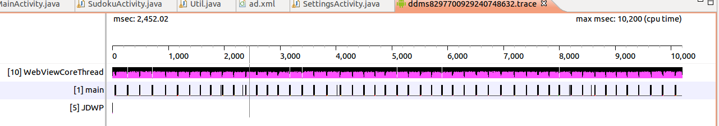
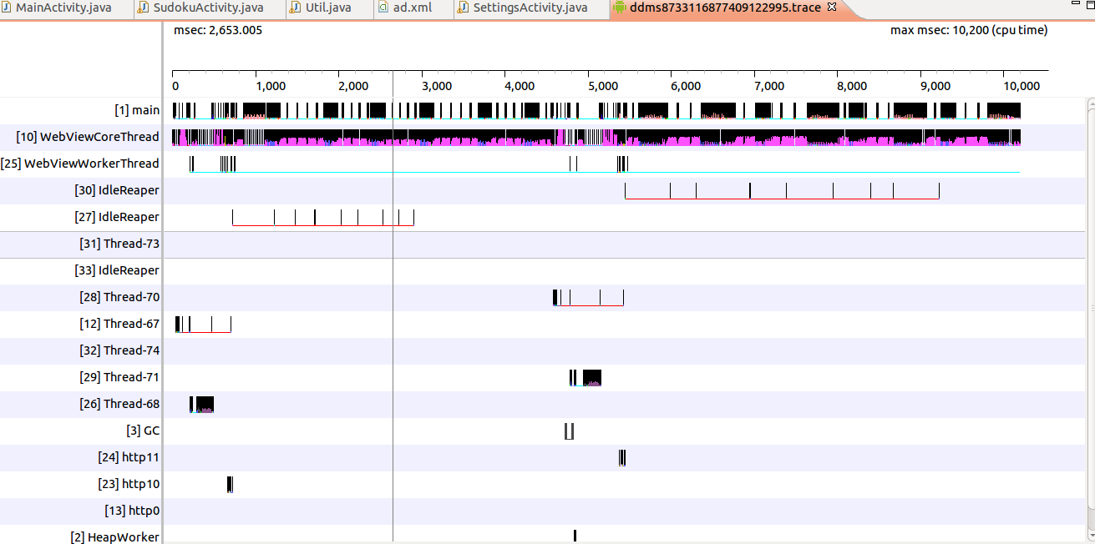
II: CPU Usage
A coarse-grained overview of resource utilization
Dalvik Debug Monitoring Service (DDMS) at system call level

Slide 5
III: Network Usage
ACCESS_NETWORK_STATE permission: allows applications to access information about networks
ConnectivityManager class answers queries about the state of network connectivity and network connectivity changes (WiFi, 3G, Bluetooth, Ethernet).
TelephonyManager class provides access to information about the telephony services on the device (3G/4G or LTE)
Application Resource Optimizer project (ARO) provide further insights into what is essentially radio resource control (RRC- based type of diagnostics).

Slide 6
Trust Evaluation Metrics Based on Supported Privacy Level

Slide 7
Trust Evaluation Testing and Verification
Verification based on the use of sensors on multiple devices
A smartphone communicates directly with a smart watch or on-board diagnostics (OBD) sensor on an automobile
If there is a discrepancy in the sensor measurements, the trust evaluation of the device can be reduced
Use case: smartphones communicate with an in-vehicle OBD sensor
get geolocation information, such as speed, engine RPM, fuel consumption, etc.

Slide 8
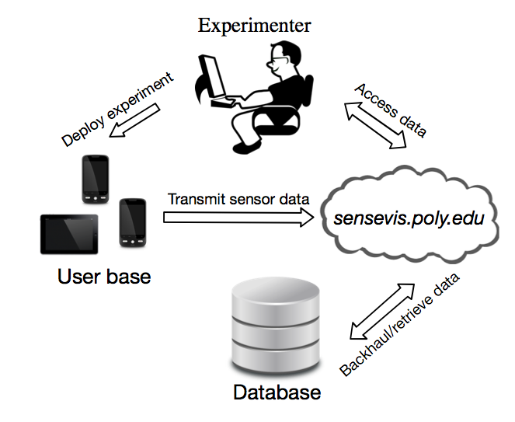
Vehicle Data Collection
Data collection
Backend storage
Data visualization

Slide 9
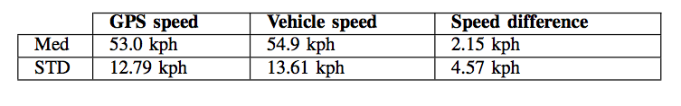
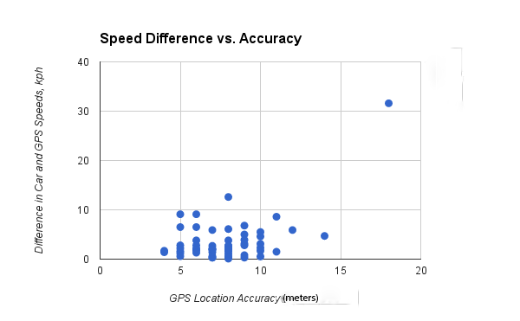
Geolocation Data Analysis
Median and standard deviation of the speed measured by GPS and OBD sensor, over 58 data samples : no anomaly in speed
When plotting individual data samples, we can see a data outlier

Slide 10
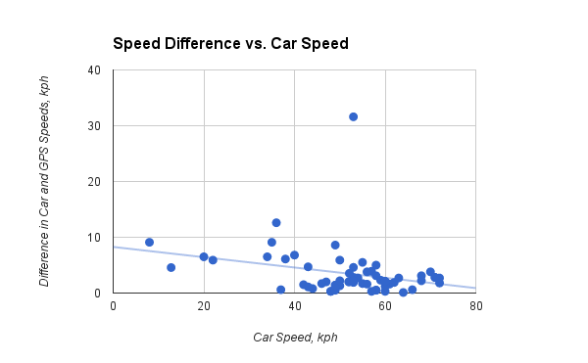
Geolocation Data Analysis (cont.)
Speed differences vary linearly with vehicle speed (other than the outlier)
the higher the vehicle speed, the smaller difference between vehicle speed and GPS speed
A minimum mean square error (MMSE) linear fit shown

Slide 11
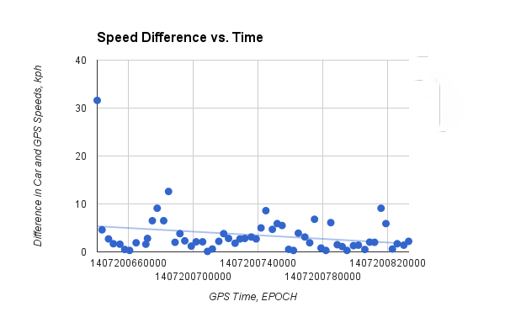
Geolocation Data Analysis (cont.)
Excluding the outlier, differences between vehicle speed and GPS speed fluctuate around a constant value over time

