Slide 1

Bank Credit Card Customer Marketing Strategy Based on Churn Model
2022 Fall Class 1 Team C
Yinping Guo
Hanlu Huang
Hairong Qu
Xiaofeng Wu
Yaoyao Zhu
12/17/2022

Slide 2
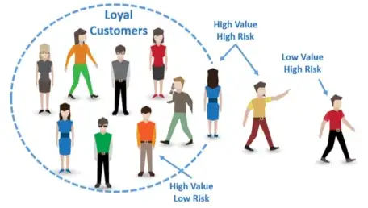
Executive Summary
Focus on the right message for the right people at the right time.
The manager at our bank was disturbed with more and more customers leaving our credit card services in the past year.
As customers churn rate continues to rise, we aim to improve our Customer Relationship Management (CRM) and the marketing strategy to reverse the trend
This report is an attempt at providing actionable marketing strategies by identifying segments of customers with high Return of Investment (ROI).

Slide 3
Executive Summary Cont.
We explores data with three prime perspectives:
What customers are we losing?
Behaviors and insights analysis to characterize churners
Why are we losing them?
Machine learning modeling and feature importance analysis to identify key factors contribute to customer churn
How can we stop them from losing?
Customer segmentation to locate at risk customers with high ROI for marketing.
Using the best suited analytical approach, it throws light on churn prediction with recommendations to curb it and suggests effective marketing strategies for customer base retention and possibly growth.

Slide 4

Defining task
Many businesses, once emphasizing heavily on growing new customers, start to realize the importance of keeping existing customers.
Harvard Business Review reported that studies suggest bagging new customers could be anywhere from 5 to 25 times more cost-incurring than holding on to an existing ones

Slide 5
Defining Task Cont.
Our top priority in this business problem is to identify customers who are getting churned and key factors behind those decisions.
Eventually we can provide our Customer relationship management team with high ROI customers at risk, and actionable solutions on marketing strategies.
Even if we predict non-churning customers as churned, it won't harm our business. But predicting churning customers as Non-churning will do. So recall (TP/TP+FN) is going to be the main model evaluation metric in the study.

Slide 6

Credit card business: Issuer (Banks) vs Network (MC, Visa, AE, Discover)
How Do Credit Card Companies Make Money?
Interest (caldholders)
Interchange or Merchant fees (Merchants)
Fees
Annual Fees
Cash Advance Fees
Balance Transfer Fees
Late Fees
General strategies to grow credit card customers
Provide Multiple Card Types.
Offer a Balance Transfer Program.
Credit Limit Increases. ...
Adjust Lending Policies. ...
Consistently Marketing your Card Program.
Business Understanding

Slide 7
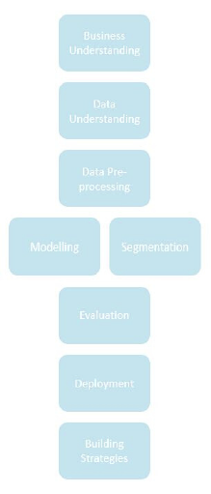
Approach
Business Understanding
Data Understanding
Data Pre-processing
Modeling – Segmentation
Evaluation
Deployment
Building Strategies

Slide 8
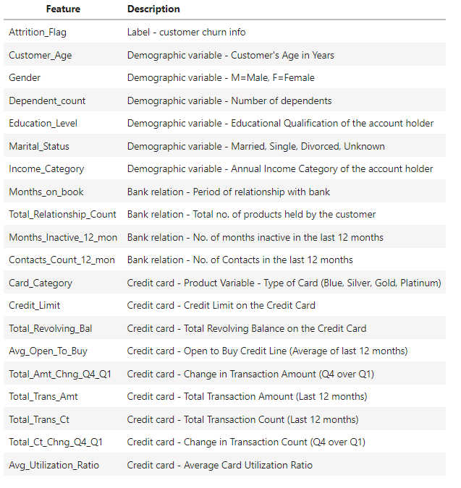
Data At a Glance
From Kaggle
Sample: 10127
Features: 21
Numeric features: 14
Categorical features: 7
No duplicates
Education Level has 15% and Marital status has 7.4% “Unknown” values

Slide 9

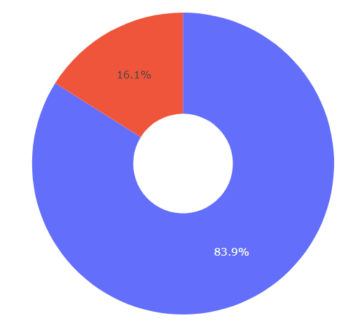
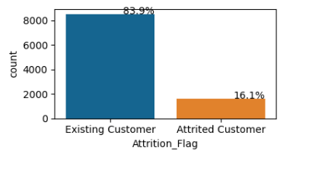
EDA (Target)
Target label is imbalanced. Need to consider balancing the data using either class weight or SMOTE

Slide 10
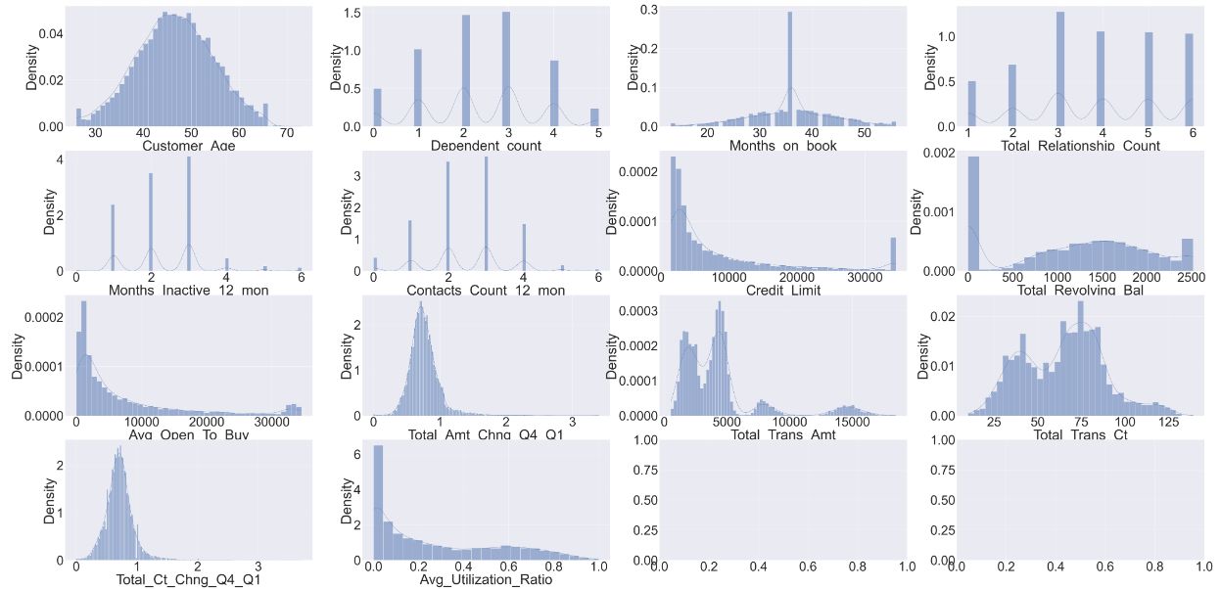
EDA (Numeric Features)

Slide 11
Data at a Glance
Observations
Customer_Age distribution is fairly normal but slightly left-skewed.
Dependent_count distribution is also fairly normal but slightly left-skewed.
Months_on_book distribution is fairly normal but slightly left-skewed.
Total_Relationship_Count distribution is fairly normal but slightly left-skewed.
The Months_Inactive_12_mon distribution is right-skewed.
Contacts_Count_12_mon distribution is fairly normal but slightly right-skewed.
Credit_Limit distribution is very right-skewed.
Total_Revolving_Bal distribution is fairly normal but slightly left-skewed due to many customers with very low balances.
Avg_Open_To_Buy distribution is very right-skewed.
Total_Amt_Chng_Q4_Q1 distribution is very right-skewed.
Total_Trans_Amt distribution is very right-skewed.
Total_Trans_Ct distribution is fairly normal but slightly right-skewed.
Total_Ct_Chng_Q4_Q1 distribution is very right-skewed.
Avg_Utilization distribution is right-skewed.

Slide 12
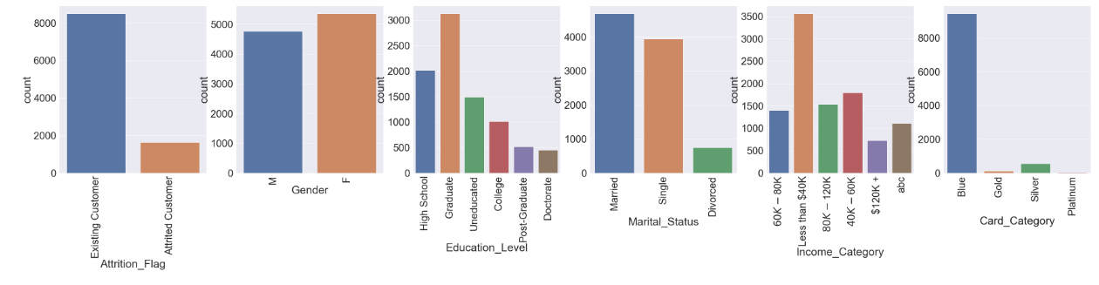
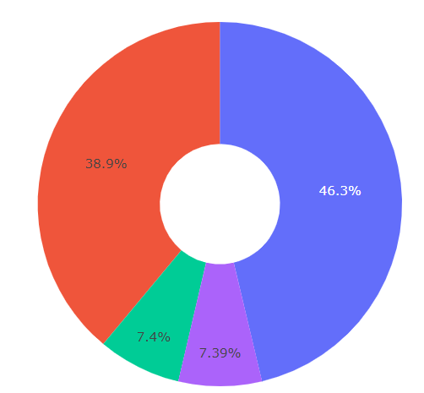
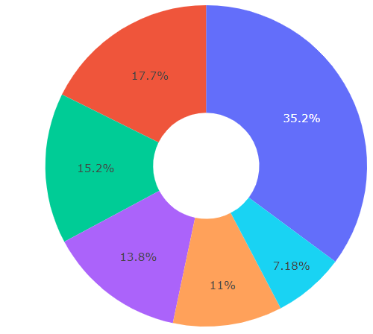
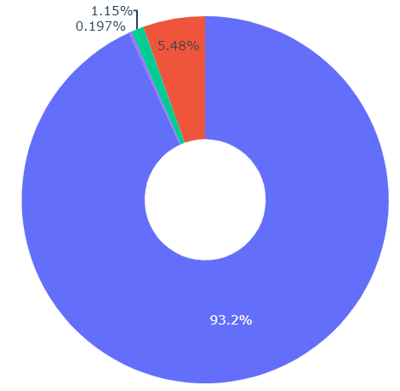
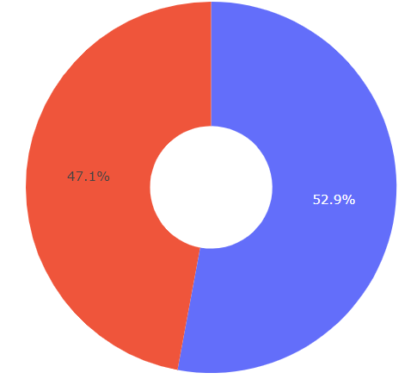
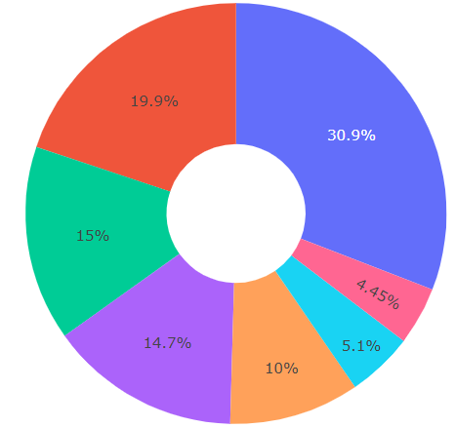
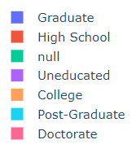
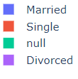
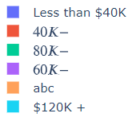
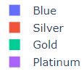

EDA (Categorical Features)

Slide 13
EDA (Categorical Features)
Observations
Gender : most of the customers is female, but it is not a huge difference.
Education_Level : most of the customers is Graduate. The second largest group is High-School.
Marital_Status : most customers is Married. The second largest is Single. The smallest group is those that are Divorced.
Income_Category : most of the customers is less than 40K. The second largest group is the next bin up at $40K-60K. We also notice a large group of customers with an incorrect category of 'abc' that we can probably remove and treat for.
Card_Category : most of the customers is Blue. The second largest group is Silver members. If we assume that Blue is the base card then we can probably bin these categories to the 'Basic Members' and 'Premium Members'.

Slide 14
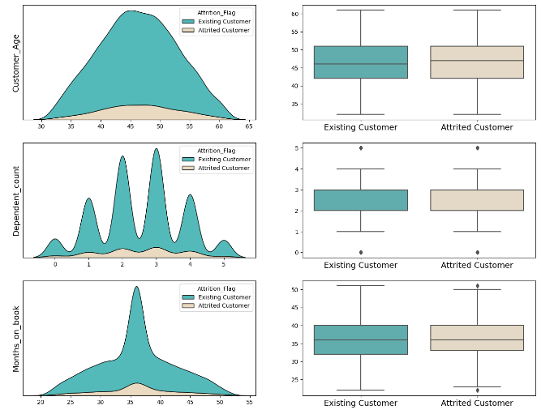
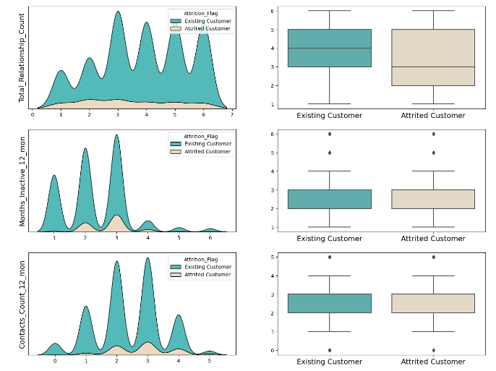
EDA (Numeric Features -Attrition_Flag)

Slide 15
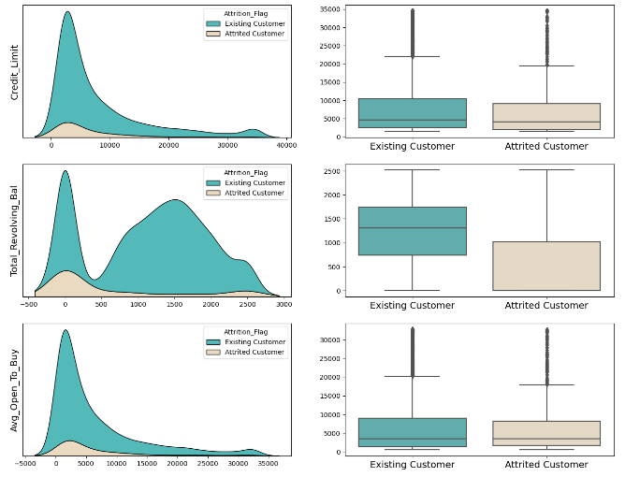
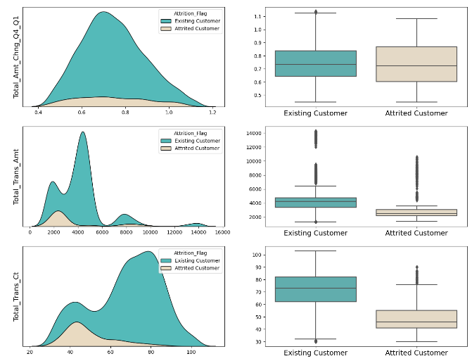
EDA (Numeric Features -Attrition_Flag)

Slide 16
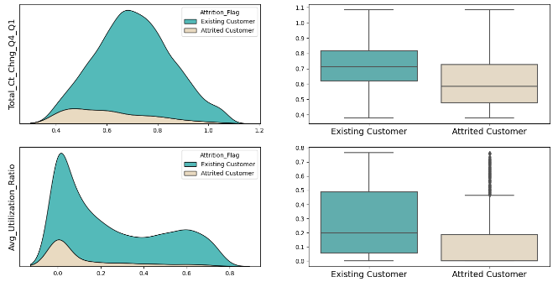
EDA (Numeric Features -Attrition_Flag)

Slide 17
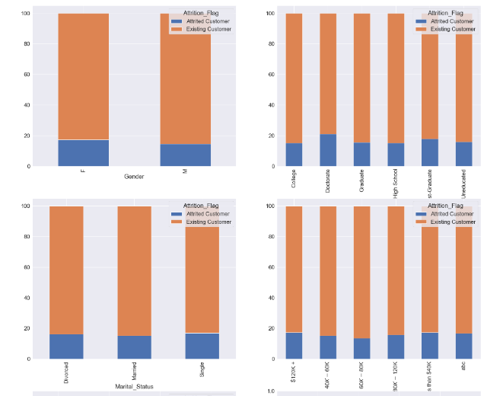
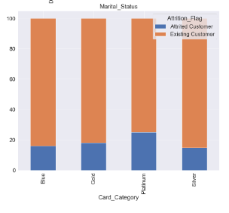
EDA (Categorical - Attrition_Flag)

Slide 18
EDA (Features - Attrition_Flag )
Observations
A slightly larger percentage of women closed their accounts.
The largest attrition rate is seen among those with a doctoral degree, but they are relatively similar across the education levels.
The attrition rates are quite similar across marital statuses as well, but the single members do have a slightly higher percentage.
The attrition rate is also similar across income bins, but those making <$40K have a slightly higher percentage than the others.
The attrition rate across the card types is also quite similar, but unexpectedly we do see that the 'Platinum' members have the highest attrition rate, and it is one of the most significant differences across any of the categorical columns.

Slide 19
EDA (Features - Attrition_Flag )
Features likely contribute to churn:
Total_Relationship_Count
Total_Revolving_Bal
Total_Trans_Amt
Total_Trans_Ct
Avg_Utilization_Ratio
Total_Amt_Chng_Q4_Q1
Total_Ct_Chng_Q4_Q1
Features NOT likely contribute to churn:
Customer_Age
Dependent_count
Months_on_book
Months_Inactive_12_mon
Contacts_Count_12_mon
Credit_Limit
Avg_Open_To_Buy

Slide 20
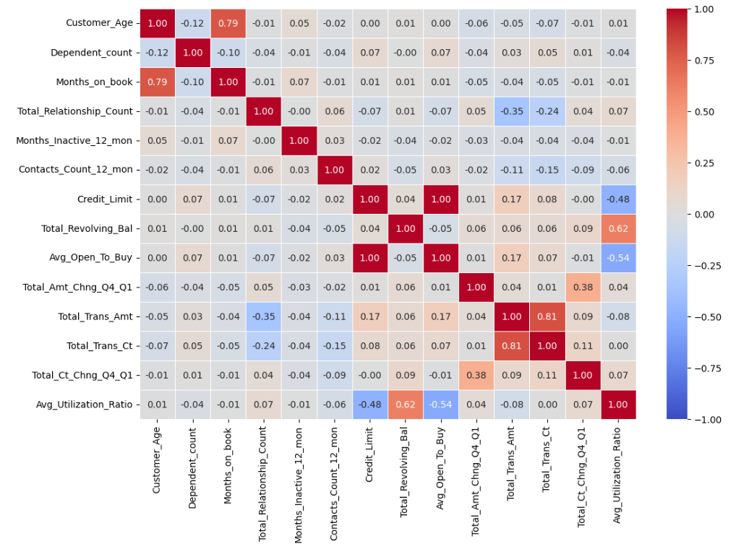
EDA (Correlation between Numeric Features)
Observations
Total_Revolving_Bal = Credit_Limit - Avg_Open_To_Buy
Avg_Utilization_Ratio = Total_Revolving_Bal / credit limit
Usually Total_Revolving_Bal is much smaller than Avg_Open_To_Buy. Thus Credit_Limit is close to Avg_Open_To_Buy in most columns. Correlation is 1.0 between them. We can drop Avg_Open_To_Buy column
Customer_age correlates well with Months_On_Book (0.79)
Total_Trans_Ct also well correlates with Total_Trans_Amt (0.81). This is also understandable.
Also correlates well are Total_Revolving_Bal and Ave_Utlization_Ratio

