Slide 1
Customer Retention Prediction
Yi Zhou
11/11/2021

Slide 2
Agenda
Background
01
Case Study
02
Data
Feature engineering
Prediction models
Business Insights
03
Opportunities
04

Slide 3
Background
A key to a company’s growth is its ability to keep customers
In the context of E-commerce, i.e., non-subscription based business, customer retention = repeated visits from the same customer
Why matters?
More cost-efficient to keep existing customers than acquiring new ones
Distinguish different types of shoppers and understand their need
Allow preemptive measures to prevent churns
Evaluate if a marketing campaign or a sale event is successful

Slide 4
Case Study
PrimeBuy Inc.
Online store for multi-category consumer goods
Data
User activity data of PrimeBuy between Oct 2019 and Mar 2020
Source: Kaggle data collected by Open CDP project
Focal interest
How to measure customer retention of PrimeBuy
What we can tell from user activities about retention
Value-adding opportunities and strategies

Slide 5
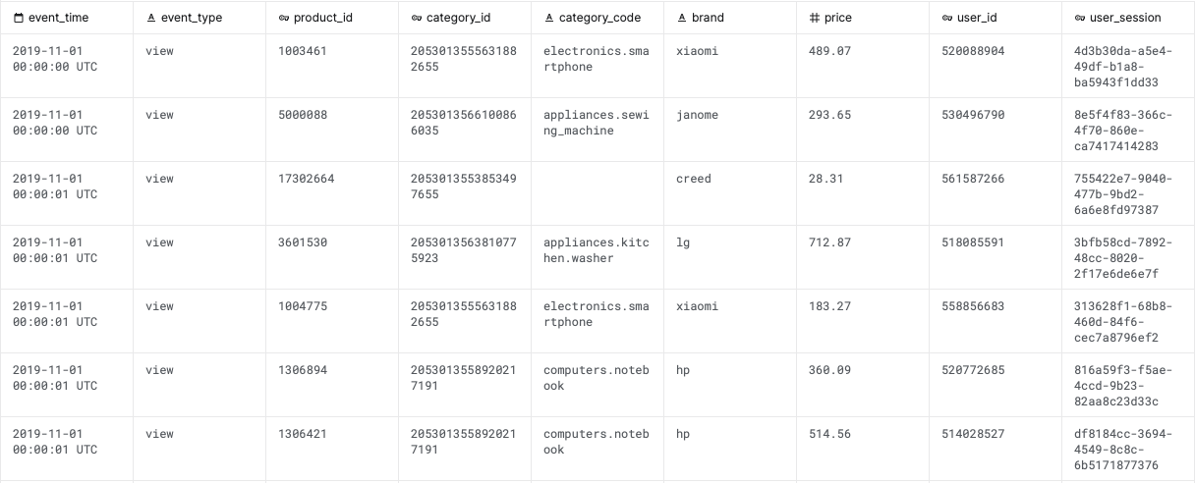
Data
Six-month coverage from Oct 2019 to Mar 2020
286 million user activities from PrimeBuy (44GB+)
Each row stands for a particular activity (e.g. view) on a certain product by a user
Nine columns
Notes:
Event_time: timestamp of an event in UTC
Event_type: Either view, cart, or purchase
Product_id: Unique identifier of a product
Category_id: Unique identifier of a category of products
Category_code: Category name if available
Brand: Brand name of a product if available
Price: Product price
User_id: Unique identifier of a user
User_session: Temporary user session ID. Will change whenever users log off and back on

Slide 6
Data
Three types of events: view, cart, purchase
Most popular category is electronics-smartphone
Average product price is about $170
Fully populated info except for category code and brand
Notes:
Event_time: timestamp of an event in UTC
Event_type: Either view, cart, or purchase
Product_id: Unique identifier of a product
Category_id: Unique identifier of a category of products
Category_code: Category name if available
Brand: Brand name of a product if available
Price: Product price
User_id: Unique identifier of a user
User_session: Temporary user session ID. Will change whenever users log off and back on

Slide 7
Question formulated
Objective
Challenges
Not enough features
Predict if customers visited in 2019 Q4 would visit in 2020 Q1
Quarterly interval suits the nature of PrimeBuy business
Raw data need to be consolidated
Good for holiday event retro study
Visit includes all activities including view

Slide 8
Feature Engineering
Data preparation
Retention indicator: 0 – Lost; 1 - Retained
Sampling
Explore dimensions of features that can best separate two classes
Categories visited
Frequency of activities
Activity type
Price of product
…and more
Notes:
Features explored:
# of events
# of sessions
*Total user value (purchase amount)
*Products that are popular and high customer retention
Category group
Pending cart items
Tenure
Date of activity

Slide 9
Data preparation
In 2019 Q4, there were 7.9M users (>100M rows).
3.3M returned in 2020 Q1
Retention rate is about 42%
Randomly select 5% of 2019 Q4 users and use their activity data for analysis
Reduce to 393K users (and 8.9M rows)
Notes:
This is one solution to large datasets without scaling up computing power.

Slide 10
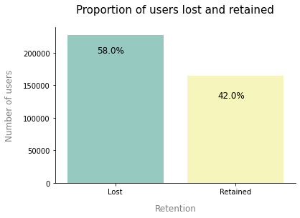
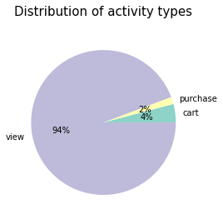
Retention rate for the sample is also 42%
Balanced dataset
94% of user activities are view
Data Overview

Slide 11
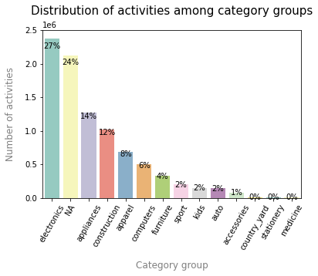
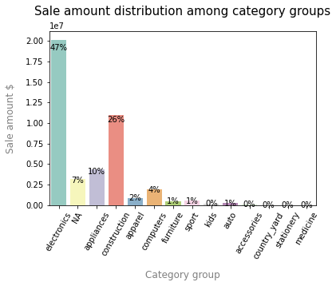
172K+ products and 1.2K categories are divided into 14 groups
27% of activities are on electronics
Electronics and construction take up >70% of sale
Product categories
Notes:
PrimeBuy sells a range of products, but the primary website traffic and sale come from electronics sale

Slide 12
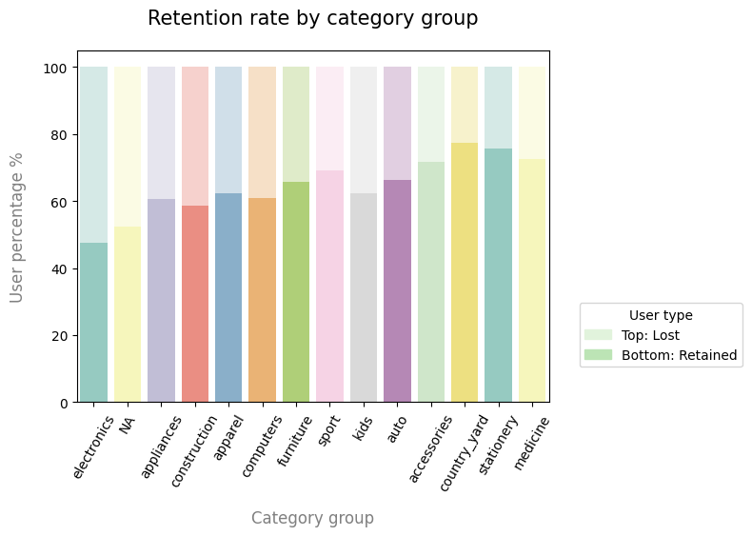
Customers of each group have different probabilities of coming back
Use one-hot encoded category groups as features
Product categories
Notes:
PrimeBuy sells a range of products, but the primary website traffic and sale come from electronics sale

Slide 13
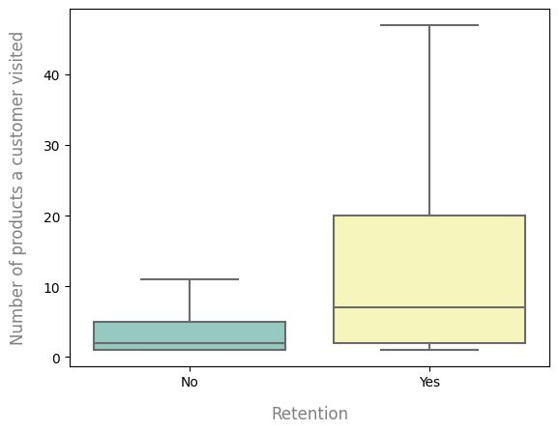
Product variety
A retained user tend to view more products compared to a churner
Add number of products a customer visited as a feature

Slide 14
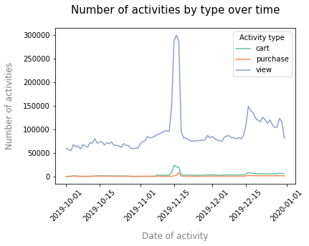
Holiday spree
Customer activities surged during mid-Nov and the second half of Dec
Potentially due to sale events or marketing campaigns

Slide 15
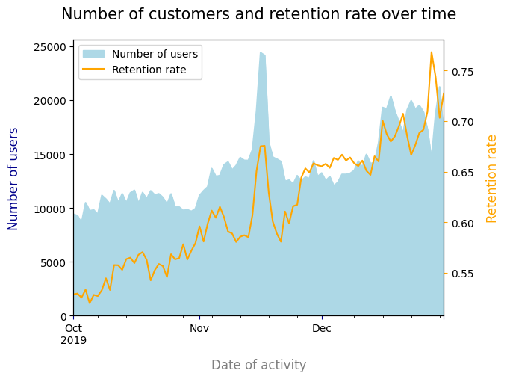
Holiday spree
Number of users also sees an increase during events
Customer visiting during holiday were more likely retained

Slide 16
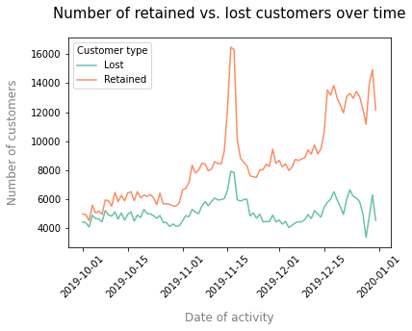
Holiday spree
Customer who would come back tend to shop on multiple days.
Use one-hot encoded dates of activity as features

Slide 17
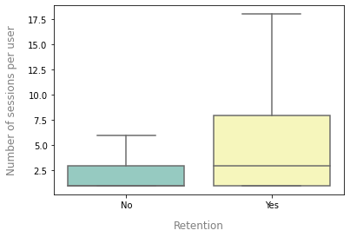
User sessions
Retained users tend to have more sessions
Add number of sessions per customer as a feature
Notes:
PrimeBuy sells a range of products, but the primary website traffic and sale come from electronics sale

Slide 18
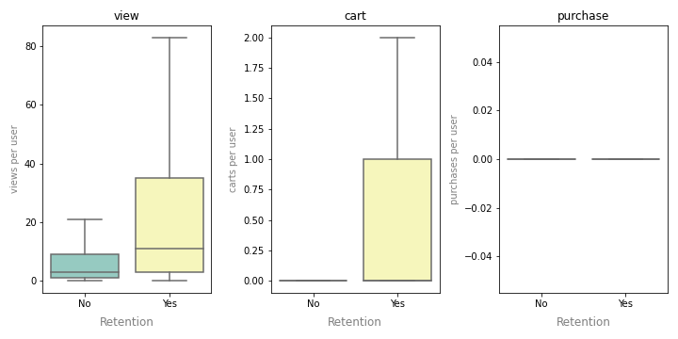
Activity frequency
# of views and carts also distinguish lost and retained users quite well
While # of purchases is not since purchase events are rare
Add number of view and cart per customer as a feature
Notes:
PrimeBuy sells a range of products, but the primary website traffic and sale come from electronics sale

Slide 19
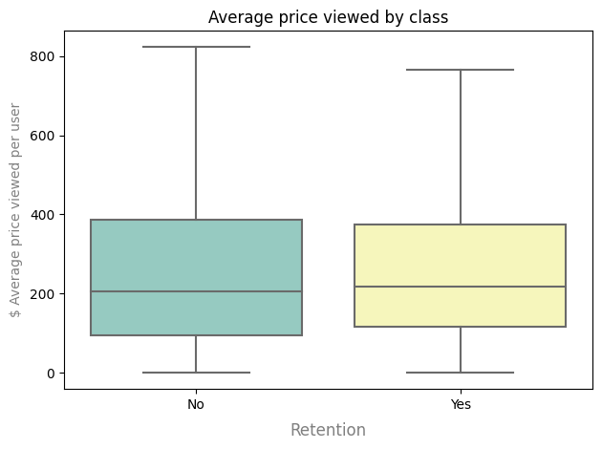
Product price
Retained users and lost customers are visiting similar price tiers of products
Price of products user viewed doesn’t have much predictive power

Slide 20
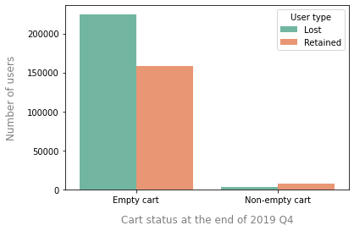
Pending cart
Whether a user has items in cart
Empty cart: 40% retention
Non-empty cart: 69% retention
Add a pending cart indicator as a feature

Slide 21
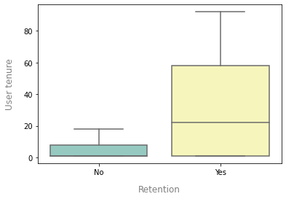
Tenure
Calculated as days between a user’s first and last activity
A proxy of tenure
Add customer tenure as a feature
Notes:
PrimeBuy sells a range of products, but the primary website traffic and sale come from electronics sale

Slide 22
Feature engineering - Summary
Consolidated activity data to user level
Added 111 features based on how well it separates retained users from lost users
# of carts per user
# of views per user
# of sessions per user
# of products visited
Tenure per user
Pending cart flag per user
One-hot encoded category group
One-hot encoded date of activities
Collinearity between number of views and number of products
Remove number of products
All other features’ correlations are below 0.8 and VIF < 10

Slide 23
Prediction Models
Two-class Classification problem
Input: customer level activity features
Output: whether a customer would come back (1) or not (0)
Models:
Logistic regression
Random forest
XGBoost
Train-Test split: 80/20

Slide 24
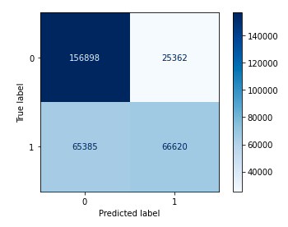
Logistic regression
Grid search on 10-fold CV set
Standard Scaler
Mean 0 and Variance 1
Train and test set performance converges
0-class prediction is better than 1-class
Low false positive
High false negative
 | Logistic model
Accuracy | 0.72
ROC AUC | 0.69
F1 score – Class 0 | 0.78
F1 score – Class 1 | 0.60
Note: Detailed model results can be found in the Appendix

Slide 25
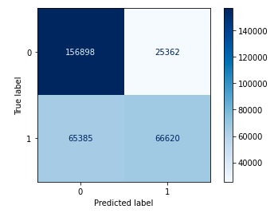
Random forest
Grid search on 5-fold CV set
Train set performance converges with Test set
0-class prediction is better than 1-class
Low false positive
High false negative
 | Random Forest
Accuracy | 0.71
ROC AUC | 0.68
F1 score – Class 0 | 0.77
F1 score – Class 1 | 0.59
Note: Detailed model results can be found in the Appendix

Slide 26
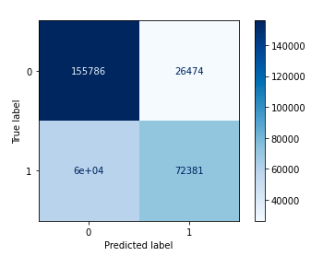
XGBoost
Random search on 5-fold CV set
Train set performance converges with Test set
0-class prediction is better than 1-class
Better at reducing False Negative
 | XGBoost
Accuracy | 0.72
ROC AUC | 0.70
F1 score – Class 0 | 0.78
F1 score – Class 1 | 0.62
Note: Detailed model results can be found in the Appendix

Slide 27
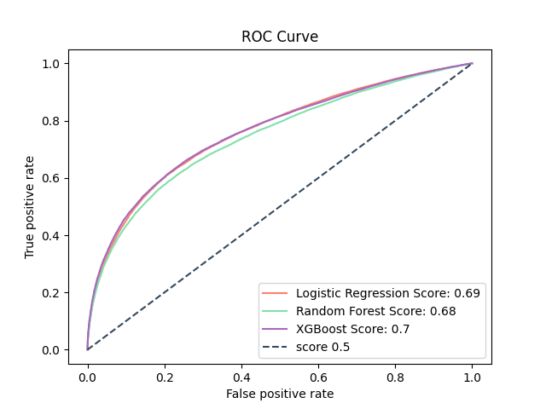
Model Selection
XGBoost slightly better than the others
 | Logistic model | Random forest | XGBoost
Accuracy | 0.72 | 0.71 | 0.72
ROC AUC | 0.69 | 0.68 | 0.70
F1 score – Class 0 | 0.78 | 0.77 | 0.78
F1 score – Class 1 | 0.60 | 0.59 | 0.62
Note: Detailed model results can be found in the Appendix
Notes:
Logistic:
* All features are standardized
Grid search suggests L1 and alpha=10, max_iter=200
RF:
* Grid search suggests max_depth=6, max_features=‘sqrt’, n_estimator=100

Slide 28
Business Insights
The model does a good job finding churners (TNR = 0.85)
For retention, false negative is better than false positive
Boost user activities and engagement to increase customer retention
Churners are usually less active, log in on fewer days, and check out fewer products
Although some inactive customers also returned, they may be “wandering shoppers” and would churn in the future
Tenure is the most important feature in predicting retention
Ideas: curated newsletters, personalized ads, product differentiation, pending cart reminder
Holiday events increased customer retention
Strengthen relationship with existing customers
Connect with new ones

Slide 29
Opportunities
The main constraint of model performance is limited data
Need longer history + more User/Product information
Combine with user data (within compliance boundary):
Historical activities
Account/membership/retail credit card status
Cluster users into different types (e.g. discount hunter, impulse buyers, etc)
Combine with product data:
Better identify complement and substitute products
Sale event, discount amount and frequency
Understand why view-to-purchase ratio is low

Slide 30
Thank you!
Q & A

Slide 31
Links
Project Git repo link: https://github.com/yz-joy/user-retention
Kaggle data: https://www.kaggle.com/mkechinov/ecommerce-behavior-data-from-multi-category-store

Slide 32
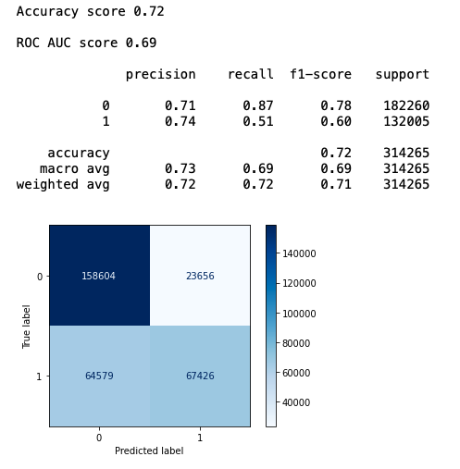
Appendix
Logistic regression
Train set performance

Slide 33
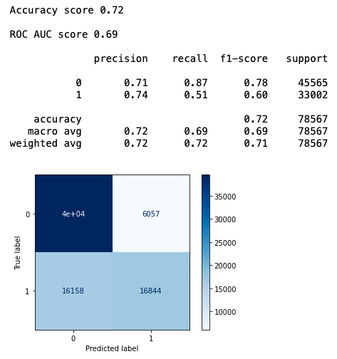
Appendix
Logistic regression
Test set performance

Slide 34
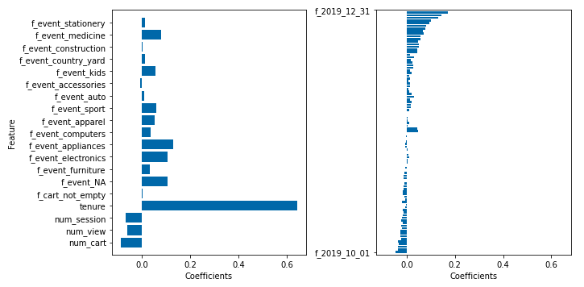
Appendix
Logistic regression coefficients

Slide 35
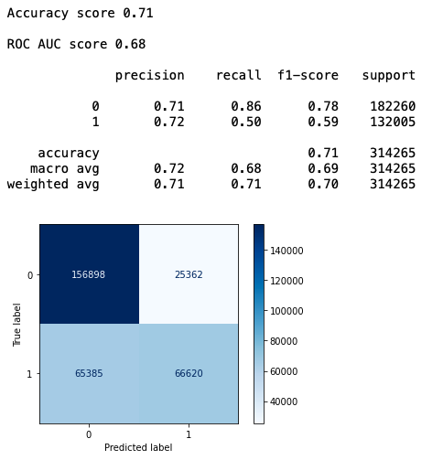
Appendix
Random forest
Train set performance

Slide 36
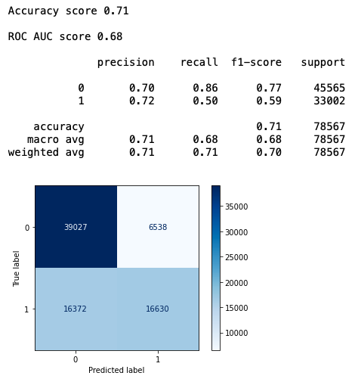
Appendix
Random forest
Test set performance

Slide 37
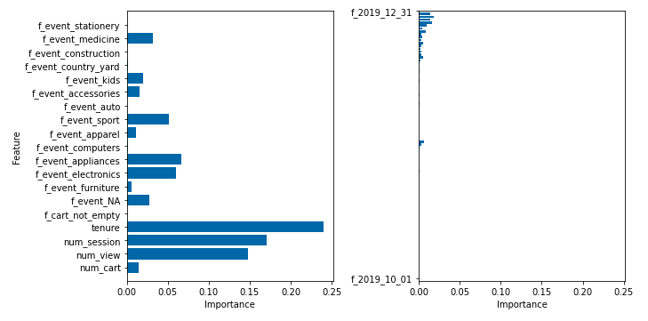
Appendix
Random forest coefficients

Slide 38
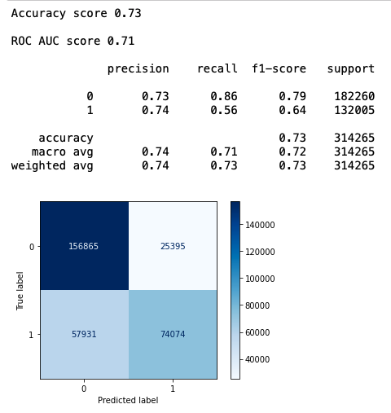
Appendix
XGBoost
Train set performance

Slide 39

Appendix
XGBoost
Test set performance

Slide 40
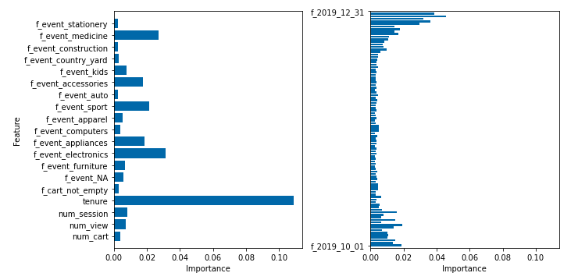
Appendix
XGBoost coefficients

Slide 41
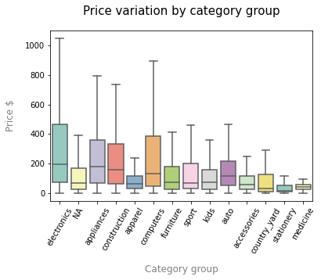
Appendix
Price variation: only able to observe items that users viewed. One single product can have multiple prices

Slide 42
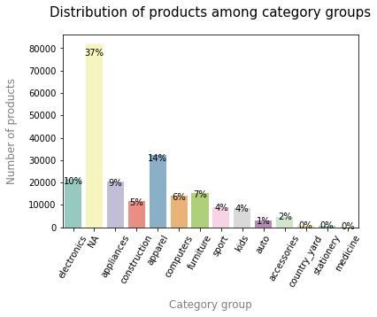
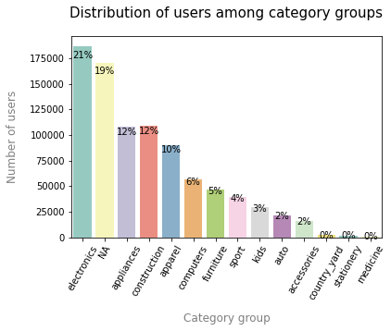
Most products are in unknown category groups
Distribution of users is similar to distribution of activities
Appendix

