Slide 1
Customer Retention Prediction
Yi Zhou
11/11/2021

Slide 2
Background
A key to a company’s growth is its ability to keep customers
In the context of E-commerce, i.e., non-subscription based business, customer retention = repeated visits from the same customer
Why matters?
More cost-efficient to keep existing ones than acquiring new ones
Distinguish different types of shoppers and understand their need
Allow preemptive measures to prevent customers from leaving
Evaluate if a marketing campaign/sale event is successful

Slide 3
Case study
PrimeBuy Inc.
Online store for multi-category consumer goods
Mainly electronics and appliances
Data
User activity data for a online retailer between Oct 2019 and Mar 2020
Source: Kaggle data collected by Open CDP project
Focal interest
Analyze what user activities affect retention
Predict if a customer will come back within a certain time frame

Slide 4
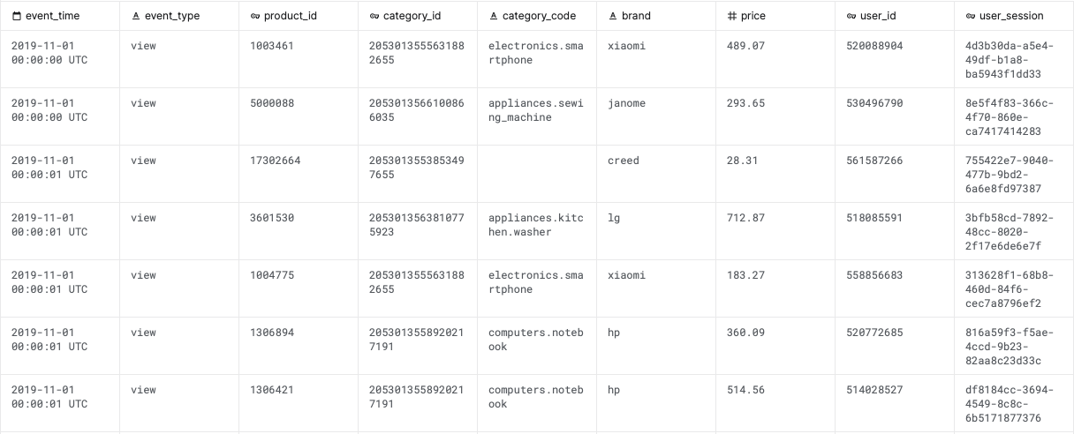
Data
286 million user activities from PrimeBuy (44GB+)
Six-month coverage from Oct 2019 to Mar 2020
Each row stands for a particular activity (e.g. view) on a certain product by a user
Nine columns
Notes:
Event_time: timestamp of an event in UTC
Event_type: Either view, cart, or purchase
Product_id: Unique identifier of a product
Category_id: Unique identifier of a category of products
Category_code: Category name if available
Brand: Brand name of a product if available
Price: Product price
User_id: Unique identifier of a user
User_session: Temporary user session ID. Will change whenever users log off and back on

Slide 5
Question formulated
Objective
Challenges
Not enough features
Predict if 2019 Q4 customers would return in 2020 Q1
Quarterly interval suits the nature of PrimeBuy business
Good for holiday event retro study
Raw data need to be consolidated

Slide 6
Sample data
In 2019 Q4, there were 7.9M users (>100M rows).
3.3M of which returned in 2020 Q1
Retention rate is about 42%
Randomly select 5% of 2019 Q4 users and use their activity data for analysis
Reduce to 393K users (and 8.9M rows)
Notes:
This is one solution to large datasets without scaling up computing power.

Slide 7
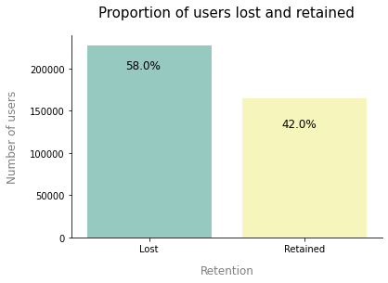
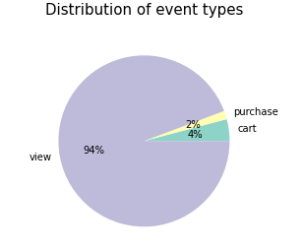
Retention rate for the sample is also 42%
94% of user activities are view
First impression
Notes:
Balanced dataset
Data preparation and feature engineering:
* Find dimensions of features that best separate two classes
* Some plots of variables and how well it distinguish the two classes

Slide 8
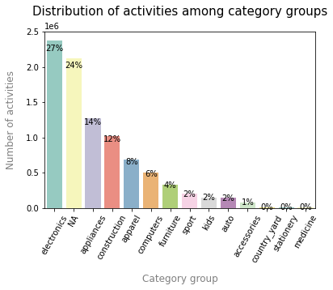
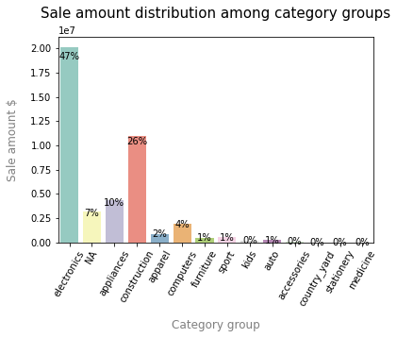
172K+ products and 1.2K categories are divided into 14 groups
27% of activities are on electronics
Electronics and construction take up >70% of sale
Categories
Notes:
PrimeBuy sells a range of products, but the primary website traffic and sale come from electronics sale

Slide 9
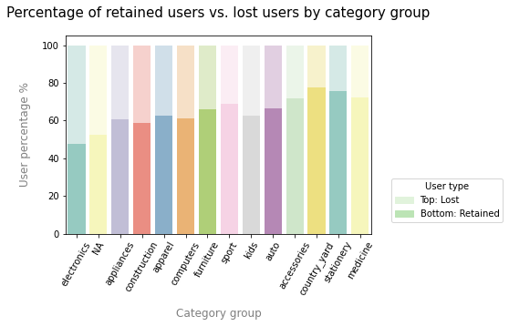
Categories
Customers of each group have different probabilities of coming back
Notes:
PrimeBuy sells a range of products, but the primary website traffic and sale come from electronics sale

Slide 10
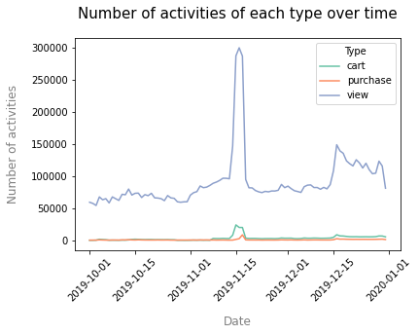
Holiday spree
User activities surged during mid-Nov and the second half of Dec
Potentially some sale events ongoing

Slide 11
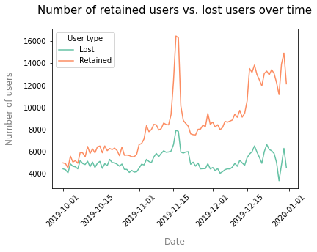
Holiday spree
Users visiting during holiday were more likely retained
Users who would come back tend to shop on multiple days.

Slide 12
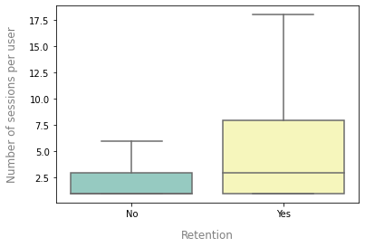
Activeness vs. Retention
Retained users tend to have more sessions
Notes:
PrimeBuy sells a range of products, but the primary website traffic and sale come from electronics sale

Slide 13
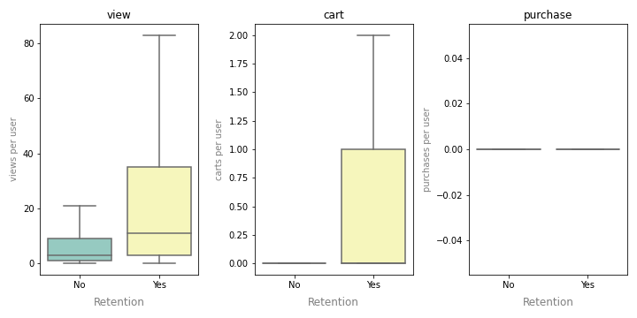
Activeness vs. Retention
# of views and carts also distinguish lost and retained users quite well
While # of purchases is not since purchase events are rare
Notes:
PrimeBuy sells a range of products, but the primary website traffic and sale come from electronics sale

Slide 14
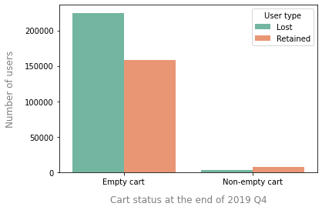
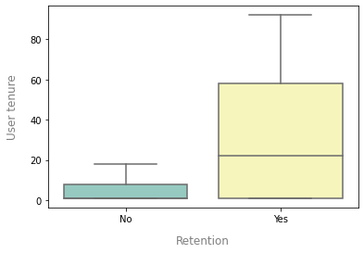
Other helpful features
Whether a user has items in cart
Tenure: Days between a user’s first and last activity

Slide 15
Summary – Feature engineering
Consolidate activity data to user level and added 111 features based on how well it separates retained users from lost users
# of carts
# of views
# of sessions
Tenure
Items in cart flag
Category group dummy
Date dummy
No multicollinearity: All features’ correlations are below 0.8
Split data 4:1 into train and test sets

Slide 16
Models
 | Logistic model | Random forest | XGBoost
Accuracy | 0.72 | 0.71 | 0.72
ROC AUC | 0.69 | 0.68 | 0.70
F1 score – class 0 | 0.78 | 0.77 | 0.78
F1 score – class 1 | 0.59 | 0.59 | 0.62
Note: Detailed model results can be found in the Appendix
Notes:
Logistic:
* All features are standardized
Grid search suggests L1 and alpha=10, max_iter=200
RF:
* Grid search suggests max_depth=6, max_features=‘sqrt’, n_estimator=100

Slide 17
Summary & Recommendations
Able to identify >85% of churners
They are less active, log in on fewer days, and check out fewer products
Could send regular newsletters or coupons to prompt activities
Less able to identify returning users
Some appear to be inactive as well with only 1-2 views
Even though they returned in the next quarter, they could be what’s called “wandering shoppers” and also require additional efforts retaining
Holiday creates opportunities to retain users
Strengthen relationship with existing customers
Connect with new ones

Slide 18
Opportunities
The main constraint of model performance is limited data
Longer history + more User/Product information
Non-holiday user retention analysis
Combine with user data if any:
Better identify existing vs. new users
Account/membership/retail credit card status
Cluster users into different types (e.g. discount hunter, impulse buyers, etc)
Combine with product data if any:
Better identify complement and substitute products
Sale event, discount amount and frequency

Slide 19
Thank you!
Q & A

Slide 20
Reference
Git repo link

Slide 21
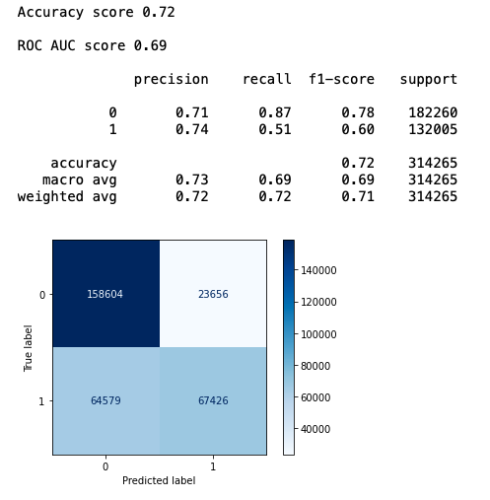
Appendix
Logistic regression
Train set performance

Slide 22
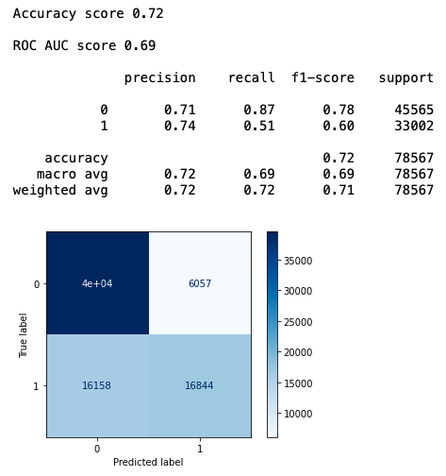
Appendix
Logistic regression
Test set performance

Slide 23
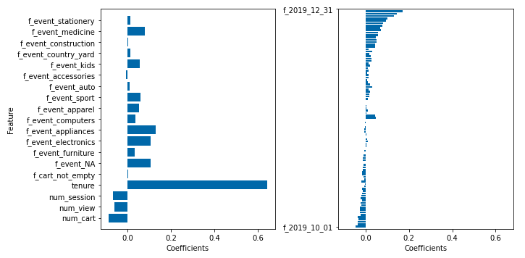
Appendix
Logistic regression coefficients

Slide 24
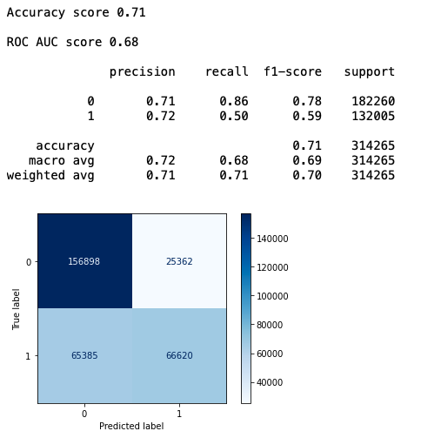
Appendix
Random forest
Train set performance

Slide 25
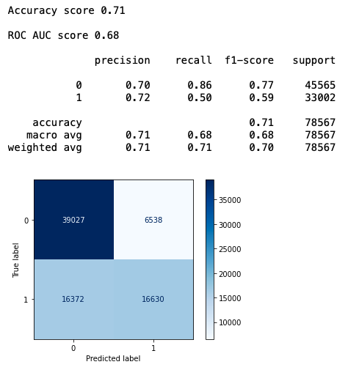
Appendix
Random forest
Test set performance

Slide 26
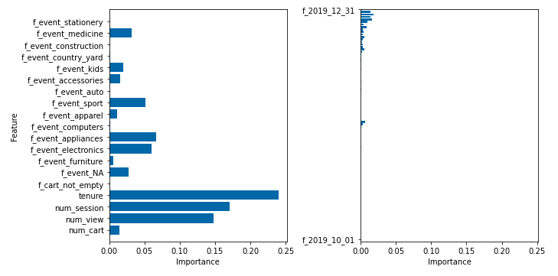
Appendix
Random forest coefficients

Slide 27
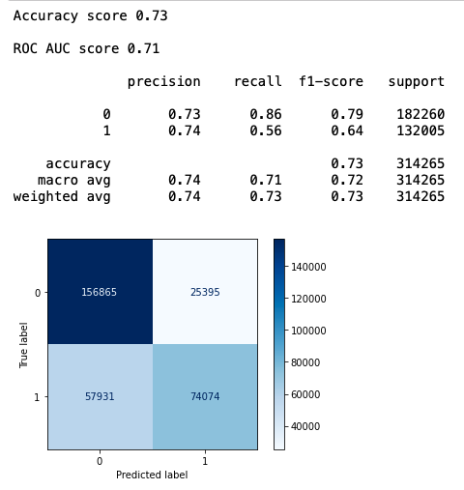
Appendix
XGBoost
Train set performance

Slide 28

Appendix
XGBoost
Test set performance

Slide 29
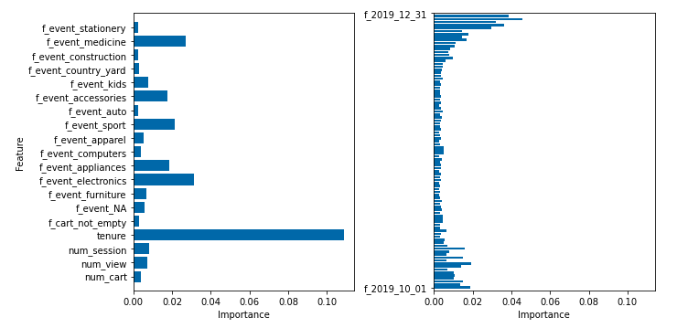
Appendix
XGBoost coefficients

Slide 30
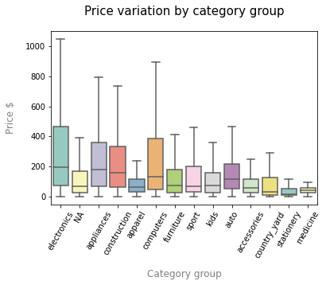
Appendix
Price variation: only able to observe items that users viewed. One single product can have multiple prices

Slide 31
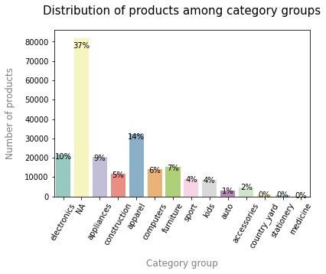
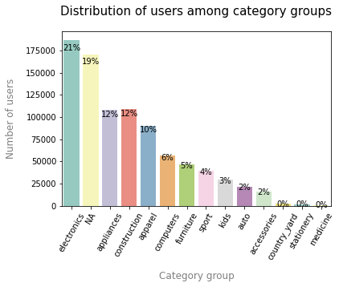
Most products are in unknown category groups
Distribution of users is similar to distribution of activities
Appendix

Slide 32
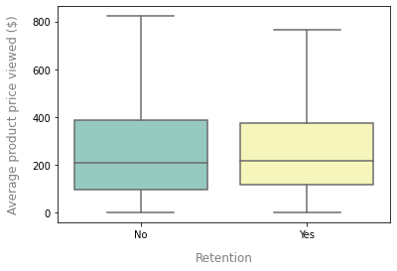
Appendix
Price of products user viewed doesn’t have much indicative power

