Slide 1
Predicting S&P 500 Stock Outperformance
Data Bootcamp Final Project
Kashish Hundia & John Zhang

Slide 2
Motivation
Why try to predict stock outperformance?
  Most investors aim to beat the market benchmark (SPY)
  Firm fundamentals may contain information about future performance
  Question: can we use company financial data to identify likely outperformers?

Slide 3
Project Objective
Primary goal
  Predict whether an S&P 500 stock will outperform SPY over the next 12 months
  Frame the problem as a binary classification task
  Extend the exploratory analysis from the midterm into a predictive setting

Slide 4
Data Sources
S&P 500 constituents
  List of companies obtained from Wikipedia
  Firm-level financial data and historical prices from yfinance
  All data is publicly available

Slide 5
Financial Features Used
Key categories of features
  Valuation metrics: P/E, price-to-book
  Profitability metrics: margins, ROE, ROA
  Leverage and balance-sheet measures: debt, cash, enterprise value
  Risk indicator: beta

Slide 6
Target Variable
Definition of outperformance
  Compute forward 12-month stock return
  Compare stock return to SPY return over same period
  Label = 1 if stock return > SPY, otherwise 0
  Resulting dataset is imbalanced (fewer outperformers)

Slide 7
Data Preparation
Preprocessing steps
  Drop observations missing key fundamentals
  Create ratio-based features (e.g., debt-to-market-cap)
  One-hot encode sector variable
  Handle missing values using median imputation during modeling

Slide 8
Models and Methods
Models evaluated
  Logistic Regression
  Gradient Boosting
  Decision Tree
  Random Forest

Slide 9
Evaluation Metrics
How models are evaluated
  Accuracy
  Precision and recall
  F1 score (important due to class imbalance)
  ROC-AUC (ability to rank outperformers vs underperformers)

Slide 10
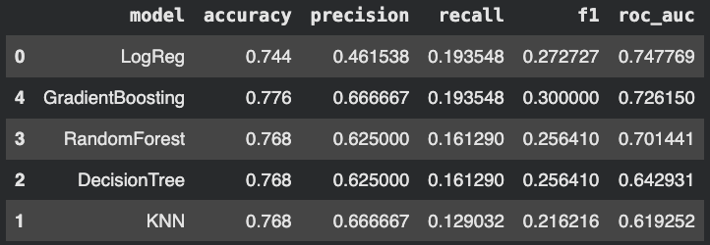
Model Comparison Results
Overall performance summary
  Logistic Regression achieves highest ROC-AUC (~0.75)
  Gradient Boosting achieves highest F1 score
  Tree-based ensemble models outperform simpler baselines

Slide 11
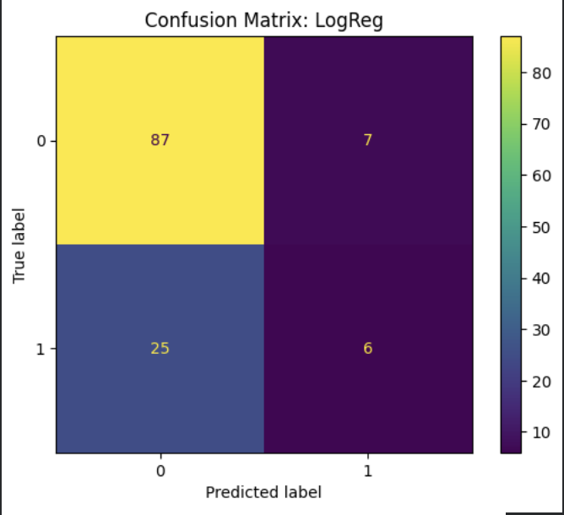
Confusion Matrix (Logistic Regression)
What the confusion matrix shows
  Model correctly identifies most underperforming stocks
  Model misses a significant number of outperformers
  Indicates a conservative prediction strategy

Slide 12
ROC Curve Interpretation
Understanding the ROC curve
  ROC-AUC of ~0.75 indicates performance above random guessing
  Model is better at ranking stocks than making hard classifications
  Useful for screening or ranking applications

Slide 13
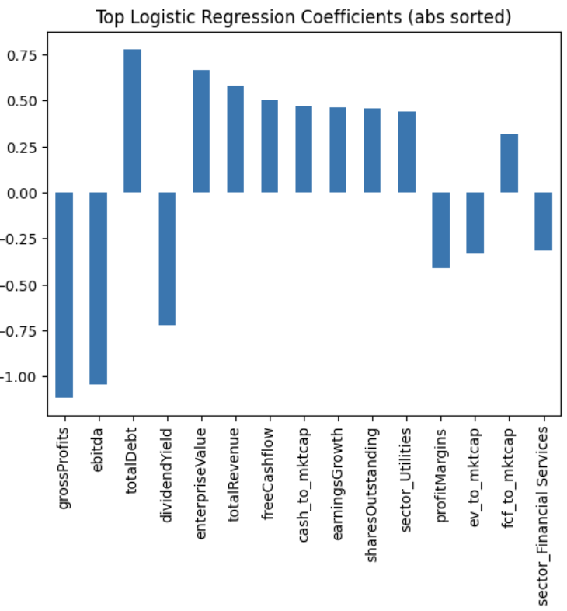
Feature Interpretation
Key patterns from model coefficients
  Positive associations: enterprise value, revenue, free cash flow, earnings growth etc…
  Negative associations: dividend yield etc…

Slide 14
Key Takeaways
What we learned
  Financial fundamentals contain some predictive signal
  Predicting market outperformance is inherently difficult
  Models perform better at ruling out underperformers than finding winners

Slide 15
Limitations
Important caveats
  Fundamental data is a snapshot, not time-stamped historical fundamentals
  Market returns depend on many external factors
  Results should not be interpreted as trading advice

Slide 16
Next Steps
Possible extensions
  Use time-stamped quarterly fundamentals
  Evaluate performance across multiple time periods
  Incorporate macroeconomic indicators
  Test alternative model architectures

