Slide 1
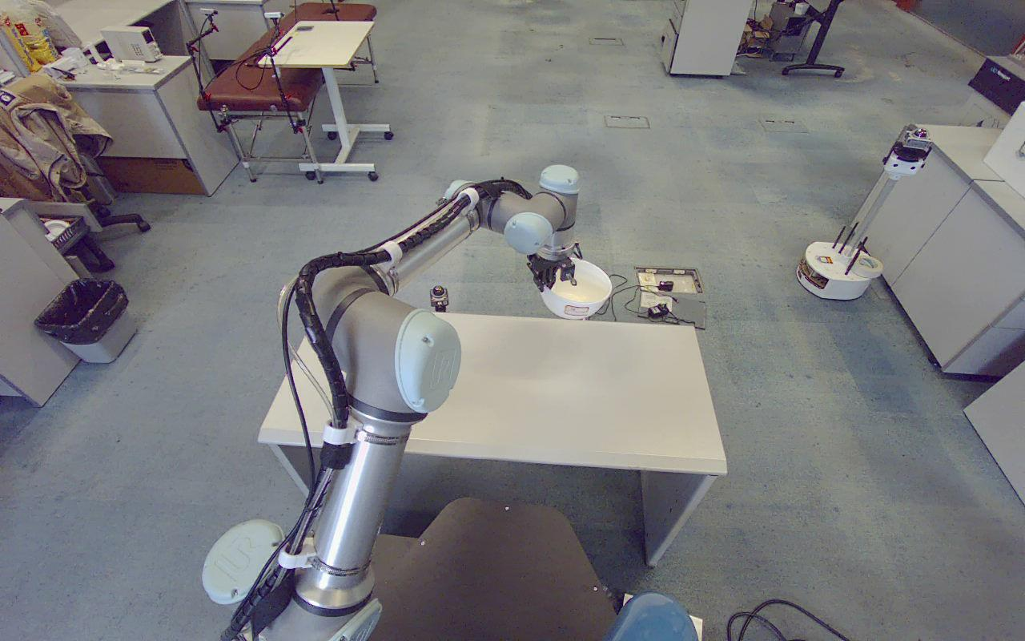
ROBOTICS / RESEARCH PROGRESS
Geometry-
Constrained
Bowl Manipulation
From visual rim grasping
to repeatable placement
RGB-D perception
Radial contact geometry
Taught placement
Original hardware image | 23 Sep 2026
02 OCT 2026
Notes:
【中文演讲备注】
本项目围绕规则圆碗的视觉抓取和指定位置放置展开。除了实现“看到碗、夹起来、放下去”，本阶段重点研究抓取方位变化时，如何尽量保持碗与夹爪之间的相对关系。汇报分为几何原理、完整任务执行和实验证据三个部分。封面使用 9 月 23 日的真实抬碗照片，用于展示硬件平台和抓取场景；这张早期照片不作为后续径向方法的对比验证。
【资料来源】
docs/圆碗径向抓取修改_20260928.md
debug_output/planning_diagnosis_20260923/white_lifted.jpg

Slide 2
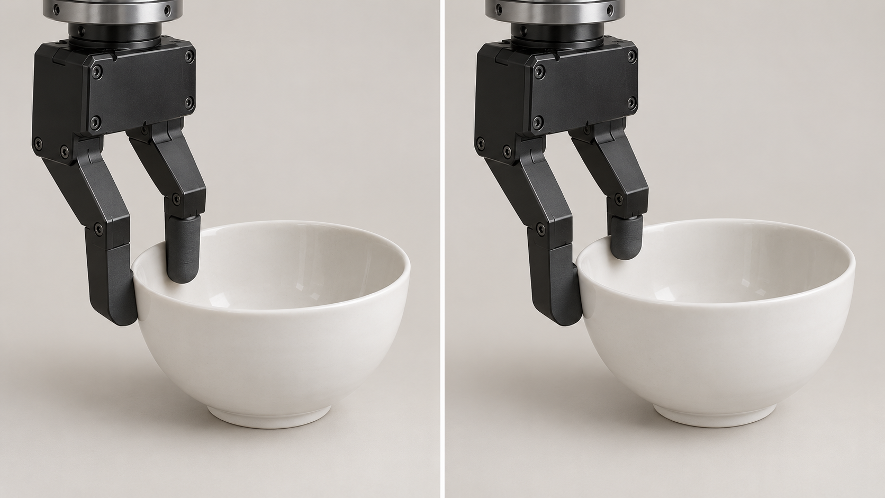
DESIGN QUESTION
A fixed tool pose does not fix the bowl center
ILLUSTRATIVE RENDERING
Contact geometry matters
Different contacts change the bowl-to-gripper offset.
Teaching controls the tool
A fixed release pose does not directly constrain the bowl center.
Design objective
Make the grasp relationship more consistent.
AI-generated contact illustration | Same bowl type; different rim engagement
Principle illustration; no experimental measurements are represented.
02 / 12
Notes:
【中文演讲备注】
首先解释为什么只把所有释放点设置成相同 RPY，并不能保证每次落在同一个位置。示教和运动控制约束的是工具位姿，而碗中心还取决于夹爪夹住了碗的哪个位置、以什么方向和深度夹住。接触关系不同，工具到碗中心的偏移就可能不同。这里使用的是 AI 生成的接触示意，不是两次实际实验，也不表示测得了某个偏移量。我们要做的是先稳定抓取关系，再研究放置误差。
【资料来源】
docs/圆碗径向抓取修改_20260928.md
assets/contact_geometry.png (AI-generated illustration)

Slide 3
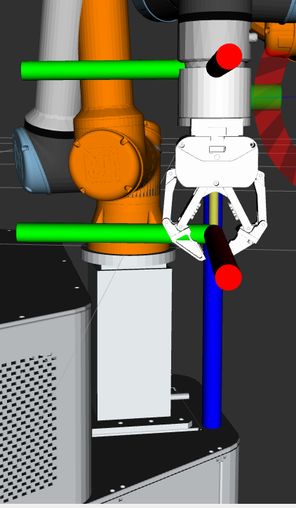
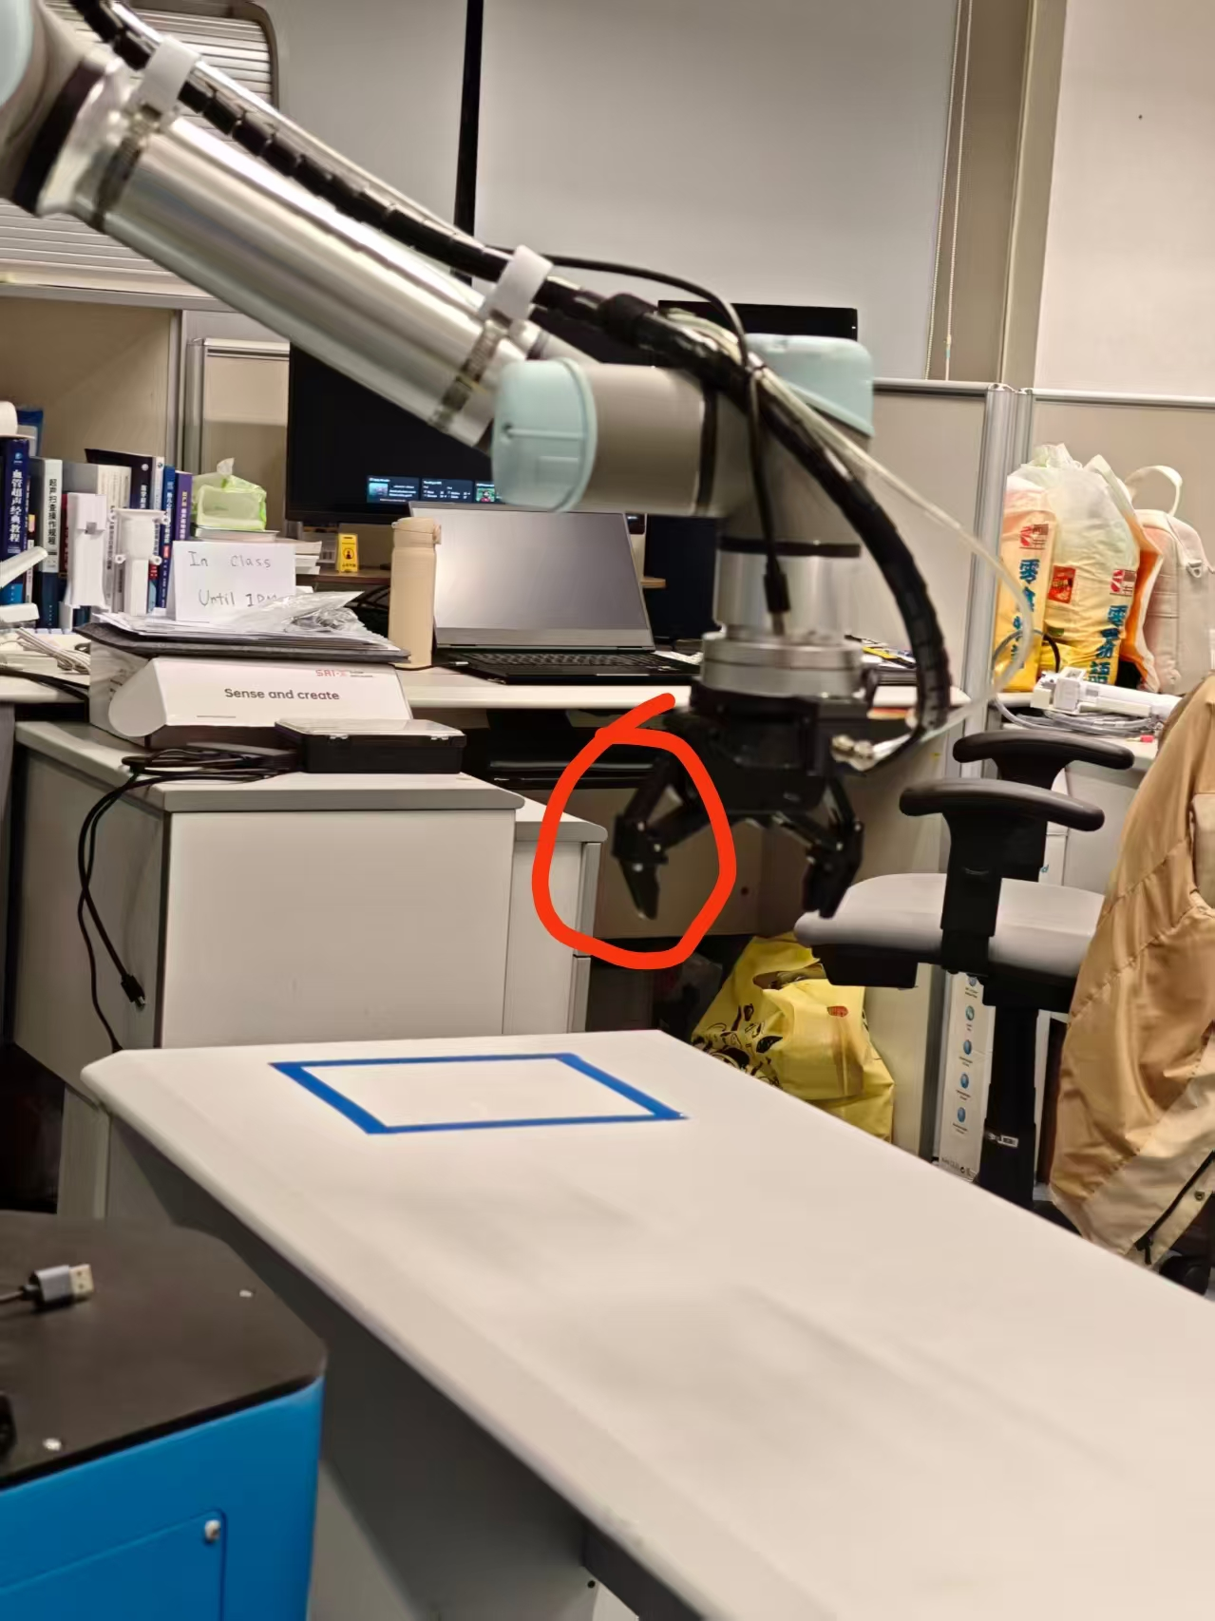
CONTRIBUTION 01 / GRASP GEOMETRY
Radial alignment with fixed finger assignment
Left outside; right inside
Preserve the identity of each physical finger.
Radial closing direction
Tool +Y points outward; −Y points toward the bowl center.
Consistent engagement
RViz frame check
Green axis = tool +Y
Keep grasp height and insertion depth consistent.
Physical finger identification
Circled finger = left
Original user reference images; the physical left finger was identified as tool +Y.
03 / 12
Notes:
【中文演讲备注】
核心约束包括两个部分：夹爪闭合轴沿圆心到碗沿的径向，同一个物理手指始终在碗外。用户已经通过照片和 RViz 确认左指对应工具正 Y，因此当前配置保持左外右内。这样可以减少不同抓取方位以及方向翻转造成的相对关系变化。圆碗的旋转对称性并不意味着带工具偏置和线缆的实际夹爪可以随意翻转。固定抓取高度、深度和避免滑动同样是这一设计成立的前提。
【资料来源】
docs/left_finger_reference_20260928.jpeg
docs/left_finger_positive_y_rviz_20260928.png
src/rim_locator/rim_locator/rim_detection.py

Slide 4
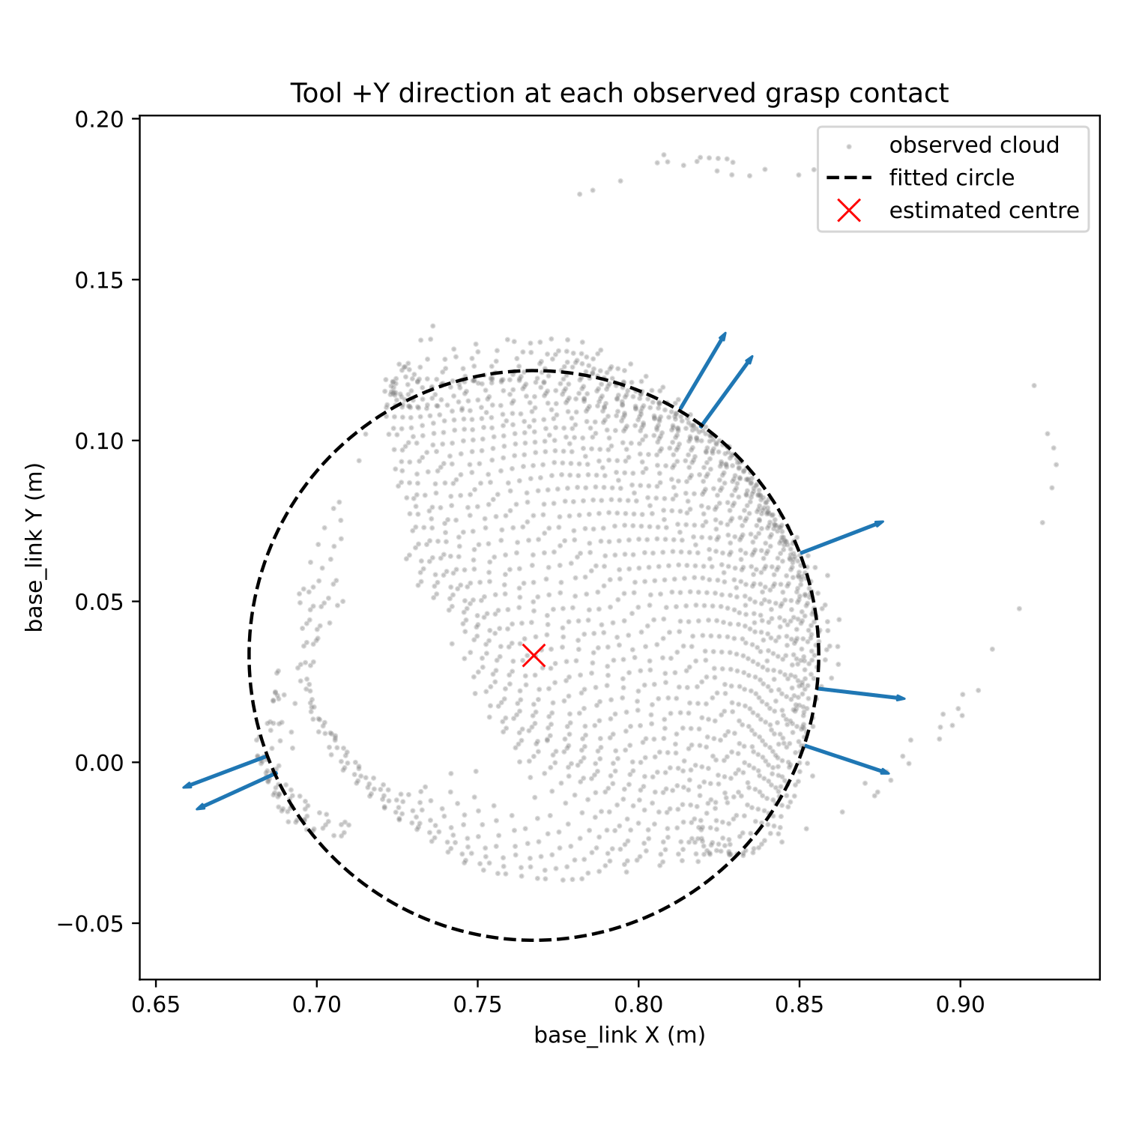
CONTRIBUTION 02 / OBSERVED CONTACT SUPPORT
Global shape guides, local geometry validates
OBSERVED GEOMETRY
Global shape
Fit the observed rim to estimate center and radial direction.
Local contact support
Check wall patches at multiple neighborhood scales.
Cross-check the grasp
Compare the wall direction and observed contact with the circle.
Preserve measured positions
Do not project grasp contacts onto an idealized rim.
Original point-cloud replay visualization | circle_radial_replay_final_20260928
04 / 12
Notes:
【中文演讲备注】
这里的设计将整体形状和局部接触分工。圆拟合提供圆心、半径以及有符号的径向方向；局部碗壁搜索验证该位置是否存在可靠的接触证据。实现中会比较不同尺度的局部法线，并检查点数、高度跨度、残差和方向一致性。圆模型通过后，候选还要满足接触半径误差与壁面方向偏差条件。重要的是，输出抓取点保留真实观测位置，不把点移动到拟合圆周上。图来自保存点云的实际算法回放。
【资料来源】
src/rim_locator/rim_locator/circle_fit.py
src/rim_locator/rim_locator/rim_detection.py
debug_output/circle_radial_replay_final_20260928/radial_grasps.svg

Slide 5
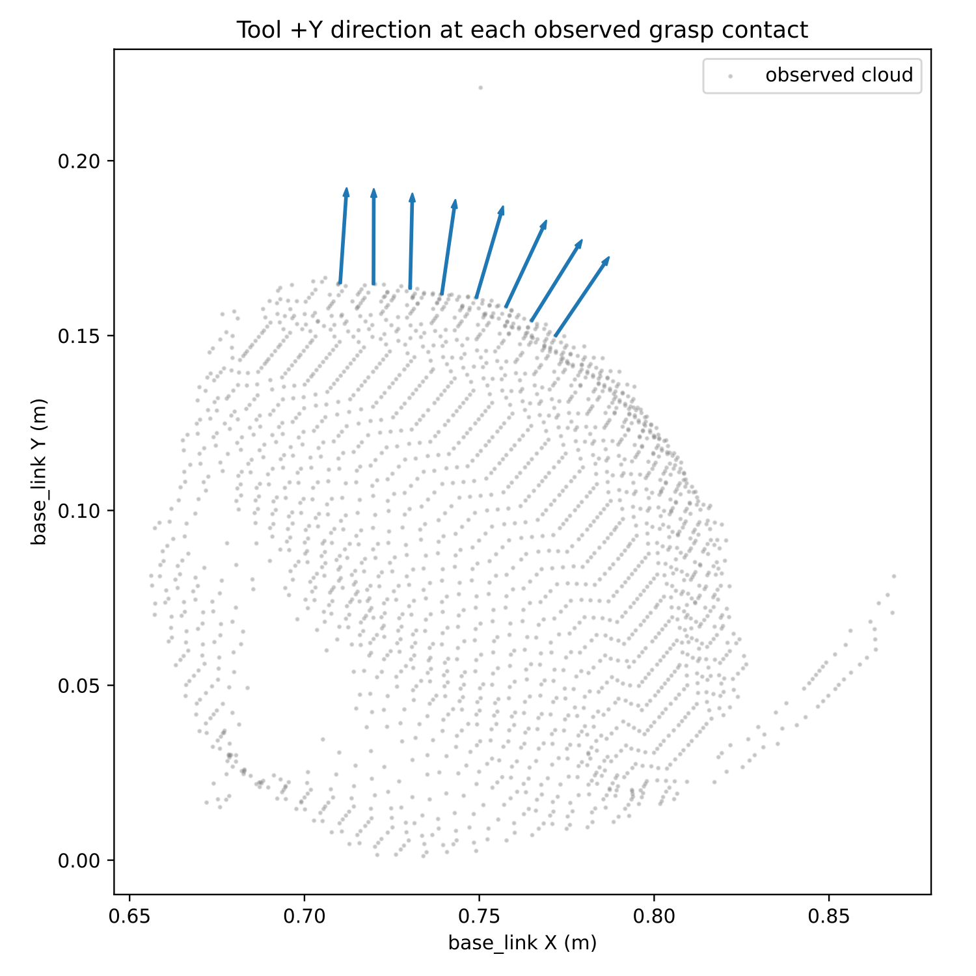
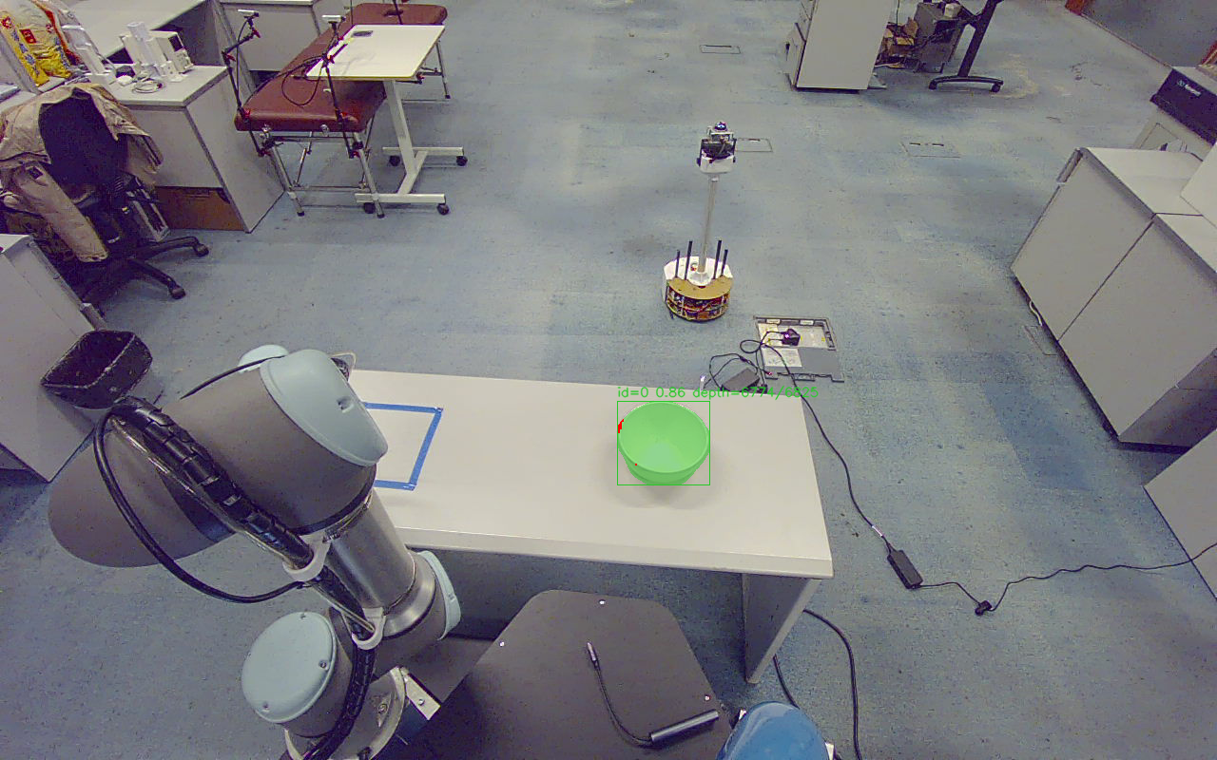
METHOD / PARTIAL OBSERVATIONS
Use reliable local evidence when the rim is incomplete
LIVE PLANNING PREVIEW
Approximately 103° coverage; 8 grasp candidates.
Prefer validated radial geometry; use supported wall directions when arc coverage is insufficient.
Separate live and offline observations from the same diagnostic session | 28 Sep 2026
05 / 12
Notes:
【中文演讲备注】
部分观测下，碗的实例分割可能完整，但可用于几何拟合的顶部深度点只覆盖一段圆弧。当前方法优先使用通过检查的圆心径向；只有圆弧覆盖或占用角度区间不足时，才采用有多尺度壁面支持的局部方向。备用分支不利用已被拒绝的短弧圆心来决定方向。这里左图对应实时规划预览，圆弧约 103 度，生成了 8 个候选并完成七段规划；旁边的几何图来自同次调试归档中的独立新采样，不能当成同一帧。它们均不代表本次进行了实机抓取。
【资料来源】
docs/圆碗径向抓取修改_20260928.md
debug_output/circle_wall_fallback_20260928/live_plan/result.json
debug_output/circle_wall_fallback_20260928/fresh_geometry/radial_grasps.svg

Slide 6
PRINCIPLE / TAUGHT PLACEMENT
Placement depends on the tool-to-center offset
BOWL CENTER AT RELEASE
c = p + R r
Bowl center = tool position + rotated object offset
Teaching fixes the release pose
Store full position and orientation in consistent frames.
Radial grasping constrains the offset
The aim is lower variation in the bowl-to-tool relationship.
Residual error remains
Calibration, contact depth and slip still affect placement.
Illustrative rendering; not a measured placement trial
Geometric explanation under fixed bowl geometry, consistent engagement, and no slip.
06 / 12
Notes:
【中文演讲备注】
这个式子是汇报中解释设计原理的重点。释放时碗中心等于工具位置，加上经工具姿态旋转后的工具到碗中心偏移。示教固定工具位置和姿态，径向抓取以及固定手指身份尝试让相对偏移保持一致。对于相同圆碗，在固定夹持高度、深度且不滑动的理想情况下，不同方位抓取可以获得相近的工具坐标系中心偏移。实际中仍有深度误差、接触变形和标定偏差。目前程序没有实现基于每次估计偏移的在线释放补偿，这里解释的是设计依据。
【资料来源】
docs/圆碗径向抓取修改_20260928.md
src/grasp_executor/grasp_executor/grasp.py
src/grasp_executor/config/place_zones.json

Slide 7
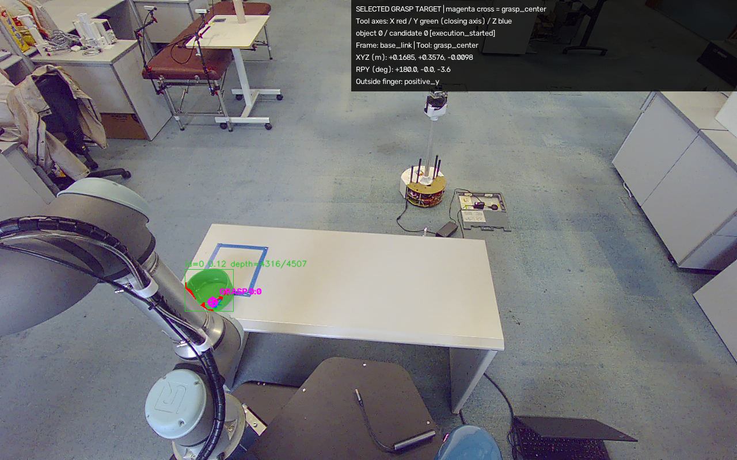
CONTRIBUTION 03 / TASK FEASIBILITY
Select a grasp that supports the complete task
SEVEN MOTION SEGMENTS
01
Approach
02
Descend to grasp
03
Lift
04
Transfer to pre-release
05
Descend to release
06
Retreat
07
Return to saved home
Try another candidate before motion if complete planning fails.
Selected target overlay from a real task | 29 Sep 2026, 14:26:44 | The overlay is a target pose.
07 / 12
Notes:
【中文演讲备注】
局部几何合格只是第一步。程序对同一只碗生成有限数量的候选，并检查完整七段抓放返程路径。候选在尚未运动时不可规划，就可以尝试下一个；一旦动作开始，失败不会自动从张爪步骤重新抓取。返回起点使用保存的关节配置，避免相同末端位姿对应不同关节分支。右图叠加的是应用抓取偏移后的目标位姿，execution_started 只表示已经开始执行相关候选，并不能作为实测到位或抓牢的证明。
【资料来源】
src/grasp_executor/grasp_executor/candidates.py
src/grasp_executor/grasp_executor/moveit_ros.py
debug_output/place_execution/20260929_142644/round_0001/grasp_pose_overlay.png

Slide 8
SYSTEM DESIGN / FEEDBACK
Advance execution using measured state
GRIPPER STATE CONFIRMATION
Confirm open before descent.
Confirm closed and settled before lift.
Confirm release before retreat.
Recorded feedback: Close 679 → 37 | Open 24 → 680
TEMPORARY TF LOSS
Use fresh joint measurements with validated forward kinematics.
16 integration checks passed; 12 joint configurations cross-checked.
Gripper state confirmation does not verify that an object is held.
Gripper feedback: real task log, 28 Sep 2026 | TF fallback: isolated simulation, 29 Sep 2026
08 / 12
Notes:
【中文演讲备注】
夹爪部分从命令和固定等待，改为校验控制寄存器、开口位置及稳定时间。示例日志中，闭合从 679 变为 37，释放打开从 24 变为 680；这证明反馈状态发生变化，不直接证明碗被夹牢。机械臂正常使用 TF，在 TF 暂时不可用时使用新鲜六关节测量和已交叉核验的本地正运动学。启动核验、反馈新鲜度和到位条件继续生效。TF 故障注入结果来自隔离模拟控制器，没有连接机器人硬件，不能把模拟恢复当作已经完成所有实机故障验证。
【资料来源】
src/grasp_executor/grasp_executor/gripper_command.py
debug_output/place_execution/20260928_211216/round_0003/grasp_executor.log
docs/TF反馈恢复_20260929.md
debug_output/tf_feedback_recovery_20260929/validation_summary.json

Slide 9
EXPERIMENT / OFFLINE REPLAY
More observations produced valid grasp candidates
FRAMES WITH VALID CANDIDATES
14 / 20 → 18 / 20
Partial-arc acceptance
23 / 27 → 27 / 27
Supported local-wall fallback
Observed-contact radial candidates
Supported local-wall fallback
Two different replay sets. Candidate generation is not physical grasp success.
Historical replay evidence | circle_partial_arc_fix_20260928 and circle_wall_fallback_20260928
09 / 12
Notes:
【中文演讲备注】
第一组有 20 份历史点云，圆弧覆盖条件调整后，生成有效候选的帧数从 14 增加到 18。第二组有 27 份点云，在加入有支持的局部碗壁备用分支后，从 23 增加到 27。这是两个不同数据集、不同阶段的回放结果，不能把两个数列直接串成同一组实验。两侧是该项目实际回放可视化，目的是说明候选来源；数字以保存的 JSON 汇总为依据。这些结果支持候选生成可用性的改善，但不是抓取成功率，也没有证明当前版本在新场景中百分之百可用。
【资料来源】
debug_output/circle_partial_arc_fix_20260928/replay.json
debug_output/circle_wall_fallback_20260928/replay.json

Slide 10
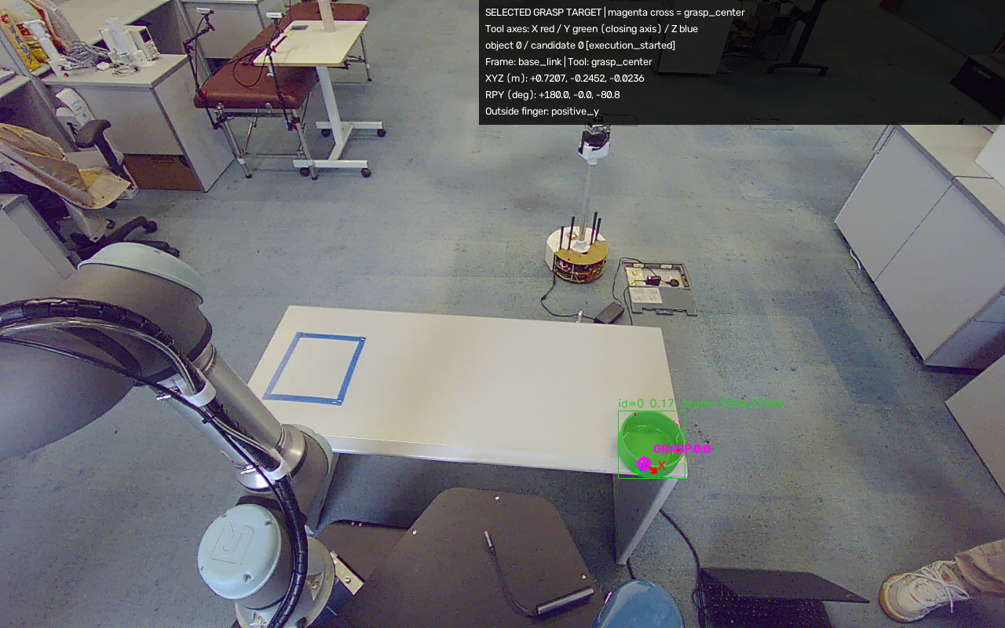
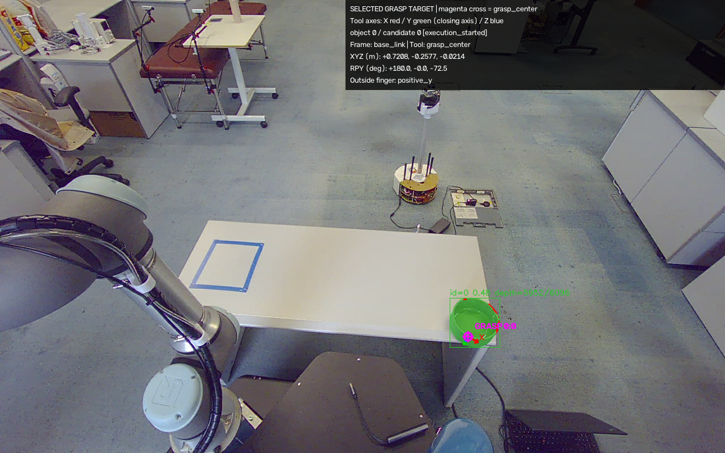
IMPLEMENTED CAPABILITIES / HARDWARE RECORDS
A complete single-bowl demonstration workflow
BLUE TARGET
UPPER LEFT
LOWER RIGHT
14:20:46 | command sequence completed
14:22:52 | command sequence completed
14:26:44 | command sequence completed
One command, one bowl
Six taught destinations
Traceable results
Fresh observation; release, retreat and fixed home return.
Five spatial zones plus blue; explicit XYZ input is also supported.
Saved masks, candidate poses, point clouds and configuration snapshots.
Images from separate trials, 29 Sep 2026 | Completed command sequences; physical outcomes not automatically verified.
10 / 12
Notes:
【中文演讲备注】
这里展示三个独立任务保存的原始抓取位姿图，分别是 blue、左上和右下，图像并非同一次运动的连续帧。对应运行记录均有完整命令流程完成状态，但 grasp_verified 和 placement_verified 仍然为 false，所以不能直接把它们计作已独立验证的物理成功。功能方面，每次启动重新观察一只碗，按选择的示教目标完成放置、退回和返程。视觉增加桌面 ROI、分块推理及有限重观察，任务保存配置、候选和诊断图，便于逐次复现。
【资料来源】
debug_output/place_execution/20260929_142046/result.json
debug_output/place_execution/20260929_142252/result.json
debug_output/place_execution/20260929_142644/result.json
New_run/README.md

Slide 11
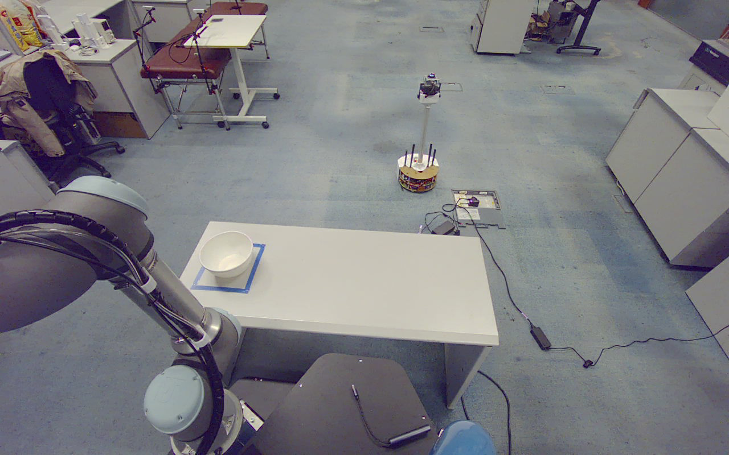
NEXT EXPERIMENT / PLANNED EVALUATION
Measure placement repeatability directly
PLANNED COMPARISON
Wall-normal grasping
vs. signed radial grasping
Vary the source position
Repeat across positions and grasp directions.
Measure physical outcomes
Grasp success, XY placement error and cycle time.
Separate the methods
Report radial and fallback trials independently.
Target quantity: bowl-center distance to the taught target
Original scene image; no measured placement-error distribution is available in the current evidence set.
11 / 12
Notes:
【中文演讲备注】
下一步实验应直接验证设计假设：在相同碗、相同目标位置和相同夹持高度深度下，径向方法是否比原壁面方向方法具有更小的放置误差。改变碗的起始位置和抓取方位，进行重复试验，分别记录检测失败、无候选、规划失败、夹空、掉落和放偏。落点指标使用碗中心到目标中心的平面距离，报告均值、离散程度和最大值。图是实际桌面观测，但当前没有系统测量的落点分布，因此不展示虚构误差图。
【资料来源】
docs/圆碗径向抓取修改_20260928.md
debug_output/table_roi_update_20260928/after/rgb.png

Slide 12
DESIGN CONTRIBUTIONS
Make the grasp relationship
more consistent.
01
Consistent geometry
Radial alignment and fixed finger identity.
02
Observed contact support
Global shape with local wall validation.
03
Complete-task feasibility
Select candidates for the full motion cycle.
NEXT MILESTONE
Quantified physical success and placement repeatability
Original hardware photograph | 23 Sep 2026
Notes:
【中文演讲备注】
总结本项目的三项设计贡献：第一，用有符号径向和固定内外手指约束抓取关系；第二，用整体形状指导方向，同时用真实局部壁面验证接触；第三，以完整抓放返程可行性选择候选。这些是相对于项目原实现的设计改进，并不在本汇报中声称已完成学术首创性证明。反馈和诊断改进使方法能够在现有硬件上实施与复查。下一阶段要通过对比实验量化物理抓取成功和放置重复性。
【资料来源】
docs/圆碗径向抓取修改_20260928.md
docs/demo_implementation_20260925.md
docs/TF反馈恢复_20260929.md

