Slide 1
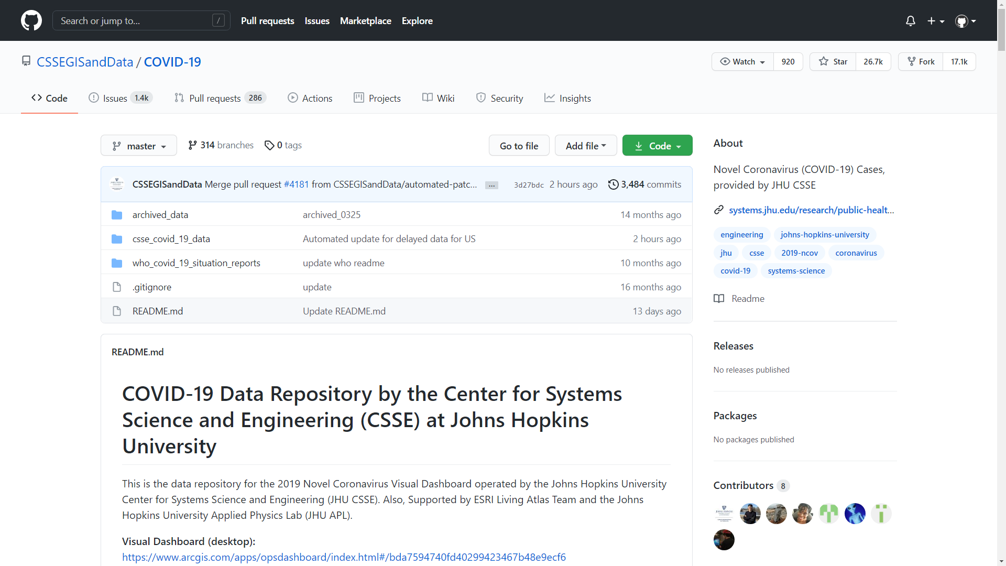
INFO 634
Group Project
Covid-19 Data Mining
Group 5
Evan Falkowski - ejf85@drexel.edu
Puneet Sihag - ps943@drexel.edu
Yiyun Zhang - yz523@drexel.edu

Slide 2
Table of Content
Introduction
Data Information
EDA
Data Visualization
Model training and evaluation
Observation and Next steps

Slide 3
Introduction
The project aims at performing a time-series prediction of state-wise Covid-19 data for US and study the impact of vaccination against Covid-19. The project also aims at comparing the past Covid-19 cases with predicted cases in order to study and analyze the vaccination impact.
The data set was acquired from : https://github.com/CSSEGISandData/COVID-19/tree/master/csse_covid_19_data
The data set being used is updated by CSSE at Johns Hopkins University on their Github repository on daily basis.
For analysis regarding cases within the US, we utilized:
time_series_covid19_confirmed_US.csv at master · CSSEGISandData/COVID-19 · GitHub

Slide 4
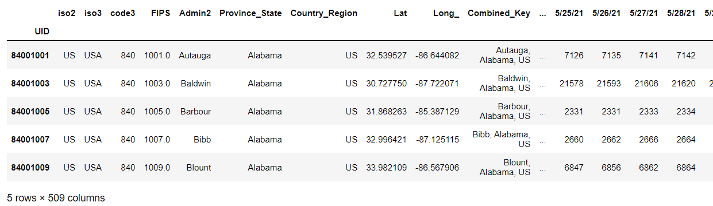
Data Information
Our data at a closer look:
From 1/20/2020 - 6/4/2021 & Number range 1 - 33326437
https://github.com/CSSEGISandData/COVID-19/blob/master/csse_covid_19_data/csse_covid_19_time_series/time_series_covid19_confirmed_US.csv

Slide 5


EDA- Exploratory Data analysis
Data Processing
Load data
Sum total confirmed cases
Convert to dataframe
Convert string to datetime objects

Slide 6
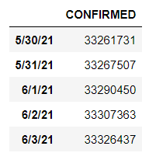
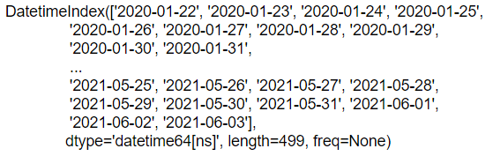
EDA- Exploratory Data analysis
Data Processing
Processed data ->
Data type

Slide 7
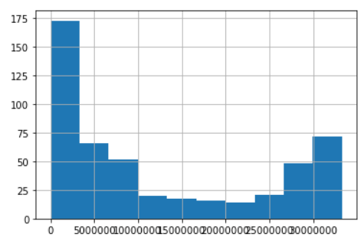
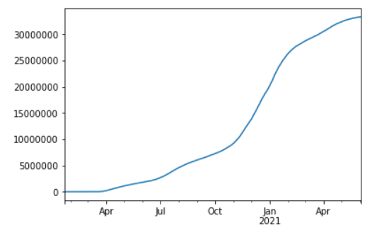
Covid19 Confirmed Cases in US
Data Visualization
Data Visualization
Create time series
Line Plot
Histogram Plot

Slide 8
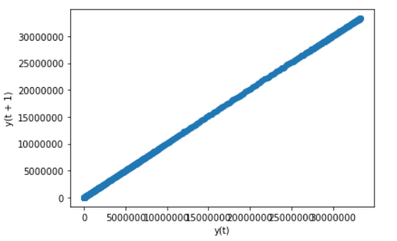
Data Visualization
Data Visualization
Lag Plot
Transform time series forecasting problems
Has value pairs:
If the points cluster along a diagonal, good to be modeled
Value(t), Value(t+1)

Slide 9
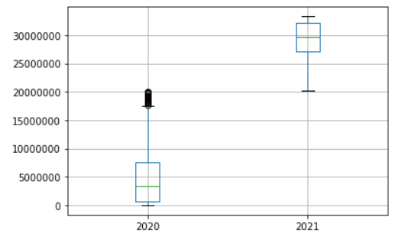
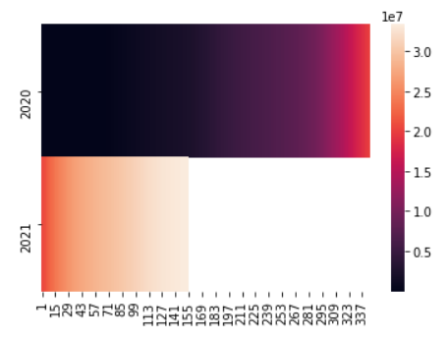
Data Visualization
Outlier and Interval Detection
Boxplot & Heatmap Plot
From plot results, there are outliers and intervals in 2020. We decided to keep them to maintain data integrity.

Slide 10
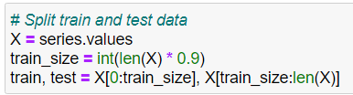
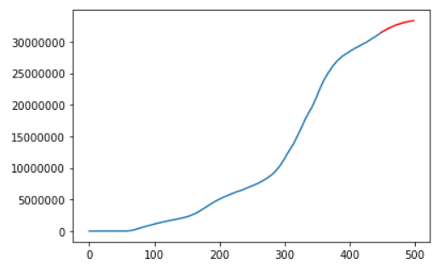
Model training and Evaluation
Prediction and Model evaluation - Persistence Model
Split train and test data
Plot train and test data

Slide 11

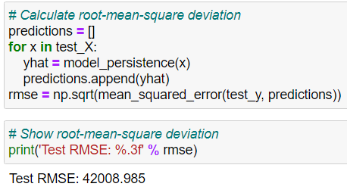
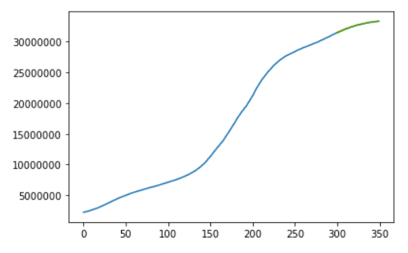
Model training and Evaluation
Persistence Model
Define persistence model
Calculate and show root-mean-square deviation
Plot result

Slide 12

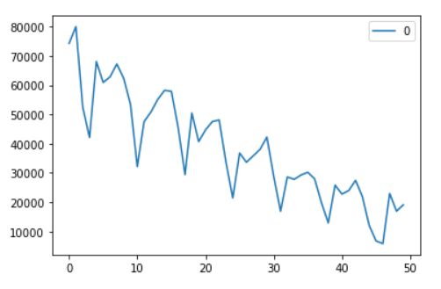
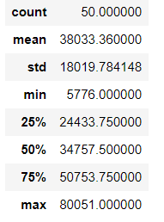
Model training and Evaluation
Persistence Model
Residual Forecast Errors Visualization
Calculate residuals
Line Plot
Describe

Slide 13
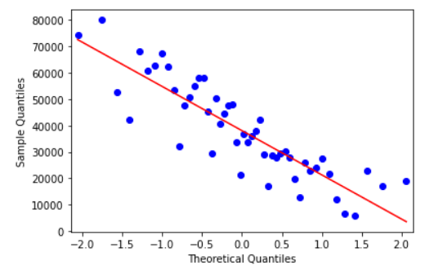
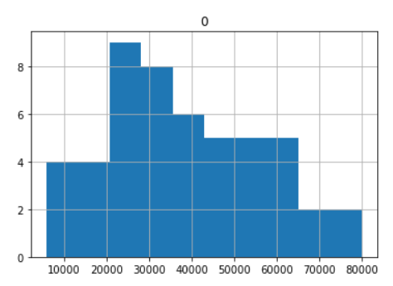
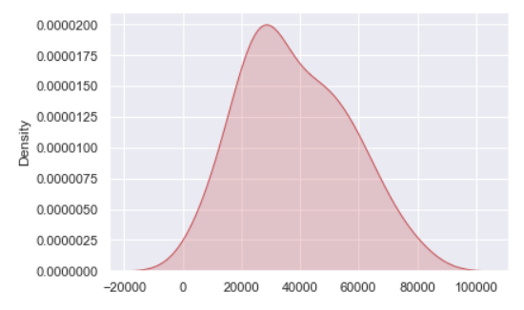
Model training and Evaluation
Persistence Model
Residual Forecast Errors Visualization
Histograms Plot
Q-Q Plot
Density Plot

Slide 14

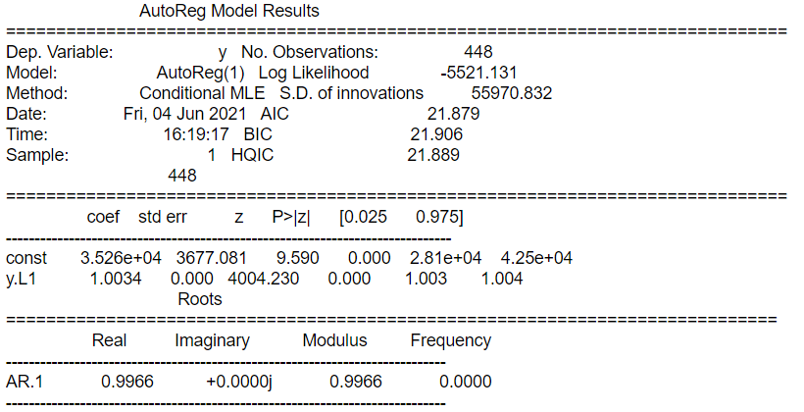
Covid19 Confirmed Cases in US
Model training and Evaluation
Prediction and Model evaluation - Autoregression Model
Define and train autoregression model
Display model summary

Slide 15
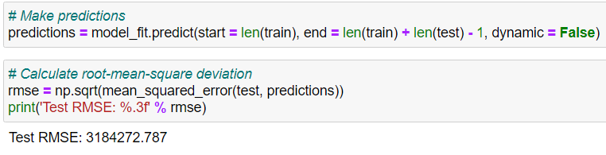
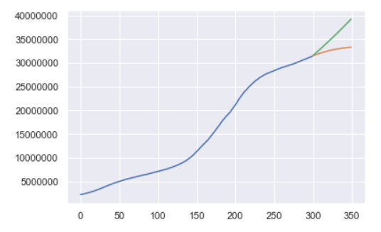
Model training and Evaluation
Autoregression Model
Calculate and show root-mean-square deviation
Plot result

Slide 16
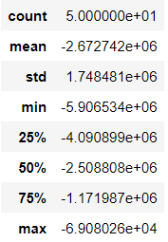
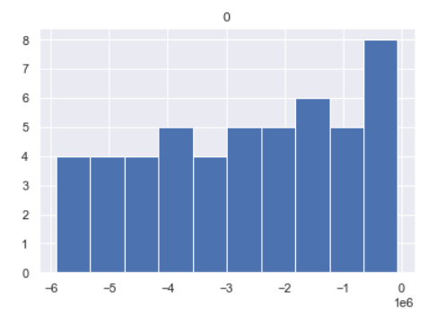
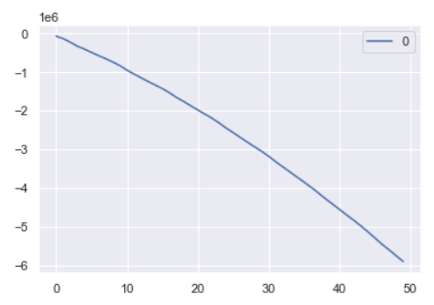
Model training and Evaluation
Autoregression Model
Residual Forecast Errors Visualization
Line Plot
Describe
Histograms Plot

Slide 17
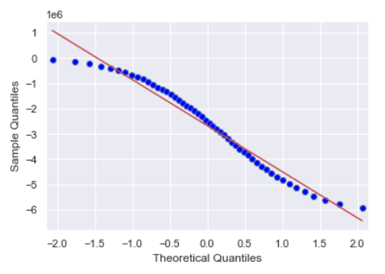
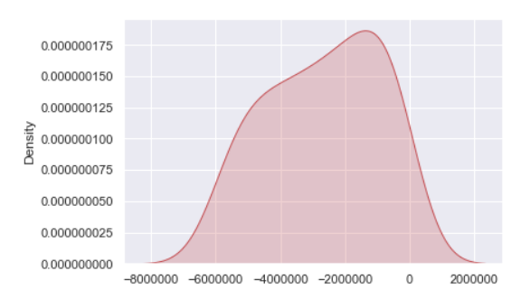
Model training and Evaluation
Autoregression Model
Residual Forecast Errors Visualization
Q-Q Plot
Density Plot

Slide 18
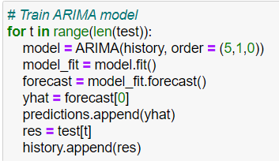
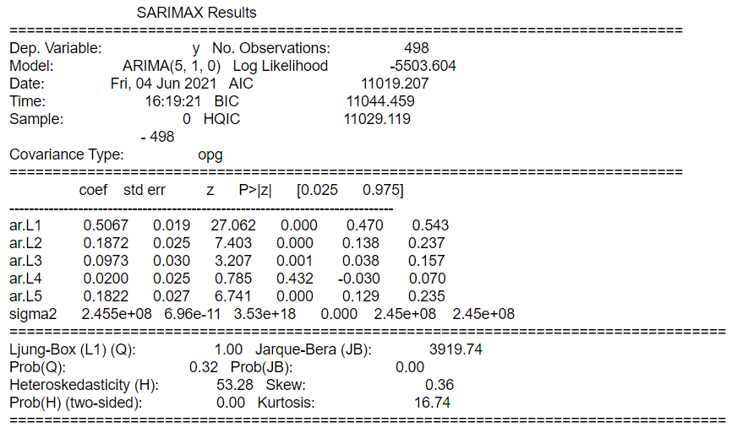
Model training and Evaluation
Prediction and Model evaluation - ARIMA Model
Define and train autoregression model
Display model summary

Slide 19
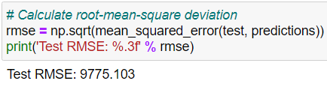
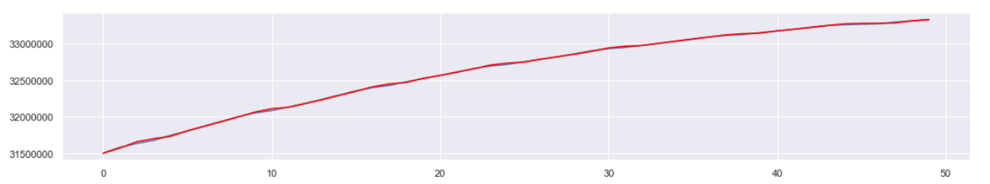
Model training and Evaluation
ARIMA Model
Calculate and show root-mean-square deviation
Plot result

Slide 20
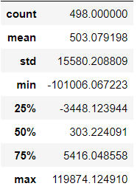
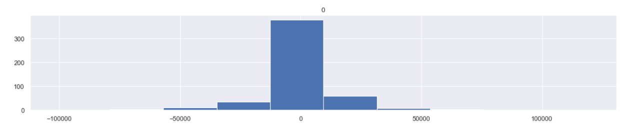
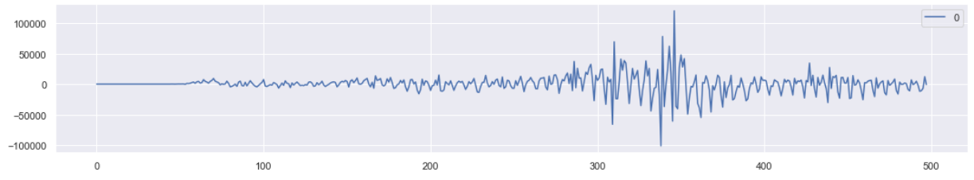
Model training and Evaluation
ARIMA Model
Residual Forecast Errors Visualization
Describe
Histograms Plot
Line Plot

Slide 21
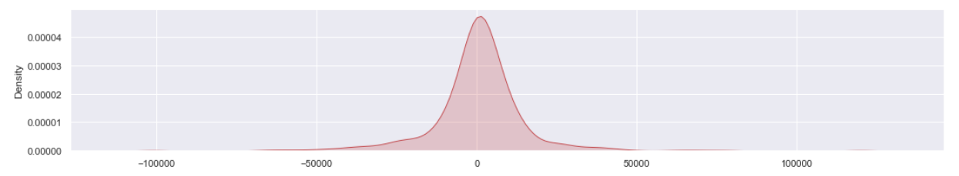
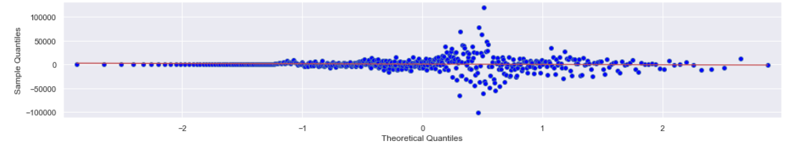
Model training and Evaluation
ARIMA Model
Residual Forecast Errors Visualization
Q-Q Plot
Density Plot

Slide 22
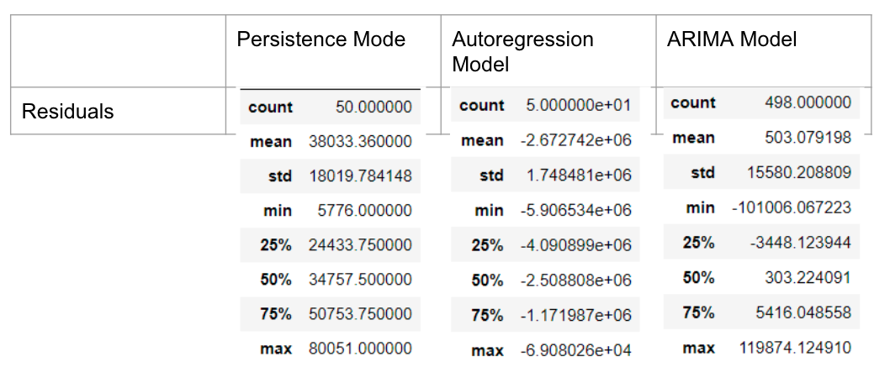
Model training and Evaluation
RMSE & Residual Comparison:
 | Persistence Mode | Autoregression Model | ARIMA Model
RMSE | 42008.985 | 3184272.787 | 9775.103

Slide 23
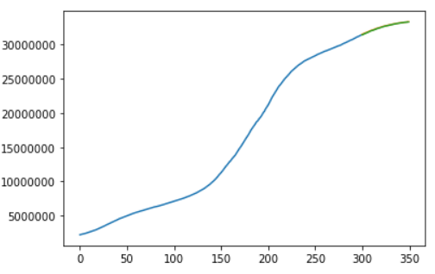
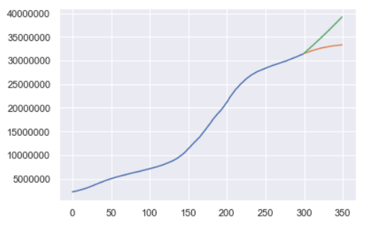
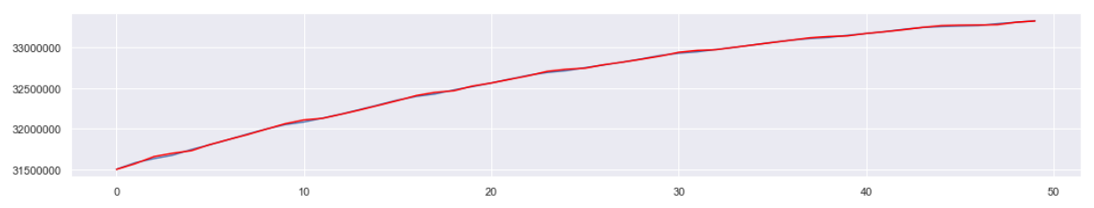
Model Evaluation
Autoregression Model Persistence Model
ARIMA Model

Slide 24
Observation and Challenges
Observations:
The Autoregression Model shows the actual confirmed cases are higher than the prediction.
The Persistence Model and ARIMA Model has very similar result that prediction and actual confirmed are very close.
Challenges:
The data had to be inferred to compare “recovered cases” and ”new cases” in order to understand the vaccination impact.

Slide 25
Next Steps
Selection of best performance model
Results comparison and analysis from Covid-19 in USA vs World

