Slide 1
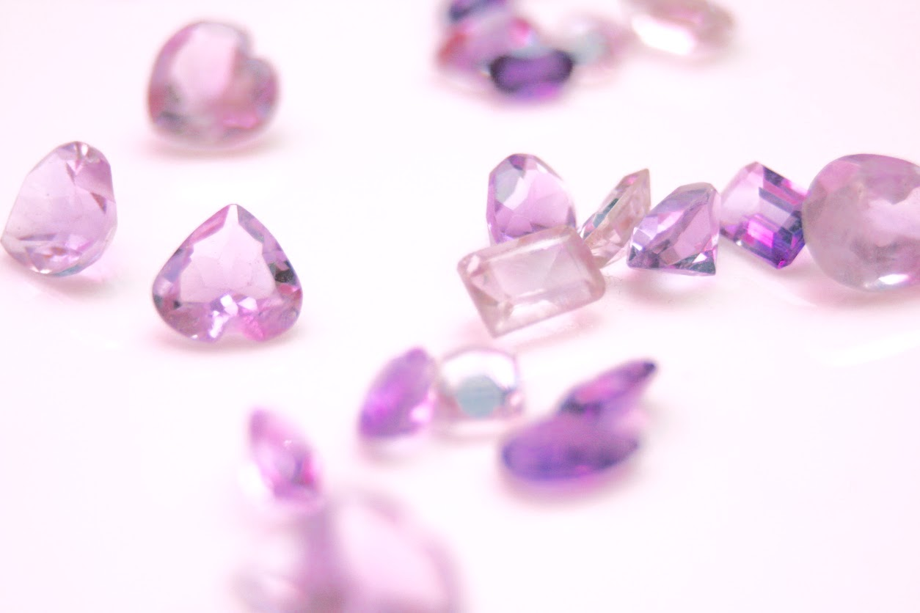
TensorFlow
Gemstone Classification
Hong Son, Yiyun Zhang (Ben), Brian Kong
Notes:
1-7 + 26 - Brian

Slide 2
The Goal
Experiment the functionality, usability, and capacity of Tensorflow with a case study.
Our case study relates to classifying gemstones. A gemstone is mineral, stone, or organic matter that can be cut and polished or used as jewelry or other ornament.
Our research expands from a previous research done by Syarif Hidayatullah State Islamic University where they worked on image processing problems around three types of gemstone
We expand from ANN to CNN Model
We will be using CNN Model to perform the classification.

Slide 3
Business Problem
This project can be useful for the creation of a gemstone identification app
Targeted at those who have a profession or a hobby for collecting rocks and identifying gemstones
For example, if someone needs to fix gemstones, they can use the app to find out what gemstone they would need to get.
Another example, is developing a collection of gemstone and sorting it.
Or just coming across a shiny looking rock and wondering what it is.

Slide 4
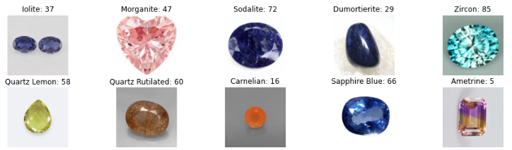
Dataset
https://www.kaggle.com/lsind18/gemstones-images
3,200+ images of different gemstones and 87 classes
The pictures were passed from minerals.net and rasavgems.com so we are assuming that the majority of the images are real gemstones
The train data consists of ~2,800 files while the test data consist of ~40 files

Slide 5
Tensorflow
Tensorflow is a framework created by the Google Brain Team for creating Deep Learning models
It can be used to solve complex problems with great accuracy
Tensorflow can be used to solve problems related to images, videos, text, or even audio
Tensorflow was also created with processing limitations in mind
Can run on almost all computers and even some smartphones
Important - high end computers are needed on the back-end
Tensorflow Lite - offers a lighter weight solution that is intended for mobile platforms
Main advantage is simplifying things for the developer. It takes care of a lot of the detailed work when it comes to tuning algorithms so that the developer can focus on a more macro view of the application.

Slide 6
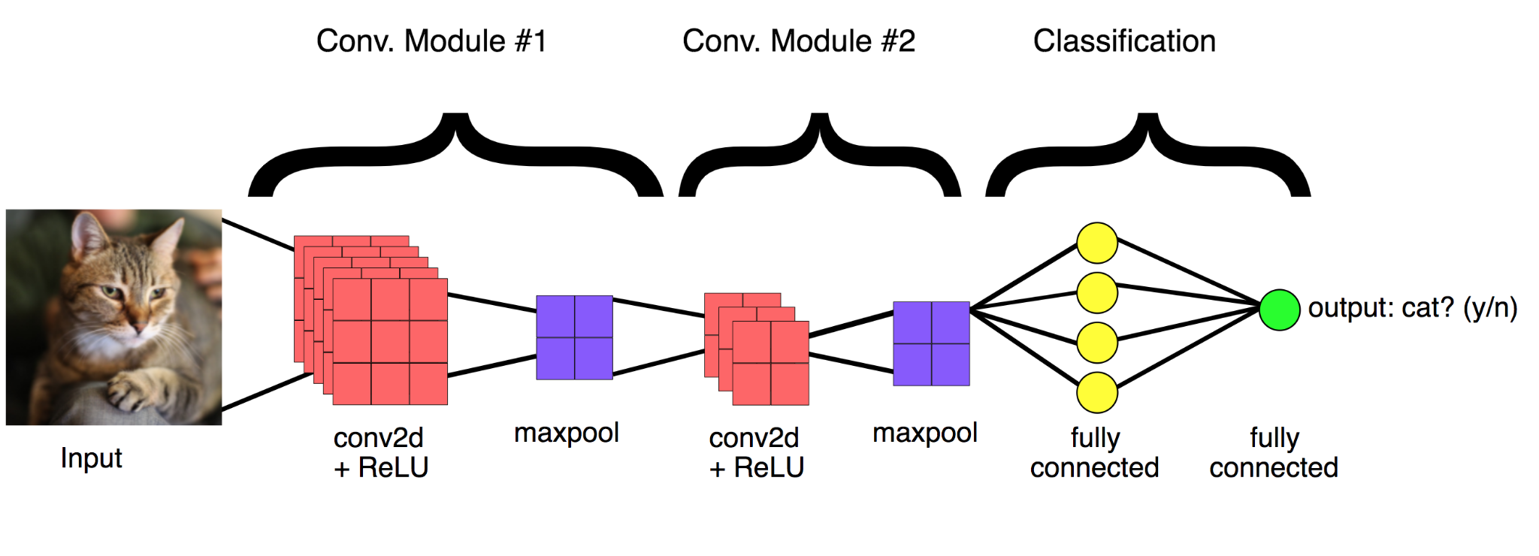
CNN
Convolutional Neural Networks, effective for processing image data
First introduced in the 1980s by Yann LeCun, a postdoctoral computer science researcher. Early versions could recognize handwritten digits
CNN takes in an image’s raw pixel data as input and learns how to extract these features
We can study the arrangement of pixels and the relationship between them.
Notes:
https://www.youtube.com/watch?v=A60X_NDte7o
Input goes into the convolution layer then goes into pooling layer to decrease the computational power required for processing. This is repeated multiple times until finally being moved into the FC layer where it exists as a flattened column vector.

Slide 7
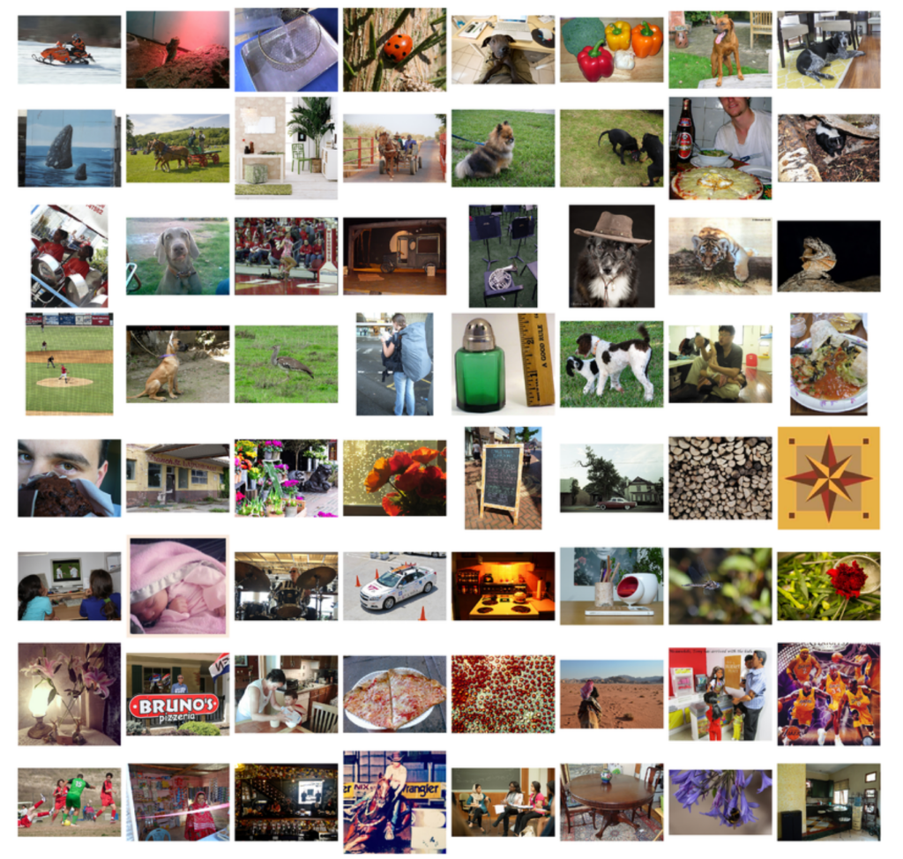
Methods Employed
VGG16 Model
Our Own CNN Model

Slide 8
VGG16 Model
We will be using the VGG16 convolutional neural network model for image classification and detection. VGG16 is a CNN model, the 16 signifies that it is a 16-layer model: 13 convolutional layers and 3 fully-connected layers.
Pre-trained model by Keras - According to the Keras official website, VGG16 has 0.713 top 1 accuracy and 0.901 top 5 accuracy in ImageNet, which is a dataset of approximate 140 million image data belonging to 1000 classes.

Slide 9
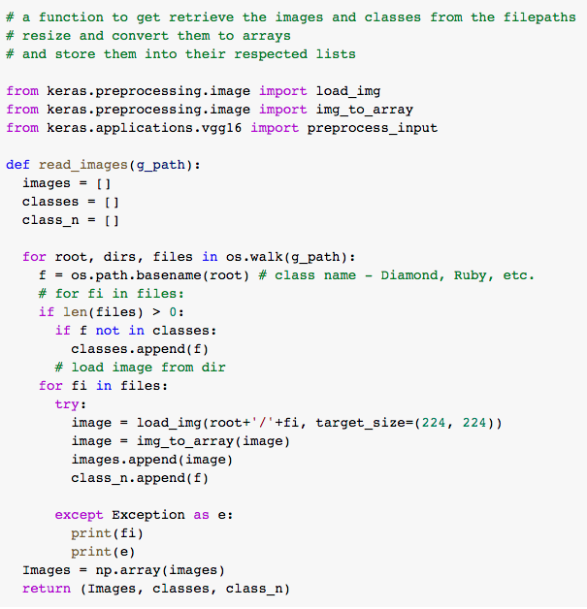
Data Quality / Prep
Get the Images from the folders: Image
Load and prepare the image/resize
Get the folder that the image comes from
Class/Label

Slide 10
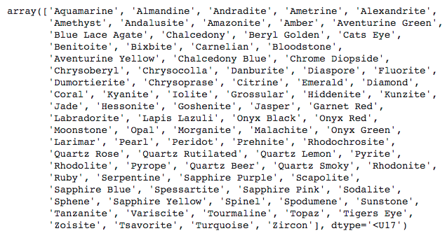
Classes

Slide 11
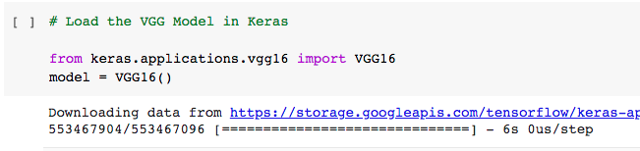
Load VGG16
It is easy to implement since it’s already pre-trained from existing data
Load the model through Keras

Slide 12
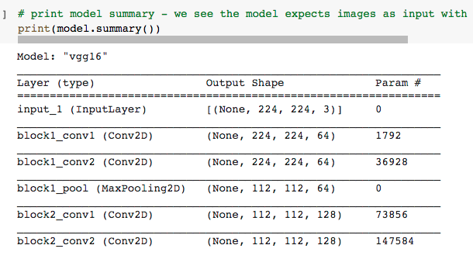
Print VGG16 Model Summary
Looking at the summary shows that it requires the image to be
224 X 224 Pixels
With 3 channels (x, y, z)

Slide 13
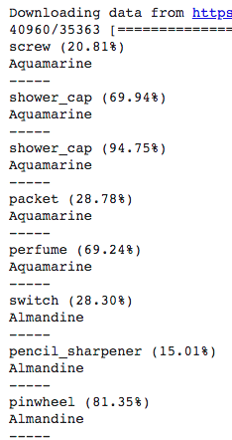
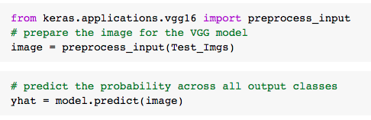
Predict Using VGG16
Then prepare the test data and predict the classes
Our first 8 predictions and the classes are shown on
the right

Slide 14
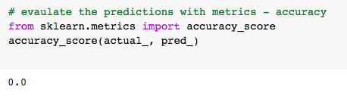
Results
What we found from doing this part is that the VGG16 model is not a great resource for predicting gemstones.
We see a range of different predictions but some shows up in different gemstones such as shower cap (39/363), pick (36/363), hair slide(24/363), pencil sharpener (21/363), and croquet ball(12/363).
We think that VGG16 would be better for classifying objects related common household items, technologies and animals.

Slide 15
Own CNN Model
We also trained our own CNN model using data from our train set to see how it would perform against VGG 16 Model.
Link is here
Notes:
https://1513041.mediaspace.kaltura.com/media/INFO+607+Tensorflow/1_kqkg9atw

Slide 16
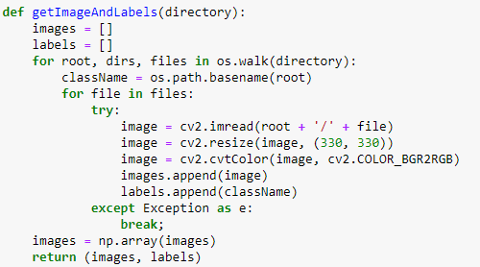
Data Preparation
Reading each image from disk.
Standardizing size and Color.
Converting into a Numpy Array.

Slide 17
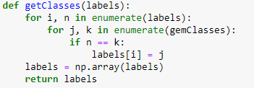
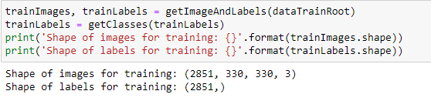
Get Image Labels
Converting string labels to numbers.
Create 2 arrays containing images and corresponding names of the classes.

Slide 18
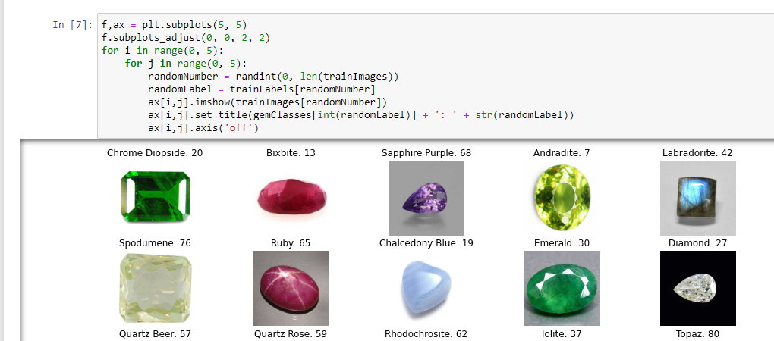
Plotting Images with labels

Slide 19
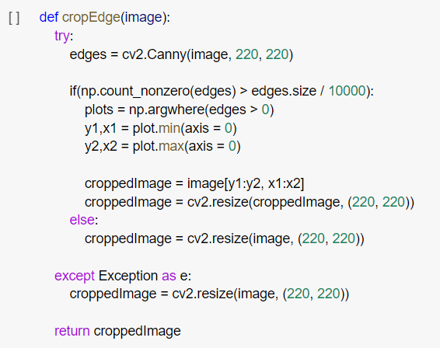
Crop Edges

Slide 20
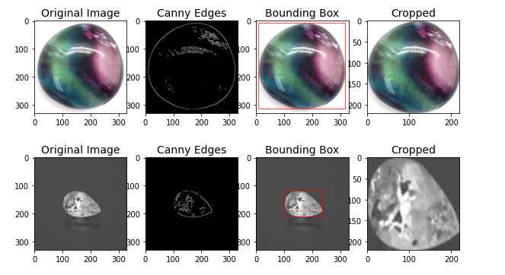
Cropping Images

Slide 21
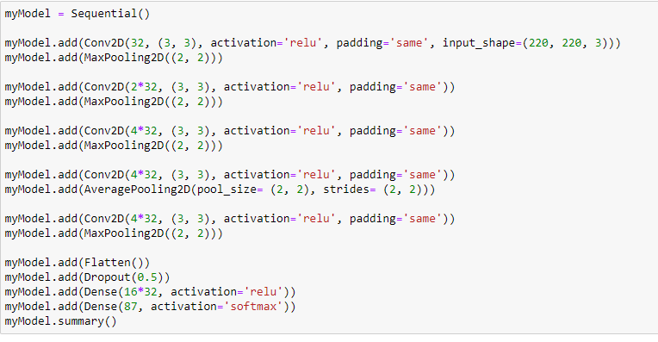
Model Creation
1x Conv2D 32 Pool
1x Conv2D 64 Pool
3x Conv2D 128 Pool
1x FLAT
1x Drop
1x Dense 512
1x Dense Len/Classes

Slide 22
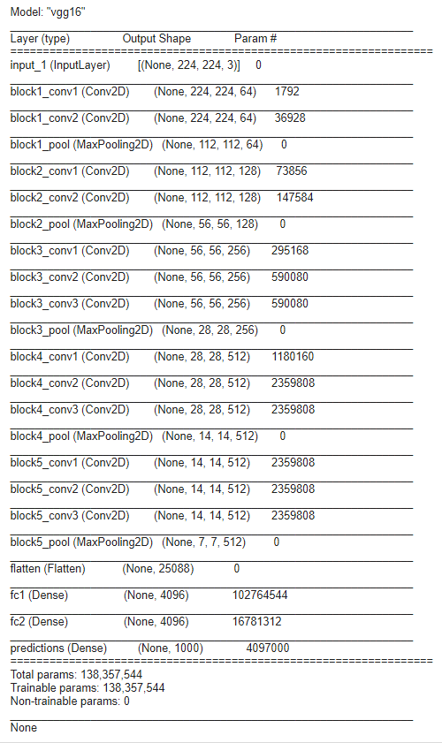
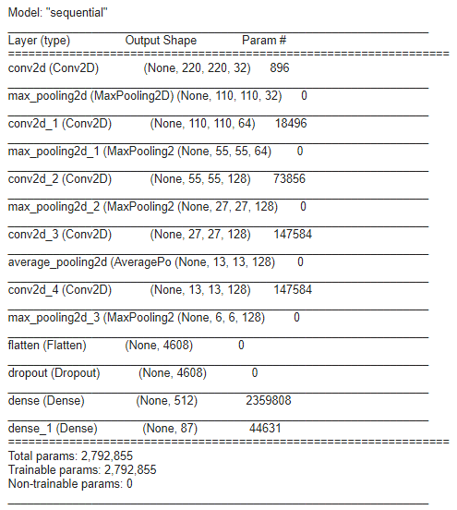
Model Comparison

Slide 23
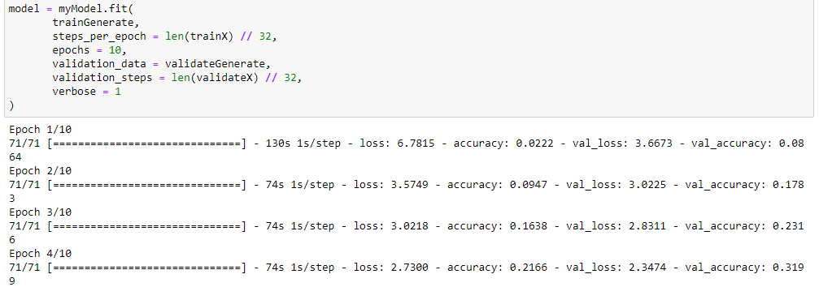
Fitting the model
Note that we only ran this with 10 epochs.

Slide 24
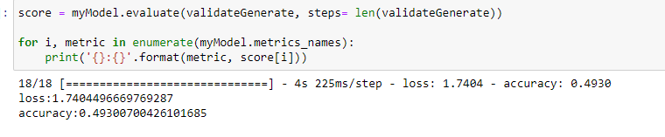
Accuracy and Loss
Accuracy is the number of right predictions / the total number of predictions.
Likely would have seen better results with more epochs.

Slide 25
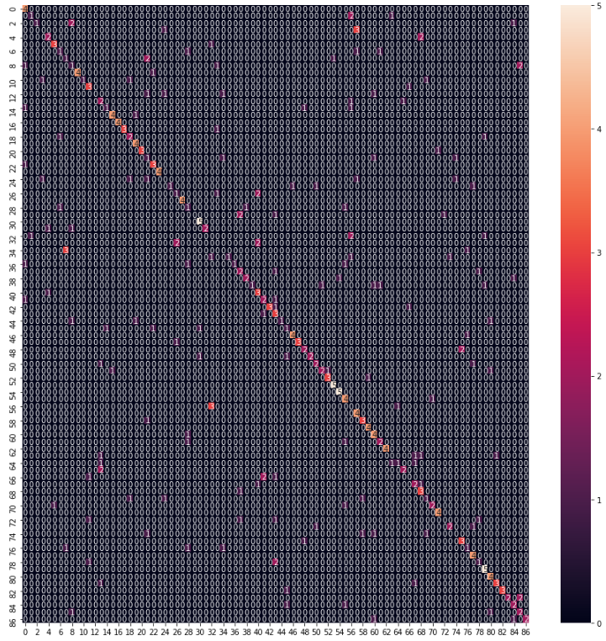

F1 Score and Confusion Matrix
The F1 score, also known as F measure
shows the accuracy of the test in a balanced way
calculates both precision and recall value in order to determine the accuracy.

Slide 26
Conclusion
We learned the functionality of CNN Model
Images goes through a series of convolution layers, pooling, and then classified through softmax.
Tensorflow helped reduced the load of the work
For this problem, we would have to write a lot of logic if we didn’t use Tensorflow
Tensorflow can be used for difficult problems. This is a difficult task so ~50% accuracy isn’t too bad with the epochs we used (10 epochs)
We expect it to improve with more epochs
Google Collab crashed with more than 18+ epochs

Slide 27
References
Heo, M. (2020). [TensorFlow 2 Deep Learning] CNN. https://www.youtube.com/watch?v=A60X_NDte7o
Kofler, M. (2017). Deep Learning with Tensorflow: Part 1 — theory and setup. Towards Data Science. https://towardsdatascience.com/deep-learning-with-tensorflow-part-1-b19ce7803428
Mahapatra, S. (2018). Why Deep Learning over Traditional Machine Learning? Towards Data Science. https://towardsdatascience.com/why-deep-learning-is-needed-over-traditional-machine-learning-1b6a99177063
Maula, Ismatul, et al. "Development of a Gemstone Type Identification System Based on HSV Space Colour Using an Artificial Neural Network Back Propagation Algorithm." International Conference on Science and Technology (ICOSAT 2017)-Promoting Sustainable Agriculture, Food Security, Energy, and Environment Through Science and Technology for Development. Atlantis Press, 2017. https://www.researchgate.net/publication/325465942_Development_of_a_Gemstone_Type_Identification_System_Based_on_HSV_Space_Colour_Using_an_Artificial_Neural_Network_Back_Propagation_Algorithm
Pai, A. (2020). CNN vs. RNN vs. ANN – Analyzing 3 Types of Neural Networks in Deep Learning. Analytics Vidhya. https://www.analyticsvidhya.com/blog/2020/02/cnn-vs-rnn-vs-mlp-analyzing-3-types-of-neural-networks-in-deep-learning/
Tensorflow Blog. (2018). Colab: An easy way to learn and use TensorFlow. https://blog.tensorflow.org/2018/05/colab-easy-way-to-learn-and-use-tensorflow.html

Slide 28
Questions?

