Slide 1
Local Deployment and Infrastructure Acceleration for a Financial QA System
Yuan Zhao| May 2026

Slide 2
System Architecture
Type 1: Exact Fact
NL2SQL
SQLite
40K XBRL rows
Answer
Generation
User Query
Intent Router
LoRA Adapter
Query Rewrite
Hybrid RAG
BM25 + Dense + Cross-Encoder
Type 2: Qualitative
ChromaDB
516K vector chunks
Type 3: Chat
Direct Answer
No retrieval needed
92 S&P 100 tickers | 2019-2024 | ~120K text chunks + ~40K structured XBRL rows

Slide 3
Motivation
Accuracy:
Cloud LLM APIs (GPT-4o) have knowledge cutoff issues -- miss recent FY2023 data
Cloud APIs hallucinate financial numbers -- 42.9% value accuracy on our benchmark
Privacy:
Sending proprietary financial queries to external APIs
Cost:
GPT-4o: $2.50 / 1M input tokens and $10 / 1M output tokens
Speed:
Run Three different module in a local device with 26GB memory space is challenge.

Slide 4
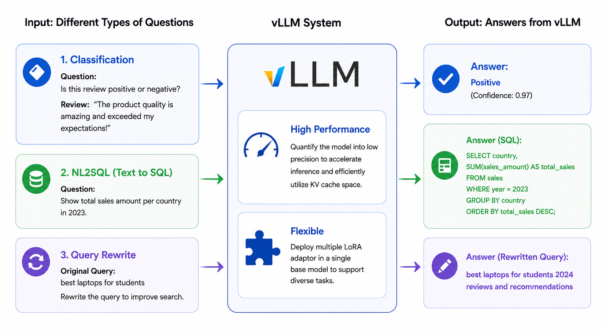
vLLM Solve the Problem:
LLM

Slide 5
Quantization Strategy: FP16 vs INT8 vs AWQ4
Method | Weight Size | VRAM (weights) | KV Cache Budget
FP16 | 16-bit | ~6 GB | ~18 GB
INT8 | 8-bit | ~3 GB | ~21 GB
AWQ4 | 4-bit | ~1.5 GB | ~22.5 GB

Slide 6
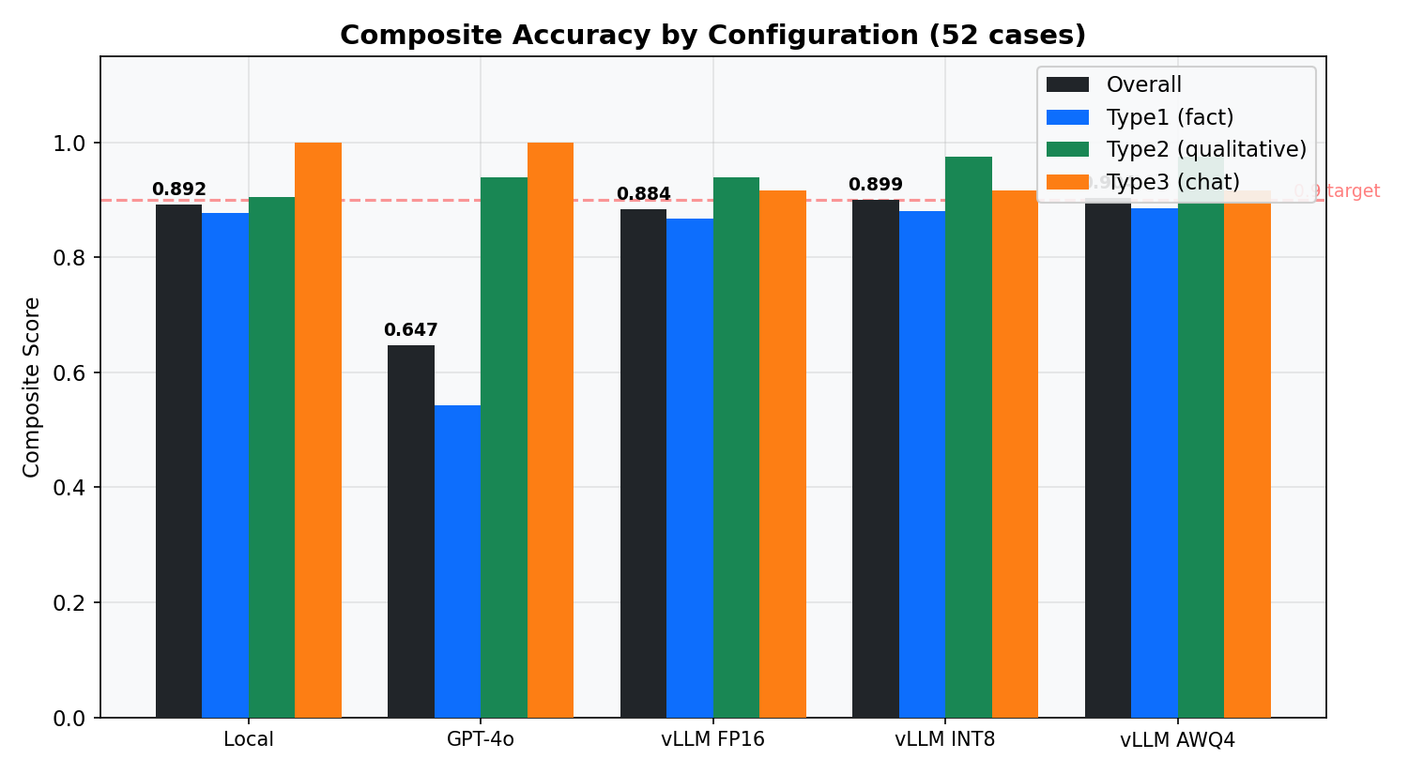
Accuracy: Unified 52-Case Benchmark Compare with GPT-4o
AWQ4 achieves the highest overall composite score (0.904), crossing the 0.9 target. GPT-4o fails on Type1 due to knowledge cutoff.

Slide 7
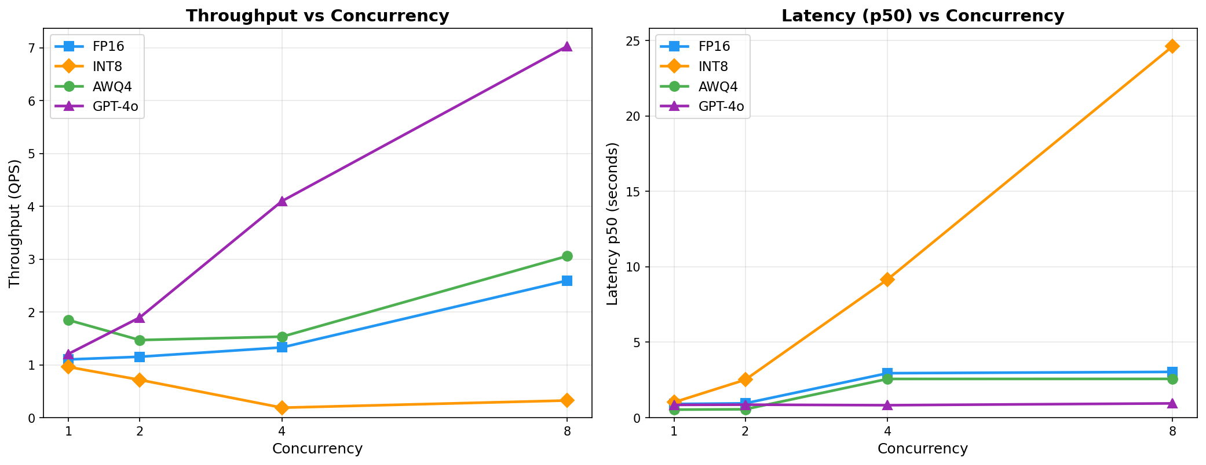
Performance: Throughput and Latency
AWQ4 have best performance in local device.

Slide 8
Final Results: AWQ4 vs Cloud (GPT-4o)
Metric | AWQ4 (Local) | GPT-4o (API)
Composite Accuracy | 0.9038 | 0.6467
Value Accuracy | 100% | 42.9%
Intent Accuracy | 100% | 100%
Keyword Hit Rate | 93.9% | 75.7%
Fluency (1-5) | 3.4 | 4.7
Latency p50 (c=1) | 0.53s | 0.85s
Peak QPS | 3.46 (c=16) | 7.03 (c=8)
Cost per 1K queries | ~$0 | ~$15-30
Data Privacy | Fully local | Sent to OpenAI

Slide 9

Conclusion & Future Plan
Conclusion:
A local 3B model with LoRA SFT and AWQ4 Quantization + vLLM achieves 0.90 accuracy,
100% value accuracy, and 0.53s latency -- beating GPT-4o on financial QA at $0/query.
Future Plan:
Fluency gap – larger scale answer generator
Multi-GPU scaling -- tensor parallelism or load-balanced vLLM for >5 QPS
Github Link

