Slide 1
Introduction of Strategy
Version 1.0
Minglun Zhang, Yajie Zhang

Slide 2
Step 1: Select the pool of tickers that we will put into the filter based on daily data. Specify the sector and industry that each stock is in.
Step 2: Build The Filter (daily data)
Goal: Have a dynamic watchlist that consists of n stocks that fulfill the filters.
Filters: the stock is chosen if all filters fulfilled
Volume is larger than a1
Price change compared to the previous day is larger than a2
Volume change compared to the previous day is larger than a3
Turnover rate is larger than a4
Market capital is larger than a5

Slide 3
Step 3: Strategy
The strategy is based on DMA.
Signals: If the short-term MA was greater than the long-term by B(which should be relatively large) and tried to hit on the long-term MA
Order size: order size C depend on the limitation of the trading stocks
Limit Order Price: greater than the buy-in price by D
Improvement: MA “cloud”, classify signals by “strength”
Step 4: Backtest and Regression
Backtest the strategy and perform regression on the factors

Slide 4
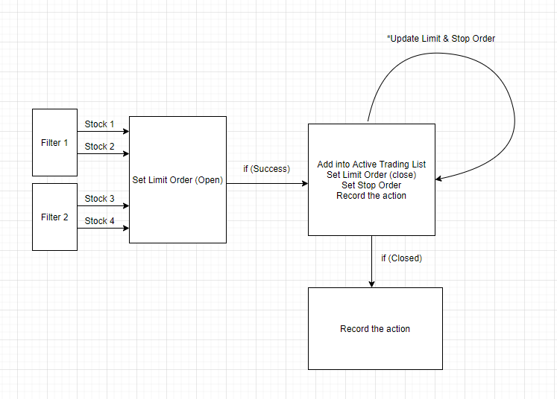
Flow of Model

Slide 5
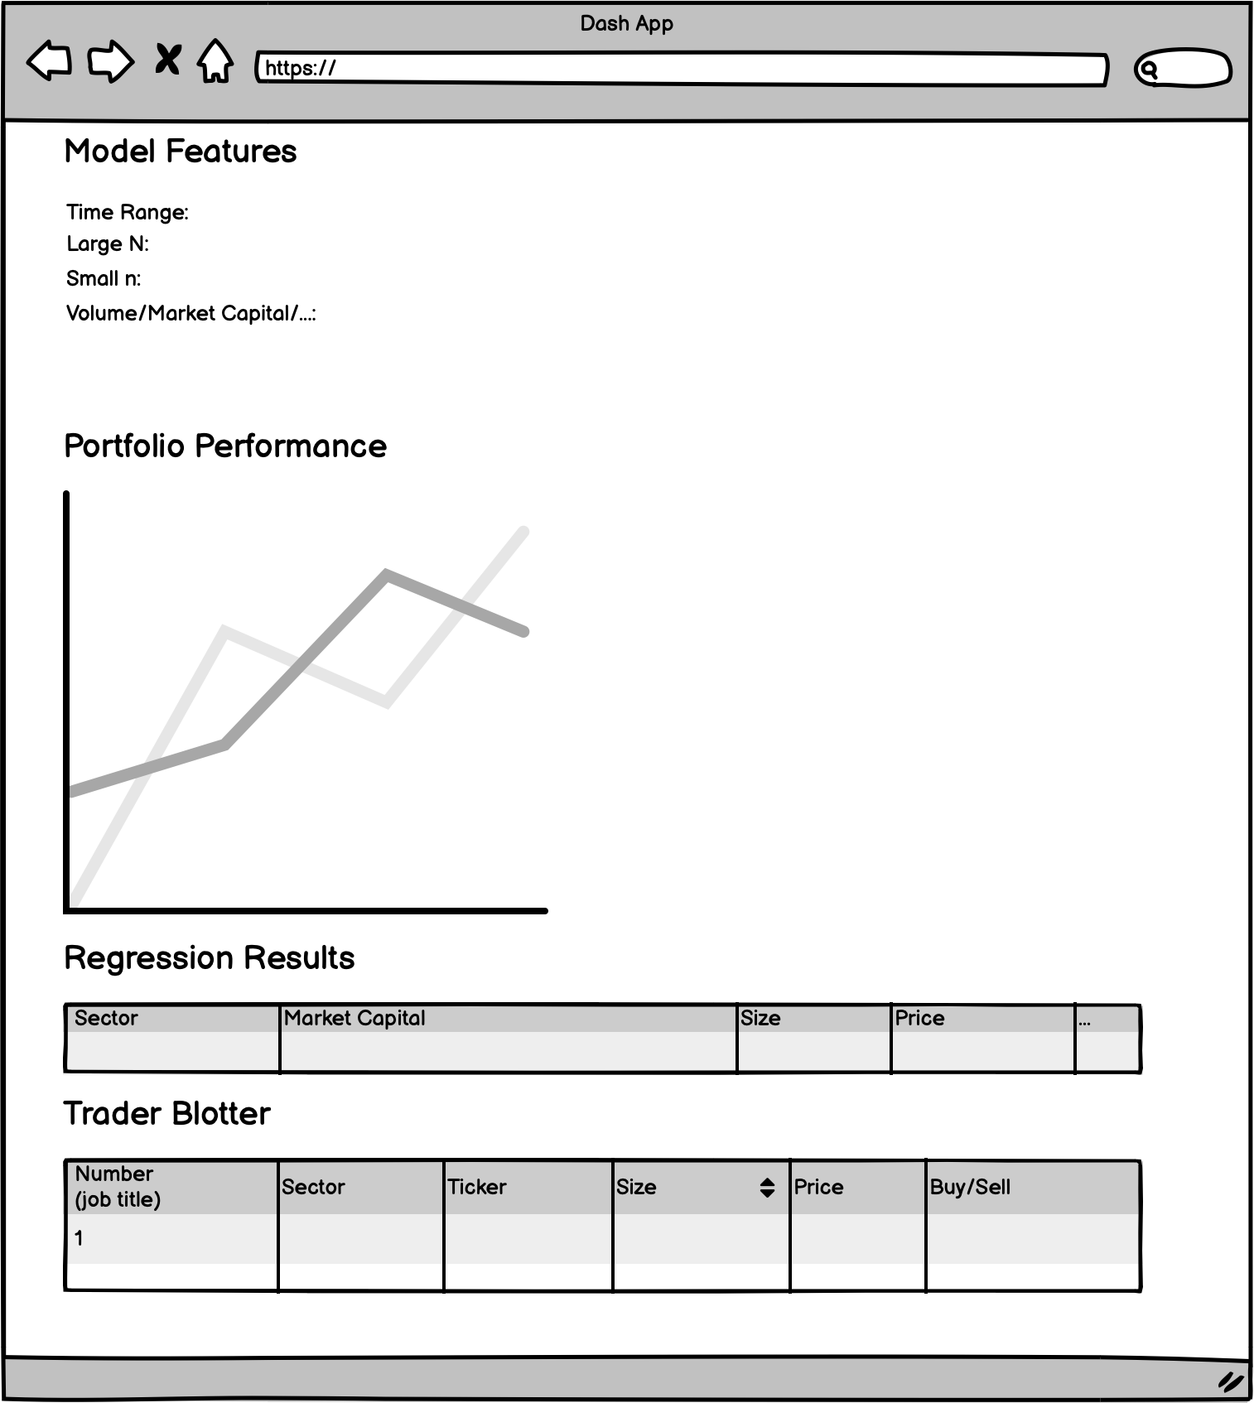
Dash App Wireframe

